Slide 1
Memory for VLA
Seokmin Lee
2026.07.02

Slide 2
contents
Previous Approaches
Experimental Settings
Ideas

Slide 3
Previous Approaches

Slide 4
Previous Approaches
In General, There are two types of Memory
Symbolic memory (with Planner)
Perceptual memory (without Planner)

Slide 5
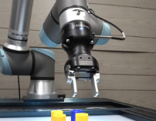
Symbolic Memory – hierarchical structure
“put yellow cube into the bin”
Action
chunk
Next subtask
VLM
VLA
Dino v2
tokenizer
tokenizer
Dino v2
tokenizer
“grasp the blue cube, move left, grasp the yellow cube …”
Our final Goal is "clean the desk“.
What is next subtask?
“put yellow cube into the bin”
Current Image
Subtask history
Current Image
Next subtask

Slide 6

Symbolic Memory – hierarchical structure
Planner is called at every iteration
Action chunking keeps VLM latency affordable
But still have latency issue : latency critical tasks
Predicted subtasks are accumulated in the subtask history
Consecutive duplicate subtasks are removed

Slide 7
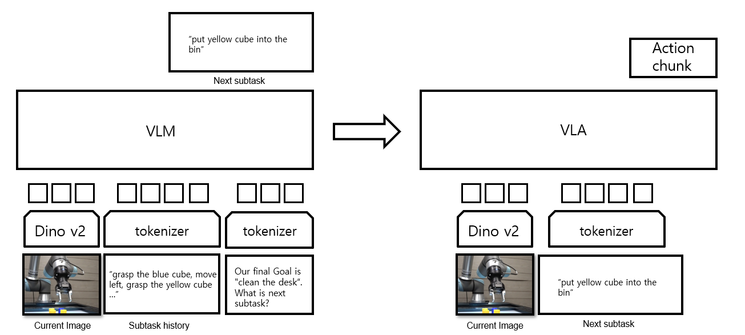
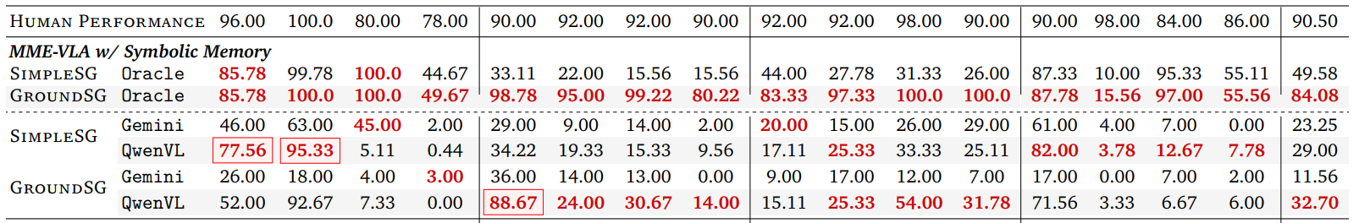
Robomme - symbolic, simple
Generate subtasks without grounding to the target.
Limited performance ceiling.

Slide 8
Robomme - symbolic, grounded
Follows the standard subtask generation pipeline (shown below).
Extends each subtask with the target object's image coordinates.
Example: Put the yellow cube at [120, 10] into the bin.
Requires additional annotation for target grounding.

Slide 9
Robomme - symbolic, grounded
High performance with a latency-free oracle planner.
A low-latency, accurate planner is sufficient without modifying the VLA.
Existing VLM planners (e.g., Gemini, Qwen) are still inadequate.
Planner latency, weak grounding, and subtask prediction errors remain major bottlenecks.

Slide 10
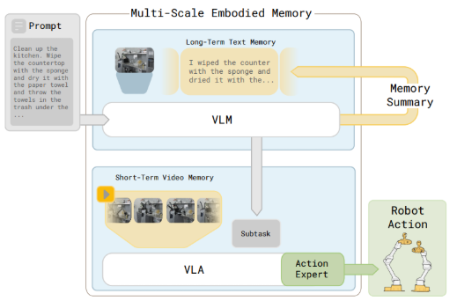
MEM (Physical intelligence)
Introduces a video encoder with causal temporal attention.
History summarization

Slide 11

Perceptual Memory
Action
chunk
VLA
Dino v2
Dino v2
Dino v2
Dino v2
Dino v2
tokenizer
“clean the desk”
past Image
past Image
past Image
past Image
current Image
Final Goal

Slide 12
Perceptual Memory
Store past keyframes or uniformly sampled frames as memory.
No VLM planner latency.
The key challenge is identifying which frames are worth storing.
Action loss provides an extremely sparse supervision signal for keyframe selection.
Manual keyframe annotation is not scalable.

Slide 13
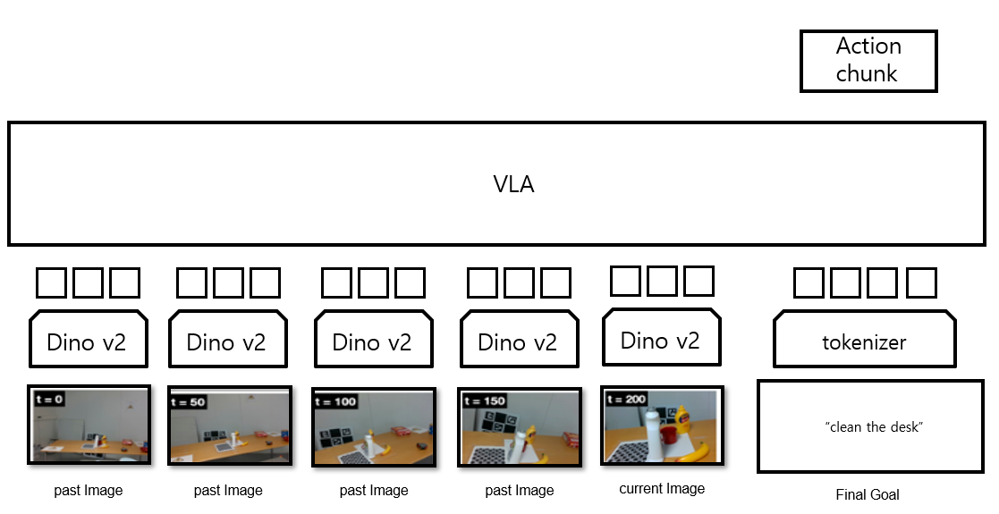
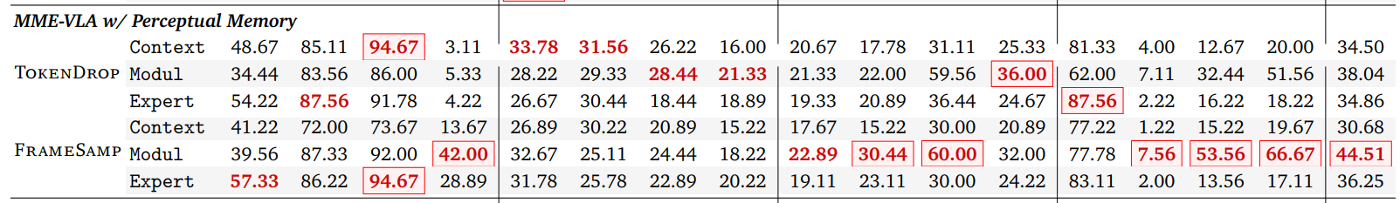
Robomme – perceptual, sampling
Uniformly samples past frames as memory.
Current state-of-the-art memory strategy.

Slide 14
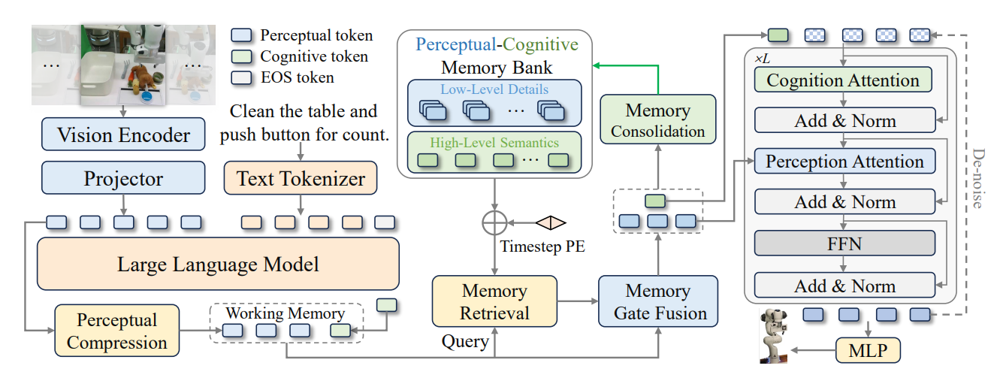
Memory VLA (ICLR 2026)
No qualitative analysis
Limited ablation studies
No evaluation of whether the retrieved frames are actually informative or relevant
Compared only against naïve baselines

Slide 15
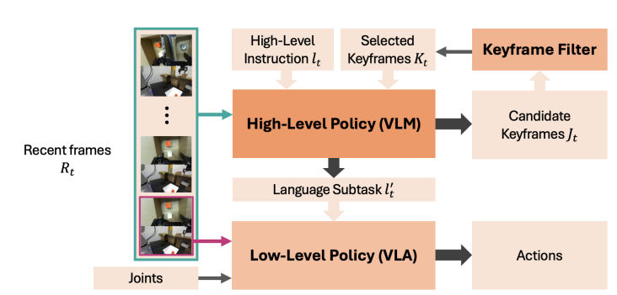
MemER (ICLR 2026)
Planner predicts keyframes.
Requires keyframe annotations.
Scalability is limited by the need for manual annotations.

Slide 16
Experimental Settings

Slide 17
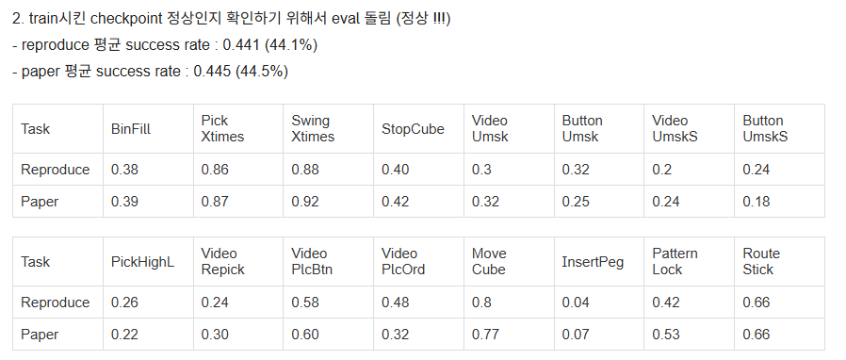
Experimental Settings : Training
Training : 4 x A100 GPUs
Planner training : unexpected performance issue; training log is different from author’s one.
VLA training : Running well.
PCI (~2 days) : evaluation success
Nvlink : issue is resolved & Training in progress.

Slide 18
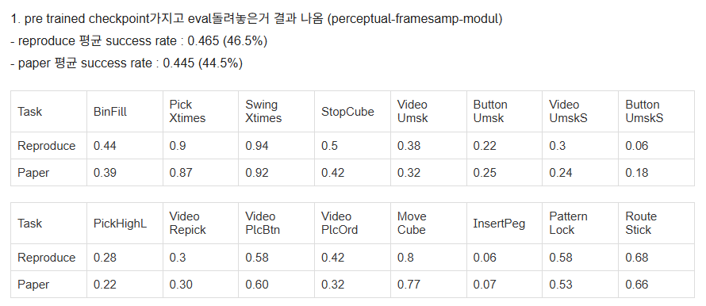
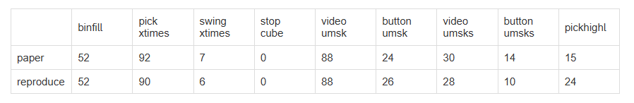
Experimental Settings : Evaluation
Evaluation : 2 x RTX 4090 GPUs
Both the planner and VLA run without issues.
Planner : 1~1.5 days
VLA : 4~5 hours

Slide 19
Evaluation Settings : ToDo
Successfully train Planner is the only thing we should do

Slide 20
Ideas

Slide 21
Ideas – Perceptual
Can a perceptual memory system identify informative past frames using only sparse supervision?
Enabling reliable keyframe selection from sparse learning signals could have significant research impact.
If not, explicit keyframe annotations may be necessary.
While this is justifiable—similar to symbolic approaches that require subtask annotations—the scalability of manual keyframe annotation remains an open question.

Slide 22
Ideas – Symbolic
If we pursue a symbolic approach, the grounded planner should be modular rather than relying on a monolithic VLM.
Instead of invoking the planner at every iteration, trigger it only when necessary (e.g., upon detecting meaningful events or uncertainty).
The upper performance bound is promising, making this direction worth exploring.
Alternatively, an agent-based planner may be a better fit.
Using a full VLM as the planner feels excessive for this role.

Slide 23
The End

