Slide 1
Operating Systems
Deadlock

Slide 2
Non-Deadlock Bugs
Make up a majority of concurrency bugs.
Two major types of non deadlock bugs:
Atomicity violation
Order violation

Slide 3
Atomicity-Violation Bugs
The desired serializability among multiple memory accesses is
violated.
Simple Example found in MySQL:
Two different threads access the field proc_info in the struct thd.
1
2
3
4
5
6
7
8
9
Thread1::
if(thd->proc_info){
…
fputs(thd->proc_info , …);
…
}
Thread2::
thd->proc_info = NULL;

Slide 4
Atomicity-Violation Bugs (Cont.)
Solution: Simply add locks around the shared-variable references.
1 pthread_mutex_t lock = PTHREAD_MUTEX_INITIALIZER; 2
Thread1::
pthread_mutex_lock(&lock);
if(thd->proc_info){ 6 …
7 fputs(thd->proc_info , …);
8 …
9 }
10 pthread_mutex_unlock(&lock); 11
Thread2::
pthread_mutex_lock(&lock);
thd->proc_info = NULL;
pthread_mutex_unlock(&lock);

Slide 5
Order-Violation Bugs
The desired order between two memory accesses is flipped.
i.e., A should always be executed before B, but the order is not enforced during execution.
Example:
The code in Thread2 seems to assume that the variable mThread has already been initialized (and is not NULL).
Thread1::
void init(){
mThread = PR_CreateThread(mMain, …); 4 }
5
Thread2::
void mMain(…){
mState = mThread->State
9 }

Slide 6
Order-Violation Bugs (Cont.)
Solution: Enforce ordering using condition variables
pthread_mutex_t mtLock = PTHREAD_MUTEX_INITIALIZER;
pthread_cond_t mtCond = PTHREAD_COND_INITIALIZER;
int mtInit = 0; 4
Thread 1::
void init(){ 7 …
8 mThread = PR_CreateThread(mMain,…); 9
10
11
12
13
14
15
16 }
17
Thread2::
void mMain(…){ 20 …
// signal that the thread has been created.
pthread_mutex_lock(&mtLock); mtInit = 1; pthread_cond_signal(&mtCond); pthread_mutex_unlock(&mtLock);
…

Slide 7
Order-Violation Bugs (Cont.)
21 |  | // wait for the thread to be initialized …
22 |  | pthread_mutex_lock(&mtLock);
23 |  | while(mtInit == 0)
24 |  | pthread_cond_wait(&mtCond, &mtLock);
25 |  | pthread_mutex_unlock(&mtLock);
26
27 |  | mState = mThread->State;
28 |  | …
29 | }

Slide 8
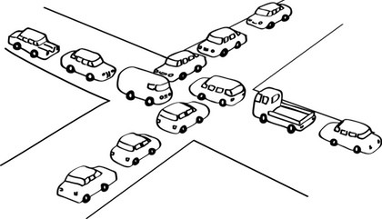
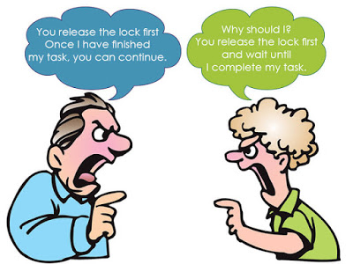
Deadlock

Slide 9
Layers of Locks
mutex A mutex B | Thread 1 lock A lock B // do something unlock B unlock A | Thread 2 lock B lock A // do something unlock A unlock B
Thread 1 | Thread 2
lock(A)
lock(B)
unlock(B)
unlock(A)
 | lock(B)
 | lock(A)
 | unlock(A)
 | unlock(B)
Thread 1 | Thread 2
lock(A)
lock(B)
 | lock(B)
unlock(B)
unlock(A) | lock(A)
 | unlock(A)
 | unlock(B)
Thread 1 | Thread 2
lock(A) | lock(B)
lock(B) | lock(A)
Deadlock :(

Slide 10
When Can Deadlocks Occur?
Four classic conditions for deadlock
Mutual exclusion: resources can be exclusively held by one process
Hold and wait: A process holding a resource can block, waiting for another resource
No preemption: one process cannot force another to give up a resource
Circular wait: given conditions 1-3, if there is a circular wait then there is potential for deadlock
One more issue:
Buggy programming: programmer forgets to release one or more resources

Slide 11
Circular Waiting
Simple example of circular waiting
Thread 1 holds lock a, waits on lock b
Thread 2 holds lock b, waits on lock a
Thread 1 | Thread 2
lock(A) | lock(B)
lock(B) | lock(A)
Thread 2
Lock A
Lock B
Thread 1

Slide 12
Methods for Handling Deadlocks
Ensure that the system will never enter a deadlock state:
Deadlock prevention
Deadlock avoidence
Allow the system to enter a deadlock state and then recover
Ignore the problem and pretend that deadlocks never occur in the system; used by most operating systems, including UNIX

Slide 13
Deadlock Prevention
Mutual Exclusion
not required for sharable resources (e.g., read-only files); must hold for non-sharable resources
Hold and Wait
must guarantee that whenever a process requests a resource, it does not hold any other resources
Require process to request and be allocated all its resources before it begins execution, or allow process to request resources only when the process has none allocated to it.
Low resource utilization; starvation possible

Slide 14
Deadlock Prevention (Cont.)
No Preemption
If a process that is holding some resources requests another resource that cannot be immediately allocated to it, then all resources currently being held are released
Preempted resources are added to the list of resources for which the process is waiting
Process will be restarted only when it can regain its old resources, as well as the new ones that it is requesting
Circular Wait
impose a total ordering of all resource types, and require that each process requests resources in an increasing order of enumeration

Slide 15
Lock ranking
If circular waiting can be prevented, no deadlocks can occur
Technique to prevent circles: lock ranking
Locate all locks in the program
Number the locks in the order (rank) they should be acquired
Add assertions that trigger if a lock is acquired out-of-order
No automated way of doing this analysis
Requires careful programming by the developer(s)

Slide 16
Lock Ranking Example
#1: mutex A #2: mutex B | Thread 1 lock A assert(islocked(A)) lock B // do something unlock B unlock A | Thread 2 assert(islocked(A)) lock B lock A // do something unlock A unlock B
Rank the locks
Add assertions to enforce rank ordering
In this case, Thread 2 assertion will fail at runtime

Slide 17
When Ranking Doesn’t Work
Example: Thread Safe List
In some cases, it may be impossible to rank order locks, or prevent circular waiting
In these cases, eliminate the no preemption condition using trylock()
class SafeList { method append(SafeList more_items){
lock(self)
lock(more_items)
Problem:
Safelist A, B
Thread 1: A.append(B)
Thread 2: B.append(A)
Solution: Replace lock() with trylock()
method append(SafeList more_items){
while (true) {
lock(self) if (trylock(more_items) == locked_OK)
break
unlock(self)
} // now both lists are safely locked

Slide 18
Deadlock Avoidance
Each process declare the maximum number of resources of each type that it may need
The deadlock-avoidance algorithm dynamically examines the resource-allocation state to ensure that there can never be a circular-wait condition
Resource-allocation state is defined by the number of available and allocated resources, and the maximum demands of the processes
Requires that the system has some additional a priori information available

Slide 19
Safe State
When a process requests an available resource, system must decide if immediate allocation leaves the system in a safe state
System is in safe state if there exists a sequence <P₁, P₂, …, P_{n}> of ALL the processes in the systems such that for each P_{i}, the resources that P_{i} can still request can be satisfied by currently available resources + resources held by all the P_{j}, with j < I
That is:
If P_{i}’s resource needs are not immediately available, then P_{i} can wait until all P_{j} have finished
When P_{j} is finished, P_{i} can obtain needed resources, execute, return allocated resources, and terminate
When P_{i} terminates, P_{i +1} can obtain its needed resources, and so on

Slide 20
Basic Facts
If a system is in safe state ⇒ no deadlocks
If a system is in unsafe state ⇒ possibility of deadlock
Avoidance ⇒ ensure that a system will never enter an unsafe state.

Slide 21
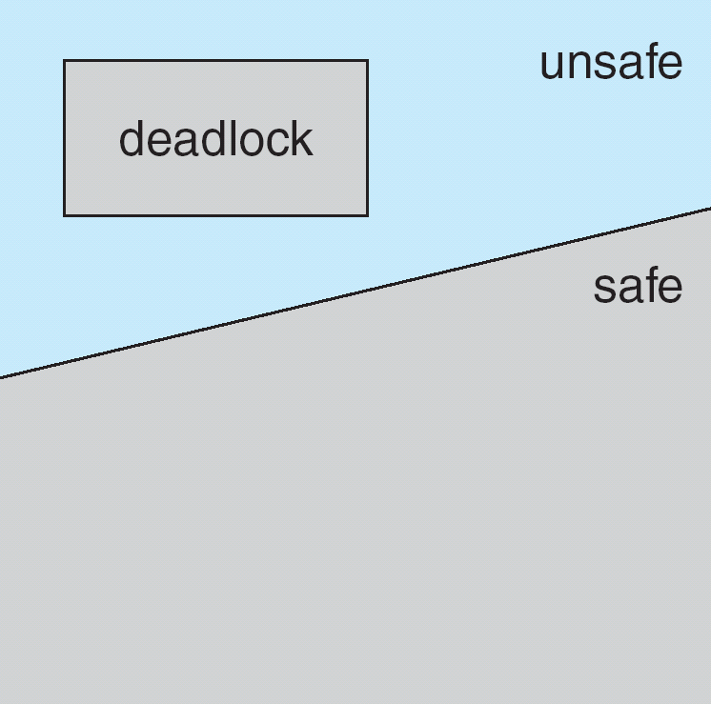
Safe, Unsafe, Deadlock State

Slide 22
Avoidance Algorithms
Single instance of a resource type
Use a resource-allocation graph
Multiple instances of a resource type
Use the banker’s algorithm

Slide 23
Resource-Allocation Graph Scheme
Claim edge P_{i} → R_{j} indicated that process P_{j} may request resource R_{j}; represented by a dashed line
Claim edge converts to request edge when a process requests a resource
Request edge converted to an assignment edge when the resource is allocated to the process
When a resource is released by a process, assignment edge reconverts to a claim edge
Resources must be claimed a priori in the system

Slide 24
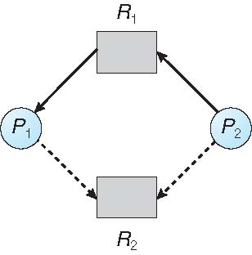
Resource-Allocation Graph
assignment
request
claim
claim
Safe state

Slide 25
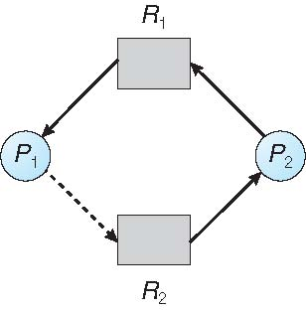
Unsafe State In Resource-Allocation Graph
If requested, deadlock occurs.

Slide 26
Banker’s Algorithm
Multiple instances
Each process must a priori claim maximum use
When a process requests a resource it may have to wait
When a process gets all its resources it must return them in a finite amount of time

Slide 27
Banker’s behavior
Clients asking for loans
Max loan is agreed with the banker.
The banker has many clients, and knows not all clients need their limits simultaneously.
After fulfilling their needs, the clients will pay-back their loan.
So, the banker can agree with clients to lend more money than available.
Example
The banker has only 10 units, but he agrees with totally 22 units loan.
Client | Used | Max
Alice | 0 | 6
Bob | 0 | 5
Carole | 0 | 4
David | 0 | 7
Client | Used | Max
Alice | 1 | 6
Bob | 1 | 5
Carole | 2 | 4
David | 4 | 7
Available=10
Available=2

Slide 28
Data Structures for the Banker’s Algorithm
Available: Vector of length m. If available [j] = k, there are k instances of resource type R_{j} available
Max: n x m matrix. If Max [i,j] = k, then process P_{i} may request at most k instances of resource type R_{j}
Allocation: n x m matrix. If Allocation[i,j] = k then P_{i} is currently allocated k instances of R_{j}
Need: n x m matrix. If Need[i,j] = k, then P_{i} may need k more instances of R_{j} to complete its task
Need [i,j] = Max[i,j] – Allocation [i,j]
Let n = number of processes, and m = number of resources types.

Slide 29
Resource-Request Algorithm for Process P_{i}
Request_{i} = request vector for process P_{i}.
If Request_{i} [j] = k then process P_{i} wants k instances of resource type R_{j}
1. If Request_{i} ≤ Need_{i} go to step 2. Otherwise, raise error condition, since process has exceeded its maximum claim
2. If Request_{i} ≤ Available, go to step 3. Otherwise P_{i} must wait, since resources are not available
3. Pretend to allocate requested resources to P_{i} by modifying the state as follows:
Available = Available – Request_{i};
Allocation_{i} = Allocation_{i} + Request_{i};
Need_{i} = Need_{i} – Request_{i};
If safe ⇒ the resources are allocated to P_{i}
If unsafe ⇒ P_{i} must wait, and the old resource-allocation state is restored

Slide 30
Safety Algorithm
1. Let Work and Finish be vectors of length m and n, respectively. Initialize:
Work = Available
Finish [i] = false for i = 0, 1, …, n- 1
2. Find an i such that both:
(a) Finish [i] = false
(b) Need_{i} ≤ Work
If no such i exists, go to step 4
3. Work = Work + Allocation_{i} Finish[i] = true go to step 2
4. If Finish [i] == true for all i, then the system is in a safe state

Slide 31
Example of Banker’s Algorithm
5 processes P₀ through P₄;
3 resource types:
A (10 instances), B (5 instances), and C (7 instances)
Snapshot at time T₀:
Allocation Max Available
A B C A B C A B C
P₀ 0 1 0 7 5 3 3 3 2
P₁ 2 0 0 3 2 2
P₂ 3 0 2 9 0 2
P₃ 2 1 1 2 2 2
P₄ 0 0 2 4 3 3

Slide 32
Example (Cont.)
The content of the matrix Need is defined to be Max – Allocation
Allocation Need Available
A B C A B C A B C
P₀ 0 1 0 7 4 3 3 3 2
P₁ 2 0 0 1 2 2
P₂ 3 0 2 6 0 0
P₃ 2 1 1 0 1 1
P₄ 0 0 2 4 3 1
The system is in a safe state since the sequence < P₁, P₃, P₄, P₂, P₀> satisfies safety criteria
5 3 2
10 4 7
7 4 3
7 4 5

Slide 33
Example: P₁ Request (1,0,2)
Check that Request ≤ Available : (1,0,2) ≤ (3,3,2) ⇒ true
Allocation Need Available
A B C A B C A B C
P₀ 0 1 0 7 4 3 2 3 0
P₁ 3 0 2 0 2 0
P₂ 3 0 2 6 0 0
P₃ 2 1 1 0 1 1
P₄ 0 0 2 4 3 1
Executing safety algorithm shows that sequence < P₁, P₃, P₄, P₀, P₂> satisfies safety requirement
5 3 2
10 4 7
7 4 3
7 4 5

Slide 34
Pop quiz
Allocation Need Available
A B C A B C A B C
P₀ 0 1 0 7 4 3 3 3 2
P₁ 2 0 0 0 2 0
P₂ 3 0 2 6 0 0
P₃ 2 1 1 0 1 1
P₄ 0 0 2 4 3 1
Can request for (3,3,0) by P₄ be granted?
Can request for (0,2,0) by P₀ be granted?
0 0 2
3 3 2
1 0 1

Slide 35
Deadlock Detection
Allow system to enter deadlock state
Detection algorithm
Resource allocation graph
Use the Banker’s algorithm (multiple instances)
Recovery scheme

Slide 36
Single Instance of Each Resource Type
Maintain wait-for graph
Nodes are processes
P_{i} → P_{j} if P_{i} is waiting for P_{j}
Periodically invoke an algorithm that searches for a cycle in the graph. If there is a cycle, there exists a deadlock
An algorithm to detect a cycle in a graph requires an order of n² operations, where n is the number of vertices in the graph

Slide 37
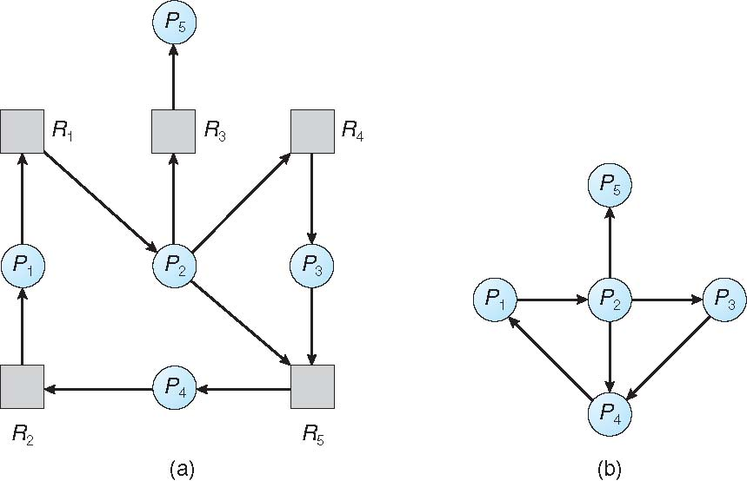
Resource-Allocation Graph and Wait-for Graph
Resource-Allocation Graph
Corresponding wait-for graph

Slide 38
Detection-Algorithm Usage
When, and how often, to invoke depends on:
How often a deadlock is likely to occur?
How many processes will need to be rolled back?
one for each disjoint cycle

Slide 39
Recovery from Deadlock: Process Termination
Abort all deadlocked processes
Abort one process at a time until the deadlock cycle is eliminated
In which order should we choose to abort?
Minimize costs
Examples
Priority of the process
How long process has computed, and how much longer to completion
Resources the process has used
Resources process needs to complete
How many processes will need to be terminated
Is process interactive or batch?

Slide 40
Recovery from Deadlock: Resource Preemption
Selecting a victim – minimize cost
Rollback – return to some safe state, restart process for that state
Starvation problem
same process may always be picked as victim, include number of rollback in cost factor

