Slide 1
Operating Systems
Storage Devices

Slide 2
Hard Disk Drive

Slide 3
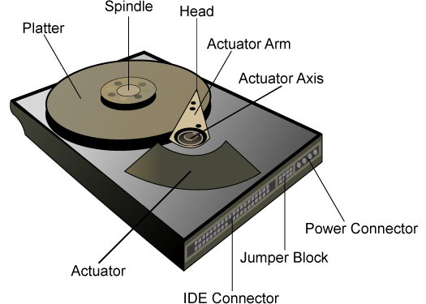
Hard Drive Hardware

Slide 4
A Multi-Platter Disk

Slide 5
Addressing and Geometry
Externally, hard drives expose a large number of sectors (blocks)
Typically 512 or 4096 bytes
Individual sector writes are atomic
Multiple sectors writes may be interrupted (torn write)
Drive geometry
Sectors arranged into tracks
A cylinder is a particular track on multiple platters
Tracks arranged in concentric circles on platters
A disk may have multiple, double-sided platters
Drive motor spins the platters at a constant rate
Measured in revolutions per minute (RPM)

Slide 6
Geometry Example
Sector
Three tracks
11
12
13
10
23
24
25
14
32
9
22
31
33
26
15
Rotation
Read head
8
21
30
34
27
0
7
20
29
35
16
1
Seeks across the various tracks
28
6
19
17
2
18
5
4
3
Outer tracks hold more data
One platter

Slide 7
Common Disk Interfaces
ST-506 → ATA → IDE → SATA
Ancient standard
Commands (read/write) and addresses in cylinder/head/sector format placed in device registers
Recent versions support Logical Block Addresses (LBA)
SCSI (Small Computer Systems Interface)
Packet based, like TCP/IP
Device translates LBA to internal format (e.g. c/h/s)
Transport independent
USB drives, CD/DVD/Bluray, Firewire
iSCSI is SCSI over TCP/IP and Ethernet

Slide 8
Types of Delay With Disks
Long delay
Three types of delay
Rotational Delay
Time to rotate the desired sector to the read head
Related to RPM
Seek delay
Time to move the read head to a different track
Transfer time
Time to read or write bytes
Rotation
11
12
13
10
23
24
25
14
32
9
22
31
33
26
15
8
21
30
34
27
0
7
20
29
35
16
1
28
6
19
17
2
18
5
4
3
Track skew: offset sectors so that sequential reads across tracks incorporate seek delay
Short delay

Slide 9

How To Calculate Transfer Time
Transfer time
T_{I/O} = T_{seek} + T_{rotation} + T_{transfer}
Assume we are transferring 4096 bytes
 | Cheetah 15K.5 | Barracuda
Capacity | 300 GB | 1 TB
RPM | 15000 | 7200
Avg. Seek | 4 ms | 9 ms
Max Transfer | 125 MB/s | 105 MB/s
T_{I/O} = 4 ms + 1 / (15000 RPM / 60 s/M / 1000 ms/s) / 2
+ (4096 B / 125 MB/s * 1000 ms/s / 2²⁰ MB/B)
T_{I/O} = 4 ms + 2ms + 0.03125 ms ≈ 6 ms
Cheetah
T_{I/O} = 9 ms + 1 / (7200 RPM / 60 s/M / 1000 ms/s) / 2
+ (4096 B / 105 MB/s * 1000 ms/s / 2²⁰ MB/B)
T_{I/O} = 9 ms + 4.17 ms + 0.0372 ms ≈ 13.2 ms
Barracuda

Slide 10
Sequential vs. Random Access
Rate of I/O
R_{I/O} = transfer_size / T_{I/O}
Access Type | Transfer Size |  | Cheetah 15K.5 | Barracuda
Random | 4096 B | T_{I/O} | 6 ms | 13.2 ms
 |  | R_{I/O} | 0.66 MB/s | 0.31 MB/s
Sequential | 100 MB | T_{I/O} | 800 ms | 950 ms
 |  | R_{I/O} | 125 MB/s | 105 MB/s
Max Transfer Rate |  |  | 125 MB/s | 105MB/s
Random I/O results in very poor disk performance!

Slide 11
Caching
Many disks incorporate caches (track buffer)
Small amount of RAM (8, 16, or 32 MB)
Read caching
Reduces read delays due to seeking and rotation
Write caching
Write back cache: drive reports that writes are complete after they have been cached
Possibly dangerous feature. Why?
Write through cache: drive reports that writes are complete after they have been written to disk
Today, some disks include flash memory for persistent caching (hybrid drives)

Slide 12
Disk Scheduling
Caching helps improve disk performance
But it can’t make up for poor random access times
Key idea: if there are a queue of requests to the disk, they can be reordered to improve performance
First come, first serve (FCFS)
Shortest seek time first (SSTF)
SCAN, otherwise known as the elevator algorithm
C-SCAN, C-LOOK, etc.

Slide 13
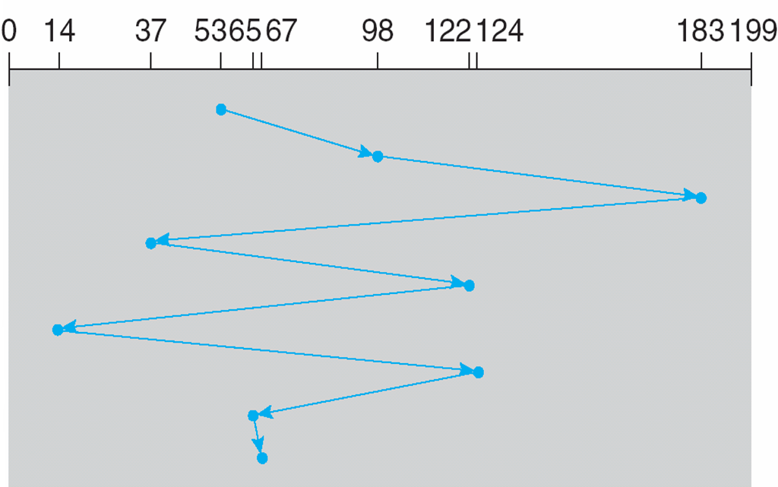
FCFS Scheduling
Most basic scheduler, serve requests in order
Head starts at block 53
Queue: 98, 183, 37, 122, 14, 124, 65, 67
Lot’s of time spent seeking
Total movement: 640 cylinders

Slide 14
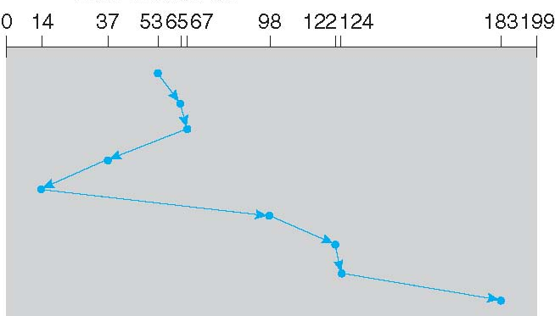
SSTF Scheduling
Idea: minimize seek time by always selecting the block with the shortest seek time
Head starts at block 53
Queue: 98, 183, 37, 122, 14, 124, 65, 67
The good: SSTF is optimal, and it can be easily implemented!
The bad: SSTF is prone to starvation
Total movement: 236 cylinders

Slide 15
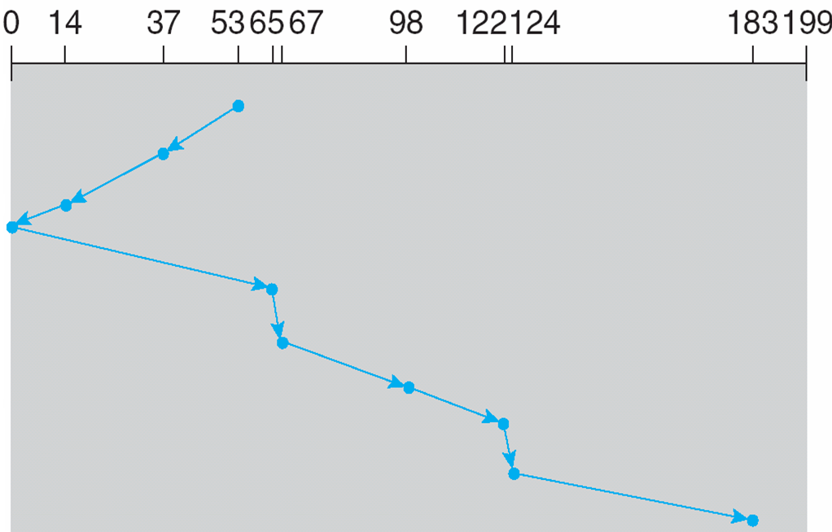
SCAN Example
Head sweeps across the disk servicing requests in order
Head starts at block 53
Queue: 98, 183, 37, 122, 14, 124, 65, 67
The good: reasonable performance, no starvation
The bad: average access times are less for requests at high and low addresses
Total movement: 236 cylinders

Slide 16
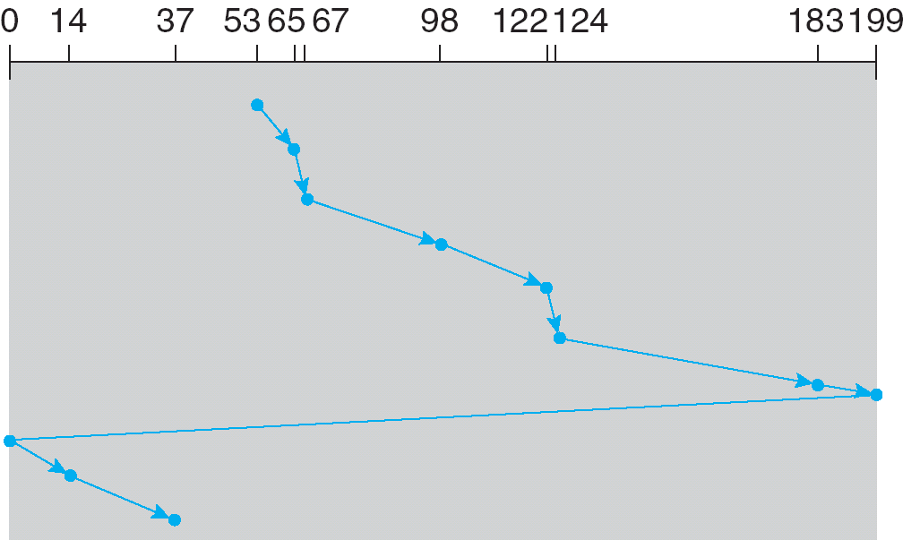
C-SCAN Example
Like SCAN, but only service requests in one direction
Head starts at block 53
Queue: 98, 183, 37, 122, 14, 124, 65, 67
The good: fairer than SCAN
The bad: worse performance than SCAN
Total movement: 382 cylinders

Slide 17
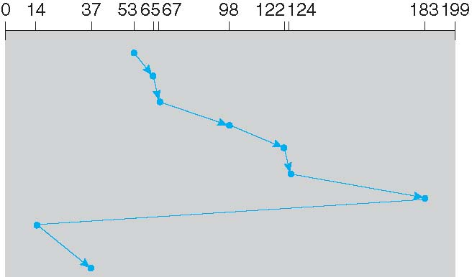
C-LOOK Example
Peek at the upcoming addresses in the queue
Head only goes as far as the last request
Head starts at block 53
Queue: 98, 183, 37, 122, 14, 124, 65, 67
Total movement: 322 cylinders

Slide 18
Implementing Disk Scheduling
We have talked about several scheduling problems that take place in the kernel
Process scheduling
Page swapping
Where should disk scheduling be implemented?
OS scheduling
OS can implement SSTF or LOOK by ordering the queue by LBA
However, the OS cannot account for rotation delay
On-disk scheduling
Disk knows the exact position of the head and platters
Can implement more advanced schedulers (SPTF)
But, requires specialized hardware and drivers

Slide 19
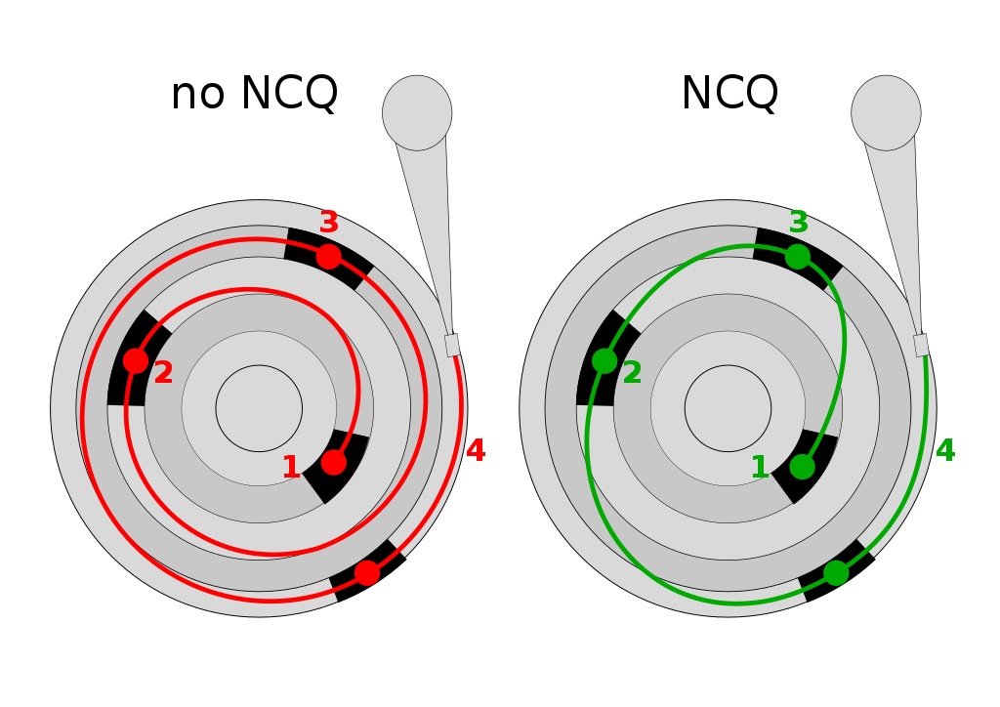
Command Queuing
Feature where a disk stores of queue of pending read/write requests
Called Native Command Queuing (NCQ) in SATA
Disk may reorder items in the queue to improve performance
E.g. batch operations to close sectors/tracks
Supported by SCSI and modern SATA drives
Tagged command queuing: allows the host to place constraints on command re-ordering

Slide 20
Raid

Slide 21
Beyond Single Disks
Hard drives are great devices
Relatively fast, persistent storage
Shortcomings:
How to cope with disk failure?
Mechanical parts break over time
Sectors may become silently corrupted
Capacity is limited
Managing files across multiple physical devices is cumbersome
Can we make 10x 1 TB drives look like a 10 TB drive?

Slide 22
Redundant Array of Inexpensive Disks
RAID: use multiple disks to create the illusion of a large, faster, more reliable disk
Externally, RAID looks like a single disk
i.e. RAID is transparent
Data blocks are read/written as usual
No need for software to explicitly manage multiple disks or perform error checking/recovery
Internally, RAID is a complex computer system
Disks managed by a dedicated CPU + software
RAM and non-volatile memory
Many different configuration options (RAID levels)

Slide 23
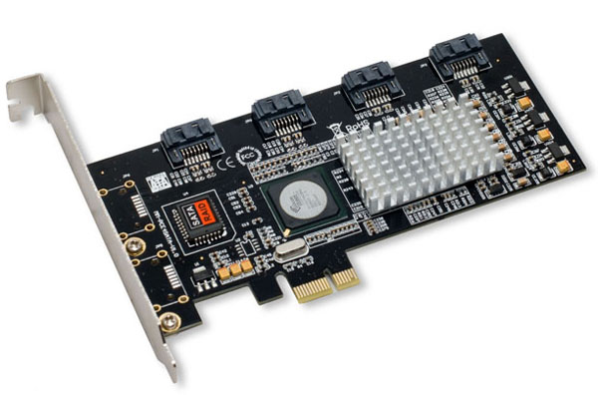
Example RAID Controller
SATA ports
RAM
CPU
Non-volatile storage

Slide 24
RAID 0: Striping
Key idea: present an array of disks as a single large disk
Maximize parallelism by striping data cross all N disks
Disk 0
Disk 1
Disk 2
Disk 3
Sequential accesses spread across all drives
Data block = 512 bytes
0
4
8
12
1
5
9
13
2
6
10
14
3
7
11
15
Random accesses are naturally spread over all drives
Stripe

Slide 25
Addressing Blocks
How do you access specific data blocks?
Disk = logical_block_number % number_of_disks
Offset = logical_block_number / number_of_disks
Example: read block 11
11 % 4 = Disk 3
11 / 4 = Physical Block 2 (starting from 0)
Disk 0
Disk 1
Disk 2
Disk 3
0
4
8
12
1
5
9
13
2
6
10
14
3
7
11
15

Slide 26
Chunk Sizing
Chunk size = 1 block
Disk 0
Disk 1
Disk 2
Disk 3
0
4
8
12
1
5
9
13
2
6
10
14
3
7
11
15
Chunk size impacts array performance
Smaller chunks → greater parallelism
Big chunks → reduced seek times
Typical arrays use 64KB chunks
Disk 0
Disk 1
Disk 2
Disk 3
0
1
8
9
2
3
10
11
4
5
12
13
6
7
14
15
Chunk size = 2 block

Slide 27

Measuring RAID Performance (1)
As usual, we focus on sequential and random workloads
Assume disks in the array have sequential access time S
10 MB transfer
S = transfer_size / time_to_access
10 MB / (7 ms + 3 ms + 10 MB / 50 MB/s) = 47.62 MB/s
Average seek time | 7 ms
Average rotational delay | 3 ms
Transfer rate | 50 MB/s

Slide 28
Measuring RAID Performance (2)
As usual, we focus on sequential and random workloads
Assume disks in the array have random access time R
10 KB transfer
R = transfer_size / time_to_access
10 KB / (7 ms + 3 ms + 10 KB / 50 MB/s) = 0.98 MB/s
Average seek time | 7 ms
Average rotational delay | 3 ms
Transfer rate | 50 MB/s

Slide 29
Analysis of RAID 0
Capacity: N
All space on all drives can be filled with data
Reliability: 0
If any drive fails, data is permanently lost
Sequential read and write: N * S
Full parallelization across drives
Random read and write: N * R
Full parallelization across all drives

Slide 30
RAID 1: Mirroring
RAID 0 offers high performance, but zero error recovery
Key idea: make two copies of all data
Disk 0
Disk 1
0
1
2
3
0
1
2
3

Slide 31
RAID 0+1 and 1+0 Examples
0+1
1+0
Mirror
Stripe
Stripe
Stripe
Mirror
Mirror
Disk 0
Disk 1
Disk 2
Disk 3
Disk 0
Disk 1
Disk 2
Disk 3
0
2
4
6
1
3
5
7
0
2
4
6
1
3
5
7
0
2
4
6
0
2
4
6
1
3
5
7
1
3
5
7
Combines striping and mirroring
Superseded by RAID 4, 5, and 6

Slide 32
Analysis of RAID 1 (1)
Capacity: N / 2
Two copies of all data, thus half capacity
Reliability: 1 drive can fail, sometime more
If you are lucky, N / 2 drives can fail without data loss
Disk 0
Disk 1
Disk 2
Disk 3
0
2
4
6
1
3
5
7
0
2
4
6
1
3
5
7

Slide 33
Analysis of RAID 1 (2)
Sequential write: (N / 2) * S
Two copies of all data, thus half throughput
Sequential read: (N / 2) * S
Half of the read blocks are wasted, thus halving throughput
Disk 0
Disk 1
Disk 2
Disk 3
0
2
4
6
1
3
5
7
0
2
4
6
1
3
5
7
Each skipped block is wasted

Slide 34
Analysis of RAID 1 (3)
Random read: N * R
Best case scenario for RAID 1
Reads can parallelize across all disks
Random write: (N / 2) * R
Two copies of all data, thus half throughput
Disk 0
Disk 1
Disk 2
Disk 3
0
2
4
6
1
3
5
7
0
2
4
6
1
3
5
7

Slide 35

The Consistent Update Problem
Mirrored writes should be atomic
All copies are written, or none are written
However, this is difficult to guarantee
Example: power failure
Many RAID controllers include a write-ahead log
Battery backed, non-volatile storage of pending writes
RAID Controller
Cache
Disk 0
Disk 1
Disk 2
Disk 3
0
2
4
6
1
3
5
7
0
2
4
6
1
3
5
7

Slide 36
Decreasing the Cost of Reliability
RAID 1 offers highly reliable data storage
But, it uses N / 2 of the array capacity
Can we achieve the same level of reliability without wasting so much capacity?
Yes!
Use information coding techniques to build light-weight error recovery mechanisms

Slide 37
RAID 4: Parity Drive
Disk 0
Disk 1
Disk 2
Disk 3
Disk 4
0
4
8
12
1
5
9
13
2
6
10
14
3
7
11
15
P0
P1
P2
P3
Disk N only stores parity information for the other N-1 disks
Disk 0 | Disk 1 | Disk 2 | Disk 3 | Disk 4
0 | 0 | 1 | 1 | 0 ^ 0 ^ 1 ^ 1 = 0
0 | 1 | 0 | 0 | 0 ^ 1 ^ 0 ^ 0 = 1
1 | 1 | 1 | 1 | 1 ^ 1 ^ 1 ^ 1 = 0
0 | 1 | 1 | 1 | 0 ^ 1 ^ 1 ^ 1 = 1
Parity calculated using XOR

Slide 38
Updating Parity on Write
How is parity updated when blocks are written?
Additive parity
Disk 0 | Disk 1 | Disk 2 | Disk 3 | Disk 4
0 | 0 | 1 | 1 | 0 ^ 0 ^ 1 ^ 1 = 0
0
0 ^ 0 ^ 0 ^ 1 = 1
Read other blocks
Update parity block
Subtractive parity
Disk 0 | Disk 1 | Disk 2 | Disk 3 | Disk 4
0 | 0 | 1 | 1 | 0 ^ 0 ^ 1 ^ 1 = 0
0
1
P_{new} = C_{old} ^ C_{new} ^ P_{old}

Slide 39
Random Writes and RAID 4
Disk 0
Disk 1
Disk 2
Disk 3
Disk 4
0
4
8
12
1
5
9
13
2
6
10
14
3
7
11
15
P0
P1
P2
P3
All writes must update the parity drive, causing serialization :(
Random writes in RAID 4
Read the target block and the parity block
Use subtraction to calculate the new parity block
Write the target block and the parity block
RAID 4 has terrible write performance
Bottlenecked by the parity drive

Slide 40
Analysis of RAID 4
Capacity: N – 1
Space on the parity drive is lost
Reliability: 1 drive can fail
Sequential Read and write: (N – 1) * S
Parallelization across all non-parity blocks
Random Read: (N – 1) * R
Reads parallelize over all but the parity drive
Random Write: R / 2
Writes serialize due to the parity drive
Each write requires 1 read and 1 write of the parity drive, thus R / 2

Slide 41
RAID 5: Rotating Parity
Disk 0
Disk 1
Disk 2
Disk 3
Disk 4
0
5
10
15
1
6
11
P3
2
7
P2
12
3
P1
8
13
P0
4
9
14
Parity blocks are spread over all N disks
Disk 0 | Disk 1 | Disk 2 | Disk 3 | Disk 4
0 | 0 | 1 | 1 | 0 ^ 0 ^ 1 ^ 1 = 0
1 | 0 | 0 | 0 ^ 1 ^ 0 ^ 0 = 1 | 0
1 | 1 | 1 ^ 1 ^ 1 ^ 1 = 0 | 1 | 1
1 | 0 ^ 1 ^ 1 ^ 1 = 1 | 0 | 1 | 1

Slide 42
Random Writes and RAID 5
Disk 0
Disk 1
Disk 2
Disk 3
Disk 4
0
5
10
15
1
6
11
P3
2
7
P2
12
3
P1
8
13
P0
4
9
14
Unlike RAID 4, writes are spread roughly evenly across all drives
Random writes in RAID 5
Read the target block and the parity block
Use subtraction to calculate the new parity block
Write the target block and the parity block
Thus, 4 total operations (2 reads, 2 writes)
Distributed across all drives

Slide 43
Analysis of Raid 5
Capacity: N – 1 [same as RAID 4]
Reliability: 1 drive can fail [same as RAID 4]
Sequential Read and write: (N – 1) * S [same]
Parallelization across all non-parity blocks
Random Read: N * R [vs. (N – 1) * R]
Unlike RAID 4, reads parallelize over all drives
Random Write: N / 4 * R [vs. R / 2 for RAID 4]
Unlike RAID 4, writes parallelize over all drives
Each write requires 2 reads and 2 write, hence N / 4

Slide 44
Comparison of RAID Levels
N – number of drives
S – sequential access speed
R – random access speed
D – latency to access a single disk
 |  | RAID 0 | RAID 1 | RAID 4 | RAID 5
 | Capacity | N | N / 2 | N – 1 | N – 1
 | Reliability | 0 | 1 (maybe N / 2) | 1 | 1
Throughput | Sequential Read | N * S | (N / 2) * S | (N – 1) * S | (N – 1) * S
 | Sequential Write | N * S | (N / 2) * S | (N – 1) * S | (N – 1) * S
 | Random Read | N * R | N * R | (N – 1) * R | N * R
 | Random Write | N * R | (N / 2) * R | R / 2 | (N / 4) * R
Latency | Read | D | D | D | D
 | Write | D | D | 2 * D | 2 * D

Slide 45
RAID 6
Disk 0
Disk 1
Disk 2
Disk 3
Disk 4
0
4
8
P3₀
1
5
P2₀
P3₁
2
P1₀
P2₁
9
P0₀
P1₁
6
10
P0₁
3
7
11
Two parity blocks per stripe
Any two drives can fail
N – 2 usable capacity
No overhead on read, significant overhead on write
Typically implemented using Reed-Solomon codes

Slide 46
Choosing a RAID Level
Best performance and most capacity?
RAID 0
Greatest error recovery?
RAID 1 (1+0 or 0+1) or RAID 6
Balance between space, performance, and recoverability?
RAID 5

Slide 47
Other Considerations
Many RAID systems include a hot spare
An idle, unused disk installed in the system
If a drive fails, the array is immediately rebuilt using the hot spare
RAID can be implemented in hardware or software
Hardware is faster and more reliable…
But, migrating a hardware RAID array to a different hardware controller almost never works
Software arrays are simpler to migrate and cheaper, but have worse performance and weaker reliability
Due to the consistent update problem

Slide 48
SSD

Slide 49
Beyond Spinning Disks
Hard drives have been around since 1956
The cheapest way to store large amounts of data
Sizes are still increasing rapidly
However, hard drives are typically the slowest component in most computers
CPU and RAM operate at GHz
PCI-X and Ethernet are GB/s
Hard drives are not suitable for mobile devices
Fragile mechanical components can break
The disk motor is extremely power hungry

Slide 50
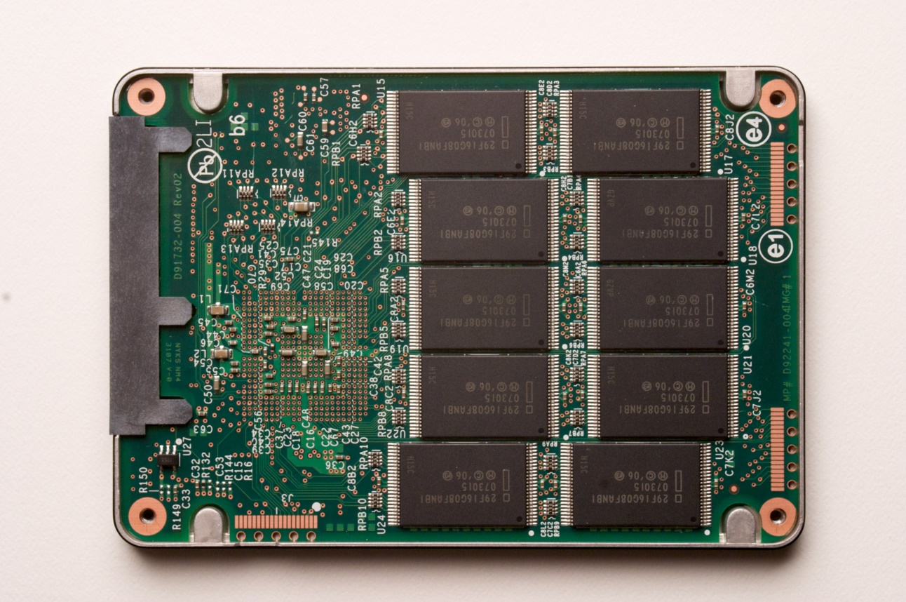
Solid State Drives
NAND flash memory-based drives
High voltage is able to change the configuration of a floating-gate transistor
State of the transistor interpreted as binary data
Data is striped across all chips
Flash memory chip

Slide 51
Advantages of SSDs
More resilient against physical damage
No sensitive read head or moving parts
Immune to changes in temperature
Greatly reduced power consumption
No mechanical, moving parts
Much faster than hard drives
>500 MB/s vs ~200 MB/s for hard drives
No penalty for random access
Each flash cell can be addressed directly
No need to rotate or seek
Extremely high throughput
Although each flash chip is slow, they are RAIDed

Slide 52
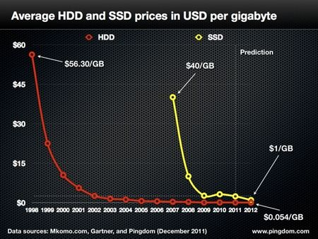

Slide 53
Challenges with Flash
Flash memory is written in pages, but erased in blocks
Pages: 4 – 16 KB, Blocks: 128 – 256 KB
Thus, flash memory can become fragmented
Leads to the write amplification problem
Flash memory can only be written a fixed number of times
Typically 3000 – 5000 cycles for MLC
SSDs use wear leveling to evenly distribute writes across all flash cells

Slide 54
Write Amplification
G moved to new block by the garbage collector
Cleaned block can now be rewritten
Block X
Block Y
Stale pages cannot be overwritten or erased individually
A
G
C’’
K
D
G
C’
F’
F’’
J
B
A’
A’’
L
E
D’
D’’
H
A’’’
C
F
B’
E’
B’’
E’’
I
B’’’
Once all pages have been written, valid pages must be consolidated to free up space
Write amplification: a write triggers garbage collection/compaction
One or more blocks must be read, erased, and rewritten before the write can proceed

Slide 55
Garbage Collection
Garbage collection (GC) is vital for the performance of SSDs
Older SSDs had fast writes up until all pages were written once
Even if the drive has lots of “free space,” each write is amplified, thus reducing performance
Many SSDs over-provision to help the GC
240 GB SSDs actually have 256 GB of memory
Modern SSDs implement background GC
However, this doesn’t always work correctly

Slide 56
The Ambiguity of Delete
Goal: the SSD wants to perform background GC
But this assumes the SSD knows which pages are invalid
Problem: most file systems don’t actually delete data
On Linux, the “delete” function is unlink()
Removes the file meta-data, but not the file itself

Slide 57
Delete Example
Block X
File metadata (inode, name, etc.)
Metadata is overwritten, but the file remains
Meta
File
File
Meta
Meta
File
File
Meta
File
File
File
File is written to SSD
File is deleted
The GC executes
9 pages look valid to the SSD
The OS knows only 2 pages are valid
Lack of explicit delete means the GC wastes effort copying useless pages
Hard drives are not GCed, so this was never a problem

Slide 58
TRIM
New SATA command TRIM (SCSI – UNMAP)
Allows the OS to tell the SSD that specific LBAs are invalid, may be GCed
Block X
TRIM
Meta
File
File
Meta
Meta
File
File
Meta
File
File
File
OS support for TRIM
Win 7, OSX Snow Leopard, Linux 2.6.33, Android 4.3
Must be supported by the SSD firmware

Slide 59
Wear Leveling
Recall: each flash cell wears out after several thousand writes
SSDs use wear leveling to spread writes across all cells
Typical consumer SSDs should last ~5 years

Slide 60
Wear Leveling Examples
If the GC runs now, page G must be copied
Wait as long as possible before garbage collecting
Block X
Block Y
A
C’’
K
D
G
C’
F’
F’’
G’
Dynamic Wear Leveling
B
A’
A’’
L
E
D’
D’’
H
A’’’
C
F
B’
E’
B’’
E’’
I
B’’’
Blocks with long lived data receive less wear
Block X
Block Y
M*
J
M*
A
D
G
M
M’
M’’
M’’’
A
D
G
J
Static Wear Leveling
N*
N*
B
E
H
K
N
N’
N’’
N’’’
B
E
H
K
O*
I
O*
C
F
L
O
O’
O’’
C
F
I
O’’’
L
SSD controller periodically swap long lived data to different blocks

Slide 61
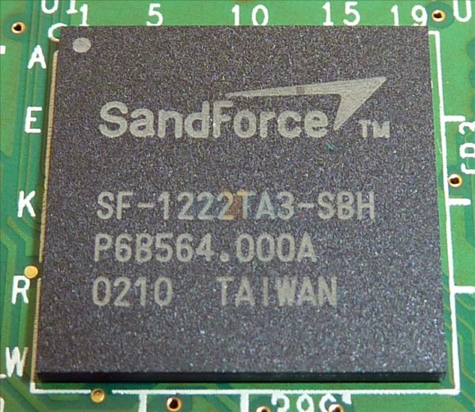
SSD Controllers
SSDs are extremely complicated internally
All operations handled by the SSD controller
Maps LBAs to physical pages
Keeps track of free pages, controls the GC
May implement background GC
Performs wear leveling via data rotation
Controller performance is crucial for overall SSD performance

Slide 62
Flavors of NAND Flash Memory
Multi-Level Cell (MLC)
Single-Level Cell (SLC)
Multiple bits per flash cell
For two-level: 00, 01, 10, 11
2, 3, and 4-bit MLC is available
Higher capacity and cheaper than SLC flash
Lower throughput due to the need for error correction
3000 – 5000 write cycels
Consumes more power
Consumer-grade drives
One bit per flash cell
0 or 1
Lower capacity and more expensive than MLC flash
Higher throughput than MLC
10000 – 100000 write cycles
Expensive, enterprise drives

