Slide 1
Operating Systems
Processes

Slide 2
Running Dynamic Code
One basic function of an OS is to execute and manage code dynamically, e.g.:
A command issued at a command line terminal
An icon double clicked from the desktop
Jobs/tasks run as part of a batch system (MapReduce)
A process is the basic unit of a program in execution

Slide 3
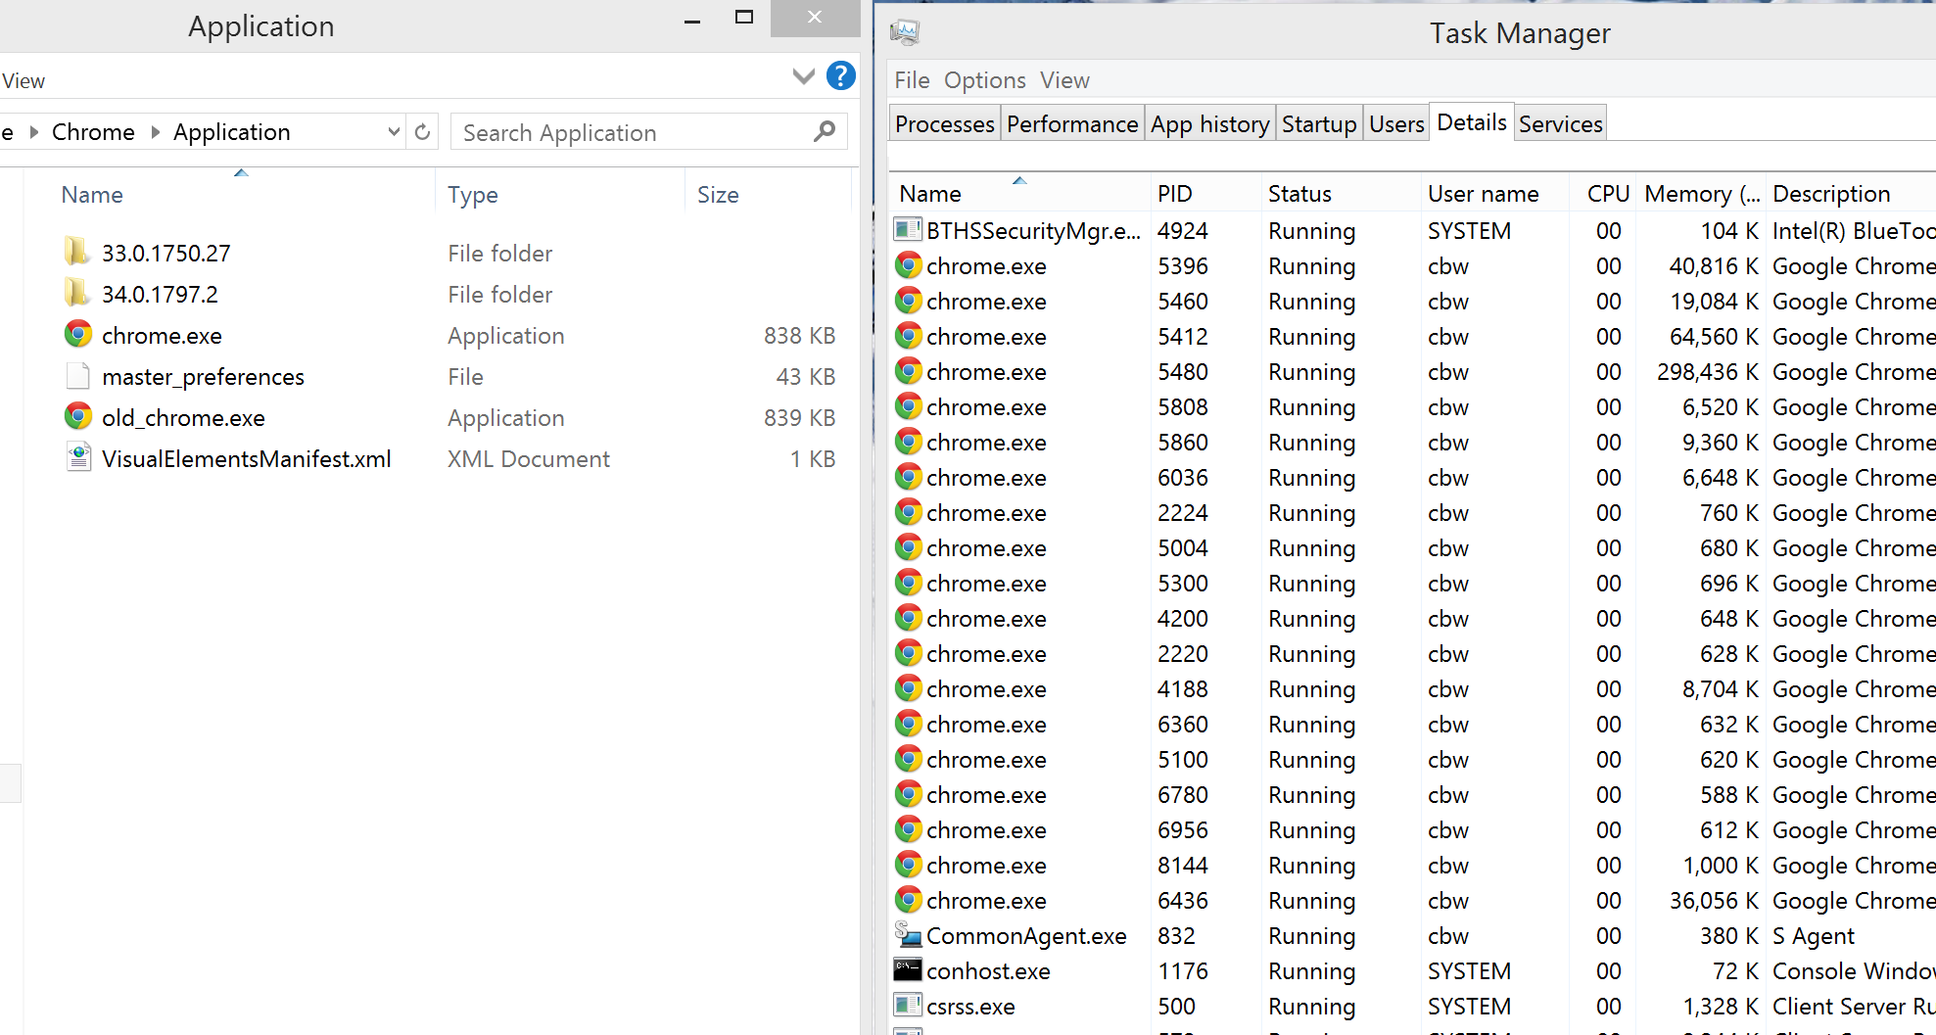
Programs and Processes
Process
The running instantiation of a program, stored in RAM
Program
An executable file in long-term storage
One-to-many relationship between program and processes

Slide 4
From the Loader to the Kernel
Once a program is loaded, the kernel must manage this new process
Program Control Block (PCB): kernel data structure representing a process
Has at least one thread (possibly more…)
Keeps track of the memory used by the process
Code segments
Data segments (stack and heap)
Keeps runtime state of the process
CPU register values
EIP

Slide 5
Program Control Block (PCB)
OS structure that represents a process in memory
Created for each process by the loader
Managed by the kernel
struct task_struct { // Typical Unix PCB
pid t_pid; // process identifier long state; // state of the process unsigned int time_slice; //scheduling information struct task_struct *parent; // this process’s parent struct list_head children; // this process’s children struct files_struct *files; // list of open files struct mm_struct *mm; // address space of this process
};

Slide 6
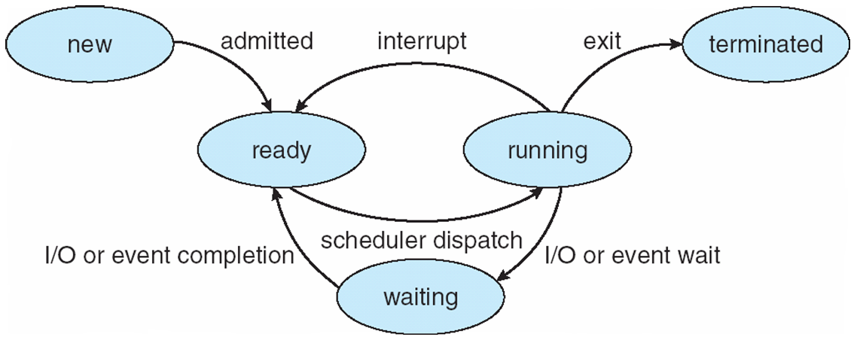
Process States
As a process executes, it changes state
new: The process is being created
running: Instructions are being executed
waiting: The process is waiting for some event to occur
ready: The process is waiting to be assigned to a processor
terminated: The process has finished execution

Slide 7

Parents and Children
On Unix/Linux, all processes have parents
i.e. which process executed this new process?
If a process spawns other processes, they become it’s children
This creates a tree of processes
If a parent exits before its children, the children become orphans
If a child exits before the parent calls wait(), the child becomes a zombie

Slide 8
Process Tree
init is a special process started by the kernel
Always roots the process tree

Slide 9
Additional Execution Context
File descriptors
stdin, stdout, stderr
Files on disk
Sockets
Pipes
Permissions
User and group
Access to specific APIs
Memory protection
Environment
$PATH
Shared Resources
Locks
Mutexes
Shared Memory

Slide 10
Example: UNIX

Slide 11
UNIX Process Management
fork() – system call to create a copy of the current process, and start it running
No arguments!
exec() – system call to change the program being run by the current process
wait() – system call to wait for a process to finish
signal() – system call to send a notification to another process
Notes:
UNIX splits creating a process into two steps, each of them a lot simpler.

Slide 12
UNIX Process Management
Child Process
pid = fork();
if (pid == 0)
exec(…);
else
wait(pid);
main() {
…
}
pid = 0
pid = fork();
if (pid == 0)
exec(…);
else
wait(pid);
pid = fork();
if (pid == 0)
exec(…);
else
wait(pid);
pid = 9418
Original Process
Notes:
How is this used – typically, fork a process, child and parent are now both running the same program. One sets up the child program, and runs exec – becoming the new program
The parent, usually, waits for the child to finish

Slide 13
Question: What does this code print?
int child_pid = fork();
if (child_pid == 0) { // I'm the child process
printf("I am process #%d\n", getpid());
return 0;
} else { // I'm the parent process
printf("I am parent of process #%d\n", child_pid);
return 0;
}
Notes:
Parent could print first, or child could print first – you don’t know!

Slide 14
Implementing UNIX fork()
Steps to implement UNIX fork()
Create and initialize the process control block (PCB) in the kernel
Create a new address space
Initialize the address space with a copy of the entire contents of the address space of the parent
Inherit the execution context of the parent (e.g., any open files)
Inform the scheduler that the new process is ready to run

Slide 15
Implementing UNIX exec()
Steps to implement UNIX exec()
Load the new program into the current address space
Copy command line arguments into memory in the new address space
Initialize the hardware context to start execution
EIP = Entry point in the ELF header
ESP = A newly allocated stack

Slide 16
Process Termination
Typically, a process will wait(pid) until its child process(es) complete
abort(pid) can be used to immediately end a child process

Slide 17
Context switching

Slide 18
Context Switching
Context switching
Saves state of a process before a switching to another process
Restores original process state when switching back
Simple concept, but:
How do you save the state of a process?
How do you stop execution of a process?
How do you restart the execution of process that has been switched out?

Slide 19
The Process Stack
Each process has a stack in memory that stores:
Local variables
Arguments to functions
Return addresses from functions
On x86:
The stack grows downwards
ESP (Stack Pointer register) points to the bottom of the stack (i.e. the newest data)
EBP (Base Pointer) points to the base of the current frame
Instructions like push, pop, call, ret, int, and iret all modify the stack

Slide 20
stack_exam.c
int bar(int a, int b) {
int r = rand();
return a + b - r;
}
int foo(int a) {
int x, y;
x = a * 2;
y = a - 7;
return bar(x, y);
}
int main(void) {
…
foo(12);
…
}

Slide 21
$ gcc -g -fno-stack-protector -m32 -o stack_exam stack_exam.c
$ objdump --disassemble –M intel ./stack_exam
…
804842a: e8 c0 ff ff ff call 80483ef <foo>
804842f: b8 00 00 00 00 mov eax,0x0
…
080483ef <foo>:
80483ef: 55 push ebp
80483f0: 89 e5 mov ebp, esp
80483f2: 83 ec 28 sub esp, 0x28
80483f5: 8b 45 08 mov eax, [ebp+0x8]
80483f8: 01 c0 add eax, eax
80483fa: 89 45 f4 mov [ebp-0xc], eax
80483fd: 8b 45 08 mov eax, [ebp+0x8]
8048400: 83 e8 07 sub eax, 0x7
8048403: 89 45 f0 mov [ebp-0x10],eax
8048406: 8b 45 f0 mov eax, [ebp-0x10]
8048409: 89 44 24 04 mov [esp+0x4],eax
804840d: 8b 45 f4 mov eax, [ebp-0xc]
8048410: 89 04 24 mov [esp], eax
8048413: e8 bc ff ff ff call 80483d4 <bar>
8048418: c9 leave
8048419: c3 ret
…
Memory
EBP
main()’s local variables
12 | Argument to foo()
0x804842f | Return addr to main()
Saved EBP
24 | x = a * 2
5 | y = a - 7
5 | 2nd arg for bar()
24 | 1st arg for bar()
0x8048418 | Return addr to foo()
main()’s
Frame
EIP
ESP
foo()’s
Frame

Slide 22
Memory
EBP
foo()’s local variables
5 | 2nd arg for bar()
24 | 1st arg for bar()
0x8048418 | Return addr to foo()
Saved EBP
Some # | Result of rand()
…
080483d4 <bar>:
80483d4: 55 push ebp
80483d5: 89 e5 mov ebp, esp
80483d7: 83 ec 18 sub esp, 0x18
80483da: e8 31 ff ff ff call 8048310 <rand@plt>
80483df: 89 45 f4 mov [ebp-0xc], eax
80483e2: 8b 45 0c mov eax, [ebp+0xc]
80483e5: 8b 55 08 mov edx, [ebp+0x8]
80483e8: 01 d0 add eax,edx
80483ea: 2b 45 f4 sub eax, [ebp-0xc]
80483ed: c9 leave
80483ee: c3 ret
…
foo()’s
Frame
EIP
ESP
bar()’s
Frame
leave → mov esp, ebp; pop ebp;
Return value is placed in EAX

Slide 23
Stack Switching
We’ve seen that the stack holds
Local variables
Arguments to functions
Return addresses
… basically, the state of a running program
Crucially, a process’ control flow is stored on the stack
If you modify the stack, you also modify control flow
Stack switching is effectively process switching

Slide 24
Switching Between Processes
Process 1 calls into switch() routine
CPU registers are pushed onto the stack
The stack pointer is saved into memory
The stack pointer for process 2 is loaded
CPU registers are restored
switch() returns back to process 2

Slide 25
Process 1’s Code
Process 1’s Stack
EIP
a = b + 1;
switch();
b--;
Top Frame
Return addr
Saved EAX
…
Saved EDX
ESP
OS Code
<switch>:
push eax
push ebx
…
push edx
mov [cur_esp], esp
mov esp, [saved_esp]
pop edx
…
pop ebx
pop eax
ret
OS Memory
Saved ESP for Process 1
Saved ESP for Process 2
Process 2’s Stack
Top Frame
Return addr
Saved EAX
…
Saved EDX
Process 2’s Code
puts(my_str);
switch();
my_str[0] = ‘\n’;
i = strlen(my_str);
switch();

Slide 26
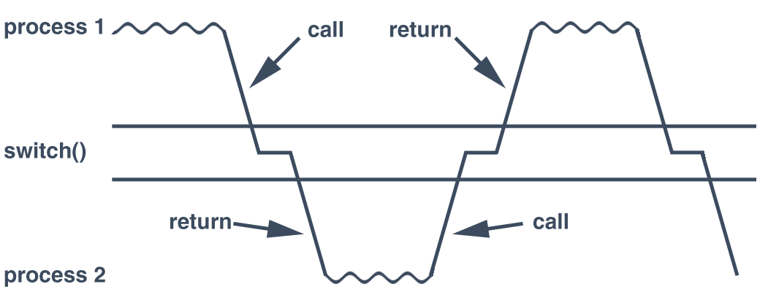
Abusing Call and Return
Context switching uses function call and return mechanisms
Switches into a process by returning from a function
Switches out of a process by calling into a function

Slide 27
What About New Processes?
But how do you start a process in the first place?
A new process doesn’t have a stack…
… and it never called into switch()
Pretend that there was a previous call
Build a fake initial stack frame
This frame looks exactly like the instruction just before main() called into switch()
When switch() returns, it’ll allow main() to run from the beginning

Slide 28
Process 1’s Code
EIP
a = b + 1;
switch();
b--;
OS Memory
OS Code
Saved ESP for Process 1
Address of New Stack
<switch>:
push eax
push ebx
…
push edx
mov [cur_esp], esp
mov esp, [saved_esp]
pop edx
…
pop ebx
pop eax
iret
Initial Stack Frame
argv[…]
argc
0 (null return addr)
Address of main()
0 (null EDX)
…
0 (null EAX)
New Process
ESP
main() {
…
}

Slide 29
When Do You Switch Processes?
To share CPU between multiple processes, control must eventually return to the OS
When should this happen?
What mechanisms implements the switch from user process back to the OS?
Four approaches:
Voluntary yielding
Switch during API calls to the OS
Switch on I/O
Switch based on a timer interrupt

Slide 30
Voluntary Yielding
Idea: processes must voluntary give up control by calling an OS API, e.g. thread_yield()
Problems:
Misbehaving or buggy apps may never yield
No guarantee that apps will yield in a reasonable amount of time
Wasteful of CPU resources, i.e. what if a process is idle-waiting on I/O?

Slide 31
Interjection on OS APIs
Idea: whenever a process calls an OS API, this gives the OS an opportunity to context switch
E.g. printf(), fopen(), socket(), etc…
The original Apple Macintosh used this approach
Cooperative multi-tasking
Problems:
Misbehaving or buggy apps may never yield
Some normal apps don’t use OS APIs for long periods of time
E.g. a long, CPU intensive matrix calculation

Slide 32
I/O Context Switch Example
What’s happening here?
struct terminal {
queue<char> keystrokes; /* buffered keystrokes - array or list */
process *waiting; /* process waiting for input */
...
};
process *current; /* the currently running process */
queue<process *> active; /* linked list of other processes ready to run */
char get_char(terminal *term) {
if (term->keystrokes.empty()) {
term->waiting = current; /* sleep waiting for input */
switch_to(active.pop_head()); /* and switch to next active process */
}
return term->keystrokes.pop_head();
}
void interrupt(terminal *term, char key) {
term->keystrokes.push_tail(key); /* add keystroke to buffer */
if (term->waiting) {
active.push_tail(term->waiting); /* and wake up sleeping process */
term->waiting = NULL;
}
}

Slide 33
Context Switching on I/O
Idea: when one process is waiting on I/O, switch to another process
I/O APIs already go through the OS, so context switching is easy
Problems:
Some apps don’t have any I/O for long periods of time

Slide 34
Preemptive Context Switching
So far, our processes will not switch to another process until some action is taken
e.g. an API call or an I/O interrupt
Idea: use a timer interrupt to force context switching at set intervals
Interrupt handler runs at a fixed frequency to measure how long a process has been running
If it’s been running for some max duration (scheduling quantum), the handler switches to the next process
Problems:
Requires hardware support (a programmable timer)
Thankfully, this is built-in to most modern CPUs

Slide 35
Isolation

Slide 36
Process Isolation
At this point, we can execute multiple processes concurrently
Problem: how do you stop processes from behaving badly?
Overwriting kernel memory
Reading/writing data from other processes
Disabling interrupts
Crashing the whole computer
Etc.

Slide 37
Thought Experiment
How can we implement execution with limited privilege?
Use an interpreter or a simulator
Execute each program instruction in a simulator
If the instruction is permitted, do the instruction
Otherwise, stop the process
Basic model in Javascript, Java, …
However, interpreters and simulators are slow
How do we go faster?
Run the unprivileged code directly on the CPU
Notes:
Upsides? Downsides to this approach? Essentially what you do in Javascript in a browser – simulate the execution of the script, one line at a time.

Slide 38
Protected Mode
Most modern CPUs support protected mode
x86 CPUs support three rings with different privileges
Ring 0: OS kernel
Ring 1, 2: device drivers
Ring 3: userland
Most OSes only use rings 0 and 3
Ring 3
Ring 2
Ring 1
Ring 0
Kernel
Device Drivers
Device Drivers
Applications
38

Slide 39
Real vs. Protected
On startup, the CPU starts in 16-bit real mode
Protected mode is disabled
Assumes segment:offset addressing
Typically, bootloader switches CPU to protected mode
mov eax, cr0
or eax, 1 ; set bit 1 of CR0 to 1 to enable pmode
mov cr0, eax

Slide 40
Dual-Mode Operation
Ring 0: kernel/supervisor mode
Execution with the full privileges of the hardware
Read/write to any memory, access any I/O device, read/write any disk sector, send/read any packet
Ring 3: user mode or “userland”
Limited privileges
Only those granted by the operating system kernel
Notes:
Obviously, you need the part that has full rights to be really reliable!

Slide 41
Privileged Instructions
Examples?
sti/cli – Enable and disable interrupts
Any instruction that modifies the CR0 register
Controls whether protected mode is enabled
hlt – Halts the CPU
What should happen if a user program attempts to execute a privileged instruction?
General protection (GP) exception gets thrown by the CPU
Control is transferred to the OSes exception handler
Notes:
Change which memory locations a user program can access
Send commands to I/O devices
Read data from/write data to I/O devices
Jump into kernel code
…

Slide 42
Changing Modes
Applications often need to access the OS
i.e. system calls
Writing files, displaying on the screen, receiving data from the network, etc…
But the OS is ring 0, and apps are ring 3
How do apps get access to the OS?
Apps invoke system calls with an interrupt
E.g. int 0x80
int causes a mode transfer from ring 3 to ring 0

Slide 43
Mode Transfer
Application executes trap (int) instruction
EIP, CS, and EFLAGS get pushed onto the stack
Mode switches from ring 3 to ring 0
Save the state of the current process
Push EAX, EBX, …, etc. onto the stack
Locate and execute the correct syscall handler
Restore the state of process
Pop EAX, EBX, … etc.
Place the return value in EAX
Use iret to return to the process
Switches back to the original mode (typically 3)
Userland
Kernel Mode

Slide 44
System Call Example
Software executes int 0x80
Pushes EIP, CS, and EFLAGS
CPU transfers execution to the OS handler
Look up the handler in the IVT
Switch from ring 3 to 0
OS executes the system call
Save the processes state
Use EAX to locate the system call
Execute the system call
Restore the processes state
Put the return value in EAX
Return to the process with iret
Pops EIP, CS, and EFLAGS
Switches from ring 0 to 3
Main Memory
OS Code
printf()
0x80 Handler
Syscall Table
EIP
User Program
IVT

