Slide 1
Operating Systems
Introduction:
Hardware and Operating System

Slide 2

What is an Operating System?
A program that acts as an intermediary between a user of a computer and the computer hardware
Operating system goals:
Execute user programs and make solving user problems easier
Make the computer system convenient to use
Use the computer hardware in an efficient manner

Slide 3
What is an Operating System?
An OS is any and all software that sits between a user program and the hardware
Hardware (e.g., mouse, keyboard)
Operating System
User Program
OS is a resource manager and allocator
Decides between conflicting requests for hardware access
Attempts to be efficient and fair
OS is a control program
Controls execution of user programs
Prevents errors and improper use

Slide 4
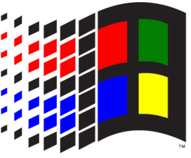

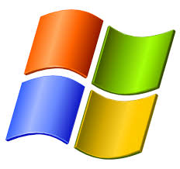
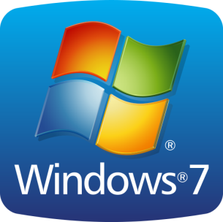
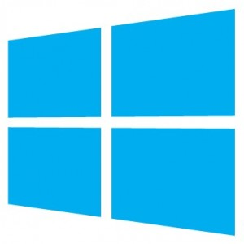










Many Different OSes
Windows
3.1
98
XP
Linux
debian
Ubuntu
CentOS
BSD
FreeBSD
OpenBSD

Slide 5
Two Common OS Families
POSIX
Anything Unix-ish
e.g. Linux, BSDs, Mac, Android, iOS, QNX
Windows
Stuff shipped by Microsoft
Nowadays that’s basically everything, at least for computers with large (MB~GB) main memory.

Slide 6
Basic Computer Architecture
Architecture determines many properties of the OS
How does the OS load and take control?
How does the OS interacts with devices?
How does the OS manage CPU and memory?
This discussion will focus on the IBM PC architecture
Until recently, most computers could still run MS-DOS based programs from the 80’s and 90’s
Remains the most popular architecture
But not for long…
Alternatives: Amiga, Macintosh, PowerPC, etc.

Slide 7
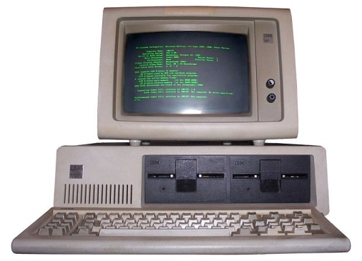
Some History
1981: IBM releases a Personal Computer (PC) to compete with Apple
Basic Input/Output System (BIOS) for low-level control
Three high-level OSes, including MS-DOS
Developers were asked to write software for DOS or BIOS, not bare-metal hardware
1982: Compaq and others release IBM-compatible PCs
Different hardware implementations (except 808x CPU)
Reverse engineered and reimplemented BIOS
Relied on customized version of MS-DOS

Slide 8
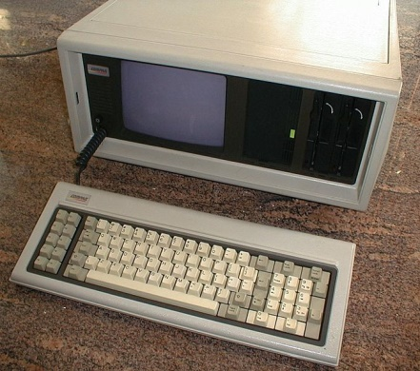
IBM Loses Control
1985: IBM clones dominated computer sales
Used the same underlying CPUs and hardware chips
Close to 100% BIOS compatibility
MS-DOS was ubiquitous
Thus, IBM PC hardware became the de-facto standard
1986: Compaq introduces 80386-based PC
1990’s: Industry is dominated by “WinTel”
Intel x86 CPU architectures (Pentium 1, 2, and 3)
Windows 3.1, NT, 95 software compatibility

Slide 9
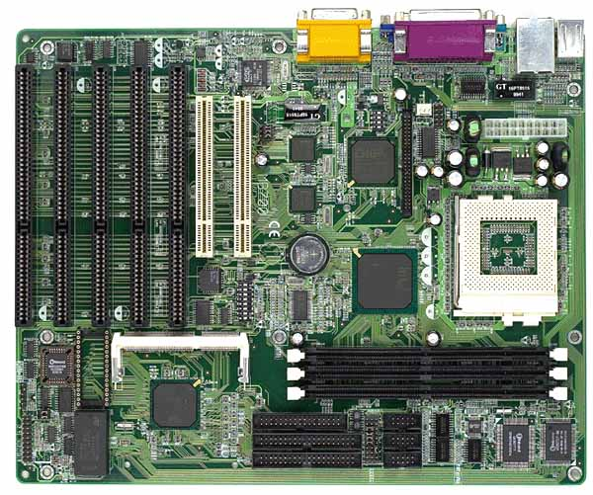
CPU Socket
Many different physical socket standards
This is a Pentium 1 socket
Physical standard is less important than Instruction Set Architecture (ISA)
IBM PCs are Intel 80836 compatible
Original x86 design
Intel, AMD, VIA
Today’s dominant ISA: x86-64, developed by AMD

Slide 10
Slots for random access memory (RAM)
Pre-1993: DRAM (Dynamic RAM)
Post-1993: SDRAM (Synchronous DRAM)
Current standard: Double data rate SDRAM (DDR SDRAM)
North Bridge
Coordinates access to main memory

Slide 11
I/O device slots
Attached to the south-bridge bus
Very old standard: ISA slots
Built in I/O also on the PCI/ISA bus
South-bridge
Facilitates I/O between devices, the CPU, and main memory
Slightly less old standard: PCI slots
Other types:
AGP slots
PCI-E slots

Slide 12
Storage connectors
Also controlled by the South Bridge
Old standard: Parallel ATA (P-ATA)
AT Attachment Packet Interface (ATAPI)
Evolution of the Integrated Drive Electronics (IDE) standard
Other standards
Small Computer System Interface (SCSI)
Serial ATA (SATA)

Slide 13
CPU(s)
L1, L2, L3 Cache
All devices compete for access to memory
North/South Bridge
Memory
Graphics
Graphics Memory
…
I/O
I/O
I/O

Slide 14
x86 History
1978: Intel 8086 – 16 bit
1982: Intel 80286 – introduces protected mode and memory paging
1985: Intel 80386 – 32 bit
1989: Intel 80486 – integrates x87 FPU and cache
1993: Pentium and Pentium MMX
1997, 1999: Pentium II and III
2003, 2004: AMD Athlon 64 and Pentium 4
AMD pioneers the move to 64 bit x86-64

Slide 15
Architecture review

Slide 16
Basic CPU Layout
Main Memory
System Bus
L1 (and L2, L3) Cache
Instruction Fetch
Floating Point (FPU)
Arithmetic and Logic (ALU)
Arithmetic and Logic (ALU)
Registers
Decode
Control Unit

Slide 17
Storage Hierarchy
Smaller / Faster
CPU Registers
1KB
CPU L1/L2/L3 Cache
1 - 32MB
Main Memory (RAM)
4 - 256GB
Solid State Drive (SSD)
32 GB – 1 TB
Hard Drive
512 GB – 4 TB
Tape Drive
1 – 8 TB
Larger / Slower

Slide 18
Typical Memory Layout
Top
0xFFFF
Example: 64KB of memory
2¹⁶ bytes
Addresses from 0 to 65535
Not all memory is free
Specific ranges get used by devices, system services, the BIOS, etc.
Memory mapped devices
0xF000
Free Memory
0x0DFF
BIOS Code
0x00FF
Interrupt Vector
Bottom
0x0000

Slide 19
Communicating with Devices
CPU and devices execute concurrently
How do CPU and devices communicate?
I/O Ports
I/O-only memory space shared by the CPU and a device
Memory mapping
Regions of RAM that are shared by the CPU and a device
Interrupts
Signal from a device to the CPU
Interrupt causes the OS to switch to handler code

Slide 20
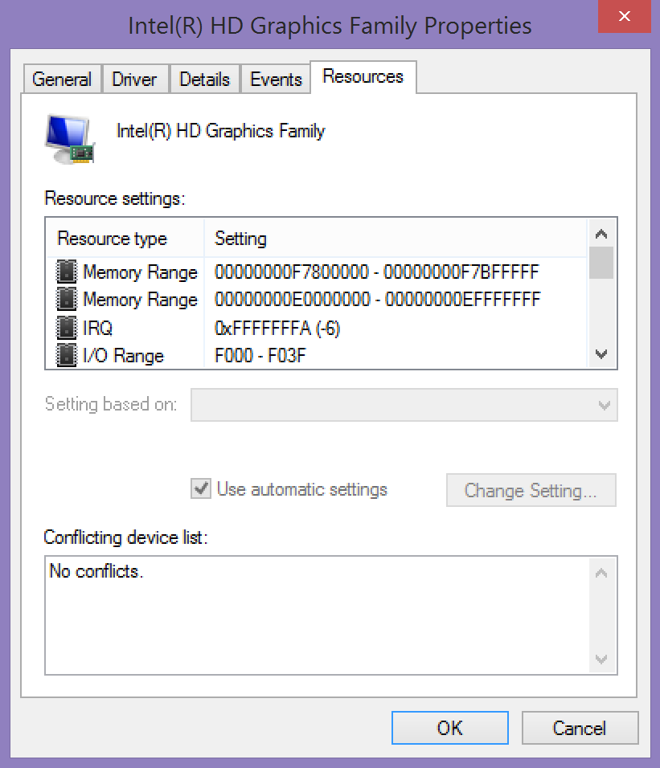
Shared Memory
Interrupt
I/O Ports

Slide 21
I/O Ports
Oldest method of interacting with devices
CPU and devices share a virtual 16-bit memory space
Each device is assigned some portion of the address space
E.g. 0xF000 – 0xF03F
CPU and device communicate by reading/writing to the virtual memory space

Slide 22
Problem With I/O Ports
CPU must mediate all transfers
Suppose you want to move data from disk to memory…
CPU must copy each 16-bit value from the I/O port to memory
All I/O must be synchronous
Suppose the disk wants to send data…
… but the CPU isn’t reading the I/O port with in
Bottom line: I/O ports are slow

Slide 23
Direct Memory Access (DMA)
Enables devices to transfer blocks of data directly to memory
Interrupt generated when transfer is completed
Much faster than the alternative method
Interrupt generated after each byte is transferred

Slide 24
DMA in Action
CPU(s)
Memory
(Instructions and Data)
Instructions
Data
Data via
I/O Ports
Interrupts
Device
Data via DMA

Slide 25
Interrupts
Interrupts transfer control from the running code to an interrupt handler
Each interrupt is assigned a number
Number acts as an index into the Interrupt Vector Table
Table maps interrupt numbers to handlers
Interrupts cause a context switch
State of the CPU must be saved before the switch…
… and restored after the handler completes
Main Memory
0xFFFF
0x01 Handler
0xA146
0x00FF
Interrupt Number | Pointer to Handler
0x02 | 0x0000
0x01 | 0xA146
Interrupt Vector
0x0000

Slide 26
Interrupt Timeline
file.read();
Context Switch
file.read();
User Process
CPU
Interrupts are an example of asynchronous messaging
Interrupts enable the CPU and devices to work in parallel
Interrupt Handler
Idle
I/O Device
Transferring
Time
Read done, raise interrupt
Read done, raise interrupt

Slide 27
Today’s Servers/Desktops
Much greater homogeneity/compatibility
Apple and PC use the same internals
Powerful industry groups ratify strict standards for hardware compatibility
Joint Electron Device Engineering Council (JEDEC)
PCI Special Interest Group (PCI SIG)
USB Implementors Forum (USB-IF)
No longer IBM-PC compatible
x86-64
Unified Extensible Firmware Interface (UEFI) instead of Basic Input/Output System (BIOS)

Slide 28
Booting up

Slide 29

What Happens After You Push Power?
A lot happens in between
Pushing power…
… And arriving at the desktop
Basic steps
Start the BIOS
Load settings from CMOS
Initializing devices
Run POST (Power-On Self Test)
Initiate the bootstrap sequence

Slide 30
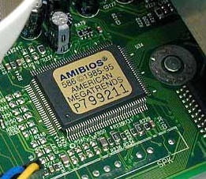
Starting the BIOS
Basic Input/Output System (BIOS)
A mini-OS burned onto a chip
Begins executing a soon as a PC powers on
Code from the BIOS chip gets copied to RAM at a low address (e.g. 0xFF)
jmp 0xFF (16 bits) written to RAM at 0xFFFF0 (2²⁰-16)
x86 CPUs always start with 0xFFFF0 in the EIP register
Essential goals of the BIOS
Check hardware to make sure its functional
Install simple, low-level device drivers
Scan storage media for a Master Boot Record (MBR)
Load the boot record into RAM
Tells the CPU to execute the loaded code

Slide 31
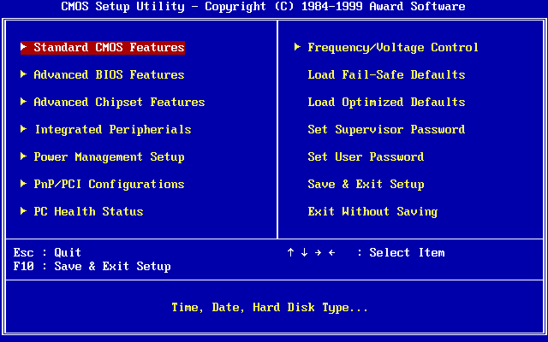
Loading Settings from CMOS
BIOS often has configurable options
Values stored in battery-backed CMOS memory

Slide 32
Initialize Devices
Scans and initializes hardware
CPU and memory
Keyboard and mouse
Video
Bootable storage devices
Installs interrupt handlers in memory
Builds the Interrupt Vector Table
Runs additional BIOSes on expansion cards
Video cards and SCSI cards often have their own BIOS
Runs POST test
Check RAM by read/write to each address

Slide 33
Bootstrapping
Problem: we need to find and load a real OS
BIOS identifies all potentially bootable devices
Tries to locate Master Boot Record (MBR) on each device
Order in which devices are tried is configurable
MBR has code that can load the actual OS
Code is known as a bootloader
Example bootable devices:
Hard drive, SSD, floppy disk, CD/DVD/Bluray, USB flash drive, network interface card

Slide 34
The Master Boot Record (MBR)
Special 512 byte file written to sector 1 (address 0) of a storage device
Contains
446 bytes of executable code
Entries for 4 partitions
Address |  | Description | Size (Bytes)
Hex | Dec.
0x000 | 0 | Bootstrap code area | 446
0x1BE | 446 | Partition Entry #1 | 16
0x1CE | 462 | Partition Entry #2 | 16
0x1DE | 478 | Partition Entry #3 | 16
0x1EE | 494 | Partition Entry #4 | 16
0x1FE | 510 | Magic Number | 2
 |  | Total: | 512
Too small to hold an entire OS
Starts a sequence of chain-loading

Slide 35
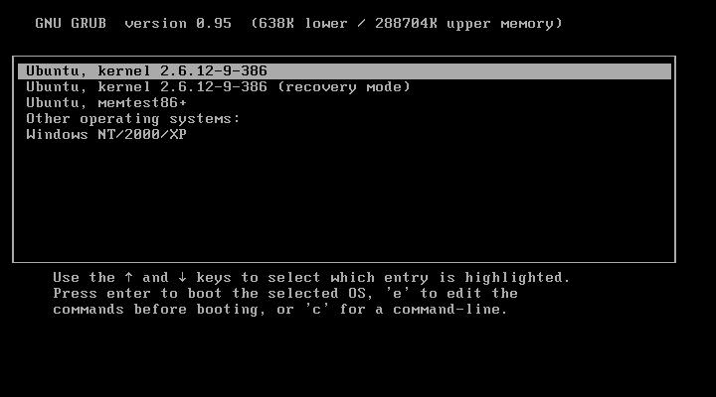
Example Bootloader: GRUB
Grand Unified Bootloader
Used with Unix, Linux, Solaris, etc.

Slide 36
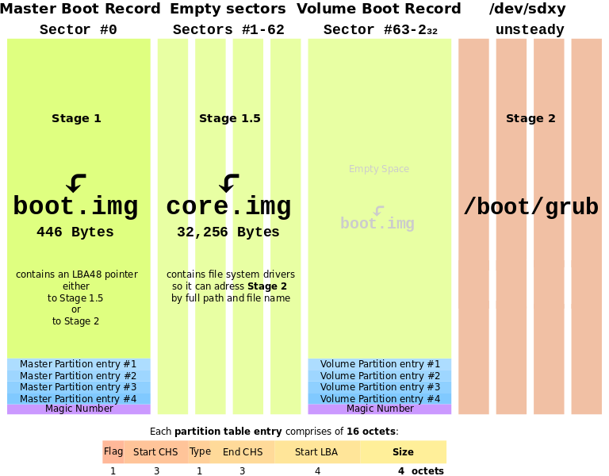

Slide 37
Interface to applications

Slide 38
System Call Interface
System call table
Layer of indirection to abstract the OS APIs
Table is always located at a fixed position
Each OS API is given a specific index in the table
Programs access APIs via the table, instead of hard coding the function address

Slide 39
Traps: Software Interrupts
Software can also generate interrupts
Traps and exceptions are software interrupts
Example:
mov eax, 1 ; system call number goes in EAX, exit() = 1
xor ebx, ebx ; exit() takes one parameter
int 0x80 ; transfer control to the Linux kernel

Slide 40
(Simplified) System Call Example
Software executes int 0x80, pushes EIP
CPU looks up handler in the IVT
CPU transfers control to the OS handler
Handler looks up EAX in the syscall table
Jump to the API code
Main Memory
0xFFFF
OS Code
0xC0F4
printf()
EAX | Pointer to API
1 | 0xC0F4
0xA146
0x80 Handler
Syscall Table
EIP
mov eax, 1
xor ebx, ebx
int 0x80
User Program
Interrupt Number | Pointer to Handler
0x80 | 0xA146
IVT
0x0000

Slide 41
CPU Support for System Calls
Many CPUs provide instruction support for invoking system calls
On x86, system calls are initiated via an interrupt
Example: Linux system calls
On x86, int 0x80 is the system call interrupt
EAX holds the table index of the desired API
EAX | Function
1 | sys_exit
2 | sys_fork
3 | sys_read
4 | sys_write

Slide 42
Kernel

Slide 43
Towards a Kernel
“The one program running at all times on the computer” is the kernel
Typically loaded by the bootloader
Questions:
What are the features that kernels should implement?
How should we architect the kernel to support these features?

Slide 44
Kernel Features
Device management
Required: CPU and memory
Optional: disks, keyboards, mice, video, etc.
Loading and executing programs
System calls and APIs
Protection and fault tolerance
E.g. a program crash shouldn’t crash the computer
Security
E.g. only authorized users should be able to login

Slide 45
Architecting Kernels
Three basic approaches
Monolithic kernels
All functionality is compiled together
All code runs in privileged kernel-space
Microkernels
Only essential functionality is compiled into the kernel
All other functionality runs in unprivileged user space
Hybrid kernels
Most functionality is compiled into the kernel
Some functions are loaded dynamically
Typically, all functionality runs in kernel-space

Slide 46
Monolithic Kernel
Kernel Space
User Space
Monolithic Kernel Code
CPU Scheduling
Program Loader
Memory Manager
User Program
Error Handling
System APIs
Security Policies
File Systems
Device Drivers

Slide 47
Microkernel
Kernel Space
User Space
File System
Disk Driver
Kernel Code
Memory Manager
Networking Service
Network Card Driver
CPU Scheduling
User Program 1
Interprocess Communication
User Program 2

Slide 48
Hybrid Kernel
Kernel Space
User Space
Kernel Code
Third-Party Code
Memory Manager
CPU Scheduling
Device Driver
Security Policies
Error Handling
Device Driver
File Systems
System APIs
File System
Program Loader
User Program

Slide 49



Research Kernels:
Mach
L4
GNU Hurd
Kernels for Embedded System:
QNX
Microkernels:
Small code base,
Few features
Hybrid Kernels:
Pretty large code base,
Some features delegated
Monolithic Kernels:
Huge code base,
Many features

Slide 50
Pros/Cons of Monolithic Kernels
Advantages
Single code base eases kernel development
Robust APIs for application developers
No need to find separate device drivers
Fast performance due to tight coupling
Disadvantages
Large code base, hard to check for correctness
Bugs crash the entire kernel (and thus, the machine)

Slide 51
Pros/Cons of Microkernels
Advantages
Small code base, easy to check for correctness
Excellent for high-security systems
Extremely modular and configurable
Choose only the pieces you need for embedded systems
Easy to add new functionality (e.g. a new file system)
Services may crash, but the system will remain stable
Disadvantages
Performance is slower: many context switches
No stable APIs, more difficult to write applications

