Slide 1





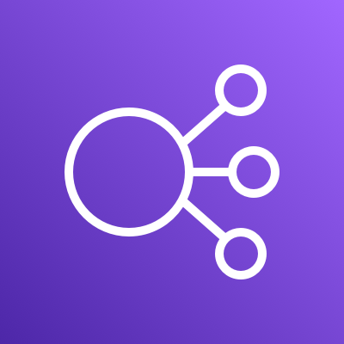


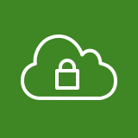

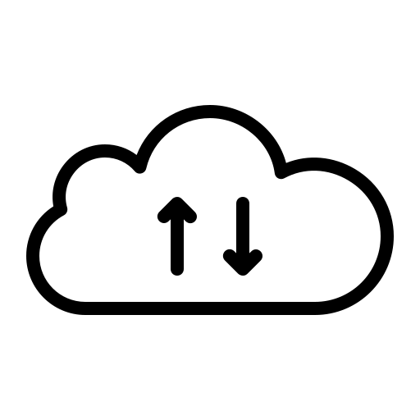
















AWS Cloud
Region
VPC
Public subnet
- WEB2
Private subnet
- WAS
Private subnet
- API
Private subnet
- DB
Auto Scaling group
Auto Scaling group
Security group
Public subnet
- WEB2
Private subnet
- WEB
Security group
Security group
Auto Scaling group
Security group
Private subnet
- RDS2
Private subnet
- RDS1
Security group
Security group
Private subnet
-Bastion
Availability Zone
Availability Zone
Security group

