Slide 1
Introduction
Sangmyung Univ., 휴먼지능정보공학전공

Slide 2
Overview
Course title : Computer Networks & Programming
Background
  Target: 2학년 2학기
  Prerequisite: 없음
  3 Credits
  2 hours lecture, 1 hours lab
Texts
  Computer Networking: A Top-down Approach, 6th Edition, Kurose and Ross, 2013
Additional Reading:
  Data Communications and Networks, 5th Edition, Forouzan, McGraw-Hill, 2013
  Computer Networks: A Systems Approach, 5th Edition, Peterson & Davie, Morgan Kaufmann, 2012

Slide 3
Overview
Grading Policy
  Mid-term : 35 %
  Final : 35 %
  Lab reports : 30%
    Wireshark 등 네트워크 분석 tool을 이용한 실습
Lecturer
  정진우 교수
  공학관 513호
  Tel: 02-2287-5452
  jjoung@smu.ac.kr

Slide 4
Internet Overview

Slide 5
Contents
Internet Overview
  Internet의 구조
  Internet의 원리: Packet switching
Network model
  Layered model
  Addressing

Slide 6
What’s the Internet:
Internet: “network of networks”
  Interconnected ISPs (Internet Service Providers, 통신사업자)
protocols control sending, receiving of messages
  e.g., TCP, IP, HTTP, 802.11, 5G
  Internet standards
    RFC: Request for comments, Published Standards from IETF
    IETF: Internet Engineering Task Force, A well-known Standardization Organization
Infrastructure that provides services to applications:
  Web, VoIP, email, games, e-commerce, social nets, …

Slide 7
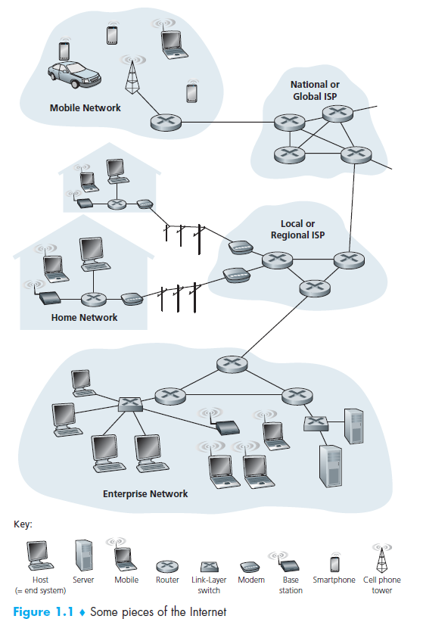
Internet infrastructure:
millions of connected computing devices:
  hosts = end systems, running network apps
communication links
  광섬유, 구리선, 무선, 인공위성
  transmission rate: bandwidth
Packet switches: forward packets (data 묶음)
  중계기 (router와 switch)

Slide 8
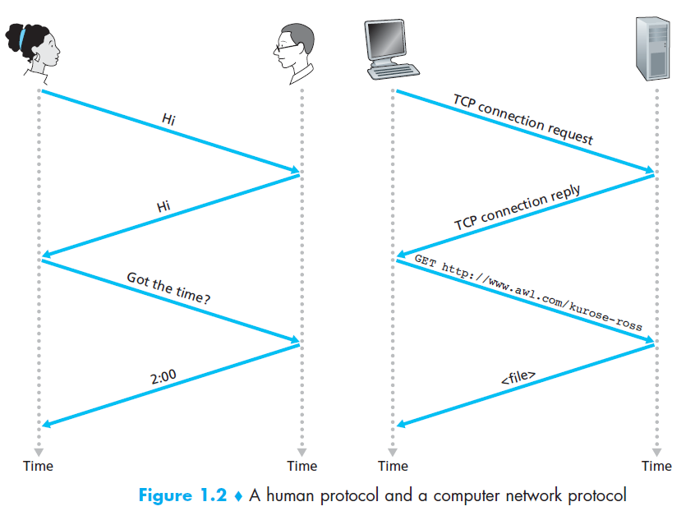
Protocol
protocols define format, order of messages sent and received among network entities, and actions taken on message transmission and receipt

Slide 9
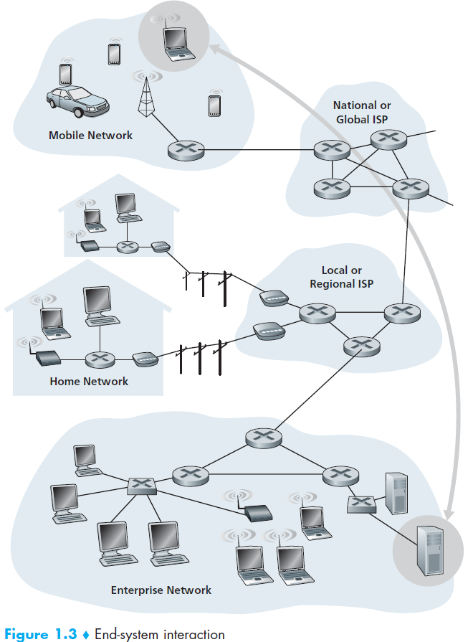
A closer look at network structure:
network edge:
  hosts: clients and servers
  servers often in data centers
access networks, physical media:
  wired, wireless communication links
network core:
  interconnected routers
  network of networks

Slide 10
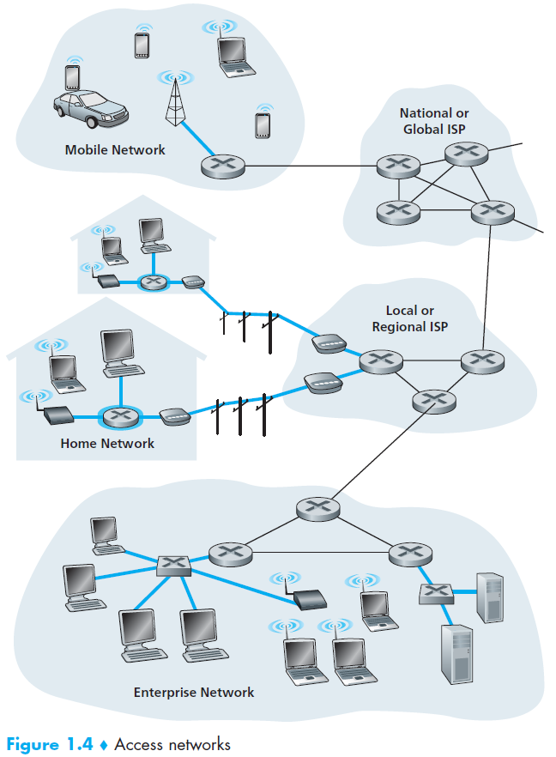
Access networks and physical media
Q: How to connect end systems to edge router?
  residential access nets
  institutional access networks (school, company)
  mobile access networks

Slide 11
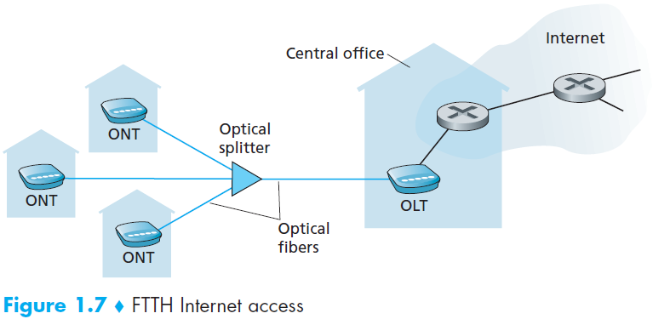
Access net: Fiber to the home (FTTH)
ONT: Optical network terminator
OLT: Optical line terminator
Provides an optical fiber path from the central office (CO) directly to the home
The average downstream speed of US FTTH was 20Mbps in 2011

Slide 12







Access net: Home Network
wireless
devices
to/from headend or central office
often combined
in single box
cable or DSL modem or ONT
wireless access
point (54 Mbps)
router, firewall, NAT
wired Ethernet (100 Mbps)

Slide 13
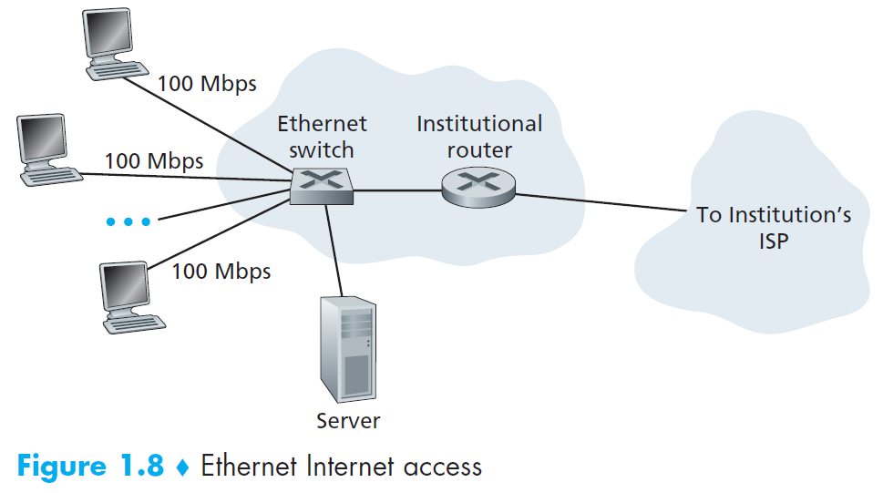
Access net: Enterprise Internet access
typically used in companies, universities, etc
  10 Mbps, 100Mbps, 1Gbps, 10Gbps transmission rates
  today, end systems typically connect into Ethernet switch
institutional servers include mail server & web server

Slide 14









Wireless access networks
shared wireless access network connects end system to router
  via base station aka “access point”
wireless LANs:
  within building (100 m)
  802.11b/g/n (WiFi): 11, 54, 150 Mbps transmission rate
wide-area wireless access
  provided by cellular operator, 10’s km
  between 1 and 100 Mbps
  3G, 4G: LTE
to Internet
to Internet

Slide 15


Host: sends packets of data
host sending function:
  takes application message
  breaks into smaller chunks, known as packets, of length L bits
  transmits packet into access network at transmission rate R
    link transmission rate = link capacity = link bandwidth
two packets,
L bits each
2
1
R: link transmission rate
host
Transmission delay
= time to put a packet into a link
= L (bits) / R (bit per sec)

Slide 16
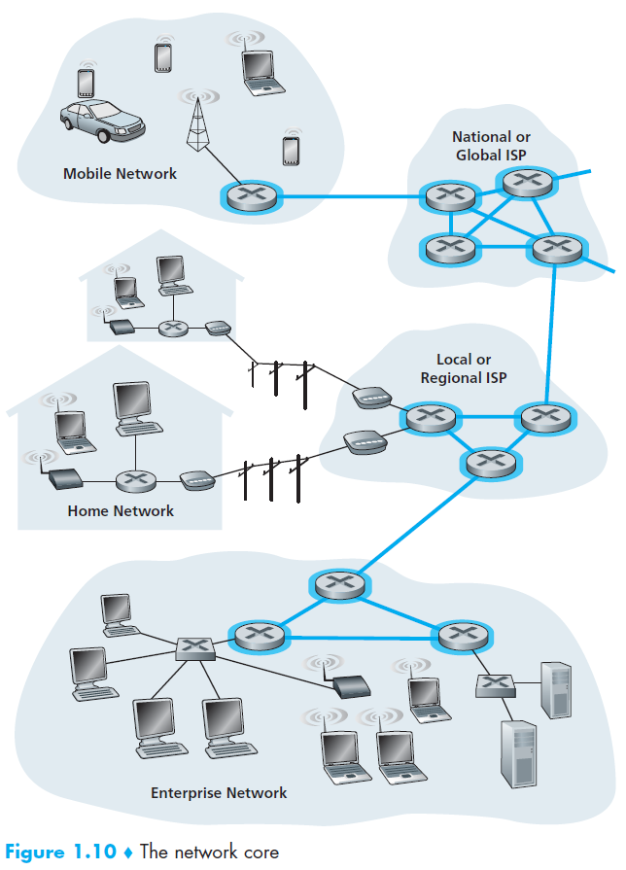
The network core
mesh of interconnected routers
packet-switching: hosts break application-layer messages into packets
  forward packets from one router to the next, across links on path from source to destination
  each packet transmitted at full link capacity

Slide 17
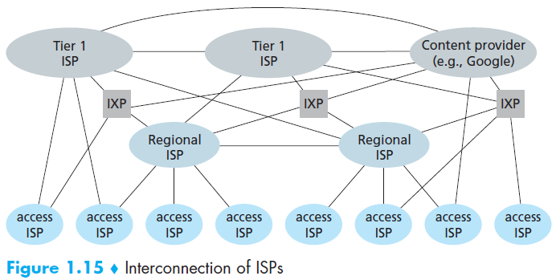
Internet structure
at center: small # of well-connected large networks
“tier-1” commercial ISPs (e.g., Level 3, Sprint, AT&T, NTT), national & international coverage
content provider network (e.g, Google): private network that connects it data centers to Internet, often bypassing tier-1, regional ISPs
Internet Exchange Point (IXP) (typically in a stand-alone building with its own switches), which is a meeting point where multiple ISPs can peer together. There are roughly 300 IXPs in the Internet today

Slide 18
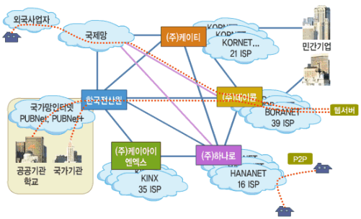
국내 Internet 망

Slide 19
Contents
Internet Overview
  Internet의 구조
  Internet의 원리: Packet switching
Network model
  Layered model
  Addressing

Slide 20





Packet-switching: store-and-forward
L bits
per packet
source
3
2
1
R bps
R bps
destination
It takes L/R seconds to transmit (push out) L-bit packet into link at R bps
example: if L = 1 Mbits and R = 10 Mbps then one-hop transmission delay = 0.1 sec
Store and forward: entire packet must arrive at router before it can be transmitted on next link
end-to-end delay = 2L/R (assuming zero propagation delay)

Slide 21
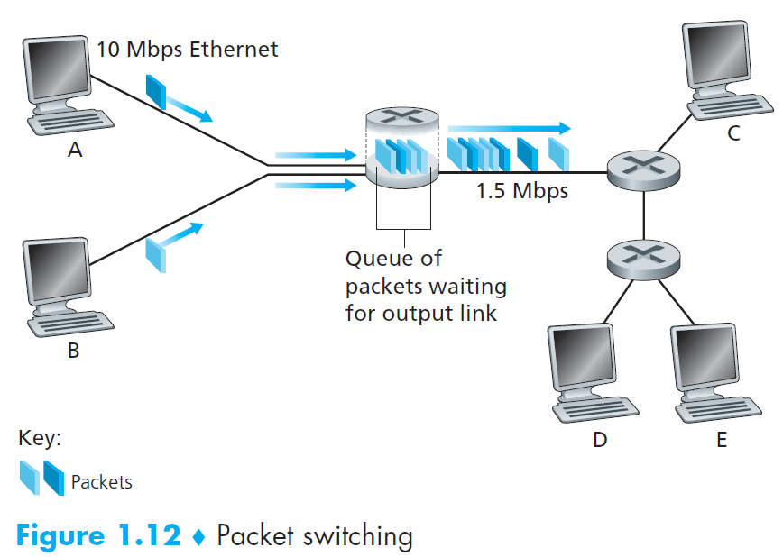
Packet Switching: queuing delay, loss
queuing and loss:
If arrival rate (in bits) to link exceeds transmission rate of link for a period of time:
  packets will queue, wait to be transmitted on link
  packets can be dropped (lost) if memory (buffer) fills up

Slide 22
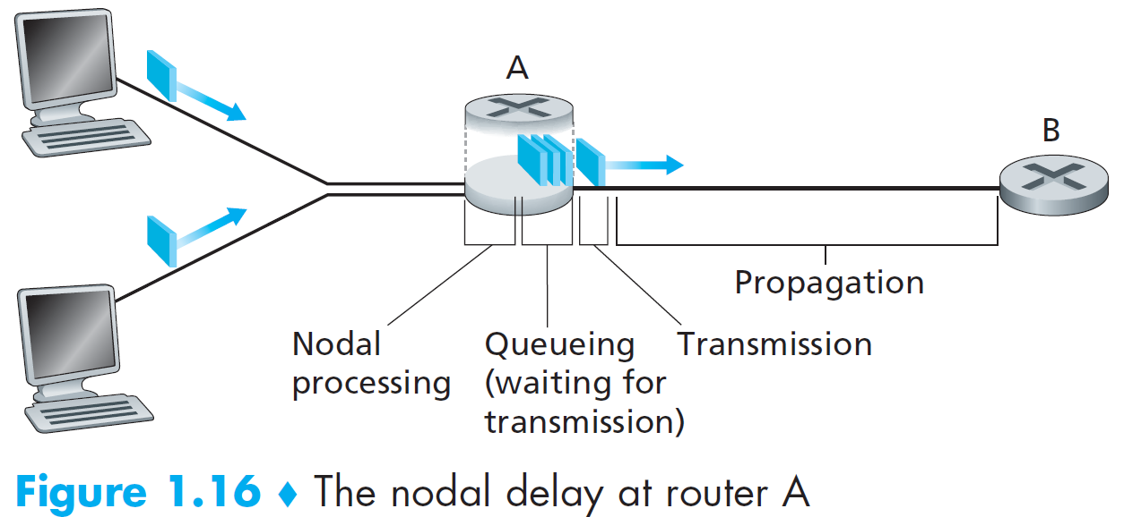

Delay components in a node
d_{proc}: nodal processing
check bit errors
determine output link

Slide 23
Queuing delay and Loss
packets queue in router buffers
packet arrival rate to link (temporarily) exceeds output link capacity
packets queue, wait for turn
packet being transmitted (delay)
A
B
packets queueing (delay)
free (available) buffers: arriving packets
dropped (loss) if no free buffers

Slide 24
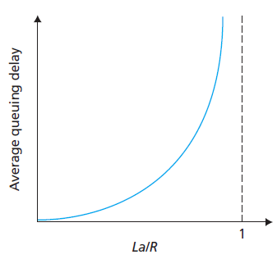

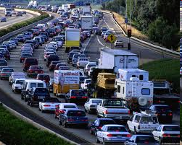
Queuing delay
R: link bandwidth (bps)
L: packet length (bits)
a: average packet arrival rate
La/R ~ 0: avg. queuing delay small
La/R →1: avg. queuing delay large
La/R > 1: more “work” arriving than can be serviced, average delay infinite

Slide 25
Throughput
Throughput: rate (bits/time unit) at which bits transferred between sender/receiver
  Instantaneous throughput: rate at given point in time
  Average throughput: rate over longer period of time
Throughput depends on many things such as link rates, node capabilities, network policy, etc.
link capacity
R_{s} bits/sec
server sends bits
into pipe
pipe that can carry
Bits at rate
R_{s} bits/sec
pipe that can carry
Bits at rate
R_{c} bits/sec
bottleneck link :
link on end-end path that constrains end-end throughput

Slide 26
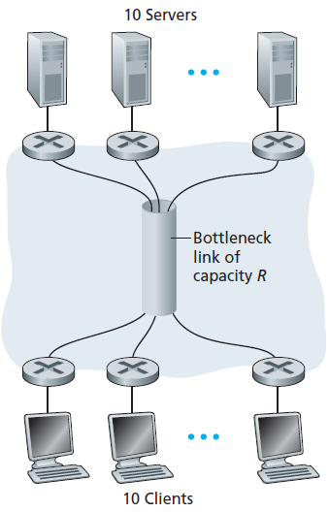
Throughput: Internet scenario
per-connection end-end throughput:
min(Rc, Rs, R/10)
in practice: Rc or Rs is often bottleneck

Slide 27
Two key network-core functions
routing: determines source-destination route taken by packets
forwarding: move packets from router’s input to appropriate router output
routing algorithm
local forwarding table
header value
output link
0100
0101
0111
1001
3
2
2
1
1
3
2
0111
dest address in arriving
packet’s header

Slide 28
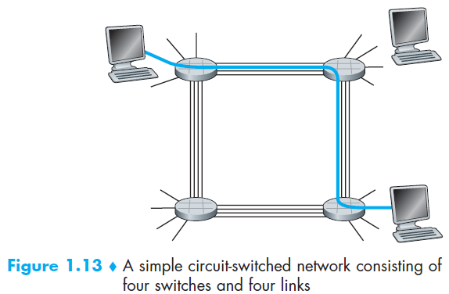
Alternative core: circuit switching
end-end resources allocated to, reserved for “call” between source & destination:
In diagram, each link has four circuits.
  call gets 2nd circuit in top link and 1st circuit in right link.
dedicated resources: no sharing
  circuit-like (guaranteed) performance
circuit segment idle if not used by call (no sharing)
Commonly used in traditional telephone networks

Slide 29
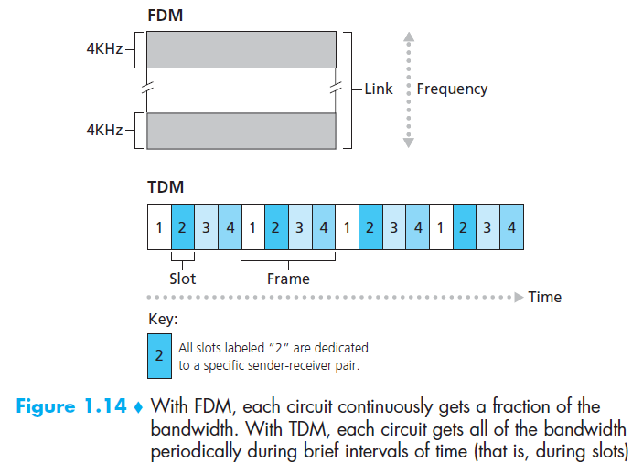
Circuit switching: FDM versus TDM

Slide 30
Packet switching versus circuit switching
packet switching allows more users to use network!
example:
10 Mb/s link
each user:
  1Mb/s when “active”
  active 10% of time
circuit-switching:
  10 users
packet switching:
  with 35 users, probability > 10 active at same time is less than .0004
N
users
…..
10 Mbps link

Slide 31
Packet switching versus circuit switching
is packet switching a “slam dunk winner?”
great for bursty data
  resource sharing
  simpler, no call setup
excessive congestion possible: packet delay and loss
  protocols needed for reliable data transfer, congestion control
Q: How to provide circuit-like behavior?
  bandwidth guarantees needed for audio/video apps
  still an unsolved problem

Slide 32
Network Model

Slide 33
Contents
Internet Overview
  Internet의 구조
  Internet의 원리: Packet switching
Network model
  Layered Model
  Addressing

Slide 34
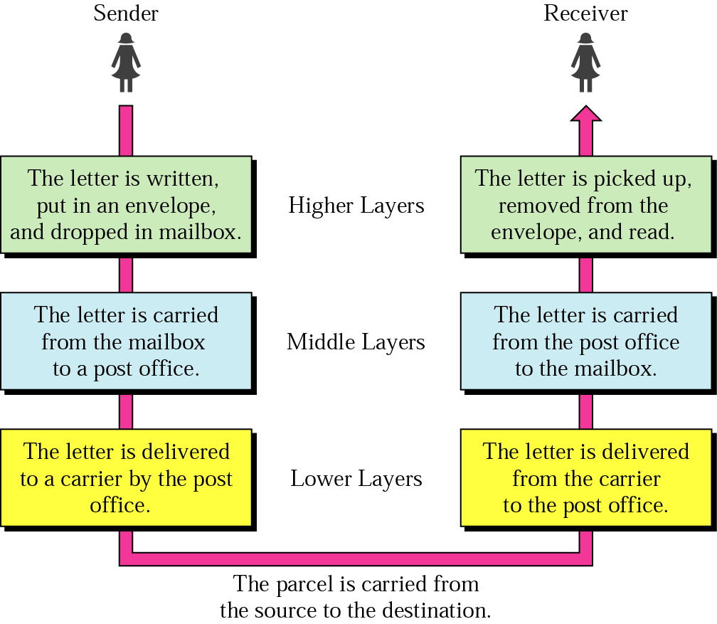
Layered Model: Sending a Letter
A task is done in different levels of abstractions.

Slide 35

OSI Model
ISO (International Standards Organization) introduced OSI (Open Systems Interconnection) model in the late 70s

Slide 36

Interaction between layers in the OSI model

Slide 37

Data transfer using the OSI model
Encapsulation with header and possibly trailer

Slide 38

Application Layer
Application layer is responsible for providing services to the user.
Produces “user message”.
  e.g. email, FTP file, web page

Slide 39

Presentation Layer
Presentation layer is responsible for translation, compression, and encryption.
  Translation: from character strings, numbers to bit streams. (from an email message to an encrypted bit stream)

Slide 40

Session Layer
Session layer establishes, maintains, and synchronizes the interaction among communicating systems.
  동영상 stream의 영상 frame과 음성 동기화

Slide 41

Transport Layer
The transport layer is responsible for process-to-process delivery of an entire message.
  a process: a running program
  we need a process identification mechanism (address)
From Session layer: Message
To network layer: Segment

Slide 42
Transport Layer: Duties
Process (or port) addressing
Segmentation and reassembly of a message
Connection control (optional)
  up until the completion of the message transfer
Flow control (optional)
  is not to overflow the receiver
Congestion control (optional)
  is not to overflow the network
Error control (optional)

Slide 43

Reliable Process-to-Process Delivery of a Message

Slide 44


Network Layer
The network layer is responsible for the host-to-host delivery of packets possibly across multiple networks
From transport layer: Segment
To data link layer: Packet (= datagram)

Slide 45

Network Layer: Duties
Logical addressing and routing

Slide 46

Data Link Layer
The data link layer provides a reliable (error-free) link
From network layer: Packet (or sometimes it is called Datagram)
To physical layer: Frame

Slide 47
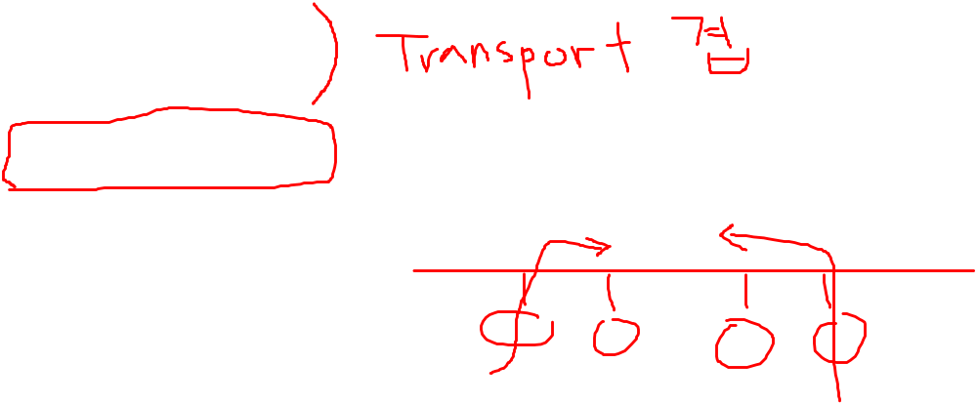
Data Link Layer: Duties
Framing
Physical addressing
Flow control
Error control
Access control

Slide 48

Hop-to-Hop Delivery

Slide 49

Physical Layer
The physical layer carries a bit stream over a physical medium.
It deals mechanical and electrical specification, the procedures and functions
From data link layer: Frame
To transmission medium: Bit stream (Electromagnetic Signal)

Slide 50

Summary of Layers

Slide 51
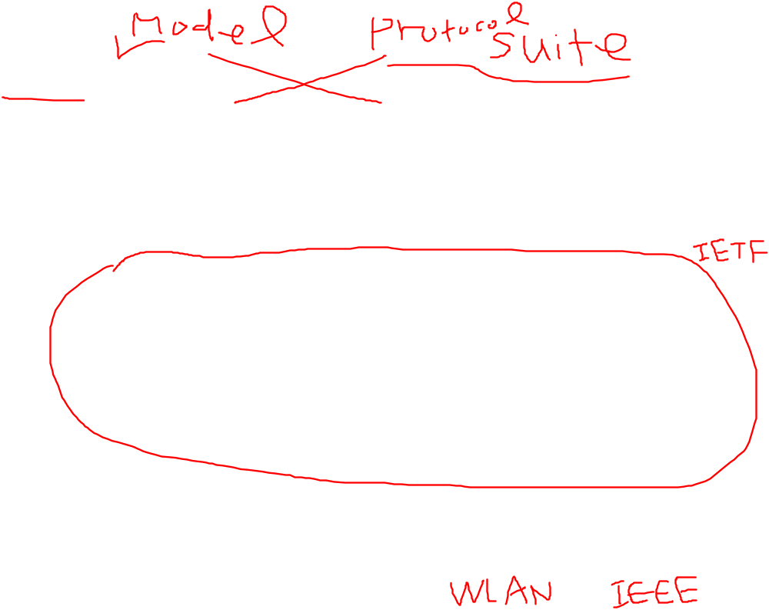

TCP/IP and OSI Model

Slide 52
TCP/IP Protocol Suite
Host-to-network : Physical and data link layer
  No specific protocol
Network layer
  IP(Internet Protocol), ARP(Address Resolution Protocol), RARP(Reverse ARP), ICMP(Internet Control Message Protocol), IGMP(Internet Group Message Protocol)
Transport layer
  TCP(Transmission Control Protocol), UDP(User Datagram Protocol), SCTP(Stream Control Transmission Protocol),
Application Layer
  Combined session, presentation, and application layers

Slide 53
Contents
Internet Overview
  Internet의 구조
  Internet의 원리: Packet switching
Network model
  Layered Model
  Addressing

Slide 54

Addressing
Four levels of addresses in TCP/IP protocols
  Physical (Link, MAC, Data link layer) address
  Logical (IP, Network) address
  Port address
  Specific address

Slide 55

Relationship of Layers and Addresses

Slide 56

Physical Address
A node with physical address 10 sends a frame to a node with physical address 87. The two nodes are connected by a link (bus topology LAN). As the figure shows, the computer with physical address 10 is the sender, and the computer with physical address 87 is the receiver.
07:01:02:01:2C:4B
A 6-byte (12 hexadecimal digits) physical address.

Slide 57

Activity 1
How many addresses are in the 6-byte address space?
What will happen if two stations in a Local Area Network have the same physical address?
How would you guarantee every station in a network has unique physical address?
  Hint: A physical address is imprinted in Network Interface Card (NIC) when it is produced at a factory.
2-<number>

Slide 58

Logical (IP) Address
The physical addresses will change from hop to hop, but the logical addresses usually remain the same
Logical address 형태: 172.52.231.254

Slide 59
Activity 2
How many addresses are there in the 32bit address space?
What will happen if two stations in different networks have the same logical address?
How would you guarantee every station in all the networks has unique logical address?
  Hint: A logical address is assigned according to a station’s location.
2-<number>

Slide 60

Port Address
The physical addresses change from hop to hop, but the logical and port addresses usually remain the same.

Slide 61
Specific Address
Some application have user-friendly addresses that are designed for that specific address
Example 1: e-mail address: jjoung@smu.ac.kr
  Defines the recipient of an e-mail
Example 2: URL (Universal Resource Locator) : www.smu.ac.kr
  Used to find a document on the WWW

Slide 62
Activity 3
Open a CMD window
Type “tracert www.arm.com” or “tracert www.mit.edu” or tracert wherever you want to try.
Google a visual traceroute tool.
Download and install.
Try traceroute a destination.
Question: How does the traceroute program works?

