Slide 1
ABAP PROXY
Developments on
Application System & Integration System

Slide 2
Introduction
ABAP proxies are used when ABAP applications needs to send and receive data.
SAP ECC
(Application System)
SAP PI
(Integration System)
Data

Slide 3
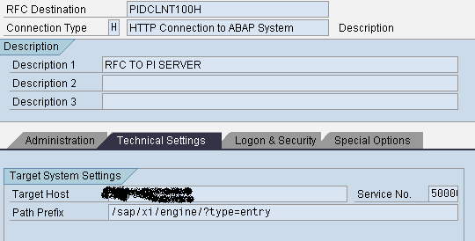
Communication
Transport Protocol : HTTP
RFC Destinations : Type H (HTTP Connections to ABAP System)

Slide 4
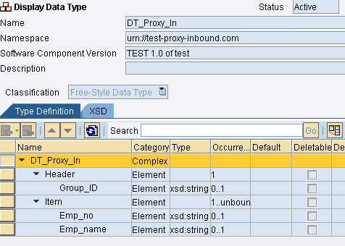
Development on SAP-PI
Enterprises Service Repository :
Create Data Type

Slide 5
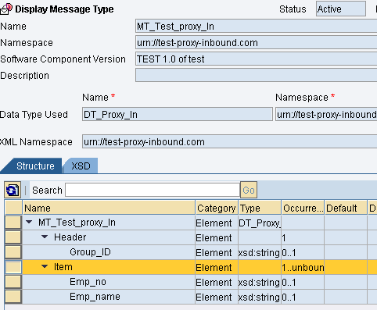
Development on SAP-PI
Enterprises Service Repository :
Create Message Type

Slide 6
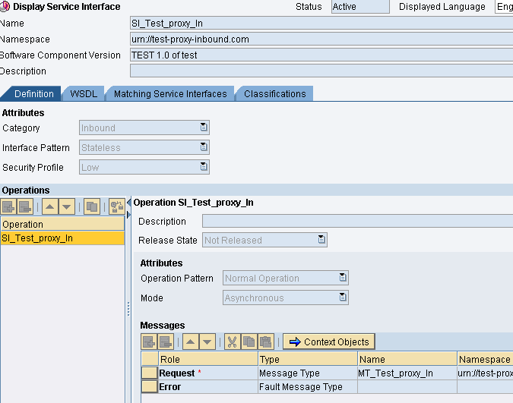
Development on SAP-PI
Enterprises Service Repository :
Create Service Interface

Slide 7
Development on SAP-ECC
→In proxies, it will generate 3 objects at Application System :
ABAP Class.
Structure for Message Type.
Structure of Data Type.

Slide 8
Development on SAP-ECC
(Inbound Proxy)
SAP ECC
(Application System)
SAP PI
(Integration System)
Data

Slide 9
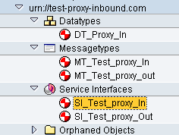
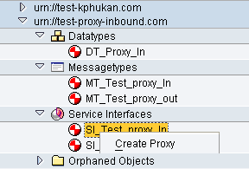
Development on SAP-ECC (Inbound Proxy)
T-code : SPROXY
Open the node for your Service (Inbound / Outbound) & Right click
Click on CREATE PROXY.
This Development is for Inbound Proxy.

Slide 10
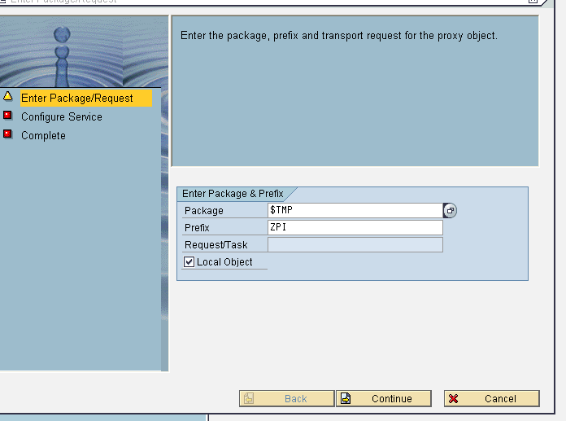
Development on SAP-ECC (Inbound Proxy)
Give Package Name & Prifix : Click on Continue .

Slide 11
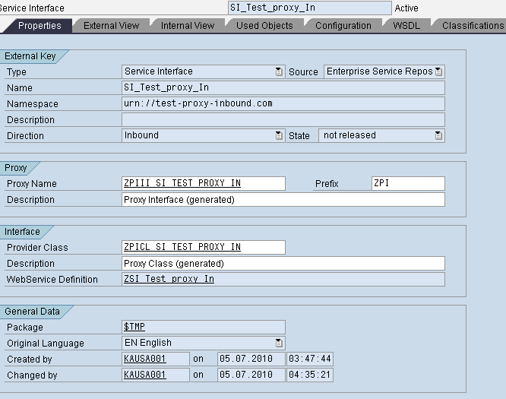
Development on SAP-ECC (Inbound Proxy)
After Completing this creation process, this screen will be there.

Slide 12
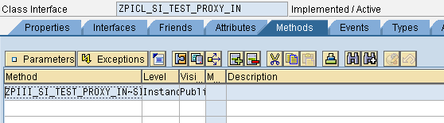
Development on SAP-ECC (Inbound Proxy)
SAVE → Activate. Double click on Provider Class, this screen will be there :
Double click on Method.

Slide 13
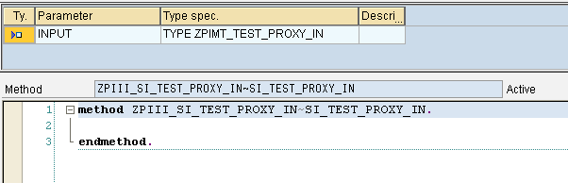
Development on SAP-ECC (Inbound Proxy)
This screen will be there, you have to write your code here in this method.

Slide 14
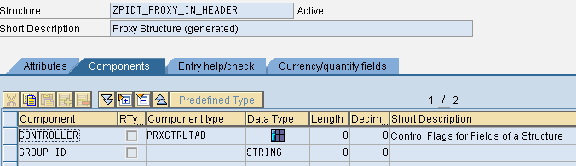
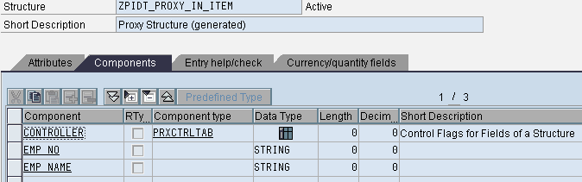
Development on SAP-ECC (Inbound Proxy)
Header Structure and Item Structures will be in INPUT Parameter :

Slide 15
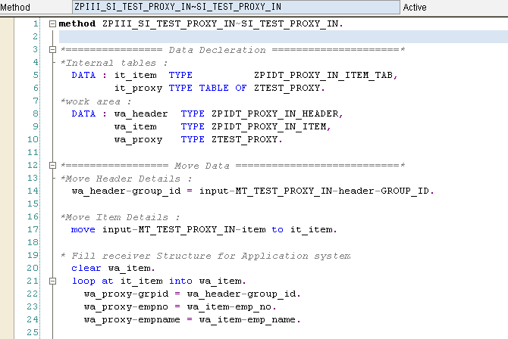
Development on SAP-ECC (Inbound Proxy)
Write code as below :

Slide 16
Development on SAP-ECC
(Inbound Proxy)
Post the data in Table
Post the data using Function Module
Inbound Proxy is Complete.

Slide 17
Development on SAP-ECC
(Outbound Proxy)
SAP ECC
(Application System)
SAP PI
(Integration System)
Data

Slide 18
Development on SAP-ECC (Outbound Proxy)
T-code : SPROXY
Open the node for your Service (Inbound / Outbound) & Right click
Click on CREATE PROXY.
This Development is for Outbound Proxy.
In this Case, choose Outbound Service Interface for Creation of Proxy.

Slide 19
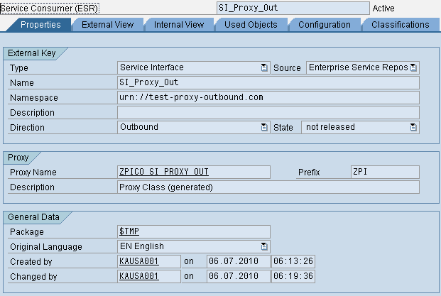
Development on SAP-ECC (Outbound Proxy)
After Completing this creation process, this screen will be there.

Slide 20
Development on SAP-ECC (Outbound Proxy)
For Outbound Proxy, an executable code in ABAP will be written to call that proxy.
In this Example, we are writing that code in Executable program in SE38.
First Pick data from Table.
Fill Proxy Structure & send to Integration System.

Slide 21
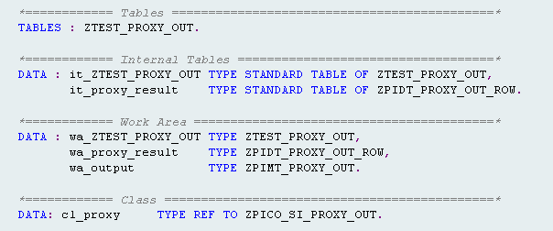
Development on SAP-ECC (Outbound Proxy)
For this example, Data Declaration part will be as below :

Slide 22
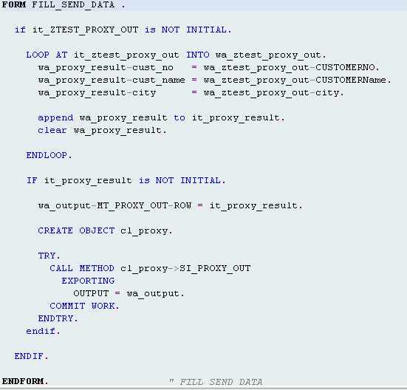
Development on SAP-ECC (Outbound Proxy)
For this example, code for filling & Sending Proxy data Subroutine will be as below :

Slide 23
Thanks !

