Slide 1

Team Convention
{ ROS } ver_0.1
Clean Code For Our Program

Slide 2
Introduction
The purpose of this document is to increase the efficiency of the software team.
When a team makes a code together, there must be certain rules to make it easier to read and maintain the code.
To do so, this document will suggest you a coding style.
You will not be able to keep this document 100% in all situations.
If inevitable, you can ignore this document and code it. But if that happens, your code may be logically out of order. Please check it again.
Additionally, we will also cover clean codes and refactoring. We encourage you to make the most of the methods written in this document.
If you have any suggestions, feel free to do so. Our team always welcomes your proposal. Let's discuss it together and make our code clean and logical.
I'm looking forward to a project with you.
See you then ^^
This start date of this project : 2022-01-22

Slide 3
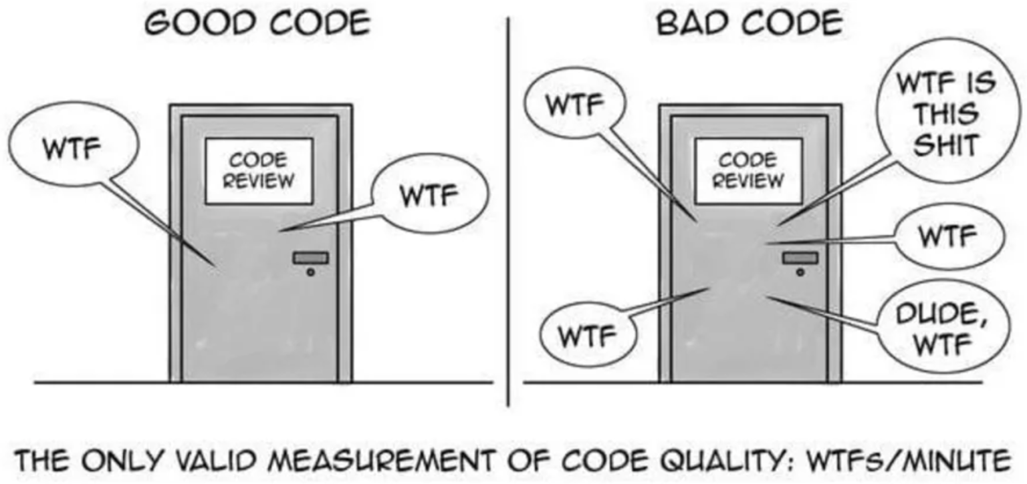
Chaptal 1
First I recommend you read the “ Clean Code ”, written by Robert C. Martin.
Chapter 1 will discuss how to create good code. This can be a very abstract concept depending on the person. He said to have good and bad codes divided according to the amount of WTFs shouted per minute. The picture below is a reconstruction of his painting and re-drawing it.
Chapter 1 will discuss how to create good code. This can be a very abstract concept depending on the person. Robert C. Martin is said to have good and bad codes divided according to the amount of WTFs shouted per minute.
The picture below is a reconstruction of his painting and re-drawing it.

