Slide 1
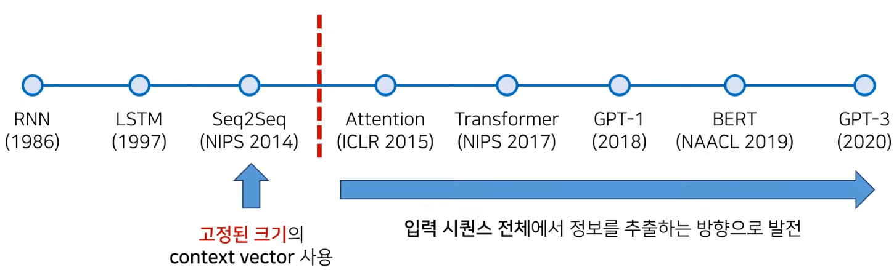
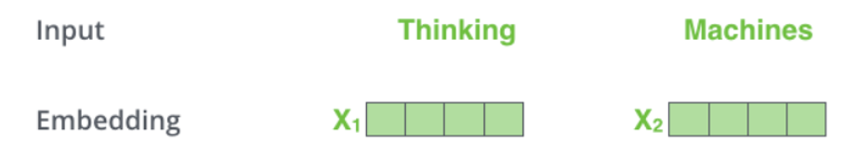
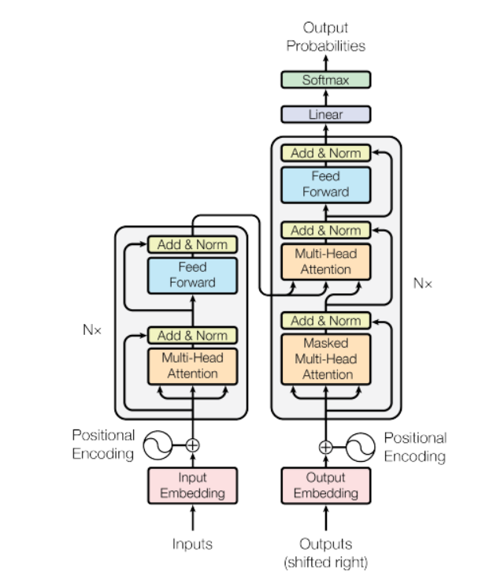
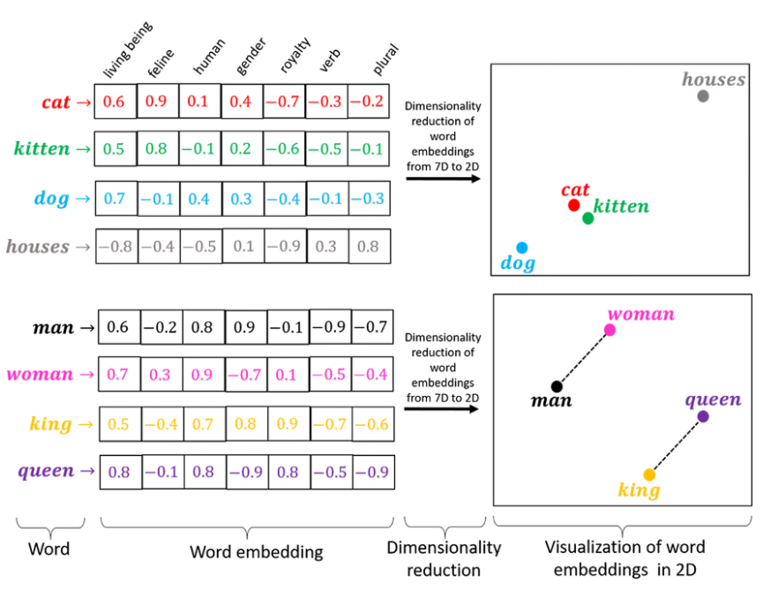
Recap
김성수
[4] A. Vaswani et al., "Attention is all you need," in Advances in neural information processing systems, 2017, pp. 5998-6008.
[5] T. Mikolov, K. Chen, G. Corrado, and J. Dean, "Efficient estimation of word representations in vector space," arXiv preprint arXiv:1301.3781, 2013. (Word2Vec)
History
Attention is all you need[4]
Word2Vec[5]
Word2Vec showed that we can use a vector (a list of numbers) to properly represent words in a way that captures semantic or meaning-related relationships

Slide 2
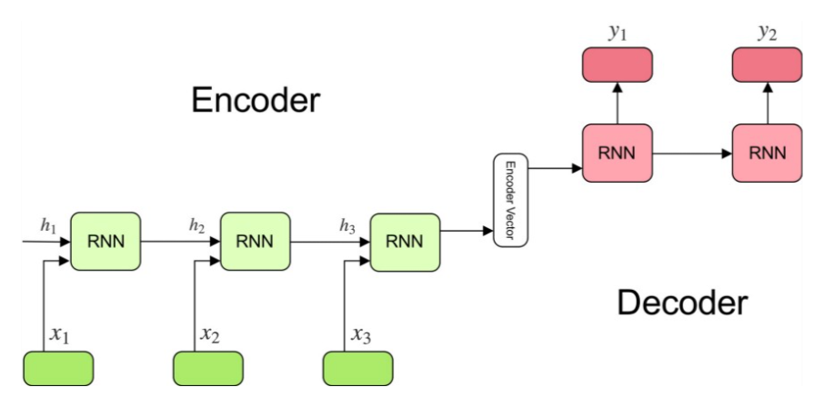
Seq2Seq[1]
김성수
[1] I. Sutskever, O. Vinyals, and Q. V. Le, "Sequence to sequence learning with neural networks," in Advances in neural information processing systems, 2014, pp. 3104-3112.
Introduced for the first time in 2014 by Google
Task : Machine translation
Fixed – length input with a fixed-length output
Encoder-Decoder model
Encoder : Stack of RNN(LSTM, GRU)
Decoder : Stack of RNN(Decodes context vector from encoder)

Slide 3
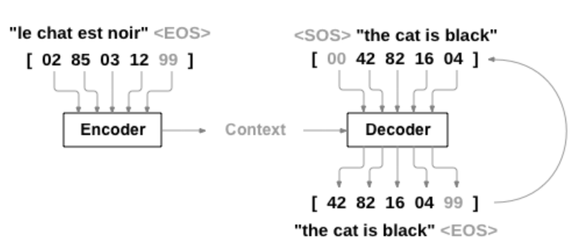
Seq2Seq[1]
김성수
[1] I. Sutskever, O. Vinyals, and Q. V. Le, "Sequence to sequence learning with neural networks," in Advances in neural information processing systems, 2014, pp. 3104-3112.
Introduced for the first time in 2014 by Google
Task : Machine translation
Fixed – length input with a fixed-length output
Model can map sequences of different lengths to each other
Encoder-Decoder model
What if the input sentence is long, can a single vector from the encoder hold all the relevant information to provide to the decoder?
Is it possible to focus on a few relevant words in a sentence when predicting the target word rather than a single vector holding the information about the entire sentence?

Slide 4
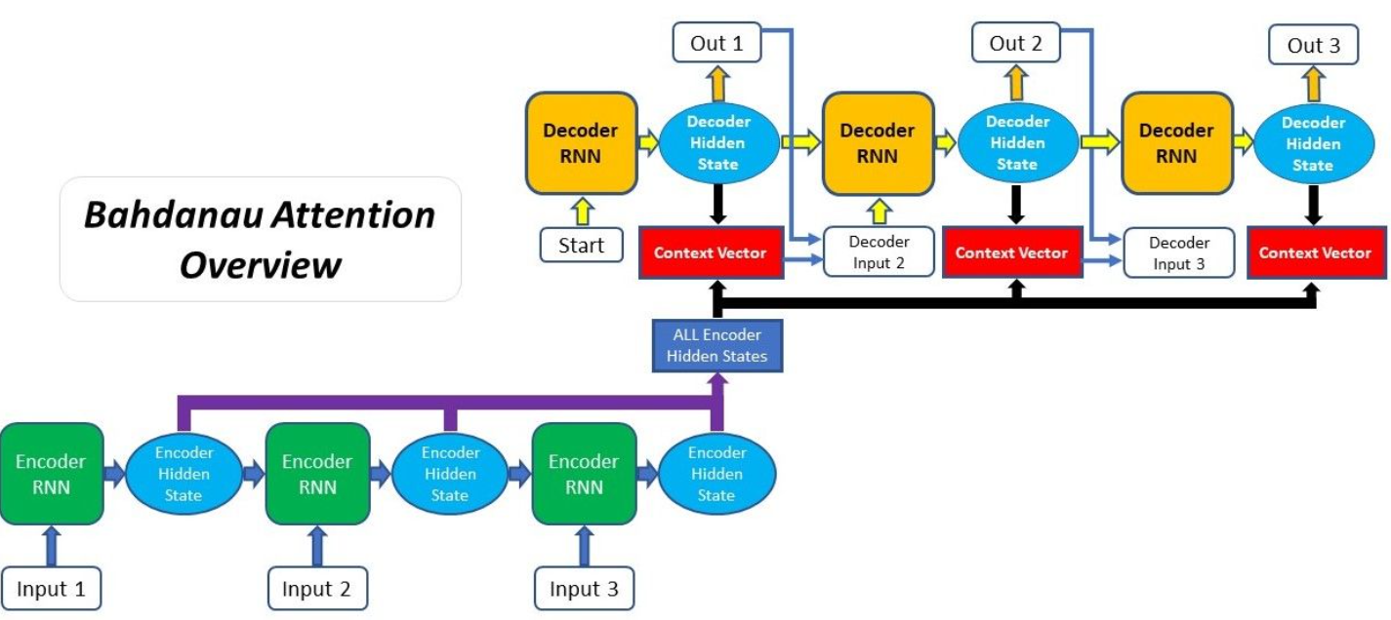
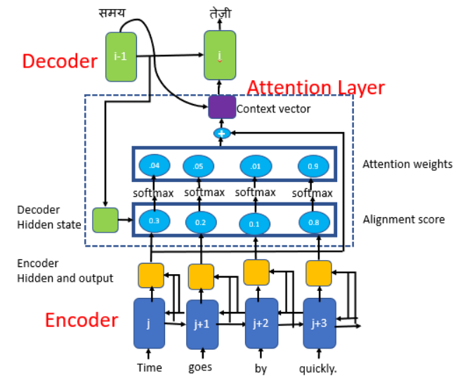
Attention mechanism[2],[3]
김성수
[2]D. Bahdanau, K. Cho, and Y. Bengio, "Neural machine translation by jointly learning to align and translate," arXiv preprint arXiv:1409.0473, 2014. [ICLR 2015]
[3]M.-T. Luong, H. Pham, and C. D. Manning, "Effective approaches to attention-based neural machine translation," arXiv preprint arXiv:1508.04025, 2015.
Avoid attempting to learn a single vector representation for each sentence
Instead, pays attention to specific input vectors of the input sequence based on the attention weights.
Bahadanau et al[2] : Learns to align and translate jointly(Linear combination of encoder state and the decoder states)

Slide 5
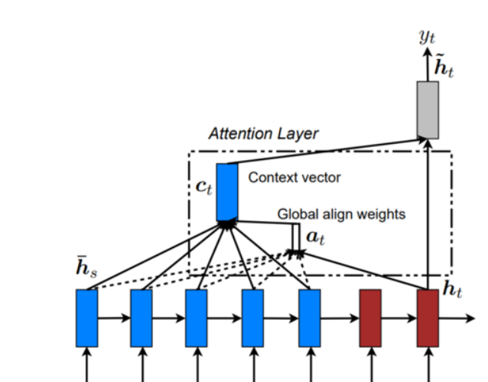
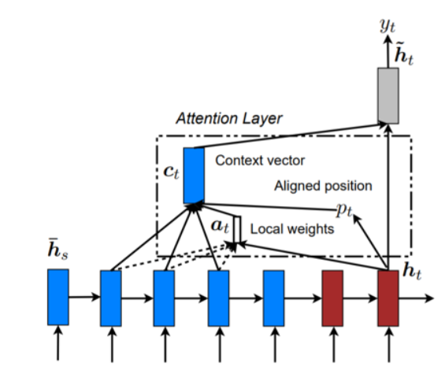
Attention mechanism[2],[3]
김성수
[2]D. Bahdanau, K. Cho, and Y. Bengio, "Neural machine translation by jointly learning to align and translate," arXiv preprint arXiv:1409.0473, 2014. [ICLR 2015]
[3]M.-T. Luong, H. Pham, and C. D. Manning, "Effective approaches to attention-based neural machine translation," arXiv preprint arXiv:1508.04025, 2015.
Avoid attempting to learn a single vector representation for each sentence
Instead, pays attention to specific input vectors of the input sequence based on the attention weights.
Luong et al[3] : Global, Local attention
Global attention : Attention is placed on all source positions
Local attention : Attention is placed only on a small subset of the source positions
Global attention
Local attention

Slide 6
Transformer[4]
김성수
[4] A. Vaswani et al., "Attention is all you need," in Advances in neural information processing systems, 2017, pp. 5998-6008.
RNN, LSTM을 쓰지 않고 Attention만 써보자 [All you need]

Slide 7
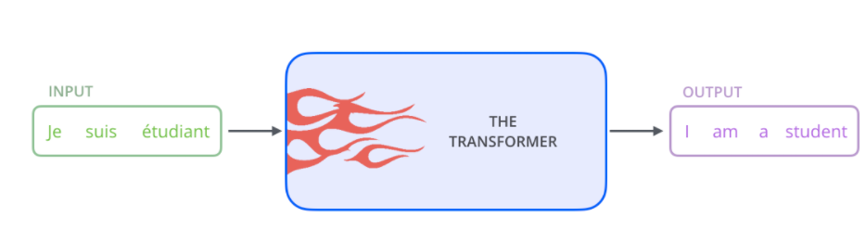
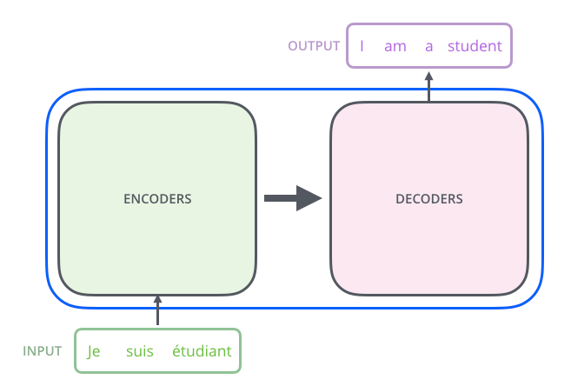
Transformer[4]
김성수
[4] A. Vaswani et al., "Attention is all you need," in Advances in neural information processing systems, 2017, pp. 5998-6008. http://jalammar.github.io/illustrated-transformer/
Transformer architecture (Encoder, Decoder 구조)

Slide 8
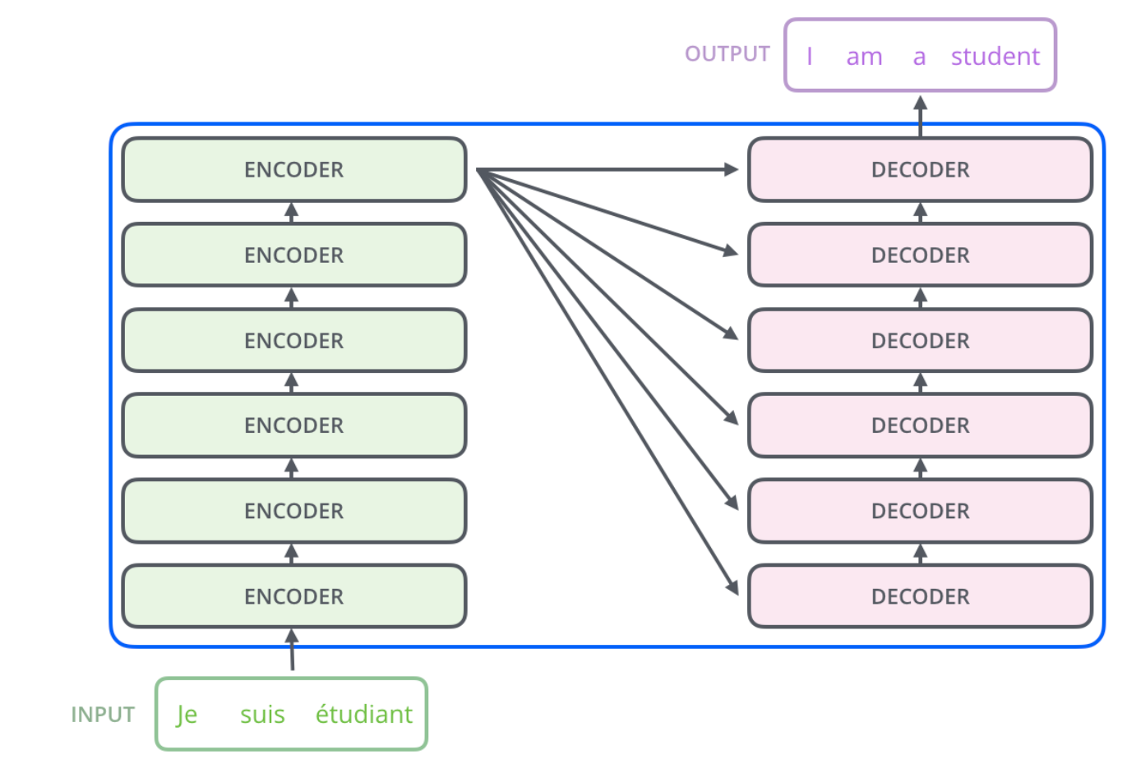
Transformer[4]
김성수
[4] A. Vaswani et al., "Attention is all you need," in Advances in neural information processing systems, 2017, pp. 5998-6008.
Encoder : Identical structure ( Do not share weights)

Slide 9
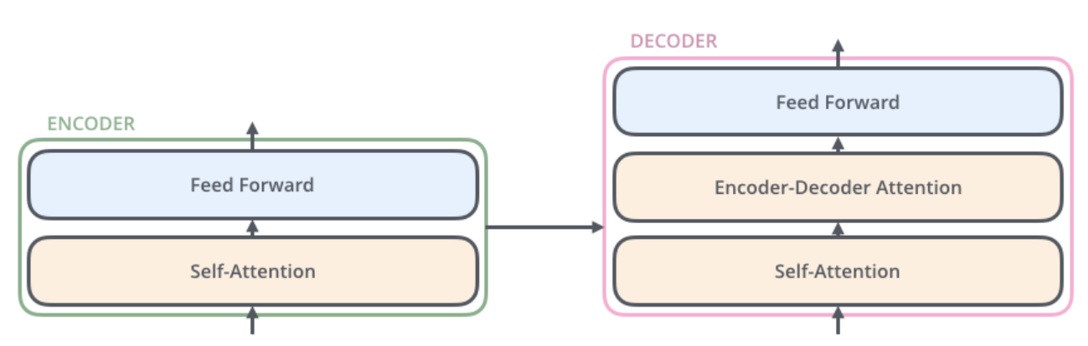
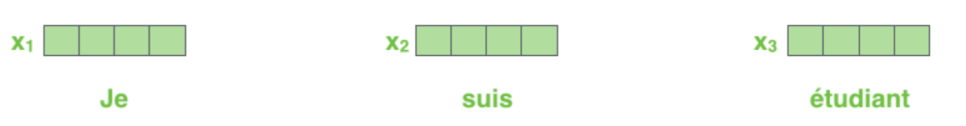
Transformer[4]
김성수
[4] A. Vaswani et al., "Attention is all you need," in Advances in neural information processing systems, 2017, pp. 5998-6008.
Encoder : Self-Attention + Feed forward Neural Network
Inputs : Word embedding(Word2Vec[8])
[8]T. Mikolov, K. Chen, G. Corrado, and J. Dean, "Efficient estimation of word representations in vector space," arXiv preprint arXiv:1301.3781, 2013.

Slide 10
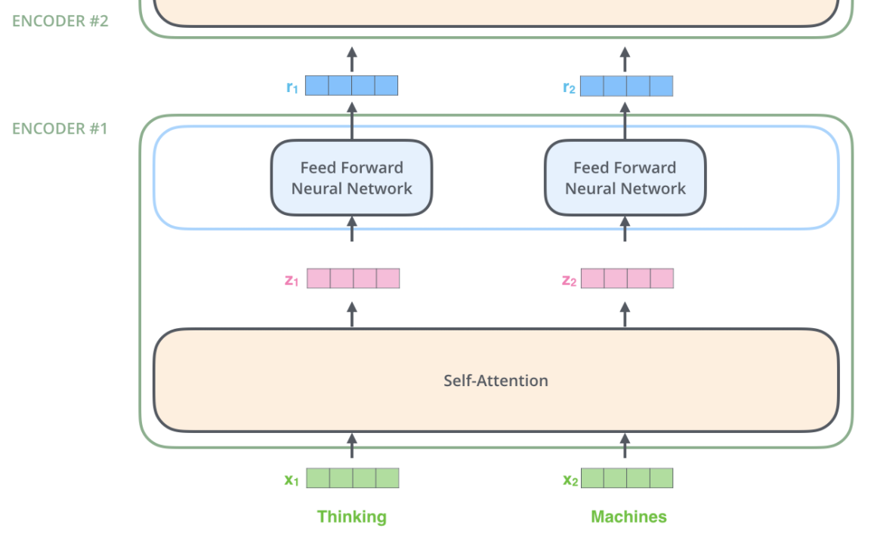
Transformer[4]
김성수
[4] A. Vaswani et al., "Attention is all you need," in Advances in neural information processing systems, 2017, pp. 5998-6008.
Two layers in Encoder

Slide 11
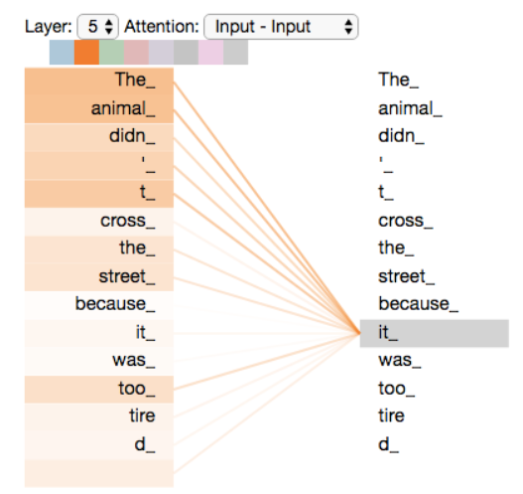
Transformer[4]
김성수
[4] A. Vaswani et al., "Attention is all you need," in Advances in neural information processing systems, 2017, pp. 5998-6008.
Self – Attention at a high level
“It” 이 무엇인지 어떻게 알지?
Self attention allows model to associate “it” with ”animal”
As the model processes each word (each position in the input sequence), self attention allows it to look at other positions in the input sequence for clues that can help lead to a better encoding for this word
“The animal didn’t cross the street because it was too tired”

Slide 12
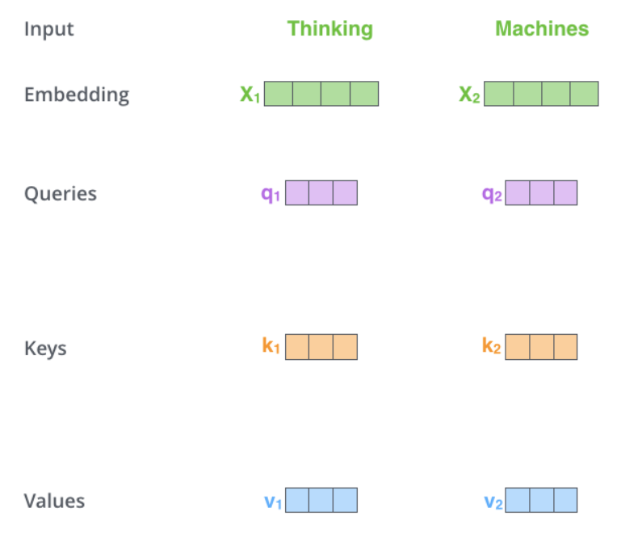
Transformer[4]
김성수
[4] A. Vaswani et al., "Attention is all you need," in Advances in neural information processing systems, 2017, pp. 5998-6008.
Self – Attention mechanism : Queries, Keys, Values
Step 1 : Create three vectors from each of the encoder’s input vectors(=for each word)
** Note : Dimension of embedding vector != Dimension of Query,Key,Value vector

Slide 13
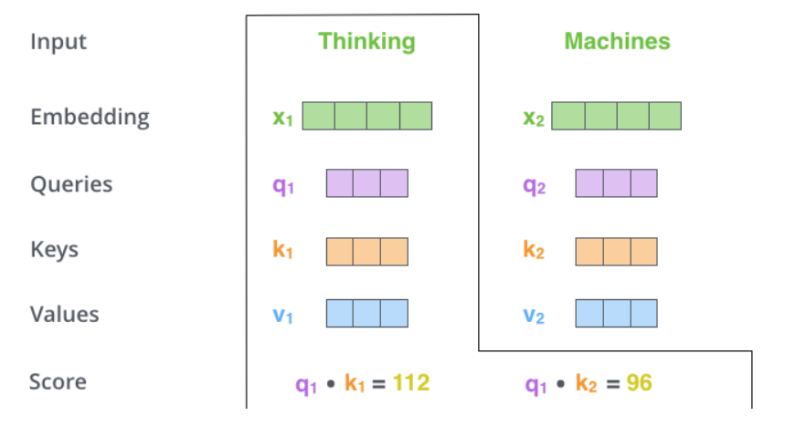
Transformer[4]
김성수
[4] A. Vaswani et al., "Attention is all you need," in Advances in neural information processing systems, 2017, pp. 5998-6008.
Self – Attention mechanism : Queries, Keys, Values
Step 2 : Calculate a score by dot product of Query & Key vectors

Slide 14
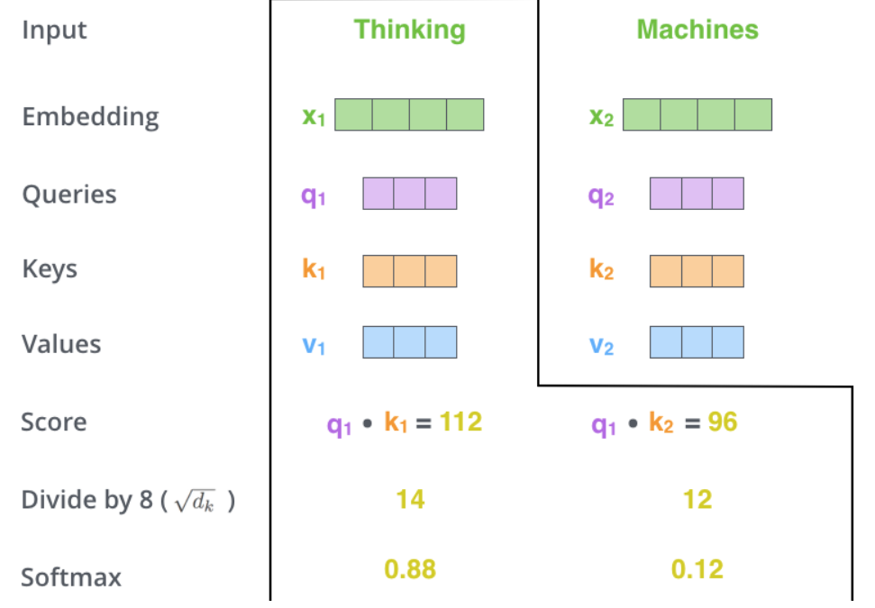
Transformer[4]
김성수
[4] A. Vaswani et al., "Attention is all you need," in Advances in neural information processing systems, 2017, pp. 5998-6008.
Self – Attention mechanism : Queries, Keys, Values
Step 3 : Divide the scores by the square root of the dimension of the key vector
To get more stable gradients while training
Pass the result through a softmax operation

Slide 15
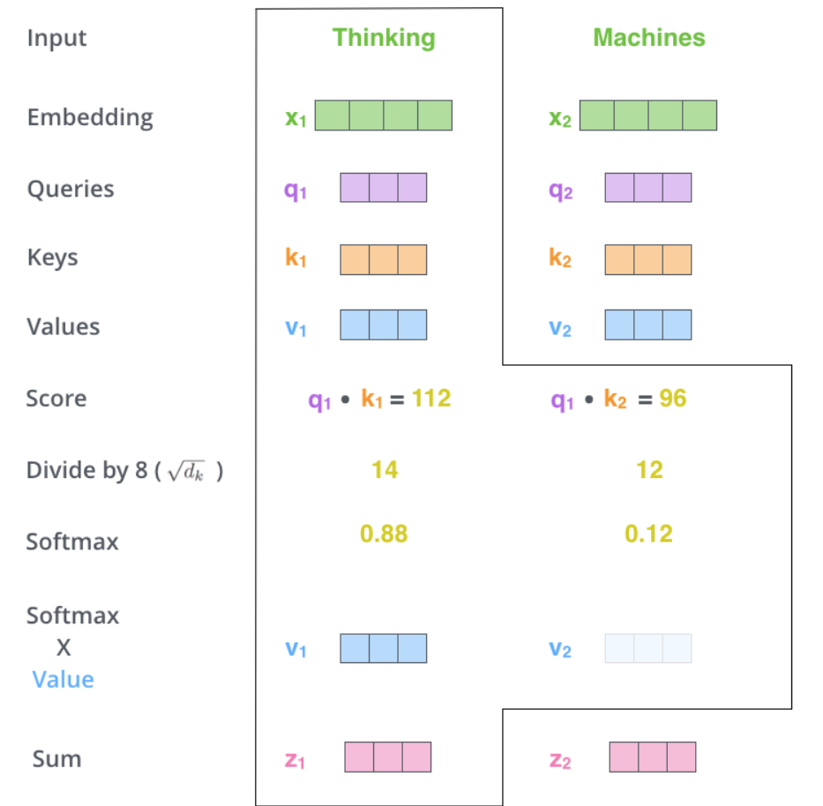
Transformer[4]
김성수
[4] A. Vaswani et al., "Attention is all you need," in Advances in neural information processing systems, 2017, pp. 5998-6008.
Self – Attention mechanism : Queries, Keys, Values
Step 4 : Multiply each value vector by the softmax score
Step 5 : Sum up the weighted value vectors

Slide 16
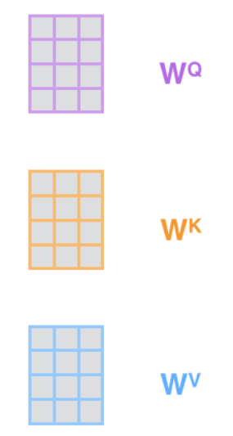
Transformer[4]
김성수
[4] A. Vaswani et al., "Attention is all you need," in Advances in neural information processing systems, 2017, pp. 5998-6008.
Self – Attention mechanism : Trainable papameters(Weights)

Slide 17
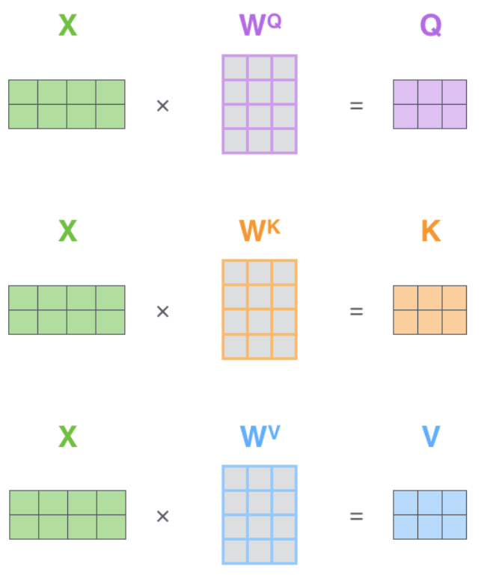
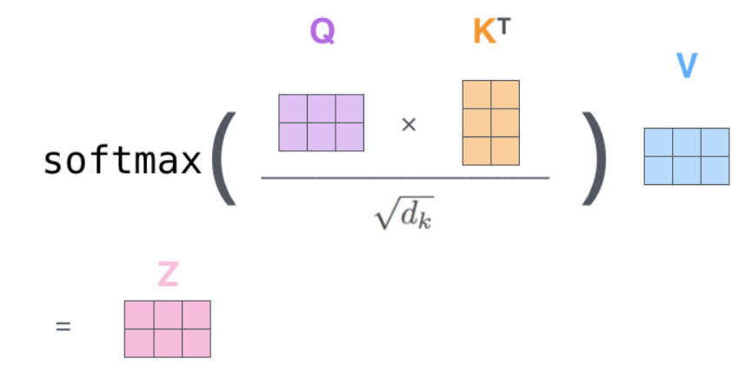
Transformer[4]
김성수
[4] A. Vaswani et al., "Attention is all you need," in Advances in neural information processing systems, 2017, pp. 5998-6008.
Self – Attention mechanism : Matrix Calculation

Slide 18
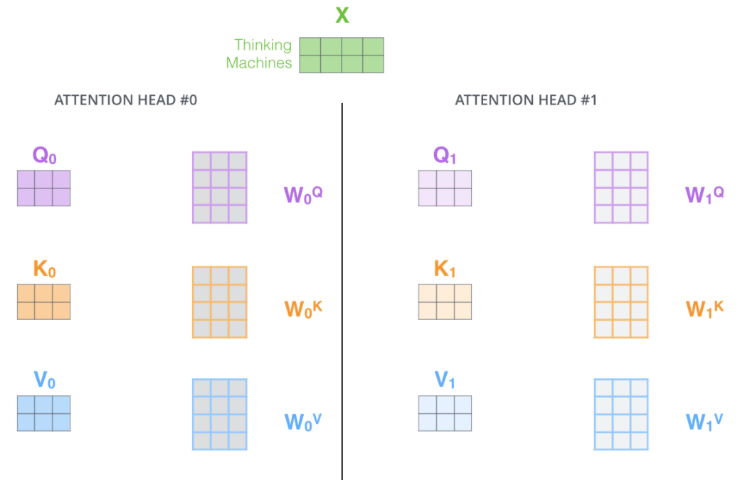
Transformer[4]
김성수
[4] A. Vaswani et al., "Attention is all you need," in Advances in neural information processing systems, 2017, pp. 5998-6008.
Multi – head attention
1. Expands the model’s ability to focus on different positions
Z contains a little bit of every other encoding, but it could be dominated by the the actual word itself
“The animal didn’t cross the street because it was too tired”, we would want to know which word “it” refers to.
2. It gives the attention layer multiple “representation subspaces”
We can have multiple sets of Query/Key/Value weight matrices
Each of these sets is randomly initialized. Then, after training, each set is used to project the input embeddings (or vectors from lower encoders/decoders) into a different representation subspace.

Slide 19
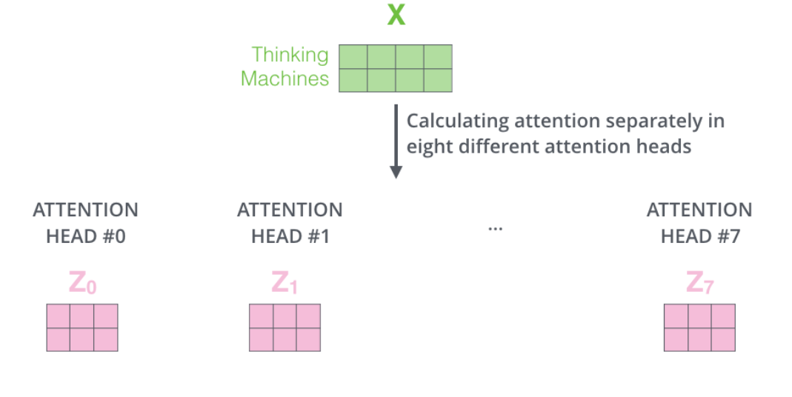
Transformer[4]
김성수
[4] A. Vaswani et al., "Attention is all you need," in Advances in neural information processing systems, 2017, pp. 5998-6008.
Multi – head attention
Eight different heads → Eigth different Z matrices
Feed – forward layer is not expecting eigth matrices
We need to condense these eight down into a single matrix

Slide 20
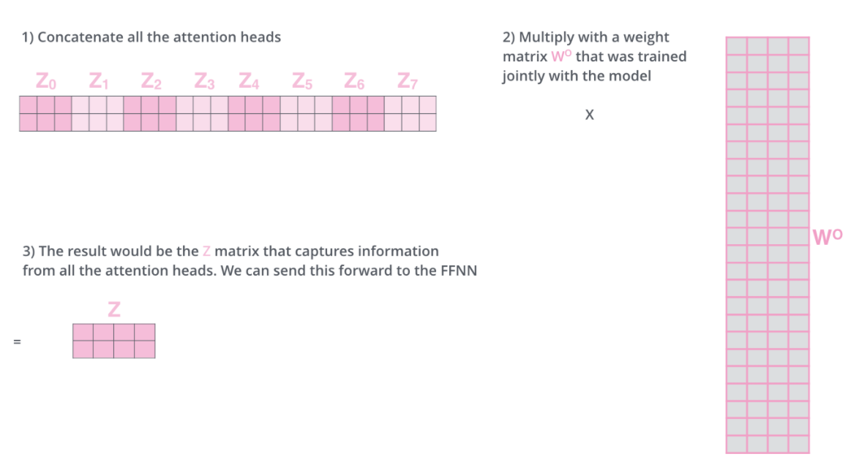
Transformer[4]
김성수
[4] A. Vaswani et al., "Attention is all you need," in Advances in neural information processing systems, 2017, pp. 5998-6008.
Multi – head attention
Eight different heads → Eigth different Z matrices
Feed – forward layer is not expecting eigth matrices
We need to condense these eight down into a single matrix

Slide 21
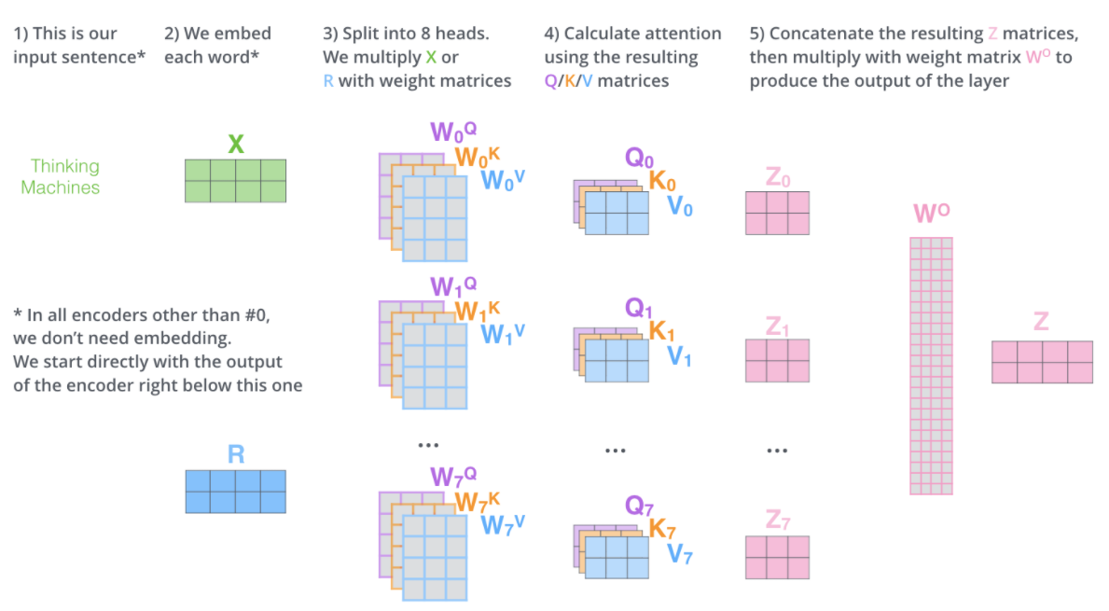
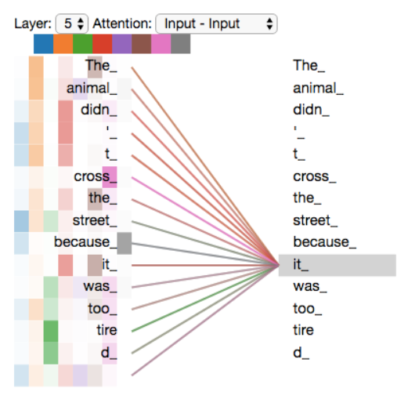
Transformer[4]
김성수
[4] A. Vaswani et al., "Attention is all you need," in Advances in neural information processing systems, 2017, pp. 5998-6008.
Overview

Slide 22
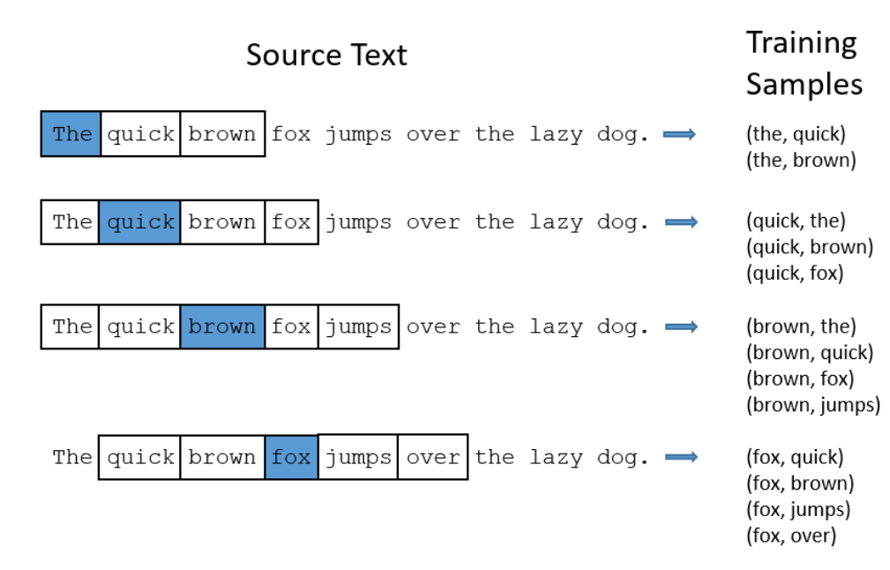
Word2Vec[5]
김성수
Continuous bag of words(CBOW)
Main idea : “비슷한 위치에서 등장하는 단어들은 비슷한 의미를 가진다”
Sliding window
중심단어를 기준으로 window 크기 만큼의 주변단어를 선택해가며 학습을 진행

Slide 23
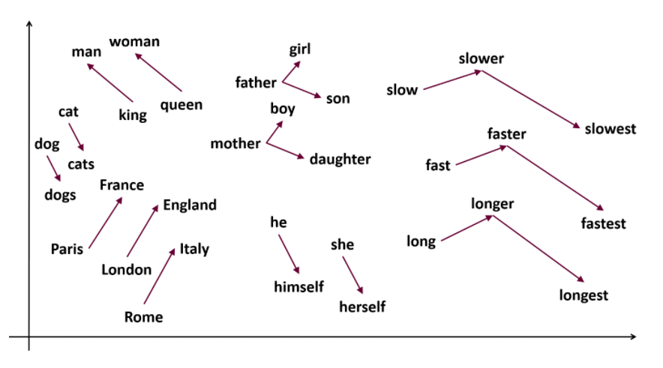
Word2Vec[5]
김성수
Word embeddings
Embedding of “stick” : A vector of 200 floats

Slide 24
Importance of context
김성수
Word2Vec[5] simply produce an embedding based on the literal spelling of a word
Do not factor in how the word is being used (문맥을 고려하지 않음)
I can’t trust you
They have no trust left for their friend
He has a trust fund
The bank remains closed on public holidays
Don’t go near the river bank

Slide 25
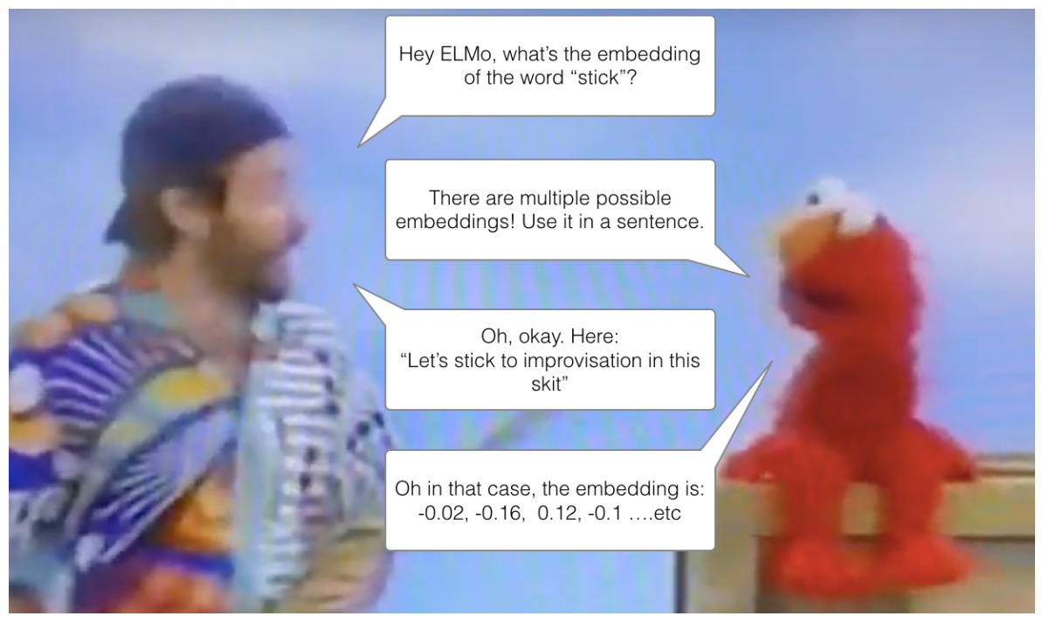
ELMo
김성수
[6] (ELMo) M. Peters et al., "Deep contextualized word representations. arXiv 2018," arXiv preprint arXiv:1802.05365, vol. 12, 1802.
Embeddings from Language Models
Feature based approach로 word를 embedding 하지 말고, 우리도 CV에서 처럼 문장의 상황마다 단어의 context를 파악할 수 있도록 만들자! ( Ex: CNN의 Resnet-50 backbone)
“Stick”

Slide 26
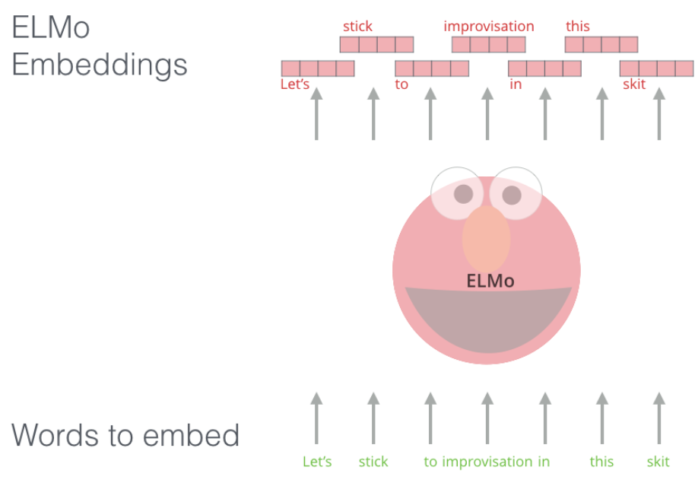
ELMo
김성수
[6] (ELMo) M. Peters et al., "Deep contextualized word representations. arXiv 2018," arXiv preprint arXiv:1802.05365, vol. 12, 1802.
Main Idea : 문맥을 반영한 word embedding
Instead of using a fixed embedding for each word, ELMo looks at the entire sentence before assigning each word in it an embedding

Slide 27
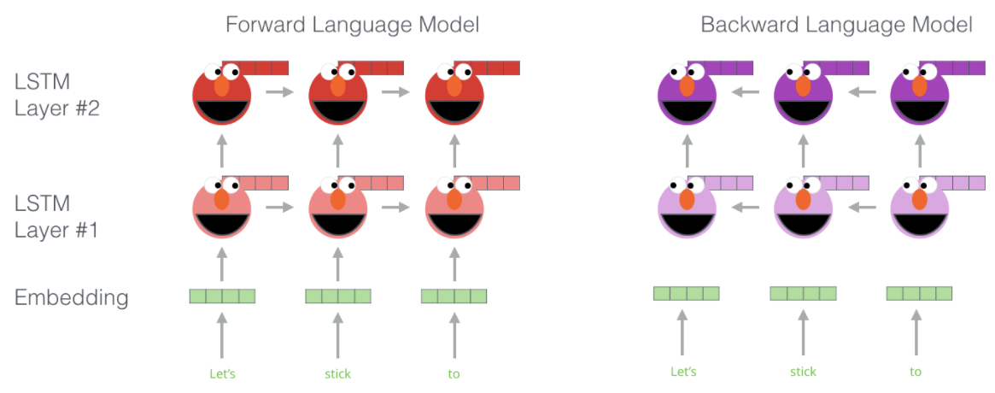
ELMo
김성수
[6] (ELMo) M. Peters et al., "Deep contextualized word representations. arXiv 2018," arXiv preprint arXiv:1802.05365, vol. 12, 1802.
Main Idea : 문맥을 반영한 word embedding

Slide 28
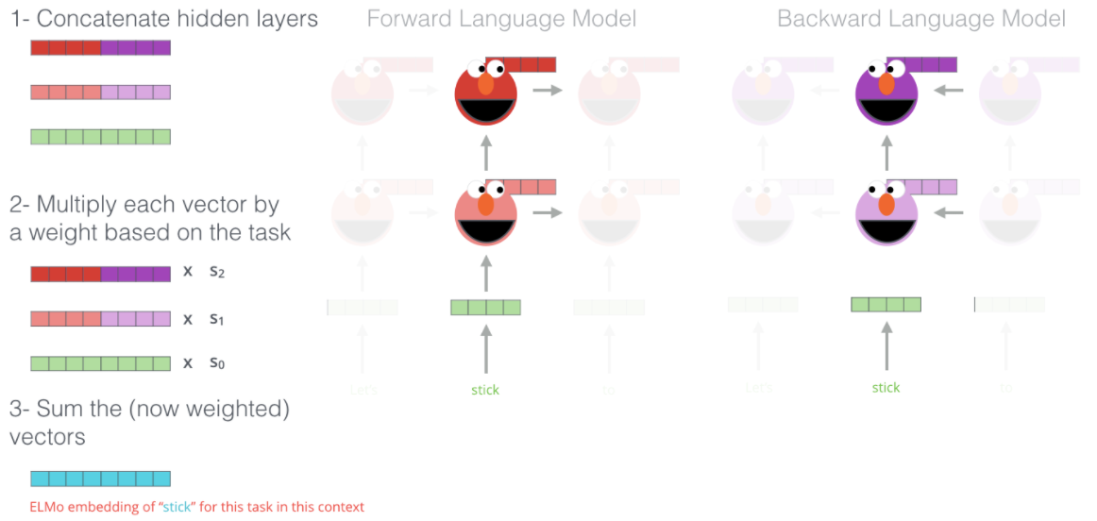
ELMo
김성수
[6] (ELMo) M. Peters et al., "Deep contextualized word representations. arXiv 2018," arXiv preprint arXiv:1802.05365, vol. 12, 1802.
Main Idea : 문맥을 반영한 word embedding

Slide 29
BERT[7]
김성수
[7] J. Devlin, M.-W. Chang, K. Lee, and K. Toutanova, "Bert: Pre-training of deep bidirectional transformers for language understanding," arXiv preprint arXiv:1810.04805, 2018.
단어, 문장, 언어를 어떻게 표현해야 여러 down stream task에 강력한 pretrained model을 만들 수 있을까?
Transformer의 encoder구조를 사용하여 language representation을 학습
Fine tuning을 통해 NLP의 다양한 task(text classification, answering..)를 수행할 수 있도록 설계/학습된 강력한 pretrained model
당시 NLP의 11개 영역에서 SOTA를 달성
Recap : Transformer

Slide 30

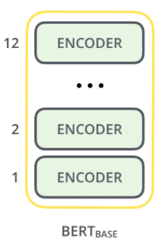
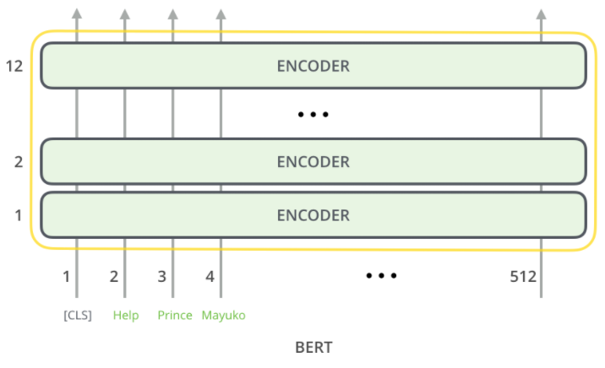
BERT[7]
김성수
[7] J. Devlin, M.-W. Chang, K. Lee, and K. Toutanova, "Bert: Pre-training of deep bidirectional transformers for language understanding," arXiv preprint arXiv:1810.04805, 2018.
단어, 문장, 언어를 어떻게 표현해야 여러 down stream task에 강력한 pretrained model을 만들 수 있을까?
Transformer의 encoder구조를 사용하여 language representation을 학습
Fine tuning을 통해 NLP의 다양한 task(text classification, answering..)를 수행할 수 있도록 설계/학습된 강력한 pretrained model
당시 NLP의 11개 영역에서 SOTA를 달성

Slide 31
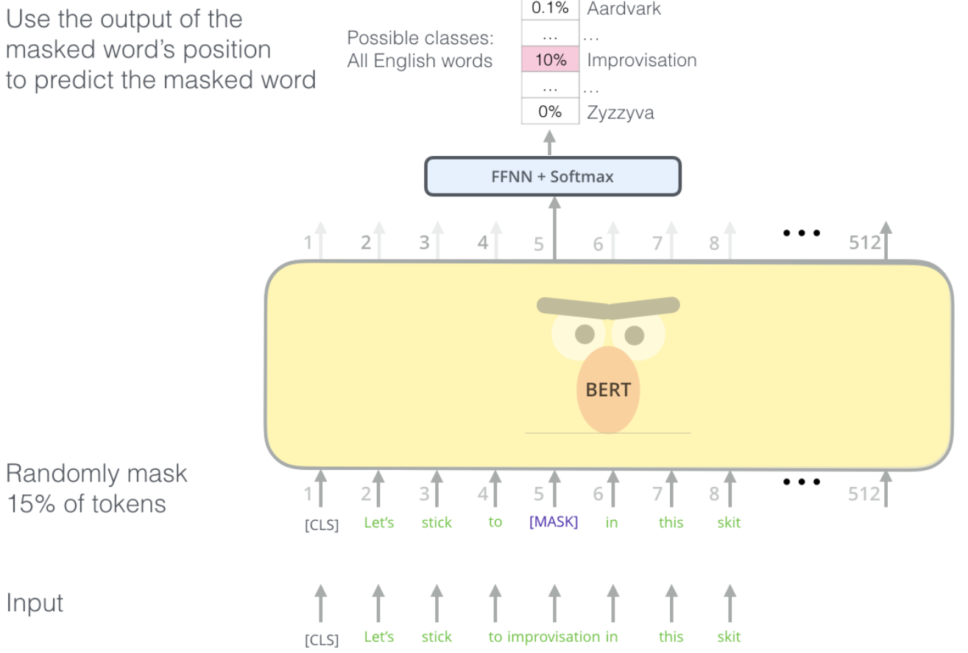
BERT[7]
김성수
[7] J. Devlin, M.-W. Chang, K. Lee, and K. Toutanova, "Bert: Pre-training of deep bidirectional transformers for language understanding," arXiv preprint arXiv:1810.04805, 2018.
단어, 문장, 언어를 어떻게 표현해야 여러 down stream task에 강력한 pretrained model을 만들 수 있을까?
BERT의 핵심 Idea : Mask를 쓰자!(Masked Language Model)
1. Mask로 문장의 일부 단어를 가려 놓고, 그것을 predict하게 하자
문장의 15%정도를 masking하고, masking된 단어가 무엇인지 맞추어 나가며 문맥을 파악하는 능력을 학습
Input 일부 단어들은 random한 단어로 변경된 상태에서 학습 (일종의 noise)
Self – Supervised Learning
나는 하늘이 예쁘다고 생각한다 -> 나는 하늘이 [Mask] 생각한다.
나는 하늘이 예쁘다고 생각한다 -> 나는 하늘이 흐리다고 생각한다.
나는 하늘이 예쁘다고 생각한다 -> 나는 하늘이 예쁘다고 생각한다.

Slide 32
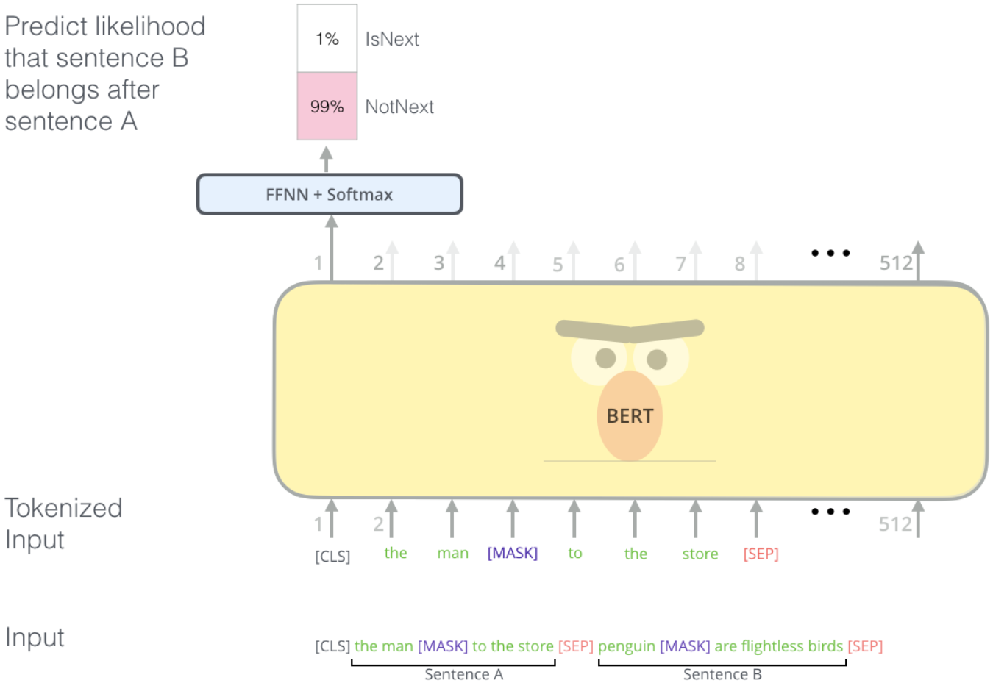
BERT[7]
김성수
[7] J. Devlin, M.-W. Chang, K. Lee, and K. Toutanova, "Bert: Pre-training of deep bidirectional transformers for language understanding," arXiv preprint arXiv:1810.04805, 2018.
단어, 문장, 언어를 어떻게 표현해야 여러 down stream task에 강력한 pretrained model을 만들 수 있을까?
BERT의 핵심 Idea : Mask를 쓰자!(Masked Language Model)
2. Next Sentence prediction(NSP)
다음 문장이 올바른 문장인지 맞추는 문제 : 두 문장 사이의 관계를 학습
문장 A와 B를 이어 붙인것이 input으로 들어가며, 5:5의 비율로 관련있는 문장(IsNext label) 또는 관련 없는 문장(NonNext label)을 사용

Slide 33
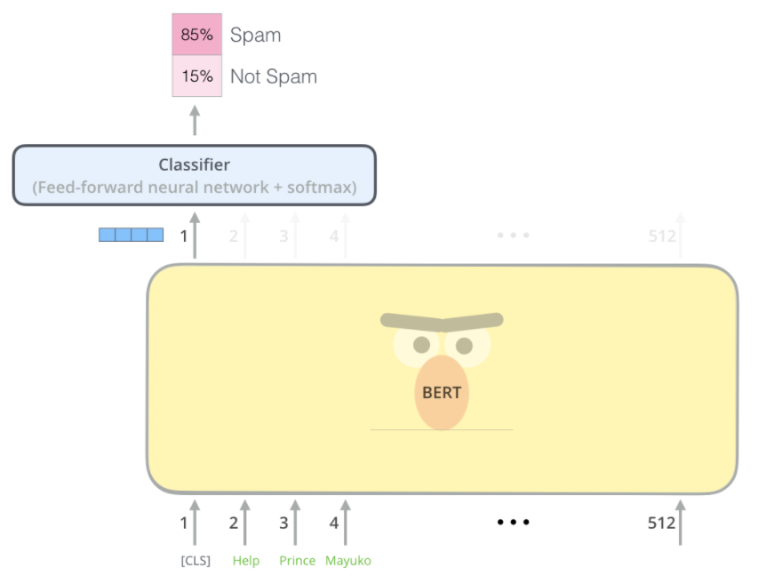
BERT[7]
김성수
[7] J. Devlin, M.-W. Chang, K. Lee, and K. Toutanova, "Bert: Pre-training of deep bidirectional transformers for language understanding," arXiv preprint arXiv:1810.04805, 2018.
Ex: Sentence classification
학습된 BERT를 fine-tuning할 때 (classification task라면) Image task에서의 fine-tuning과 비슷하게 class label 개수만큼의 output을 가지는 Dense Layer를 붙여서 사용

Slide 34
ViT[8]
김성수
공통점
Transformer의 encoder 구조를 사용
CLS token을 이용한 classification
차이점
문장이 아닌 Image를 여러 token으로 분리하여 해석
Mask를 사용하지 않음

Slide 35
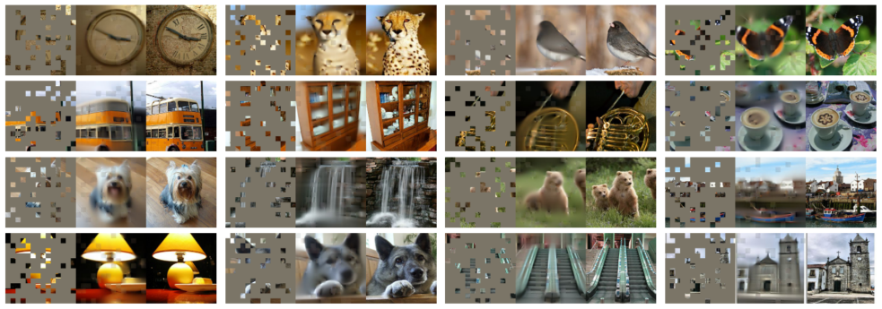
MAE[9]
김성수
[9] K. He, X. Chen, S. Xie, Y. Li, P. Dollár, and R. Girshick, "Masked Autoencoders Are Scalable Vision Learners," arXiv preprint arXiv:2111.06377, 2
Masked Autoencoders Are Scalable Vision Learners[9]
Masked
Autoencoders
Scalable
Vision Learners
are
BERT..?
Transformer?
Scalability..?
ViT..?
Features?
Context?

Slide 36
MAE[9]
김성수
[9] K. He, X. Chen, S. Xie, Y. Li, P. Dollár, and R. Girshick, "Masked Autoencoders Are Scalable Vision Learners," arXiv preprint arXiv:2111.06377, 2
Masked Autoencoders Are Scalable Vision Learners[9]
어떻게 하면 BERT[7]의 idea를 image 에 대해서도 적용할 수 있을까?
Image와 language의 특성이 매우 다른것을 고려할 때, 과연 어떤 일이 일어날까?
In vision, CNNs were dominant over the last decade
Convolutions typically operate on regular grids and it is not straightforward to integrate ‘indicators’ such as mask tokens or positional embeddings
This architectural gap has been addressed with the introduction of Vision Transformer (ViT)
What makes masked autoencoding different between vision and language?
Information density is different between language and vision
Languages = Human-generated signals
Highly semantics
Information – dense
The model needs sophisticated language understanding
Ex ) In Autumn the _______ falls from the trees.
Images = Natural signals
Heavy spatial redundancy
Ex ) A missing patch can be recovered from neighboring pathces with little high-level understadning of parts, objects, and scenes : Interpolation, Inpainting…

Slide 37
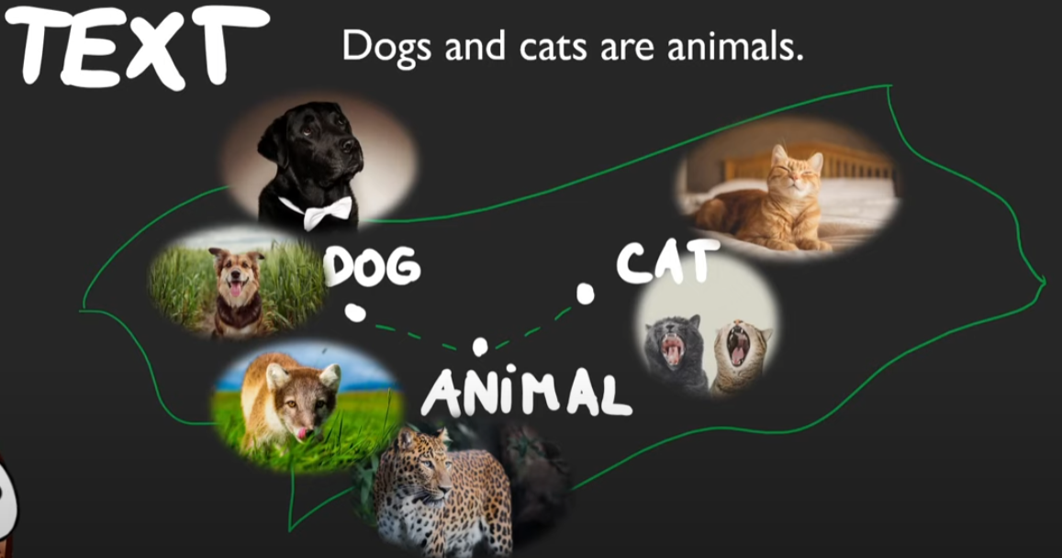

MAE[9]
김성수
[9] K. He, X. Chen, S. Xie, Y. Li, P. Dollár, and R. Girshick, "Masked Autoencoders Are Scalable Vision Learners," arXiv preprint arXiv:2111.06377, 2
Decoders (Mapping the latent representation back to the input)
Plays a different role between reconstructing text and images
Vision
Decoder reconstruct pixels
Output is of a lower semantic level than common recognition tasks
Language
Decoder predicts missing words that contain rich semantic information
MASK in language and Image

Slide 38
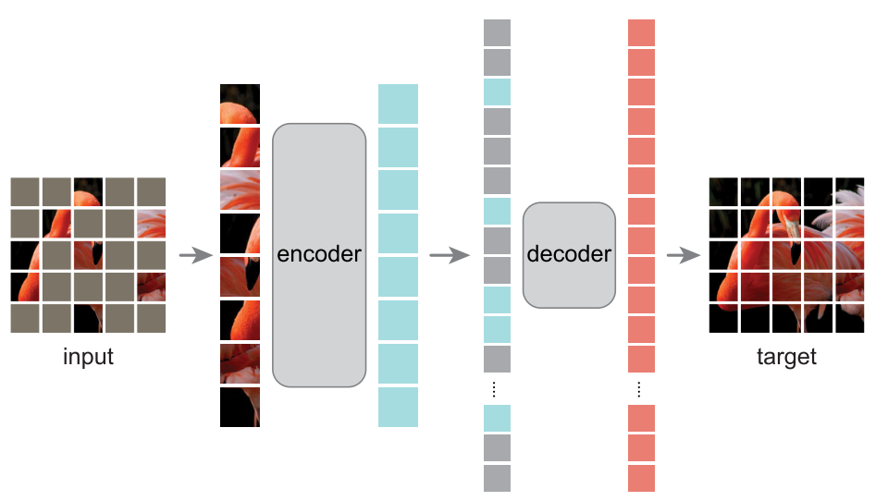
MAE[9]
김성수
[9] K. He, X. Chen, S. Xie, Y. Li, P. Dollár, and R. Girshick, "Masked Autoencoders Are Scalable Vision Learners," arXiv preprint arXiv:2111.06377, 2
Architecture

Slide 39
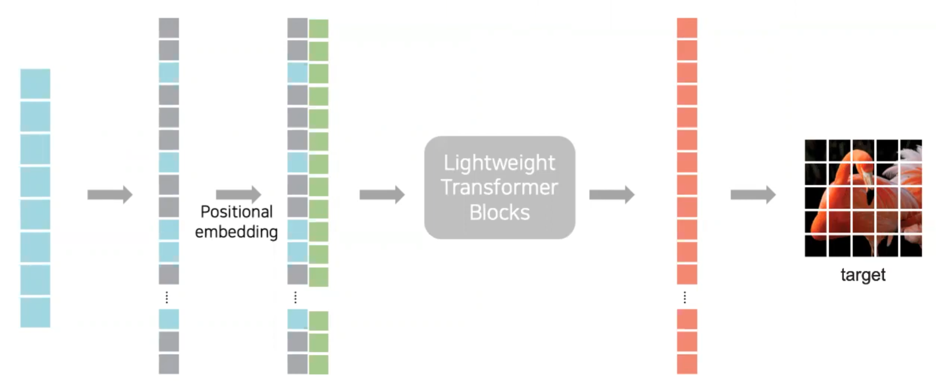
MAE[9]
김성수
[9] K. He, X. Chen, S. Xie, Y. Li, P. Dollár, and R. Girshick, "Masked Autoencoders Are Scalable Vision Learners," arXiv preprint arXiv:2111.06377, 2
Architecture

Slide 40
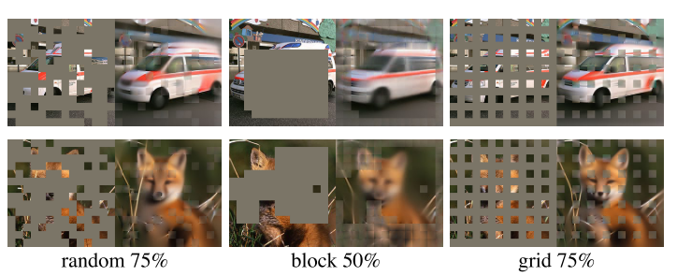
MAE[9]
김성수
[9] K. He, X. Chen, S. Xie, Y. Li, P. Dollár, and R. Girshick, "Masked Autoencoders Are Scalable Vision Learners," arXiv preprint arXiv:2111.06377, 2
Result

Slide 41
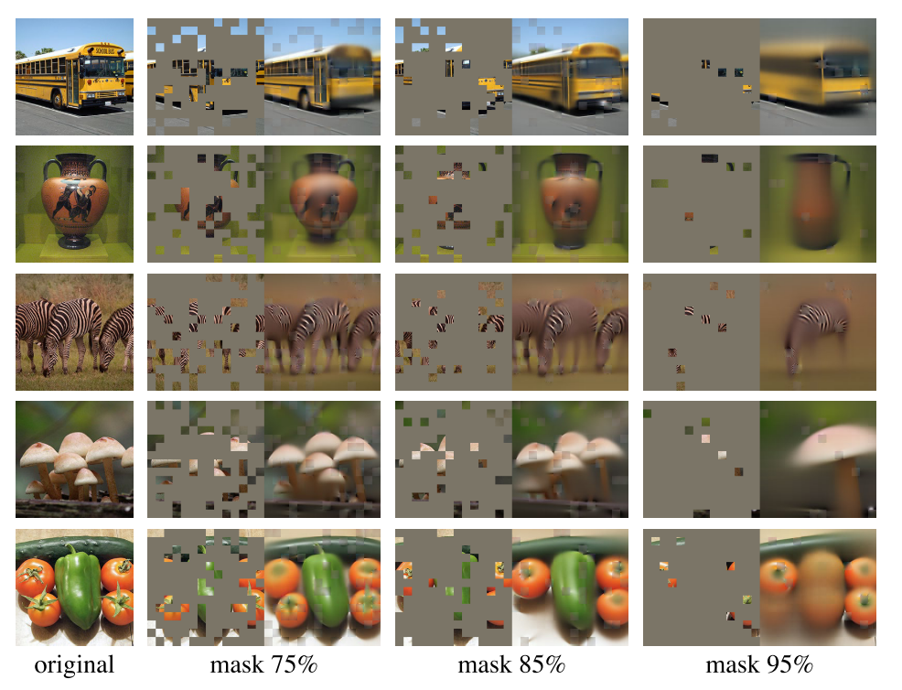
MAE[9]
김성수
[9] K. He, X. Chen, S. Xie, Y. Li, P. Dollár, and R. Girshick, "Masked Autoencoders Are Scalable Vision Learners," arXiv preprint arXiv:2111.06377, 2
Result

Slide 42
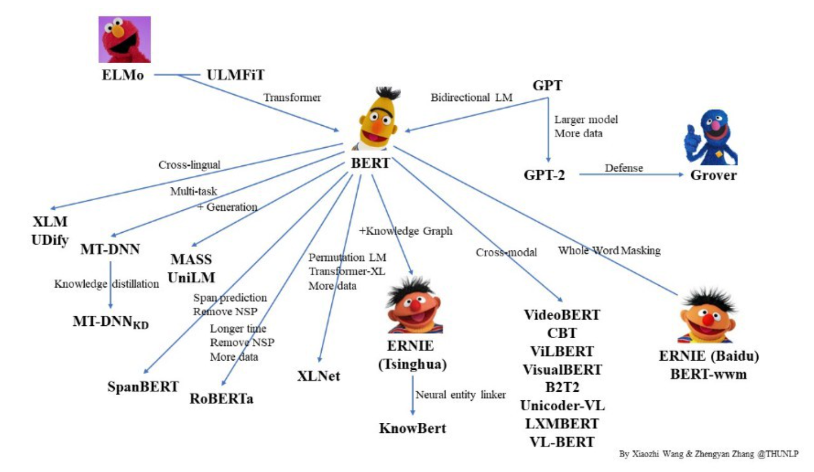
Conclusion
김성수
제발 무해한척하면서 대학원생을 괴롭히지마…
ELMo : Embeddings from Language Models
BERT : Bidirectional Encoder Repersentations from Transformer
ERNIE : Enhanced Language Representation with Informative Entities

Slide 43
Next week
김성수
About ClS token
About positional encodings In images
Papers : Transformer in person re-identification (How to의 사고확장을 위해)

