Slide 1
Ingredients
Banana Bread:
2 whole eggs
3/4 cup granulated sugar
3/4 cup brown sugar
2 tsp salt
1 cup milk
1/4 cup melted butter
2-3 ripe bananas
1 tbsp vanilla paste (or extract)
1 1/2 cup all purpose flour
1 tbsp baking soda
Brown Butter Semifreddo:
2 cups heavy cream
1/2 cup honey
2 tbsp vanilla paste (or extract)
1/2 cup melted brown butter
Praline:
2 tbsp hot water
1/2 cup brown sugar
1/2 cup peanut butter

Slide 2
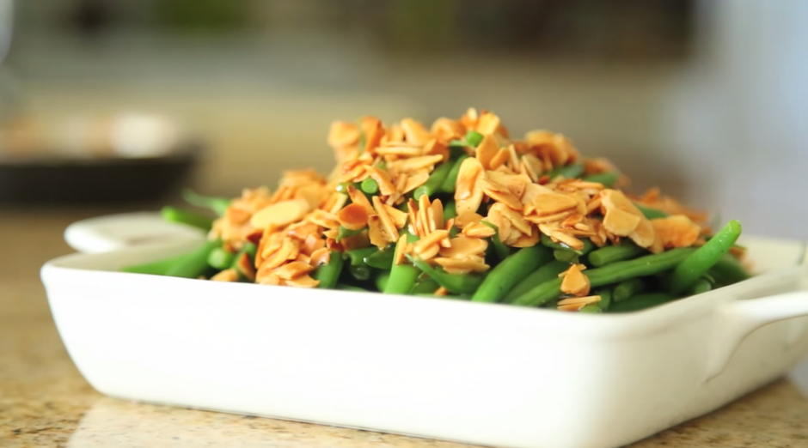
Green Beans Almondine

