Slide 1
MVC1
User
(Browser)
JSP
1 request
View
Controller
4 response
2
Model
(Bean)
DB
3

Slide 2
MVC2
Browser
(Client)
Servlet
(Controller)
Service
DAO
DB
1 request
2 instantiate
(결과 저장)
3
Select view
JSP
(View)
Java Beans
(Model)
4
5 response
retrieve

Slide 3
Library vs framework
Your Code
You call Library
Framework Call you
Library
Framework
Contains

Slide 4
Static page
Client
Web Server
(80)
1 GET /path/index.html
4 STATUS … file contents
3 file contents
2 read /path/index.html
FileSystem

Slide 5
dynamic page
Client
Web Application Server
Ex) Tomcat
GET /url.Servlet?uid=Hong
STATUS … <Response Hong>
1. doGet(req, res)
JVM
2. <response Hong>
Servlet
1. doGet(res, req)
GET /url.Servlet?uid=Mun
2. <response Mun>
STATUS … <Response Mun>
DB

Slide 6
Web service architecture
WAS(Web Application Service)
e.g. Tomcat
Client
(browser,
Mobile App)
Servlet Container
Web Server
Request
Send Request to Container
Transfer result to client
JSP, Servlet
(Dynamic
Processing)
DB
e.g. MySQL
DB
Connection
Response

Slide 7
Servlet program
JVM(Java Virtual Machine)
2
Servlet Life Cycle
Servlet
Container
Instantiate & call init()
Thread A
init()
Ready to serve request
Thread B
3
service()
Handle multiple request and send response
Thread C
Destroy()
1
Web Server
Request to Servlet Container

Slide 8
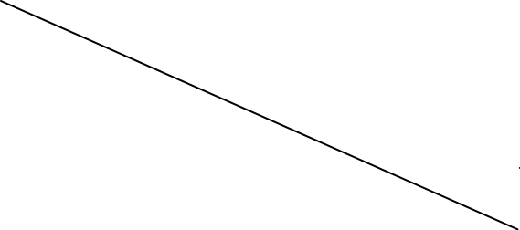
Mvc flow of control
HTML
or
JSP
Java Code
(business logic)
2-1
2-2
0
Arguments
(Form data)
Result
(Beans)
Requests
Beans
1
…
JSP1
JSP2
JSP3
…
Form
(User)
Servlet
4
Submit form
3
Forwarding
Request에 Bean 저장
(Session or application scope)
Beans에서 데이터 추출 후
Output을 설정
2-3
최종 결과 Result
5

Slide 9
Proxy
Proxy
Singleton
Prototype

Slide 10
DefaultFormattingConversionService
Converter
Registry
Conversion
Service
Formatter
Registry
DefaultFormatting
ConversionService

Slide 11
AOP native approach
Class A
Class B
Class C
Logging
Cross
cutting
concerns
Security
Transaction

Slide 12
AOP crosscutting concerns
Class A
Class B
Class C
Aspect Logging
Aspect Security
Aspect Transaction

Slide 13
Proxy Pattern

