Slide 1

Development Of Automatic Flow Control System Based On LabView
Chemical Engineering Department
Du-Seob Kim
Seung-Gyu Ann
*Tae-Won Kang
Notes:
전반부 발표 : 안승규
후반부 발표 : 김두섭 지도교수 : 강태원

Slide 2
CONTENTS
01.
Introduction
02.
Composition of equipment
03.
Simulation results
04.
Conclusion
Notes:
목차 : 서론 → 이론 → 장치의 구성 → 시뮬레이션 결과 → 결론

Slide 3
01
Introduction

Slide 4

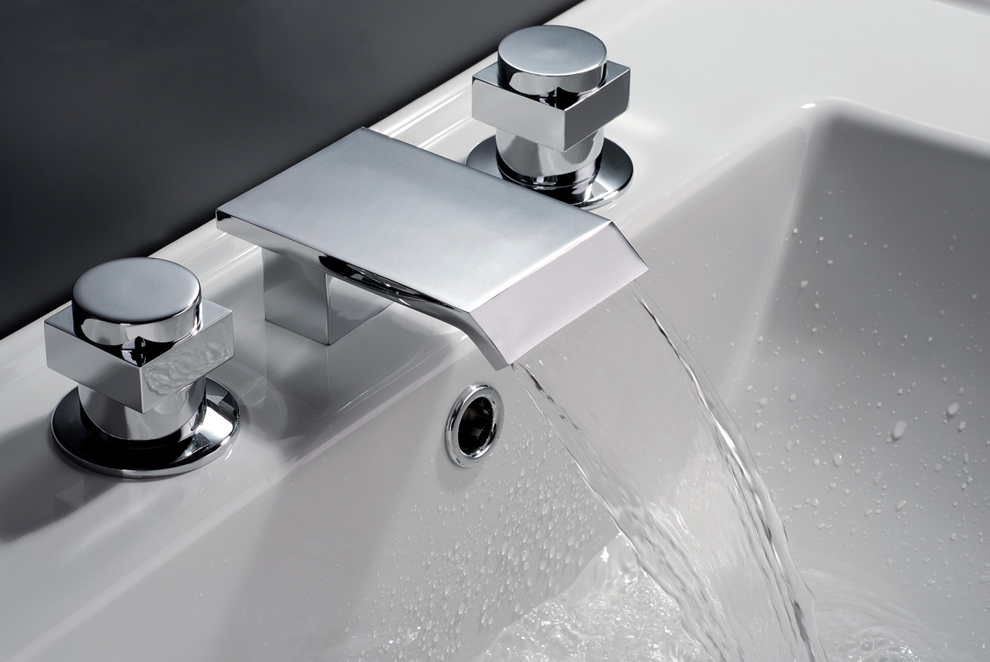
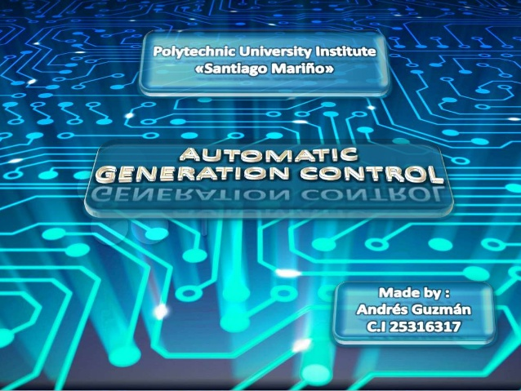
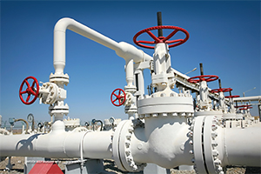
01. Introduction
4
Notes:
배경 : 산업의 발달/효과적인 제어의 필요성 → 부적절한 제어로 인한 사고사례 → 유량제어 → 자동제어//현재의 기술

Slide 5
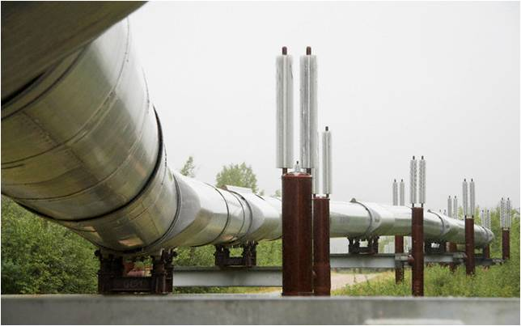
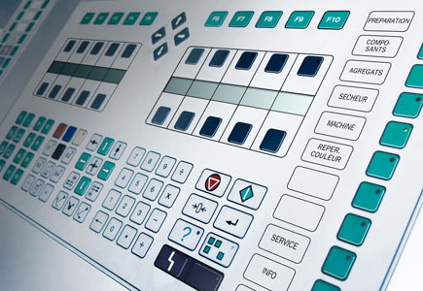
01. Introduction
Flow control
To reach the desired value that fluid
through pipes or channel
Automatic control
To modify for desired value automatically
from data of process
5
Notes:
이론1 : 유량제어소개 → 자동제어소개

Slide 6
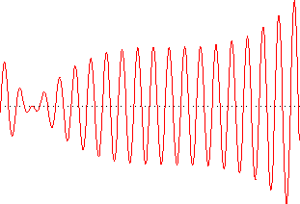

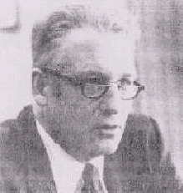
01. Introduction
Divergence
Consistent oscillation
John G. Ziegler
Nathaniel B. Nichols
Introduction of Ziegler-Nichols tuning method (1942)
Experimental method
 | K_{C} | τ_{I} | τ_{D}
P controller | 0.5K_{U} | - | -
PI controller | K_{U}/2.2 | 0.83P_{U} | -
PID controller | K_{U}/1.7 | 0.5P_{U} | 0.125P_{U}
Critical gain, K_{U}
Critical oscillation period, P_{U}
6
Notes:
이론3 : Ziegler-Nichols 이론 : 비례 이득을 변화시키며 단위 계단 입력에 대한 시스템의 응답이 감쇠가 없는 임계 감쇠(Critical damping) 상태가 되는 임계이득(K_{U}) 와 임계 진동 주기(P_{U})를 이용하여 P, I, D 계수 값을 선정하는 방법이 이용
각 제어기에 따른 계수는 표와 같이 계산됨

Slide 7
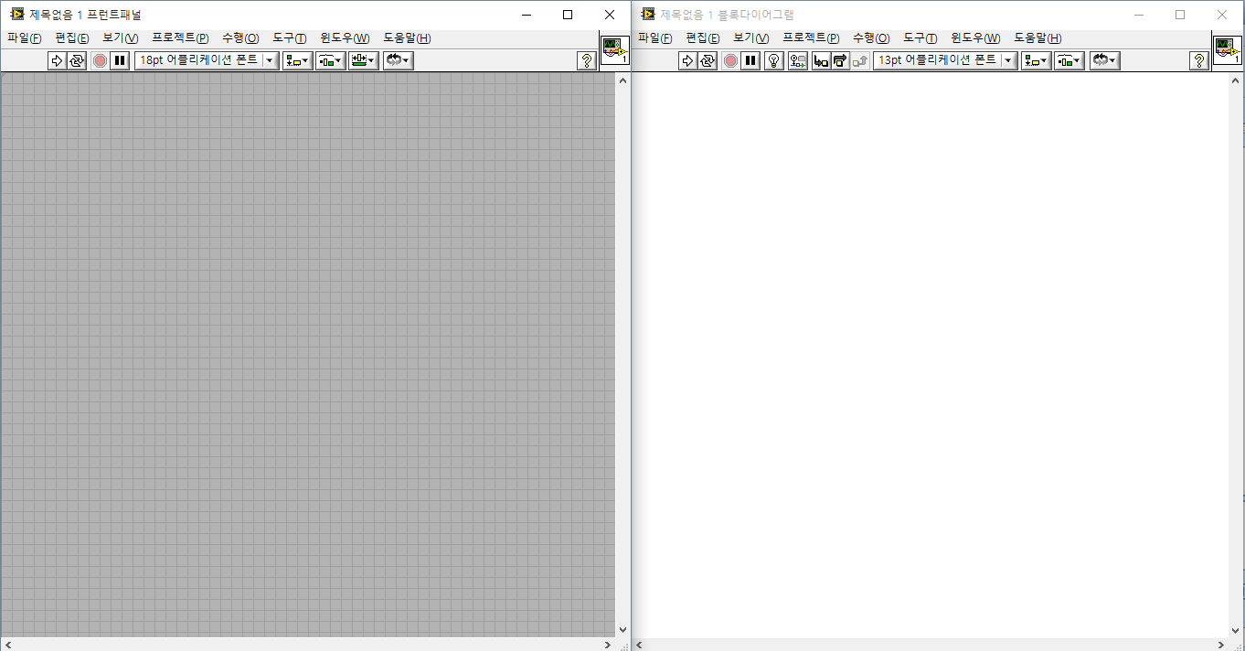
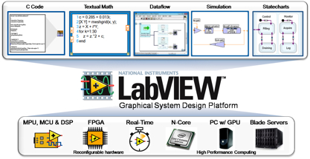

01. Introduction
Front panel
Control (Input)
Indicator (Output)
User interface
Block diagram
Source code similar
to flow chart
Non-sequential
programming
LabView
Specialized program in measurement and control
Program based on graphic
7
Notes:
이론4 : LabView → Front Panel and Block diagram

Slide 8
01. Introduction
Programming automatic flow system
based on LabView
Analysis and combination of relation
between software and hardware
Each variable setting of PID control
by Ziegler-Nichols tuning method
Development of optimized
automatic flow control system
8
Notes:
목적 : 랩뷰를 이용한 자동유량제어시스템 프로그래밍 → 소프트웨어와 하드웨어 사이의 관계 분석 → Ziegler-Nichols 튜닝법을 통한 P, PI, PID 제어 각각의 변수를 설정 → 최적화된 자동유량제어시스템의 구축

Slide 9
02
Composition of equipment

Slide 10
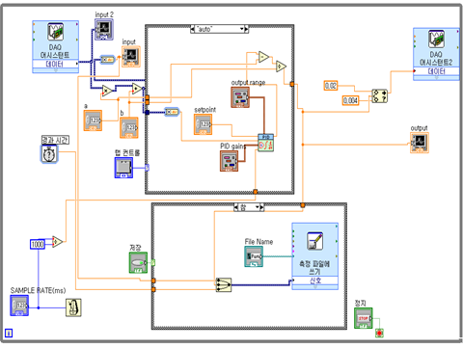
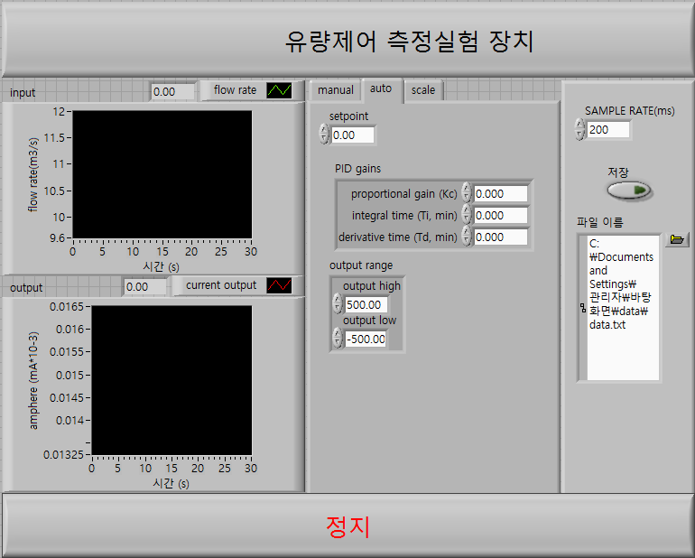
02. Composition of equipment
Composition of software (Block diagram)
Composition of software (Front panel)
10

Slide 11
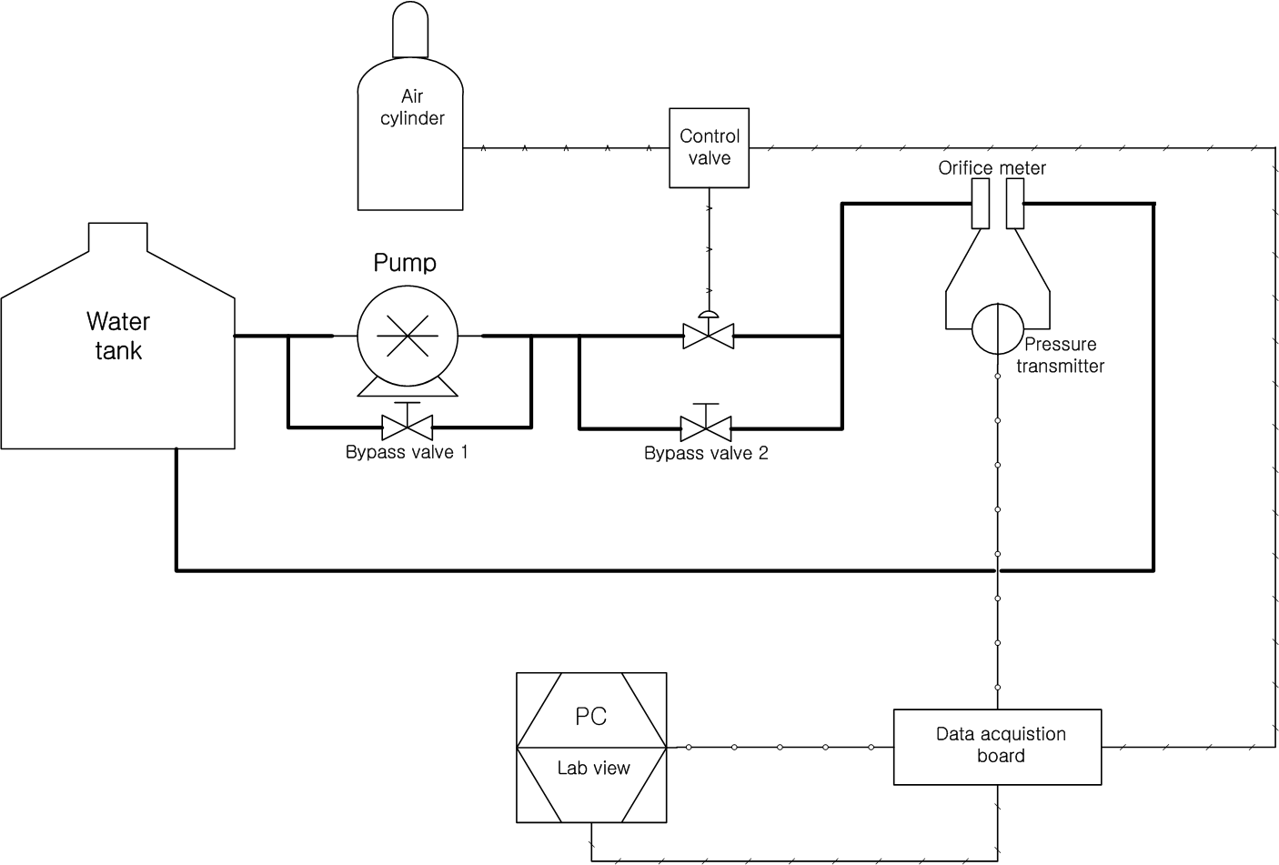
02. Composition of equipment
11

Slide 12
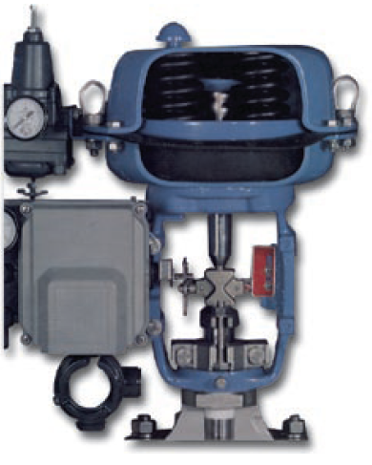
02. Composition of equipment
TYPE-300
MSD-2
XE-151
12
Air filter regulator
Maximum supply pressure : 17 bar
Output range : 0-80 bar
Effect of supply pressure variation :Less them 0.01 bar

Slide 13
02. Composition of equipment
TYPE-300
MSD-2
XE-151
∙ Pneumatic positioner
∙ Supply electric current range : 4- 20 mA
∙ Supply pressure range : 1.4~7 bar
∙ Air filter regulator
∙ Maximum supply pressure : 17 bar
∙Output range : 0-8 bar
∙ Multi spring diaphragm
∙ Air to open
∙ Spring range : 0.2-1.0 bar
∙ Max supply pressure : 1.4 bar
13
Air filter regulator
Maximum supply pressure : 17 bar
Output range : 0-80 bar
Effect of supply pressure variation :Less them 0.01 bar

Slide 14
03
Simulation results

Slide 15
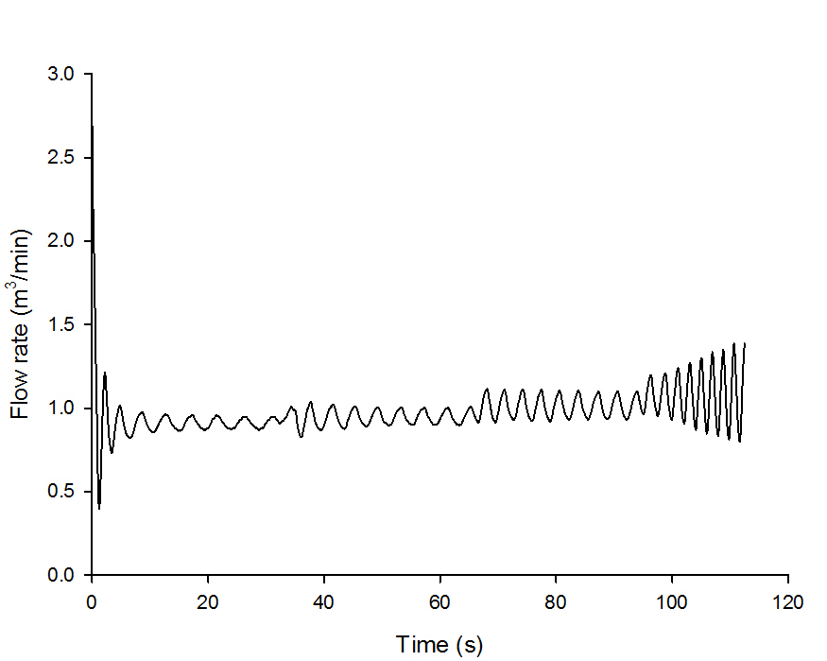
03. Simulation results
Setting the PID parameters using Ziegler-Nichols tuning method
SP = 1.2 m³/min
 | K_{C} | τ_{I}(min) | τ_{D}(min)
P controller | 3.5000 | - | -
PI controller | 3.1818 | 0.03091 | -
PID controller | 4.1176 | 0.01862 | 0.004655
K_{U}= 5
K_{U}= 6
K_{U}= 7
K_{U}= 8
1
15

Slide 16
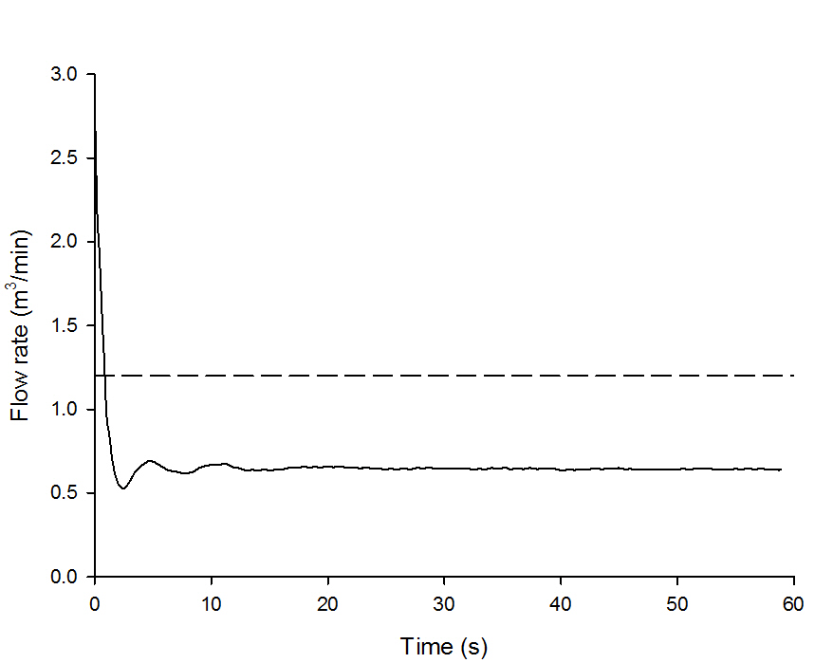
03. Simulation results
P control using Ziegler-Nichols tuning method
SP = 1.2 m³/min
K_{C} = 3.5
 | K_{C} | τ_{I}(min) | τ_{D}(min)
P controller | 3.5000 | - | -
PI controller | 3.1818 | 0.03091 | -
PID controller | 4.1176 | 0.01862 | 0.004655
Set point
Off set
16

Slide 17
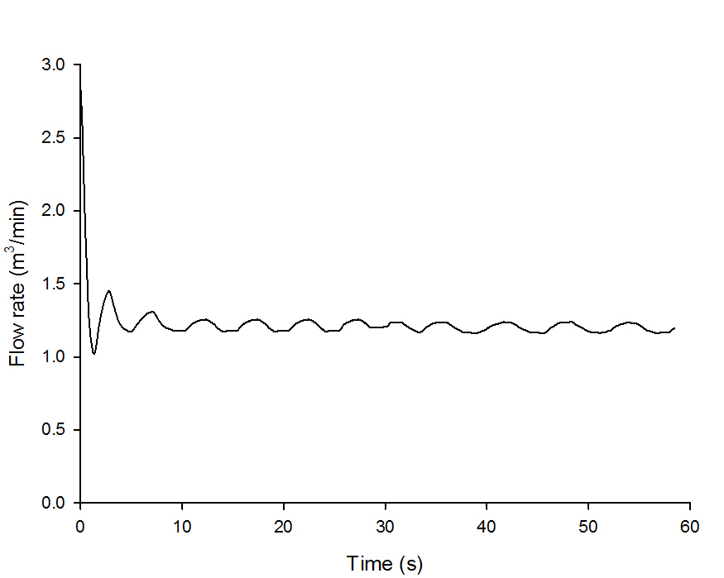
03. Simulation results
PI control using Ziegler-Nichols tuning method
SP = 1.2 m³/min
K_{C} = 3.2
τ_{I} = 0.03091 min
 | K_{C} | τ_{I} (min) | τ_{D}(min)
P controller | 3.5000 | - | -
PI controller | 3.1818 | 0.03091 | -
PID controller | 4.1176 | 0.01862 | 0.004655
17

Slide 18
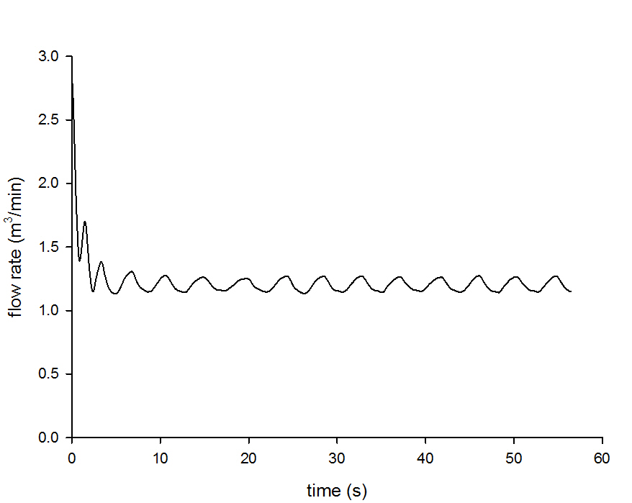
03. Simulation results
PID control using Ziegler-Nichols tuning method
SP = 1.2 m³/min
K_{C} = 4.12
τ_{I} = 0.01862 min
τ_{D} = 0.00466 min
 | K_{C} | τ_{I} (min) | τ_{D}(min)
P controller | 3.5000 | - | -
PI controller | 3.1818 | 0.03091 | -
PID controller | 4.1176 | 0.01862 | 0.004655
18

Slide 19
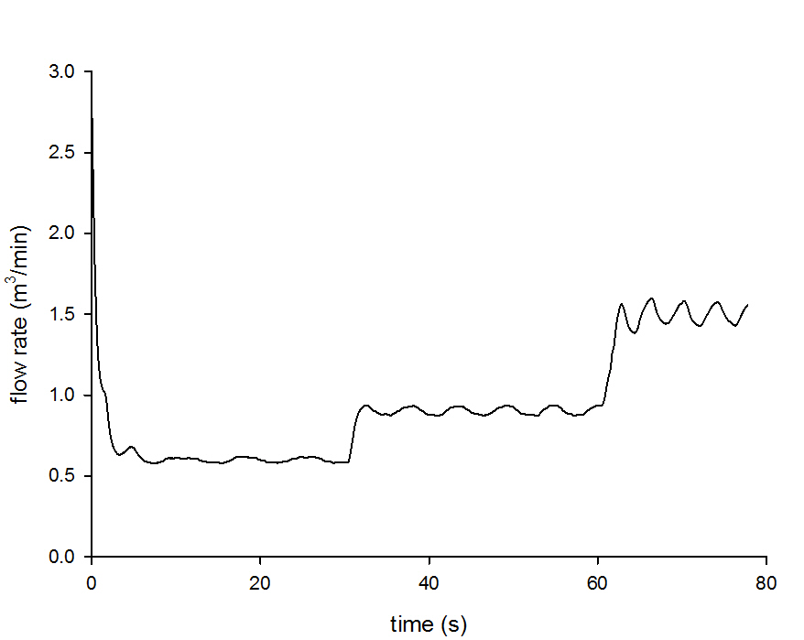
03. Simulation results
Set point change
SP = 1.2 m³/min
K_{C} = 4.12
τ_{I} = 0.01862 min
τ_{D} = 0.00466 min
SP = 1.5 m³/min
SP = 0.9 m³/min
SP = 0.6 m³/min
19

Slide 20
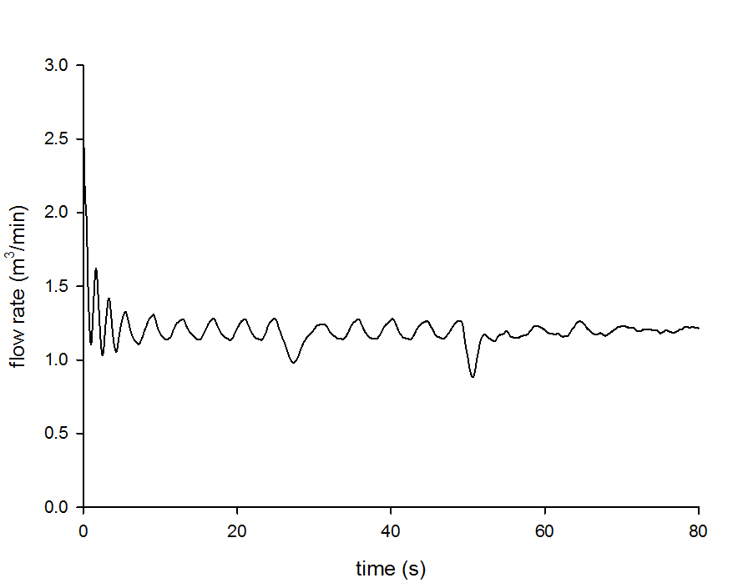
03. Simulation results
Disturbance change
SP = 1.2 m³/min
K_{C} = 4.12
τ_{I} = 0.01862 min
τ_{D} = 0.00466 min
33 % change
67 % change
20

Slide 21
04
Conclusion

Slide 22
04. Conclusion
P control | Confirmation of offset
PI control | Offset elimination
PID control | Offset elimination and faster response than PI control
Set point change | Stable response
Disturbance change | Stable response
22

Slide 23
04. Conclusion
PID control by Ziegler-Nichols tuning method was successful
to control the flow rate
Software
Hardware
23

Slide 24
Thank You!
Any Question?

