Slide 1
CSC 680 Advanced Computer Algorithms
LECTURE 7. Single-Source Shortest Paths

Slide 2
Agenda
Single-Source Shortest Paths
Properties of shortest paths
Dijkstra’s algorithm
Correctness
Analysis
Breadth-first search

Slide 3

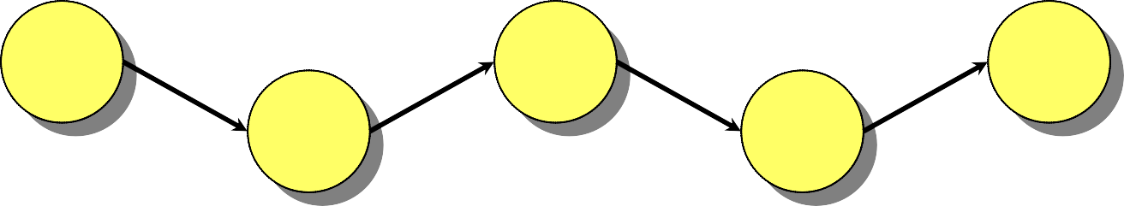
Paths in Graphs
Consider a digraph G = (V, E) with edge-weight function w : E → R. The weight of path p = v₁ → v₂ → … → v_{k} is defined to be
k −1
w( p) = ∑ w(v_{i} , v_{i+1}) .
i=1
Example:
v ₁ v₃
v₅
4 –2 –5 1
v₂ v₄
w(p) = –2

Slide 4
Shortest Paths
A shortest path from u to v is a path of minimum weight from u to v. The shortest- path weight from u to v is defined as
δ(u, v) = min{w(p) : p is a path from u to v}.
Note: δ(u, v) = ∞ if no path from u to v exists.

Slide 5

Optimal Substructure
Theorem. A subpath of a shortest path is a shortest path.
Proof. Cut and paste:

Slide 6
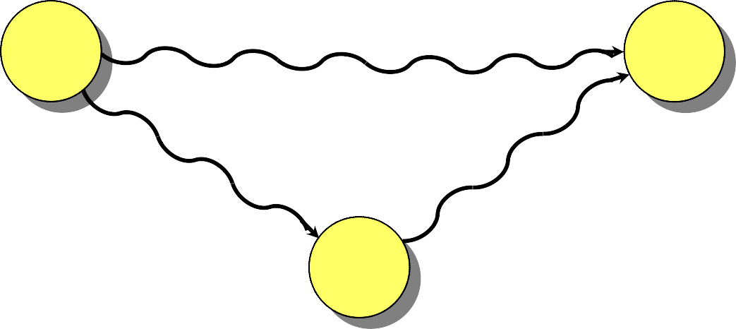
Triangle Inequality
Theorem. For all u, v, x ∈ V, we have
δ(u, v) ≤ δ(u, x) + δ(x, v).
Proof.
δ(u, v)
u
v
δ(u, x)
δ(x, v)
x

Slide 7
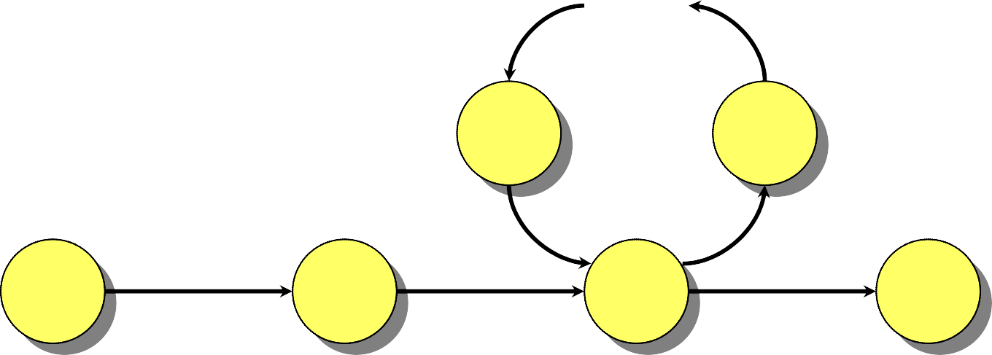
Well-Definedness of Shortest Paths
If a graph G contains a negative-weight cycle, then some shortest paths may not exist.
Example:
…
< 0
u
v

Slide 8
Single-Source Shortest Paths
Problem. From a given source vertex s ∈ V, find the shortest-path weights δ(s, v) for all v ∈ V.
If all edge weights w(u, v) are nonnegative, all shortest-path weights must exist.
IDEA: Greedy.
Maintain a set S of vertices whose shortest- path distances from s are known.
At each step add to S the vertex v ∈ V – S
whose distance estimate from s is minimal.
Update the distance estimates of vertices adjacent to v.

Slide 9
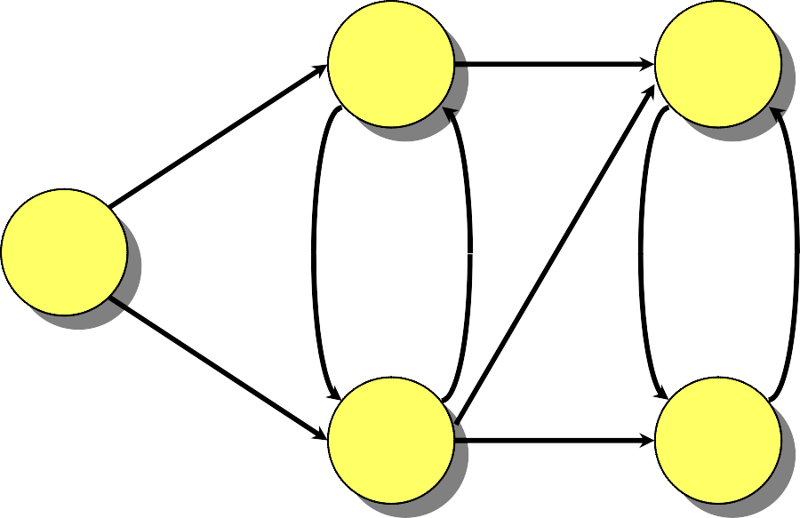
Example of Dijkstra’s Algorithm
Graph with nonnegative edge weights:
2
B
D
10
A
8
1 4
7 9
3
C
E
2

Slide 10
Example of Dijkstra’s Algorithm
∞
∞
D
Initialize:
2
B
10
A
8
0
1 4
7 9
3
Q: A B C D E
0 ∞ ∞ ∞ ∞
C
∞
E
∞
2
S: {}

Slide 11
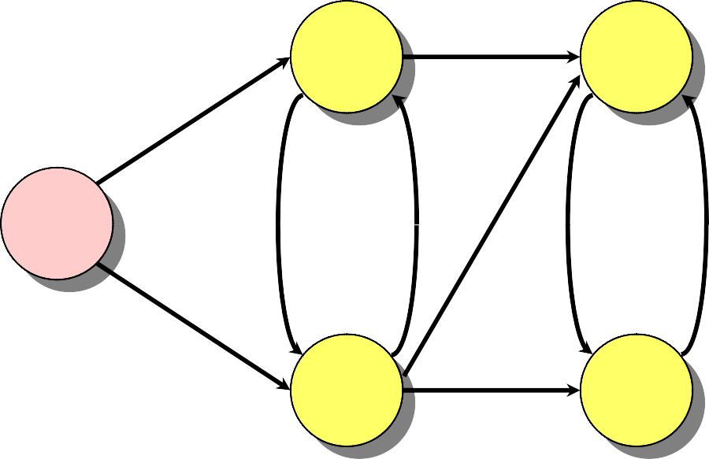
Example of Dijkstra’s Algorithm
∞
B
∞
D
“A” ← EXTRACT-MIN(Q):
10
2
0
A
8
1 4
7 9
3
Q: A B C D E
0 ∞ ∞ ∞ ∞
C
∞
E
∞
2
S: { A }

Slide 12
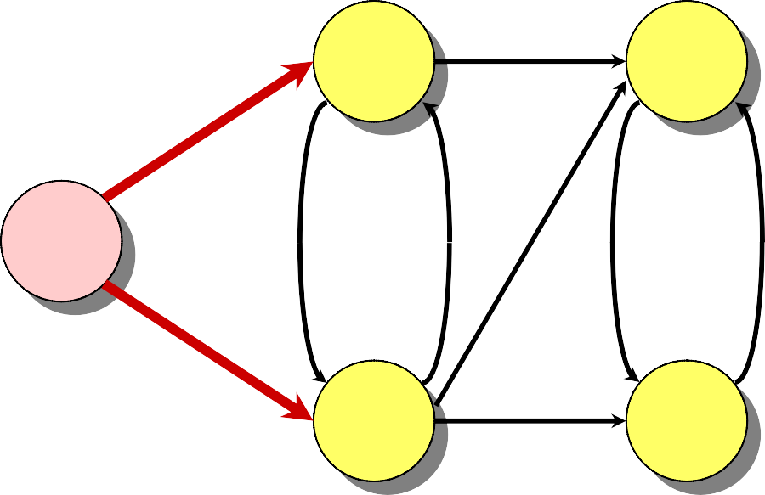
Example of Dijkstra’s Algorithm
10
B
∞
D
Relax all edges leaving A:
10
2
0
A
8
1 4
7 9
3
Q: A B C D E
C
3
E
∞
2
0 ∞ ∞ ∞ ∞
10 3 ∞ ∞
S: { A }

Slide 13
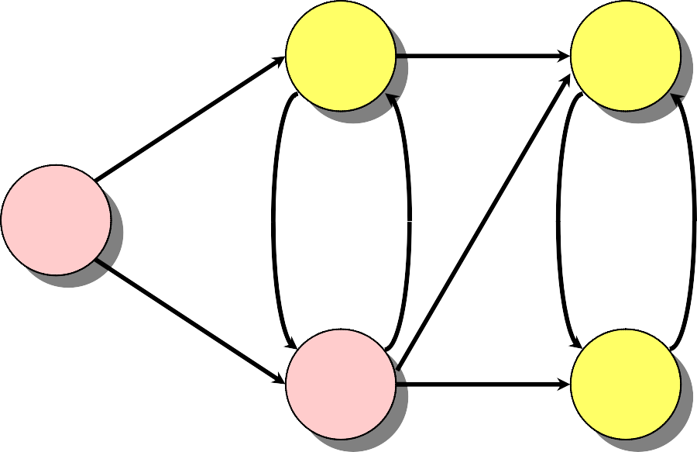
Example of Dijkstra’s Algorithm
10
B
∞
D
“C” ← EXTRACT-MIN(Q):
10
2
A
8
0
1 4
7 9
3
Q: A B C D E
C
3
E
∞
2
0 ∞ ∞ ∞ ∞
10 3 ∞ ∞
S: { A, C }

Slide 14
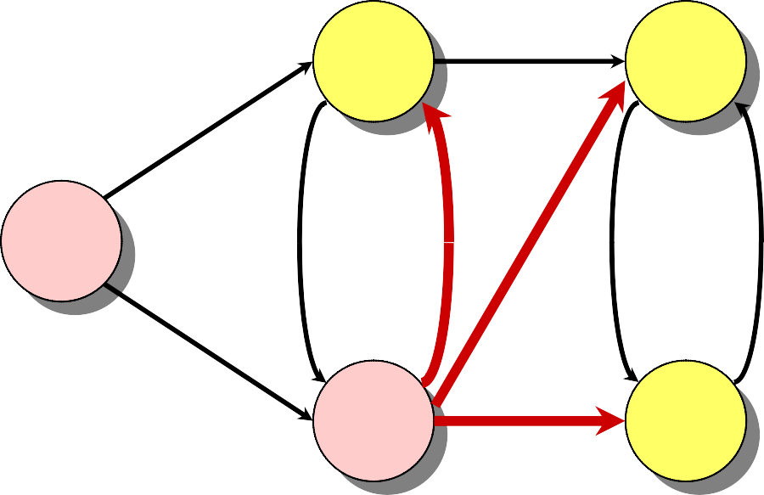
Example of Dijkstra’s Algorithm
7
B
11
D
Relax all edges leaving C:
10
2
8
0
A
1 4
7 9
3
Q: A B C D E
C
3
E
5
2
0 ∞ ∞ ∞ ∞
10 3 ∞ ∞
7 11 5
S: { A, C }

Slide 15
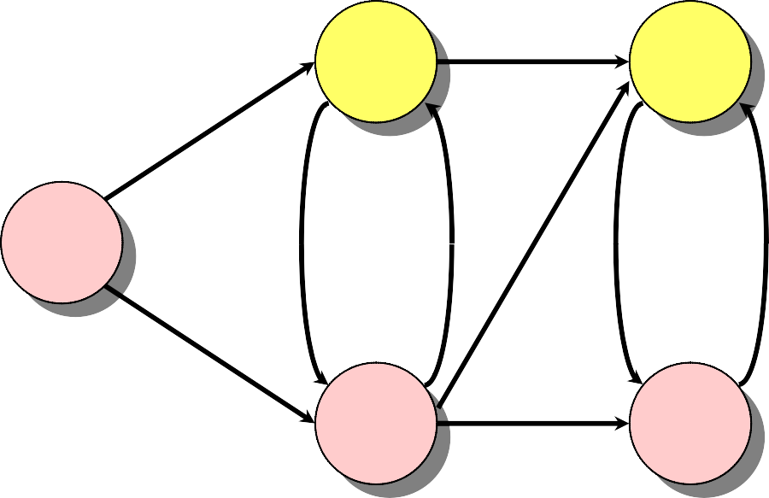
Example of Dijkstra’s Algorithm
7
B
11
D
“E” ← EXTRACT-MIN(Q):
10
2
8
0
A
1 4
7 9
3
Q: A B C D E
C
3
E
5
2
0 ∞ ∞ ∞ ∞
10 3 ∞ ∞
7 11
5
S: { A, C, E }

Slide 16
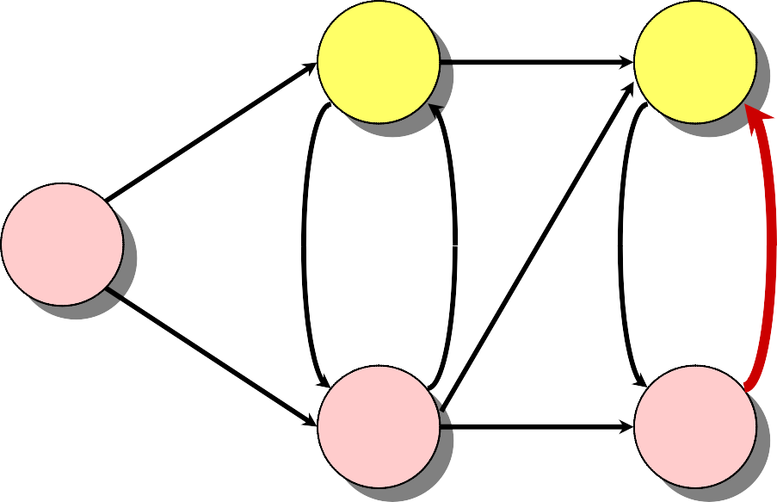
Example of Dijkstra’s Algorithm
7
B
11
D
Relax all edges leaving E:
10
2
8
0
A
1 4
7 9
3
Q: A B C D E
C
3
E
5
2
0 ∞ ∞ ∞ ∞
10 3 ∞ ∞
7 11
7 11
5
S: { A, C, E }

Slide 17
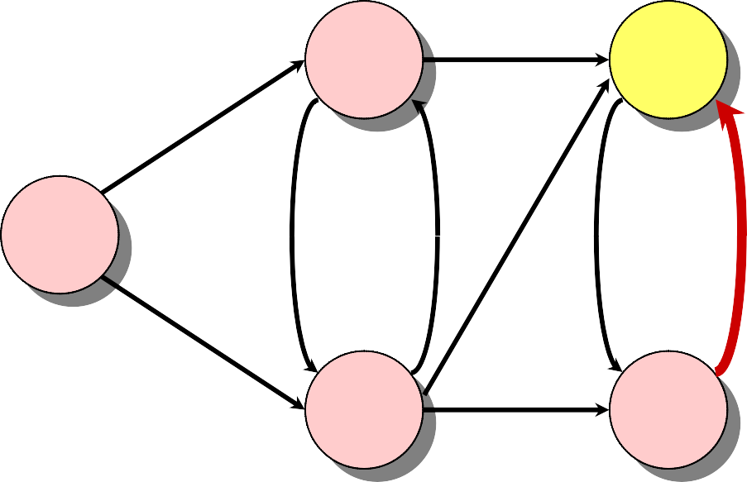
Example of Dijkstra’s Algorithm
7
B
11
D
“B” ← EXTRACT-MIN(Q):
10
2
8
0
A
1 4
7 9
3
Q: A B C D E
C
3
E
5
2
0 | ∞ | ∞ | ∞ | ∞
 | 10 | 3 | ∞ | ∞
 | 7 |  | 11 | 5
 | 7 |  | 11
S: { A, C, E, B }

Slide 18
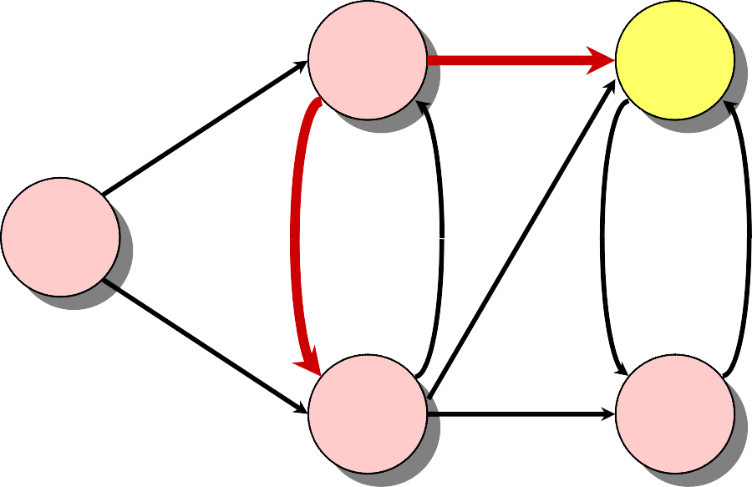
Example of Dijkstra’s Algorithm
7
B
9
D
Relax all edges leaving B:
10
2
8
0
A
1 4
7 9
3
Q: A B C D E
C
3
E
5
2
0 ∞ ∞ ∞ ∞
10 3 ∞ ∞
7 11
11
9
5
7
S: { A, C, E, B }

Slide 19
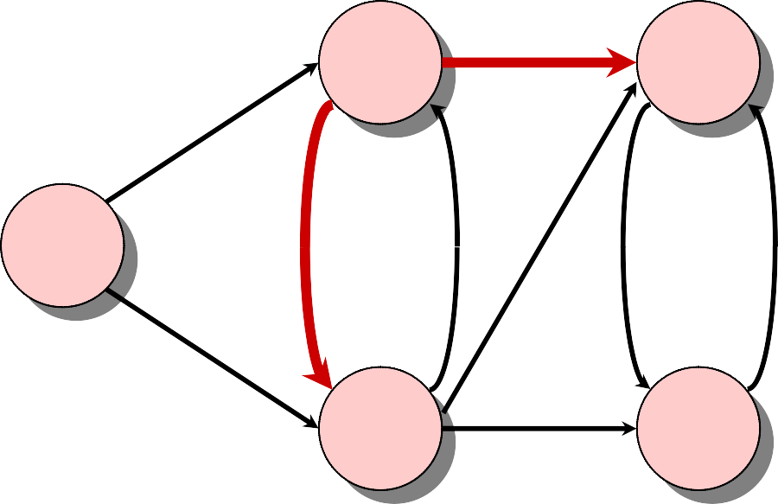
Example of Dijkstra’s Algorithm
7
B
9
D
“D” ← EXTRACT-MIN(Q):
10
2
8
0
A
1 4
7 9
Q: A B C D E
3
C
3
E
5
2
0 ∞ ∞ ∞ ∞
10 3 ∞ ∞
7 11
11
5
7
S: { A, C, E, B, D }
9

Slide 20
Dijkstra’s algorithm
d[s] ← 0
for each v ∈ V – {s}
do d[v] ← ∞
S ← ∅
Q ← V
⊳ Q is a priority queue maintaining V – S

Slide 21
Dijkstra’s Algorithm
d[s] ← 0
for each v ∈ V – {s}
do d[v] ← ∞
S ← ∅
Q ← V
while Q ≠ ∅
⊳ Q is a priority queue maintaining V – S
do u ← EXTRACT-MIN(Q)
S ← S ∪ {u}
for each v ∈ Adj[u]
do if d[v] > d[u] + w(u, v)
then d[v] ← d[u] + w(u, v)

Slide 22
Dijkstra’s Algorithm
d[s] ← 0
for each v ∈ V – {s}
do d[v] ← ∞
S ← ∅
Q ← V
while Q ≠ ∅
⊳ Q is a priority queue maintaining V – S
do u ← EXTRACT-MIN(Q)
S ← S ∪ {u}
for each v ∈ Adj[u]
do if d[v] > d[u] + w(u, v)
then d[v] ← d[u] + w(u, v)
relaxation step
Implicit DECREASE-KEY

Slide 23
Correctness — Part I
Lemma 1. Initializing d[s] ← 0 and d[v] ← ∞ for all v ∈ V – {s} establishes d[v] ≥ δ(s, v) for all v ∈ V, and this invariant is maintained over any sequence of relaxation steps.

Slide 24
Correctness — Part I
Lemma 1. Initializing d[s] ← 0 and d[v] ← ∞ for all v ∈ V – {s} establishes d[v] ≥ δ(s, v) for all v ∈ V, and this invariant is maintained over any sequence of relaxation steps.
Proof. Suppose not. Let v be the first vertex for
which d[v] < δ(s, v), and let u be the vertex that caused d[v] to change: d[v] = d[u] + w(u, v). Then,
d[v] < δ(s, v)
≤ δ(s, u) + δ(u, v)
≤ δ(s,u) + w(u, v)
≤ d[u] + w(u, v)
supposition triangle inequality
sh. path ≤ specific path
v is first violation
Contradiction.

Slide 25
Correctness — Part II
Lemma 2. Let u be v’s predecessor on a shortest path from s to v. Then, if d[u] = δ(s, u) and edge (u, v) is relaxed, we have d[v] = δ(s, v) after the relaxation.

Slide 26
Correctness — Part II
Lemma 2. Let u be v’s predecessor on a shortest path from s to v. Then, if d[u] = δ(s, u) and edge (u, v) is relaxed, we have d[v] = δ(s, v) after the relaxation.
Proof. Observe that δ(s, v) = δ(s, u) + w(u, v). Suppose that d[v] > δ(s, v) before the relaxation. (Otherwise, we’re done.) Then, the test d[v] > d[u] + w(u, v) succeeds, because d[v] > δ(s, v) =
δ(s, u) + w(u, v) = d[u] + w(u, v), and the algorithm sets d[v] = d[u] + w(u, v) = δ(s, v).

Slide 27
Correctness — Part III
Theorem. Dijkstra’s algorithm terminates with
d[v] = δ(s, v) for all v ∈ V.

Slide 28
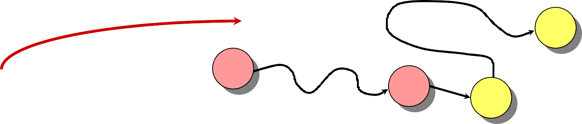
Correctness — Part III
Theorem. Dijkstra’s algorithm terminates with
d[v] = δ(s, v) for all v ∈ V.
Proof. It suffices to show that d[v] = δ(s, v) for every v ∈ V when v is added to S. Suppose u is the first vertex added to S for which d[u] > δ(s, u). Let y be the first vertex in V – S along a shortest path from s to u, and let x be its predecessor:
u
s
x
S, just before adding u.
y
Notes:
y cannot be u, since otherwise d[u] = δ(s, u) by the previous Lemma.

Slide 29
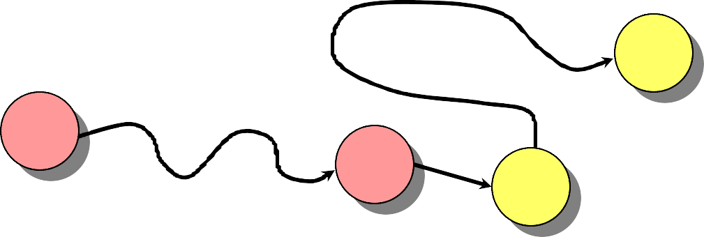
Correctness — Part III (cont’d)
S
u
s
x
y
Since u is the first vertex violating the claimed invariant, we have d[x] = δ(s, x). When x was added to S, the edge (x, y) was relaxed, which implies that d[y] = δ(s, y) ≤ δ(s, u) < d[u]. But, d[u] ≤ d[y] by our choice of u. Contradiction.
Notes:
At the time u is being added into S, d[u] is the smallest value in the priority queue.

Slide 30
Analysis of Dijkstra
while Q ≠ ∅
do u ← EXTRACT-MIN(Q)
S ← S ∪ {u}
for each v ∈ Adj[u]
do if d[v] > d[u] + w(u, v)
then d[v] ← d[u] + w(u, v)

Slide 31
Analysis of Dijkstra
while Q ≠ ∅
do u ← EXTRACT-MIN(Q)
S ← S ∪ {u}
for each v ∈ Adj[u]
do if d[v] > d[u] + w(u, v)
then d[v] ← d[u] + w(u, v)
|V |
times

Slide 32
Analysis of Dijkstra
while Q ≠ ∅
do u ← EXTRACT-MIN(Q)
S ← S ∪ {u}
|V |
times
for each v ∈ Adj[u]
do if d[v] > d[u] + w(u, v)
then d[v] ← d[u] + w(u, v)
degree(u) times

Slide 33
Analysis of Dijkstra
while Q ≠ ∅
do u ← EXTRACT-MIN(Q)
S ← S ∪ {u}
|V |
times
for each v ∈ Adj[u]
do if d[v] > d[u] + w(u, v)
then d[v] ← d[u] + w(u, v)
degree(u) times
Handshaking Lemma ⇒ Θ(E) implicit DECREASE-KEY’s.

Slide 34
Analysis of Dijkstra
while Q ≠ ∅
do u ← EXTRACT-MIN(Q)
S ← S ∪ {u}
|V |
times
for each v ∈ Adj[u]
do if d[v] > d[u] + w(u, v)
then d[v] ← d[u] + w(u, v)
degree(u) times
Handshaking Lemma ⇒ Θ(E) implicit DECREASE-KEY’s.
^{Time = Θ(V·T}EXTRACT-MIN ^{+ E·T}DECREASE-KEY⁾
Note: Same formula as in the analysis of Prim’s minimum spanning tree algorithm.

Slide 35
Analysis of Dijkstra (cont’d)
^{Time = Θ(V)·T}EXTRACT-MIN ^{+ Θ(E)·T}DECREASE-KEY
Q
^{T}EXTRACT-MIN ^{T}DECREASE-KEY
Total

Slide 36
Analysis of Dijkstra (cont’d)
^{Time = Θ(V)·T}EXTRACT-MIN ^{+ Θ(E)·T}DECREASE-KEY
Q
^{T}EXTRACT-MIN ^{T}DECREASE-KEY O(V) O(1)
Total
array
O(V²)

Slide 37
Analysis of Dijkstra (cont’d)
^{Time = Θ(V)·T}EXTRACT-MIN ^{+ Θ(E)·T}DECREASE-KEY
Q
^{T}EXTRACT-MIN ^{T}DECREASE-KEY O(V) O(1)
O(lg V) O(lg V)
Total
array
binary heap
O(V²)
O(E lg V)

Slide 38
Analysis of Dijkstra (cont’d)
^{Time = Θ(V)·T}EXTRACT-MIN ^{+ Θ(E)·T}DECREASE-KEY
Q
^{T}EXTRACT-MIN ^{T}DECREASE-KEY
Total
array
binary heap
Fibonacci heap
O(V) O(1)
O(lg V) O(lg V)
O(V²)
O(E lg V)
O(lg V) amortized
O(1)
amortized
O(E + V lg V)
worst case

Slide 39
Unweighted Graphs
Suppose that w(u, v) = 1 for all (u, v) ∈ E. Can Dijkstra’s algorithm be improved?

Slide 40
Unweighted graphs
Suppose that w(u, v) = 1 for all (u, v) ∈ E. Can Dijkstra’s algorithm be improved?
Use a simple FIFO queue instead of a priority queue.

Slide 41
Unweighted Graphs
Suppose that w(u, v) = 1 for all (u, v) ∈ E. Can Dijkstra’s algorithm be improved?
Use a simple FIFO queue instead of a priority queue.
Breadth-first search
while Q ≠ ∅
do u ← DEQUEUE(Q)
for each v ∈ Adj[u]
do if d[v] = ∞
then d[v] ← d[u] + 1 ENQUEUE(Q, v)

Slide 42
Unweighted Graphs
Suppose that w(u, v) = 1 for all (u, v) ∈ E. Can Dijkstra’s algorithm be improved?
Use a simple FIFO queue instead of a priority queue.
Breadth-first search
while Q ≠ ∅
do u ← DEQUEUE(Q)
for each v ∈ Adj[u]
do if d[v] = ∞
then d[v] ← d[u] + 1 ENQUEUE(Q, v)
Analysis: Time = O(V + E).

Slide 43
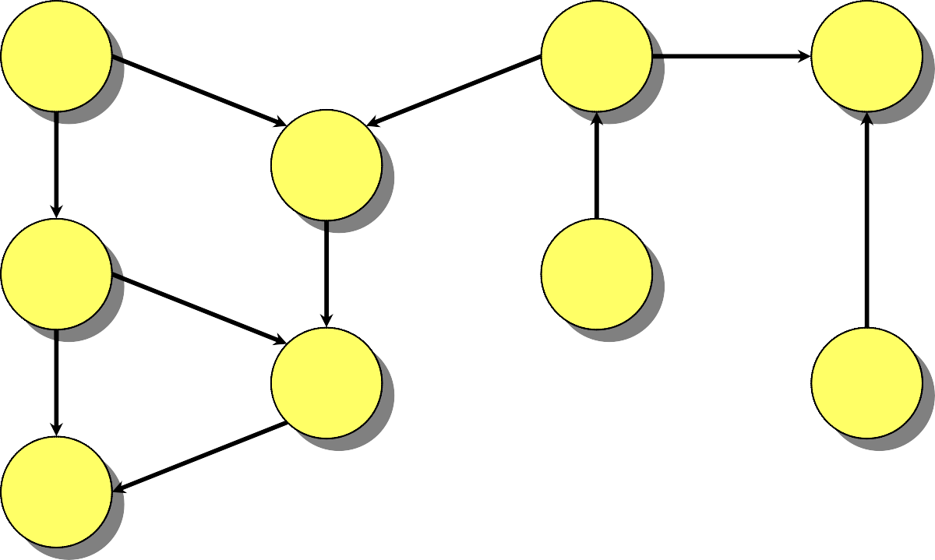
Example of Breadth-First Search
a
f
h
d
b
g
e
i
c
Q:

Slide 44
Example of Breadth-First Search
0
a
f
h
d
b
g
e
i
c
0
Q: a

Slide 45
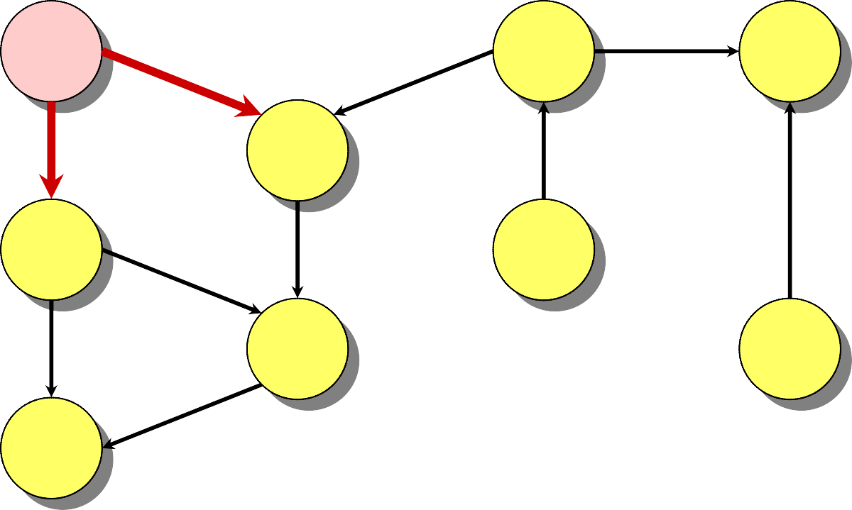
Example of Breadth-First Search
0
a
f
h
1
d
1
b
g
e
i
c
1 1
Q: a b d

Slide 46
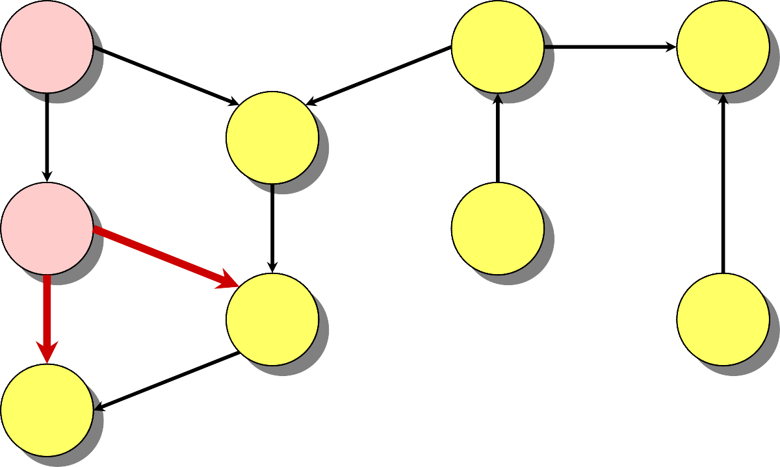
Example of Breadth-First Search
0
a
f
h
1
d
1
b
g
e
i
2
1 2 2
2
c
Q: a b d c e

Slide 47
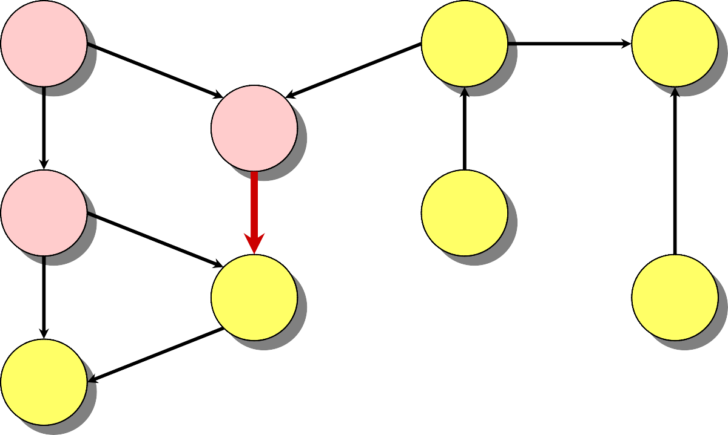
Example of Breadth-First Search
0
a
f
h
1
d
1
b
g
e
i
2
2
c
2 2
Q: a b d c e

Slide 48
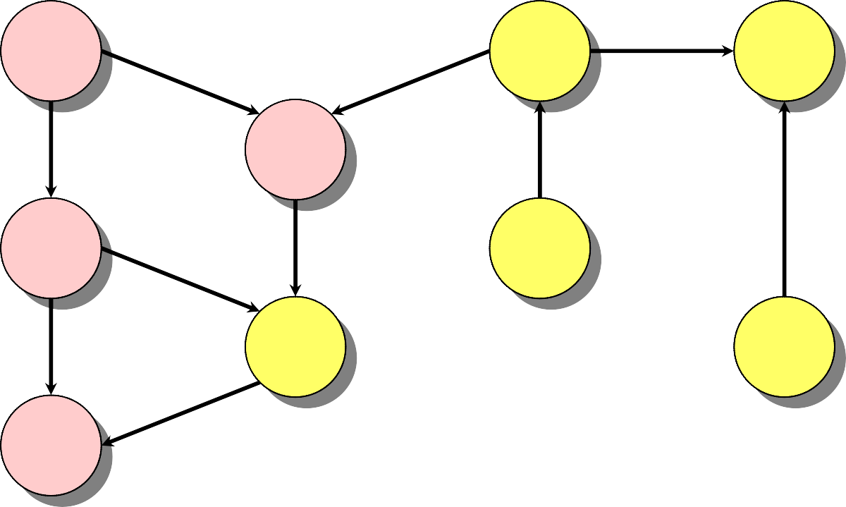
Example of Breadth-First Search
0
a
f
h
1
d
1
b
g
e
i
2
2
c
2
Q: a b d c e

Slide 49
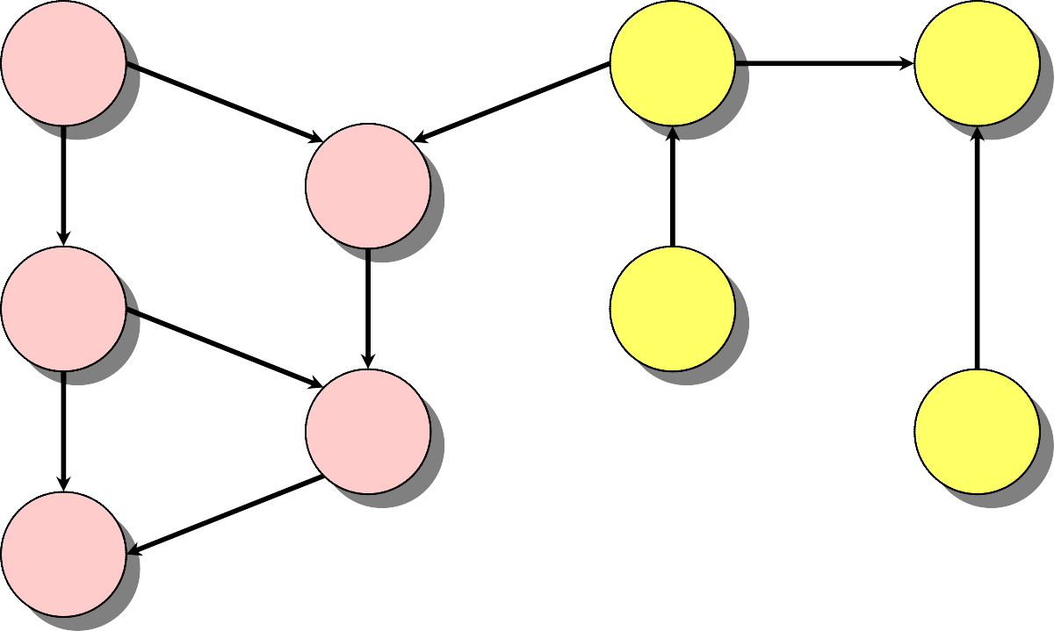
Example of Breadth-First Search
0
a f h
1
d
3
1
b
g
e
2
i
3
2
c
3 3
Q: a b d c e g i

Slide 50
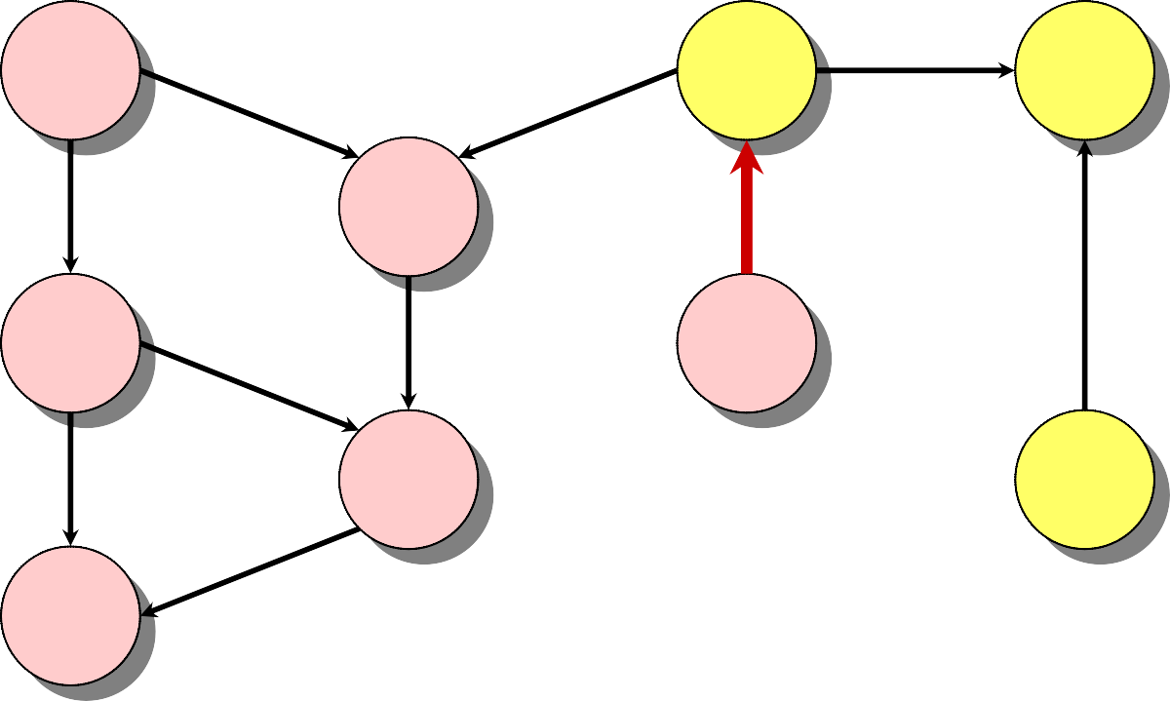
Example of Breadth-First Search
4
0
a f h
1
d
3
1
b
g
e
2
i
3
2
c
3 4
Q: a b d c e g i f

Slide 51
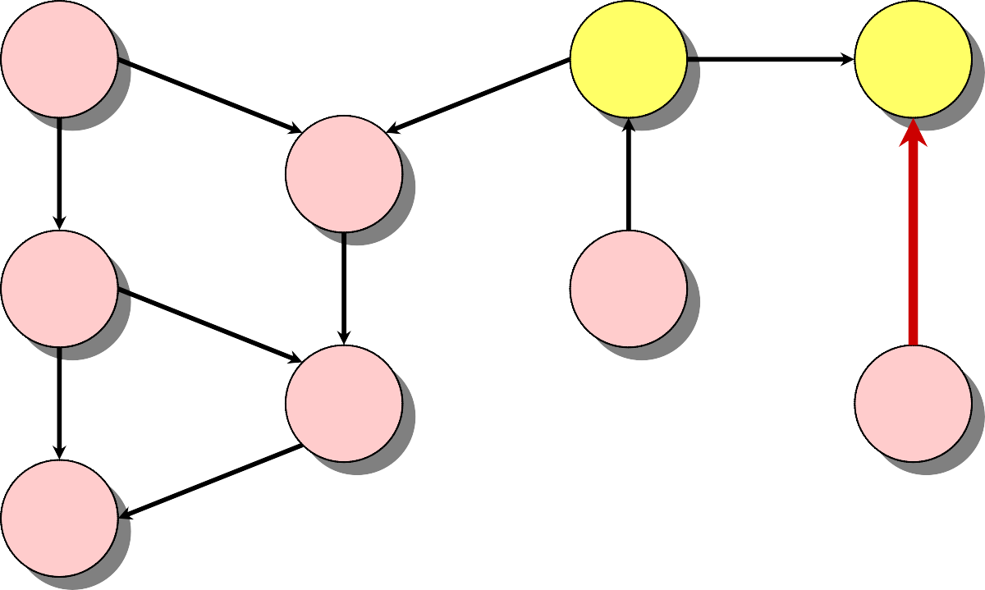
Example of Breadth-First Search
4
f
4
h
0
a
1
d
3
1
b
g
e
2
i
3
2
c
4 4
Q: a b d c e g i f h

Slide 52
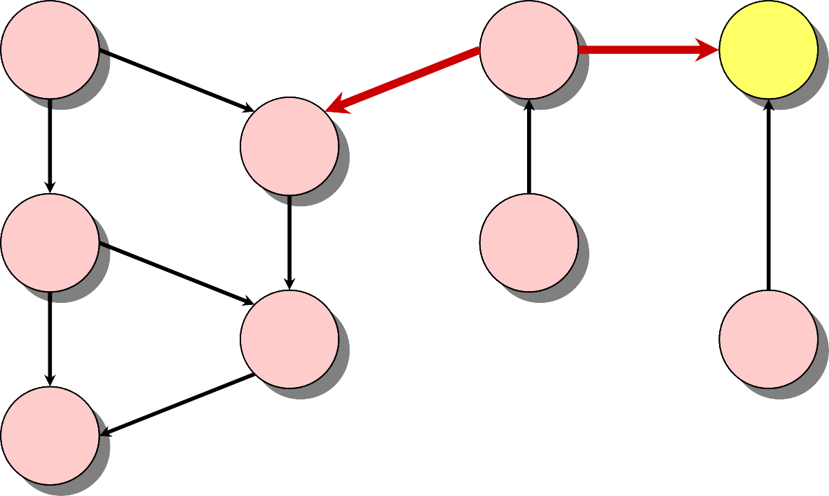
Example of Breadth-First Search
4
f
4
h
0
a
1
d
3
1
b
g
e
2
i
3
2
c
4
Q: a b d c e g i f h

Slide 53
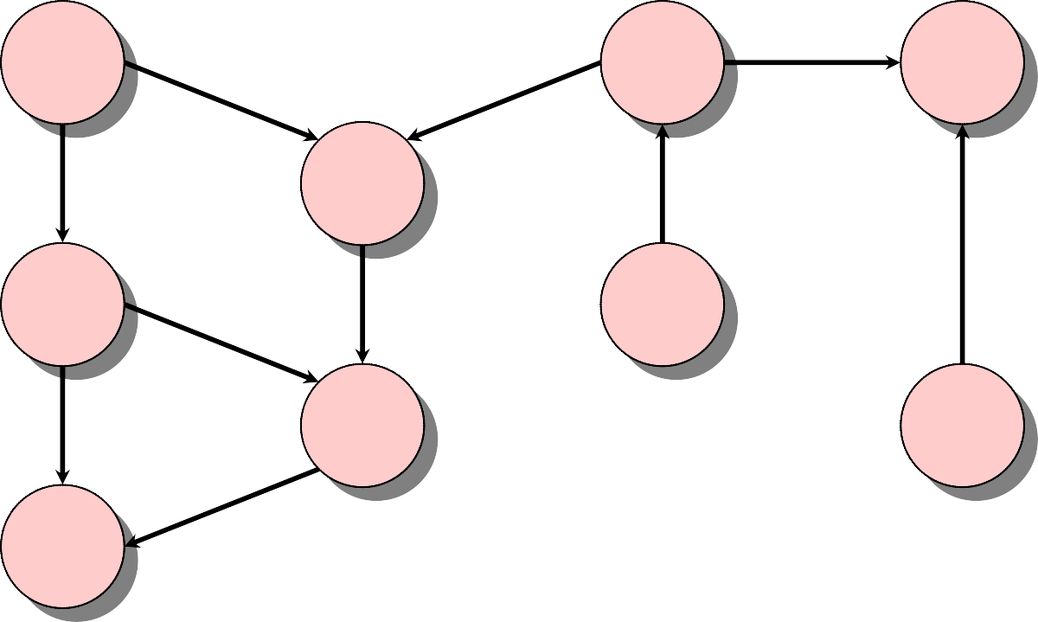
Example of Breadth-First Search
4
f
4
h
0
a
1
d
3
1
b
g
e
2
i
3
2
c
Q: a b d c e g i f h

Slide 54
Example of Breadth-First Search
4
f
4
h
0
a
1
d
3
1
b
g
e
2
i
3
2
c
Q: a b d c e g i f h

Slide 55
Correctness of BFS
while Q ≠ ∅
do u ← DEQUEUE(Q)
for each v ∈ Adj[u]
do if d[v] = ∞
then d[v] ← d[u] + 1 ENQUEUE(Q, v)
Key idea:
The FIFO Q in breadth-first search mimics the priority queue Q in Dijkstra.
Invariant: v comes after u in Q implies that
d[v] = d[u] or d[v] = d[u] + 1.

