Slide 1
CSC 580 Computer Algorithms
LECTURE 10. Balanced Search Trees

Slide 2
Agenda
Balanced Search Trees
Red-black trees
Height of a red-black tree
Rotations
Insertion

Slide 3
Balanced Search Trees
The height of a binary search tree can be O(n).
Balanced search tree: A search-tree data structure for which a height of O(lg n) is guaranteed when implementing a dynamic set of n items.
AVL trees
2-3 trees
Examples:
2-3-4 trees
B-trees
Red-black trees

Slide 4
Red-Black Trees
This data structure is a binary search tree with an extra one- bit color field in each node.
Red-black properties:
Every node is either red or black.
The root and leaves (NIL’s) are black.
If a node is red, then its parent is black.
All simple paths from any node x to a descendant leaf have the same number of black nodes = black-height(x).

Slide 5
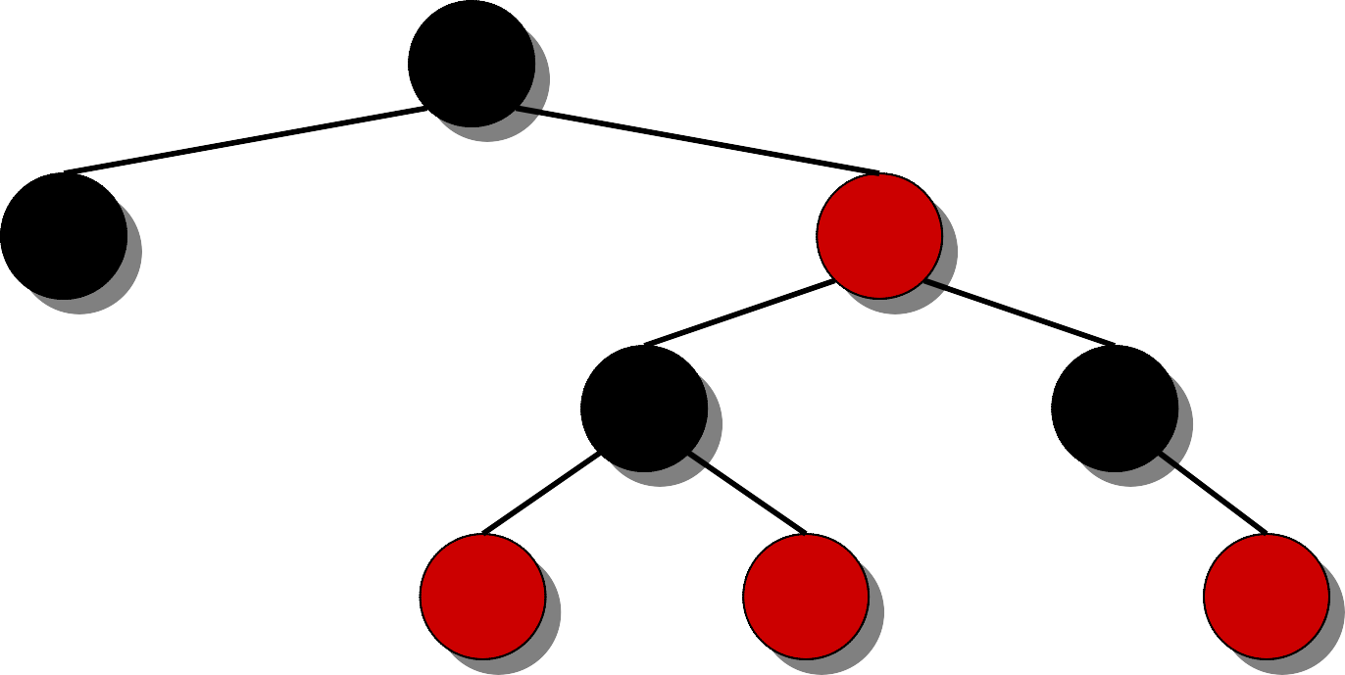
Example of a Red-Black Tree
7
bh = 2
3
18
bh = 2
NIL NIL
10
22
h = 4
bh = 1
NIL
8
NIL NIL NIL NIL NIL
bh = 1
bh = 0
11
26
NIL
4. All simple paths from any node x to a descendant leaf have the same number of black nodes = black-height(x).
1. Every node is either red or black.
2. The root and leaves (NIL’s) are black.
3. If a node is red, then its parent is black.

Slide 6
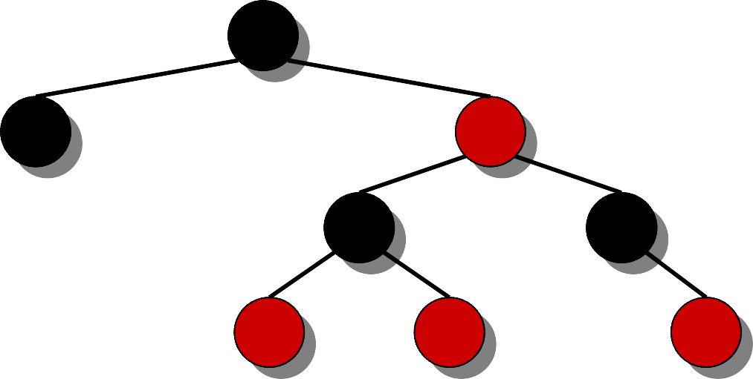
Height of a Red-Black Tree
Theorem. A red-black tree with n keys has height
h ≤ 2 lg(n + 1).
Proof. (The book uses induction. Read carefully.)
INTUITION:
Merge red nodes into their black parents.

Slide 7
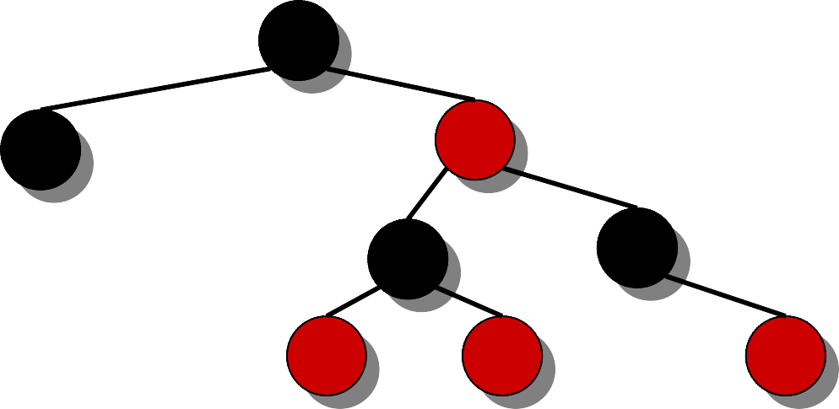
Height of a Red-Black Tree
Theorem. A red-black tree with n keys has height
h ≤ 2 lg(n + 1).
Proof. (The book uses induction. Read carefully.)
INTUITION:
Merge red nodes into their black parents.

Slide 8
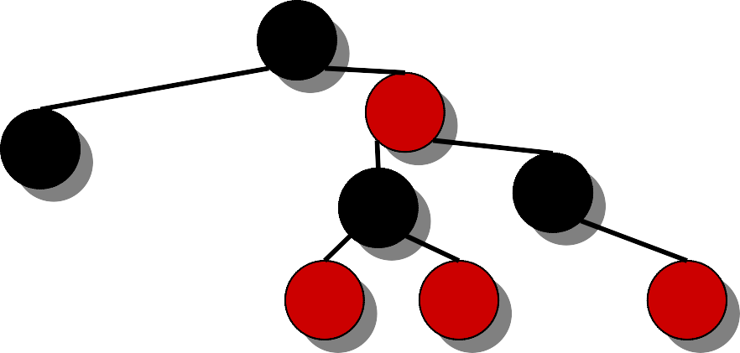
Height of a Red-Black Tree
Theorem. A red-black tree with n keys has height
h ≤ 2 lg(n + 1).
Proof. (The book uses induction. Read carefully.)
INTUITION:
Merge red nodes into their black parents.

Slide 9
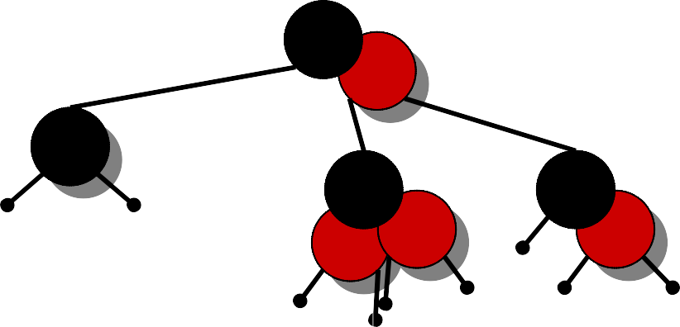
Height of a Red-Black Tree
Theorem. A red-black tree with n keys has height
h ≤ 2 lg(n + 1).
Proof. (The book uses induction. Read carefully.)
INTUITION:
Merge red nodes into their black parents.

Slide 10
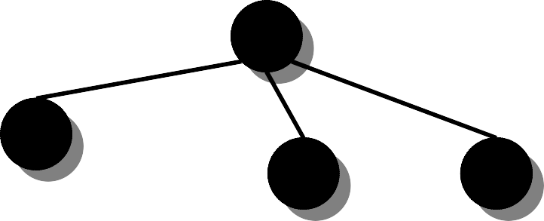
Height of a Red-Black Tree
Theorem. A red-black tree with n keys has height
h ≤ 2 lg(n + 1).
Proof. (The book uses induction. Read carefully.)
INTUITION:
Merge red nodes into their black parents.

Slide 11
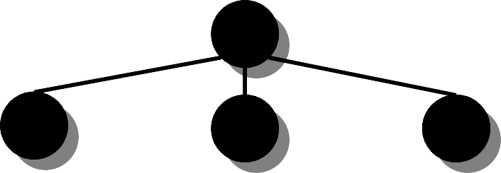
Height of a Red-Black Tree
Theorem. A red-black tree with n keys has height
h ≤ 2 lg(n + 1).
Proof. (The book uses induction. Read carefully.)
INTUITION:
Merge red nodes into their black parents.
h′
This process produces a tree in which each node has 2, 3, or 4 children.
The 2-3-4 tree has uniform depth h′ of leaves.

Slide 12


Proof (cont'd)
We have h′ ≥ h/2, since at most half the nodes on any path are red.
The number of leaves in each binary tree is n + 1
⇒ n + 1 ≥ 2^{h'}
⇒ lg(n + 1) ≥ h' ≥ h/2
⇒ h ≤ 2 lg(n + 1).
h
h′

Slide 13
Query Operations
Corollary. The queries SEARCH, MIN, MAX, SUCCESSOR, and PREDECESSOR
all run in O(lg n) time on a red-black tree with n nodes.

Slide 14
Modifying Operations
The operations INSERT and DELETE cause modifications to the red-black tree:
the operation itself,
color changes,
restructuring the links of the tree via
“rotations”.

Slide 15
Rotations
B
RIGHT-ROTATE(B)
A
A
LEFT-ROTATE(A)
B
γ
α
α
β
β
γ
Rotations maintain the inorder ordering of keys:
• a ∈ α, b ∈ β, c ∈ γ ⇒ a ≤ A ≤ b ≤ B ≤ c.
A rotation can be performed in O(1) time.

Slide 16
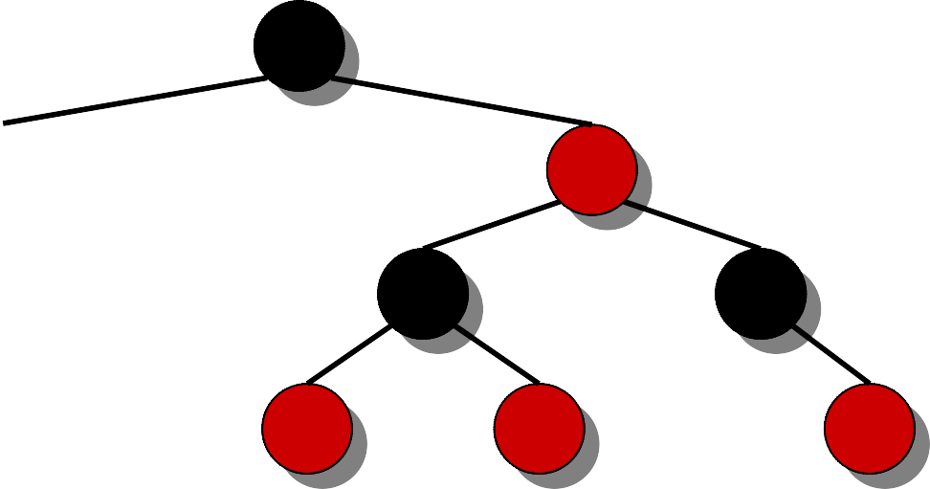
Insertion into a Red-Black Tree
IDEA: Insert x in tree. Color x red. Only red- black property 3 might be violated. Move the violation up the tree by recoloring until it can be fixed with rotations and recoloring.
7
Example:
Insert x =15.
3
18
Recolor, moving the violation up the tree.
10
22
8
11
26
15

Slide 17
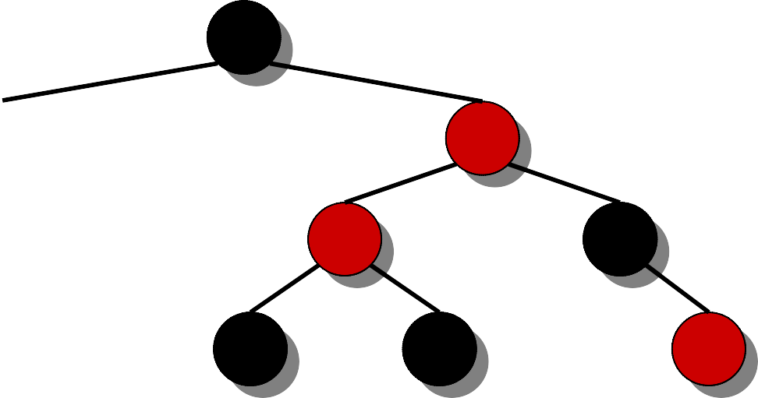
Insertion into a Red-Black Tree
IDEA: Insert x in tree. Color x red. Only red- black property 3 might be violated. Move the violation up the tree by recoloring until it can be fixed with rotations and recoloring.
7
Example:
Insert x =15.
3
18
Recolor, moving the violation up the tree.
RIGHT-ROTATE(18).
10
22
8
11
26
15

Slide 18
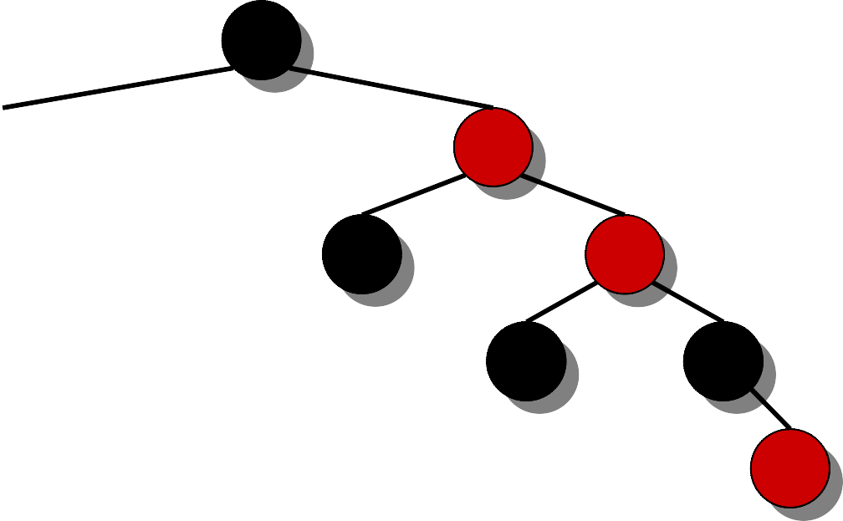
Insertion into a Red-Black Tree
IDEA: Insert x in tree. Color x red. Only red- black property 3 might be violated. Move the violation up the tree by recoloring until it can be fixed with rotations and recoloring.
7
Example:
Insert x =15.
3
10
Recolor, moving the violation up the tree.
RIGHT-ROTATE(18).
LEFT-ROTATE(7) and recolor.
8
18
11
15
22
26

Slide 19
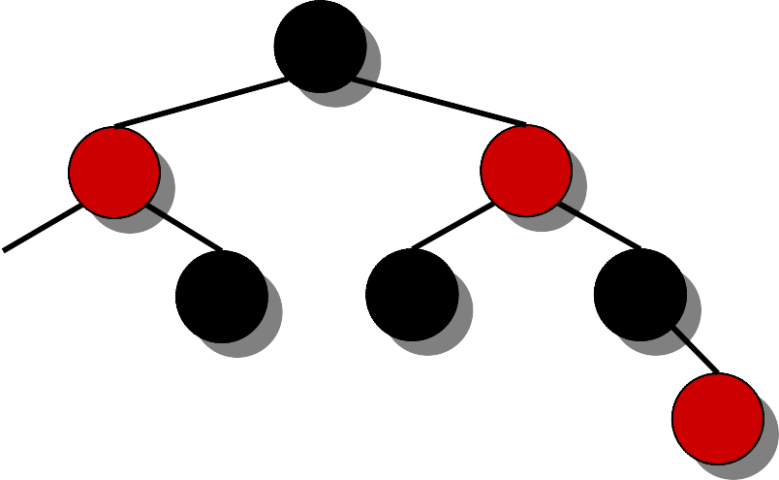
Insertion into a Red-Black Tree
IDEA: Insert x in tree. Color x red. Only red- black property 3 might be violated. Move the violation up the tree by recoloring until it can be fixed with rotations and recoloring.
10
Example:
Insert x =15.
Recolor, moving the violation up the tree.
7
18
3
8
11
15
22
26
• RIGHT-ROTATE(18).
• LEFT-ROTATE(7) and recolor.

Slide 20
Pseudo Code
RB-INSERT(T, x) TREE-INSERT(T, x)
color[x] ← RED
⊳ only RB property 3 can be violated
while x ≠ root[T] and color[p[x]] = RED
do if p[x] = left[p[p[x]]
then y ← right[p[p[x]] if color[y] = RED then ⟨Case 1⟩
else if x = right[p[x]]
then ⟨Case 2⟩
⟨Case 3⟩
⊳ y = aunt/uncle of x
⊳ Case 2 falls into Case 3
else ⟨“then” clause with “left” and “right” swapped⟩
color[root[T]] ← BLACK

Slide 21
Graphical Notation
Let denote a subtree with a black root.
All ’s have the same black-height.

Slide 22
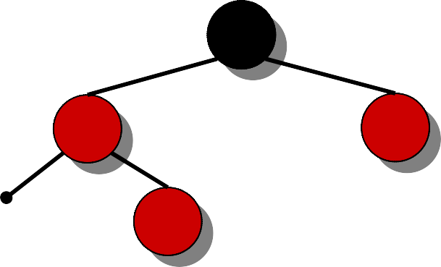
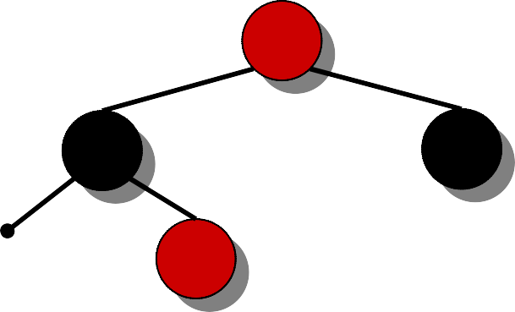
Case 1
Recolor
C
C
new x
D
A
x
D
y
A
B
B
(Or, children of
A are swapped.)
Push C’s black onto A and D, and recurse, since C’s parent may be red.

Slide 23
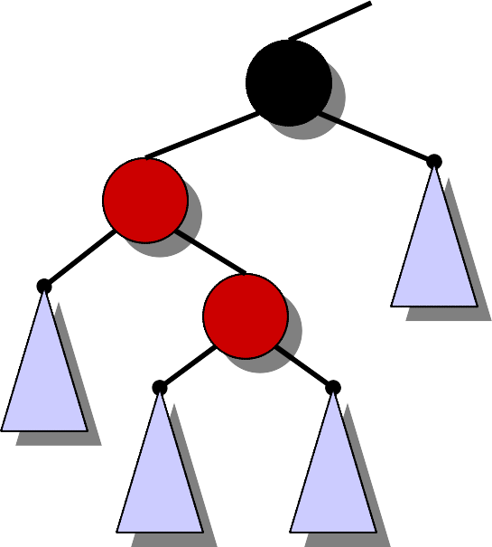
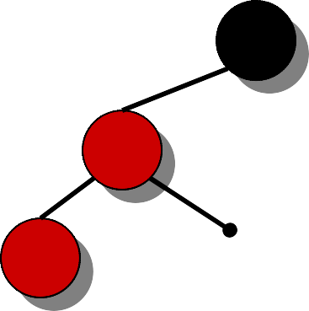
Case 2
LEFT-ROTATE(A)
C
C
y
y
A
x
B
B
x
A
Transform to Case 3.

Slide 24

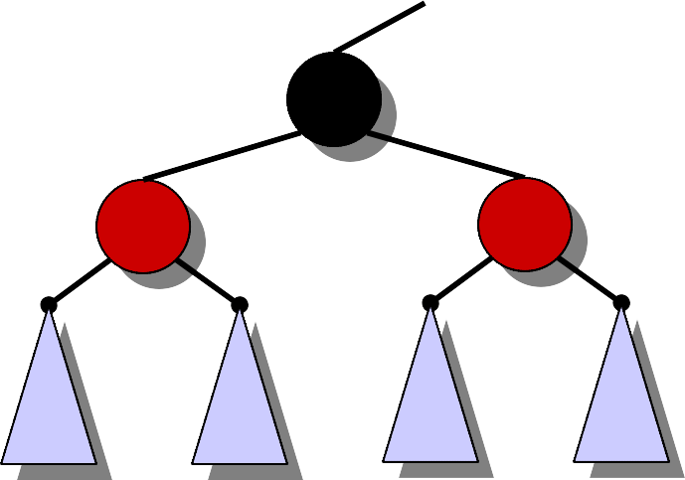
Case 3
RIGHT-ROTATE(C)
y
A
C
B
B
C
x
A
Done! No more violations of RB property 3 are possible.

Slide 25
Analysis
Go up the tree performing Case 1, which only recolors nodes.
If Case 2 or Case 3 occurs, perform 2 or 1 rotation, and terminate.
Running time: O(lg n) with O(1) rotations.
RB-DELETE — same asymptotic running time and number of rotations as RB-INSERT (see textbook).

