Slide 1
CSC 580 Computer Algorithms
LECTURE 11. Augmenting Data Structures

Slide 2
Agenda
Augmenting Data Structures
Dynamic order statistics
Methodology
Interval trees

Slide 3

Dynamic Order Statistics
returns the i th smallest element in the dynamic set S.
returns the rank of x ∈ S in the sorted order of S’s elements.
OS-SELECT(i, S):
OS-RANK(x, S):
IDEA: Use a red-black tree for the set S, but keep subtree sizes in the nodes.
key
Notation for nodes:
size

Slide 4
Example of an OS-tree
M 9
C
P
5
3
A
F
N
Q
1
3
1
1
D H
1 1
size[x] = size[left[x]] + size[right[x]] + 1

Slide 5
Selection
Implementation trick: Use a sentinel
(dummy record) for NIL such that size[NIL] = 0.
OS-SELECT(x, i)
⊳ ith smallest element in the subtree rooted at x
k ← size[left[x]] + 1
⊳ k = rank(x)
if | i = k | then return x
if | i < k
then return OS-SELECT( left[x], i )
else return OS-SELECT( right[x], i – k )
(OS-RANK is in the textbook.)

Slide 6
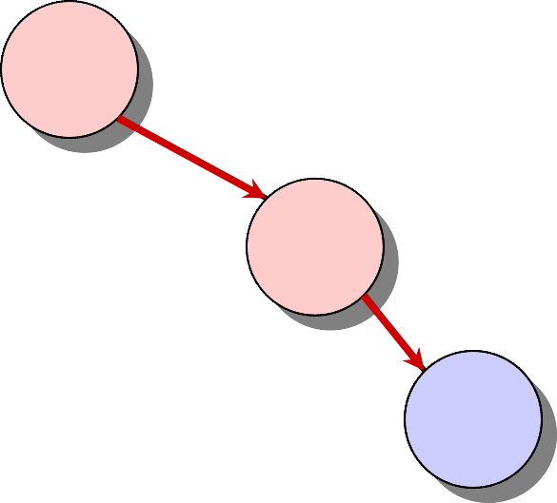
Example
OS-SELECT(root, 5)
i = 5
k = 6
M
9
i = 5
k = 2
C
P
5
3
A
F i = 3
k = 2
H
N
Q
1
3
1
1
D
i = 1
1 1 k = 1
Running time = O(h) = O(lg n) for red-black trees.

Slide 7
Data Structure Maintenance
Q. Why not keep the ranks themselves in the nodes instead of subtree sizes?
A. They are hard to maintain when the red-black tree is modified.
Modifying operations: INSERT and DELETE.
Strategy: Update subtree sizes when inserting or deleting.

Slide 8
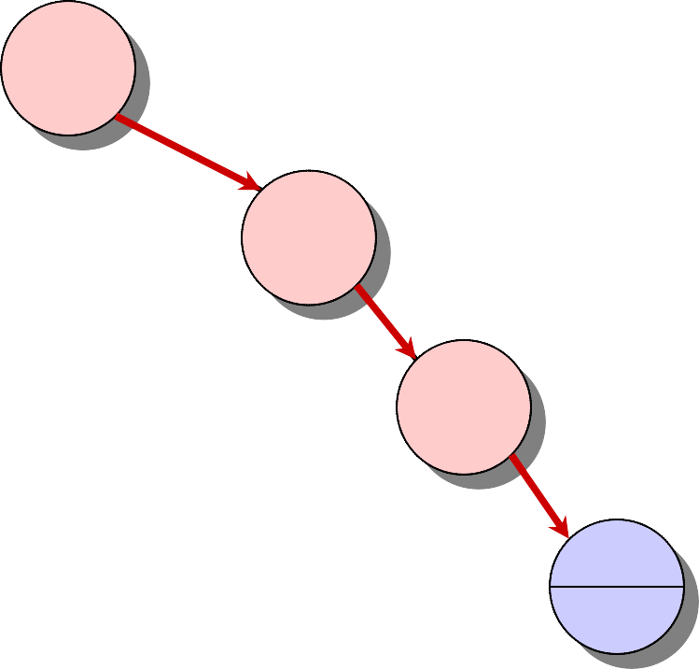
Example of Insertion
INSERT(“K”)
M
10
C
P
6
3
A
F
N
Q
1
4
1
1
D
H
1
2
K 1

Slide 9
Handling Rebalancing
Don’t forget that RB-INSERT and RB-DELETE may also need to modify the red-black tree in order to maintain balance.
Recolorings: no effect on subtree sizes.
Rotations: fix up subtree sizes in O(1) time.
Example:
E C
16 16
4 7
C
E
11
8
7 3 3 4
∴RB-INSERT and RB-DELETE still run in O(lg n) time.

Slide 10
Data-Structure Augmentation
Methodology: (e.g., order-statistics trees)
Choose an underlying data structure (red- black trees).
Determine additional information to be stored in the data structure (subtree sizes).
Verify that this information can be maintained for modifying operations (RB- INSERT, RB-DELETE — don’t forget rotations).
Develop new dynamic-set operations that use the information (OS-SELECT and OS-RANK).
These steps are guidelines, not rigid rules.

Slide 11
Interval Trees
Goal: To maintain a dynamic set of intervals, such as time intervals.
i = [7, 10]
low[i] = 7
5
4
10 = high[i]
11
15
17
19
18 22 23
8
Query: For a given query interval i, find an interval in the set that overlaps i.

Slide 12
Following the Methodology
Choose an underlying data structure.
Red-black tree keyed on low (left) endpoint.
Determine additional information to be stored in the data structure.
Store in each node x the largest value m[x] in the subtree rooted at x, as well as the interval int[x] corresponding to the key.
int m

Slide 13
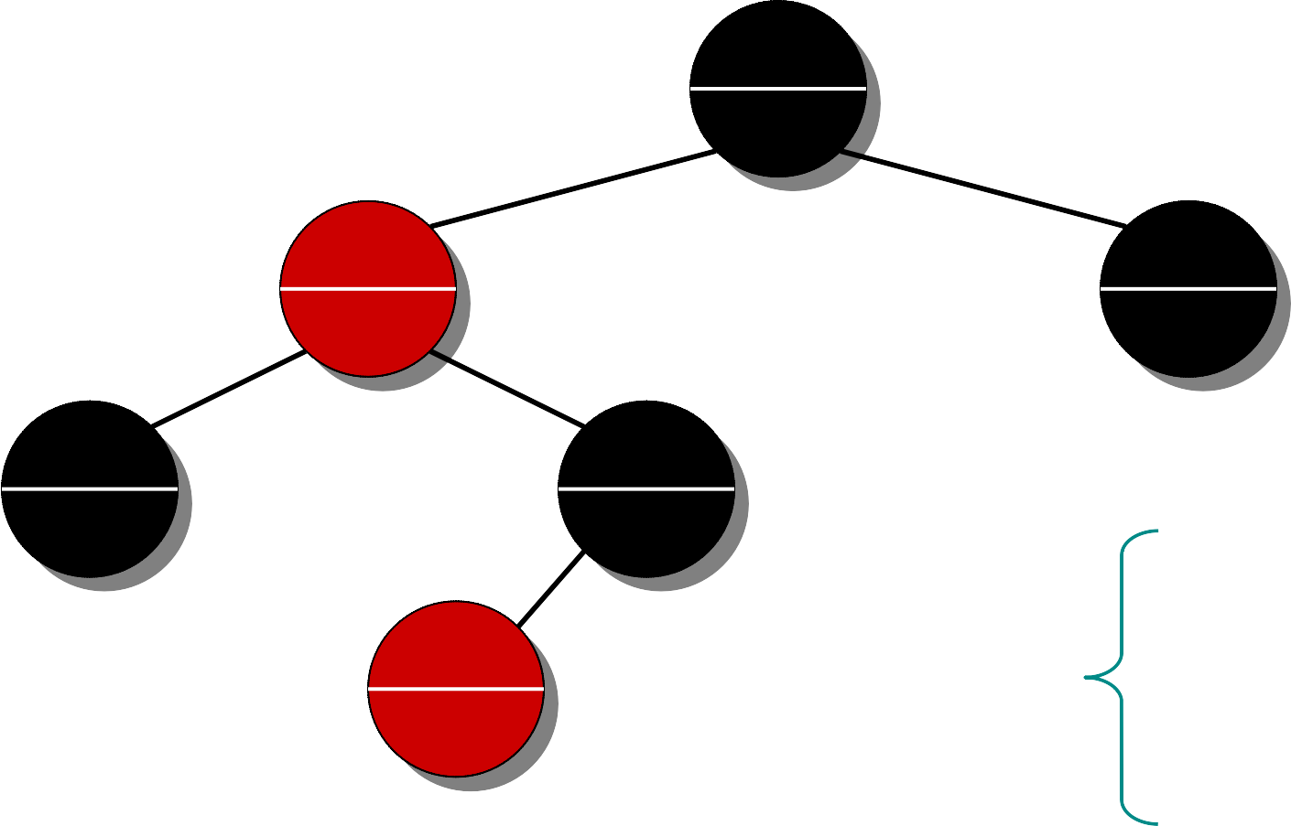
Example Interval Tree
17,19
23
5,11
18
4,8
8
7,10
10
22,23
23
15,18
18
m[x] = max
high[int[x]]
m[left[x]]
m[right[x]]

Slide 14
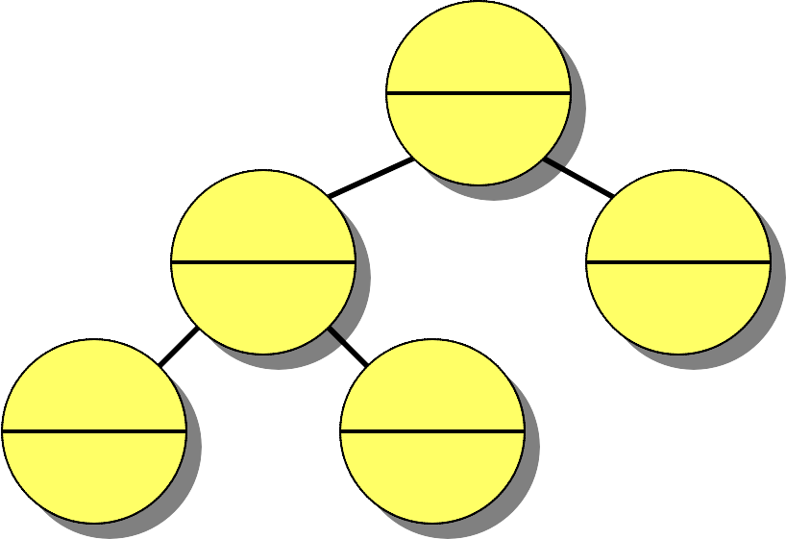
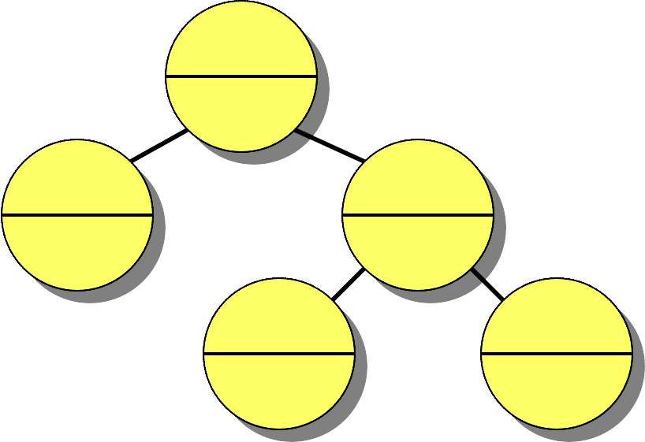
Modifying Operations
Verify that this information can be maintained for modifying operations.
INSERT: Fix m’s on the way down.
Rotations — Fixup = O(1) time per rotation:
11,15
30
6,20
30
6,20
30
11,15
19
19
30
30 14 14
19
Total INSERT time = O(lg n); DELETE similar.

Slide 15
New Operations
4. Develop new dynamic-set operations that use the information.
INTERVAL-SEARCH(i)
x ← root
while x ≠ NIL and (low[i] > high[int[x]]
or low[int[x]] > high[i])
do ⊳ i and int[x] don’t overlap
if left[x] ≠ NIL and low[i] ≤ m[left[x]]
then x ← left[x]
else x ← right[x]
return x

Slide 16
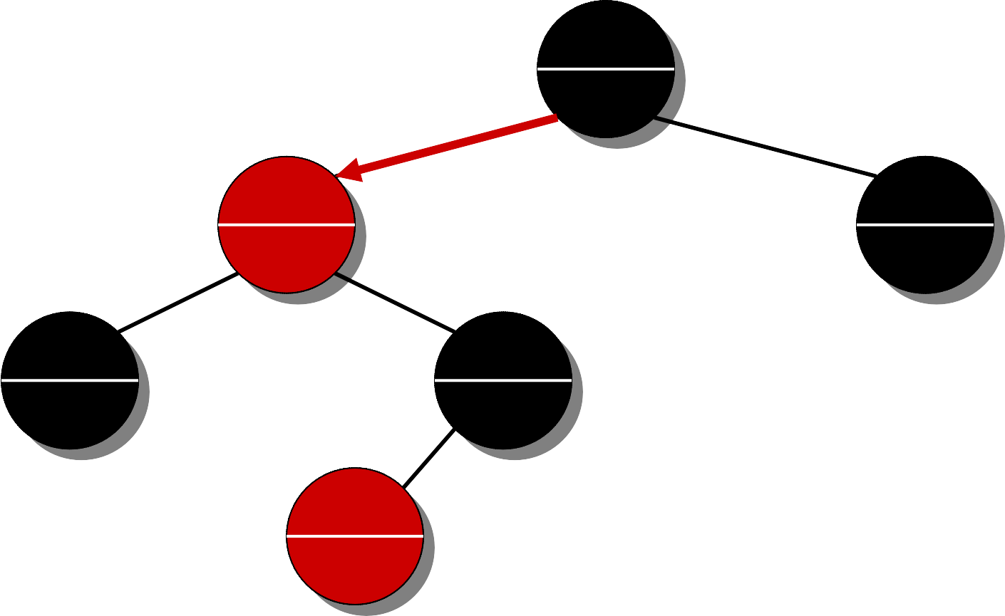
Example 1: INTERVAL-SEARCH([14,16])
x
17,19
23
5,11
18
22,23
23
4,8
8
15,18
18
[14,16] and [5,11] don’t overlap
14 > 8 ⇒ x ← right[x]
[14,16] and [15,18] overlap
return [15,18]
7,10
10
x ← root
[14,16] and [17,19] don’t overlap
14 ≤ 18 ⇒ x ← left[x]

Slide 17
Example 2: INTERVAL-SEARCH([12,14])
x
17,19
23
5,11
18
22,23
23
4,8
8
15,18
18
7,10
10
x = NIL ⇒ no interval that overlaps [12,14] exists
[12,14] and [5,11] don’t overlap
12 > 8 ⇒ x ← right[x]
[12,14] and [15,18] don’t overlap
12 > 10 ⇒ x ← right[x]
x ← root
[12,14] and [17,19] don’t overlap
12 ≤ 18 ⇒ x ← left[x]

Slide 18
Analysis
Time = O(h) = O(lg n), since INTERVAL-SEARCH does constant work at each level as it follows a simple path down the tree.
List all intervals overlapping with the given interval i:
Search, list, delete, repeat.
Insert them all again at the end.
Time = O(k lg n), where k is the total number of overlapping intervals.
This is an output-sensitive bound. Best algorithm to date: O(k + lg n).

Slide 19
Correctness
Theorem. Let L be the set of intervals in the left subtree of node x, and let R be the set of intervals in x’s right subtree.
If the search goes right, then
{ i ′ ∈ L : i ′ overlaps i } = ∅.
If the search goes left, then
if (L R) contains an interval that overlaps i, then L contains such an interval. Or equivalently,
{i ′ ∈ L : i ′ overlaps i } = ∅
⇒ {i ′ ∈ R : i ′ overlaps i } = ∅.
In other words, it’s always safe to take only 1 of the 2 children: we’ll either find something, or nothing was to be found.
∩

Slide 20
Correctness Proof
Proof. Suppose first that the search goes right.
If left[x] = NIL, then we’re done, since L = ∅.
Otherwise, the code dictates that we must have low[i] > m[left[x]]. The value m[left[x]] corresponds to the high endpoint of some interval j ∈ L, and no other interval in L can have a larger high endpoint than high[ j].
j
i
low(i)
…
high[ j] = m[left[x]]
Therefore, {i ′ ∈ L : i ′ overlaps i } = ∅.

Slide 21
Proof (cont'd)
Suppose that the search goes left, and assume that
{i ′ ∈ L : i ′ overlaps i } = ∅.
Then, the code dictates that low[i] ≤ m[left[x]] =
high[ j] for some j ∈ L.
Since j ∈ L, it does not overlap i, and hence
high[i] < low[ j].
But, the binary-search-tree property implies that for
all i ′ ∈ R, we have low[ j] ≤ low[i ′].
Therefore, {i ′ ∈ R : i ′ overlaps i } = ∅.
i
j
i ′
…

