Slide 1
CSC 580 Computer Algorithms
LECTURE 12. Dynamic Programming

Slide 2
Agenda
Dynamic Programming
History
Longest common subsequence
Optimal substructure
Overlapping sub-problems
RNA secondary structure

Slide 3
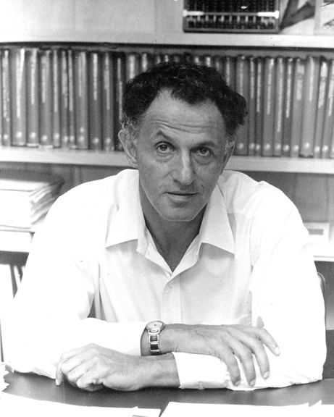
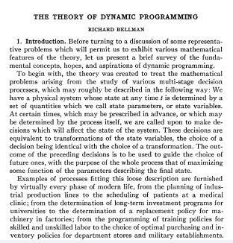
Dynamic Programming History
Richard Bellman: Pioneered the systematic study of dynamic programming in 1950s.
Etymology.
Dynamic programming = planning over time.
Secretary of Defense was hostile to mathematical research.
Bellman sought an impressive name to avoid confrontation.

Slide 4
Algorithmic Paradigms
Divide-and-conquer: Break up a problem into independent sub-problems, solve each sub-problem, and combine solution to sub-problems to form solution to original problem.
Dynamic programming: Break up a problem into a series of overlapping sub-problems, and build up solutions to larger and larger sub-problems.
fancy name for caching away intermediate results in a table for later reuse

Slide 5

Dynamic Programming
Design technique, like divide-and-conquer.
Example: Longest Common Subsequence (LCS)
Given two sequences x[1 . . m] and y[1 . . n], find a longest subsequence common to them both.
“a” not “the”
x: A B C B D A B
y: B D C A B A
BCBA = LCS(x, y)
functional notation, but not a function

Slide 6
Brute-Force LCS Algorithm
Check every subsequence of x[1 . . m] to see if it is also a subsequence of y[1 . . n].
Analysis
Checking = O(n) time per subsequence (linear scan to match greedily).
2^{m} subsequences of x (each bit-vector of length m determines a distinct subsequence of x).
Worst-case running time = O(n2^{m})
= exponential time.

Slide 7
Towards a Better Algorithm
Simplification:
Look at the length of a longest-common subsequence.
Extend the algorithm to find the LCS itself.
Notation: Denote the length of a sequence s
by | s |.
Strategy: Consider prefixes of x and y.
• Define c[i, j] = | LCS(x[1 . . i], y[1 . . j]) |.
Then, c[m, n] = | LCS(x, y) |.

Slide 8
Recursive Formulation
Theorem.
c[i–1, j–1] + 1 if x[i] = y[j],
c[i, j] =
max{c[i–1, j], c[i, j–1]} otherwise.
Proof. Case x[i] = y[ j]:
1 2 i
m
x:
…
1 2
=
j
n
y:
…
Let z[1 . . k] = LCS(x[1 . . i], y[1 . . j]), where c[i, j]
= k. Then, z[k] = x[i], or else z could be extended. Thus, z[1 . . k–1] is CS of x[1 . . i–1] and y[1 . . j–1].

Slide 9
Proof (cont'd)
Claim: z[1 . . k–1] = LCS(x[1 . . i–1], y[1 . . j–1]).
Suppose w is a longer CS of x[1 . . i–1] and y[1 . . j–1], that is, | w | > k–1. Then, cut and paste: w || z[k] (w concatenated with z[k]) is a common subsequence of x[1 . . i] and y[1 . . j] with | w || z[k] | > k. Contradiction, proving the claim.
Thus, c[i–1, j–1] = k–1, which implies that c[i, j]
= c[i–1, j–1] + 1.
Other cases are similar.

Slide 10
Dynamic-Programming Hallmark #1
Optimal substructure
An optimal solution to a problem (instance) contains optimal solutions to sub-problems.
If z = LCS(x, y), then any prefix of z is an LCS of a prefix of x and a prefix of y.

Slide 11
Recursive Algorithm for LCS
LCS(x, y, i, j)
if x[i] = y[ j]
then c[i, j] ← LCS(x, y, i–1, j–1) + 1
else c[i, j] ← max{LCS(x, y, i–1, j),
LCS(x, y, i, j–1)}
Worst-case: x[i] ≠ y[ j], in which case the algorithm evaluates two subproblems, each with only one parameter decremented.

Slide 12
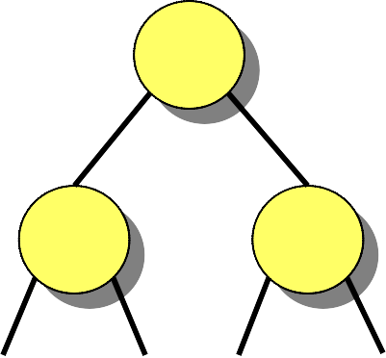
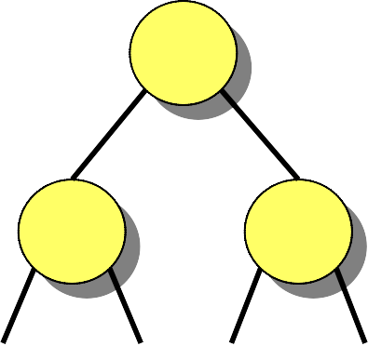
Recursion Tree
m = 3, n = 4:
3,4
^{2,4}
3,3,
same subproblem
1,4
2,3
2,3,
3,2,
m+n
1,3
^{2,2}
1,3,
2,2,
Height = m + n ⇒ work potentially exponential.,
but we’re solving subproblems already solved!

Slide 13
Dynamic-Programming Hallmark #2
Overlapping subproblems
A recursive solution contains a “small” number of distinct subproblems repeated many times.
The number of distinct LCS subproblems for two strings of lengths m and n is only mn.

Slide 14
Memorization Algorithm
Memorization: After computing a solution to a subproblem, store it in a table. Subsequent calls check the table to avoid redoing work.
LCS(x, y, i, j)
if c[i, j] = NIL
then if x[i] = y[j]
then c[i, j] ← LCS(x, y, i–1, j–1) + 1
else c[i, j] ← max{LCS(x, y, i–1, j),
LCS(x, y, i, j–1)}
same as before
Time = Θ(mn) = constant work per table entry. Space = Θ(mn).

Slide 15
Dynamic-Programming Algorithm
IDEA:
Compute the table bottom-up.
A
B
C
B
D
B
A
C
D
A
B
A
0 0 0 0 0 0 0 0
0 0 1 1 1 1 1 1
0 0 1 1 1 2 2 2
0 0 1 2 2 2 2 2
0 1 1 2 2 2 3 3
0 1 2 2 3 3 3 4
0 1 2 2 3 3 4 4
B
B
0
0
0
B
1
1
1
1
1
1
B
Time = Θ(mn).
D
D
0
0
1
1
1
2
2
2
Reconstruct LCS by tracing backwards.
C
C
0
0
1
2
2
2
2
2
A
A
0
1
1
2
2
2
3
3
Space = Θ(mn).
Exercise:
O(min{m, n}).
B
0
1
2
2
3
3
3
4
B
A
A
0
1
2
2
3
3
4
4

Slide 16
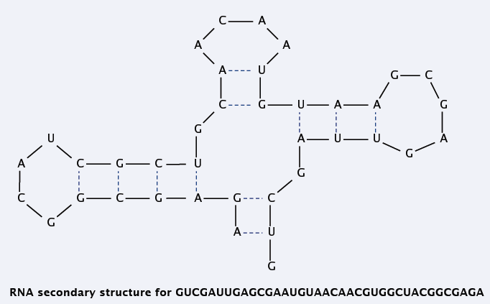
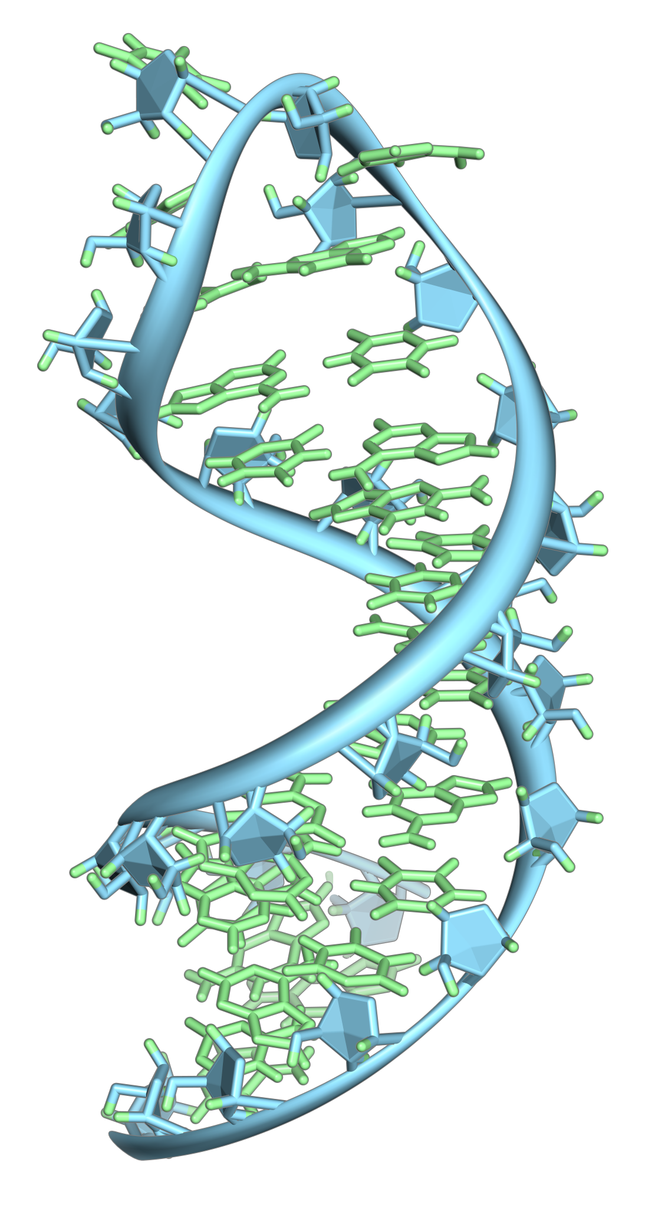
RNA Secondary Structure
RNA. String B = b₁b₂…b_{n} over alphabet { A, C, G, U }.
Secondary structure: RNA is single-stranded so it tends to loop back and form base pairs with itself. This structure is essential for understanding behavior of molecule.

Slide 17
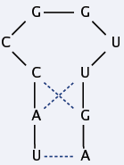
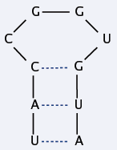
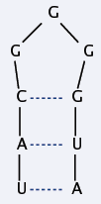

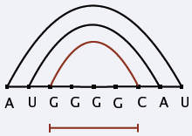
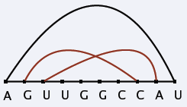
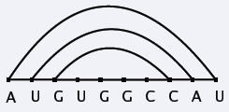
RNA Secondary Structure (cont’d)
Secondary structure: A set of pairs S = { (b_{i}, b_{j}) } that satisfy:
[Watson-Crick] S is a matching and each pair in S is a Watson-Crick complement: A–U, U–A, C–G, or G–C.
[No sharp turns] The ends of each pair are separated by at least 4 intervening bases. If (b_{i}, b_{j}) ∈ S, then i < j – 4.
[Non-crossing] If (b_{i}, b_{j}) and (b_{k}, b_{l}) are two pairs in S, then we cannot have i < k < j < l.
base
pair

Slide 18
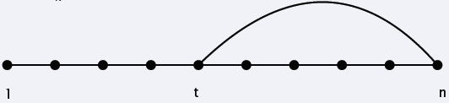
RNA Secondary Structure: Sub-Problems
Free energy: Usual hypothesis is that an RNA molecule will form the secondary structure with the minimum total free energy.
Goal: Given an RNA molecule B = b₁b₂…b_{n}, find a secondary structure S that maximizes the number of base pairs.
First attempt: OPT(j) = maximum number of base pairs in a secondary structure of the substring b₁b₂ … b_{j}.
Choice: Match b_{t} and b_{n}.
Difficulty: Results in two subproblems but one of wrong form.
Find secondary structure in b₁b₂ … b_{t–1}.
Find secondary structure in b_{t+1}b_{t+2} … b_{n–1}.
approximate by number of base pairs
OPT(t-1)
need more sub-problems

Slide 19
Dynamic Programming Over Intervals
Notation. OPT(i, j) = maximum number of base pairs in a secondary structure of the substring b_{i} b_{i+1} … b_{j}.
Case 1. If i ≥ j – 4.
OPT(i, j) = 0 by no-sharp turns condition.
Case 2. Base b_{j} is not involved in a pair.
OPT(i, j) = OPT(i, j – 1).
Case 3. Base b_{j} pairs with b_{t} for some i ≤ t < j – 4.
Non-crossing constraint decouples resulting sub-problems.
OPT(i, j) = 1 + max _{t} { OPT(i, t – 1) + OPT(t + 1, j – 1) }.
take max over all t’s that satisfy i ≤ t < j – 4 and
b_{t} and b_{j} are Watson-Crick complements

Slide 20
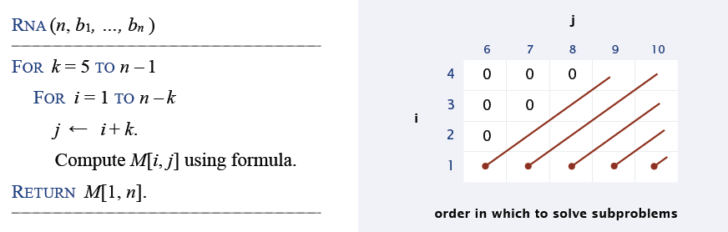
Bottom-Up DP Over Intervals
Q. In which order to solve the sub-problems?
A. Do shortest intervals first.
Theorem. The dynamic programming algorithm solves the RNA secondary substructure problem in O(n³) time and O(n²) space.

Slide 21
Summary
Polynomial number of sub-problems.
Solution to original problem can be computed from sub-problems.
Natural ordering of sub-problems from smallest to largest, with an easy-to-compute recurrence that allows one to determine the solution to a sub-problem from solutions to smaller sub-problems.

