Slide 1
CSC 580 Computer Algorithms
LECTURE 13. Greedy Algorithms

Slide 2
Agenda
Greedy Algorithms (and Graphs)
Graph representation
Minimum spanning trees
Optimal substructure
Greedy choice
Prim’s greedy MST algorithm

Slide 3

Graphs
Definition. A directed graph (digraph)
G = (V, E) is an ordered pair consisting of
a set V of vertices (singular: vertex),
a set E ⊆ V × V of edges.
In an undirected graph G = (V, E), the edge set E consists of unordered pairs of vertices.
In either case, we have | E | = O(V ²). Moreover, if G is connected, then | E | ≥ | V | – 1, which implies that lg | E | = Θ(lg V).
(Reference: CLRS, Appendix B.)

Slide 4
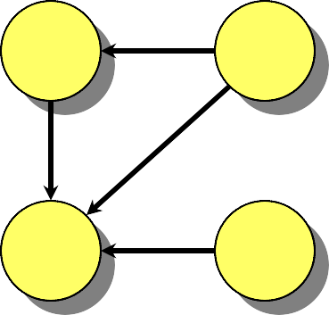
Adjacency-Matrix Representation
The adjacency matrix of a graph G = (V, E), where V = {1, 2, …, n}, is the matrix A[1 . . n, 1 . . n] given by
1 if (i, j) ∈ E,
0 if (i, j) ∉ E.
A[i, j] =
A | 1 | 2 | 3 | 4
1 | 0 | 1 | 1 | 0
2 | 0 | 0 | 1 | 0
3 | 0 | 0 | 0 | 0
4 | 0 | 0 | 1 | 0
2 1
Θ(V ²) storage
⇒ dense
representation.
3 4

Slide 5

Adjacency-List Representation
An adjacency list of a vertex v ∈ V is the list Adj[v] of vertices adjacent to v.
Adj[1] = {2, 3}
2 1
Adj[2] = {3}
Adj[3] = {}
Adj[4] = {3}
3 4
For undirected graphs, | Adj[v] | = degree(v). For digraphs, | Adj[v] | = out-degree(v).
Handshaking Lemma: ∑_{v∈V} | Adj[v] | = 2 |E| for undirected graphs ⇒ adjacency lists use Θ(V + E) storage — a sparse representation (for either type of graph).

Slide 6
Minimum Spanning Trees
Input: A connected, undirected graph G = (V, E) with weight function w : E → R.
For simplicity, assume that all edge weights are distinct. (CLRS covers the general case.)
Output: A spanning tree T — a tree with edges in G that connects all vertices — of minimum weight:
w(T ) =
∑ w(u, v) .
(u,v)∈T

Slide 7
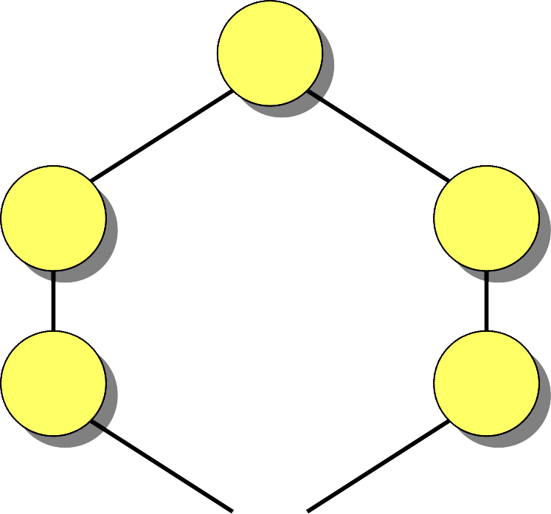
Example of MST
6
12
5
9
14
7
8
15
3
10

Slide 8
Optimal Substructure
MST T:
(Other edges of G
are not shown.)
u
T
2
T₁
v
Remove any edge (u, v) ∈ T.
Then, T is partitioned into two subtrees T₁ and T₂.
Theorem. The subtree T₁ is an MST of G₁ = (V₁, E₁), the subgraph of G induced by the vertices of T₁:
V₁ = vertices of T₁,
E₁ = { (x, y) ∈ E : x, y ∈ V₁ }.
Similarly for T₂.

Slide 9
Proof of Optimal Substructure
Proof. Cut and paste:
w(T) = w(u, v) + w(T₁) + w(T₂).
If T₁′ were a lower-weight spanning tree than T₁ for
G₁, then T ′ = {(u, v)} ∪ T₁′ ∪ T₂ would be a lower-weight spanning tree than T for G.
Do we also have overlapping subproblems?
•Yes.
Great! Then, dynamic programming may work?
•Yes, but MST exhibits another powerful property which leads to an even more efficient algorithm.

Slide 10
Hallmark for “Greedy” Algorithms
Greedy-choice property A locally optimal choice is globally optimal.
Theorem. Let T be the MST of G = (V, E), and let A ⊆ V. Suppose that (u, v) ∈ E is the least-weight edge connecting A to V – A. Then, (u, v) ∈ T.

Slide 11
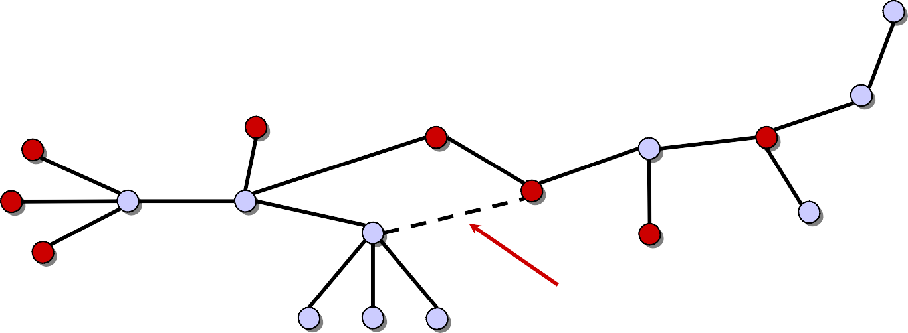
Proof of Theorem
Proof. Suppose (u, v) ∉ T. Cut and paste.
T: v
u
∈ A
∈ V – A
(u, v) = least-weight edge connecting A to V – A

Slide 12
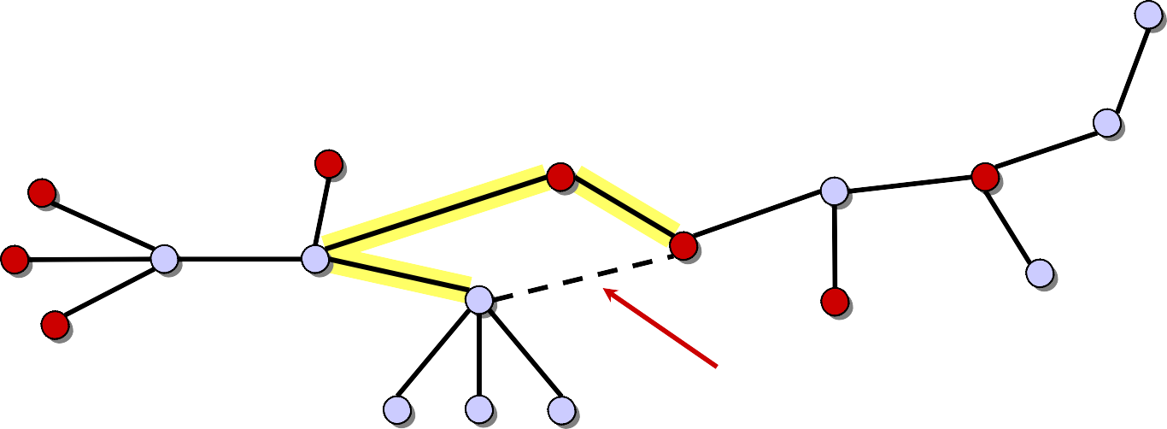
Proof of Theorem
Proof. Suppose (u, v) ∉ T. Cut and paste.
T: v
u
∈ A
∈ V – A
(u, v) = least-weight edge connecting A to V – A
Consider the unique simple path from u to v in T.

Slide 13
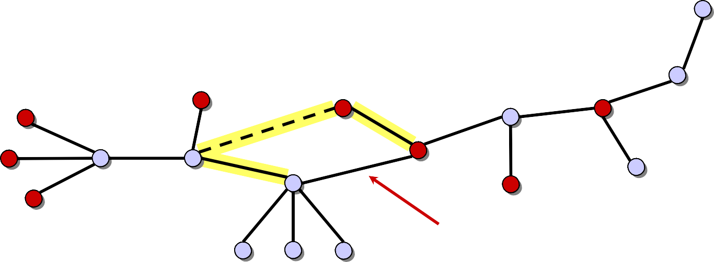
Proof of Theorem
Proof. Suppose (u, v) ∉ T. Cut and paste.
T: v
u
∈ A
∈ V – A
(u, v) = least-weight edge connecting A to V – A
Consider the unique simple path from u to v in T.
Swap (u, v) with the first edge on this path that connects a vertex in A to a vertex in V – A.

Slide 14
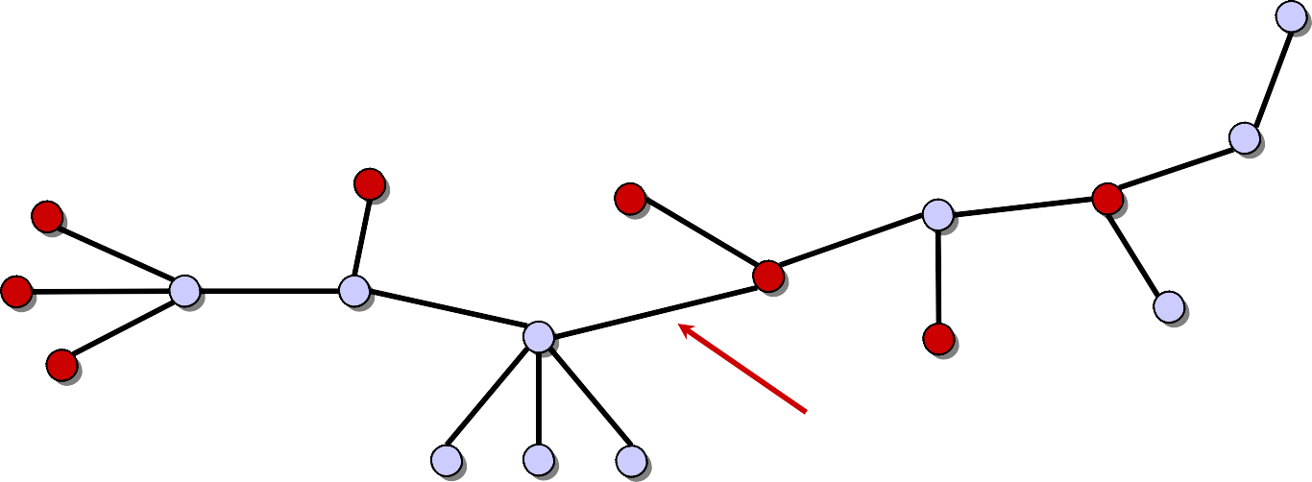
Proof of Theorem
Proof. Suppose (u, v) ∉ T. Cut and paste.
T ′: v
u
∈ A
∈ V – A
(u, v) = least-weight edge connecting A to V – A
Consider the unique simple path from u to v in T.
Swap (u, v) with the first edge on this path that connects a vertex in A to a vertex in V – A.
A lighter-weight spanning tree than T results.

Slide 15
Prim’s Algorithm
IDEA: Maintain V – A as a priority queue Q. Key each vertex in Q with the weight of the least- weight edge connecting it to a vertex in A.
Q ← V
key[v] ← ∞ for all v ∈ V
key[s] ← 0 for some arbitrary s ∈ V
while Q ≠ ∅
do u ← EXTRACT-MIN(Q)
for each v ∈ Adj[u]
do if v ∈ Q and w(u, v) < key[v]
then key[v] ← w(u, v)
π[v] ← u
⊳ DECREASE-KEY
At the end, {(v, π[v])} forms the MST.

Slide 16
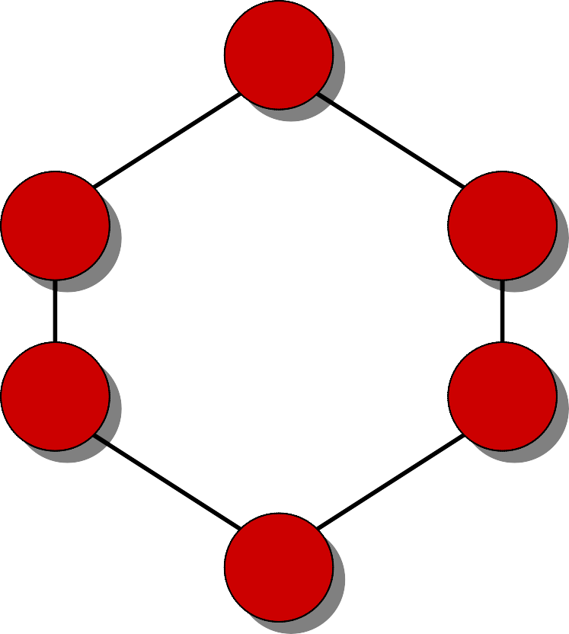
Example of Prim’s Algorithm
∞
∈ A
∈ V – A
6
12
5
9
∞
∞
∞
14
7
8
15
∞
0
∞
3
10
∞

Slide 17
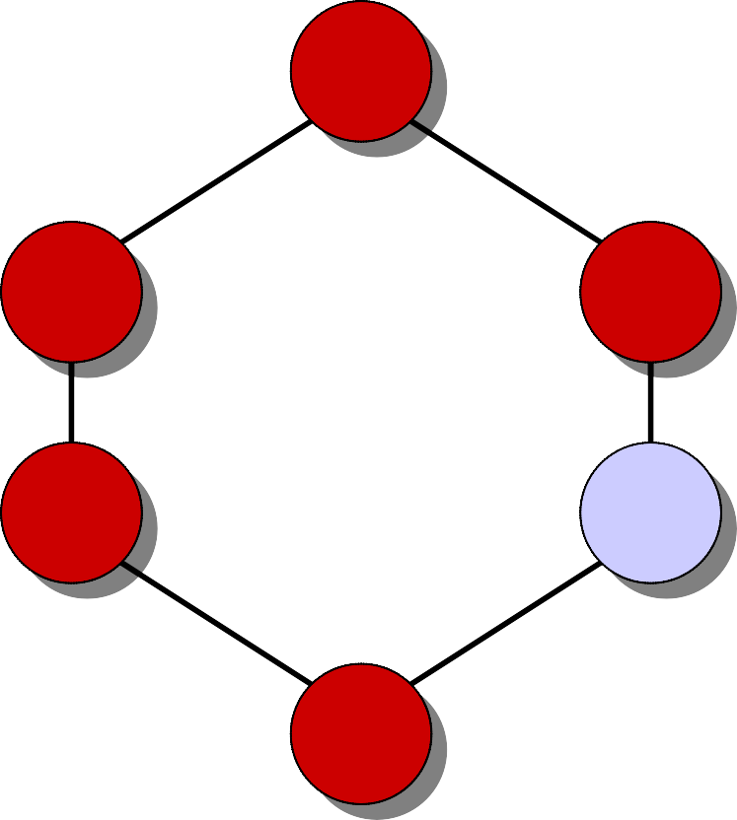
Example of Prim’s Algorithm
∞
∈ A
∈ V – A
6
12
5
9
∞
∞
∞
14
7
8
15
∞
0
∞
3
10
∞

Slide 18
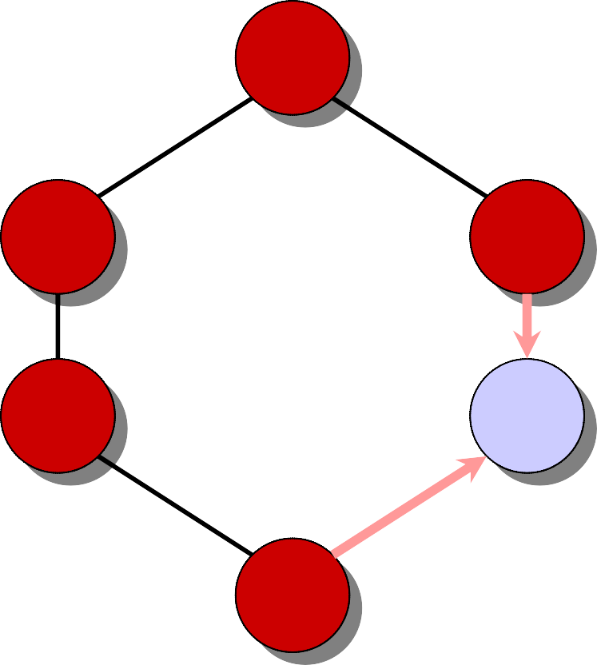
Example of Prim’s Algorithm
∞
∈ A
∈ V – A
6
12
5
9
∞
7
∞
14
7
8
15
∞
0
15
3
10
10

Slide 19
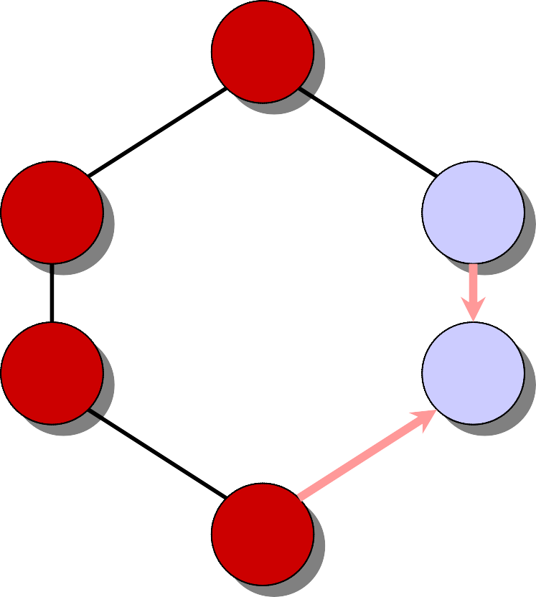
Example of Prim’s Algorithm
∞
∈ A
∈ V – A
6
12
5
9
∞
7
∞
14
7
8
15
∞
0
15
3
10
10

Slide 20
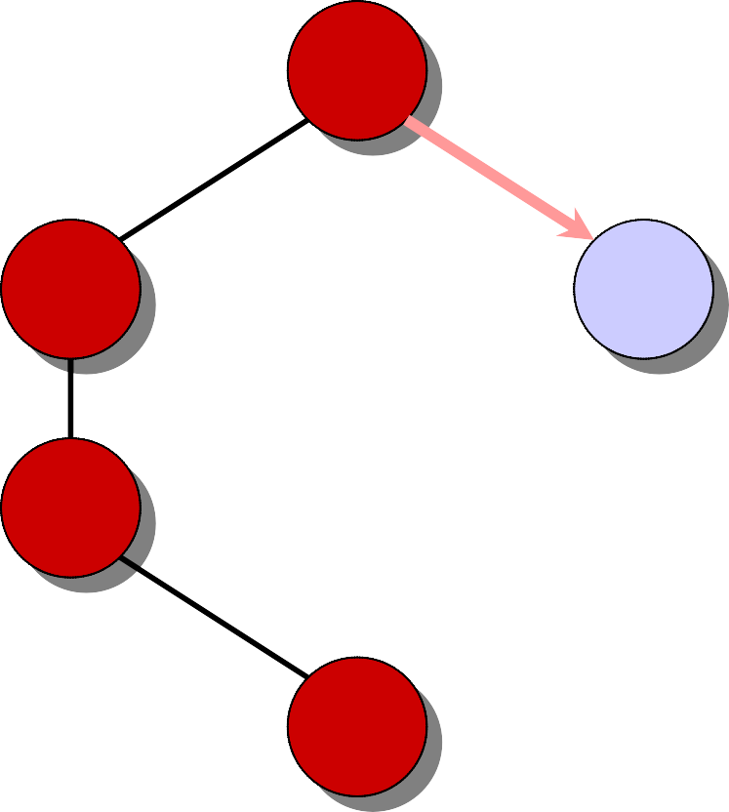
Example of Prim’s Algorithm
12
∈ A
∈ V – A
6
12
5
9
5
7
9
14
7
8
15
∞
0
15
3
10
10

Slide 21
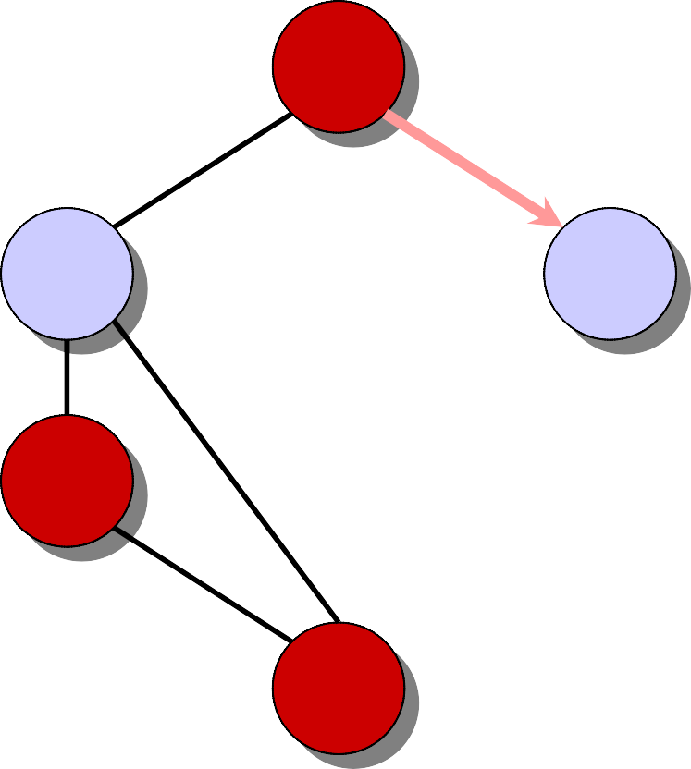
Example of Prim’s Algorithm
∈ A
∈ V – A
12
6
12
5
9
5
7
9
14
7
8
15
∞
0
15
3
10
10

Slide 22
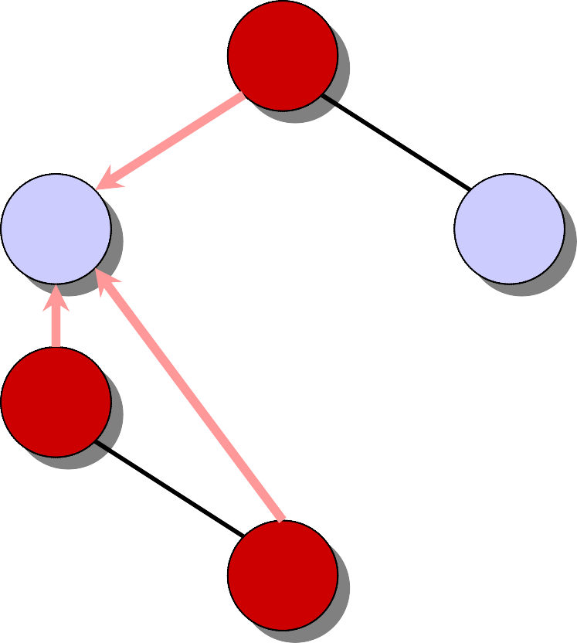
Example of Prim’s Algorithm
∈ A
∈ V – A
6
5
6
12
9
5
7
9
14
14
7
8
15
0
15
3
10
8

Slide 23
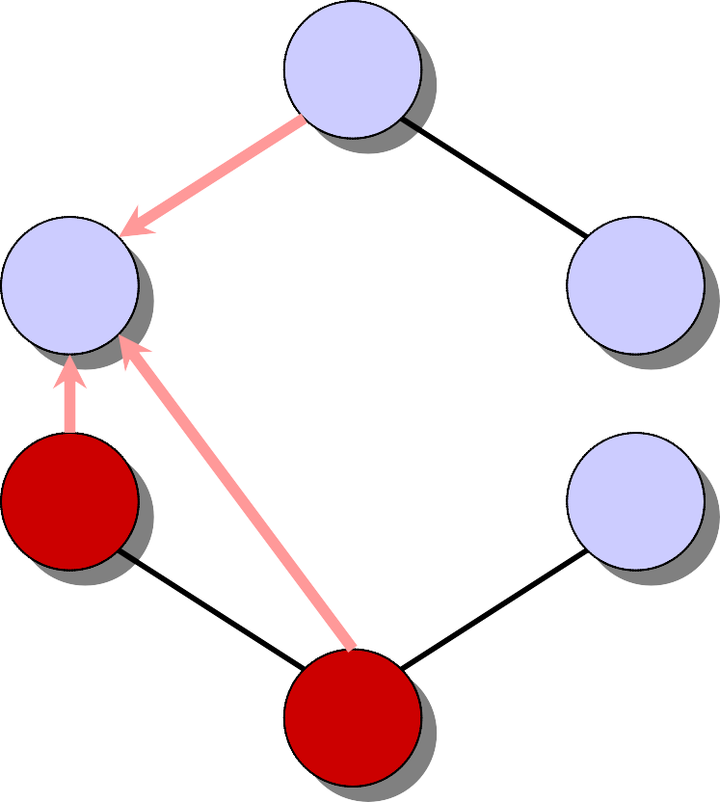
Example of Prim’s Algorithm
∈ A
∈ V – A
6
6
12
5
9
5
7
9
14
14
7
8
15
0
15
3
10
8

Slide 24
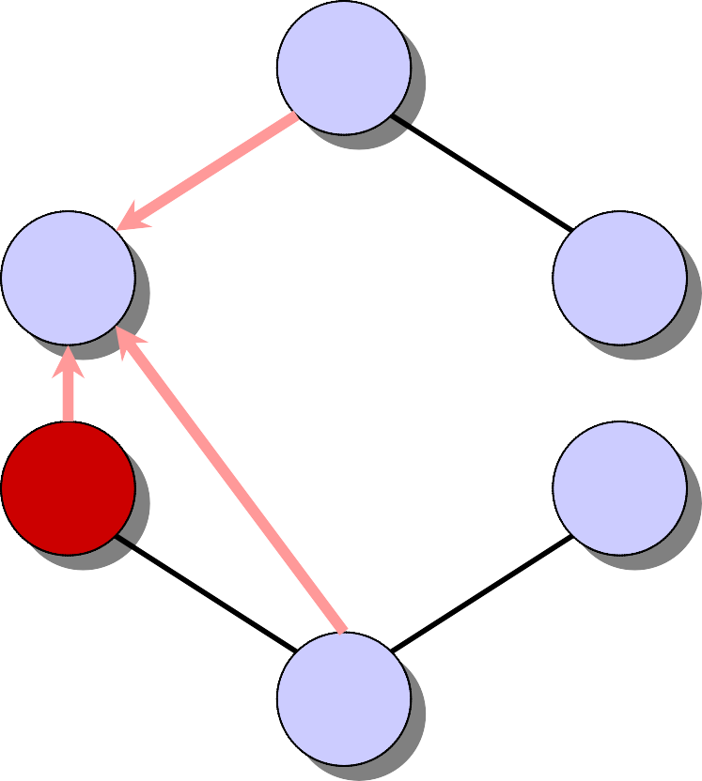
Example of Prim’s Algorithm
∈ A
∈ V – A
6
6
12
5
9
5
7
9
14
14
7
8
15
0
15
3
10
8

Slide 25
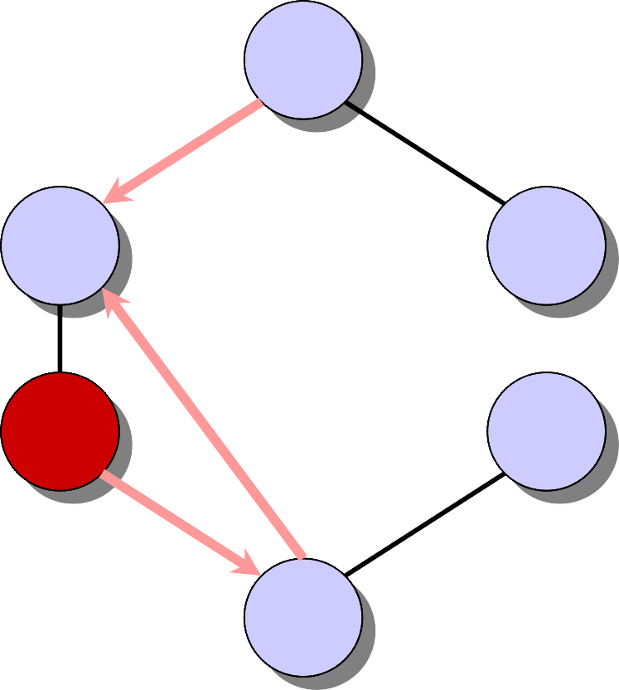
Example of Prim’s Algorithm
∈ A
∈ V – A
6
6
12
5
9
5
7
9
14
7
8
15
3
0
15
3
10
8

Slide 26
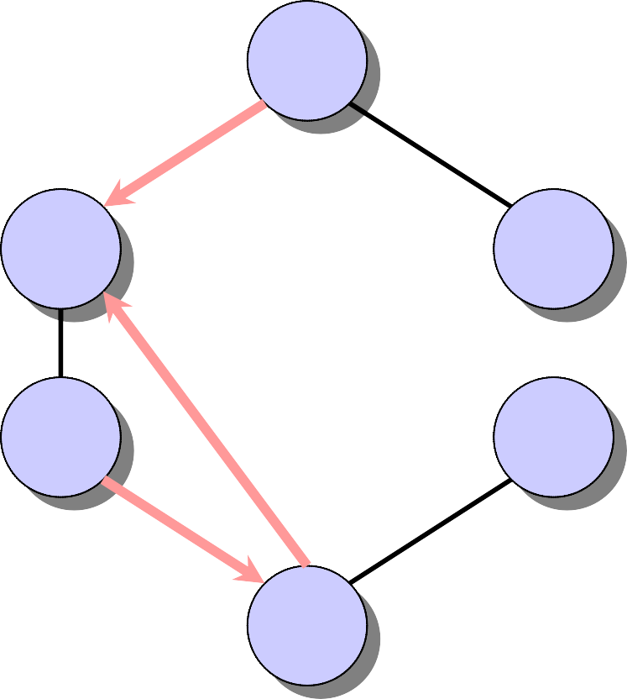
Example of Prim’s Algorithm
∈ A
∈ V – A
6
6
12
5
9
5
7
9
14
7
8
15
3
0
15
3
10
8

Slide 27
Example of Prim’s Algorithm
∈ A
∈ V – A
6
6
12
5
9
5
7
9
14
7
8
15
3
0
15
3
10
8

Slide 28
Example of Prim’s Algorithm
∈ A
∈ V – A
6
6
12
5
9
5
7
9
14
7
8
15
3
0
15
3
10
8

Slide 29
Analysis of Prim‘s Algorithm
Q ← V
key[v] ← ∞ for all v ∈ V
key[s] ← 0 for some arbitrary s ∈ V
while Q ≠ ∅
do u ← EXTRACT-MIN(Q)
Θ(V)
total
|V |
times
for each v ∈ Adj[u]
do if v ∈ Q and w(u, v) < key[v]
then key[v] ← w(u, v)
π[v] ← u
degree(u) times
Handshaking Lemma ⇒ Θ(E) implicit DECREASE-KEY’s.
^{Time = Θ(V)·T}EXTRACT-MIN ^{+ Θ(E)·T}DECREASE-KEY

Slide 30
Analysis of Prim‘s Algorithm (cont'd)
^{Time = Θ(V)·T}EXTRACT-MIN ^{+ Θ(E)·T}DECREASE-KEY
Q
^{T}EXTRACT-MIN ^{T}DECREASE-KEY
Total
array
binary heap
Fibonacci heap
O(V) O(1)
O(V²)
O(lg V)
O(lg V) amortized
O(lg V)
O(1)
amortized
O(E lg V)
O(E + V lgV)
worst case

Slide 31
MST Algorithms
Kruskal’s algorithm (see CLRS):
Uses the disjoint-set data structure (Chapter 21).
Running time = O(E lg V).
Best to date:
Karger, Klein, and Tarjan [1993].
Randomized algorithm.
O(V + E) expected time.

