Slide 1
CSC 580 Computer Algorithms
LECTURE 14. NP-Completeness

Slide 2
Agenda
NP-Completeness
Computational problems
Class NP
NP-completeness
Polynomial-time reduction
Cook theorem
Proof of NP-complete problems

Slide 3
Computational Problems

Slide 4
Decision Problems
Decision problem = any problem whose answer is one bit: “yes” or “no”
Examples:
– Do these line segments have an intersection?
– Does this Super Mario Bros. level have a solution?
– Does the Rubik’s Cube always have a solution in 20 moves?
– Given a sequence of cards, is there a Crazy Eights subsequence trick of at least 17 cards?
– Does a given weighted graph have a negative cycle?

Slide 5
Optimization vs. Decision
The decision problem is in a sense “easier,” or at least “no harder” than the optimization version of the problem.
Example: SHORTEST_PATH vs. PATH
PATH: given a directed graph G, vertices u and v, and an integer k, does a path exist from u to v consisting of at most k edges?
We can solve PATH by solving SHORTEST-PATH and then comparing the number of edges in the shortest path found to the value of the decision-problem parameter k.
Evidence that a decision problem is hard is also evidence that its related optimization problem is hard.

Slide 6
The Class NP
NP: Any decision problem A for which there exists a polynomial time algorithm V & c > 0
if x is a yes-input for A, then ∃ y, |y|<|x|^{c} , V(x,y) = True
if x is a no-input for A, then ∀y, V(x,y) = False
V is a `verification algorithm’
y is a `certificate’ for x
Notes:
Say :
1. one sided requirement
2, example for k-coloring, example for SAT, example fo COMPOSITE

Slide 7
P vs NP
Is P=NP ? Is it easy to solve as to verify ?
The question has been open since 70’s
How can we make progress on this problem?
Find the “hardest” problems in NP and just work on them: the NP-complete problems

Slide 8
NP-Complete Problems:
The “hardest” problems in NP
How would you define NP-Complete?
NP-Complete
NP
P

Slide 9
Polynomial Time Reductions
Let A and B be decision problems
A is polynomial time reducible to B if ∃ polynomial time algorithm R s.t.
R transforms input x to problem A into inputs R(x) to problem B so that
x is a yes-input for A if and only if R(x) is a yes-input for B
Notation: A ≤ B

Slide 10
Polynomial Time Reductions (cont’d)
A instances B instances
YES
instances
R
R
YES
Instances
NO
instances
NO
instances

Slide 11
A ≤ B
Claim: If ∃ polynomial time algorithm for B then ∃ polynomial time algorithm for A
Algorithm for A
x
R(x)
Algorithm for B
Yes
Reduction R
No
Runtime for A: runtime of R + runtime of algorithm for B
If R runs in time p(|x|) & B’s algorithm runs in time q(|y|), then on input x the runtime is p(|x|)+q(p(|x|))=poly(|x|) time.

Slide 12
Reductions are Useful
Algorithm for A
Two uses:
Showing how to solve A using algorithm for B
Showing B is at least as hard as A.
R(x)
Yes/No
x
Reduction R
Algorithm for B

Slide 13
B is NP-complete
B is in NP
for all problems A in NP, A≤B
(B is NP-hard)
How do you show a reduction FOR ALL problems A in NP?
Let’s see ↓

Slide 14
Cook-Levin Theorem (1971)
Circuit Satisfiability (cSAT) is NP-complete
The first NP-complete problem,
Many standard others follow: Karp 1972

Slide 15
Circuit-Satisfiability: cSAT
Given a circuit with n-inputs and one output, is there a way to assign 0-1 values to the inputs so that the output value is 1 (true)?
1
1
0
Yes, this circuit is satisfiable: 110
But more generally, best Known algorithm is BRUTE FORCE: Try out all 2^{n} assignments
AND
NOT
OR
1

Slide 16
Proving Cook-Levin Theorem (I)
cSAT is in NP
Given an assignment to inputs of C, can verify quickly if output is 1.
⇒ Thus cSAT is in NP

Slide 17
Proving Cook-Levin Theorem (II)
cSAT is NP-complete
For any decision problem A ∈NP
show A≤ cSAT.
How to transform input x to A into a circuit C in polynomial time such that
A(x)=yes iff C is satisifiable
Notes:
Say x is a yes instance to A if C is a satisfiable circut

Slide 18
Prove Problems are NP-Complete
Reductions are Transitive
Theorem: Let C be in NP and B NP-complete if B≤C, then C is NP-complete as well
(at least as hard as B)
Proof: For all A in NP, A ≤ B ≤ C.
Recipe: To show C is NP-Complete,
(1) prove C is in NP;
(2) prove we can reduce a previously shown NP-Complete problem to C

Slide 19

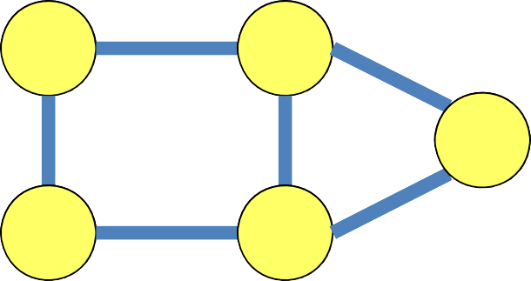


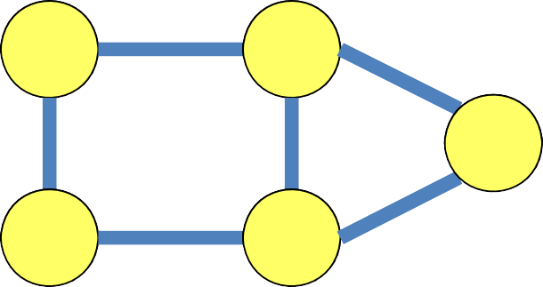

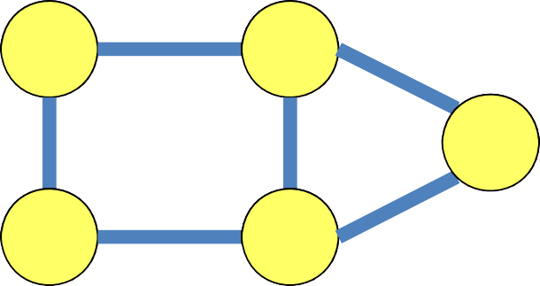




















Some Known NP-Complete Problems
Given a graph, does it have vertex cover of size ≤ k?
Given a graph, is there a simple path of length ≥ k? (Hamiltonian)
Given a graph, can it be colored with 3 colors?
Given a Boolean circuit, are there inputs that make the output true?
x
OR
y
AND
OR

Slide 20
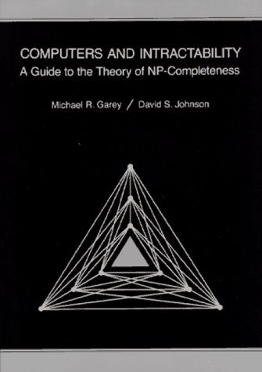
Reference of NP-Complete Problems
Garey and Johnson’s book

Slide 21
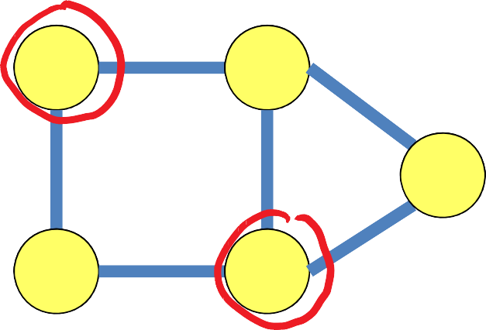
Independent Set
Independent set =
subset of vertices inducing no edges
Problem: Given a graph and integer , is there an independent set of size
?

Slide 22
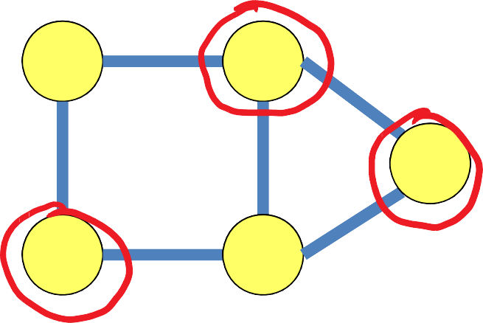
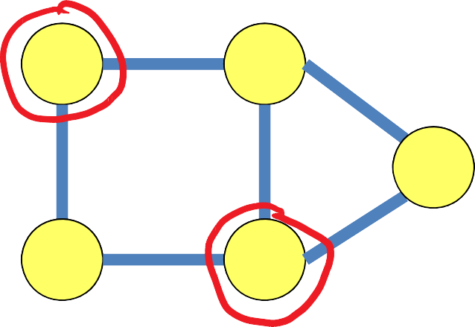
Vertex Cover Independent Set
has a vertex cover of size if and only if
has an independent set of size
So
reduces
IS is NP‐complete
VC is NP‐complete
Vertex Cover
Independent Set

Slide 23
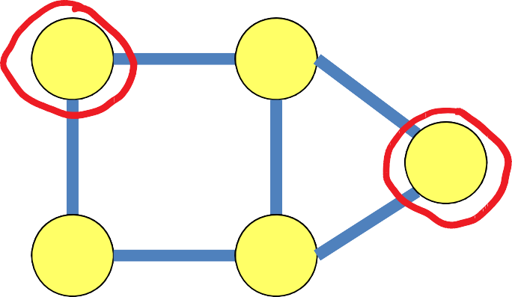
Dominating Set
Dominating set = subset of vertices
such that every other vertex is adjacent to someone in the subset
Problem: Given a graph and integer , is there a dominating set of size ?

Slide 24
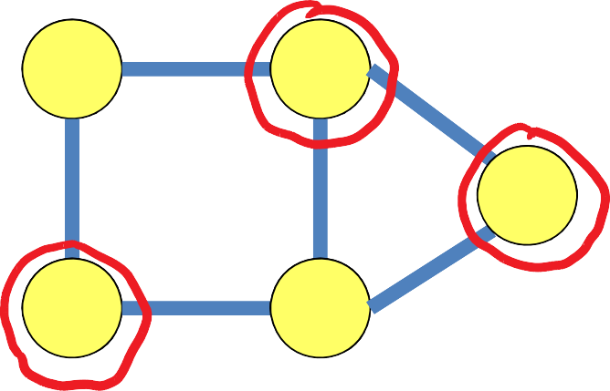
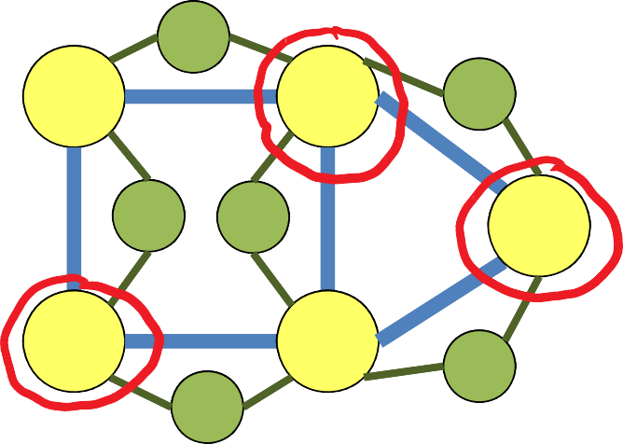
Vertex Cover Dominating Set
has a vertex cover of size if and only if
has a dominating set of size
So
VC is NP‐complete
reduces
DS is NP‐complete
Vertex Cover
Dominating Set

Slide 25
Bad & Good News
Many problems are NP‐complete
Can often find approximate solutions in polynomial time
– Within factor of optimal (e.g., Vertex Cover)
– Within 0.0001% of optimal (e.g., Vertex Cover in planar graphs)

Slide 26
Unknown Complexity in NP
Graph Isomorphism: Given two graphs G₁=(V₁,E₁) and G₂=(V₂,E₂), is there a mapping f from V₁ to V₂ such that (u,v) is in E₁ iff (f(u),f(v)) is in E₂
Important Problem !!!
Obviously in NP: given a certificate f and verify it in polynomial time
Best algorithm: 2^{sqrt(V )}
Unlikely to be NP-complete

