Slide 1
CSC 580 Computer Algorithms
LECTURE 4. Quicksort

Slide 2

Agenda
Quicksort
Divide and conquer
Partitioning
Worst-case analysis
Intuition
Randomized quicksort
Analysis

Slide 3
Quicksort
Proposed by C.A.R. Hoare in 1962.
Divide-and-conquer algorithm.
Sorts “in place” (like insertion sort, but not like merge sort).
Very practical (with tuning).

Slide 4
Divide and Conquer
Quicksort an n-element array:
Divide: Partition the array into two subarrays around a pivot x such that elements in lower subarray ≤ x ≤ elements in upper subarray.
≤ x x ≥ x
Conquer: Recursively sort the two subarrays.
Combine: Trivial.
Key: Linear-time partitioning subroutine.
≤ x
x
≥ x

Slide 5
Partitioning Subroutine
PARTITION(A, p, q) ⊳ A[ p . . q]
_{Running time}
_{= O(n) for n}
_{elements.}
x ← A[ p] ⊳ pivot = A[ p] i ← p
for j ← p + 1 to q
do if A[ j] ≤ x
then
i ← i + 1
exchange A[i] ↔ A[ j]
exchange A[ p] ↔ A[i]
return i
Invariant: x ≤ x
≥ x
?
x
≤ x
≥ x
?
p
i
j
q

Slide 6
Example of Partitioning
6 | 10 | 13 | 5 | 8 | 3 | 2 | 11
i | j
6
10
13
5
8
3
2
11

Slide 7
Example of Partitioning
6 | 10 | 13 | 5 | 8 | 3 | 2 | 11
i |  | j
6
10
13
5
8
3
2
11

Slide 8
Example of Partitioning
6 | 10 | 13 | 5 | 8 | 3 | 2 | 11
i |  |  | j
6
10
13
5
8
3
2
11

Slide 9
Example of Partitioning
6 | 10 | 13 | 5 | 8 | 3 | 2 | 11
6 | 5 | 13 | 10 | 8 | 3 | 2 | 11
 | i |  | j
6
10
13
5
8
3
2
11
6
5
13
10
8
3
2
11

Slide 10
Example of Partitioning
6 | 10 | 13 | 5 | 8 | 3 | 2 | 11
6 | 5 | 13 | 10 | 8 | 3 | 2 | 11
 | i |  |  | j
6
10
13
5
8
3
2
11
6
5
13
10
8
3
2
11

Slide 11
Example of Partitioning
6 | 10 | 13 | 5 | 8 | 3 | 2 | 11
6 | 5 | 13 | 10 | 8 | 3 | 2 | 11
 | i |  |  |  | j
6
10
13
5
8
3
2
11
6
5
13
10
8
3
2
11

Slide 12
Example of Partitioning
6 | 10 | 13 | 5 | 8 | 3 | 2 | 11
6 | 5 | 13 | 10 | 8 | 3 | 2 | 11
6 | 5 | 3 | 10 | 8 | 13 | 2 | 11
 |  | i |  |  | j
6
10
13
5
8
3
2
11
6
5
13
10
8
3
2
11
6
5
3
10
8
13
2
11

Slide 13
Example of Partitioning
6 | 10 | 13 | 5 | 8 | 3 | 2 | 11
6 | 5 | 13 | 10 | 8 | 3 | 2 | 11
6 | 5 | 3 | 10 | 8 | 13 | 2 | 11
 |  | i |  |  |  | j
6
10
13
5
8
3
2
11
6
5
13
10
8
3
2
11
6
5
3
10
8
13
2
11

Slide 14
Example of Partitioning
6 | 10 | 13 | 5 | 8 | 3 | 2 | 11
6 | 5 | 13 | 10 | 8 | 3 | 2 | 11
6 | 5 | 3 | 10 | 8 | 13 | 2 | 11
6 | 5 | 3 | 2 | 8 | 13 | 10 | 11
 |  |  | i |  |  | j
6
10
13
5
8
3
2
11
6
5
13
10
8
3
2
11
6
5
3
10
8
13
2
11
6
5
3
2
8
13
10
11

Slide 15
Example of Partitioning
6 | 10 | 13 | 5 | 8 | 3 | 2 | 11
6 | 5 | 13 | 10 | 8 | 3 | 2 | 11
6 | 5 | 3 | 10 | 8 | 13 | 2 | 11
6 | 5 | 3 | 2 | 8 | 13 | 10 | 11
 |  |  | i |  |  |  | j
6
10
13
5
8
3
2
11
6
5
13
10
8
3
2
11
6
5
3
10
8
13
2
11
6
5
3
2
8
13
10
11

Slide 16
Example of Partitioning
6 | 10 | 13 | 5 | 8 | 3 | 2 | 11
6 | 5 | 13 | 10 | 8 | 3 | 2 | 11
6 | 5 | 3 | 10 | 8 | 13 | 2 | 11
6 | 5 | 3 | 2 | 8 | 13 | 10 | 11
 |  |  | i |  |  |  |  | j
6
10
13
5
8
3
2
11
6
5
13
10
8
3
2
11
6
5
3
10
8
13
2
11
6
5
3
2
8
13
10
11

Slide 17
Example of Partitioning
6 | 10 | 13 | 5 | 8 | 3 | 2 | 11
6 | 5 | 13 | 10 | 8 | 3 | 2 | 11
6 | 5 | 3 | 10 | 8 | 13 | 2 | 11
6 | 5 | 3 | 2 | 8 | 13 | 10 | 11
2 | 5 | 3 | 6 | 8 | 13 | 10 | 11
 |  |  | i
6
10
13
5
8
3
2
11
6
5
13
10
8
3
2
11
6
5
3
10
8
13
2
11
6
5
3
2
8
13
10
11
2
5
3
6
8
13
10
11

Slide 18
Pseudocode for Quicksort
QUICKSORT(A, p, r)
if p < r
then q ← PARTITION(A, p, r) QUICKSORT(A, p, q–1) QUICKSORT(A, q+1, r)
Initial call: QUICKSORT(A, 1, n)

Slide 19
Analysis of Quicksort
Assume all input elements are distinct.
In practice, there are better partitioning algorithms for when duplicate input elements may exist.
Let T(n) = worst-case running time on an array of n elements.

Slide 20
Worst-Case of Quicksort
Input sorted or reverse sorted.
Partition around min or max element.
One side of partition always has no elements.
T (n) = T (0) + T (n −1) + Θ(n)
= Θ(1) + T (n −1) + Θ(n)
= T (n −1) + Θ(n)
= Θ(n² )
(arithmetic series)

Slide 21
Worst-Case Recursion Tree
T(n) = T(0) + T(n–1) + cn
T(n)

Slide 22
Worst-Case Recursion Tree
T(n) = T(0) + T(n–1) + cn
cn
T(0) T(n–1)

Slide 23
Worst-Case Recursion Tree
T(n) = T(0) + T(n–1) + cn
cn
T(0) c(n–1)
T(0) T(n–2)

Slide 24
Worst-Case Recursion Tree
T(n) = T(0) + T(n–1) + cn
cn
⎧
n
⎫
∑
= Θ(n )
c(n–1) T(0) c(n–2)
Θ
k
2
T(0)
⎩
⎭
k =1
T(0)
…
Θ(1)

Slide 25
Worst-Case Recursion Tree
T(n) = T(0) + T(n–1) + cn
cn
⎧
n
⎫
∑
= Θ(n )
c(n–1) Θ(1) c(n–2)
Θ
k
2
Θ(1)
⎩
⎭
k =1
T(n) = Θ(n) + Θ(n²)
= Θ(n²)
h = n
Θ(1)
…
Θ(1)

Slide 26
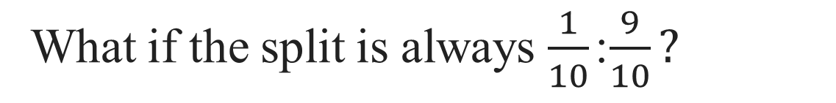
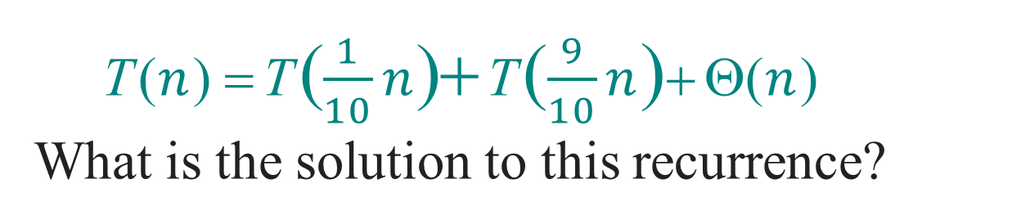
Best-Case Analysis
(For intuition only!)
If we’re lucky, PARTITION splits the array evenly:
T(n) = 2T(n/2) + Θ(n)
= Θ(n lg n)
(same as merge sort)
What if the split is always $\frac{1}{10}$ : $\frac{9}{10}?$
T ($n$) = T ( $\frac{1}{10}n$)+ T ( $\frac{9}{10}n$)+ Θ($n$)
What is the solution to this recurrence?

Slide 27
Analysis of “Almost-Best” Case
T (n)

Slide 28
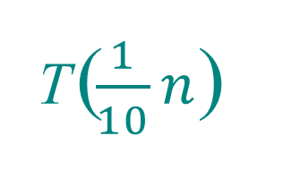
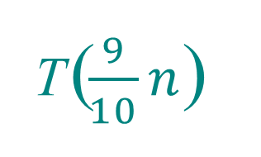
Analysis of “Almost-Best” Case
cn
T ($\frac{1}{10}n$)
T ($\frac{9}{10}n$)

Slide 29
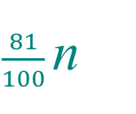
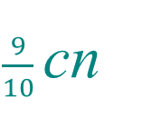
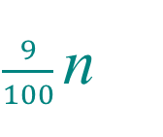
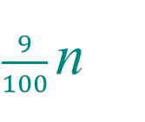
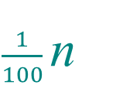
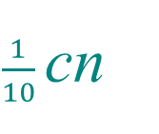
Analysis of “Almost-Best” Case
cn
$\frac{1}{10}$cn
$\frac{9}{10}$cn
T (
) T(
) T ( ) T( )
$\frac{1}{100}$n
$\frac{9}{100}$n
$\frac{9}{100}$n
$\frac{81}{100}$n

Slide 30
Analysis of “Almost-Best” Case
cn cn
cn
¹ cn
⁹ cn
log₁₀n
10
10
log n
10/9
cn
cn
cn
81
cn
1
9
9
cn
100
100
100
100
…
…
…
Θ(1)
Θ(n lg n)
Lucky!
O(n) leaves
Θ(1)
cn log₁₀n ≤ T(n) ≤ cn log_{10/9}n + O(n)

Slide 31

More Intuition
Suppose we alternate lucky, unlucky, lucky, unlucky, lucky, ….
L(n) = 2U(n/2) + Θ(n)
U(n) = L(n – 1) + Θ(n)
Solving:
lucky unlucky
L(n) = 2(L(n/2 – 1) + Θ(n/2)) + Θ(n)
= 2L(n/2 – 1) + Θ(n) ≤ 2L(n/2) + Θ(n)
= Θ(n lg n)
Lucky!
How can we make sure we are usually lucky?

Slide 32
Randomized Quicksort
IDEA: Partition around a random element.
RANDOMIZED-PARTITION(A, p, r)
i = RANDOM(p, r)
Exchange A[p] with A[i]
return PARTITION(A, p, r)
RANDOMIZED-QUICKSORT(A, p, r)
if p < r
then q ← RANDOMIZED-PARTITION(A, p, r)
RANDOMIZED-QUICKSORT(A, p, q–1)
RANDOMIZED-QUICKSORT(A, q+1, r)

Slide 33
Properties of Randomized Quicksort
Running time is independent of the input order.
No assumptions need to be made about the input distribution.
No specific input elicits the worst-case behavior.
The worst case is determined only by the output of a random-number generator.

Slide 34
Randomized Quicksort Analysis
Let T(n) = the random variable for the running time of randomized quicksort on an input of size n, assuming random numbers are independent.
For k = 0, 1, …, n–1, define the indicator random variable
1 if PARTITION generates a k : n–k–1 split, i.e., A[1] is the (k+1)th smallest number
0 otherwise.
X_{k} =
E[X_{k}] = Pr{X_{k} = 1} = 1/n, since all splits are equally likely, assuming elements are distinct.

Slide 35
Analysis (continued)
T(0) + T(n–1) + Θ(n) if 0 : n–1 split,
T(1) + T(n–2) + Θ(n) if 1 : n–2 split,
T(n–1) + T(0) + Θ(n) if n–1 : 0 split,
T(n) =
…
n−1
= ∑ X_{k} (T (k ) + T (n − k −1) + Θ(n))
k =0

Slide 36
Calculating Expectation
Take expectations of both sides.
E[T(n)] =
E
n−1
∑ X_{k} (T (k ) + T (n − k −1) + Θ(n))
k =0
⎫
⎧
⎩
⎭

Slide 37
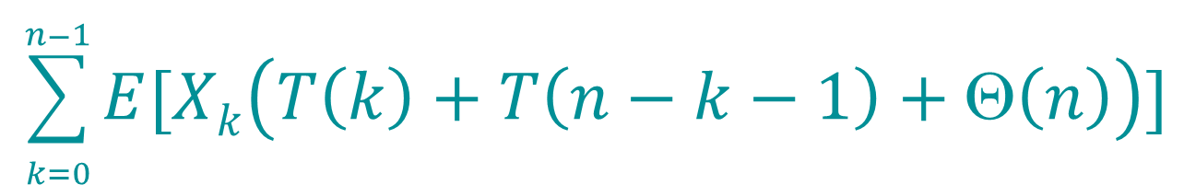
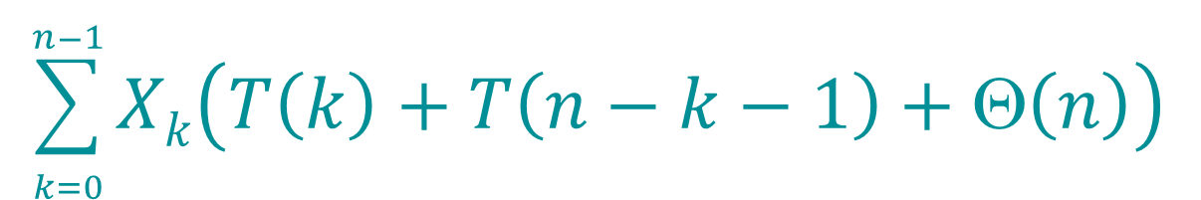
Calculating Expectation
Linearity of expectation.
E[T(n)]
= E
⎧
⎫
$$\sum_{k=0}^{n−1}{Xk\left(T\left(k\right)+T\left(n−k−1\right)+Θ\left(n\right)\right)}$$
=
⎩
⎭
$$\sum_{k=0}^{n−1}{E[Xk\left(T\left(k\right)+T\left(n−k−1\right)+Θ\left(n\right)\right)]}$$

Slide 38
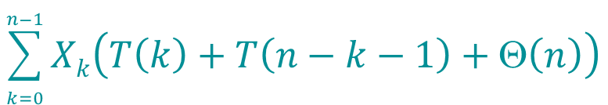
Calculating Expectation
E[T(n)]
= E
⎧
⎫
$$\sum_{k=0}^{n−1}{Xk\left(T\left(k\right)+T\left(n−k−1\right)+Θ\left(n\right)\right)}$$
⎩
⎭
n−1
= ∑ E[X_{k} (T (k ) + T (n − k − 1) + Θ(n))]
k =0
n−1
= ∑ E[X_{k} ]⋅ E[T (k ) + T (n − k − 1) + Θ(n)]
k =0
Independence of X_{k} from other random choices.

Slide 39

Calculating Expectation
E[T(n)]
= E
⎧
⎫
$$\sum_{k=0}^{n−1}{Xk\left(T\left(k\right)+T\left(n−k−1\right)+Θ\left(n\right)\right)}$$
⎩
⎭
n−1
= ∑ E[X_{k} (T (k ) + T (n − k − 1) + Θ(n))]
k =0
n−1
= ∑ E[X_{k} ]⋅ E[T (k ) + T (n − k − 1) + Θ(n)]
k =0
n−1 n−1 n−1
= ¹ ∑ E[T (k )]+ ¹ ∑ E[T (n − k − 1)]+ ¹ ∑Θ(n)
^{n} k =0 ^{n} k =0 ^{n} k =0
Linearity of expectation; E[X_{k}] = 1/n .

Slide 40
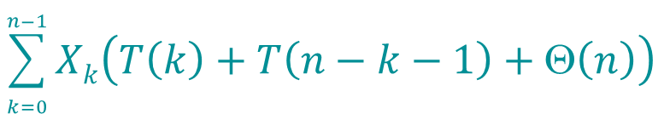
Calculating Expectation
E[T(n)]
= E
⎧
⎫
$$\sum_{k=0}^{n−1}{Xk\left(T\left(k\right)+T\left(n−k−1\right)+Θ\left(n\right)\right)}$$
⎩
⎭
n−1
= ∑ E[X_{k} (T (k ) + T (n − k − 1) + Θ(n))]
k =0
n−1
= ∑ E[X_{k} ]⋅ E[T (k ) + T (n − k − 1) + Θ(n)]
k =0
n−1 n−1 n−1
= ¹ ∑ E[T (k )]+ ¹ ∑ E[T (n − k − 1)]+ ¹ ∑Θ(n)
^{n} k =0 ^{n} k =0 ^{n} k =0
n−1
Summations have identical terms.
= ² ∑ E[T (k )]+ Θ(n)
^{n} k =0

Slide 41
Hairy Recurrence
(The k = 0 term can be absorbed in the Θ(n).)
Prove by induction: E[T(n)] ≤ an lg n for constant a > 0 .
Choose a large enough so that an lg n
dominates E[T(n)] for sufficiently large n ≥ 2.
n−1
E[T (n)] = ² ∑ E[T (k )]+ Θ(n)
n
k =0
n−1
Use fact: ∑
k =1
k lg k ≤ ¹ n² lg n − ¹n
2
2 8

Slide 42
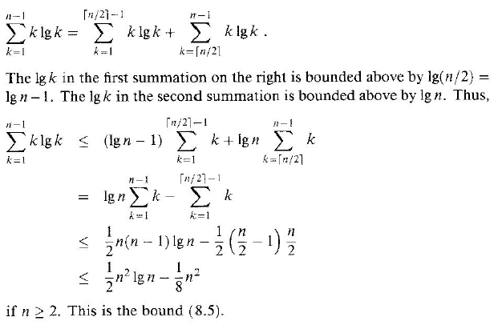
Upper Bound

Slide 43
Substitution Method
n−1
E[T (n)]≤ ² ∑ ak lg k + Θ(n)
^{n} k =1
Substitute inductive hypothesis.

Slide 44
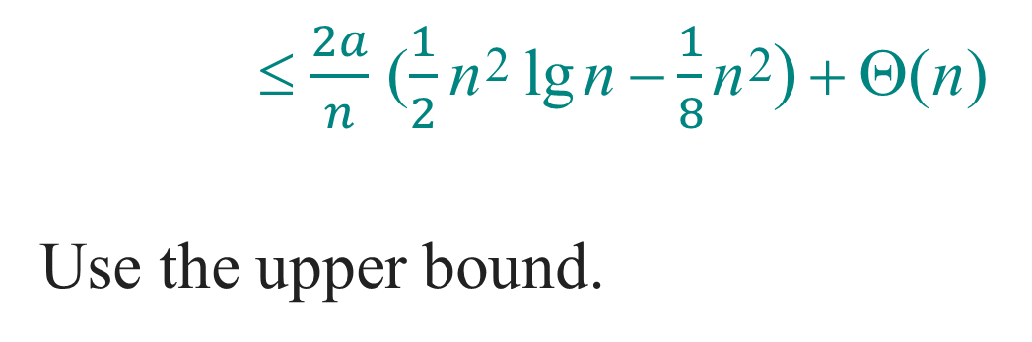
Substitution Method
n−1
E[T (n)]≤ ² ∑ ak lg k + Θ(n)
^{n} k =1
≤ $\frac{2a}{n}$ ($\frac{1}{2}$ n² lg n − $\frac{1}{8}$ n²) + Θ(n)
Use the upper bound.

Slide 45
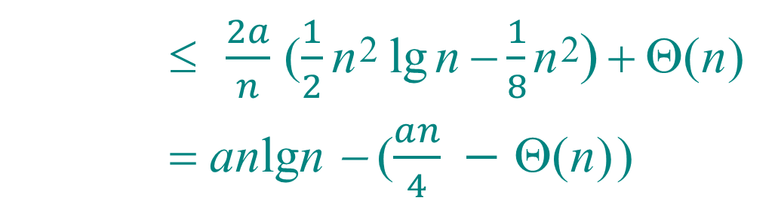
Substitution Method
n−1
E[T (n)]≤ ² ∑ ak lg k + Θ(n)
^{n} k =1
$\frac{2a}{n}$ ($\frac{1}{2}$ n² lg n − $\frac{1}{8}$ n²) + Θ(n)
= anlgn − ($\frac{an}{4} −$ Θ(n))
Express as desired – residual.

Slide 46
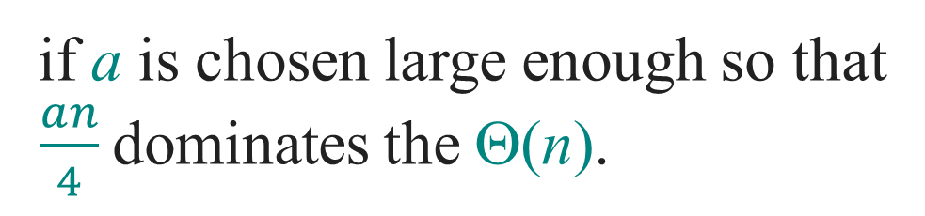
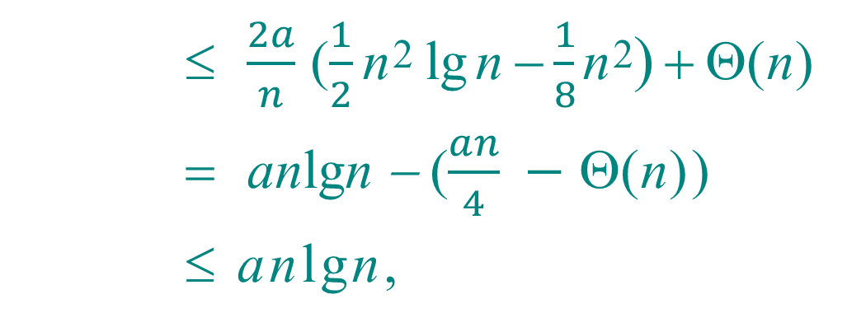
Substitution Method
n−1
E[T (n)]≤ ² ∑ ak lg k + Θ(n)
^{n} k =1
$\frac{2a}{n}$ ($\frac{1}{2}$ n² lg n − $\frac{1}{8}$ n²) + Θ(n)
anlgn − ($\frac{an}{4} −$ Θ(n))
≤ anlgn,
if a is chosen large enough so that
$\frac{an}{4}$dominates the Θ(n).

Slide 47
Quicksort in Practice
Quicksort is a great general-purpose sorting algorithm.
Quicksort is typically over twice as fast as merge sort.
Quicksort can benefit substantially from
code tuning.
Quicksort behaves well even with caching and virtual memory.

