Slide 1
CSC 580 Computer Algorithms
LECTURE 5. Heapsort

Slide 2

Agenda
Heapsort
Heap
Heap properties
Heap operations
Worst-case analysis
Application: priority queue

Slide 3
Sorting Revisited
So far we’ve talked about two algorithms to sort an array of numbers
What is the advantage of merge sort?
Answer: O(n lg n) worst-case running time
What is the advantage of insertion sort?
Answer: sorts in place
Also: When array “nearly sorted”, runs fast in practice
Next on the agenda: Heapsort
Combines advantages of both previous algorithms

Slide 4
Heaps
A heap can be seen as a complete binary tree:
What makes a binary tree complete?
Is the example above complete?
16
14
10
8
7
9
3
2
4
1

Slide 5
Heaps
A heap can be seen as a complete binary tree:
The book calls them “nearly complete” binary trees; can think of unfilled slots as null pointers
16
14
10
8
7
9
3
2
4
1
1
1
1
1
1

Slide 6
Heaps
In practice, heaps are usually implemented as arrays:
16
14
10
A =
16
14
10
8
7
9
3
2
4
1
=
8
7
9
3
2
4
1

Slide 7
Heaps
To represent a complete binary tree as an array:
The root node is A[1]
Node i is A[i]
The parent of node i is A[ ⎣i/2⎦ ] (note: integer divide)
The left child of node i is A[2i]
The right child of node i is A[2i + 1]
16
14
10
A =
16
14
10
8
7
9
3
2
4
1
=
8
7
9
3
2
4
1

Slide 8
Referencing Heap Elements
So…
Parent(i) { return ⎣i/2⎦; }
Left(i) { return 2*i; }
right(i) { return 2*i + 1; }
An aside: How would you implement this most efficiently?
Trick question, I was looking for “i << 1”, etc.
But, any modern compiler is smart enough to do this for you (and it makes the code hard to follow)

Slide 9
The Heap Property
Heaps also satisfy the heap property:
A[Parent(i)] ≥ A[i] for all nodes i > 1
In other words, the value of a node is at most the value of its parent
Where is the largest element in a heap stored?

Slide 10
Heap Height
Definitions:
The height of a node in the tree = the number of edges on the longest downward path to a leaf
The height of a tree = the height of its root
What is the height of an n-element heap? Why?
This is nice: basic heap operations take at most time proportional to the height of the heap

Slide 11
Heap Operations: Heapify()
Heapify(): maintain the heap property
Given a node i in the heap with children l and r
Assume two subtrees rooted at l and r are heaps
Problem: The subtree rooted at i may violate the heap property (How?)
Approach: Let the value of the parent node “float down” such that the subtree rooted at i satisfies the heap property
If A[i] < A[l] or A[i] < A[r], swap A[i] with the larger of A[l] and A[r]
Recurse on that subtree

Slide 12
Heap Operations: Heapify()
Heapify(A, i)
{
l = Left(i); r = Right(i); // l = 2*i and r = 2*i+1
if (l <= heap_size(A) && A[l] > A[i])
largest = l;
else
largest = i;
if (r <= heap_size(A) && A[r] > A[largest])
largest = r;
if (largest != i)
Swap(A, i, largest);
Heapify(A, largest);
}

Slide 13
Heapify() Example
16
4
10
14
7
9
3
2
8
1
A =
16
4
10
14
7
9
3
2
8
1

Slide 14
Heapify() Example
16
4
10
14
7
9
3
2
8
1
A =
16
4
10
14
7
9
3
2
8
1

Slide 15
Heapify() Example
16
4
10
14
7
9
3
2
8
1
A =
16
4
10
14
7
9
3
2
8
1

Slide 16
Heapify() Example
16
14
10
4
7
9
3
2
8
1
A =
16
14
10
4
7
9
3
2
8
1

Slide 17
Heapify() Example
16
14
10
4
7
9
3
2
8
1
A =
16
14
10
4
7
9
3
2
8
1

Slide 18
Heapify() Example
16
14
10
4
7
9
3
2
8
1
A =
16
14
10
4
7
9
3
2
8
1

Slide 19
Heapify() Example
16
14
10
8
7
9
3
2
4
1
A =
16
14
10
8
7
9
3
2
4
1

Slide 20
Heapify() Example
16
14
10
8
7
9
3
2
4
1
A =
16
14
10
8
7
9
3
2
4
1

Slide 21
Heapify() Example
16
14
10
8
7
9
3
2
4
1
A =
16
14
10
8
7
9
3
2
4
1

Slide 22
Analyzing Heapify(): Informal
Aside from the recursive call, what is the run time of Heapify()?
What is the max number of times that Heapify() is called recursively?
What is the worst-case run time of Heapify() on a heap of size n?

Slide 23
Analyzing Heapify(): Formal
Fixing up relationships between i, l, and r takes Θ(1) time
If the heap at i has n elements, how many elements can the subtrees at l or r have at most?
Draw it
Answer: 2n/3 (worst case: bottom row 1/2 full)
So run time taken by Heapify() is given by
T(n) ≤ T(2n/3) + Θ(1)
Notes:
The worst case happens when the size of the left child is 2^{k}-1 and that of the right child is 2^{k-1}-1. The tree size is (2^{k}-1)+(2^{k-1}-1)+1 =
3*2^{k-1}-1. Therefore, the size ratio of the left tree over the entire tree is (2*2^{k-1}-1)/(3*2^{k-1}-1) <=2/3.

Slide 24
Analyzing Heapify(): Formal (cont’d)
So we have
T(n) ≤ T(2n/3) + Θ(1)
By case 2 of the Master Theorem,
T(n) = O(lg n)
Thus, Heapify() takes logarithmic time

Slide 25
Heap Operations: BuildHeap()
We can build a heap in a bottom-up manner by running Heapify() on successive subarrays
Fact: for array of length n, all elements in range A[⎣n/2⎦ + 1 .. n] are heaps (Why?)
So:
Walk backwards through the array from n/2 to 1, calling Heapify() on each node.
Order of processing guarantees that the children of node i are heaps when i is processed

Slide 26
BuildHeap()
// given an unsorted array A, make A a heap
BuildHeap(A)
{
heap_size(A) = length(A);
for (i = ⎣length[A]/2⎦ downto 1)
Heapify(A, i);
}

Slide 27
BuildHeap() Example
Work through example A = {4, 1, 3, 2, 16, 9, 10, 14, 8, 7}
4
1
3
2
16
9
10
14
8
7

Slide 28
Analyzing BuildHeap()
Each call to Heapify() takes O(lg n) time
There are O(n) such calls (specifically, ⎣n/2⎦)
Thus the running time is O(n lg n)
Is this a correct asymptotic upper bound?
Is this an asymptotically tight bound?
A tighter bound is O(n)
How can this be? Is there a flaw in the above reasoning?

Slide 29
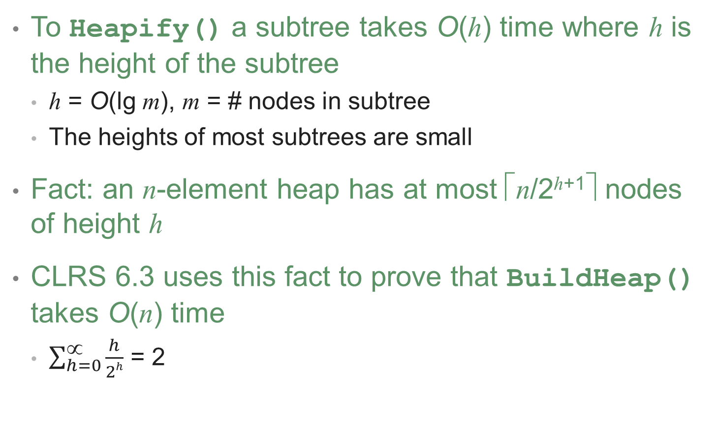
Analyzing BuildHeap(): Tight
To Heapify() a subtree takes O(h) time where h is the height of the subtree
h = O(lg m), m = # nodes in subtree
The heights of most subtrees are small
Fact: an n-element heap has at most ⎡n/2^{h+1}⎤ nodes of height h
CLRS 6.3 uses this fact to prove that BuildHeap() takes O(n) time
$\sum_{h=0}^{∝}{\frac{h}{2h}}$ = 2

Slide 30
Heapsort
Given BuildHeap(), an in-place sorting algorithm is easily constructed:
Maximum element is at A[1]
Discard by swapping with element at A[n]
Decrement heap_size[A]
A[n] now contains correct value
Restore heap property at A[1] by calling Heapify()
Repeat, always swapping A[1] for A[heap_size(A)]

Slide 31
Heapsort
Heapsort(A)
{
BuildHeap(A);
for (i = length(A) downto 2)
{
Swap(A[1], A[i]);
heap_size(A) -= 1;
Heapify(A, 1);
}
}

Slide 32
Analyzing Heapsort
The call to BuildHeap() takes O(n) time
Each of the n - 1 calls to Heapify() takes O(lg n) time
Thus the total time taken by HeapSort() = O(n) + (n - 1) O(lg n) = O(n) + O(n lg n) = O(n lg n)

Slide 33
Priority Queues
Heapsort is a nice algorithm, but in practice Quicksort usually wins
But the heap data structure is incredibly useful for implementing priority queues
A data structure for maintaining a set S of elements, each with an associated value or key
Supports the operations Insert(), Maximum(), and ExtractMax()
What might a priority queue be useful for?

Slide 34
Priority Queue Operations
Insert(S, x) inserts the element x into set S
Maximum(S) returns the element of S with the maximum key
ExtractMax(S) removes and returns the element of S with the maximum key
How could we implement these operations using a heap?

Slide 35
Implementing Priority Queues
Insert(A, key) // what’s running time?
{
heap_size[A] ++;
i = heap_size[A];
while (i > 1 AND A[Parent(i)] > key)
{
A[i] = A[Parent(i)];
i = Parent(i);
}
A[i] = key;
}

Slide 36
Implementing Priority Queues
Minimum(A)
{
// This one is really tricky:
return A[1];
}

Slide 37
Implementing Priority Queues
ExtractMin(A)
{
if (heap_size[A] < 1) { error; }
min = A[1];
A[1] = A[heap_size[A]]
heap_size[A] --;
Heapify(A, 1);
return min;
}

Slide 38
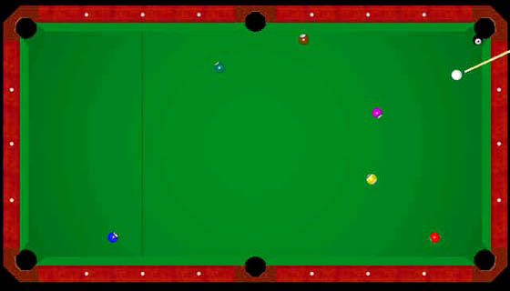
Tying It Into The “Real World”
And now, a real-world example…combat billiards
Problem: how do you simulate the physics?
Goal: Simulate the motion of n moving particles that behave
according to the laws of elastic collision.
Figure 1: boring traditional pool

Slide 39
Combat Billiards
Simplifying assumptions: Hard sphere model
Moving particles interact via elastic collisions with each other, and with fixed walls
Each particle is a sphere with known position, velocity, mass, and radius
Easy to calculate the positions of the balls at time T_{n} from time T_{n-1} if there are no collisions in between
No other forces are exerted.
No spin, no friction
Simple elastic collisions

Slide 40
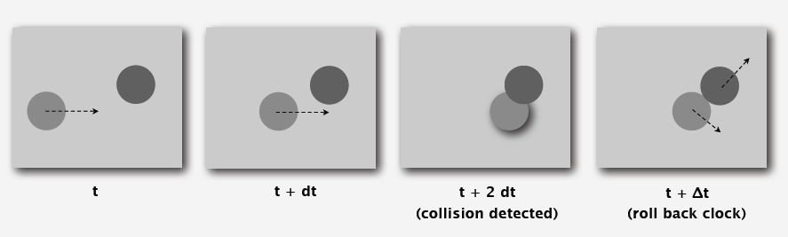
Simulating The Physics
Time-driven simulation.
• Discretize time in quanta of size dt.
• Update the position of each particle after every dt units of time, and check for overlaps.
• If overlap, roll back the clock to the time of the collision, update the velocities of the colliding particles, and continue the simulation.

Slide 41
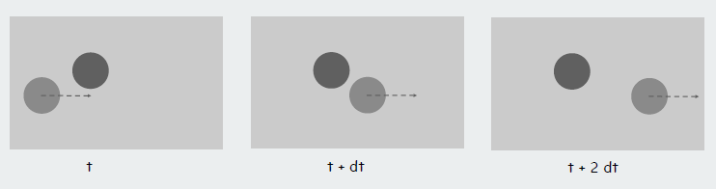
Time-Driven Simulation
Main drawbacks.
• n² overlap checks per time quantum
• May miss collisions if dt is too large and colliding particles fail to overlap when we are looking
• Simulation is too slow if dt is very small

Slide 42
Event-Driven Simulation
Given the state of the system, we can calculate when the next collision will occur for each ball
Change the state only when a collision happens.
Between collisions, particles move in straight-line trajectories
Focus only on times when collisions occur
Maintain priority queue of collision events, prioritized by time
Remove the minimum = get next collision
At each collision C_{i}:
Advance the system to the time T_{i} of the collision
Re-compute the next collision for the ball(s) involved
Find the next overall collision C_{i+1} and repeat
How should we keep track of all these collisions and when they occur?

Slide 43
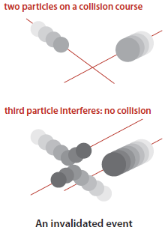
Event-Driven Simulation (cont’d)
Initialization:
• Fill PQ with all potential particle-wall and particle-particle collisions
Main loop.
• Delete the impending event from PQ
(min priority = t).
• If the event is no longer valid,
ignore it.
• Advance all particles to time t, on a straight-line trajectory.
• Update the velocities of the colliding particle(s).
• Predict future particle-wall and particle-particle collisions involving the colliding particle(s) and insert events onto PQ.

