Slide 1
CSC 580 Computer Algorithms
LECTURE 6. Sorting Lower Bounds

Slide 2
Agenda
Sorting Lower Bounds
Decision trees
Linear-Time Sorting
Counting sort
Radix sort
Conclusions

Slide 3
How Fast Can We Sort?
All the sorting algorithms we have seen so far are comparison sorts: only use comparisons to determine the relative order of elements.
E.g., insertion sort, merge sort, quicksort, heapsort.
The best worst-case running time that we’ve seen for comparison sorting is O(n lg n) .
Is O(nlgn) the best we can do?
Decision trees can help us answer this question.

Slide 4
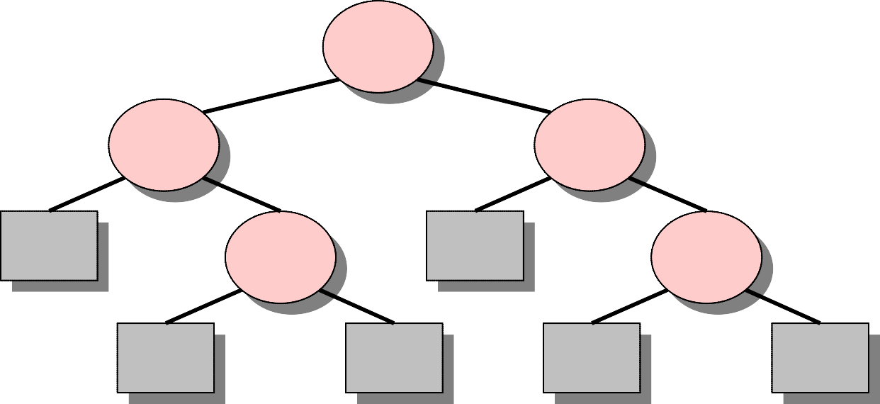
Decision-Tree Example
Sort ⟨a₁, a₂, …, a_{n}⟩
123
1:2
_{2:3}
1:3
1:3
213
2:3
132
312
231
321
Each internal node is labeled i:j for i, j ∈ {1, 2,…, n}.
• The left subtree shows subsequent comparisons if a_{i} ≤ a_{j}.
• The right subtree shows subsequent comparisons if a_{i} ≥ a_{j}.

Slide 5
Decision-Tree Example
Sort ⟨a₁, a₂, a₃⟩
⟨ 9, 4, 6 ⟩:
1:2
9 ≥ 4
_{2:3}
1:3
9 ≥ 6
123
1:3
213
2:3
4 ≤ 6
132
312
231
321
4 ≤ 6 ≤ 9
Each internal node is labeled i:j for i, j ∈ {1, 2,…, n}.
• The left subtree shows subsequent comparisons if a_{i} ≤ a_{j}.
• The right subtree shows subsequent comparisons if a_{i} ≥ a_{j}.
Each leaf contains a permutation ⟨π(1), π(2),…, π(n)⟩ to indicate that the ordering a_{π(1)} ≤ a_{π(2)} ≤ … ≤ a_{π(n)} has been established.

Slide 6
Decision-Tree Model
A decision tree can model the execution of any comparison sort:
One tree for each input size n.
View the algorithm as splitting whenever it compares two elements.
The tree contains the comparisons along all possible instruction traces.
The running time of the algorithm = the length of the path taken.
Worst-case running time = height of tree.

Slide 7
Lower Bound for Decision-Tree Sorting
Theorem. Any decision tree that can sort n
elements must have height Ω(n lg n) .
Proof. The tree must contain ≥ n! leaves, since there are n! possible permutations. A height-h binary tree has at most 2^{h} leaves. To have n! leaves, the height of the decision tree has to be at least
lg(n!)
≥ lg ((n/e)^{n})
= n lg n – n lg e
(lg is mono. increasing) (Stirling’s formula)
= Ω(n lg n) .

Slide 8
Lower Bound for Comparison Sorting
Corollary. Heapsort and merge sort are asymptotically optimal comparison sorting algorithms.
L5.10

Slide 9
Sorting in Linear Time
Counting sort: No comparisons between elements.
• Input: A[1 . . n], where A[ j]∈{1, 2, …, k} .
Output: B[1 . . n], sorted.
Auxiliary storage: C[1 . . k] .

Slide 10
Counting Sort
for i ← 1 to k
do C[i] ← 0
for j ← 1 to n
do C[A[ j]] ← C[A[ j]] + 1
for i ← 2 to k
do C[i] ← C[i] + C[i–1]
for j ← n downto 1
do B[C[A[ j]]] ← A[ j]
C[A[ j]] ← C[A[ j]] – 1
⊳ C[i] = |{key = i}|
⊳ C[i] = |{key ≤ i}|

Slide 11
Counting-Sort Example
1
2
3
4
5
1
2
3
4
A: 4 1 3 4 3
C:
B:

Slide 12
Loop 1
1
2
3
4
5
1
2
3
4
A: 4 1 3 4 3
C: 0 0 0 0
B:
for i ← 1 to k
do C[i] ← 0

Slide 13
Loop 2
1
2
3
4
5
1
2
3
4
A: 4 1 3 4 3
0
0
1
C: 0 0 0 1
B:
for j ← 1 to n
do C[A[ j]] ← C[A[ j]] + 1
⊳ C[i] = |{key = i}|

Slide 14
Loop 2
1
2
3
4
5
1
2
3
4
A: 4 1 3 4 3
0
0
1
C: 1 0 0 1
B:
for j ← 1 to n
do C[A[ j]] ← C[A[ j]] + 1
⊳ C[i] = |{key = i}|

Slide 15
Loop 2
1
2
3
4
5
1
2
3
4
A: 4 1 3 4 3
0
1
1
C: 1 0 1 1
B:
for j ← 1 to n
do C[A[ j]] ← C[A[ j]] + 1
⊳ C[i] = |{key = i}|

Slide 16
Loop 2
1
2
3
4
5
1
2
3
4
A: 4 1 3 4 3
0
1
2
C: 1 0 1 2
B:
for j ← 1 to n
do C[A[ j]] ← C[A[ j]] + 1
⊳ C[i] = |{key = i}|

Slide 17
Loop 2
1
2
3
4
5
1
2
3
4
A: 4 1 3 4 3
0
2
2
C: 1 0 2 2
B:
for j ← 1 to n
do C[A[ j]] ← C[A[ j]] + 1
⊳ C[i] = |{key = i}|

Slide 18
Loop 3
1
2
3
4
5
1
2
3
4
A: 4 1 3 4 3
B:
for i ← 2 to k
do C[i] ← C[i] + C[i–1]
C: 1 0 2 2
C': 1 1 2 2
1
1
2
2
⊳ C[i] = |{key ≤ i}|
L5.20

Slide 19
Loop 3
1
2
3
4
5
1
2
3
4
A: 4 1 3 4 3
B:
for i ← 2 to k
do C[i] ← C[i] + C[i–1]
C: 1 0 2 2
C': 1 1 3 2
1
1
3
2
⊳ C[i] = |{key ≤ i}|

Slide 20
Loop 3
1
2
3
4
5
1
2
3
4
A: 4 1 3 4 3
B:
for i ← 2 to k
do C[i] ← C[i] + C[i–1]
C: 1 0 2 2
C': 1 1 3 5
1
1
3
5
⊳ C[i] = |{key ≤ i}|

Slide 21
Loop 4
1
2
3
4
5
1
2
3
4
A: 4 1 3 4 3
C: 1 1 3 5
B: 3
C': 1 1 2 5
for j ← n downto 1
do B[C[A[ j]]] ← A[ j]
C[A[ j]] ← C[A[ j]] – 1

Slide 22
Loop 4
1
2
3
4
5
1
2
3
4
A: 4 1 3 4 3
C: 1 1 2 5
B: 3 4
C': 1 1 2 4
for j ← n downto 1
do B[C[A[ j]]] ← A[ j]
C[A[ j]] ← C[A[ j]] – 1

Slide 23
Loop 4
1
2
3
4
5
1
2
3
4
A: 4 1 3 4 3
C: 1 1 2 4
B: 3 3 4
C': 1 1 1 4
for j ← n downto 1
do B[C[A[ j]]] ← A[ j]
C[A[ j]] ← C[A[ j]] – 1

Slide 24
Loop 4
1
2
3
4
5
1
2
3
4
A: 4 1 3 4 3
C: 1 1 1 4
1
B: 1 3 3 4
C': 0 1 1 4
for j ← n downto 1
do B[C[A[ j]]] ← A[ j]
C[A[ j]] ← C[A[ j]] – 1

Slide 25
Loop 4
1
2
3
4
5
1
2
3
4
A: 4 1 3 4 3
C: 0 1 1 4
1
B: 1 3 3 4 4
C': 0 1 1 3
for j ← n downto 1
do B[C[A[ j]]] ← A[ j]
C[A[ j]] ← C[A[ j]] – 1

Slide 26
Analysis
for i ← 1 to k
Θ(k)
do C[i] ← 0
for j ← 1 to n
do C[A[ j]] ← C[A[ j]] + 1
for i ← 2 to k
do C[i] ← C[i] + C[i–1]
for j ← n downto 1
do B[C[A[ j]]] ← A[ j]
C[A[ j]] ← C[A[ j]] – 1
Θ(n)
Θ(k)
Θ(n)
Θ(n + k)

Slide 27
Running Time
If k = O(n), then counting sort takes Θ(n) time.
But, sorting takes Ω(n lg n) time!
Where’s the fallacy?
Answer:
Comparison sorting takes Ω(n lg n) time.
Counting sort is not a comparison sort.
In fact, not a single comparison between elements occurs!

Slide 28
Stable Sorting
Counting sort is a stable sort: it preserves the input order among equal elements.
A: 4 1 3 4 3
B: 1 3 3 4 4
Exercise: What other sorts have this property?
3
4
3
1
3
3
4
4
L5.30

Slide 29
Radix Sort
Origin: Herman Hollerith’s card-sorting machine for the 1890 U.S. Census.
Digit-by-digit sort.
Hollerith’s original (bad) idea: sort on most-significant digit first, generating many intermediate piles of numbers to keep track of.
Good idea: Sort on least-significant digit first with auxiliary stable sort.

Slide 30
Operation of Radix Sort
3 2 9
4 5 7
6 5 7
8 3 9
4 3 6
7 2 0
3 5 5
7 2 0
3 5 5
4 3 6
4 5 7
6 5 7
3 2 9
8 3 9
7 2 0
3 2 9
4 3 6
8 3 9
3 5 5
4 5 7
6 5 7
3 2 9
3 5 5
4 3 6
4 5 7
6 5 7
7 2 0
8 3 9

Slide 31
Correctness of Radix Sort
Induction on digit position
Assume that the numbers are sorted by their low-order (t – 1) digits.
Sort on digit t
7 2 0
3 2 9
4 3 6
8 3 9
3 5 5
4 5 7
6 5 7
3 2 9
3 5 5
4 3 6
4 5 7
6 5 7
7 2 0
8 3 9
Two numbers that differ in digit t are correctly sorted.
Two numbers equal in digit t are put in the same order as the input ⇒ correct order.

Slide 32
Analysis of Radix Sort
Assume counting sort is the auxiliary stable sort.
Sort n computer words of b bits each.
Each word can be viewed as having b/r base-2^{r}
digits.
Example: 32-bit word
8 8 8 8
r = 8 ⇒ b/r = 4 passes of counting sort on base-2⁸ digits; or r = 16 ⇒ b/r = 2 passes of counting sort on base-2¹⁶ digits.
How many passes should we make?

Slide 33
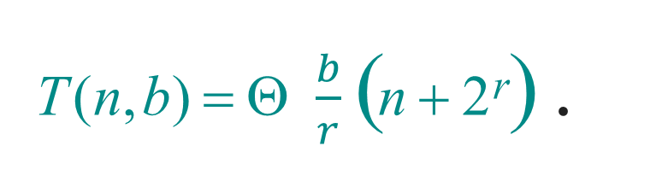
Analysis (continued)
Recall: Counting sort takes Θ(n + k) time to sort n numbers in the range from 0 to k – 1.
If each b-bit word is broken into r-bit pieces, each pass of counting sort takes Θ(n + 2^{r}) time. Since there are b/r passes, we have
⎧
⎫
T (n, b) = Θ $\frac{b}{r}$( n + 2^{r}) .
⎩
⎭
Choose r to minimize T(n, b):
Increasing r means fewer passes, but as
r >> lg n, the time grows exponentially.

Slide 34
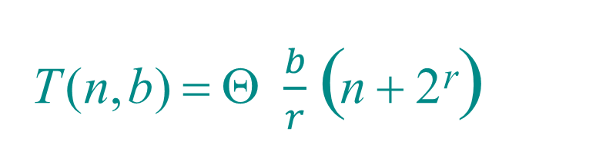
Choosing r
⎧
⎫
T (n, b) = Θ $\frac{b}{r}$( n + 2^{r})
⎩
⎭
Minimize T(n, b) by differentiating and setting to 0.
Or, just observe that we don’t want 2^{r} >> n, and there’s no harm asymptotically in choosing r as large as possible subject to this constraint.
Choosing r = lg n implies T(n, b) = Θ(bn/lg n) .
For numbers in the range from 0 to n^{d} – 1, we have b = d lg n ⇒ radix sort runs in Θ(dn) time.

Slide 35
Conclusions
In practice, radix sort is fast for large inputs, as well as simple to code and maintain.
Example (32-bit numbers):
At most 3 passes when sorting ≥ 2000 numbers.
Merge sort and quicksort do at least ⎡lg 2000⎤ = 11 passes.
Downside: Unlike quicksort, radix sort displays little locality of reference, and thus a well-tuned quicksort fares better on modern processors, which feature steep memory hierarchies.

