Slide 1
CSC 580 Computer Algorithms
LECTURE 7. Order Statistics

Slide 2
Agenda
Randomized divide and conquer
Analysis of expected time
Worst-case linear-time order statistics
Analysis

Slide 3

Order Statistics
Select the ith smallest of n elements (the element with rank i).
i = 1: minimum;
i = n: maximum;
• i = ⎣(n+1)/2⎦ or ⎡(n+1)/2⎤: median.
Naive algorithm: Sort and index ith element. Worst-case running time = Θ(n log n) + Θ(1)
= Θ(n log n),
using merge sort or heapsort (not quicksort).

Slide 4
Randomized Divide-and-Conquer
RAND-SELECT(A, p, q, i) ⊳ ith smallest of A[ p .. q]
if p = q then return A[ p]
r ← RANDOMIZED-PARTITION(A, p, q)
k ← r – p + 1 ⊳ k = rank(A[r])
then return RAND-SELECT( A, p, r – 1, i )
else return RAND-SELECT( A, r + 1, q, i – k )
k
≤ A[r] ≥ A[r]
if | i = k | then return A[ r]
if | i < k
≤ A[r]
≥ A[r]
p
r
q

Slide 5
Example
Select the i = 7th smallest:
6 10
pivot
Partition:
2 5
13 5 8
3 2 11
i = 7
6
10
13
5
8
3
2
11
2
5
3 6 8 13 10 11 k = 4
3
6
8
13
10
11
Select the 7 – 4 = 3rd smallest recursively.

Slide 6
Intuition for Analysis
(All our analyses assume that all elements are distinct.)
Lucky:
T(n) = T(9n/10) + Θ(n)
= Θ(n)
Unlucky:
T(n) = T(n – 1) + Θ(n)
= Θ(n²)
Worse than sorting!
n^{log10 / 91} = n⁰ = 1
CASE 3
arithmetic series

Slide 7
Analysis of Expected Time
The analysis follows that of randomized quicksort, but it’s a little different.
Let T(n) = the random variable for the running time of RAND-SELECT on an input of size n, assuming random numbers are independent.
For k = 0, 1, …, n–1, define the indicator random variable
1 if PARTITION generates a k : n–k–1 split,
0 otherwise.
X_{k} =

Slide 8
Analysis (cont'd)
T(max{0, n–1}) + Θ(n)
T(max{1, n–2}) + Θ(n)
⁞
T(max{n–1, 0}) + Θ(n)
To obtain an upper bound, assume that the ith element always falls in the larger side of the partition:
if 0 : n–1 split,
if 1 : n–2 split,
T(n) =
if n–1 : 0 split,
n−1
= ∑ X_{k} (T (max{k, n − k − 1}) + Θ(n)).
k =0

Slide 9
Calculating Expectation
⎧
n−1
⎫
E[T (n)] = E ∑ X_{k} (T (max{k, n − k − 1}) + Θ(n))
⎩
⎭
k =0
Take expectations of both sides.
n−1
= ∑ E[X_{k} (T (max{k, n − k − 1}) + Θ(n))]
k =0
Linearity of expectation.
n−1
= ∑ E[X_{k} ]⋅ E[T (max{k, n − k − 1}) + Θ(n)]
k =0
Independence of X_{k} from other random choices.

Slide 10
Calculating Expectation
⎧
n−1
⎫
E[T (n)] = E ∑ X_{k} (T (max{k, n − k − 1}) + Θ(n))
_{k = 0}
⎩
⎭
n−1
= ∑ E[X_{k} (T (max{k, n − k − 1}) + Θ(n))]
k =0
n−1
= ∑ E[X_{k} ]⋅ E[T (max{k, n − k − 1}) + Θ(n)]
k =0
n−1 n−1
= ¹ ∑ E[T (max{k, n − k − 1})]+ ¹ ∑Θ(n)
^{n} k =0
^{n} k =0
Linearity of expectation; E[X_{k}] = 1/n .
n−1
₌ 2
∑ E[T (k )]+ Θ(n)
Upper terms appear twice.
^{n} k =⎣n/2⎦

Slide 11
Hairy Recurrence
(But not quite as hairy as the quicksort one.)
2
n−1
E[T (n)] =
∑ E[T (k )]+ Θ(n)
^{n} k =⎣n/2⎦
Prove: E[T(n)] ≤ cn for constant c > 0 .
The constant c can be chosen large enough so that E[T(n)] ≤ cn for the base cases.
n−1
∑ k ≤ ³ n²
Use fact:
(exercise).
8
k =⎣n/2⎦

Slide 12
Substitution Method
2
n−1
n−1
∑ E[T (k )]+ Θ(n)
2
∑ ck + Θ(n)
E[T (n)] ₌
≤
^{n} k =⎣n/2⎦
^{n} k =⎣n/2⎦
Substitute inductive hypothesis.
≤ ^{2c} ⋅ ₍ ³ _{n}² ₎ _{+ Θ(n)}
Use fact.
n 8
⎧
⎫
= cn − ^{cn} − Θ(n)
⎩
⎭
4
Express as desired – residual.
≤ cn ,
if c is chosen large enough so that cn/4 dominates the Θ(n).

Slide 13
Summary
Randomized order-statistic selection
Works fast: linear expected time.
Excellent algorithm in practice.
But, the worst case is very bad: Θ(n²).
Q. Is there an algorithm that runs in linear time in the worst case?
A. Yes, due to Blum, Floyd, Pratt, Rivest, and Tarjan [1973].
IDEA: Generate a good pivot recursively.

Slide 14
Worst-Case Linear-Time Order Statistics
SELECT(i, n)
Divide the n elements into groups of 5. Find the median of each 5-element group by rote.
Recursively SELECT the median x of the ⎣n/5⎦
group medians to be the pivot.
Partition around the pivot x. Let k = rank(x).
if i = k then return x
elseif i < k
then recursively SELECT the ith smallest element in the lower part
else recursively SELECT the (i–k)th smallest element in the upper part
Same as RAND- SELECT

Slide 15
Choosing the Pivot
1. Divide the n elements into groups of 5.

Slide 16








Choosing the Pivot (cont’d)
1. Divide the n elements into groups of 5. Find the median of each 5-element group by rote.
lesser
greater

Slide 17
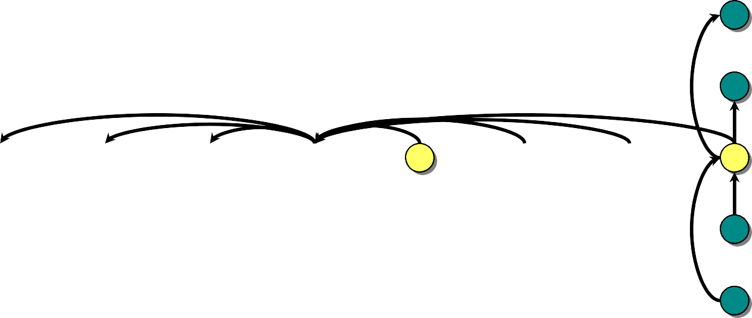

Choosing the Pivot (cont’d)
x
Divide the n elements into groups of 5. Find the median of each 5-element group by rote.
Recursively SELECT the median x of the ⎣n/5⎦
lesser
group medians to be the pivot.
greater

Slide 18
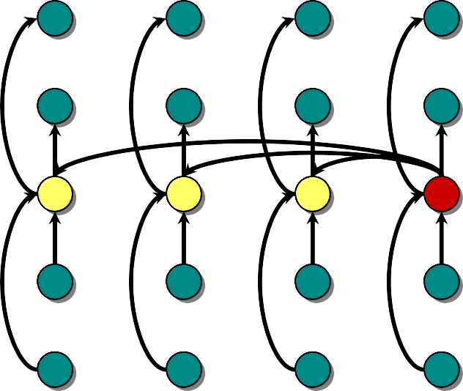
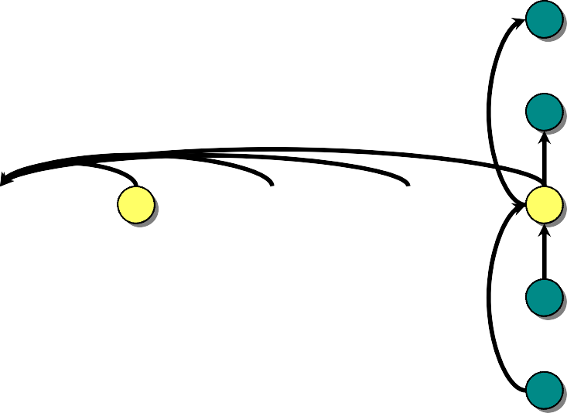
Analysis
x
At least half the group medians are ≤ x, which is at least ⎣⎣n/5⎦ /2⎦ = ⎣n/10⎦ group medians.
lesser
greater

Slide 19
Analysis (cont’d)
Assume all elements are distinct.
x
At least half the group medians are ≤ x, which is at least ⎣⎣n/5⎦ /2⎦ = ⎣n/10⎦ group medians.
Therefore, at least 3⋅ ⎣n/10⎦ elements are ≤ x.
lesser
greater

Slide 20
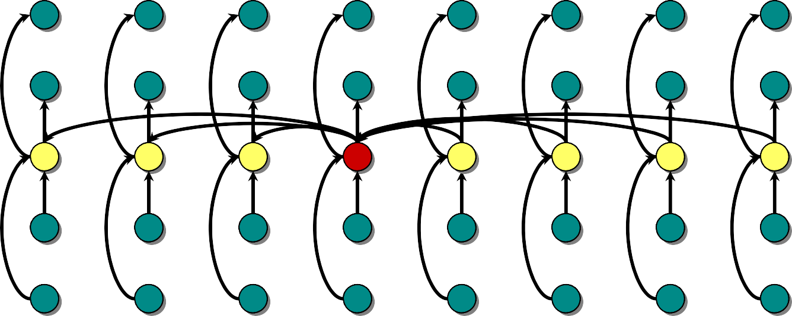
Analysis (cont’d)
Assume all elements are distinct.
x
At least half the group medians are ≤ x, which is at least ⎣⎣n/5⎦ /2⎦ = ⎣n/10⎦ group medians.
Therefore, at least 3⋅ ⎣n/10⎦ elements are ≤ x.
Similarly, at least 3⋅ ⎣n/10⎦ elements are ≥ x.
lesser
greater

Slide 21
Minor Simplification
• For n ≥ 50, we have 3⋅ ⎣n/10⎦ ≥ n/4.
Therefore, for n ≥ 50 the recursive call to SELECT in Step 4 is executed recursively on ≤ 3n/4 elements.
Thus, the recurrence for running time can assume that Step 4 takes time T(3n/4) in the worst case.
For n < 50, we know that the worst-case time is T(n) = Θ(1).

Slide 22
Developing the Recurrence
T(n)
SELECT(i, n)
Divide the n elements into groups of 5. Find the median of each 5-element group by rote.
Recursively SELECT the median x of the ⎣n/5⎦
group medians to be the pivot.
Partition around the pivot x. Let k = rank(x).
Θ(n)
T(n/5)
Θ(n)
4. if i = k then return x
elseif i < k
then recursively SELECT the ith smallest element in the lower part
else recursively SELECT the (i–k)th smallest element in the upper part
T(3n/4)

Slide 23
Solving the Recurrence
⎧
⎫
⎧
⎫
T (n) = T ¹ n + T ³ n + Θ(n)
4
⎩
⎭
⎩
⎭
5
T (n) ≤ ¹ cn + ³ cn + Θ(n)
Substitution:
T(n) ≤ cn
5 4
= ¹⁹ cn + Θ(n)
20
⎧
⎫
= cn − ¹ cn − Θ(n)
⎩
20
⎭
≤ cn ,
if c is chosen large enough to handle both the
Θ(n) and the initial conditions.

Slide 24
Conclusions
Since the work at each level of recursion is a constant fraction (19/20) smaller, the work per level is a geometric series dominated by the linear work at the root.
In practice, this algorithm runs slowly, because the constant in front of n is large.
The randomized algorithm is far more practical.
Exercise: Why not divide into groups of 3?

