Slide 1
CSC 580 Computer Algorithms
LECTURE 9. Binary Search Trees

Slide 2
Agenda
Binary search tree
Properties
Search
Insertion
Traversal
Deletion

Slide 3
Trees
Rooted Tree: collection of nodes and edges
Edges go down from root (from parents to children)
No two paths to the same node
Sometimes, children have “names” (e.g. left, right, middle, etc)

Slide 4
Binary Search Trees
Binary tree: every node has 0, 1 or 2 children
BST property:
If y is in left subtree of x, then key[y] ≤ key[x]
If y is in right subtree of x, then key[y] ≥ key[x]
3
1
8
2
6
5
7

Slide 5
Implementation
Keep pointers to parent and both children
Each NODE has
left: pointer to NODE
right: pointer to NODE
p: pointer to NODE
key: real number (or other type that supports comparisons)

Slide 6
Drawing BST’s
To help you visualize relationships:
Drop vertical lines to keep nodes in right order
For example: picture shows the only legal location to insert a node with key 4
3
1
8
2
6
5
7
1
2
3
5
6
7
8

Slide 7
Height of a BST can be...
... as small as log(n)
full balanced tree
... as much as n-1
unbalanced tree
n
n-1
...
1

Slide 8
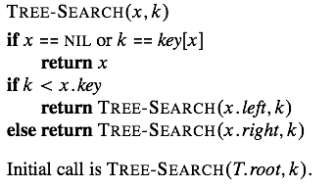
Searching a BST
Worst Case Running time: Θ(height)

Slide 9
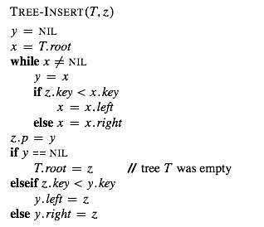
Insertion
Find location of insertion, keep track of parent during search
Worst Case Running time: Θ(height)

Slide 10
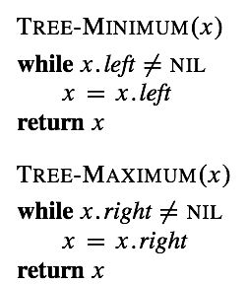
Tree Min and Max
Running time: Θ(node depth)

Slide 11
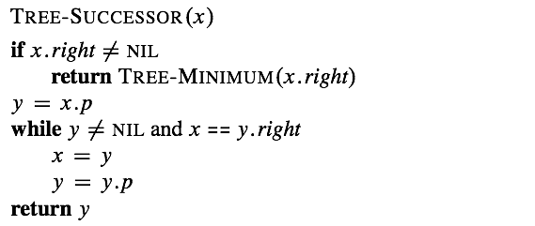
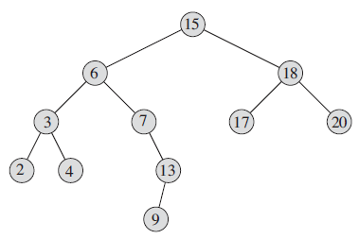
Tree Successor
Running time: Θ(height)

Slide 12
Traversals (not just for BSTs)
Traversal: an algorithm that visits every node in the tree to perform some operation, e.g.,
Printing the keys
Updating some part of the structure
3 basic traversals for trees
Inorder
Preorder
Postorder

Slide 13
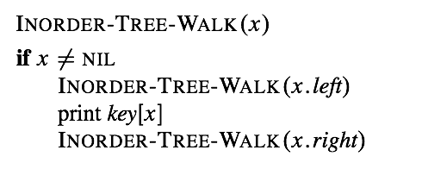
Inorder traversal
Running time: Θ(n)

Slide 14
Postorder traversal
Write pseudo code that computes
height of a BST
number of nodes in a BST
average depth
...
Example: height
Find-height(T)
if T==NIL return -1
else
h₁ := Find-height(T.left)
h₂ := Find-height(T.right)
return max(h₁, h₂) + 1

Slide 15
Preorder Traversal
Recall that insertion order affects the shape of a BST
insertion in sorted order: height n-1
random order: height O(log n) with high probability (see Sec. 12.4 of textbook for a proof)
Write pseudo code that prints the elements of a binary search tree in a plausible insertion order, that is, an insertion order that would produce this particular shape
print nodes in a preorder traversal

Slide 16
Exercise on insertion order
Exercise: Write pseudo code that takes a sorted list and produces a “good” insertion order (that would produce a balanced tree)
(Hint: divide and conquer: always insert the median of a sub-array before inserting the other elements)

Slide 17
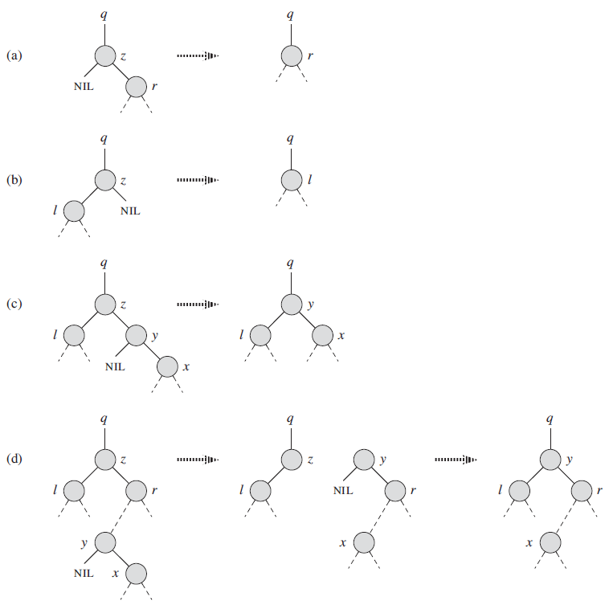
Deletion
z has no left child
z has a left child, but, no right child
z has both a left and a right child. Let y be the z’s successor.
y is z’s right child
y is not z’s right child

Slide 18
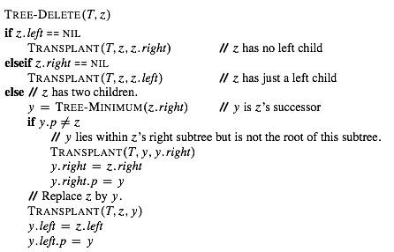
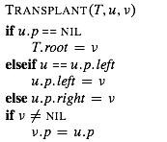
Deletion
Running time: Θ(height)

Slide 19
Binary-Search-Tree Sort
T ← ∅ ⊳ Create an empty BST
for i = 1 to n
do TREE-INSERT(T, A[i])
Perform an inorder tree walk of T.
3
Example:
A = [3 1 8 2 6 7 5]
1
8
2
6
Tree-walk time = O(n), but how long does it take to build the BST?
5
7

Slide 20
Analysis of BST Sort
BST sort performs the same comparisons as quicksort, but in a different order!
3 1 8 2 6 7 5
1 2
8 6 7 5
2
6 7 5
5
7
The expected time to build the tree is asymptotically the same as the running time of quicksort.

Slide 21
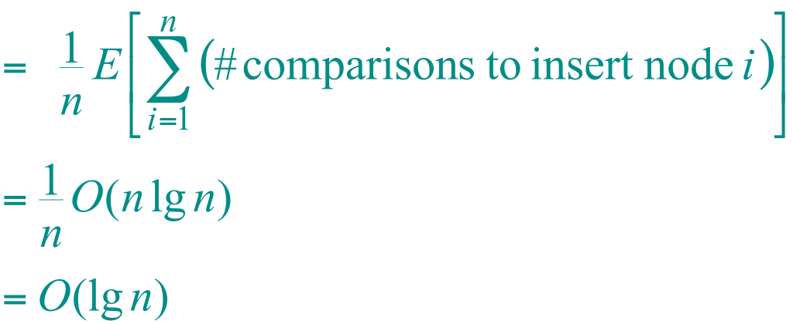
Node Depth
The depth of a node = the number of comparisons made during TREE-INSERT. Assuming all input permutations are equally likely, we have
Average node depth
(quicksort analysis)
.

Slide 22
BST Height
Each of the basic operations on a binary search tree runs in O(h) time
The height of a binary search tree varies as items are inserted
A randomly built binary search tree on n keys
Arises from inserting the keys in random order into an initially empty tree, where each of the n! permutations of the input keys is equally likely.
The expected height of a randomly built binary search tree on n distinct keys is O(log n). See CLRS Sec. 12.4

