Slide 1
CSC 680 Advanced Computer Algorithms
LECTURE 1. Amortized Analysis

Slide 2
Agenda
Amortized Analysis
Dynamic tables
Aggregate method
Accounting method
Potential method

Slide 3
Amortized Analysis
Average cost over not just one operation, but a sequence of operations dynamically changing a given data structure
Probabilistic analysis:
Average case running time: average over all possible inputs for one algorithm (operation).
If using probability, called expected running time.
Amortized analysis:
No involvement of probability
Average performance on a sequence of operations, even some operation is expensive.
Guarantee average performance of each operation among the sequence in worst case.

Slide 4

How Large Should a Hash Table Be?
Goal: Make the table as small as possible, but large enough so that it won’t overflow (or otherwise become inefficient).
Problem: What if we don’t know the proper size in advance?
Solution: Dynamic tables.
IDEA: Whenever the table overflows, “grow” it by allocating (via malloc or new) a new, larger table. Move all items from the old table into the new one, and free the storage for the old table.

Slide 5
Example of a Dynamic Table
INSERT
INSERT
1
overflow

Slide 6
Example of a Dynamic Table
INSERT
INSERT
1
1
overflow

Slide 7
Example of a Dynamic Table
INSERT
INSERT
1
1
2

Slide 8
Example of a Dynamic Table
INSERT
INSERT
INSERT
1
1
2
2
overflow

Slide 9
Example of a Dynamic Table
INSERT
INSERT
INSERT
1
2
overflow

Slide 10
Example of a Dynamic Table
INSERT
INSERT
INSERT
1
2

Slide 11
Example of a Dynamic Table
INSERT
INSERT
INSERT
INSERT
1
2
3
4

Slide 12
Example of a Dynamic Table
INSERT
INSERT
INSERT
INSERT
INSERT
1
2
3
4
overflow

Slide 13
Example of a Dynamic Table
INSERT
INSERT
INSERT
INSERT
INSERT
1
2
3
4
overflow

Slide 14
Example of a Dynamic Table
INSERT
INSERT
INSERT
INSERT
INSERT
1
2
3
4

Slide 15
Example of a Dynamic Table
INSERT
INSERT
INSERT
INSERT
INSERT
INSERT
INSERT
1
2
3
4
5
6
7

Slide 16
Worst-Case Analysis
Consider a sequence of n insertions. The worst-case time to execute one insertion is
Θ(n). Therefore, the worst-case time for n
insertions is n · Θ(n) = Θ(n²).
WRONG! In fact, the worst-case cost for
n insertions is only Θ(n) ≪ Θ(n²).
Let’s see why.

Slide 17
Tighter Analysis
Let c_{i} = the cost of the i th insertion
i
1 otherwise.
if i – 1 is an exact power of 2,
=
i | 1 | 2 | 3 | 4 | 5 | 6 | 7 | 8 | 9 | 10
size_{i} | 1 | 2 | 4 | 4 | 8 | 8 | 8 | 8 | 16 | 16
c_{i} | 1 | 2 | 3 | 1 | 5 | 1 | 1 | 1 | 9 | 1

Slide 18
Tighter Analysis
Let c_{i} = the cost of the i th insertion
i if i – 1 is an exact power of 2, 1
=
otherwise.
i size_{i}
c_{i}
1 | 2 | 3 | 4 | 5 | 6 | 7 | 8 | 9 | 10
1 | 2 | 4 | 4 | 8 | 8 | 8 | 8 | 16 | 16
1 | 1 | 1 | 1 | 1 | 1 | 1 | 1 | 1 | 1
 | 1 | 2 |  | 4 |  |  |  | 8

Slide 19
Tighter Analysis (cont’d)
n
Cost of n insertions = ∑c_{i}
i=1
⎣lg(n−1) ⎦
∑
j=0
≤ n +
₂ ^{j}
≤ 3n
= Θ(n).
Thus, the average cost of each dynamic-table operation is Θ(n)/n = Θ(1).

Slide 20
Amortized Analysis
An amortized analysis is any strategy for analyzing a sequence of operations to show that the average cost per operation is small, even though a single operation within the sequence might be expensive.
Even though we’re taking averages, however, probability is not involved!
An amortized analysis guarantees the average performance of each operation in the worst case.

Slide 21
Types of Amortized Analyses
Three common amortization arguments:
the aggregate method,
the accounting method,
the potential method.
We’ve just seen an aggregate analysis.
The aggregate method, though simple, lacks the precision of the other two methods. In particular, the accounting and potential methods allow a specific amortized cost to be allocated to each operation.

Slide 22
Accounting Method
Charge i th operation a fictitious amortized cost
ĉ_{i}, where $1 pays for 1 unit of work (i.e., time).
This fee is consumed to perform the operation.
Any amount not immediately consumed is stored in the bank for use by subsequent operations.
The bank balance must not go negative! We must ensure that
n n
∑c_{i} ≤ ∑cˆ_{i}
for all n.
i=1 i=1
Thus, the total amortized costs provide an upper bound on the total true costs.

Slide 23
Accounting Analysis of Dynamic Tables
Charge an amortized cost of ĉ_{i} = $3 for the i th insertion.
$1 pays for the immediate insertion.
$2 is stored for later table doubling.
When the table doubles, $1 pays to move a recent item, and $1 pays to move an old item. Example:
$0 $0 $0 $0 $2 $2 $2 $2
$0
overflow
$0 $0 $0 $0 $0 $0 $0 $0
$2 $2 $2

Slide 24
Accounting Analysis (cont’d)
Key invariant: Bank balance never drops below 0. Thus, the sum of the amortized costs provides an upper bound on the sum of the true costs.
i | 1 | 2 | 3 | 4 | 5 | 6 | 7 | 8 | 9 | 10
size_{i} | 1 | 2 | 4 | 4 | 8 | 8 | 8 | 8 | 16 | 16
c_{i} | 1 | 2 | 3 | 1 | 5 | 1 | 1 | 1 | 9 | 1
ĉ_{i} | 2* | 3 | 3 | 3 | 3 | 3 | 3 | 3 | 3 | 3
bank_{i} | 1 | 2 | 2 | 4 | 2 | 4 | 6 | 8 | 2 | 4
*Okay, so I lied. The first operation costs only $2, not $3.

Slide 25
Potential Method
IDEA: View the bank account as the potential energy (à la physics) of the dynamic set.
Framework:
Start with an initial data structure D₀.
Operation i transforms D_{i–1} to D_{i}.
The cost of operation i is c_{i}.
Define a potential function Φ : {D_{i}} → R, Φ(D_{i}) is called the potential of D_{i}.
The amortized cost ĉ_{i} with respect to Φ is
defined to be ĉ_{i} = c_{i} + Φ(D_{i}) – Φ(D_{i–1}).

Slide 26
Understanding Potentials
ĉ_{i} = c_{i} + Φ(D_{i}) – Φ(D_{i–1})
potential difference ΔΦ_{i}
If ΔΦ_{i} > 0, then ĉ_{i} > c_{i}. Operation i stores work in the data structure for later use.
If ΔΦ_{i} < 0, then ĉ_{i} < c_{i}. The data structure delivers up stored work to help pay for operation i.

Slide 27
Amortized Costs Bound True Costs
The total amortized cost is an upper bound of the total actual cost.
The total amortized cost of n operations is
n n
∑cˆ_{i} = ∑(c_{i} + Φ(D_{i} ) − Φ(D_{i−1}))
i=1 i=1
n
Summing both sides.
= ∑c_{i} + Φ(D_{n} ) − Φ(D₀ )
i=1
The series telescopes.
n
≥ ∑c_{i}
i=1
if we make Φ(D_{i}) ≥ 0, for all i and Φ(D₀ ) = 0.

Slide 28
Potential Analysis of Table Doubling
Define the potential of the table after the ith
insertion by Φ(D_{i}) = 2i – 2^{⎡lg i⎤}. (Assume that ₂ ⎡ lg 0 ⎤ _{= 0.)}
Note:
• Φ(D₀ ) = 0,
Φ(D_{i}) ≥ 0 for all i.
Example:
• • • • • •
( $0 $0 $0 $0 $2 $2
Φ = 2·6 – 2³ = 4
accounting method)
•
•
•
•
•
$0
$0
$0
$0
$2
$2
Notes:
Φ(D_{i}) = 2*(i – 2^{⎡lg i⎤} ⁻ ¹) : 2 times the number of insertions after the previous doubling.

Slide 29
Calculation of Amortized Costs
The amortized cost of the i th insertion is
ĉ_{i} = c_{i} + Φ(D_{i}) – Φ(D_{i–1})
i if i – 1 is an exact power of 2, 1 otherwise;
=
+ (2i – 2^{⎡lg i⎤}) – (2(i –1) – 2^{⎡ lg (i–1)⎤})
i if i – 1 is an exact power of 2, 1 otherwise;
=
_{+ 2 – 2} ^{⎡lg i⎤} ₊ ₂^{⎡lg (i–1) ⎤}.

Slide 30
Calculation
Case 1: i – 1 is an exact power of 2.
_{ĉi = i + 2 – 2}⎡lg i⎤ ₊ ₂⎡lg (i–1)⎤
= i + 2 – 2(i – 1) + (i – 1)
= i + 2 – 2i + 2 + i – 1
= 3
Case 2: i – 1 is not an exact power of 2.
_{ĉi = 1 + 2 – 2}⎡lg i⎤ ₊ ₂⎡lg (i–1)⎤
= 3
Therefore, n insertions cost Θ(n) in the worst case. Exercise: Fix the bug in this analysis to show that the amortized cost of the first insertion is only 2.

Slide 31
Example for Amortized Analysis
Stack operations:
PUSH(S, x): O(1)
POP(S): O(1)
MULTIPOP(S, k): O(min(|S|, k))
while not STACK-EMPTY(S) and k > 0
do POP(S)
k = k - 1
Let us consider a sequence of n PUSH/POP/MULTIPOP operations.
The worst case cost for MULTIPOP in the sequence is O(n), since the stack size is at most n.
Thus, the cost of the sequence is O(n²). Correct, but not tight.

Slide 32
Aggregate Analysis: Stack Operation
In fact, a sequence of n operations on an initially empty stack cost at most O(n). Why?
Each object can be POP only once (including in MULTIPOP) for each time it is PUSHed. #POPs is at most #PUSHs, which is at most n.
Thus, the average cost of an operation is O(n)/n = O(1).
Amortized cost in aggregate analysis is defined to be average cost.

Slide 33
Accounting Method: Stack Operation
Actual costs:
PUSH :1, POP :1, MULTIPOP: min(|S|, k).
Let’s assign the following amortized costs:
PUSH:2, POP: 0, MULTIPOP: 0.
Similar to a stack of plates in a cafeteria.
Suppose $1 represents a unit cost.
When pushing a plate, use one dollar to pay the actual cost of the push and leave one dollar on the plate as credit.
Whenever POPing a plate, the one dollar on the plate is used to pay the actual cost of the POP. (same for MULTIPOP).
The total amortized cost for n PUSH/POP/MULTIPOP operations is O(n), thus O(1) for average amortized cost for each operation.
Conditions hold: total amortized cost ≥ total actual cost, and amount of credits never becomes negative.

Slide 34
Potential Method: Stack Operation
Potential for a stack is the number of objects in the stack. So Φ(D₀) = 0 and Φ(D_{i}) ≥ 0.
Amortized cost of stack operations: Let s = |S|.
PUSH:
Potential change: Φ(D_{i}) - Φ(D_{i-1}) = (s+1) - s = 1.
Amortized cost: c_{i}' = c_{i} + Φ(D_{i}) - Φ(D_{i-1}) = 1 + 1 = 2.
POP:
Potential change: Φ(D_{i}) - Φ(D_{i-1}) = (s-1) – s = -1.
Amortized cost: c_{i}' = c_{i} + Φ(D_{i}) - Φ(D_{i-1}) = 1 + (-1) = 0.
MULTIPOP(S,k): k‘ = min(s, k)
Potential change: Φ(D_{i}) - Φ(D_{i-1}) = –k'.
Amortized cost: c_{i}' = c_{i} + Φ(D_{i}) - Φ(D_{i-1}) = k‘ + (-k') = 0.
So, amortized cost of each operation is O(1), and total amortized cost of n operations is O(n).
Since total amortized cost is an upper bound of actual cost, the worse case cost of n operations is O(n).

Slide 35
Example: Increasing a Binary Counter
Binary counter of length k: A[0..k-1] of bit array.
INCREMENT(A)
i←0
while i < k and A[i] = 1
do A[i]←0 (flip, reset)
i←i + 1
if i < k
then A[i]←1 (flip, set)

Slide 36
Analysis of INCREMENT(A)
Cursory analysis:
A single execution of INCREMENT takes O(k) in the worst case (when A contains all 1s)
So a sequence of n executions takes O(nk) in worst case (suppose initial counter is 0).
This bound is correct, but not tight.
The tight bound is O(n) for n executions.

Slide 37
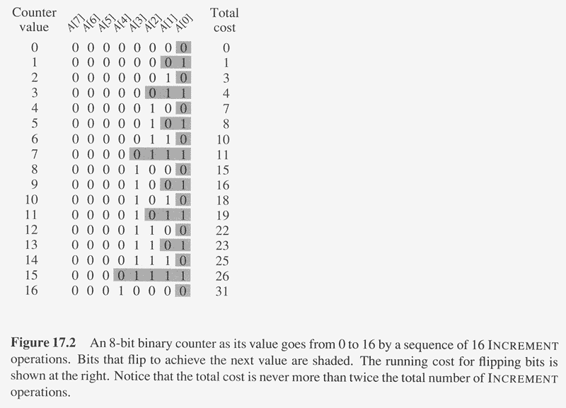
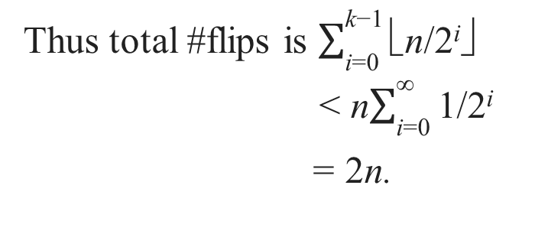
Aggregate Analysis of INCREMENT(A)
Observation: The running time is determined by #flips.
But not all bits flip each time INCREMENT is called.
A[0] flips every time, total n times.
A[1] flips every other time, ⎣n/2⎦ times.
A[2] flips every forth time, ⎣n/4⎦ times.
….
for i = 0,1,…,k-1, A[i] flips ⎣n/2^{i}⎦ times.
Thus total #flips is $\sum_{\text{i}\text{=0}}^{\text{k}\text{−1}}{\text{}\text{n}\text{/2}\text{i}\text{✗ }}$
< n$\sum_{\text{i}\text{=0}}^{\text{∞}}{\text{1}\text{/2}\text{i}}$
= 2n.

Slide 38
Amortized Analysis of INCREMENT(A)
Thus, the worst case running time is O(n) for a sequence of n INCREMENTs.
So the amortized cost per execution is O(1).

Slide 39
Accounting Method: Binary Counter
Let $1 represent each unit of cost (i.e., the flip of one bit).
Charge an amortized cost of $2 to set a bit to 1.
Whenever a bit is set, use $1 to pay the actual cost, and store another $1 on the bit as credit.
When a bit is reset, the stored $1 pays the cost.
At any point, a 1 in the counter stores $1, the number of 1’s is never negative, so is the total credit.
At most one bit is set in each operation, so the amortized cost of an operation is at most $2.
Thus, total amortized cost of n operations is O(n), and average is O(1).

Slide 40
Potential Method: Binary Counter
Define the potential of the counter after the ith INCREMENT is Φ(D_{i}) = b_{i}, the number of 1’s. clearly, Φ(D_{i}) ≥ 0.
Let us compute amortized cost of an operation
Suppose the ith operation resets t_{i} bits.
Actual cost c_{i} of the operation is at most t_{i} +1.
If b_{i} = 0, then the ith operation resets all k bits, so b_{i-1} = t_{i} = k.
If b_{i} > 0, then b_{i} = b_{i-1} – t_{i} + 1.
In either case, b_{i} ≤ b_{i-1} – t_{i} + 1.
So potential change is Φ(D_{i}) - Φ(D_{i-1}) = b_{i} - b_{i-1} ≤ b_{i-1} – t_{i} + 1 - b_{i-1} = 1 – t_{i} .
So amortized cost is: c_{i}' = c_{i} + Φ(D_{i}) - Φ(D_{i-1}) ≤ t_{i} + 1 + 1 – t_{i} = 2.
The total amortized cost of n operations is O(n).
Thus worst case cost is O(n).

Slide 41
Conclusions
Amortized costs can provide a clean abstraction of data-structure performance.
Any of the analysis methods can be used when an amortized analysis is called for, but each method has some situations where it is arguably the simplest or most precise.
Different schemes may work for assigning amortized costs in the accounting method, or potentials in the potential method, sometimes yielding radically different bounds.

