Slide 1
CSC 680 Advanced Computer Algorithms
LECTURE 10. Maximum Flow

Slide 2
Agenda
Flow networks
Properties of flow
Maximum-flow problem
Max-flow, min-cut theorem

Slide 3








Flow Networks
Definition. A flow network is a directed graph G = (V, E) with two distinguished vertices: a source s and a sink t. Each edge (u, v) ∈ E has a nonnegative capacity c(u, v). If (u, v) ∉ E, then c(u, v) = 0.
2
Example:
3
3
s
3
1
t
3
2
2

Slide 4







A Flow on a Network
positive capacity flow
2:2
1:3
2:3
s
1:3
1:3
t
2:2
u
1:2
2:3
Flow conservation (like Kirchoff’s current law):
Flow into u is 2 + 1 = 3.
Flow out of u is 0 + 1 + 2 = 3.
INTUITION: View flow as a rate, not a quantity

Slide 5
The Maximum-Flow Problem
Maximum-flow problem: Given a flow network
G, find a flow of maximum value on G.
2:2
1:3
2:3
s
1:3
1:3
t
2:2
u
1:2
2:3
The value of the maximum flow is 4.

Slide 6















Flow network Assumptions
Assumption. _{If edge} (u, v) ∈ E exists, then
(v, u) ∉ E.
Assumption. No self-loop edges (u, u) exist
1
s
1
u’
s
1
2
u
2
u
L13.5

Slide 7
Net Flow
Definition. A (net) flow on G is a function
f : V × V → R satisfying the following:
Capacity constraint: For all u, v ∈ V,
f (u, v) ≤ c(u, v).
Flow conservation: For all u ∈ V – {s, t},
∑ f (u, v) = 0.
One summation instead of two.
v∈V
Skew symmetry: For all u, v ∈ V,
f (u, v) = –f (v, u).
Note: CLRS defines positive flows and net flows; these are
equivalent for our flow networks obeying our assumptions.

Slide 8
Notation
Definition. The value of a flow f, denoted by | f |, is given by
f = ∑ f (s, v)
v∈V
= f (s,V ) .
Implicit summation notation: A set used in an arithmetic formula represents a sum over the elements of the set.
Example — flow conservation:
f (u, V) = 0 for all u ∈ V – {s, t}.

Slide 9
Simple Properties of Flow
Lemma.
f (X, X) = 0,
f (X, Y) = – f (Y, X),
f (Z, X∪Y) = f (Z, X) + f (Z, Y) if X∩Y = ∅.
f (X∪Y, Z) = f (X, Z) + f (Y, Z) if X∩Y = ∅.
Theorem. | f | = f (V, t).
Proof.
| f | | = | f (s, V)
 | = | f (V, V) – f (V–s, V) | by 4).
 | = | f (V, V–s) | by 1) & 2).
 | = | f (V, t) + f (V, V–s–t) | by 3).
 | = | f (V, t). by flow | conservation
Notes:
V – s = V – {s}

Slide 10









Flow Into the Sink
2:2
2:3
2:3
s
0:3
t
1:3
2:2
2:2
3:3
| f | = f (s, V) = 4
f (V, t) = 4

Slide 11








Cuts
Definition. A cut (S, T) of a flow network G = (V, E) is a partition of V such that s ∈ S and t ∈ T. If f is a flow on G, then the flow across the cut is f (S, T).
2:3 2:3
∈ S
∈ T
s
0:3
1:3
t
2:2
2:2
3:3
f (S, T) = (2 + 2) + (– 2 + 1 – 1 + 2) = 4

Slide 12
Another Characterization of Flow Value
Lemma. For any flow f and any cut (S, T), we have | f | = f (S, T).
Proof.
f (S, T) = f (S, V) – f (S, S) by Lemma 3)
= f (S, V) by Lemma 1)
= f (s, V) + f (S–s, V) by Lemma 4)
= f (s, V) by flow conservation
= | f |.

Slide 13















Capacity of a Cut
Definition. The capacity of a cut (S, T) is c(S, T).
2:3 2:3
∈ S
∈ T
0:3
s t
1:3
2:2
2:2
3:3
c(S, T) = (3 + 2) + (1 + 3)
= 9

Slide 14
Upper Bound on the Maximum Flow Value
Theorem. The value of any flow is bounded above by the capacity of any cut.
Proof.
f = f (S,T )
= ∑∑ f (u, v)
u∈S v∈T
≤ ∑∑c(u, v)
u∈S v∈T
= c(S,T ) .

Slide 15
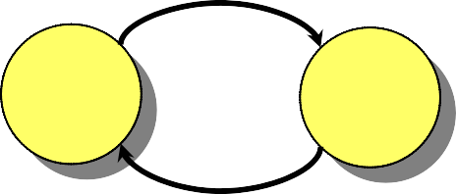

Residual Network
Definition. Let f be a flow on G = (V, E). The residual network G_{f} (V, E_{f} ) is the graph with strictly positive residual capacities
c_{f} (u, v) = c(u, v) – f (u, v) > 0.
Edges in E_{f} admit more flow.
Example:
3
G:
u
v
G_{f} :
u
v
3:5
Lemma. | E_{f} | ≤ 2| E |.
2

Slide 16


































Flow and Residual Network
_{u} 2:2
v
1:3 2:3
G
s
1:3
1:3
t
2:2
x
y
1:2
2:3
2
u
v
2
1
G_{f}
1
2
1
s
2 1
2
1
t
1
2
x y
1
2
L13.15

Slide 17














Augmenting Paths
Definition. Any path from s to t in G_{f} is an aug- menting path in G with respect to f. The flow value can be increased along an augmenting
path p by c _{f} ( p) = min {c _{f} (u, v)}.
(u,v)∈p
2
u v
2
1
1
2
1
G_{f}
s
2 1
t
2
1
1
2
x y
1
p = {s, u, x, v, t}, c_{f} (p) = 1
2

Slide 18













Augmented Flow Network
p = {s, u, x, v, t}, c_{f} (p) = 1
_{u} 2:2
v
2:3
3:3
G
s
0:3
1:3
t
2:2
x y
1:2
2:3
The value of the maximum flow is 4.
Note: Some flows on edges decreased.

Slide 19
Max-Flow, Min-Cut Theorem
Theorem. The following are equivalent:
f is a maximum flow.
f admits no augmenting paths.
| f | = c(S, T) for some cut (S, T).

Slide 20
Review
Flow value: | f | = f (s, V).
Cut: Any partition (S, T) of V such that s ∈ S
and t ∈ T.
Lemma. | f | = f (S, T) for any cut (S, T).
Corollary. | f | ≤ c(S, T) for any cut (S, T).
Residual graph: The graph G_{f} = (V, E_{f} ) with strictly positive residual capacities c_{f} (u, v) = c(u, v) – f (u, v) > 0.
Augmenting path: Any path from s to t in G_{f} .
Residual capacity of an augmenting path:
c _{f} ( p) = min {c _{f} (u, v)}.
(u,v)∈p

Slide 21
Max-Flow, Min-Cut Theorem
Theorem. The following are equivalent:
| f | = c(S, T) for some cut (S, T).
f is a maximum flow.
f admits no augmenting paths.
Proof.
⇒ (2): Since | f | ≤ c(S, T) for any cut (S, T) (by the corollary), the assumption that
| f | = c(S, T) implies that f is a maximum flow.
⇒ (3): If there were an augmenting path, the flow value could be increased, contradicting the maximality of f.

Slide 22
Proof (continued)
(3) ⇒ (1): Suppose that f admits no augmenting paths.
Define S = {v ∈ V : there exists a path in G_{f}
from s to v},
and let T = V – S. Observe that s ∈ S and t ∈ T, and thus (S, T) is a cut. Consider any vertices u ∈ S and v ∈ T.
s u v
path in G_{f}
S T
We must have c_{f} (u, v) = 0, since if c_{f} (u, v) > 0, then v ∈ S, not v ∈ T as assumed. Thus, f (u, v) = c(u, v), since c_{f} (u, v)
= c(u, v) – f (u, v). Summing over all u ∈ S and v ∈ T
yields f (S, T) = c(S, T), and since | f | = f (S, T), the theorem follows.

Slide 23
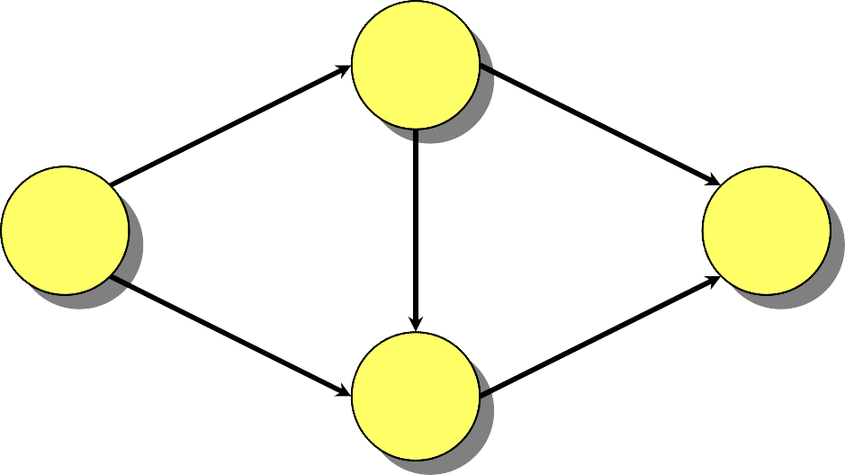
Ford-Fulkerson Max-Flow Algorithm
Algorithm:
f [u, v] ← 0 for all u, v ∈ V
while an augmenting path p in G w.r.t. f exists
do augment f by c_{f} (p)
Can be slow:
10⁹ 10⁹
G:
s t
1
10⁹ 10⁹

Slide 24
Ford-Fulkerson Max-Flow Algorithm
Algorithm:
f [u, v] ← 0 for all u, v ∈ V
while an augmenting path p in G w.r.t. f exists
do augment f by c_{f} (p)
Can be slow:
0:10⁹ 0:10⁹
G:
s t
0:1
0:10⁹ 0:10⁹

Slide 25
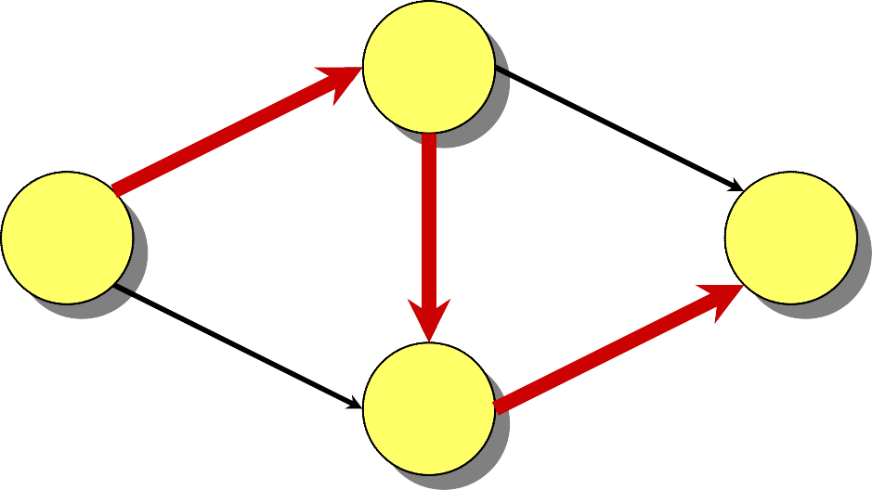
Ford-Fulkerson Max-Flow Algorithm
Algorithm:
f [u, v] ← 0 for all u, v ∈ V
while an augmenting path p in G w.r.t. f exists
do augment f by c_{f} (p)
Can be slow:
0:10⁹ 0:10⁹
G:
s t
0:1
0:10⁹ 0:10⁹

Slide 26
Ford-Fulkerson Max-Flow Algorithm
Algorithm:
f [u, v] ← 0 for all u, v ∈ V
while an augmenting path p in G w.r.t. f exists
do augment f by c_{f} (p)
Can be slow:
1:10⁹ 0:10⁹
G:
s t
1:1
0:10⁹ 1:10⁹

Slide 27
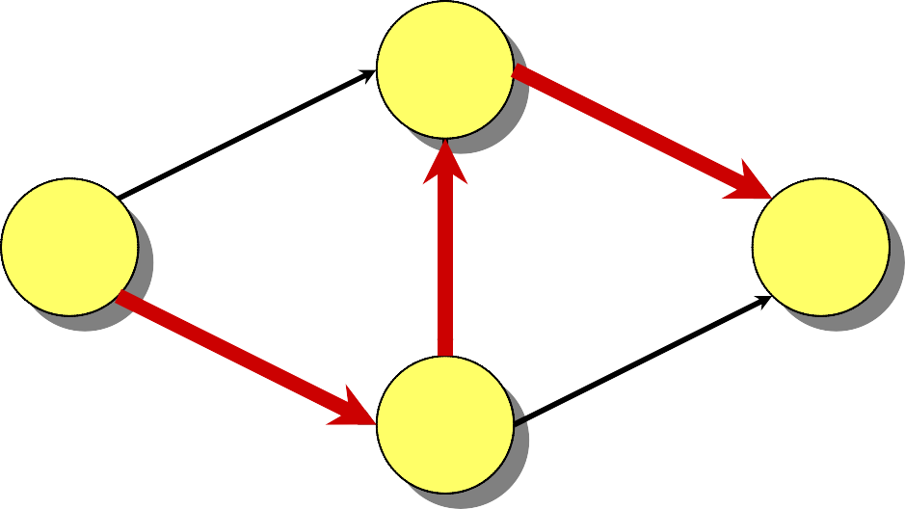
Ford-Fulkerson Max-Flow Algorithm
Algorithm:
f [u, v] ← 0 for all u, v ∈ V
while an augmenting path p in G w.r.t. f exists
do augment f by c_{f} (p)
Can be slow:
1:10⁹ 0:10⁹
G:
s t
1:1
0:10⁹ 1:10⁹

Slide 28
Ford-Fulkerson Max-Flow Algorithm
Algorithm:
f [u, v] ← 0 for all u, v ∈ V
while an augmenting path p in G w.r.t. f exists
do augment f by c_{f} (p)
Can be slow:
1:10⁹ 1:10⁹
G:
s t
0:1
1:10⁹ 1:10⁹

Slide 29
Ford-Fulkerson Max-Flow Algorithm
Algorithm:
f [u, v] ← 0 for all u, v ∈ V
while an augmenting path p in G w.r.t. f exists
do augment f by c_{f} (p)
Can be slow:
1:10⁹ 1:10⁹
G:
s t
0:1
1:10⁹ 1:10⁹

Slide 30
Ford-Fulkerson Max-Flow Algorithm
Algorithm:
f [u, v] ← 0 for all u, v ∈ V
while an augmenting path p in G w.r.t. f exists
do augment f by c_{f} (p)
Can be slow:
2:10⁹ 1:10⁹
G:
s t
1:1
1:10⁹ 2:10⁹
2 billion iterations on a graph with 4 vertices!

Slide 31
Edmonds-Karp Algorithm
Edmonds and Karp noticed that many people’s implementations of Ford-Fulkerson augment along a breadth-first augmenting path: a shortest path in G_{f} from s to t where each edge has weight 1. These implementations would always run relatively fast.
Since a breadth-first augmenting path can be found in O(E) time, their analysis, which provided the first polynomial-time bound on maximum flow, focuses on bounding the number of flow augmentations.
(In independent work, Dinic also gave polynomial-time bounds.)

Slide 32
Monotonicity Lemma
Lemma. Let δ(v) = δ_{f} (s, v) be the breadth-first distance from s to v in G_{f} . During the Edmonds- Karp algorithm, δ(v) increases monotonically.
Proof. Suppose that f is a flow on G, and augmentation produces a new flow f ′. Let δ′(v) = δ_{f ′}(s, v). We’ll show that δ′(v) ≥ δ(v) by induction on δ′(v). For the base case, δ′(s) = δ(s) = 0.
For the inductive case, consider a breadth-first path s → … → u → v in G_{f ′}. We must have δ′(v) = δ′(u) + 1, since subpaths of shortest paths are shortest paths. Certainly, (u, v) ∈ E_{f ′} , and now consider two cases depending on whether (u, v) ∈ E_{f} .

Slide 33
Case 1
Case: (u, v) ∈ E_{f} . We have
δ(v) | ≤ δ(u) + 1 | (triangle inequality)
 | ≤ δ′(u) + 1 | (induction)
 | = δ′(v) | (breadth-first path),
and thus monotonicity of δ(v) is established.

Slide 34
Case 2
Case: (u, v) ∉ E_{f} .
Since (u, v) ∈ E_{f ′} , the augmenting path p that produced f ′ from f must have included (v, u). Moreover, p is a breadth-first path in G_{f} :
p = s → … → v → u → … → t .
Thus, we have
δ(v) | = δ(u) – 1 | (breadth-first path)
 | ≤ δ′(u) – 1 | (induction)
 | ≤ δ′(v) – 2 | (breadth-first path)
 | < δ′(v) ,
thereby establishing monotonicity for this case, too.

Slide 35
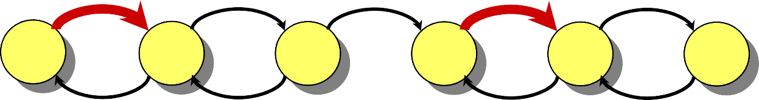
Counting Flow Augmentations
Theorem. The number of flow augmentations in the Edmonds-Karp algorithm (Ford-Fulkerson with breadth-first augmenting paths) is O(V E).
Proof. Let p be an augmenting path, and suppose that we have c_{f} (u, v) = c_{f} (p) for edge (u, v) ∈ p. Then, we say that (u, v) is critical, and it disappears from the residual graph after flow augmentation.
c_{f} (p) = 2
Example:
2 | 4 | 7 | 2 | 3
G_{f} : s 3 | 2 |  | 1 | 2 | t

Slide 36
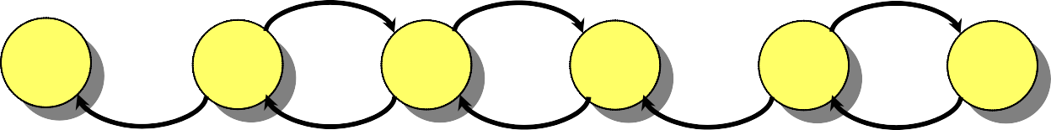
Counting Flow Augmentations
Theorem. The number of flow augmentations in the Edmonds-Karp algorithm (Ford-Fulkerson with breadth-first augmenting paths) is O(V E).
Proof. Let p be an augmenting path, and suppose that we have c_{f} (u, v) = c_{f} (p) for edge (u, v) ∈ p. Then, we say that (u, v) is critical, and it disappears from the residual graph after flow augmentation.
Example:
2 5 1
G_{f ′}:
s
t
5
4
4
3
4

Slide 37
Counting Flow Augmentations (cont’d)
The first time an edge (u, v) is critical, we have δ(v) =
δ(u) + 1, since p is a breadth-first path. We must wait until (v, u) is on an augmenting path before (u, v) can be critical again. Let δ′ be the distance function when (v, u) is on an augmenting path. Then, we have
δ′(u) = δ′(v) + 1
≥ δ(v) + 1
= δ(u) + 2
Example:
s
(breadth-first path) (monotonicity) (breadth-first path).
u
t
v

Slide 38
Counting Flow Augmentations (cont’d)
The first time an edge (u, v) is critical, we have δ(v) =
δ(u) + 1, since p is a breadth-first path. We must wait until (v, u) is on an augmenting path before (u, v) can be critical again. Let δ′ be the distance function when (v, u) is on an augmenting path. Then, we have
δ′(u) = δ′(v) + 1
≥ δ(v) + 1
= δ(u) + 2
(breadth-first path) (monotonicity) (breadth-first path).
Example:
δ(u) = 5
u
s
t
v
δ(v) = 6

Slide 39
Counting Flow Augmentations (cont’d)
The first time an edge (u, v) is critical, we have δ(v) =
δ(u) + 1, since p is a breadth-first path. We must wait until (v, u) is on an augmenting path before (u, v) can be critical again. Let δ′ be the distance function when (v, u) is on an augmenting path. Then, we have
δ′(u) = δ′(v) + 1
≥ δ(v) + 1
= δ(u) + 2
(breadth-first path) (monotonicity) (breadth-first path).
Example:
δ(u) = 5
u
s
t
v
δ(v) = 6

Slide 40
Counting Flow Augmentations (cont’d)
The first time an edge (u, v) is critical, we have δ(v) =
δ(u) + 1, since p is a breadth-first path. We must wait until (v, u) is on an augmenting path before (u, v) can be critical again. Let δ′ be the distance function when (v, u) is on an augmenting path. Then, we have
δ′(u) = δ′(v) + 1
≥ δ(v) + 1
= δ(u) + 2
(breadth-first path) (monotonicity) (breadth-first path).
Example:
δ(u) ≥ 7
u
s
t
v
δ(v) ≥ 6

Slide 41
Counting Flow Augmentations (cont’d)
The first time an edge (u, v) is critical, we have δ(v) =
δ(u) + 1, since p is a breadth-first path. We must wait until (v, u) is on an augmenting path before (u, v) can be critical again. Let δ′ be the distance function when (v, u) is on an augmenting path. Then, we have
δ′(u) = δ′(v) + 1
≥ δ(v) + 1
= δ(u) + 2
(breadth-first path) (monotonicity) (breadth-first path).
Example:
δ(u) ≥ 7
u
s
t
v
δ(v) ≥ 6

Slide 42
Counting Flow Augmentations (cont’d)
The first time an edge (u, v) is critical, we have δ(v) =
δ(u) + 1, since p is a breadth-first path. We must wait until (v, u) is on an augmenting path before (u, v) can be critical again. Let δ′ be the distance function when (v, u) is on an augmenting path. Then, we have
δ′(u) = δ′(v) + 1
≥ δ(v) + 1
= δ(u) + 2
(breadth-first path) (monotonicity) (breadth-first path).
Example:
δ(u) ≥ 7
u
s
t
v
δ(v) ≥ 8

Slide 43
Running Time of Edmonds- Karp
Distances start out nonnegative, never decrease, and are at most |V| – 1 until the vertex becomes unreachable.
Thus, (u, v) occurs as a critical edge O(V) times, because δ(v) increases by at least 2 between occurrences. Since the residual graph contains O(E) edges, the number of flow augmentations is O(V E).
Corollary. The Edmonds-Karp maximum-flow algorithm runs in O(V E²) time.
Proof. Breadth-first search runs in O(E) time, and all other bookkeeping is O(V) per augmentation.

Slide 44
Best to Date
The asymptotically fastest algorithm to date for maximum flow, due to King, Rao, and Tarjan, runs in O(VE log_{E/(V lg V)}V) time.
If we allow running times as a function of edge weights, the fastest algorithm for maximum flow, due to Goldberg and Rao, runs in time
O(min{V ^{2/3}, E ^{1/2}} ⋅ E lg (V ²/E + 2) ⋅ lg C),
where C is the maximum capacity of any edge in the graph.

