Slide 1
CSC 680 Advanced Computer Algorithms
LECTURE 11. Approximation Algorithms

Slide 2
Agenda
Flow networks
Properties of flow
Maximum-flow problem
Max-flow, min-cut theorem

Slide 3
Dealing with Hard Problems
What to do if:
Divide and conquer
Dynamic programming
Greedy
Linear Programming/Network Flows
– …
does not give a polynomial time algorithm?

Slide 4
Dealing with Hard Problems
Solution I: Ignore the problem
Can’t do it ! There are thousands of problems for which we do not know polynomial time algorithms
For example:
Traveling Salesman Problem (TSP)
Set Cover

Slide 5
Traveling Salesman Problem
Traveling Salesman Problem (TSP)
Input: undirected graph with lengths on edges
Output: shortest cycle that visits each vertex exactly once
Best known algorithm: O(n⋅2^{n}) time.

Slide 6
Set Covering
Set Cover:
– Input: subsets S₁…S_{n} of X,
∪_{i} S_{i} = X, |X|=m
– Output: C ⊆{1…n} , such that ∪_{i∈C} S_{i} = X, and |C| minimal
Best known algorithm: O(2^{n}⋅m) time(?)
Bank robbery problem:
X={plan, shoot, safe, drive, scary}
Sets:
S_{Joe} ={plan, safe}
S_{Jim}={shoot, scary, drive}
– ….

Slide 7
Dealing with Hard Problems
Exponential time algorithms for small inputs. For instance, (100/99)^{n} time is not bad for n < 1000.
Polynomial time algorithms for some (e.g., average-case) inputs
Polynomial time algorithms for all inputs, but which return approximate solutions

Slide 8
Approximation Algorithms
An algorithm A is ρ-approximate, if, on any input of size n:
The cost C_{A} of the solution produced by the algorithm, and
The cost C_{OPT} of the optimal solution are such that C_{A} ≤ ρ⋅C_{OPT}
We will see:
2-approximation algorithm for TSP in the plane
log(m)-approximation algorithm for Set Cover

Slide 9
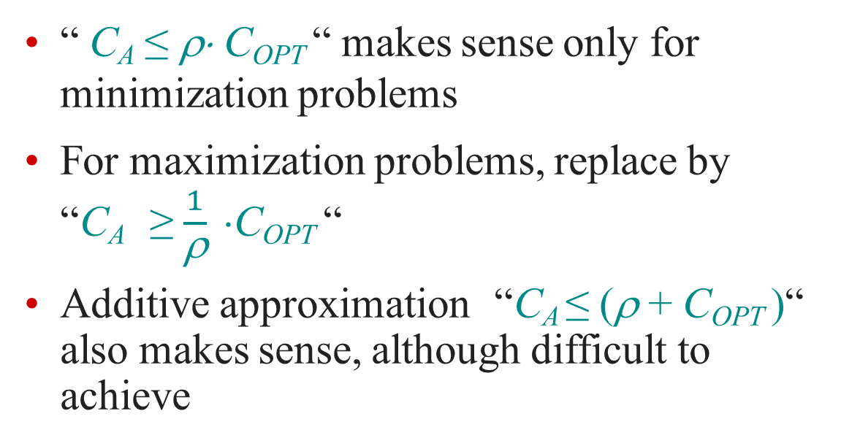
Comments on Approximation
“ C_{A} ≤ ρ⋅ C_{OPT} “ makes sense only for minimization problems
For maximization problems, replace by “C_{A} ≥ $\frac{1}{\text{ρ}} $C_{OPT} “
Additive approximation “C_{A} ≤ (ρ + C_{OPT} )“ also makes sense, although difficult to achieve

Slide 10
2-approximation for TSP
Compute MST T
An edge between any pair of points
Weight = Euclidean distance between endpoints
Compute a tree-walk W of T
Each edge visited twice
Convert W into a cycle C using shortcuts

Slide 11
2-approximation: Proof
Let C_{OPT} be the optimal cycle
Cost(T) ≤ Cost(C_{OPT} )
– Removing an edge from C_{OPT} gives a spanning tree ≥ T, a spanning tree of minimum cost.
Cost(W) = 2⋅Cost(T)
Each edge visited twice
Cost(C) ≤ Cost(W)
Triangle inequality
⇒ Cost(C) ≤ 2⋅Cost(C_{OPT} )

Slide 12
Approximation for Set Cover
Greedy algorithm:
Initialize C=∅
Repeat until all elements are covered:
Choose S_{i} which contains largest number of yet-not-covered elements
Add i to C
Mark all elements in S_{i} as covered

Slide 13
Greedy Algorithm: Example
• X={1,2,3,4,5,6}
Sets:
– S₁={1,2}
– S₂={3,4}
– S₃={5,6}
– S₄={1,3,5}
Algorithm picks C={4,1,2,3}
Not optimal!

Slide 14
log(m)-approximation
Notation:
C_{OPT} = optimal cover
|C_{OPT}| = k
Theorem. At any iteration of the algorithm, there exists S_{j} which contains at ≥ 1/k fraction of yet-not-covered elements
Proof: by contradiction.
If all sets cover <1/k fraction of yet-not-covered elements, there is no way to cover them using k sets
But C_{OPT} does that !
Therefore, at each iteration greedy covers ≥ 1/k fraction of yet-not-covered elements

Slide 15
log(m)-approximation
Let u_{i} be the number of yet-not-covered elements at the end of step i=0,1,2,…
We have
^{u}i+1
≤ u_{i} (1-1/k) u₀ = m
Therefore, after t = k⋅logm steps, we have
u_{t} ≤ u₀⋅(1-1/k)^{t} ≤ m⋅(1-1/k)^{k⋅logm} < m⋅1/e^{logm} =1
I.e., all elements are covered by the k⋅logm sets chosen by greedy algorithm
Opt size is k ⇒ greedy is log(m)-approximate
Notes:
(1 − $\frac{1}{x}$)^{x} ≈ 1/e

Slide 16
Approximation Algorithms
Very rich area
Algorithms use greedy, linear programming, dynamic programming
E.g., 1.01-approximate TSP in the plane
Sometimes can show that approximating a problem is as hard as finding exact solution !
E.g., 0.99 log(m)-approximate Set Cover

