Slide 1
CSC 680 Advanced Computer Algorithms
LECTURE 12. Clustering

Slide 2
Agenda
What and Why
Agglomerative clustering
Min-Radius clustering

Slide 3
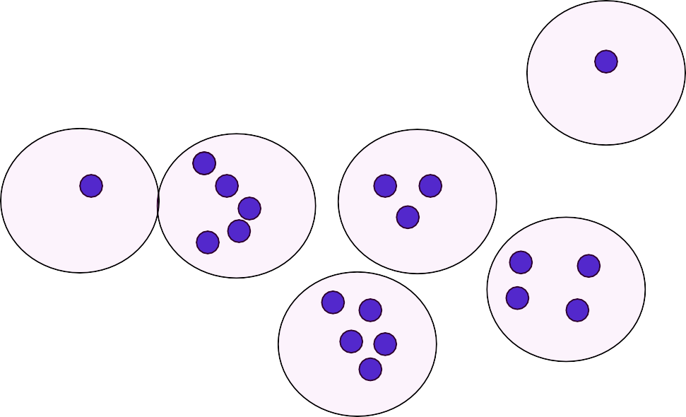
Clustering
Can we find k students to hold candy bowls so that each CSC-680 student is within r seats from a candy bowl?

Slide 4
Widely Used Tool for Analyzing Data Sets
In websites, search results, click stream data, customer behavior patterns, community discovery in social networks, medical data for patient diagnosis, photographs, music, movies, genes and proteins, word behaviors, biological species,….(lots more!)
Conceptually related to
Unsupervised learning
Dimensionality reduction
Notes:
Unsupervised learning : The notion that objects which produce similar measurements may share some intrinsic property.

Slide 5
What is clustering?
The scenario:
Given many objects
The goal:
Divide into groups so that
Objects in same group are close
Objects in different groups are farther apart
But:
What are the objects?
What is “close” and “far”? (notion of distance?)
Many formalizations!

Slide 6
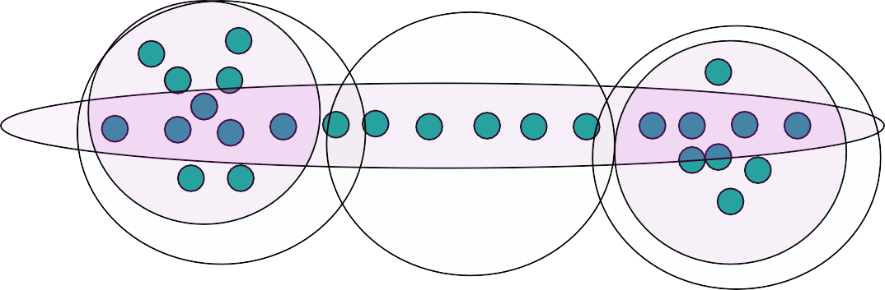
What is the goal?
How would you cluster this?
Types:
Purple – finds connected objects (for computer vision)
White – all elements in same group are close
There are millions of formulations

Slide 7
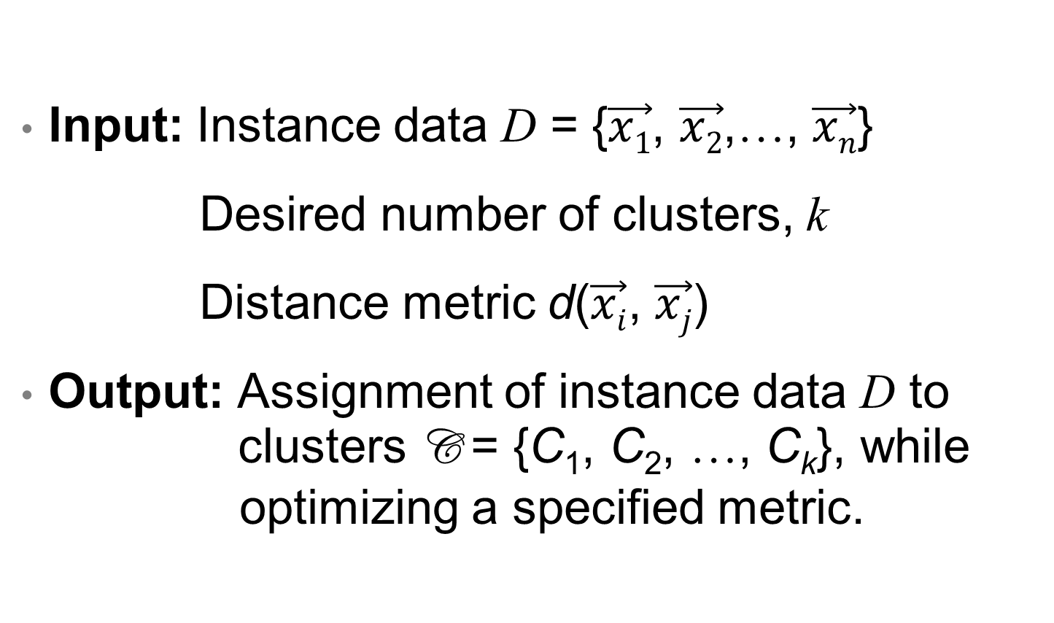
Problem Formulation: Clustering
Input: Instance data D = {$\vec{x1}$, $\vec{x2}$,…, $\vec{xn}$}
Desired number of clusters, k
Distance metric d($\vec{xi}$, $\vec{xj}$)
Output: Assignment of instance data D to clusters C = {C₁, C₂, …, C_{k}}, while optimizing a specified metric.

Slide 8
Hierarchical Agglomerative Clustering
Try to maximize spacing between clusters
Want “really close” points in same cluster
Clusters can be large in size!
Algorithm idea:
“Grow” a graph on the nodes such that connected components correspond to clusters.
Bring nearby points into same cluster quickly.
Seems like a good idea to consider points in order of distance!

Slide 9
Agglomerative Clustering Details
“Agglomerative” refers to merge.

Slide 10
Run-Time Analysis
Use a disjoint-set data structure
Step 1: n calls to MAKE_SET
Step 2: Sorting the edges takes Θ(n²logn).
Step 3: At most O(n²) iterations. Each makes
2 calls to FIND_SET
at most 1 call to UNION
Step 1 & 3 have O(n²) disjoint-set operations, n of which are MAKE_SETs. This takes O(n²) using disjoint-set forest with union by rank and path compression.
Total run-time is dominated by sorting the edges.

Slide 11
Clustering Solution Property
For k = 1, running SINGLE-LINKAGE-CLUSTER is exactly the same as running Kruskal’s MST algorithm on the complete graph whose edges are weighted by distance.
For k > 1, the graph produced is an MST with the k-1 heaviest edges removed.
the minimum distance
between a pair of clusters

Slide 12
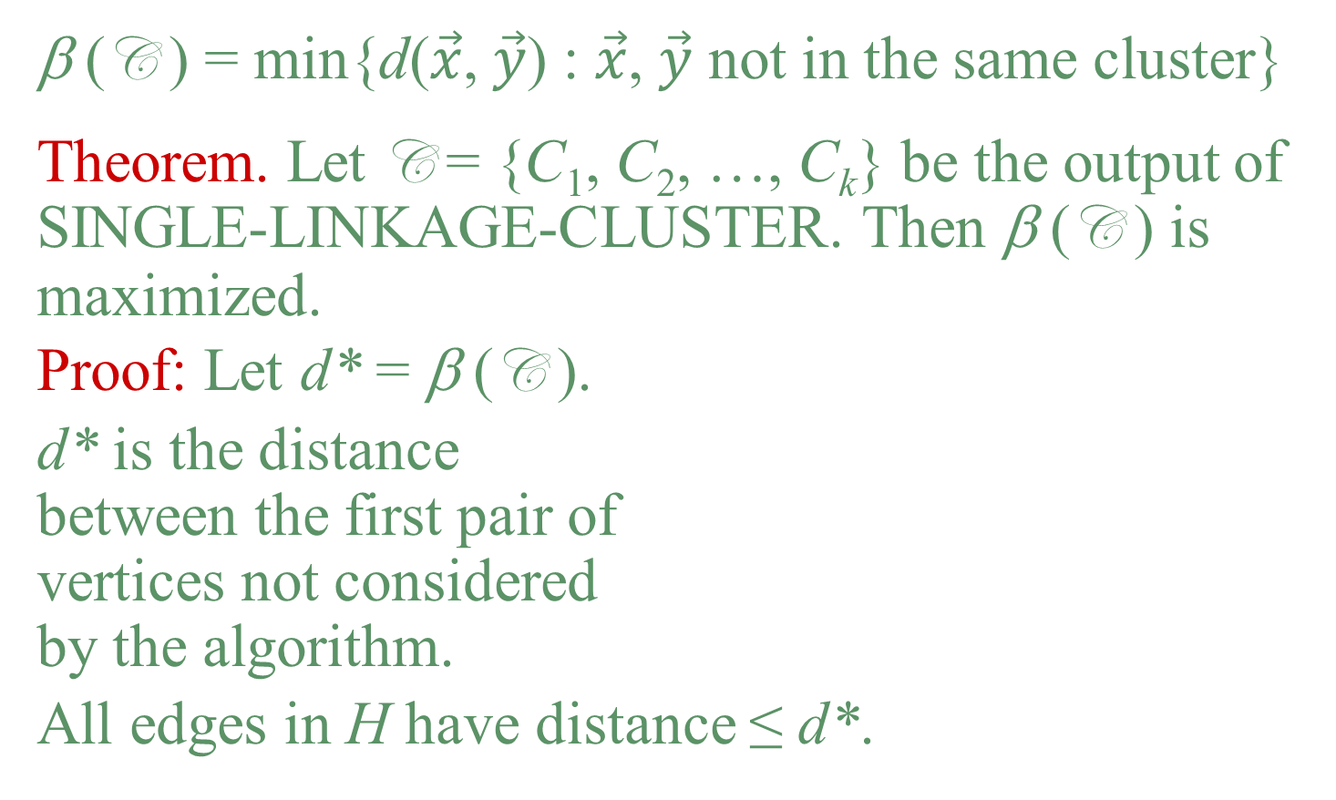
Correctness
β (C ) = min{d($\vec{x}$, $\vec{y}$) : $\vec{x}$, $\vec{y}$ not in the same cluster}
Theorem. Let C = {C₁, C₂, …, C_{k}} be the output of SINGLE-LINKAGE-CLUSTER. Then β (C ) is maximized.
Proof: Let d* = β (C ).
d* is the distance between the first pair of vertices not considered by the algorithm.
All edges in H have distance ≤ d*.

Slide 13
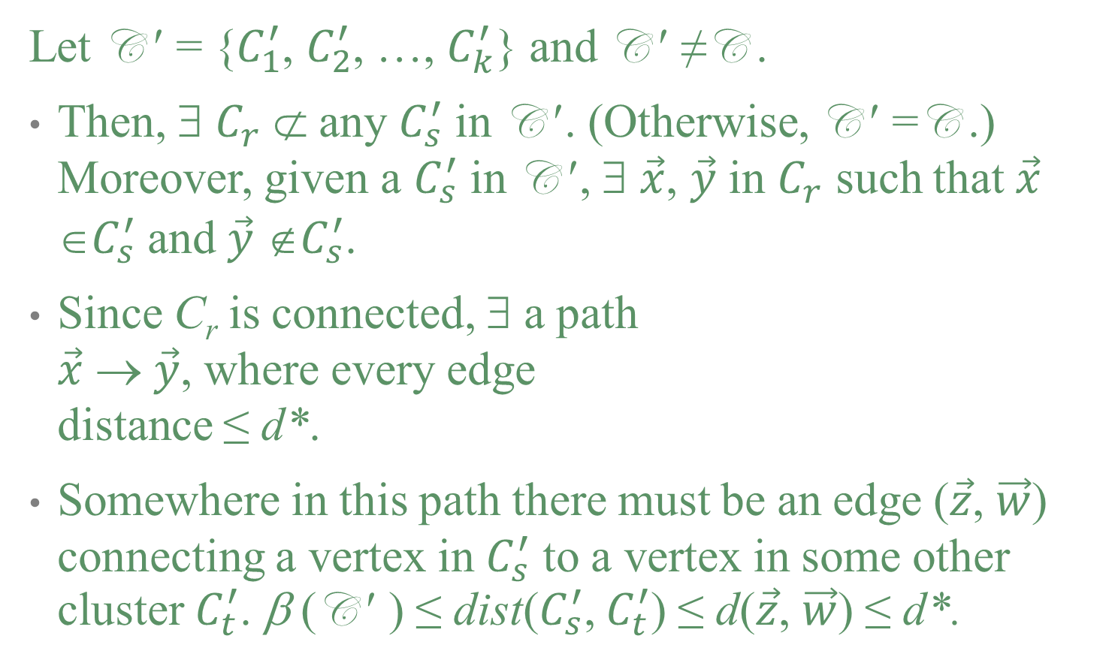
Correctness (cont’d)
Let C ′ = {$C_{1}^{′}$, $C_{2}^{′}$, …, $C_{k}^{′}$} and C ′ ≠C .
Then, ∃ $C_{r}^{ }$ ⊄ any $C_{s}^{′}$ in C ′. (Otherwise, C ′ =C .) Moreover, given a $C_{s}^{′}$ in C ′, ∃ $\vec{x}$, $\vec{y}$ in $C_{r}^{ }$ such that $\vec{x}$ ∈$C_{s}^{′}$ and $\vec{y}$ ∉$C_{s}^{′}$.
Since C_{r} is connected, ∃ a path $\vec{x}$ → $\vec{y}$, where every edge distance ≤ d*.
Somewhere in this path there must be an edge ($\vec{z}$, $\vec{w}$) connecting a vertex in $C_{s}^{′}$ to a vertex in some other cluster $C_{t}^{′}$. β (C ′ ) ≤ dist($C_{s}^{′}$, $C_{t}^{′}$) ≤ d($\vec{z}$, $\vec{w}$) ≤ d*.
Notes:
If every Cr is a subset of Cs’, then C must be equal to C’.

Slide 14
Other Distance Metrics
We can use different distance metrics:
New algorithms are needed for different metrics.
Different metrics tend to produce different clusters.
Hierarchical agglomerative clustering tends to perform worse with higher dimensional data sets.

Slide 15
Min-Radius Clustering
HAC makes objects in different clusters far apart.
MRC makes objects in the same cluster are close.
Given a radius r, find the best possible set of k centers in D such that F(C ) ≤ r, where
Each node belongs to the cluster centered at whichever of these k centers is closest to it.

Slide 16
Min-Radius Clustering Example
Given a positive integer k (in this case k = 3) and a desired radius r, we attempt to create k clusters, each having radius at most r.

Slide 17
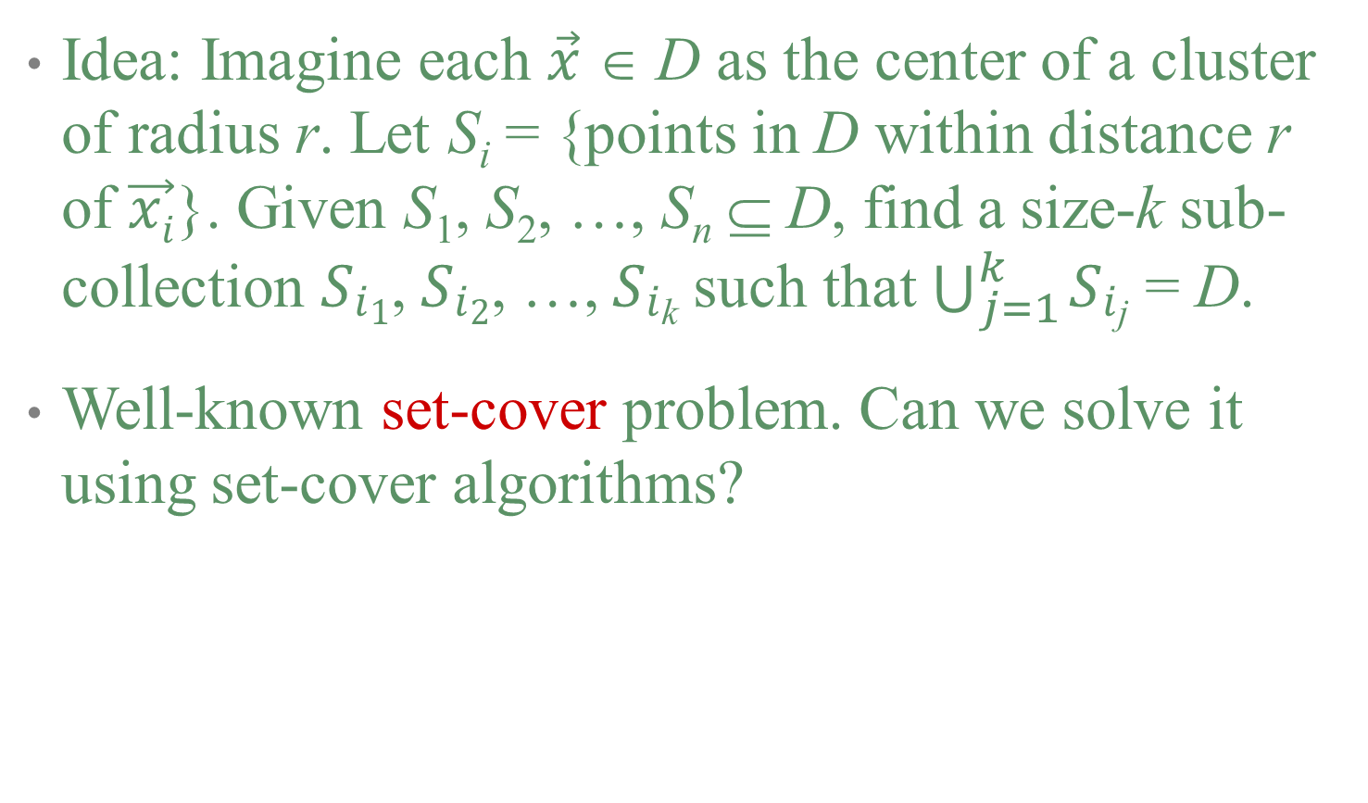
Min-Radius Clustering Algorithm
Idea: Imagine each $\vec{x}$ ∈ D as the center of a cluster of radius r. Let S_{i} = {points in D within distance r of $\vec{xi}$}. Given S₁, S₂, …, S_{n} ⊆ D, find a size-k sub-collection 𝑆_{𝑖1}, 𝑆_{𝑖2}, …, 𝑆_{𝑖k} such that $\bigcup_{j=1}^{k}{\text{S}\text{i}\text{j}}$ = D.
Well-known set-cover problem. Can we solve it using set-cover algorithms?
Notes:
The reduction is in the wrong direction.

Slide 18
Set Cover
Input:
Integer 𝑘, 𝑆₁, 𝑆₂, … , 𝑆_{𝑛} such that 𝑆_{𝑖} ⊆ 𝑃
Output: Is there 𝑆_{𝑖1}, … , 𝑆_{𝑖𝑘} such that
⋃𝑘
𝑆_{𝑖𝑗} = 𝑃?
𝑗=1
Set cover is NP-complete!
That’s ok since this reduction is in the wrong direction!
But, min radius clustering is also NP-complete!
Well, good news -- this reduction is in the right direction for something!
Notes:
NP-Complete problems can be reduced to each other.

Slide 19
O(logn)-Approximation Algorithm for Set-Cover
Algorithm:
Greedily choose the set with the largest coverage until all points are covered.
This algorithm honors the radius constraint and approximates the number of clusters by a factor of O(logn). What if we need a small number of clusters?
If there is a set-cover of size k, it outputs set-cover of size at most k⋅logn.

Slide 20
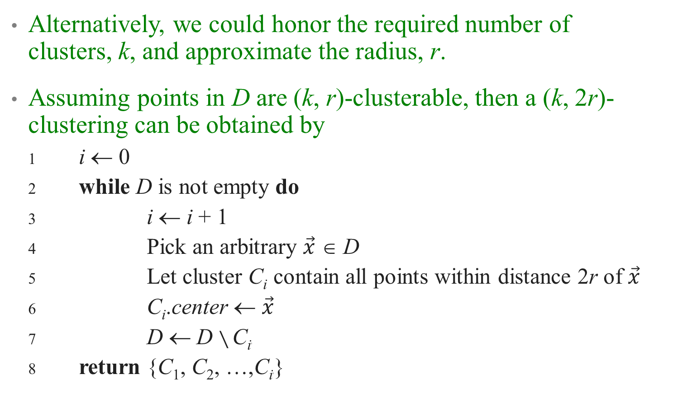
Approximate r for Radius Clustering
Alternatively, we could honor the required number of clusters, k, and approximate the radius, r.
Assuming points in D are (k, r)-clusterable, then a (k, 2r)-clustering can be obtained by
1 i ← 0
2 while D is not empty do
3 i ← i + 1
4 Pick an arbitrary $\vec{x}$ ∈ D
5 Let cluster C_{i} contain all points within distance 2r of $\vec{x}$
6 C_{i}.center ← $\vec{x}$
7 D ← D $∖$ C_{i}i
8 return {C₁, C₂, …,C_{i}i}

Slide 21
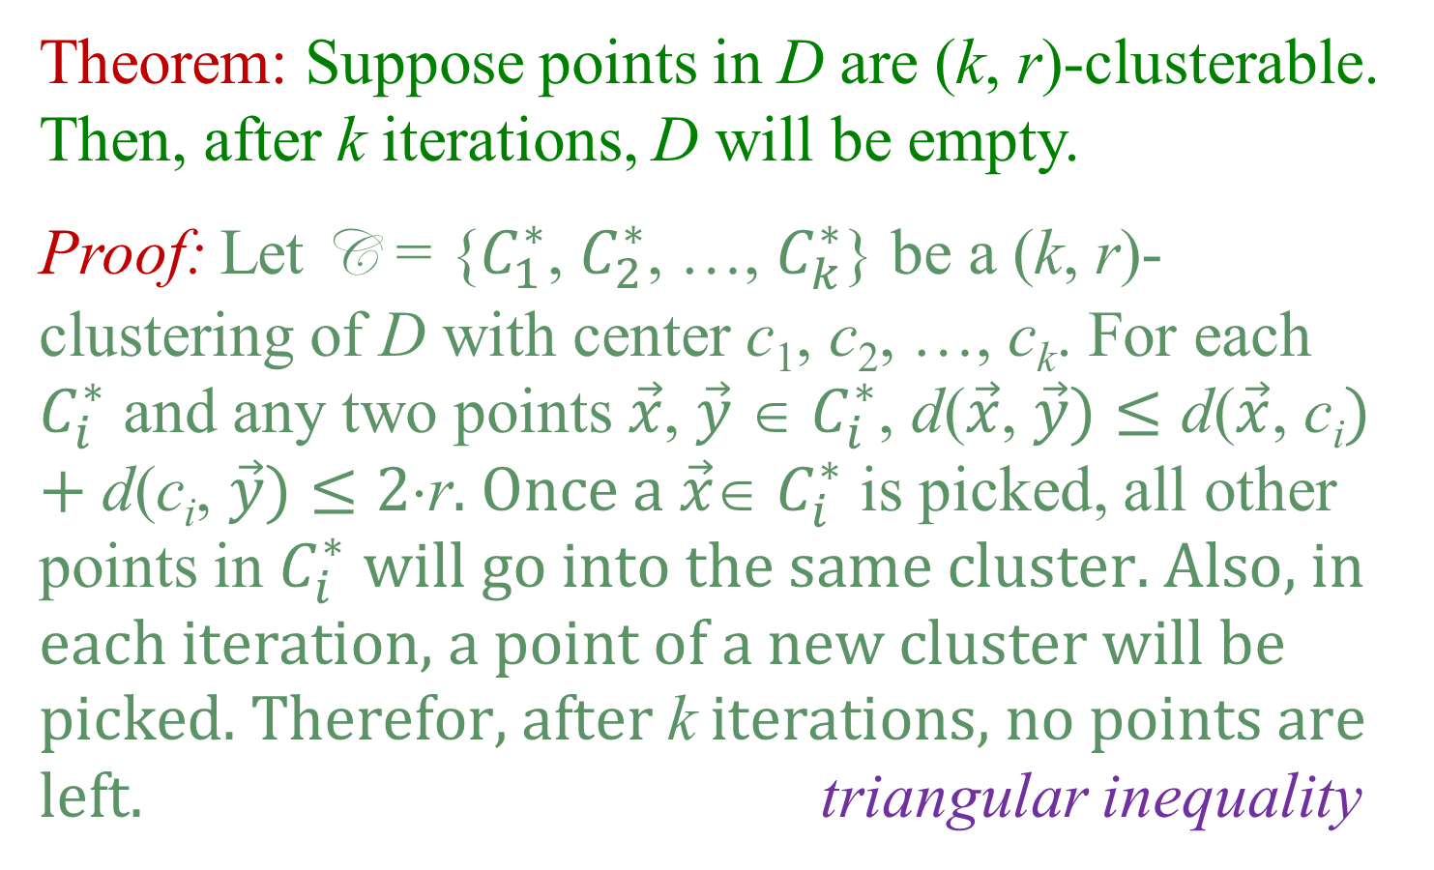
Approximate r for Radius Clustering
Theorem: Suppose points in D are (k, r)-clusterable. Then, after k iterations, D will be empty.
Proof: Let C = {$C_{1}^{∗}$, $C_{2}^{∗}$, …, $C_{k}^{∗}$} be a (k, r)-clustering of D with center c₁, c₂, …, c_{k}. For each $C_{i}^{∗}$ and any two points $\vec{x}$, $\vec{y}$ ∈ $C_{i}^{∗}$, d($\vec{x}$, $\vec{y}\text{)}≤\text{d}\text{(}\vec{x}\text{,} \text{c}\text{i}\text{)}\text{ + }\text{d}\text{(}\text{c}\text{i}\text{, }\vec{y}\text{)}≤\text{2}⋅\text{r}\text{. }\text{Once} \text{a} \vec{x}$∈ $C_{i}^{∗}$ is picked, all other points in $C_{i}^{∗}$ $\text{will} \text{go} \text{into} \text{the} \text{same} \text{cluster}\text{. }\text{Also}\text{, }\text{in} \text{each} \text{iteration}\text{, }\text{a} \text{point} \text{of} \text{a} \text{new} \text{cluster} \text{will} \text{be} \text{picked}\text{. }\text{Therefor}\text{, }\text{after} \text{k} \text{iterations}\text{, }\text{no} \text{points} \text{are} \text{left}\text{.}$ triangular inequality

Slide 22
Conclusions
Get best radius w/ pretty good number of clusters
Get best number of clusters w/ pretty good radius
Other clustering measures:
Diameter
Average distance to center
Not requiring point in D to be center
Not requiring all points to be clustered
Graph based distances – min/sparse cuts
And on and on ….

