Slide 1
CSC 680 Advanced Computer Algorithms
LECTURE 8. Single-Source Shortest Paths
with Negative Edge Weights

Slide 2
Agenda
Single-Source Shortest Paths
with Negative Edge Weights
Bellman-Ford algorithm
Linear programming and difference constraints
VLSI layout compaction

Slide 3
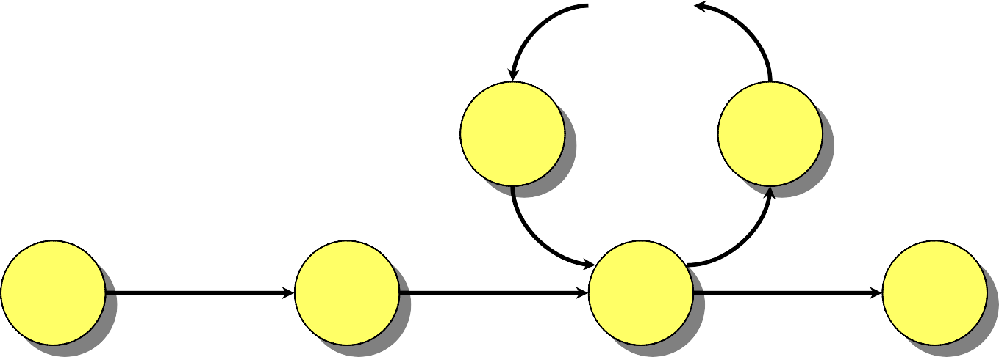

Negative-Weight Cycles
Recall: If a graph G = (V, E) contains a negative-
weight cycle, then some shortest paths may not exist.
…
Example:
< 0
u
v
Bellman-Ford algorithm: Finds all shortest-path lengths from a source s ∈ V to all v ∈ V or determines that a negative-weight cycle exists.

Slide 4
Bellman-Ford Algorithm
d[s] ← 0
for each v ∈ V – {s}
do d[v] ← ∞
for i ← 1 to |V| – 1
initialization
do for each edge (u, v) ∈ E
do if d[v] > d[u] + w(u, v)
then d[v] ← d[u] + w(u, v)
for each edge (u, v) ∈ E
do if d[v] > d[u] + w(u, v)
relaxation step
then report that a negative-weight cycle exists At the end, d[v] = δ(s, v), if no negative-weight cycles.
Time = O(V E).

Slide 5
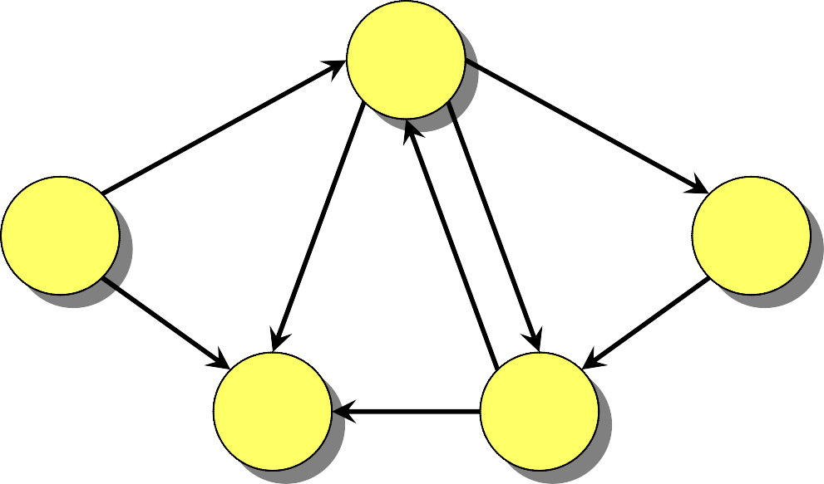
Example of Bellman-Ford
B
2
–1
A
3
2
E
1
4
–3
C
D
5

Slide 6
Example of Bellman-Ford
∞
B
–1
2
0
∞
E
A
3
2
1
4
–3
C
∞
D
∞
5
Initialization.

Slide 7
Example of Bellman-Ford
∞
B
1
2
–1
0
∞
7
3
4
3
2
A
1
E
5
4
8
–3
2
C
∞
6
D
∞
5
Order of edge relaxation.

Slide 8
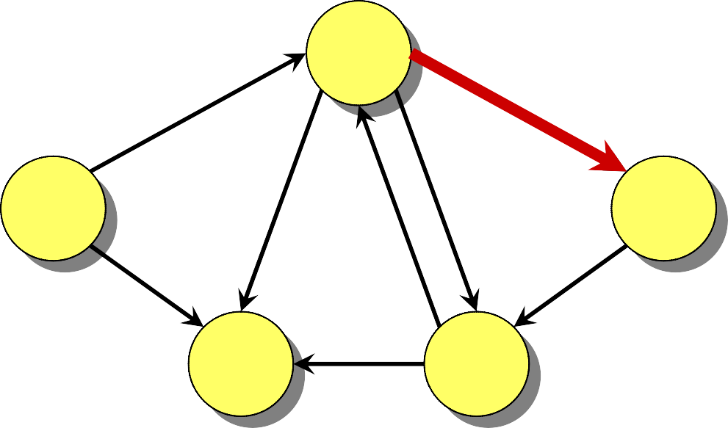
Example of Bellman-Ford
∞
B
1
2
–1
0
∞
7
3
4
3
2
A
1
E
5
4
8
–3
2
C
∞
6
D
∞
5

Slide 9
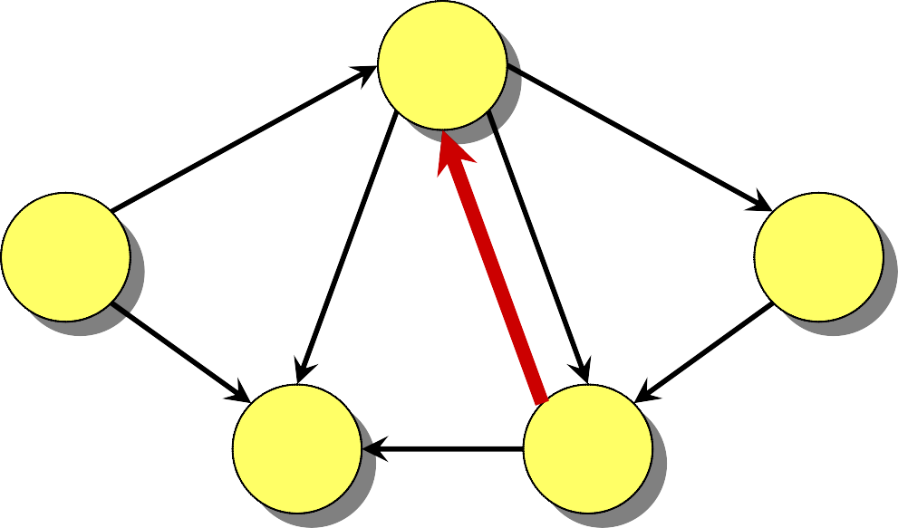
Example of Bellman-Ford
∞
B
1
2
–1
0
∞
7
3
4
3
2
A
1
E
5
4
8
–3
2
C
∞
6
D
∞
5

Slide 10
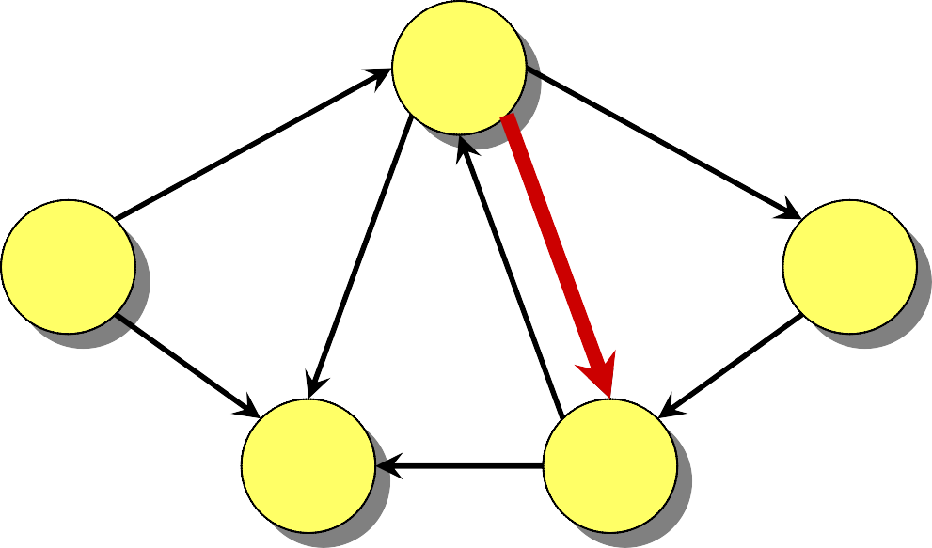
Example of Bellman-Ford
∞
B
1
2
–1
0
∞
7
3
4
3
2
A
1
E
5
4
8
–3
2
C
∞
6
D
∞
5

Slide 11
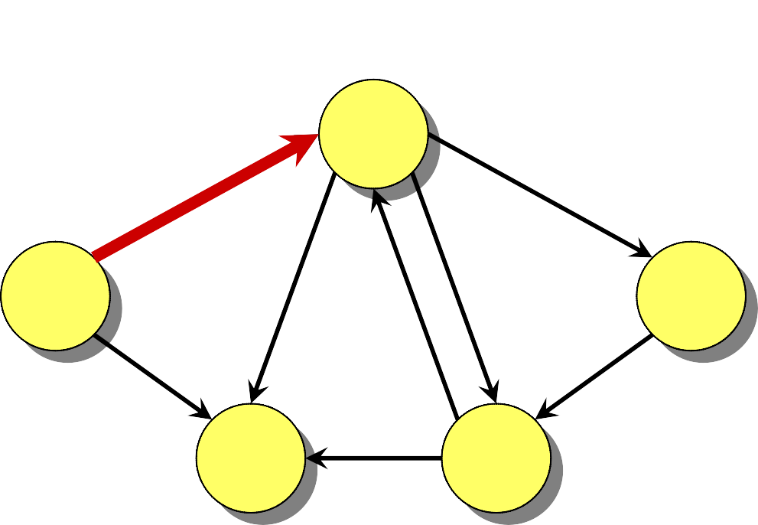
Example of Bellman-Ford
–1
B
1
–1
2
0
∞
7
3
A
4
3
2
1
E
5
4
8
–3
2
C
∞
6
D
∞
5

Slide 12
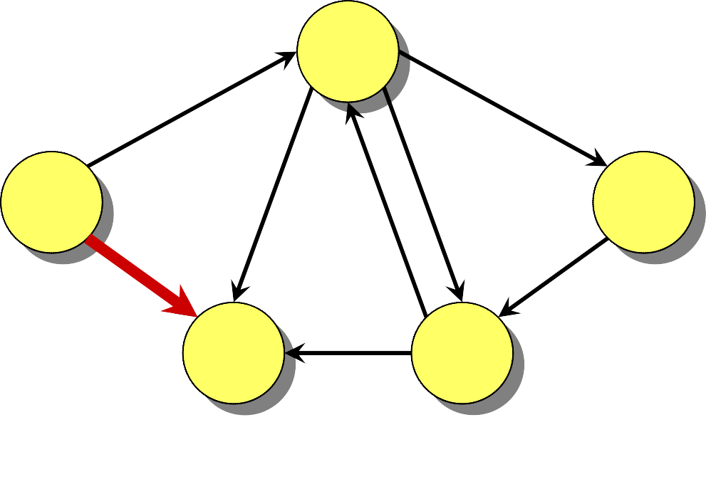
Example of Bellman-Ford
−1B
1
2
–1
0
∞
7
3
4
3
2
A
1
E
5
4
8
–3
2
C
4
6
D
∞
5
∞

Slide 13
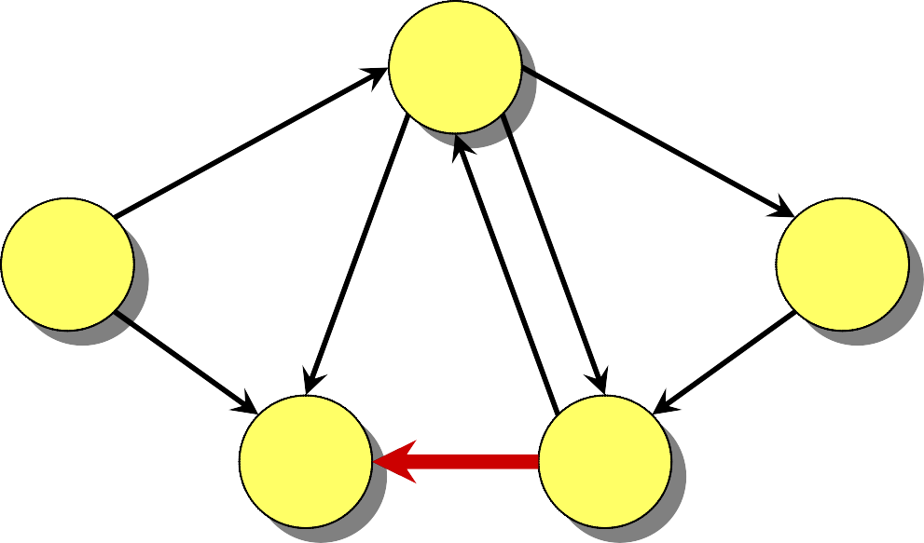
Example of Bellman-Ford
−1B
1
2
–1
0
∞
7
3
4
3
2
A
1
E
5
4
8
–3
2
C
4
6
D
∞
5

Slide 14
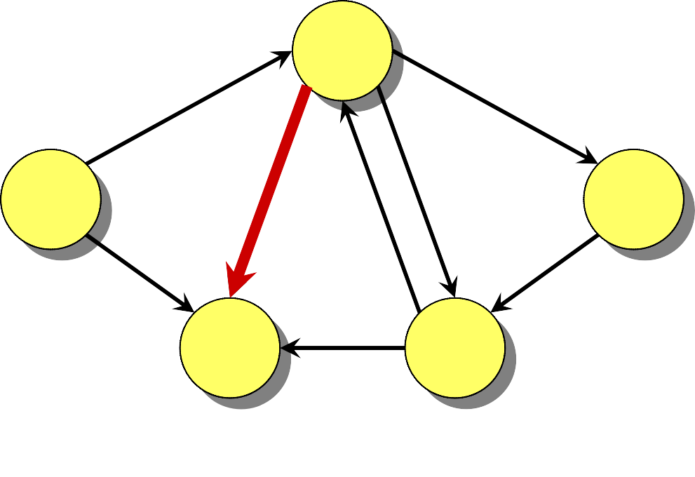
Example of Bellman-Ford
−1B
1
2
–1
0
∞
7
3
4
3
2
A
1
E
5
4
8
–3
2
C
2
6
D
∞
5
4

Slide 15
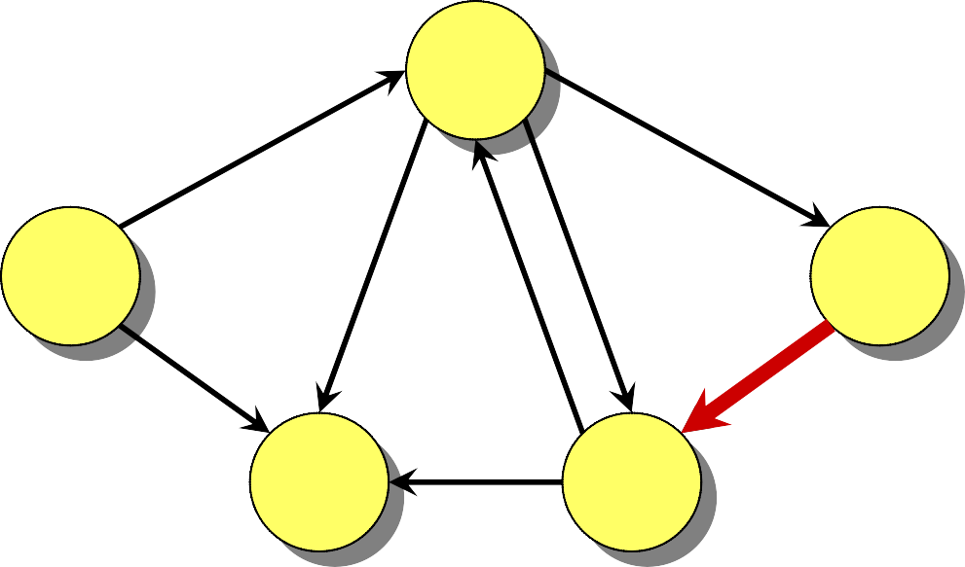
Example of Bellman-Ford
−1B
1
2
–1
0
∞
7
3
4
3
2
A
1
E
5
4
8
–3
2
C
2
6
D
∞
5

Slide 16
Example of Bellman-Ford
−1B
1
2
–1
0
∞
7
3
4
3
2
A
1
E
5
4
8
–3
2
C
2
6
D
∞
5
End of pass 1.

Slide 17
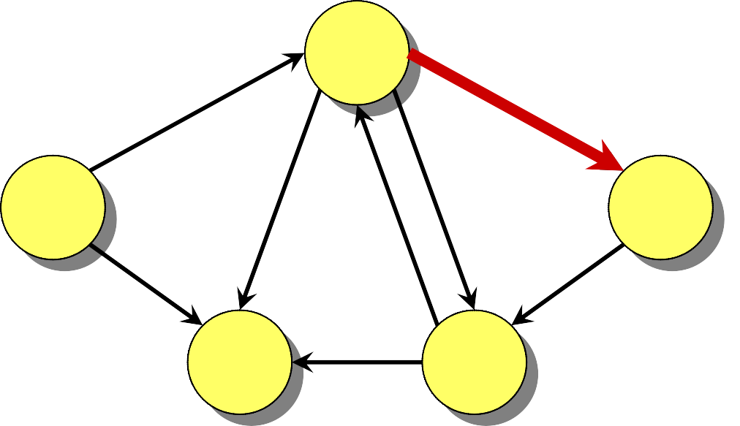
Example of Bellman-Ford
−1B
1
2
–1
∞
0
1
7
3
4
3
2
A
1
E
5
4
8
–3
2
C
2
6
D
∞
5

Slide 18
Example of Bellman-Ford
−1B
1
2
–1
0
1
7
3
4
3
2
A
1
E
5
4
8
–3
2
C
2
6
D
∞
5

Slide 19
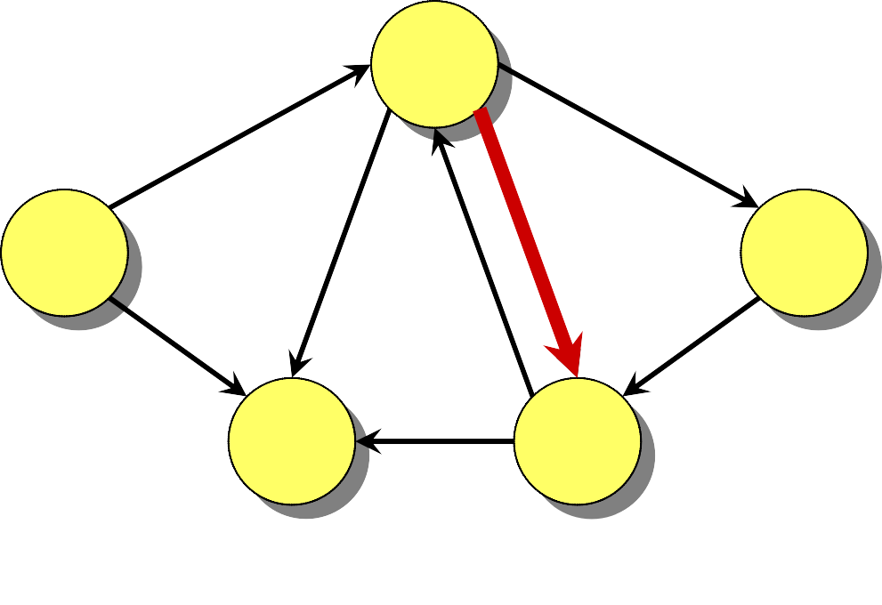
Example of Bellman-Ford
−1B
1
2
–1
0
1
7
3
4
3
2
A
1
E
5
4
8
–3
2
C
2
6
D
1
5
∞

Slide 20
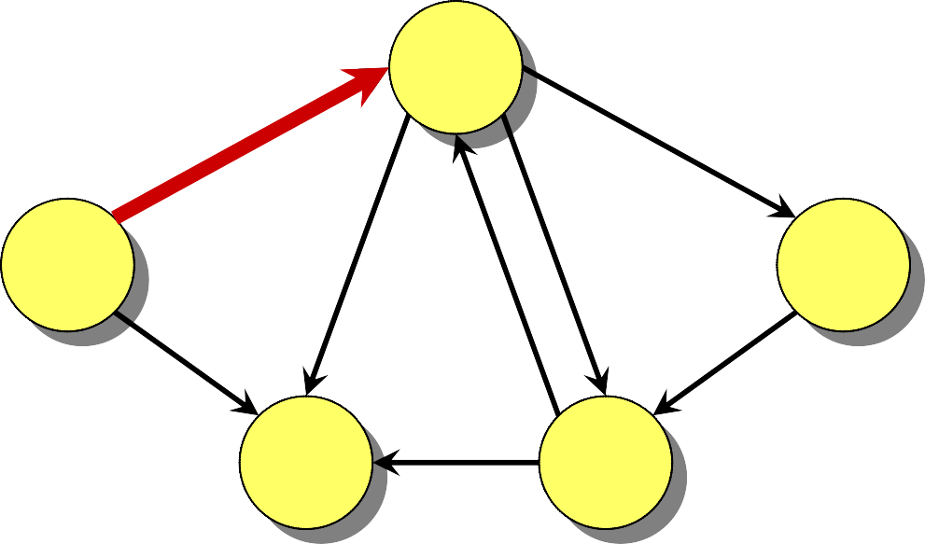
Example of Bellman-Ford
−1B
1
2
–1
0
1
7
3
4
3
2
A
1
E
5
4
8
–3
2
C
2
6
D
1
5

Slide 21
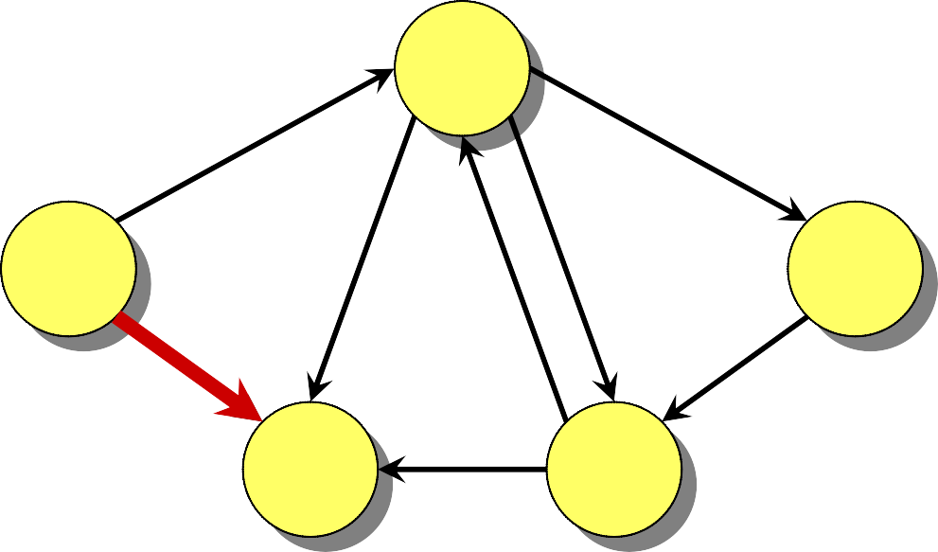
Example of Bellman-Ford
−1B
1
2
–1
0
1
7
3
4
3
2
A
1
E
5
4
8
–3
2
C
2
6
D
1
5

Slide 22
Example of Bellman-Ford
−1B
1
2
–1
0
1
7
3
4
3
2
A
1
E
5
4
8
–3
2
C
2
6
D
1
5

Slide 23
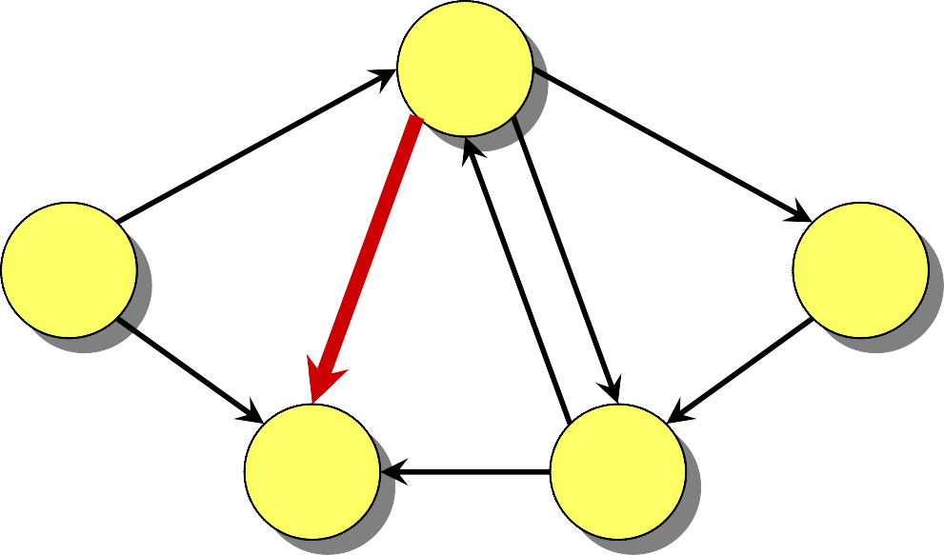
Example of Bellman-Ford
−1B
1
2
–1
0
1
7
3
4
3
2
A
1
E
5
4
8
–3
2
C
2
6
D
1
5

Slide 24
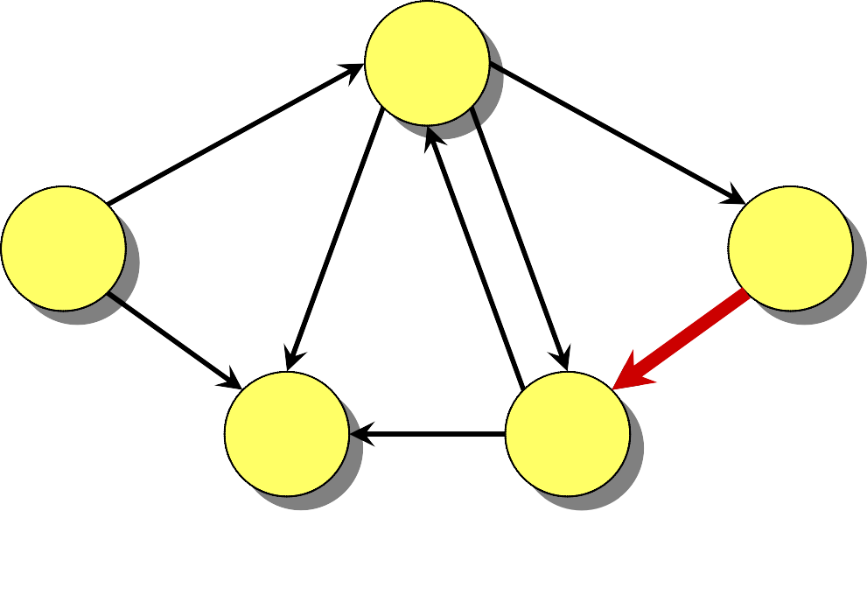
Example of Bellman-Ford
−1B
1
2
–1
0
1
7
3
4
3
2
A
1
E
5
4
8
–3
2
C
2
6
D
−2
5
1

Slide 25
Example of Bellman-Ford
−1B
1
2
–1
0
1
7
3
4
3
2
A
1
E
5
4
8
–3
2
C
2
6
D_{D}
−2
D
5
End of pass 2 (and 3 and 4).

Slide 26
Correctness
Theorem. If G = (V, E) contains no negative- weight cycles, then after the Bellman-Ford algorithm executes, d[v] = δ(s, v) for all v ∈ V.

Slide 27
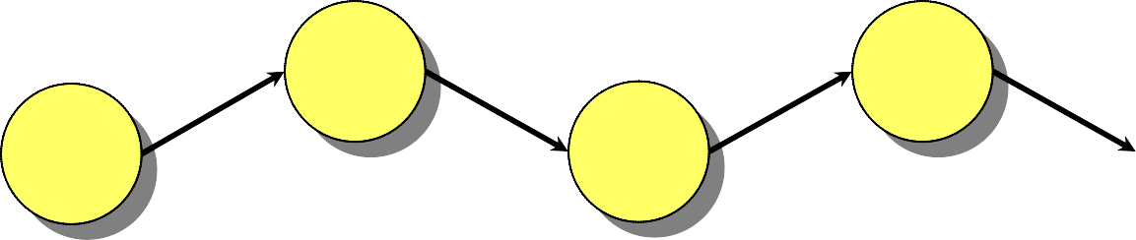
Correctness
Theorem. If G = (V, E) contains no negative- weight cycles, then after the Bellman-Ford algorithm executes, d[v] = δ(s, v) for all v ∈ V. Proof. Let v ∈ V be any vertex, and consider a shortest path p from s to v with the minimum number of edges.
v
s
v₀ v₂
v₁ v₃ v_{k}
p:
…
Since p is a shortest path, we have
δ(s, v_{i}) = δ(s, v_{i–1}) + w(v_{i–1}, v_{i}) .

Slide 28

Correctness (cont’d)
v v_{k}
s
v₁ v₃
v₀ v₂
p:
…
Initially, d[v₀] = 0 = δ(s, v₀), and d[v₀] is unchanged by subsequent relaxations (because of Lemma1 from the previous lecture that d[v] ≥ δ(s, v)).
After 1 pass through E, we have d[v₁] = δ(s, v₁). (Lemma 2)
After 2 passes through E, we have d[v₂] = δ(s, v₂).
⁞
After k passes through E, we have d[v_{k}] = δ(s, v_{k}).
Since G contains no negative-weight cycles, p is simple. Longest simple path has ≤ |V| – 1 edges.

Slide 29
Detection of Negative-Weight Cycles
Corollary. If a value d[v] fails to converge after
|V| – 1 passes, there exists a negative-weight cycle in G reachable from s.

Slide 30
Linear Programming
Let A be an m×n matrix, b be an m-vector, and c be an n-vector. Find an n-vector x that maximizes c^{T}x subject to Ax ≤ b, or determine that no such solution exists.
n
m
.
≤
maximizing
.
A
x ≤ b
_{c}T
x

Slide 31
Linear-Programming Algorithms
Algorithms for the general problem
Simplex methods — practical, but worst-case exponential time.
Interior-point methods — polynomial time and competes with simplex.

Slide 32
Linear-Programming Algorithms
Feasibility problem: No optimization criterion. Just find x such that Ax ≤ b.
In general, just as hard as ordinary LP.

Slide 33
Solving a System of Difference Constraints
Linear programming where each row of A contains exactly one 1, one –1, and the rest 0’s.
Example:
x₁ – x₂ ≤ 3 x₂ – x₃ ≤ –2 x₁ – x₃ ≤ 2
Solution:
x₁ = 3
x₂ = 0
x₃ = 2
x_{j} – x_{i} ≤ w_{ij}

Slide 34
Solving a System of Difference Constraints
Linear programming where each row of A contains exactly one 1, one –1, and the rest 0’s.
Example:
x₁ – x₂ ≤ 3 x₂ – x₃ ≤ –2 x₁ – x₃ ≤ 2
Constraint graph:
x_{j} – x_{i} ≤ w_{ij}
Solution:
x₁ = 3
x₂ = 0
x₃ = 2
(The “A”
matrix has dimensions
|E | × |V |.)
x_{j} – x_{i} ≤ w_{ij}
^{w}ij
v_{i}
v_{j}

Slide 35
Unsatisfiable Constraints
Theorem. If the constraint graph contains a negative-weight cycle, then the system of differences is unsatisfiable.

Slide 36
Unsatisfiable Constraints
Theorem. If the constraint graph contains a negative-weight cycle, then the system of differences is unsatisfiable.
Proof. Suppose that the negative-weight cycle is
v₁ → v₂ → … → v_{k} → v₁. Then, we have
x₂ – x₁ x₃ – x₂
≤ w₁₂
≤ w₂₃
⁞
^{x}k ^{– x}k–1 ^{≤ w}k–1, k
x₁ – x_{k}
≤ w_{k1}

Slide 37
Unsatisfiable Constraints
Theorem. If the constraint graph contains a negative-weight cycle, then the system of differences is unsatisfiable.
Proof. Suppose that the negative-weight cycle is
v₁ → v₂ → … → v_{k} → v₁. Then, we have
x₂ – x₁ x₃ – x₂
≤ w₁₂
≤ w₂₃
Therefore, no values for the x_{i} can satisfy the
⁞
^{x}k ^{– x}k–1 ^{≤ w}k–1, k
x₁ – | x_{k} | ≤ w_{k1}
0 |  | ≤ weight of cycle < 0
constraints.

Slide 38
Satisfying the Constraints
Theorem. Suppose no negative-weight cycle exists in the constraint graph. Then, the constraints are satisfiable.

Slide 39

Satisfying the Constraints
Theorem. Suppose no negative-weight cycle exists in the constraint graph. Then, the constraints are satisfiable.
Proof. Add a new vertex s to V with a 0-weight edge
to each vertex v_{i} ∈ V.
v₁
v₉
v₄
v₃
v₇

Slide 40
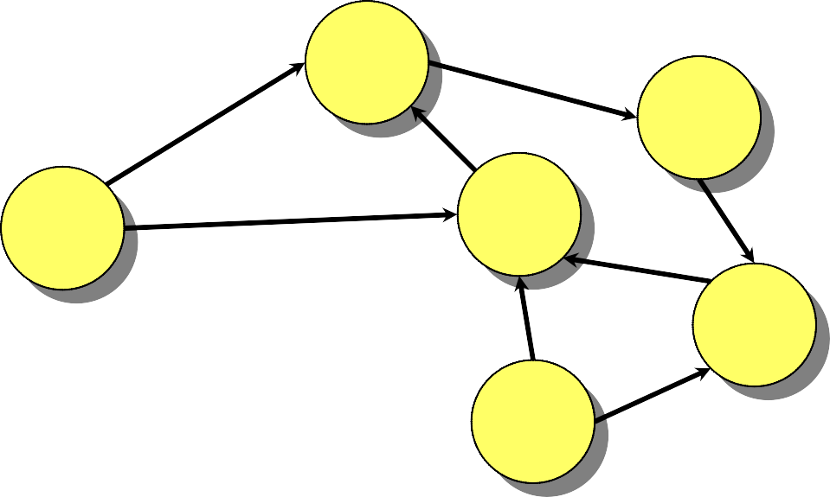
Satisfying the Constraints
Theorem. Suppose no negative-weight cycle exists in the constraint graph. Then, the constraints are satisfiable.
Proof. Add a new vertex s to V with a 0-weight edge
to each vertex v_{i} ∈ V.
v₁
0
v_{\9}
Note:
No negative-weight cycles introduced ⇒ shortest paths exist.
v₄
s
v₃
v₇

Slide 41
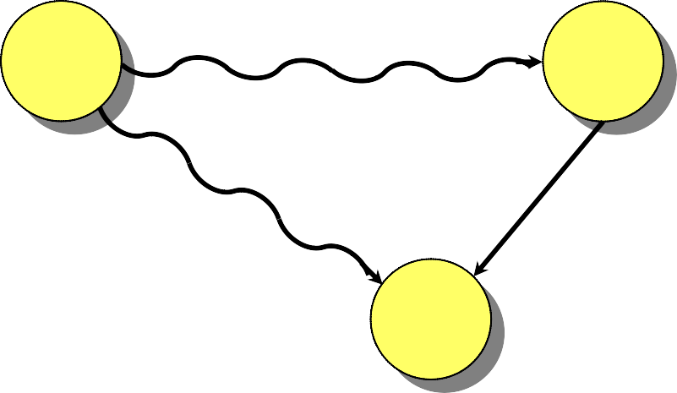
Proof (cont'd)
Claim: The assignment x_{i} = δ(s, v_{i}) solves the constraints. Consider any constraint x_{j} – x_{i} ≤ w_{ij}, and consider the shortest paths from s to v_{j} and v_{i}:
s
δ(s, v_{i})
v_{i}
^{w}ij
δ(s, v_{j})
v_{j}
By definition of δ(s, v_{j}), we have δ(s,v_{j}) ≤ δ(s, v_{i}) + w_{ij}. Since x_{i} = δ(s, v_{i}) and x_{j} = δ(s, v_{j}), the constraint x_{j} – x_{i} ≤ w_{ij} is satisfied.

Slide 42
Bellman-Ford and Linear Programming
Corollary. The Bellman-Ford algorithm can solve a system of m difference constraints on n variables in O(mn) time.
Single-source shortest paths is a simple LP problem.
In fact, Bellman-Ford maximizes x₁ + x₂ + … + x_{n} subject to the constraints x_{j} – x_{i} ≤ w_{ij} and x_{i} ≤ 0 (exercise 24.4-8).
Bellman-Ford also minimizes max_{i}{x_{i}} – min_{i}{x_{i}} (exercise 24.4-9).

Slide 43
Application to VLSI Layout Compaction
Integrated
-circuit features:
minimum separation λ
Problem: Compact (in one dimension) the space between the features of a VLSI layout without bringing any features too close together.

Slide 44
VLSI Layout Compaction
d₁
1
1
2
x₁
x₂
Constraint:
x₂ – x₁ ≥ d₁ + λ
Bellman-Ford minimizes max_{i}{x_{i}} – min_{i}{x_{i}}, which compacts the layout in the x-dimension.

