Slide 1
CSC 680 Advanced Computer Algorithms
LECTURE 9. All-Pairs Shortest Paths

Slide 2
Agenda
All-pairs shortest paths
Matrix-multiplication algorithm
Floyd-Warshall algorithm
Johnson’s algorithm

Slide 3

Shortest Paths
Single-source shortest paths
Nonnegative edge weights
Dijkstra’s algorithm: O(E + V lg V)
General
Bellman-Ford: O(VE)
DAG
One pass of Bellman-Ford: O(V + E)
All-pairs shortest paths
Nonnegative edge weights
Dijkstra’s algorithm |V| times: O(VE + V ² lg V)
General
Three algorithms today.

Slide 4
All-Pairs Shortest Paths
Input: Digraph G = (V, E), where V = {1, 2,
…, n}, with edge-weight function w : E → R.
Output: n × n matrix of shortest-path lengths
δ(i, j) for all i, j ∈ V.
IDEA:
Run Bellman-Ford once from each vertex.
Time = O(V ²E).
Dense graph (n² edges) ⇒ Θ(n ⁴) time in the worst case.
Good first try!

Slide 5
Dynamic Programming
Consider the n × n adjacency matrix A = (a_{ij}) of the digraph, and define
^{(m)} = weight of a shortest path from
^{d}ij
i to j that uses at most m edges.
Claim: We have
(0) ₌
0 if i = j,
^{d}ij
∞ if i ≠ j;
and for m = 1, 2, …, n – 1,
^{d}ij
^{(m)} = min {d
(m–1)
k ik
a_{kj} }.

Slide 6
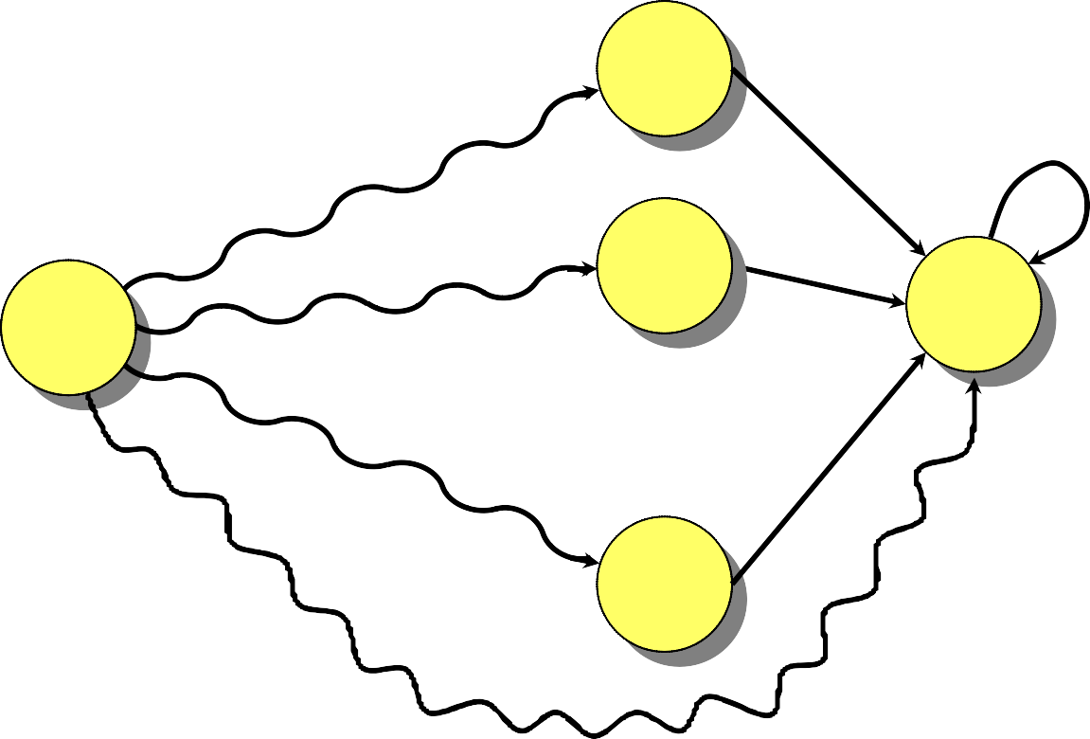
Proof of Claim
k’s
^{d}ij
^{(m)} = min {d
(m–1)
k ik
a_{kj} }
≤ m – 1 edges
≤ m – 1 edges
i
j
≤ m – 1 edges
⁞
Relaxation!
for k ← 1 to n
do if d_{ij} > d_{ik} + a_{kj}
then d_{ij} ← d_{ik} + a_{kj}
≤ m – 1 edges
Note: No negative-weight cycles implies
δ(i, j) = d_{ij} ^{(n–1)} = d_{ij} ^{(n)} = d_{ij} ^{(n+1)} = …

Slide 7
Matrix Multiplication
Compute C = A · B, where C, A, and B are n × n
matrices:
n
^{c}ij ⁼ ∑ ªik ^{b}kj .
k =1
Time = Θ(n³) using the standard algorithm.
What if we map “+” → “min” and “·” → “+”?
c_{ij} = min_{k} {a_{ik} + b_{kj}}.
Thus, D^{(m)} = D^{(m–1)} “×” A.
0 ∞ ∞ ∞
∞ 0 ∞ ∞
(0)
Identity matrix = I = _{∞ ∞ 0 ∞} = D⁰ = (d_{ij}
).
∞ ∞ ∞ 0

Slide 8
Matrix multiplication (cont‘d)
The (min, +) multiplication is associative, and with the real numbers, it forms an algebraic structure called a closed semiring.
Consequently, we can compute
_{D}(1) ₌
_{D}(2) ₌
_{D}(0) _{· A}
_{D}(1) _{· A}
= A¹
= A²
⁞ ⁞
_{D}(n–1) _{= D}(n–2) _{· A = A}n–1 ,
yielding D^{(n–1)} = (δ(i, j)).
Time = Θ(n·n³) = Θ(n⁴). No better than n × B-F.

Slide 9
Improved Matrix Multi. Algorithm
Repeated squaring: A^{2k} = A^{k} × A^{k}. Compute A², A⁴, …, A^{2⎡lg(n–1)⎤} .
O(lg n) squarings Note: A^{n–1} = A^{n} = A^{n+1} = …. Time = Θ(n³ lg n).
To detect negative-weight cycles, check the diagonal for negative values in O(n) additional time.

Slide 10
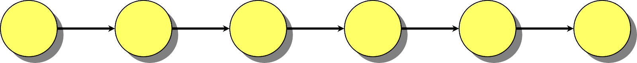
Floyd-Warshall Algorithm
Also dynamic programming, but faster!
Define c_{ij}
(k)
= weight of a shortest path from i to j with intermediate vertices belonging to the set {1, 2, …, k}.
i ≤ k ≤ k ≤ k
≤ k j
= a_{ij} .
Thus, δ(i, j) = c_{ij}
(n) (0)
. Also, c_{ij}

Slide 11
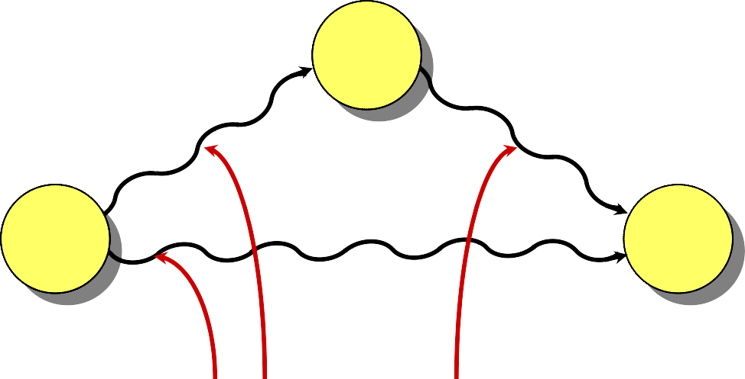
Floyd-Warshall recurrence
^{c}ij
^{(k)} = min {c
(k–1)_{, c} (k–1) _{+ c} (k–1)}
ij ik kj
k
_{cik}(k–1)
(k–1)
^{c}kj
i j
^{c}ij
(k–1)
intermediate vertices in {1, 2, …, k-1}

Slide 12
Pseudo-Code for Floyd- Warshall
for k ← 1 to n
do for i ← 1 to n
do for j ← 1 to n
do if c_{ij} > c_{ik} + c_{kj}
then c_{ij} ← c_{ik} + c_{kj}
relaxation
Notes:
Okay to omit superscripts, since extra relaxations can’t hurt.
Runs in Θ(n³) time.
Simple to code.
Efficient in practice.

Slide 13
Transitive Closure of a Directed Graph
1 if there exists a path from i to j,
0 otherwise.
Compute t_{ij} =
IDEA: Use Floyd-Warshall, but with (∨, ∧) instead of (min, +):
(k) _{= t} (k–1) _{∨ (t} (k–1) _{∧ t} (k–1)_{).}
^{t}ij
ij ik kj
Time = Θ(n³).

Slide 14
Graph Reweighting
Theorem. Given a function h : V → ℜ, reweight each edge (u, v) ∈ E by w_{h}(u, v) = w(u, v) + h(u) – h(v).
Then, for any two vertices, all paths between them are
reweighted by the same amount.
Proof. Let p = v₁ → v₂ → …→ v_{k} be a path in G. We
have
_{k −1}
w_{h} ( p) = ∑ w_{h} (v_{i} ,v_{i+1} )
= ∑(w(v_{i} ,v_{i+1} )+h(v_{i} )−h(v_{i+1} ))
= ∑ w(v_{i} ,v_{i+1} ) + h(v₁ ) − h(v_{k} )
i=1
k −1
i=1
k −1
Same amount!
i=1
= w( p) + h(v₁ ) − h(v_{k} ) .

Slide 15
Shortest Paths in Reweighted Graphs
Corollary. δ_{h}(u, v) = δ(u, v) + h(u) – h(v).
IDEA: Find a function h : V → ℜ such that w_{h}(u, v) ≥ 0 for all (u, v) ∈ E. Then, run Dijkstra’s algorithm from each vertex on the reweighted graph.
NOTE: w_{h}(u, v) ≥ 0 iff h(v) – h(u) ≤ w(u, v).

Slide 16
Johnson’s Algorithm
Find a function h : V → ℜ such that w_{h}(u, v) ≥ 0 for all (u, v) ∈ E by using Bellman-Ford to solve the difference constraints h(v) – h(u) ≤ w(u, v), or determine that a negative-weight cycle exists.
Time = O(V E).
Run Dijkstra’s algorithm using w_{h} from each vertex
u ∈ V to compute δ_{h}(u, v) for all v ∈ V.
Time = O(VE + V ² lg V).
For each (u, v) ∈ V × V, compute
δ(u, v) = δ_{h}(u, v) – h(u) + h(v) .
Time = O(V ²).
Total time = O(VE + V ² lg V).

