Slide 1
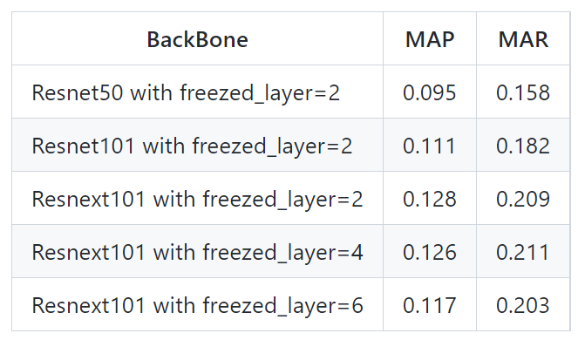
Data Sampling (54392-> 10000)
Modeling
3. Hyperparameter tuning (모델 성능 높이기)
model | Augmentation X |  | Augmentation O
Vanilla U-Net | 0.07 | 0.03 | 0.41 | 0.39
ResU-Net | - |  | -
RPA-ResU-Net | - |  | -
U-Net
Mask-RCNN

