Slide 1
Effort Model for Generalizable Deepfake Detection with Orthogonal Subspace Decomposition

Slide 2
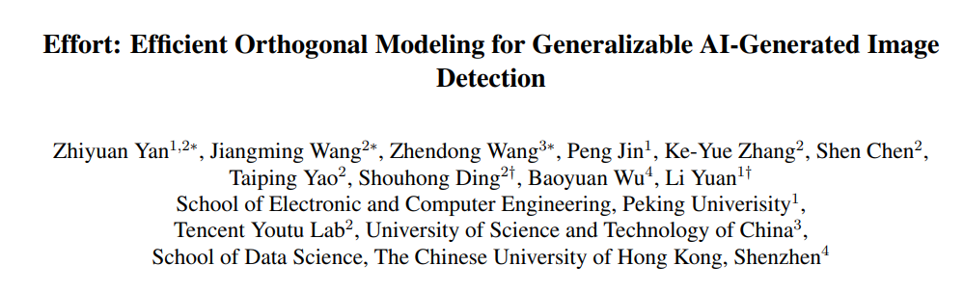
Pre-trained model
Yan et al., "Effort: Efficient Orthogonal Modeling for Generalizable AI-Generated Image Detection", ICML 2025 (arXiv, Nov 2024).

Slide 3
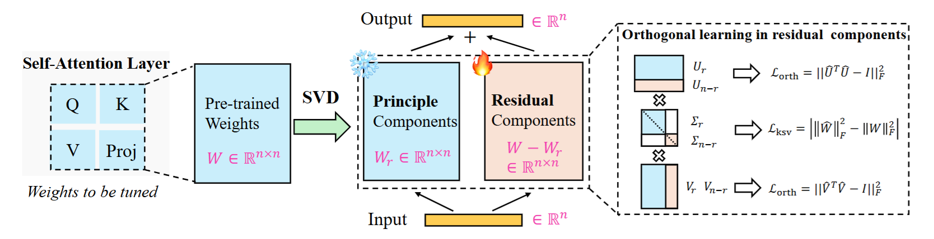
Method

Slide 4
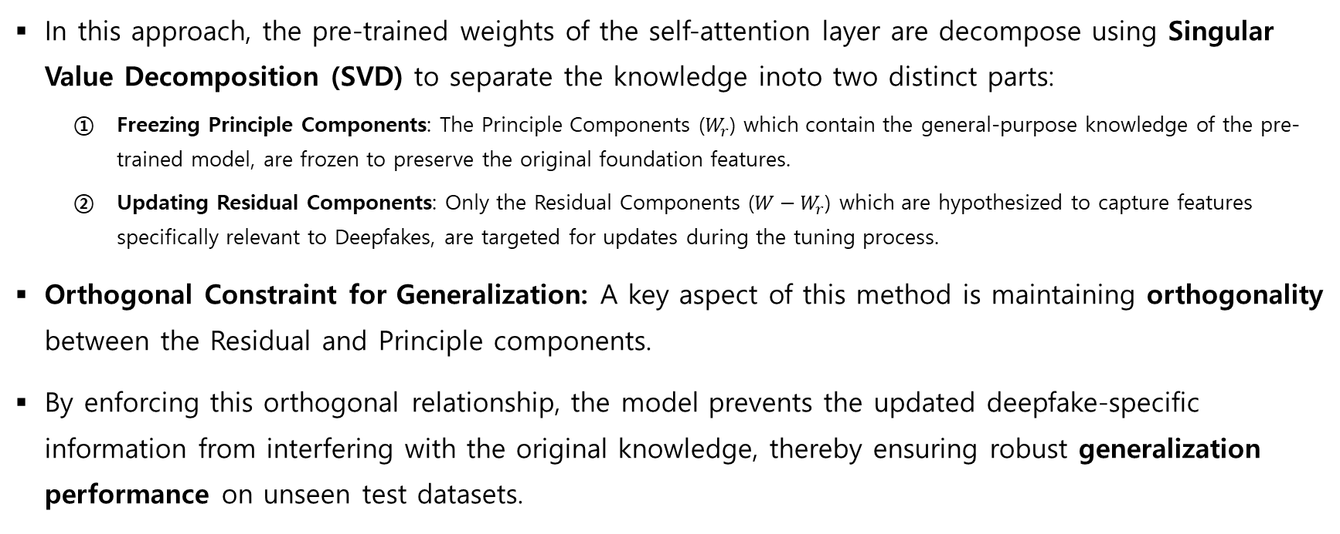
Method
In this approach, the pre-trained weights of the self-attention layer are decompose using Singular Value Decomposition (SVD) to separate the knowledge inoto two distinct parts:
  Freezing Principle Components: The Principle Components ($W_{r}$) which contain the general-purpose knowledge of the pre-trained model, are frozen to preserve the original foundation features.
  Updating Residual Components: Only the Residual Components (${W−W}_{r}$) which are hypothesized to capture features specifically relevant to Deepfakes, are targeted for updates during the tuning process.
Orthogonal Constraint for Generalization: A key aspect of this method is maintaining orthogonality between the Residual and Principle components.
By enforcing this orthogonal relationship, the model prevents the updated deepfake-specific information from interfering with the original knowledge, thereby ensuring robust generalization performance on unseen test datasets.

Slide 5
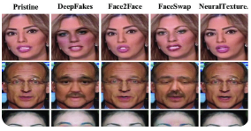
Train dataset & Weights
We utilized weights pre-trained on the FF++ dataset.
The pre-trained weights were further trained on the FF++ dataset, excluding the DeepFakeDetection fake data. We determined that the quality of images generated by DeepFakeDetection is subpar compared to current state-of-the-art deepfakes, making them less representative of modern deepfake characteristics.

Slide 6
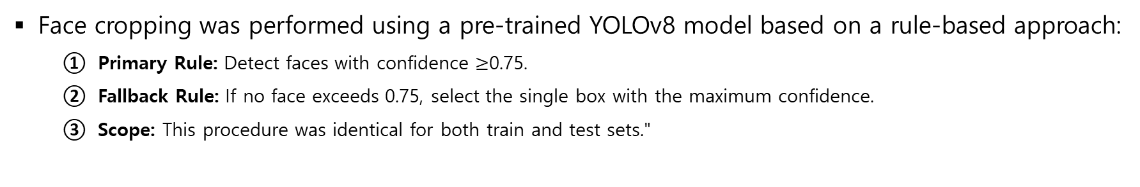
Face Cropping
Face cropping was performed using a pre-trained YOLOv8 model based on a rule-based approach:
  Primary Rule: Detect faces with confidence $≥$0.75.
  Fallback Rule: If no face exceeds 0.75, select the single box with the maximum confidence.
  Scope: This procedure was identical for both train and test sets."

Slide 7
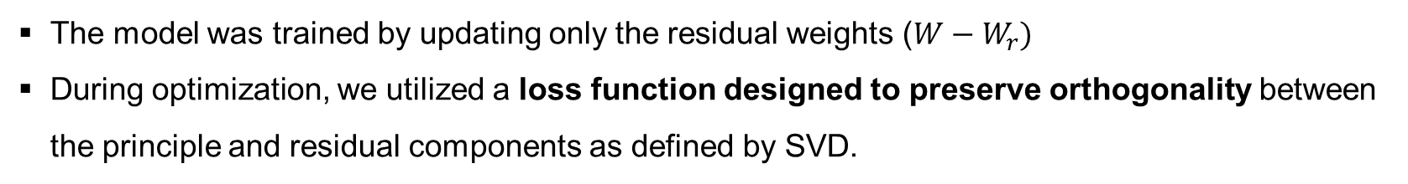
Fine-tuning
The model was trained by updating only the residual weights ($W−W_{r})$
During optimization, we utilized a loss function designed to preserve orthogonality between the principle and residual components as defined by SVD.

Slide 8
Inference
Preprocessing: Faces are converted to RGB, resized to the target resolution, and normalized using CLIP-based mean/std.
Aggregation: For videos, probabilities from sampled frames are averaged to produce a final authenticity score.
Output: Results are mapped to a baseline CSV, ensuring 100% coverage by filling failure cases with a neutral 0.5 probability.

