Slide 1
1 | 1 | 1 | 0 | 0 | 0 | 0 | 1 | 1 | 1
1 | 1 | 1 | 1 | 0 | 0 | 0 | 0 | 1 | 1
1 | 0 | 1 | 1 | 0 | 0 | 0 | 0 | 1 | 1
0 | 0 | 1 | 1 | 1 | 0 | 0 | 0 | 0 | 1
0 | 0 | 0 | 1 | 0 | 0 | 0 | 0 | 0 | 1
0 | 0 | 0 | 0 | 0 | 0 | 0 | 0 | 0 | 1
0 | 0 | 0 | 0 | 0 | 0 | 0 | 0 | 0 | 0
0 | 0 | 0 | 0 | 1 | 1 | 0 | 0 | 0 | 0
0 | 0 | 0 | 0 | 1 | 1 | 1 | 0 | 0 | 0
0 | 0 | 0 | 0 | 0 | 0 | 0 | 0 | 0 | 0
cin >> n;
for (int i = 0; i < n; i++)
{
for (int j = 0; j < n; j++)
{
cin >> board[i][j];
}
}
10
1 1 1 0 0 0 0 1 1 1
1 1 1 1 0 0 0 0 1 1
1 0 1 1 0 0 0 0 1 1
0 0 1 1 1 0 0 0 0 1
0 0 0 1 0 0 0 0 0 1
0 0 0 0 0 0 0 0 0 1
0 0 0 0 0 0 0 0 0 0
0 0 0 0 1 1 0 0 0 0
0 0 0 0 1 1 1 0 0 0
0 0 0 0 0 0 0 0 0 0

Slide 2
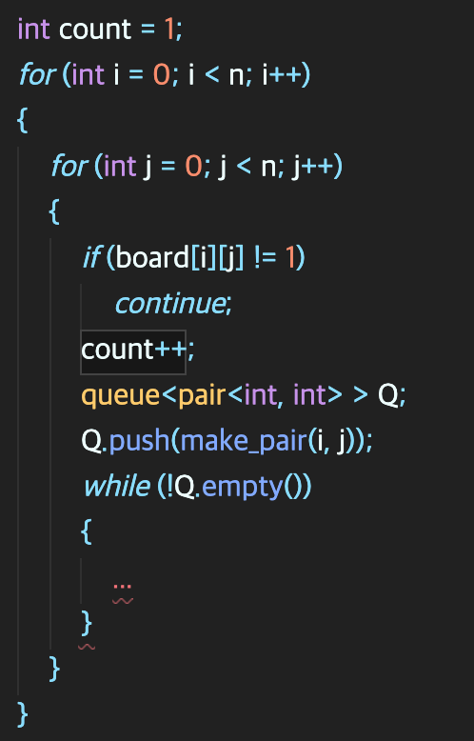
2 | 2 | 2 | 0 | 0 | 0 | 0 | 3 | 3 | 3
2 | 2 | 2 | 2 | 0 | 0 | 0 | 0 | 3 | 3
2 | 0 | 2 | 2 | 0 | 0 | 0 | 0 | 3 | 3
0 | 0 | 2 | 2 | 2 | 0 | 0 | 0 | 0 | 3
0 | 0 | 0 | 2 | 0 | 0 | 0 | 0 | 0 | 3
0 | 0 | 0 | 0 | 0 | 0 | 0 | 0 | 0 | 3
0 | 0 | 0 | 0 | 0 | 0 | 0 | 0 | 0 | 0
0 | 0 | 0 | 0 | 4 | 4 | 0 | 0 | 0 | 0
0 | 0 | 0 | 0 | 4 | 4 | 4 | 0 | 0 | 0
0 | 0 | 0 | 0 | 0 | 0 | 0 | 0 | 0 | 0

Slide 3
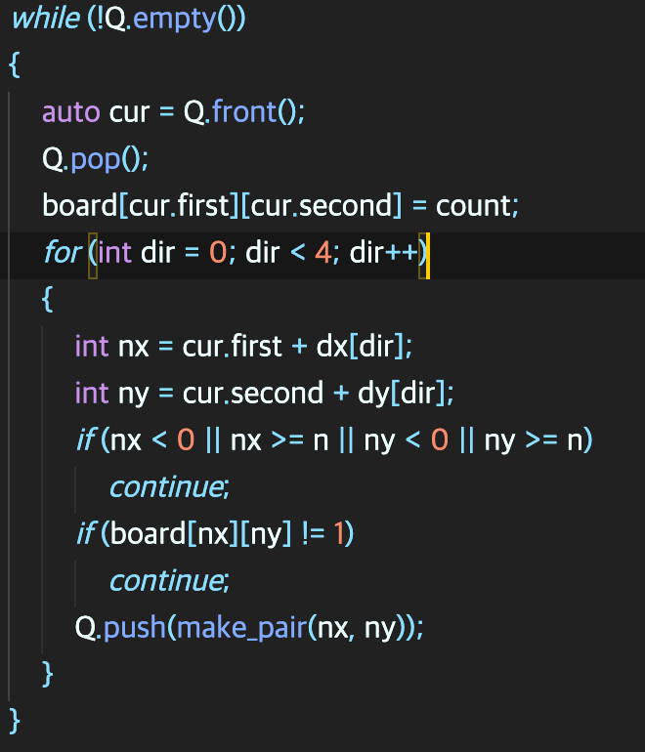
2 | 2 | 2 | 0 | 0 | 0 | 0 | 3 | 3 | 3
2 | 2 | 2 | 2 | 0 | 0 | 0 | 0 | 3 | 3
2 | 0 | 2 | 2 | 0 | 0 | 0 | 0 | 3 | 3
0 | 0 | 2 | 2 | 2 | 0 | 0 | 0 | 0 | 3
0 | 0 | 0 | 2 | 0 | 0 | 0 | 0 | 0 | 3
0 | 0 | 0 | 0 | 0 | 0 | 0 | 0 | 0 | 3
0 | 0 | 0 | 0 | 0 | 0 | 0 | 0 | 0 | 0
0 | 0 | 0 | 0 | 4 | 4 | 0 | 0 | 0 | 0
0 | 0 | 0 | 0 | 4 | 4 | 4 | 0 | 0 | 0
0 | 0 | 0 | 0 | 0 | 0 | 0 | 0 | 0 | 0

Slide 4
0 | 0 | 0 | 0 | 0 | 0 | 0 | 0 | 0 | 0
0 | 0 | 0 | 0 | 0 | 0 | 0 | 0 | 0 | 0
0 | 1 | 0 | 0 | 0 | 0 | 0 | 0 | 0 | 0
1 | 2 | 0 | 0 | 0 | 0 | 0 | 0 | 0 | 0
2 | 0 | 0 | 0 | 0 | 0 | 0 | 0 | 0 | 0
0 | 0 | 0 | 0 | 0 | 0 | 0 | 0 | 0 | 0
0 | 0 | 0 | 0 | 0 | 0 | 0 | 0 | 0 | 0
0 | 0 | 0 | 0 | 0 | 0 | 0 | 0 | 0 | 0
0 | 0 | 0 | 0 | 0 | 0 | 0 | 0 | 0 | 0
0 | 0 | 0 | 0 | 0 | 0 | 0 | 0 | 0 | 0
if (board[next] == board[start])
continue ;

Slide 5
0 | 0 | 0 | 0 | 0 | 0 | 0 | 0 | 0 | 0
0 | 0 | 0 | 0 | 0 | 0 | 0 | 0 | 0 | 0
0 | 0 | 0 | 0 | 0 | 0 | 0 | 0 | 0 | 0
0 | 0 | 0 | 0 | 0 | 0 | 0 | 0 | 0 | 0
0 | 0 | 0 | 0 | 0 | 0 | 0 | 0 | 0 | 0
0 | 0 | 0 | 1 | 0 | 0 | 0 | 0 | 0 | 0
0 | 0 | 0 | 2 | 3 | 0 | 0 | 0 | 0 | 0
0 | 0 | 0 | 0 | 0 | 0 | 1 | 2 | 3 | ?
0 | 0 | 0 | 0 | 0 | 0 | 0 | 0 | 0 | 0
0 | 0 | 0 | 0 | 0 | 0 | 0 | 0 | 0 | 0
result = 3;
if dist[cur.first][cur.second]>result)
continue ;

