Slide 1
PORT
In NXP S32K146, there are 5ports.
PORT A, B, C, D, E.
PORT A: 0~31 PORT B: 32~63 PORT C: 64~95 PORT D: 96~127 PORT E 128~159
There are 164 pins in NXP S32K146.
PTD0 -> blue led. -> PORT D 96
PTD15 -> red led -> PORT D 96+15 = 111 (pin number)
PTD16 -> green led -> PORT D 96 + 16 = 112
Each ports contain such of pins

Slide 2
PORT
PORT = Group of pins
Pull-up = high = logic 1 (on)
Pull-down = low = logic 0 (off)
Pull-desabled = neither logic 1 nor 0 ->floating condition.
If we need to use floating condition pin, we need to change condition by using Pull-up or Pull-down.

Slide 3
PORT
Addressing: Mapping the right number to the right port.
Usage: choose the port is input or output
ex) if led is blinking -> usage.
I/O operation.
Input: read data Output: send data to actuator

Slide 4
DIO
DIO (Digital input, output) - microcontroller that handling Digital signal.
1. Digital input: Detect high or low voltage levels high-1 low-0, used to read a switch state.
2. Digital output: drive digital external devices. Output high(VCC), low (ground)
3. Applications: DIO functionalities.
4. Programing Interface: It reads information from pins and interact with external devices.
5. Configuration: input: reading, output: generating

Slide 5
Tresos
AUTOSAR tool -> choice value(select parameter), then this tool make code automatically.
Tool – configuration bsw(basic software) -> (output) .c , .h
How to use?
Import -> Browse (get a file) -> ECU(CORETEXM, S32K146) -> add - module configuration(DIO, PORT).
Extra
PortPin direction - choice input, output Port-level value - original value set.
Property->auto - choose pins automatically. Resource - select what machine we use.

Slide 6
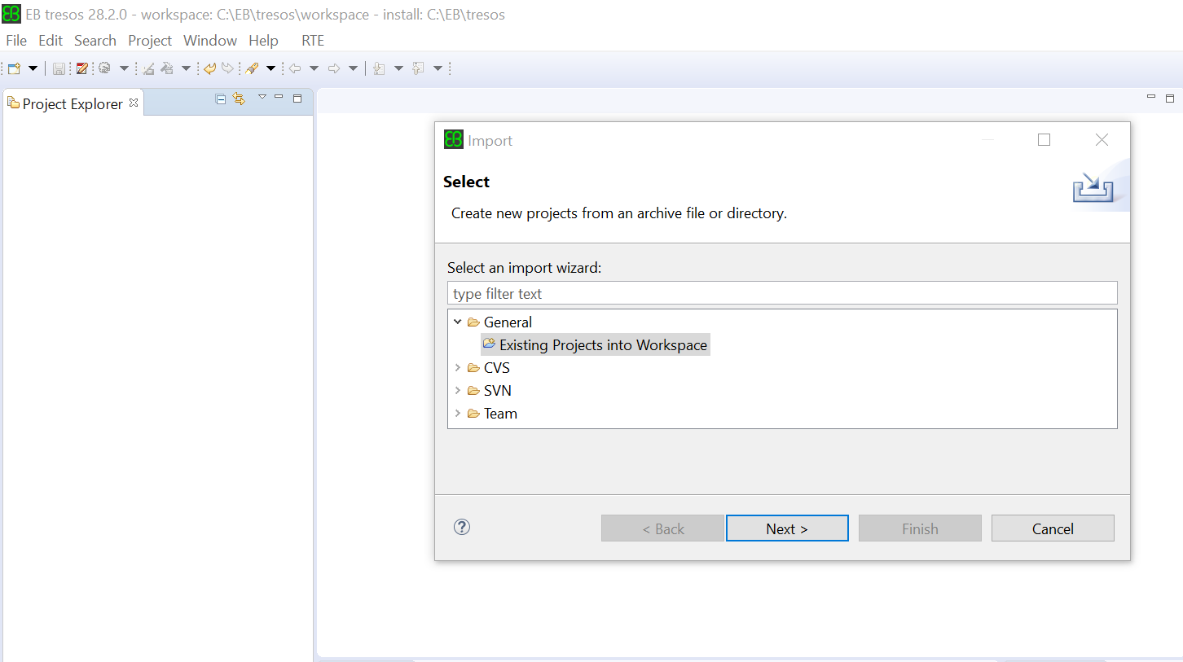
Tresos
Import

Slide 7
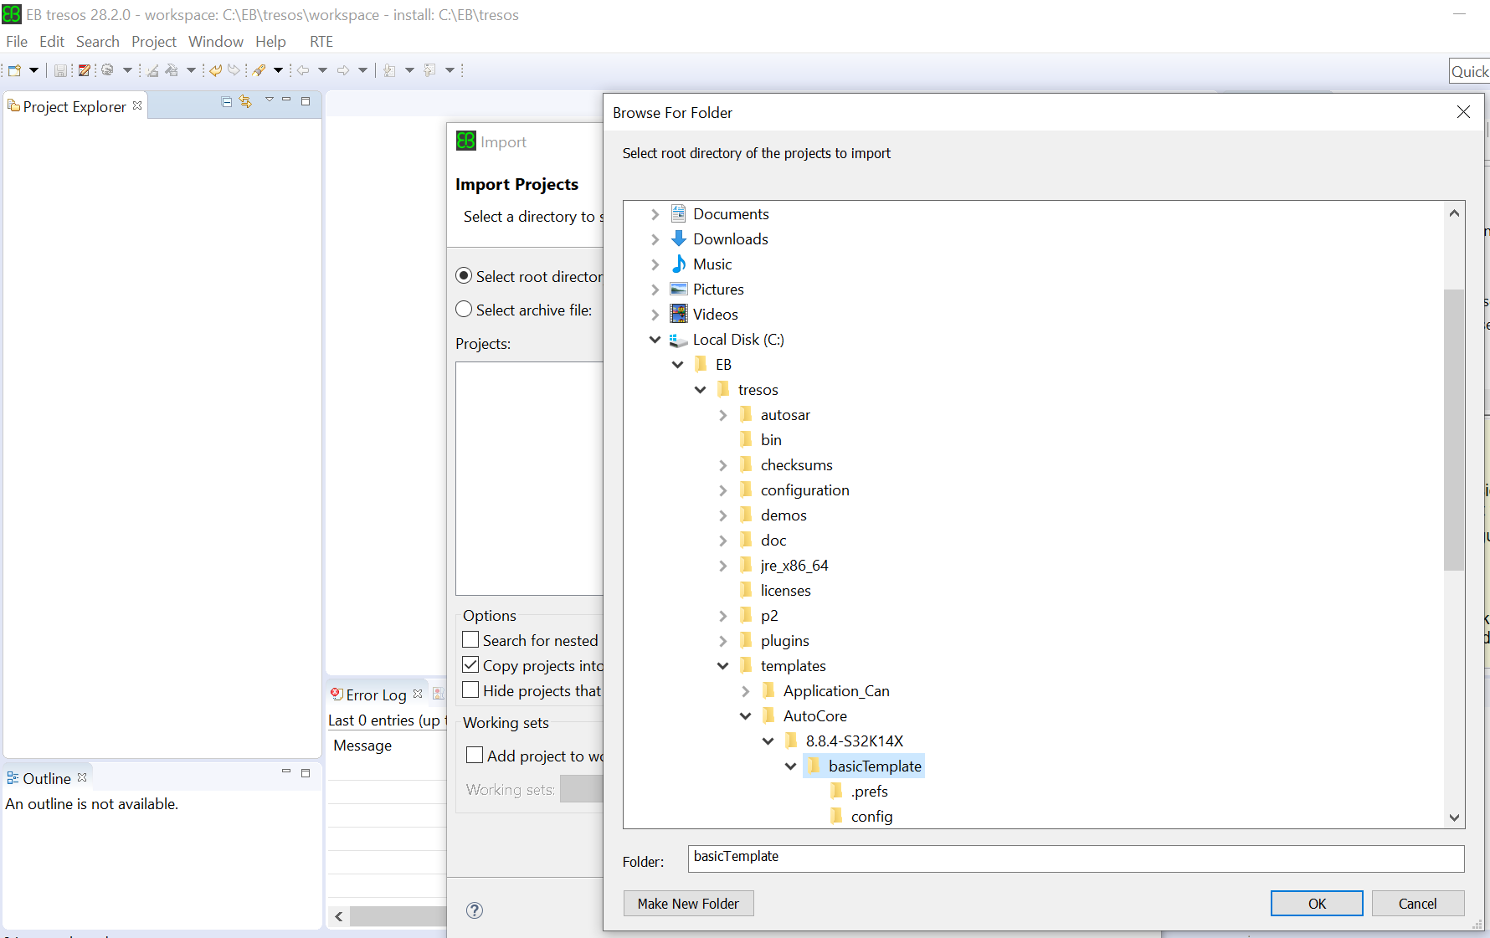
Tresos
Import
Copy basictemplete

Slide 8
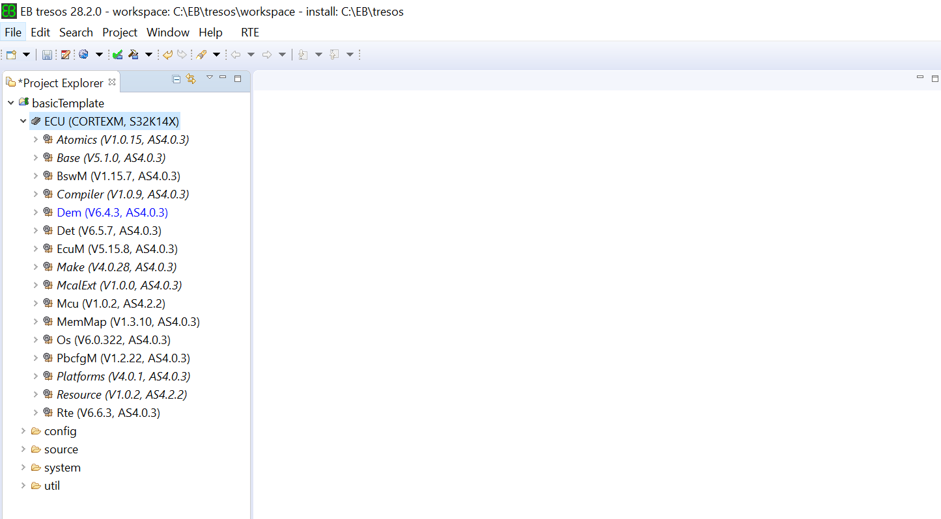
Tresos
Check ECU

Slide 9
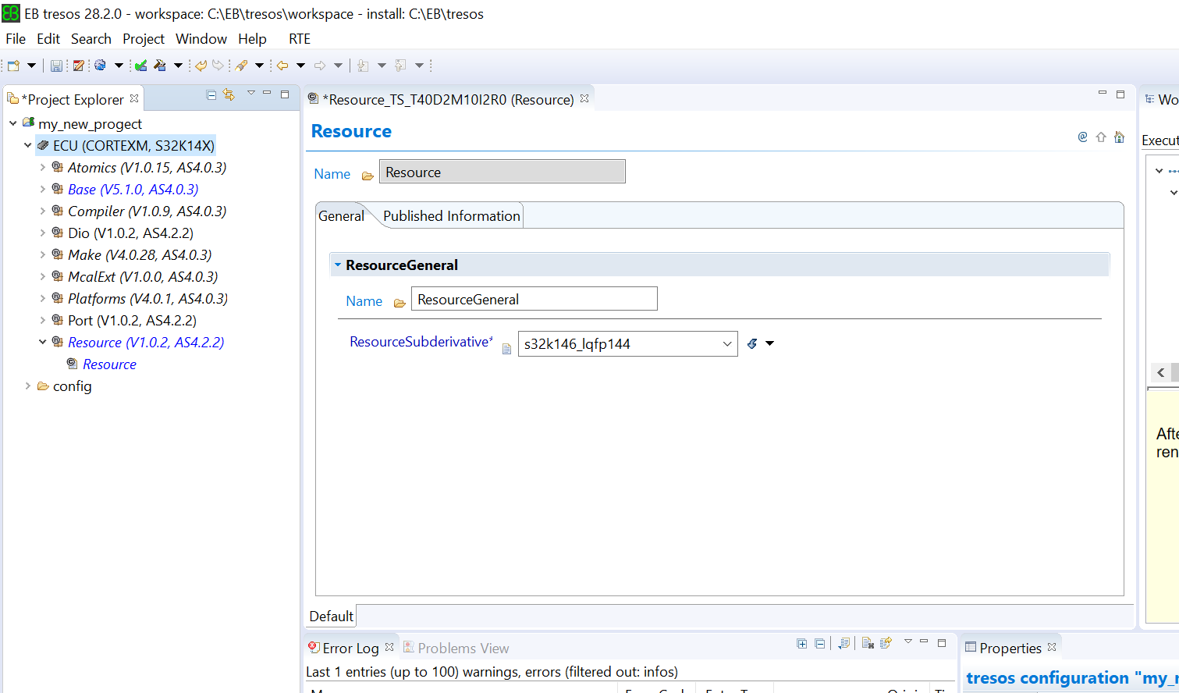
Tresos
Change the resource
S32K146_lqfp 144

Slide 10
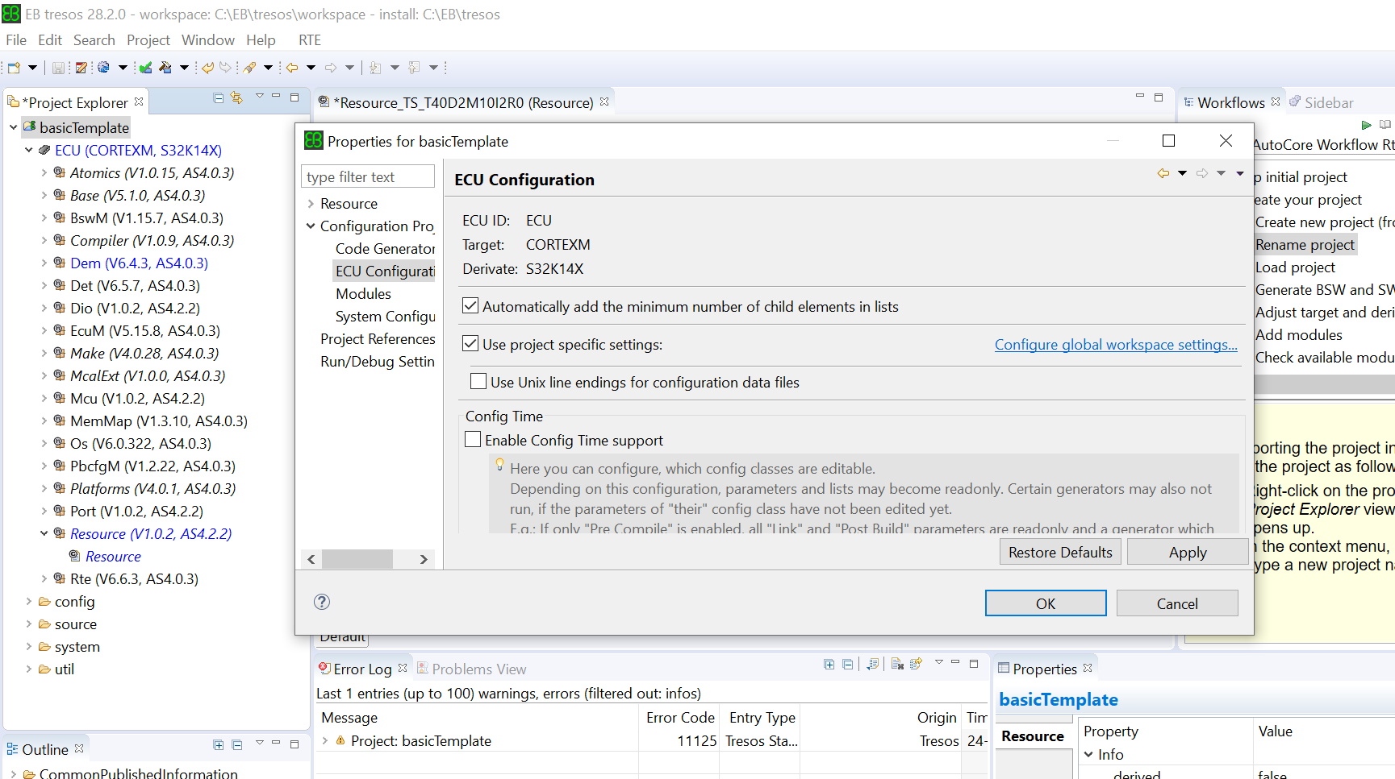
Tresos
Properties
Check the Automatically add

Slide 11
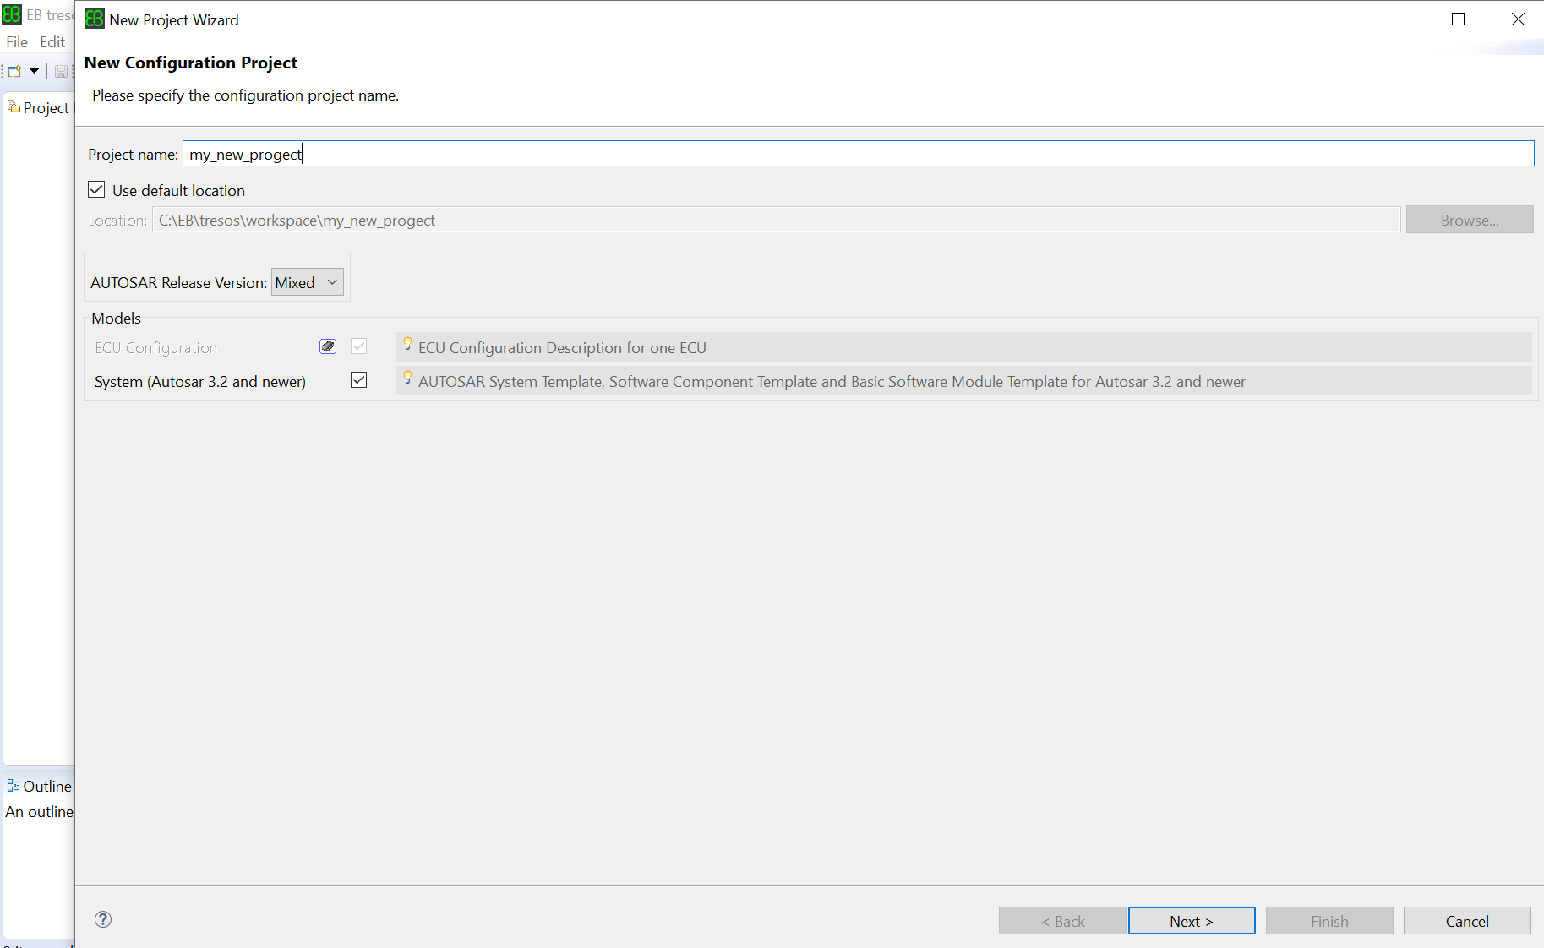
Tresos
Scratch

Slide 12
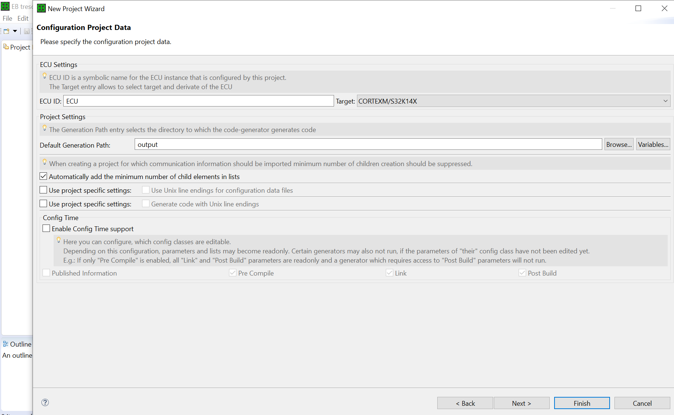
Tresos
ECU name
Check the Automatically add

Slide 13
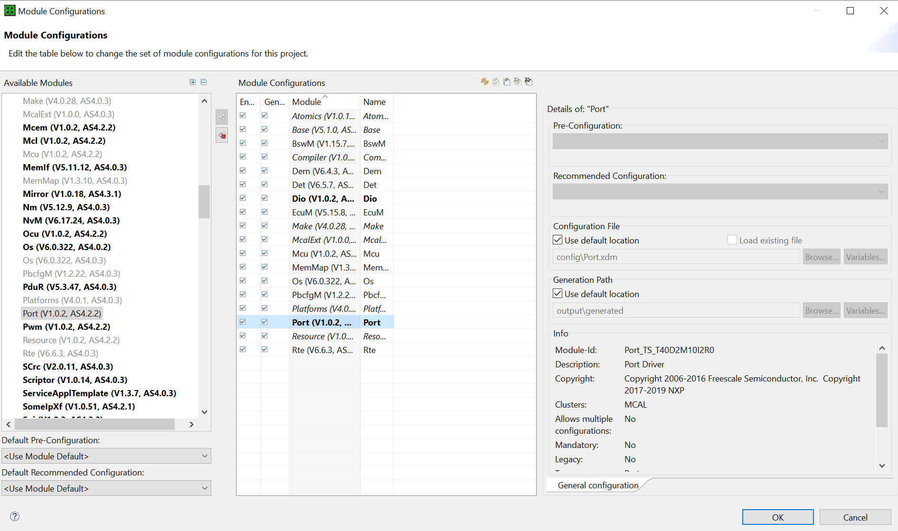
Tresos
Module Configuration
Add Port, Dio

Slide 14
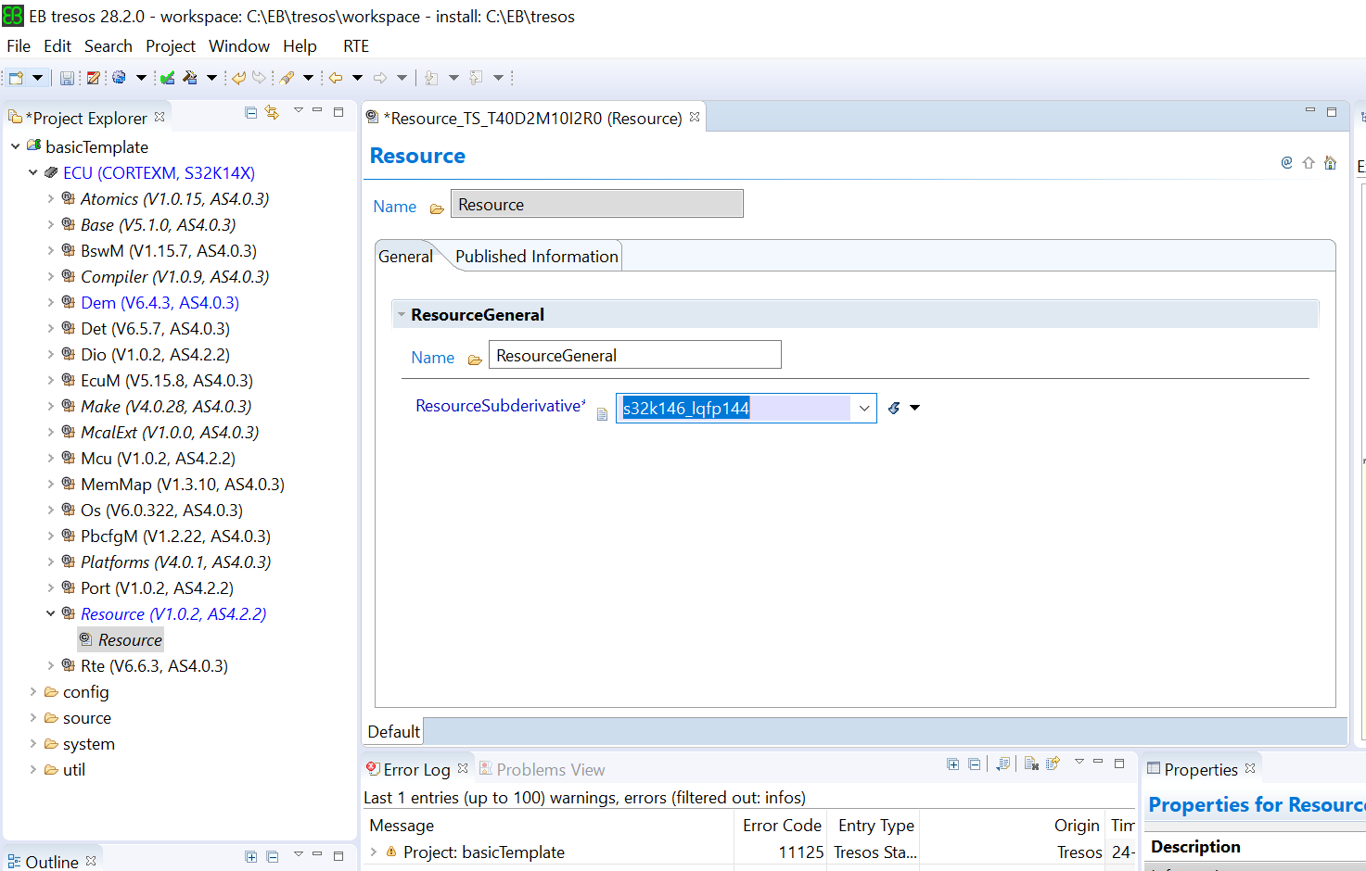
Tresos
Change the resource
S32K146_lqfp 144

