Slide 1
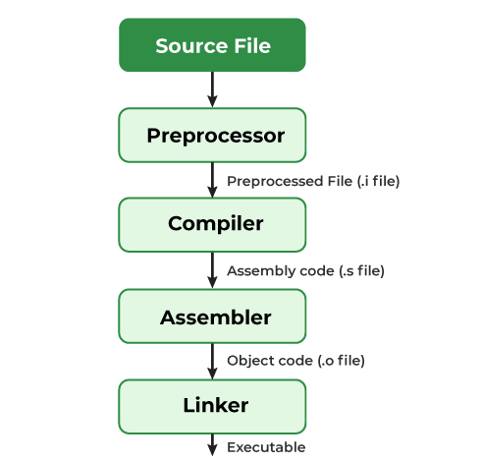
Compilation
The compilation is the process of converting the source code of the C language into machine code.
There are 4 steps for compilation process.
1. Pre-processing : preprocessing indicators (file.i)
2. Compilation: Source code to assembly code (file.s)
3. Assembly: Creates an object file (file.o)
4. Linking: Create executable programs
To do this we need Preprocessor, Compiler, Assembler, Linker.
There are 3 steps for run a C program.
1. Create source file 2. Compiling using GCC compiler 3. Executing the program
A compiler is a translating program that translates the instructions of high level language to machine level language.

Slide 2
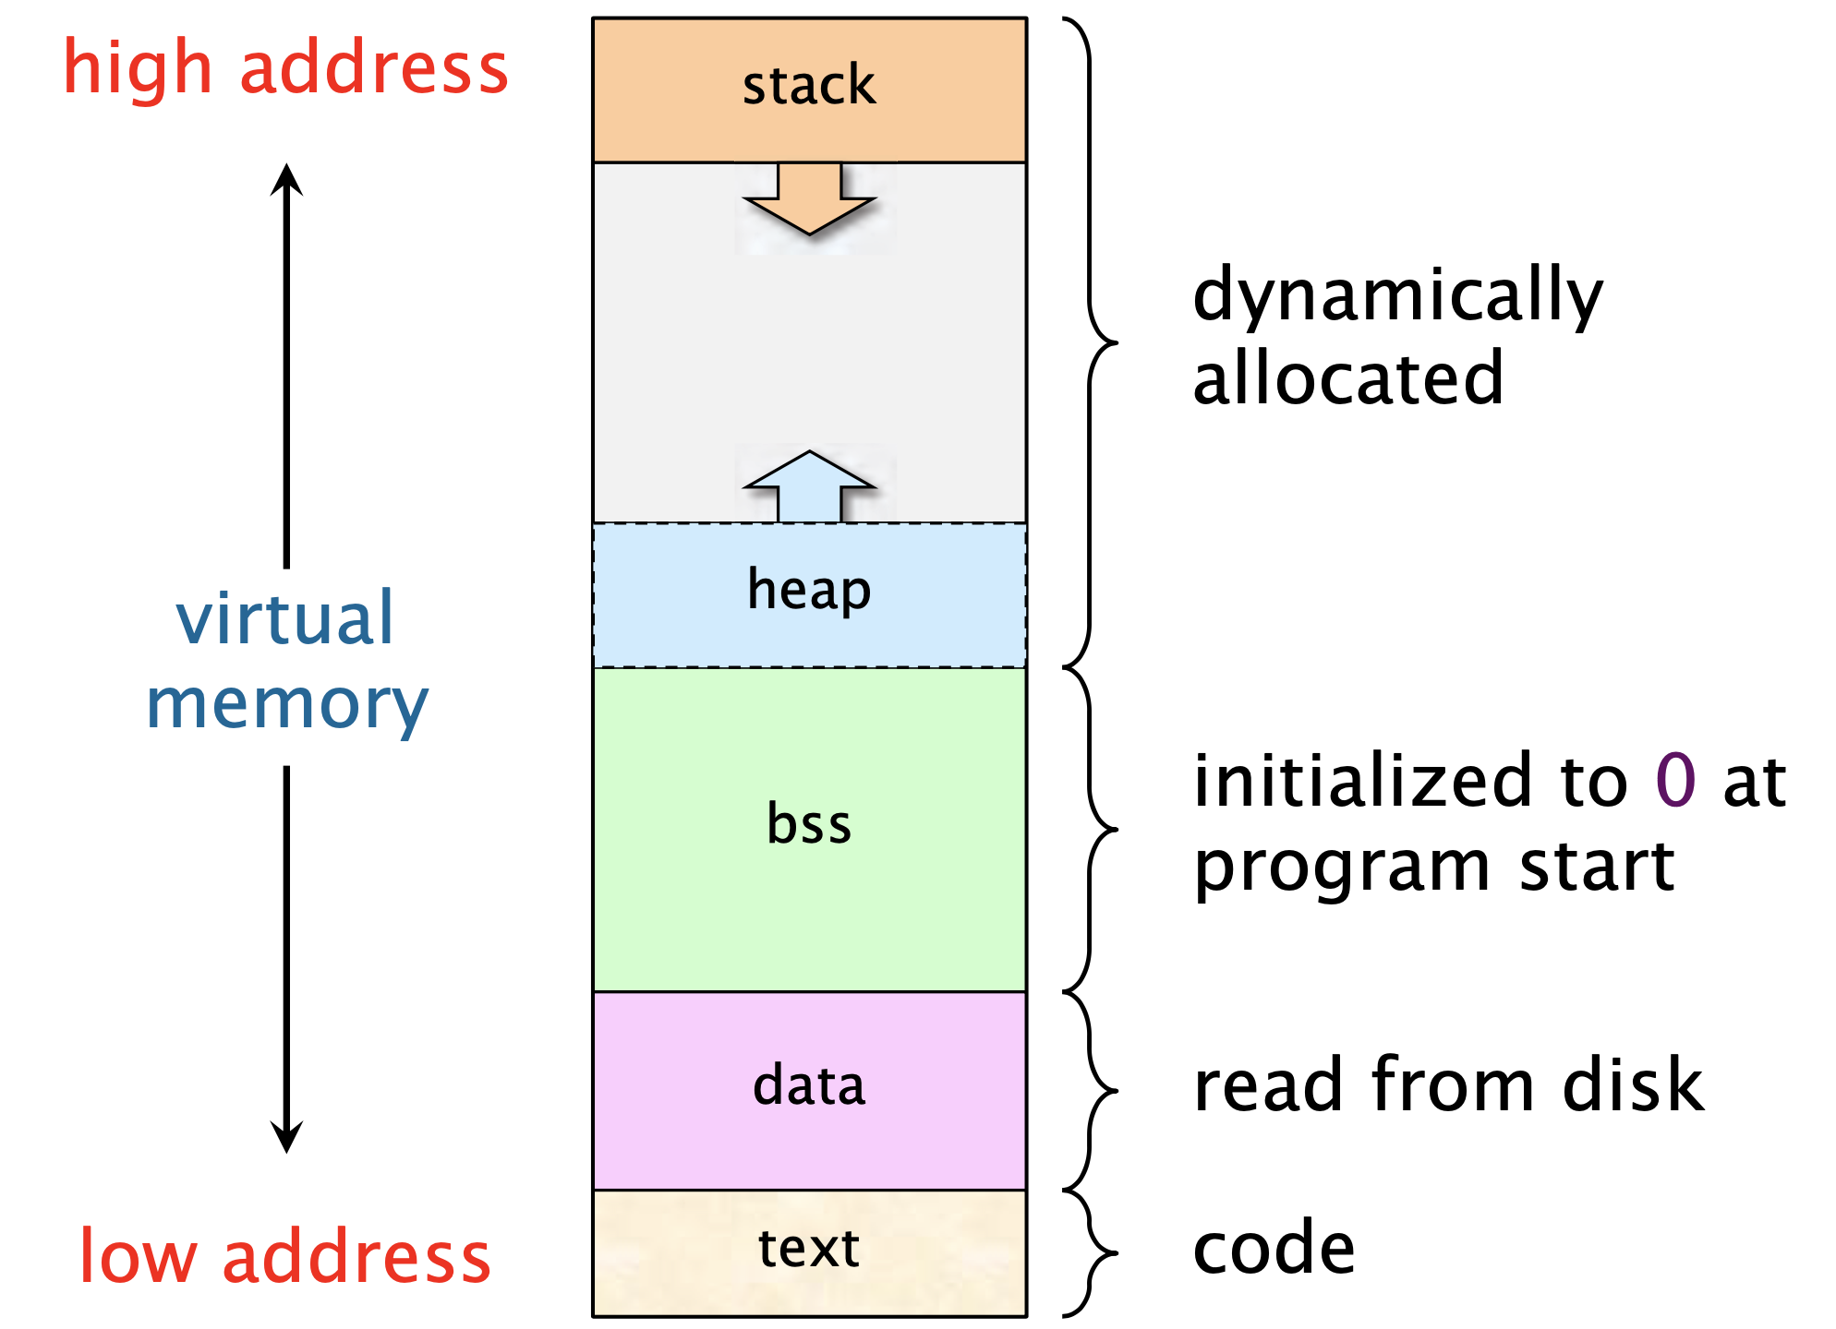
Memory layer
Four layer
1. Text(Code): store sharable frequently executed programs
2. Data: global variables and static variables that are initialized, uninitailized in program.
Int b = 10; <- initialize int a; <- uninitialize (garbage value in a)
3. Heap: dynamic memory allocation usually takes place, The stack area contains the program stack
4. Stack: adjoined the heap area and grew in the opposite direction

Slide 3
MCU peripherals (ADC,PORT, PWM, DIO)
ADC (Analog to Digital Conversion)
Sampling: a process of measuring the amplitude of a continuous-time signal at discrete instants, converting the continuous signal into a discrete signal
PORT: physical docking point which is basically used to connect the external devices to the computer
PWM: commonly used technique for effectively controlling the power supplied to electrical devices. It makes digital signal to analog signal.
DIO: It is used to receive the input of the switch (On/Off) and display the output in conjunction with the input (/5V or 5V/0V).

Slide 4
extra page (for 07/02 PM)

Slide 5
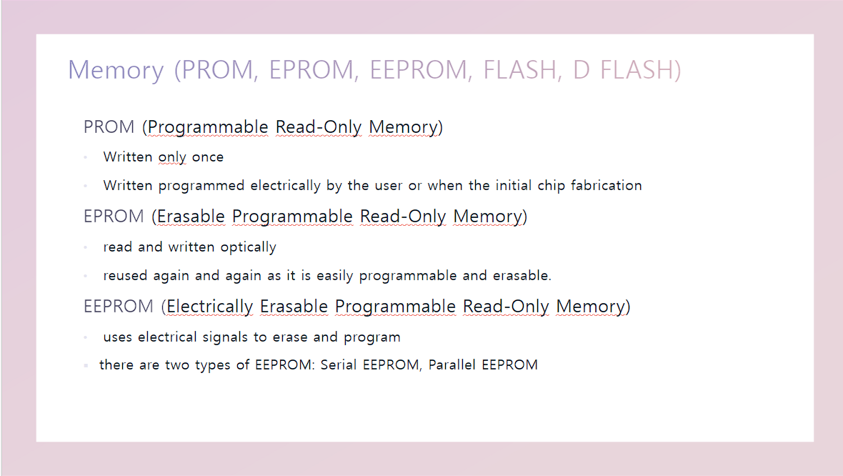

Slide 6
