Slide 1
PROJECT

Slide 2
Index
1. REQUIREMENT
2. DESIGN

Slide 3
Requirement
Turn on the LED
LED color is blue (PTD 0)
Using switch 3 (PTD 13)
If switch is pushed, Turn on the LED
If relased it, turn off the LED

Slide 4
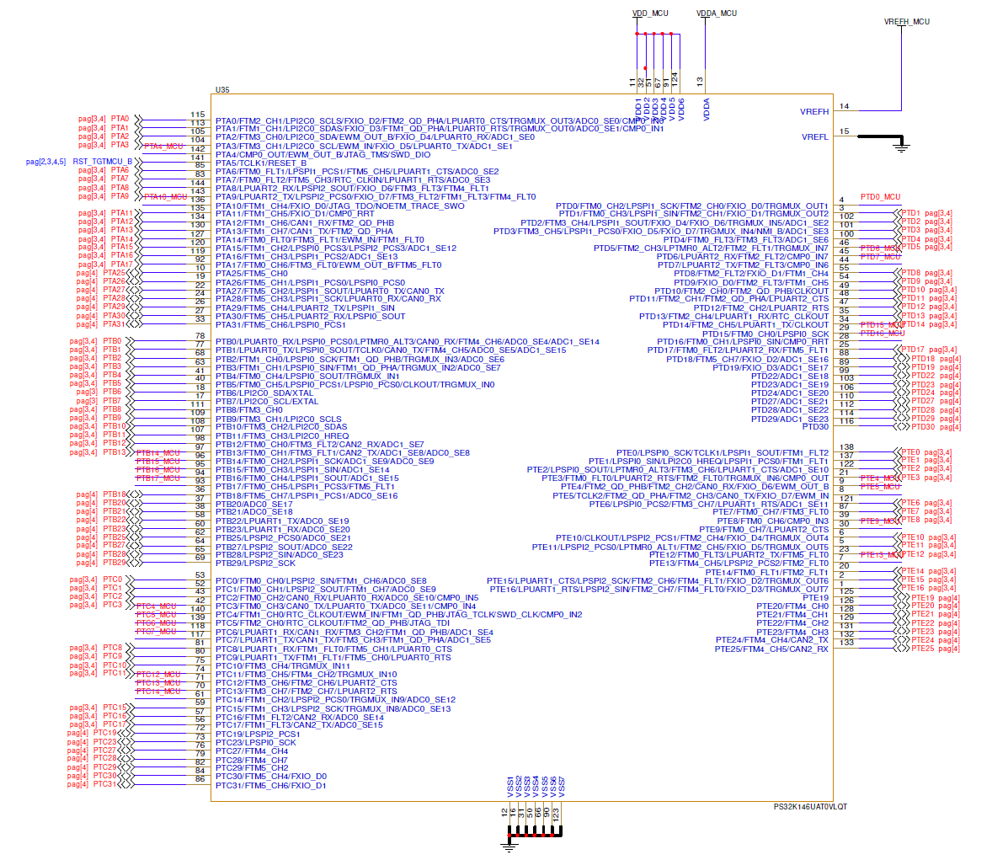
PTD0 (blue light)
PTD13 (switch 3)

Slide 5
Testing
Is the LED color is blue?
Is the LED turned on when switch 2 is pressed?
Is the LED turned off when switch 3 is pressed?
Does the LED turn off when switch 3 is released?
Does the LED operate correctly when switch 3 is pressed several times?

Slide 6
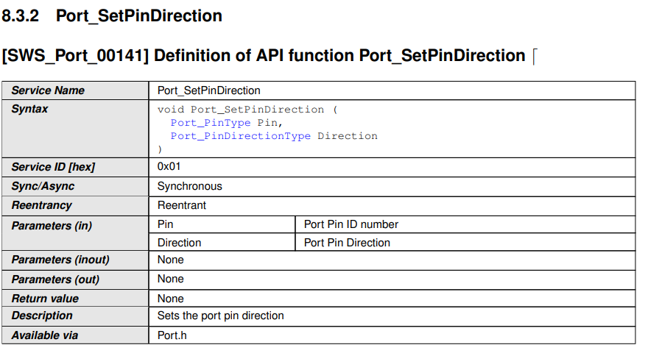
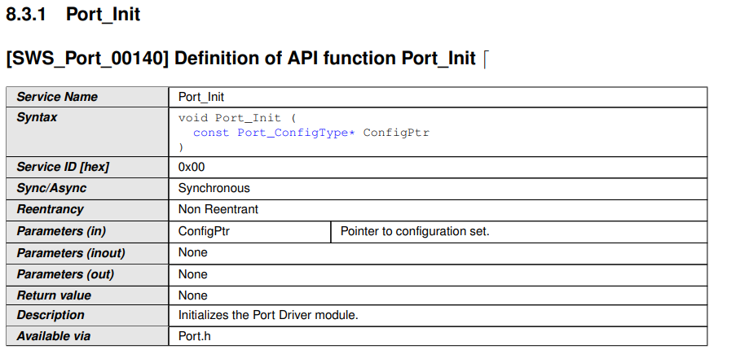
Detailed design
Software function - PORT

Slide 7
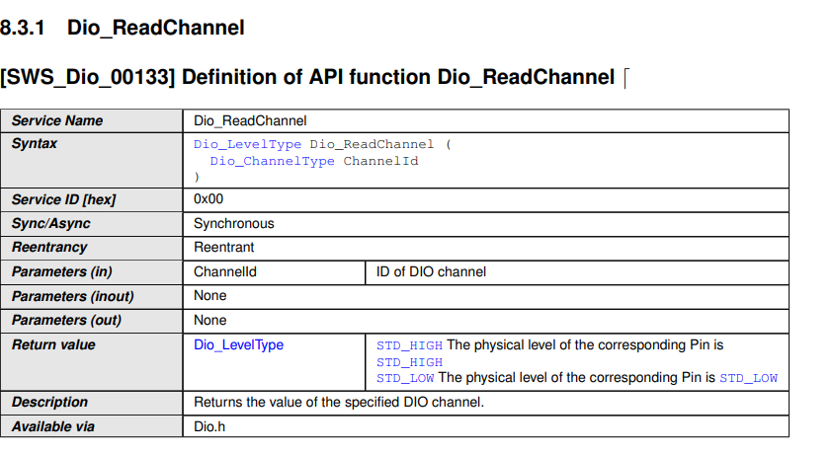
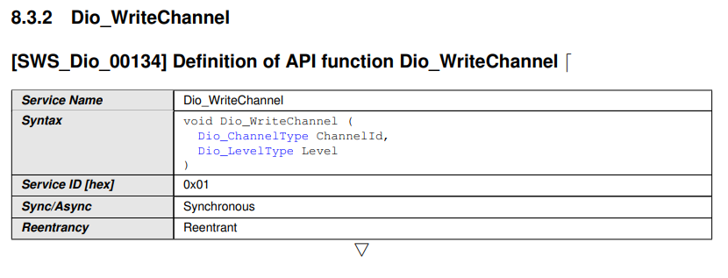
Detailed design
Software function - DIO

Slide 8
Detailed design
Logic design – Flow Chart

Slide 9
Detailed design
Interface
 | PORT | COMPONENT | PORT_PIN
INPUT | PTC 13 | SW 3 | 32*2+13 = 77
OUTPUT | PTD 15 | RED_LED | 32*3+15 = 111

Slide 10
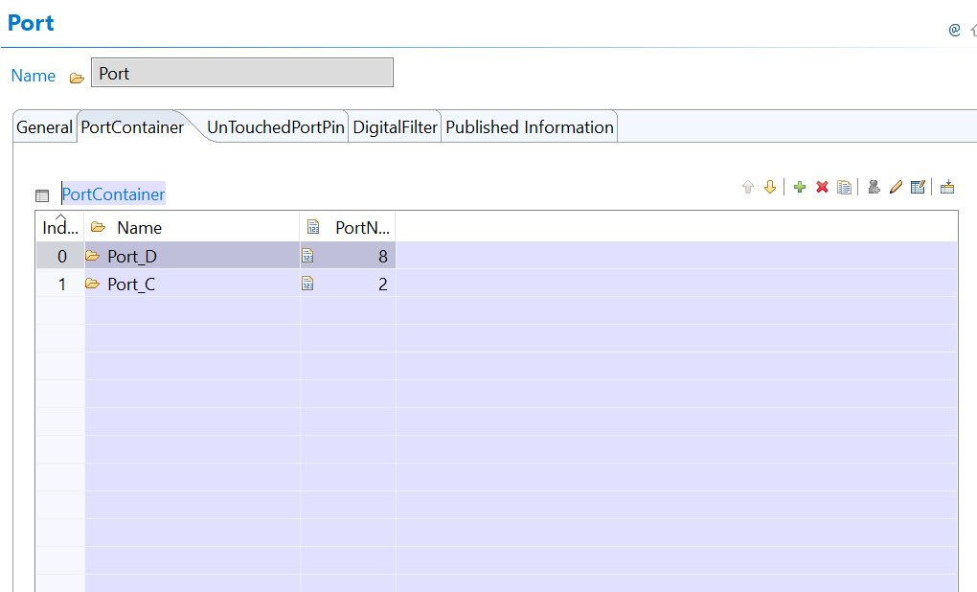
EB Tresos
Port
We use Port D & PORT C

Slide 11
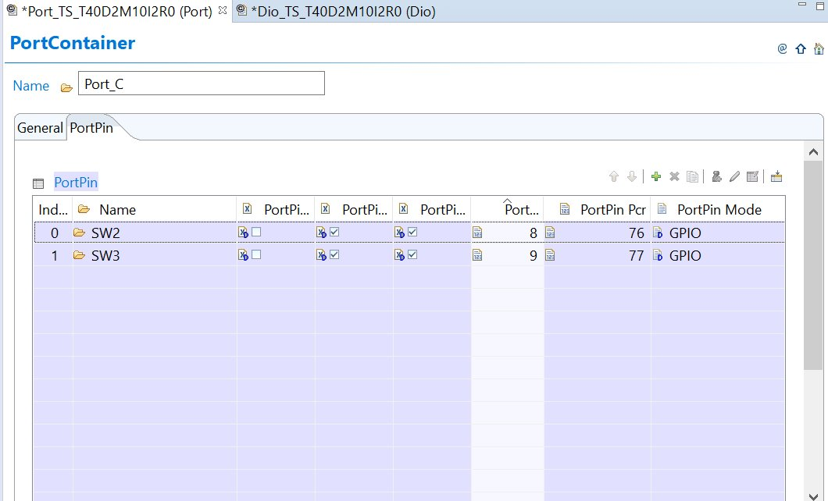
EB Tresos
In Port_C
SW2
32*2 +12 = 76
SW 3
32*2 + 13 = 77

Slide 12
EB Tresos
In Port_D
Red_LED
32*3 + 15 = 96 Blue_LED
32*3 + 0 = 96
Green_LED
32*3 + 16 = 112

Slide 13
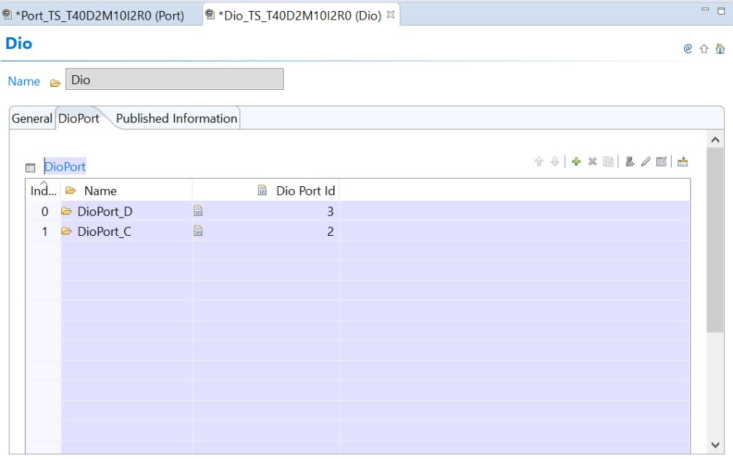
EB Tresos
DIO

Slide 14
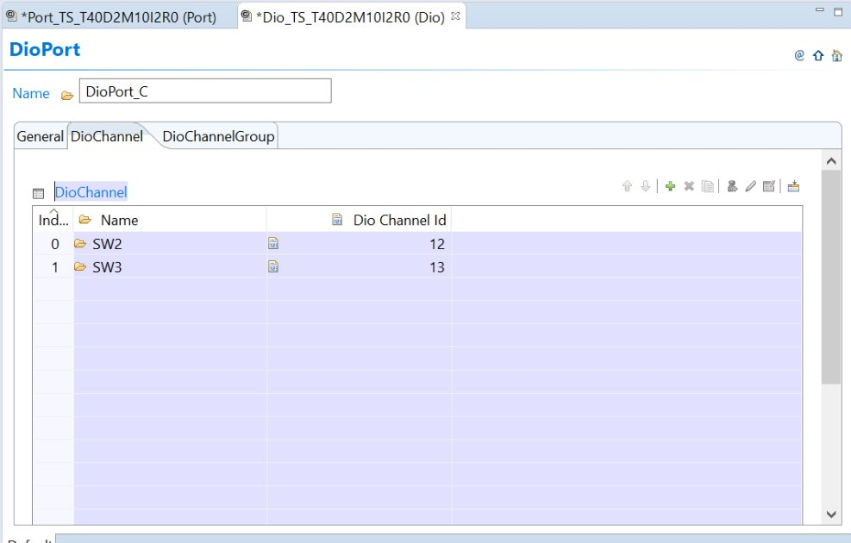
EB Tresos
In DioPort_C
SW2 – 12
SW3 - 13

Slide 15
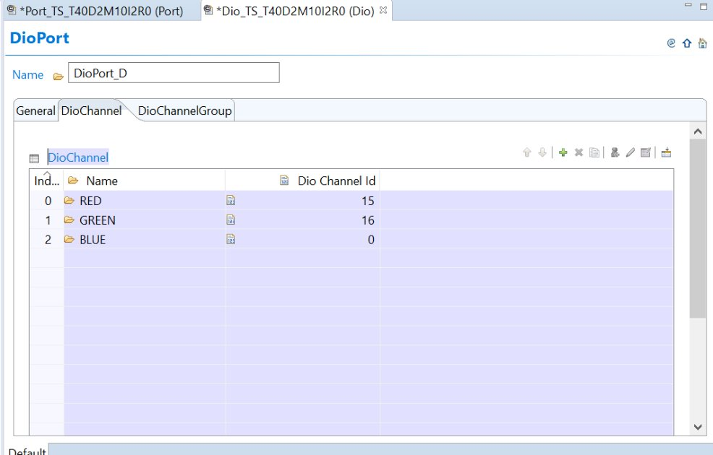
EB Tresos
In DioPort_D
Red_LED – 15
Green_LED - 16 Blue_LED - 0

Slide 16
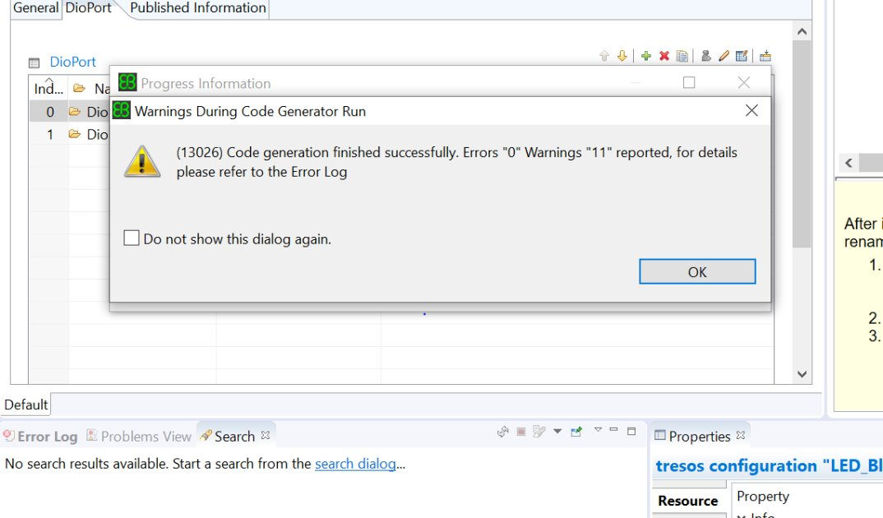
EB Tresos
Verify Project
Generate Project
Make a output folder.

Slide 17
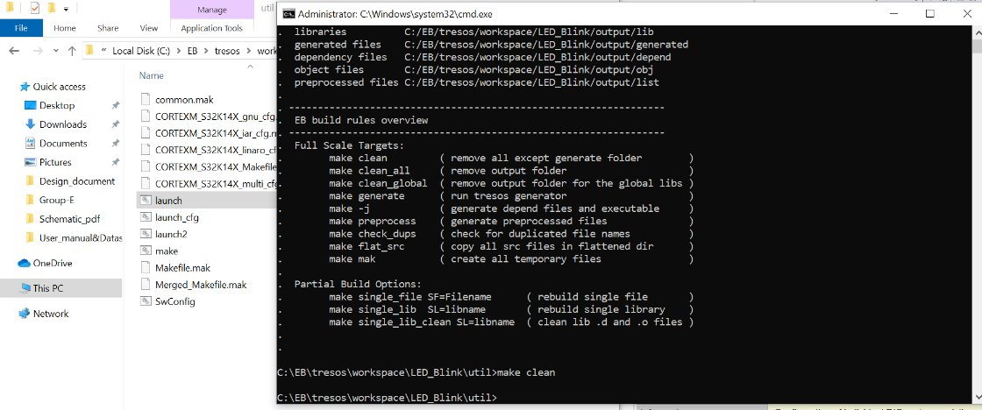
EB Tresos
Make clean
Remove all except
Generate folder

Slide 18
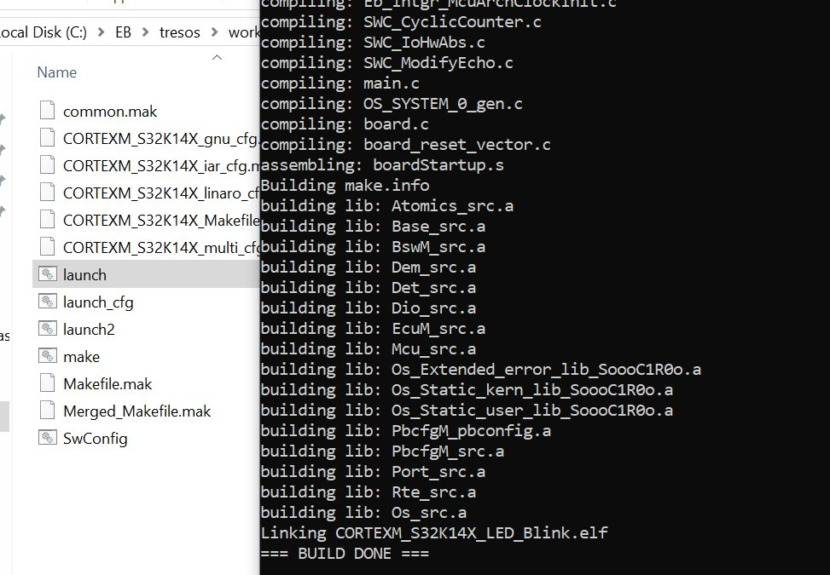
EB Tresos
Make – j
Make a .elf file

