Slide 1
Project 2- Employee Attirition
Alexander Sepenu

Slide 2
Contents
Purpose: Identify Business’s Problems & Opportunities
Identify the Top Three Factors that Contribute to Turnover
To identify factors that are associated with employee attrition
Why they are leaving & Who are leaving?
Analytical approaches: R, logistic regression, naïve Bayse and random forest models
Predicting future attrition

Slide 3
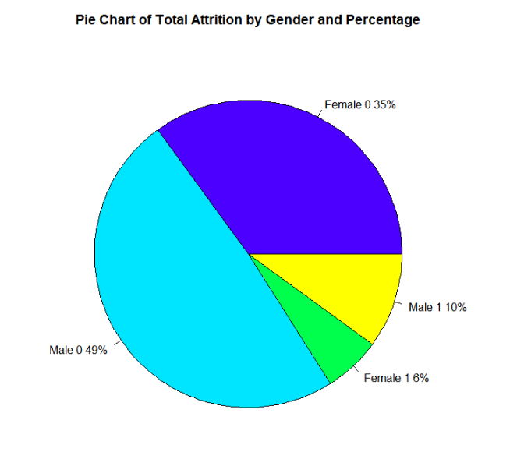
Demography

Slide 4
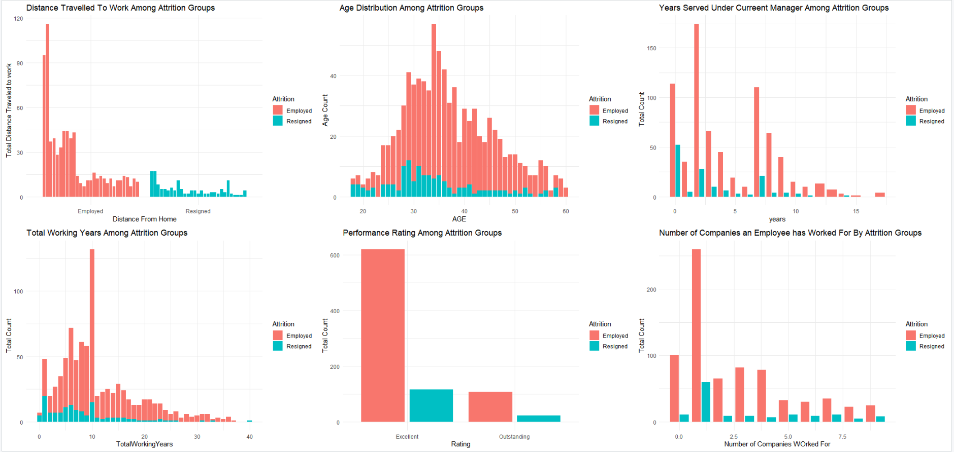
Finding Factors

Slide 5
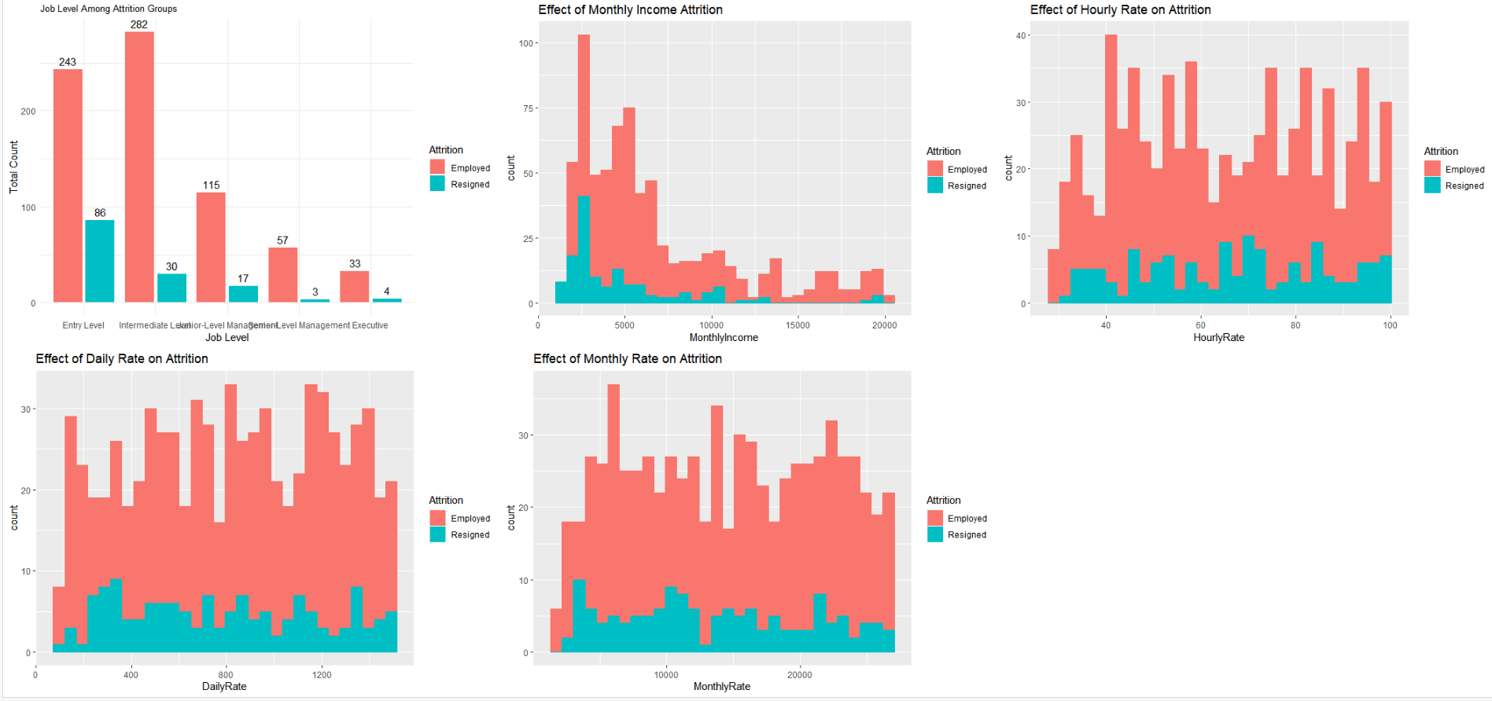
Finding Factors Cont’d

Slide 6
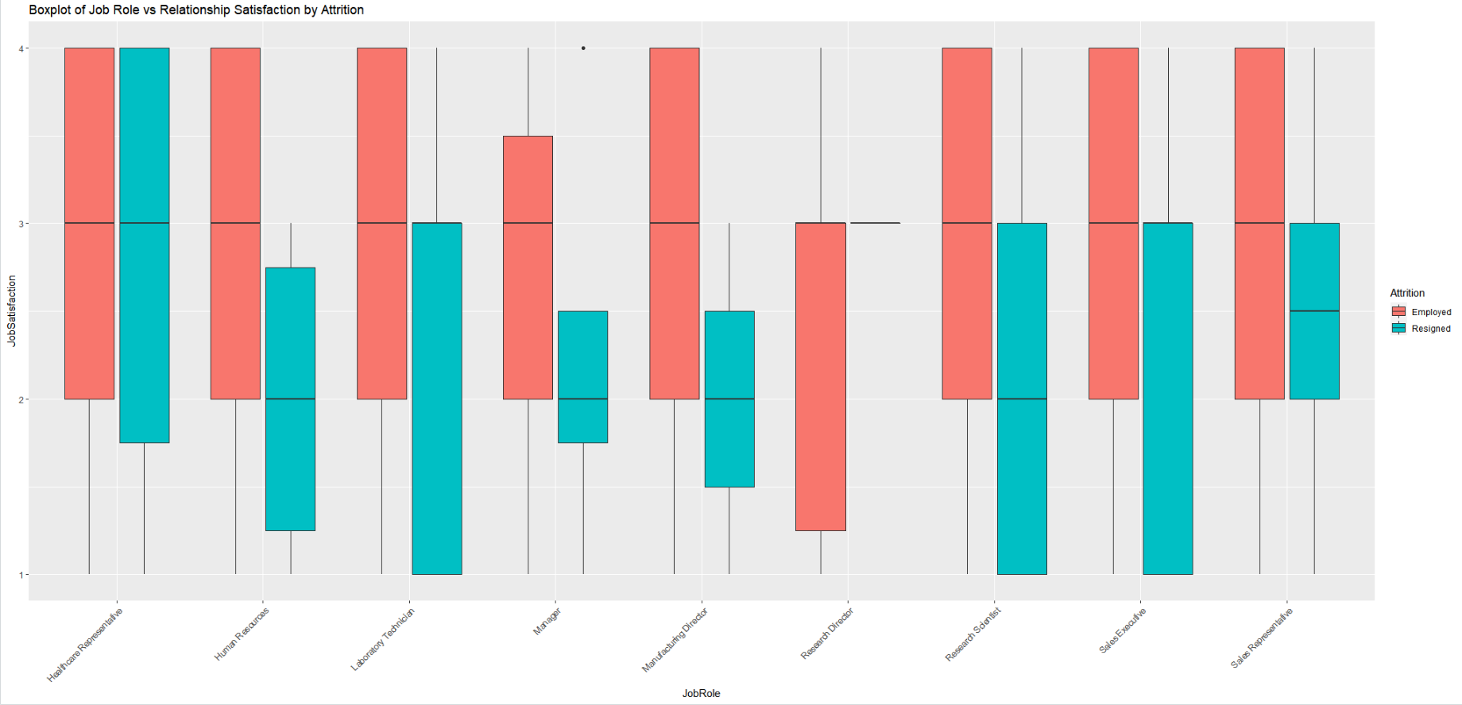
What Job Role Have the Lowest Job Satisfaction

Slide 7
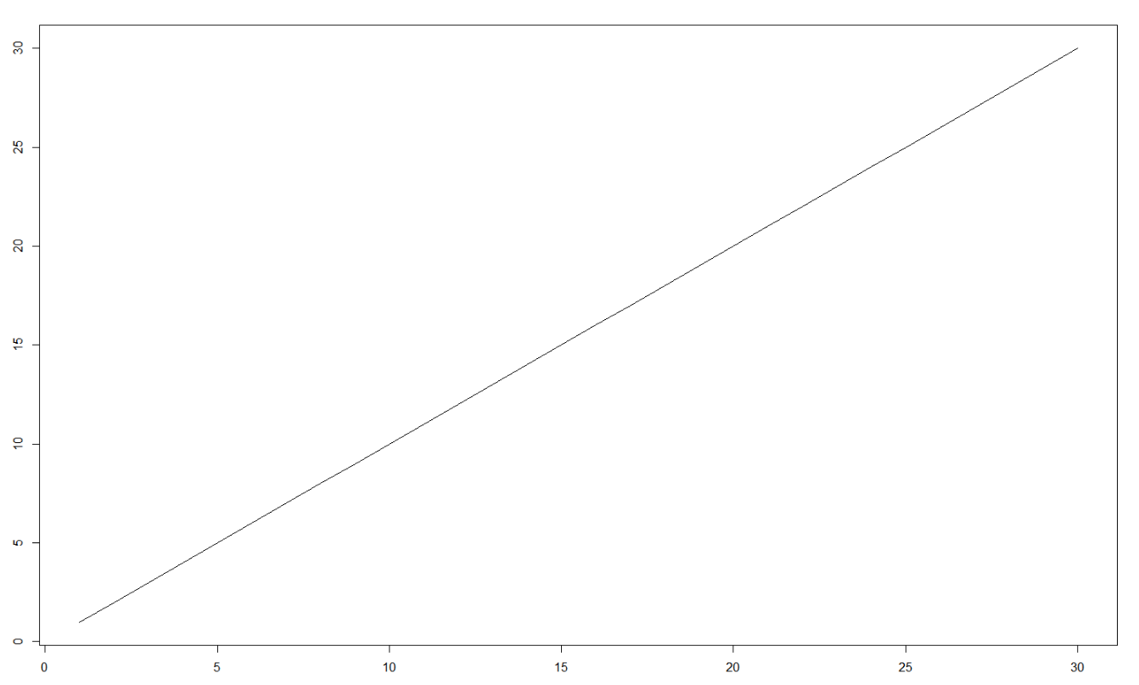
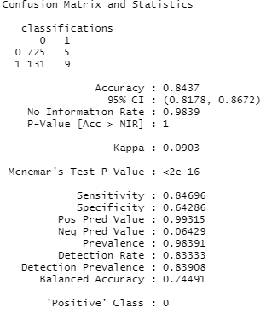
Finding Prediction Model

Slide 8
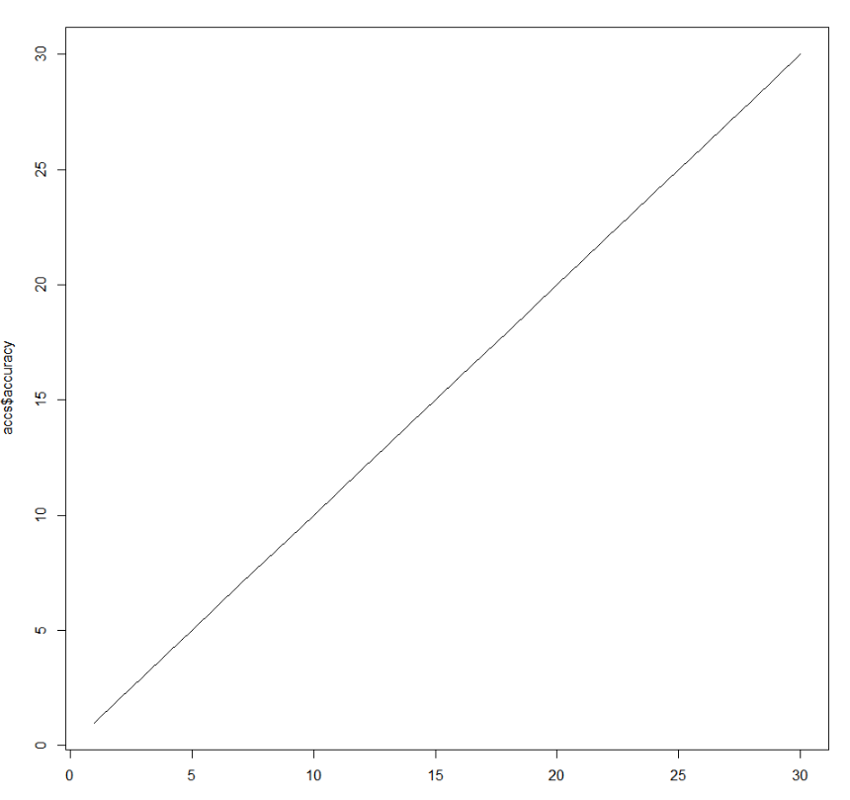
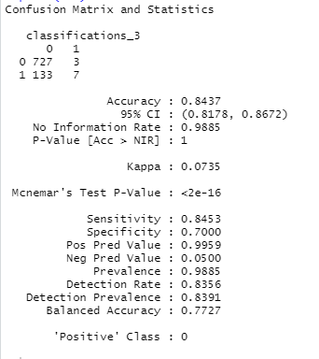
Finding Prediction Model Cont’d

Slide 9
Thank You

