Slide 1
P&D: Speech5

Slide 2
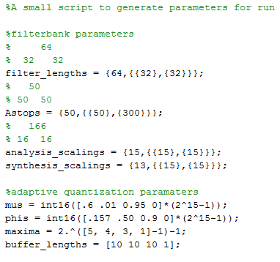
MATLAB
Flexible
Structure easily changeable
If asymmetrical: account for delay
Parameter definitions grouped in scripts
➔changing and testing new parameters easy
Originally: input scaled to full 16bit range
↔ now: not for consistency with C
Small optimization: updating power instead of recalculating

Slide 3
Parameter choices
Tuneable parameters:
Scalings
Analysis
Synthesis
➔ Trade-off clipping ↔ SNR
Phi values
Mu values
Stop band attenuations
Filter lengths
Maxima → #bits

Slide 4
Parameter tuning
Preprocessing:
Files changed to 8kHz
Audacity
70dB decimation filter
Based on PESQ only
More representative of human hearing system
Maximizing equally weighted score of:
Words_f, words_m, f116, f216, m116, m216, belasting, bir

Slide 5
Parameter tuning
Modus operandi:
Per band
Manually greedy approach:
Optimize parameter 1, then 2, then 1 again …
Scaling massive impact
Bufferlenghts:
Large impact in lowest band
Small in others
Phi and mu values in higher bands small impact
#bits:
5,4,3,0: Using bits in the highest band is not worth losing them in another band
Notes:
No optimization function found for mixed integer non linear problem

Slide 6
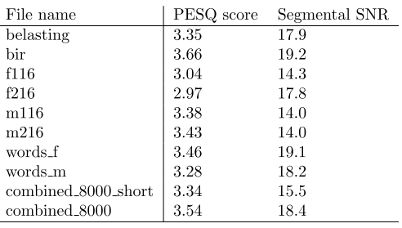
Parameter tuning: results
➔PESQ/SNR: 3,35/16,8
➔Final parameters:
➔Inherent filterdelay
= 64/8000 + 32/4000
= 16 ms

Slide 7
C
↔ MATLAB:
Less flexible
Structure hardcoded
Parameters not grouped together
Filters hardcoded
Execution order:
Buffer per buffer
Keep history between calls
Not scaling input (don’t know max value a priori)
→ Removed in MATLAB

Slide 8
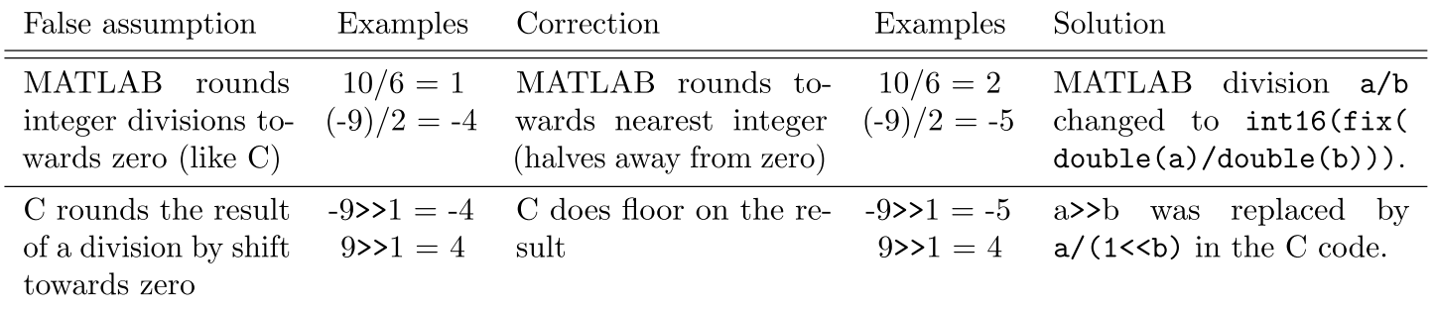
C
Changes made for consistency C – MATLAB:
Notes:
Vermeld: uiteindelijk ook integer ipv long long gedrag maar maakt geen verschil

Slide 9
C
Preparing for crypto:
Compress en decompress functions:
30 shorts →15 bytes
No bits wasted at all
Buffer to crypto: 15*40= 600 chars
Delay: 100ms
Notes:
Vermeld: uiteindelijk ook integer ipv long long gedrag maar maakt geen verschil

Slide 10
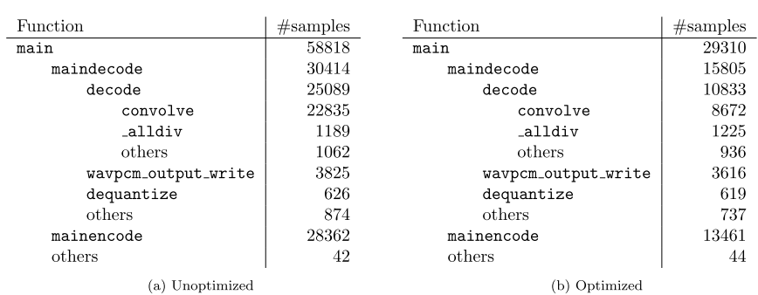
C
Performance measures
In-place functions
Profiling and optimization before DSP sessions!
Speed-up x2
Visual studio profiler
Bottleneck: convolve: only nested loop + most calls + largest numbers

Slide 11
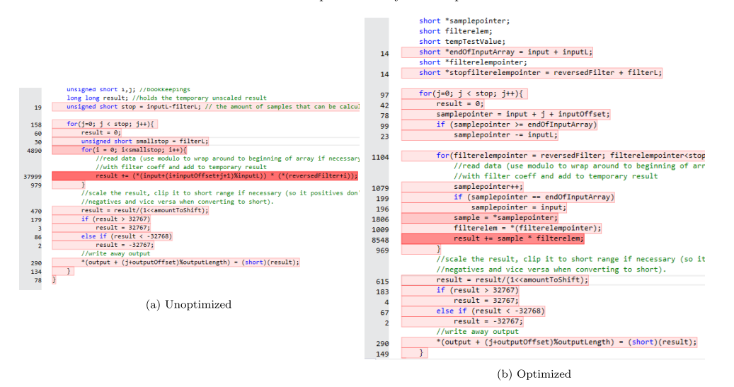
C

Slide 12
C: problems
Debugging:
Gedit → Visual Studio / CodeBlocks
Notes:
Removed:
Output checked with MATLAB
Results are the same down to the last bit

Slide 13
DSP-C: Start
21,8M cycles for 2986 samples: 7,300 cycles / sample
After original x2 speed-up in ~14,600 cycles / sample

Slide 14
DSP-C: major improvements
Convolve:
Left and right together ➔ 8%
Hypothesis
more freedom for compiler
Overhead only once
Long long ➔ int: 49%
Changed in MATLAB: no difference
➔ convolve no longer bottleneck
Notes:
Percentages op totaal en niet op de aangepaste functie

Slide 15
DSP-C: major improvements
(de)quantize:
Smaller variable types: 42%
Rewrote divisions: 38,5% on (de)quantize
Binary/linear
→ eliminates function calls
Hypothesis: enables software pipelining of outer loop
Notes:
Percentages op totaal en niet op de aangepaste functie Removed because mentioned later:
Test inline:
Synthesis+analysis fully inlined:
300k better (~5%)
At this point not worth it
Reverted for space and readability/manageability

Slide 16
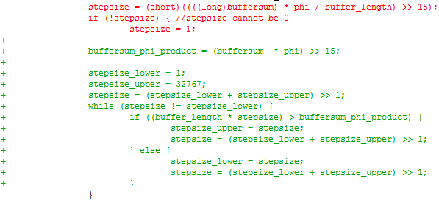
DSP-C: major improvements
Notes:
NU WEL PER FUNCTIE

Slide 17

DSP-C: major improvements
Convolve:
Division as shift: 46% on convolve
→ eliminates function call
Original:
Division for roundig to zero
New:
Complex division as shift for rounding behaviour+speed
Notes:
NU WEL PER FUNCTIE

Slide 18
DSP-C: major improvements
Convolve:
Removed modulo in output index: 11% on convolve
Combine:
Removed modulo in indices: 68% on these 2 functions
Rewriting divisions + removing modulos:
Overall gain: 39%
(de)quantize:
Combine left/right: 11%
➔ 3,2M
Notes:
NU WEL PER FUNCTIE

Slide 19
DSP-C: other improvements
Hardcoding filter coeffs in code
Must_iterate, unroll pragmas
Data_align: no noteworthy gain
Some intrinsics e.g. _abs
‘near’/‘const’ variables
Some function inlining
Inlining analysis/synthesis: 300k gain,
Reverted for cleanliness & space
Notes:
Removed: (Did not find it necessary to put this here since overall we implemented this and it did gain
UNROLL:
Only really helped in convolve (4x best)
Removed: (Don’t understand this) Looked for intrinsics:
did not help:
Parallel on on cord (subword) instead of on two cores
(might be better for P though)

Slide 20
DSP-C: results
➔ Total results:
Speed-up: 21,8M → 3,2M
= 85% or speed x 6,8
Including original x 2: 13,6
➔ bottleneck = writing output
Cheating mono input(?):
Mono implementation:
As long as input is mono:
(de)quantize only one channel & copy
→ 2,7M (16%)
At expense of slightly more code (2% of space)
Notes:
TERUG OP TOTAAL
Trg vermelden: more compiler freedom (and reduced overhead)

Slide 21
DSP:problems
Uninitialized variable
Wrong configuration
Real-time not working

Slide 22
DSP-C: summary
Including initial x2: x13,6 gain
→ 1,071 cycles/sample
Bit/bit correct output
➔ guaranteed same PESQ scores as in MATLAB:
➔ parameters still easily testable

