Slide 2
MATLAB
Flexibel
Structure easily changeable
but if asymmetrical: account for delay
Parameter definitions grouped in scripts
➔changing and testing new parameters easy
Originally: input scaled to full 16bit range
↔ now: not for consistency with C

Slide 3
Parameter choices
Tuneable parameters:
Scalings
Analysis
Synthesis
➔ Trade-off clipping ↔ SNR
Phi values
Mu values
Stop band attenuations
Filter lengths
Maxima → #bits

Slide 4
Parameter tuning
Preprocessing:
Files changed to 8kHz
Audacity
70dB decimation filter
Based on PESQ only
More representative for human hearing system
Average of scores of
Words_f, words_m, f116, f216, m116, m216, belasting, bir
All weighted equally in average

Slide 5
Parameter tuning
Modus operandi:
Per band
Manually greedy approach:
Optimize parameter 1, then 2, then 1 again …
Scaling massive impact
Bufferlenghts:
Large impact in lowest band
Small in others
Phi and mu values in higher bands small impact
#bits:
5,4,3,0: Losing two bits in other bands for highest band not worth it

Slide 6
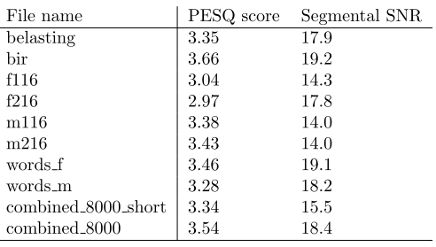
Parameter tuning: results
TABEL MET WAARDES HIER
➔Average PESQ:
➔Average SNR:
➔Inherent filterdelay:
16ms →

Slide 7
C
↔ MATLAB:
Less flexible
Structure hardcoded
Parameters not grouped together
Filters hardcoded → Filter specs only changeable by creating new filters in MATLAB
Buffer per buffer
Not scaling input (impossible real time) → changed in MATLAB
Execution order:
Buffer per buffer
Keep history between calls

Slide 8
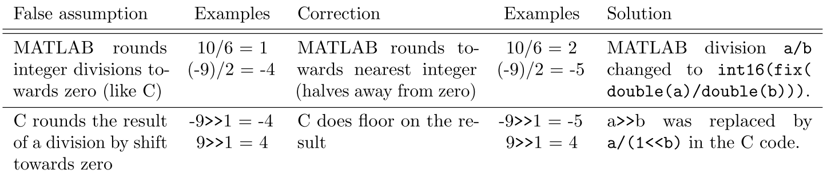
C
Changes made for consistency C – MATLAB:
Compress en decompress:
30 short values to 15 bytes
=60 bytes to 15 bytes
No bits wasted
Notes:
Vermeld: uiteindelijk ook integer ipv long long gedrag maar maakt geen verschil

Slide 9
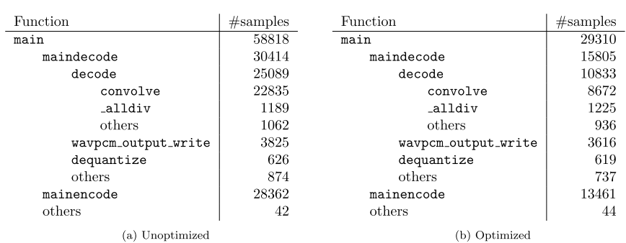
C
Performance measures
In-place functions
Profiling and optimization before DSP sessions!
Speed-up x2
Visual studio profiler
Bottleneck: convolve: only nested loop + most calls + largest numbers

Slide 10
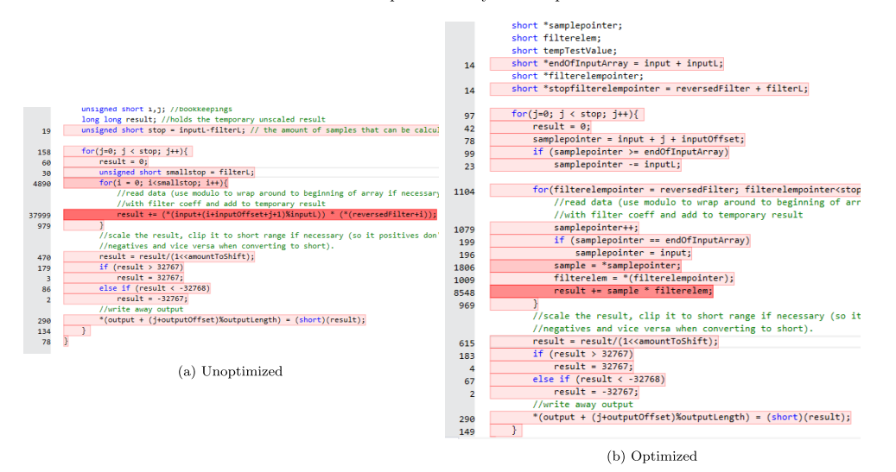
C

Slide 11
C: problems
Debugging:
Gedit → Visual Studio / CodeBlocks
Output checked with MATLAB
Compared bit/bit to MATLAB result

Slide 12
DSP-C
Start: 21,8M cycles for 2986 samples
After original x2 speed-up in C

Slide 13
DSP-C: helpfull changes
Convolve:
Left and right together ➔ 8%
Hypothesis
more freedom for compiler
Overhead only once
Long long ➔ int: 49%
Changed in MATLAB: no difference
➔ convolve no longer bottleneck
Notes:
Percentages op totaal en niet op de aangepaste functie

Slide 14
DSP-C: helpfull changes
(de)quantize:
Smaller variable types: 42%
Test inline:
Synthesis+analysis fully inlined:
300k better (~5%)
At this point not worth it
Reverted for space and readability/manageability
Notes:
Percentages op totaal en niet op de aangepaste functie

Slide 15
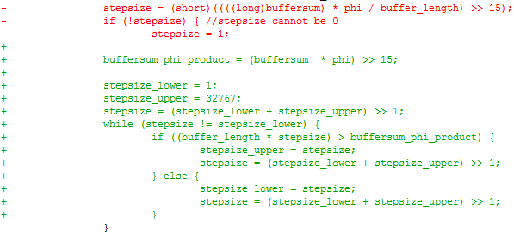
DSP-C: helpfull changes
(de)quantize:
Rewrote divisions: 38,5% on (de)quantize
Binary/linear
→ eliminates function calls
Hypothesis: enables software pipelining of outer loop
Notes:
NU WEL PER FUNCTIE

Slide 16

DSP-C: helpfull changes
Convolve:
Division as shift: 46% on convolve
→ eliminates function call
Original:
Division for roundig to zero
New:
Complex division as shift for rounding behaviour+speed
Notes:
NU WEL PER FUNCTIE

Slide 17
DSP-C: helpfull changes
Convolve:
Modulo in output index: 11% on convolve
Combine:
Modulo in indices: 68% on these 2 functions
Rewriting divisions + modulos:
Overall gain: 39%
➔ 3,6M
Notes:
NU WEL PER FUNCTIE

Slide 18
DSP-C: helpfull changes
(de)quantize:
Combine left/right: 11%
➔ Total results:
Speed-up: 21,8M → 3,2M
=85% or speed x 6,8
Including original x 2: 13,6
Cheating (?):
Mono implementation:
As long as mono input:
quantize and dequantize done once for both channels
→ 2,7M (16%)
At expense of slightly more code (2%, still in available space)
Notes:
TERUG OP TOTAAL
Trg vermelden: more compiler freedom (and reduced overhead)

Slide 19
DSP-C: tested
Hardcoding filter coeffs in code
Looked for intrinsics:
did not help:
Parallel on on cord (subword) instead of on two cores
(might be better for P though)
‘near’/‘const’ variables
Inline: reverted, 300k gain
Non-negligible now, but no more space
UNROLL:
Only really helped in convolve (4x best)

Slide 20
DSP-C:summary
Including initial x2: x13,6 gain
→ cycles/sample
Bit/bit correct output
➔ guaranteed same PESQ scores as in MATLAB:
➔ parameters still easily testable

