Slide 1
Multi-Task Learning with Adaptive Ordering
Sepehr Sameni

Slide 2

Disclaimer
Most of my examples will be about NLP, not CV.
My idea is essentially an ML algorithm not a neuroscience one and It is only inspired by our brain in an abstract way.

Slide 3
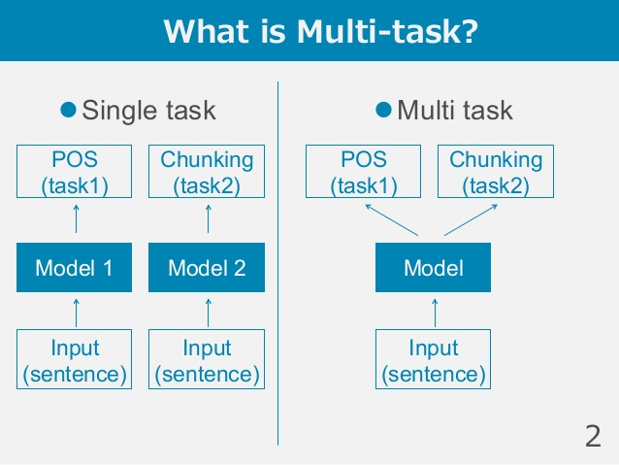
Multi-Task Learning(MTL)

Slide 4
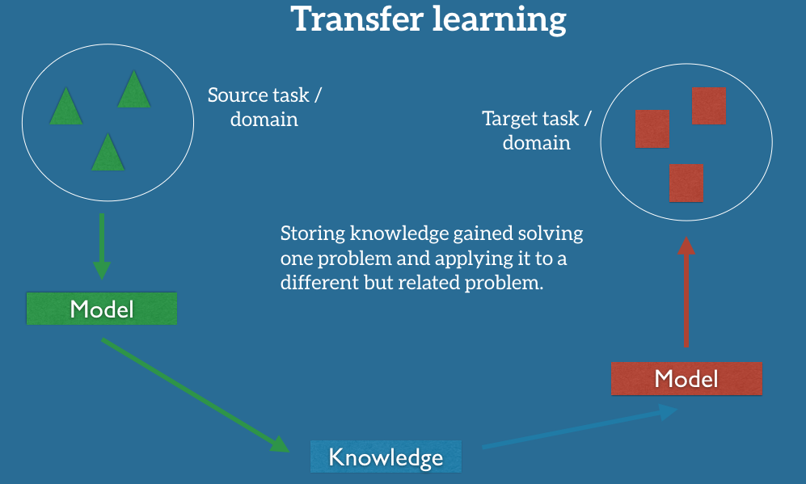
MTL Vs Transfer Learning

Slide 5
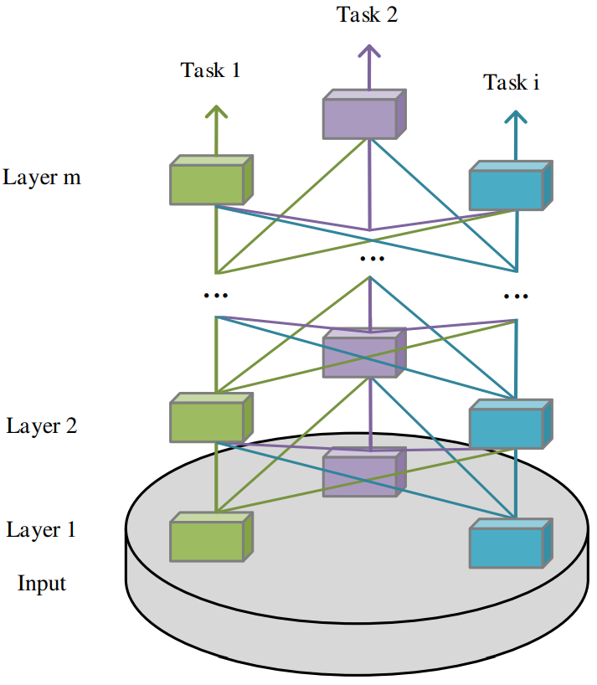
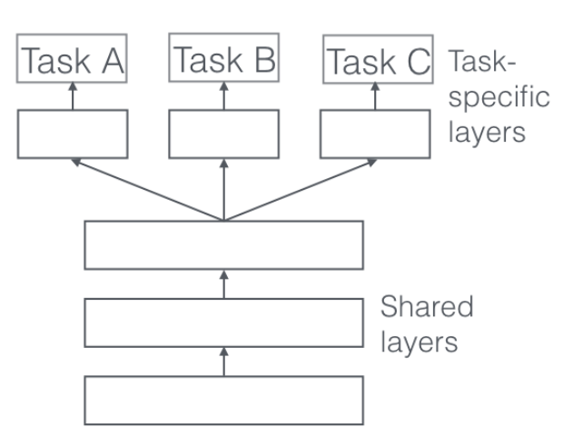
MTL architectures(I)

Slide 6
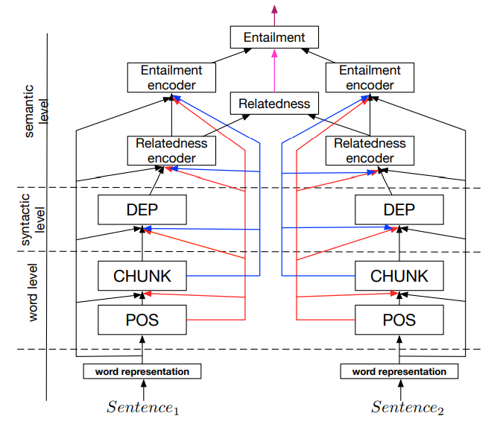
MTL architectures(II)

Slide 7
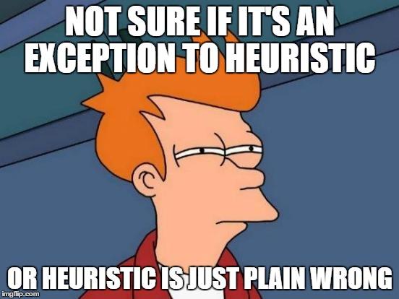
It has problems!
1) Heuristics fail, and they are also defeating the whole purpose of Deep Learning!
2) What if there were no heuristics and it was a new problem?
3) Do we really think that it is context(input) independent?

Slide 8
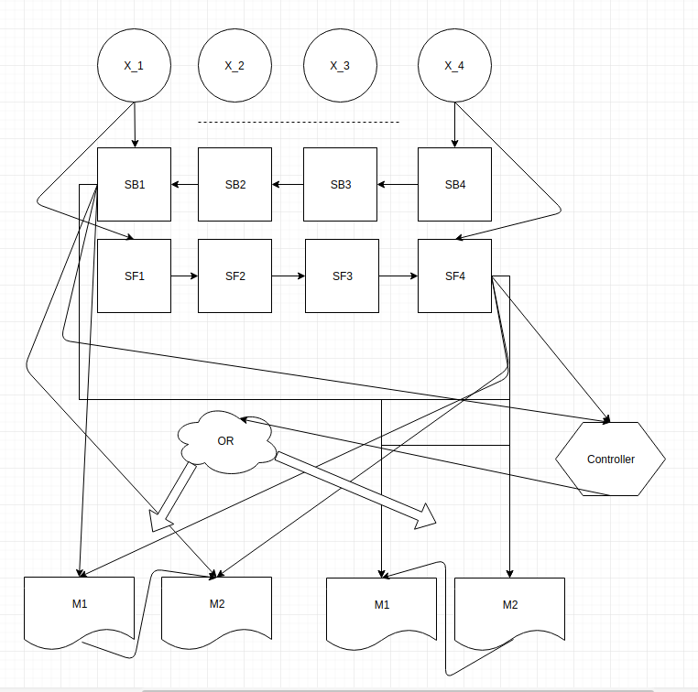
Adaptive Ordering
Let it learn :))
Brain-inspired!

Slide 9
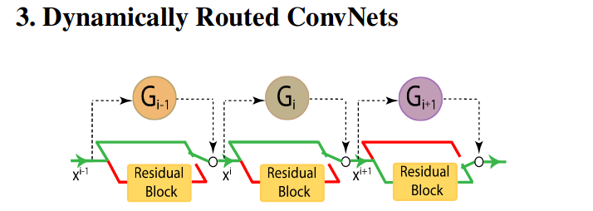
Modular design works(I)

Slide 10
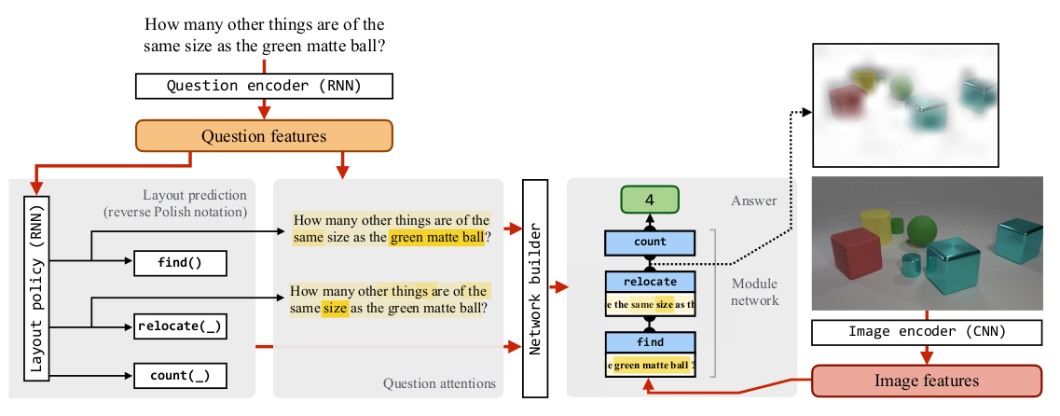
Modular design works(II)

Slide 11
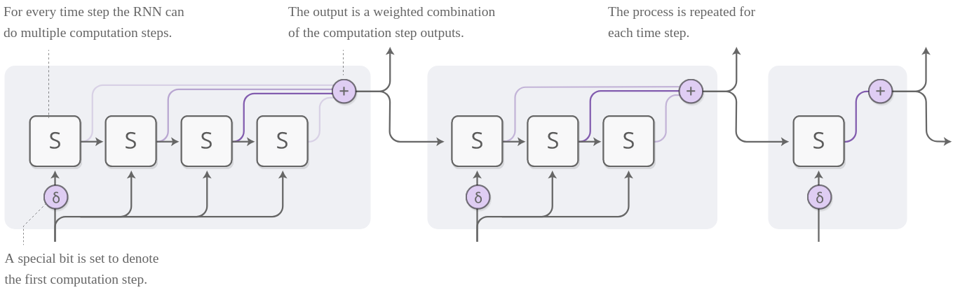
Soft Controller

Slide 12
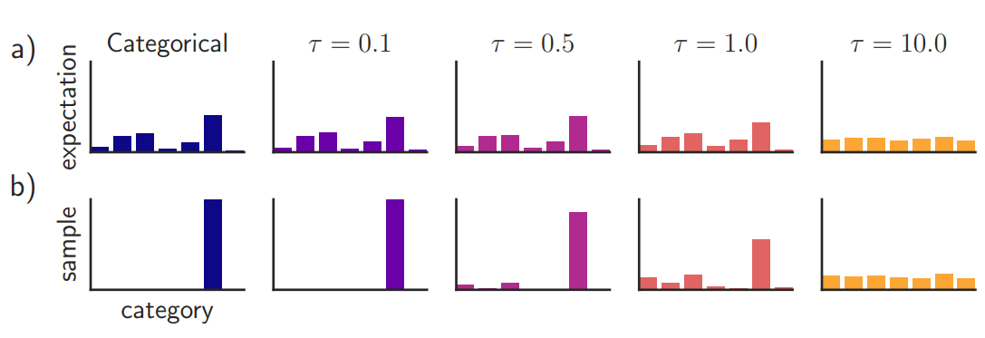
Soft Controller++

Slide 13
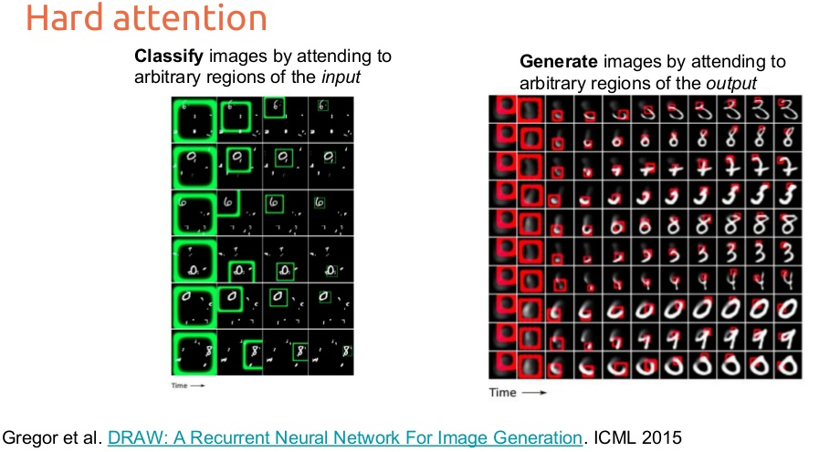
Hard Controller

Slide 14
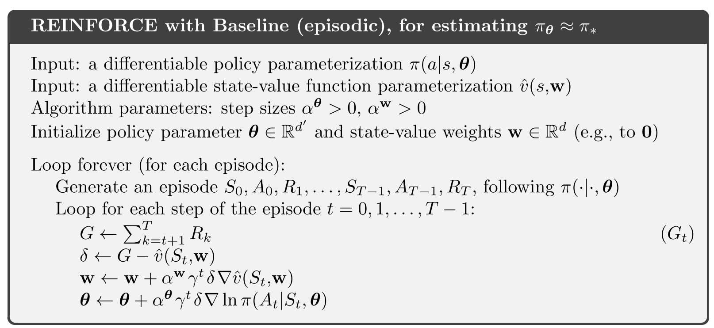
REINFORCE Algorithm

Slide 15
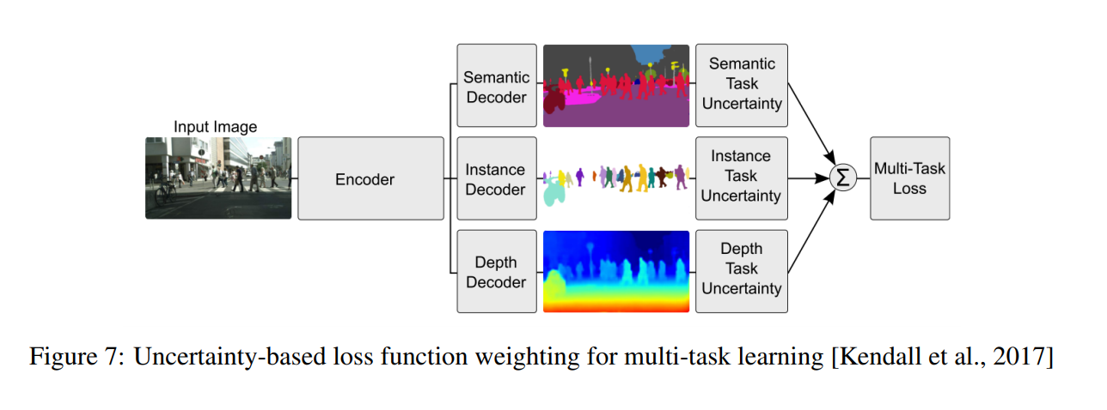
Reward function matters

Slide 16
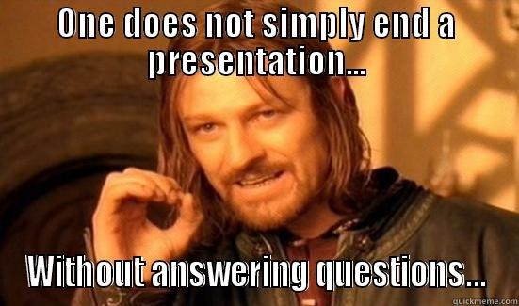
Questions?

