Slide 1
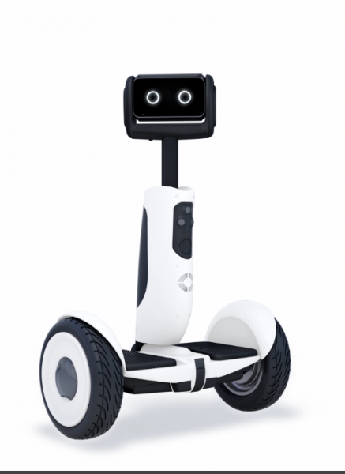

MSE 483 - Modern Control Systems Control of Two-Wheel Self-Balancing Robot
Group 20
Sepehr Rezvani – 301291960
Martin Kuppers – 301301213
Carter Brown – 301314429
Samuel Lachance - 301340641

Slide 2
About our Project
Apply materials learnt in Modern Control Systems to achieve the following goals for a self-balancing two-wheel robot:
Formulate state-space
Evaluate controllability and observability
Apply feedback control and state observers to the system
Analyze data collected from simulations
Suggest ways to improve the design based on data

Slide 3
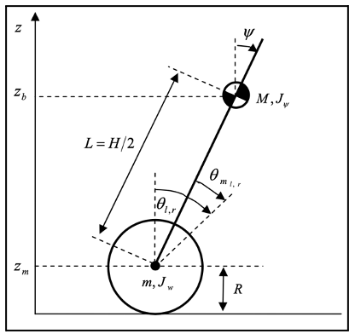
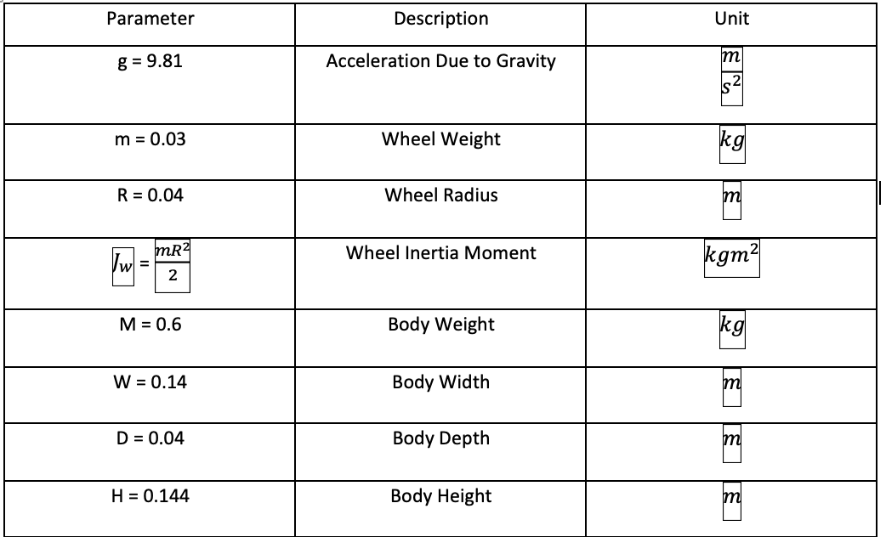
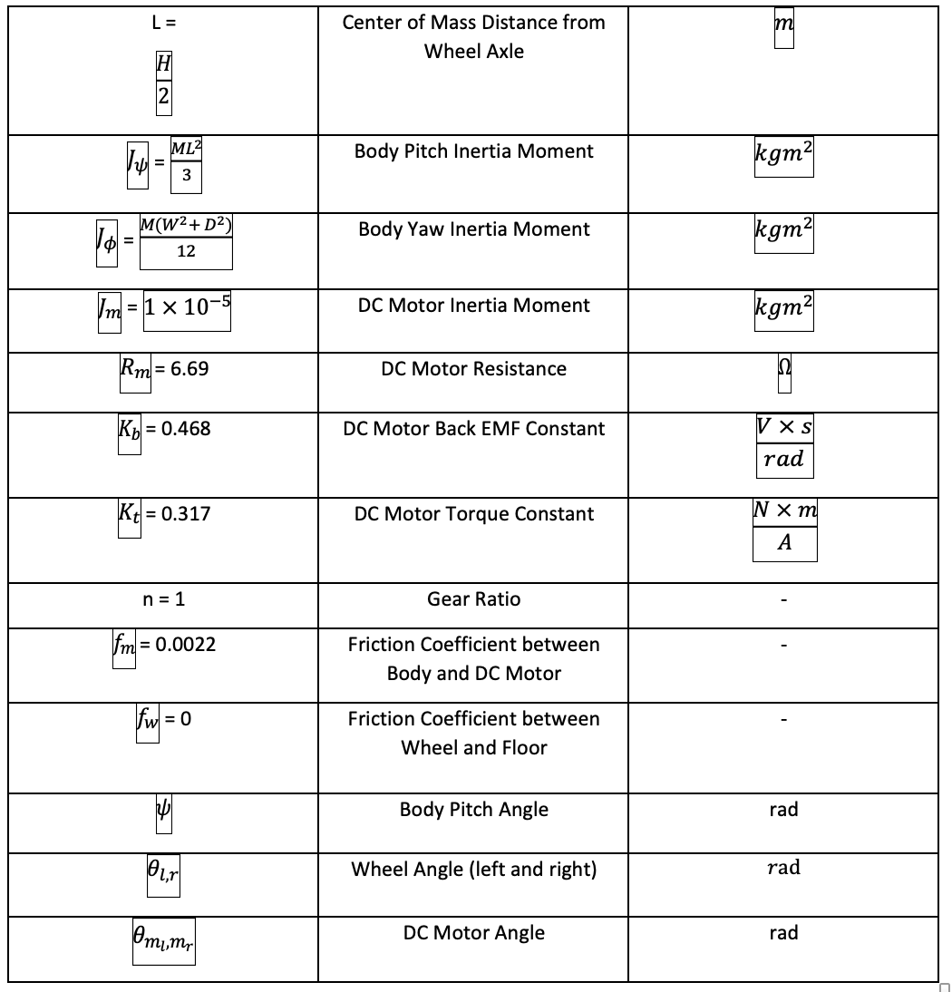
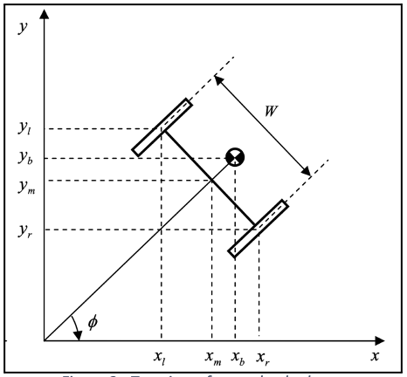
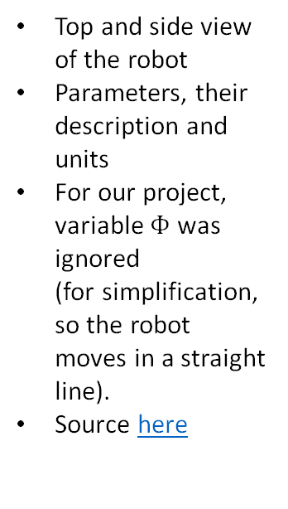
About our Project
Top and side view of the robot
Parameters, their description and units
For our project, variable $Φ$ was ignored (for simplification, so the robot moves in a straight line).
Source here

Slide 4
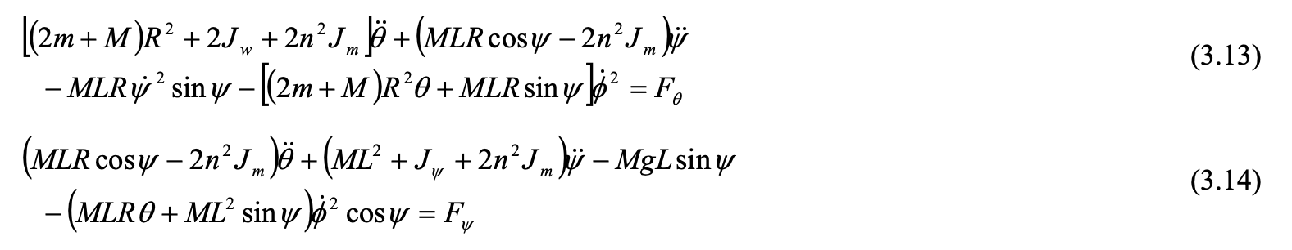
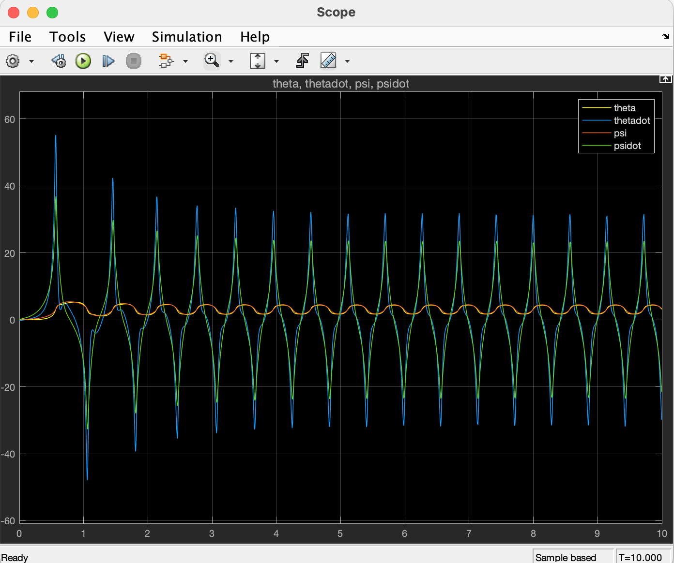

Non-Linear Model
The following formulas were used to model $ⅆ^{2}θ$ and $ⅆ^{2}ψ$ in Simulink.
The scope shows $θ,dθ, ψ,dψ$, in yellow, blue, red and green, respectively.
As expected, an oscillation is expected due to exchange of potential to kinetic energy between $θ$ and $ψ$ (in absence of friction).

Slide 5


Linearization
Linearization was done about the body's yaw parameter (ψ = 0), through this higher order terms equated to zero, sin(ψ ) = ψ and cos(ψ ) = 1. The linearized system can be seen below as the following equations.
State Variables

Slide 6
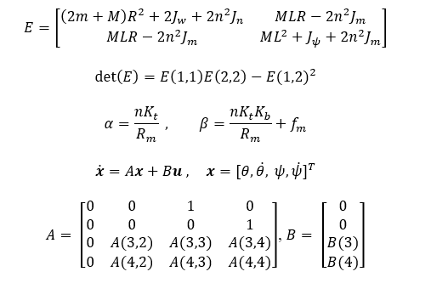
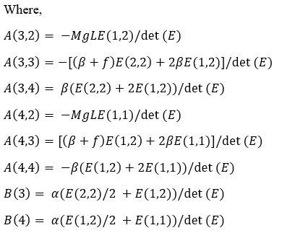
State-Space Formulation
The state-space system was based on the previous slide's equations and was found to be:

Slide 7
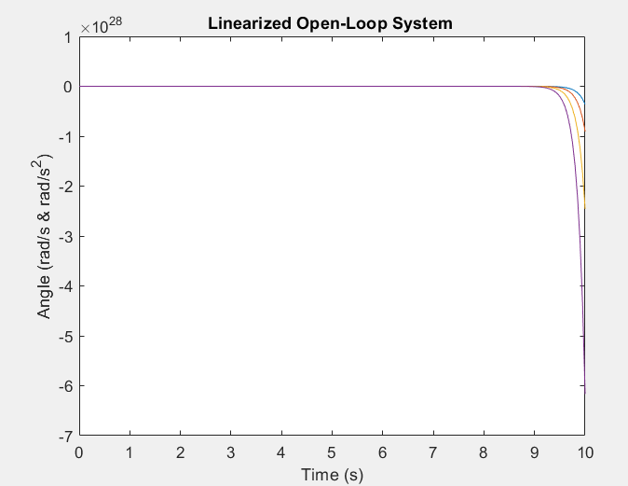
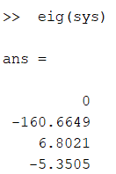
Open-Loop Stability Analysis
Stability was analyzed through 3 methods:
The eigenvalues of the system were found
The open-loop system was modeled through Simulink and given a step input
The open-loop system was modeled physically and given a step input

Slide 8
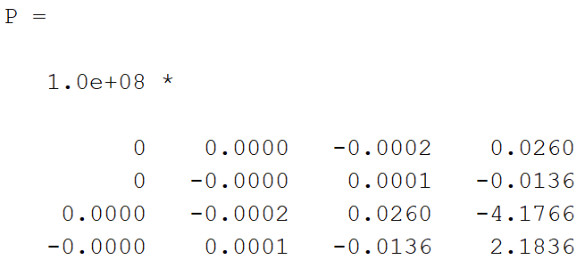
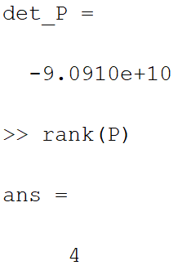
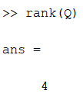

Analysis of Controllability and Observability
Controllability was found by using the controllability matrix P=[B:AB:A²B:A^{n-1}B] by hand, and then solving its determinant in MATLAB
Observability was determined through the use of Matlab where the observability matrix was found and its rank was determined
The result shows that all states of the system are observable

Slide 9
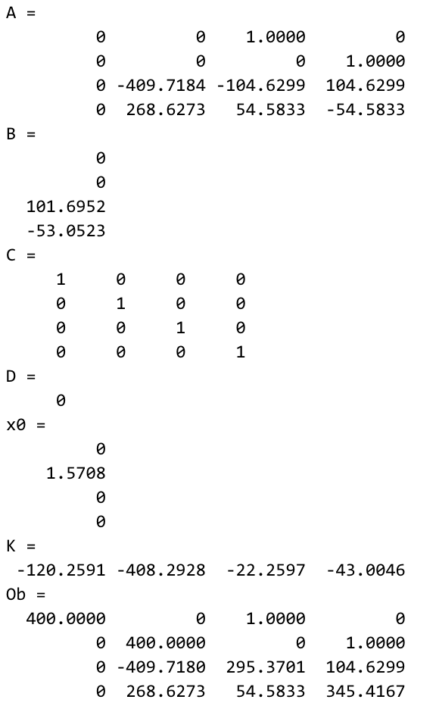
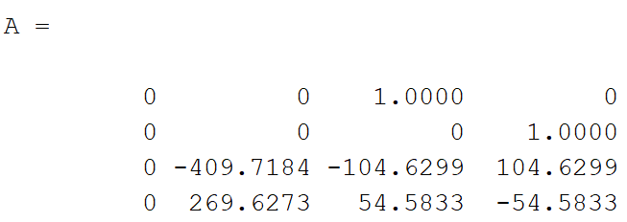
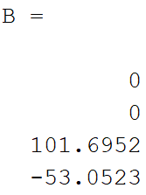
Design and Utilization of State Feedback Control
System response decisions were:
PO of 5%
t_{s} = 1s
Eigenvalues chosen: [-4+3.22i -4-3.22i -40 -60]
Using MATLAB place function to calculate K values

Slide 10
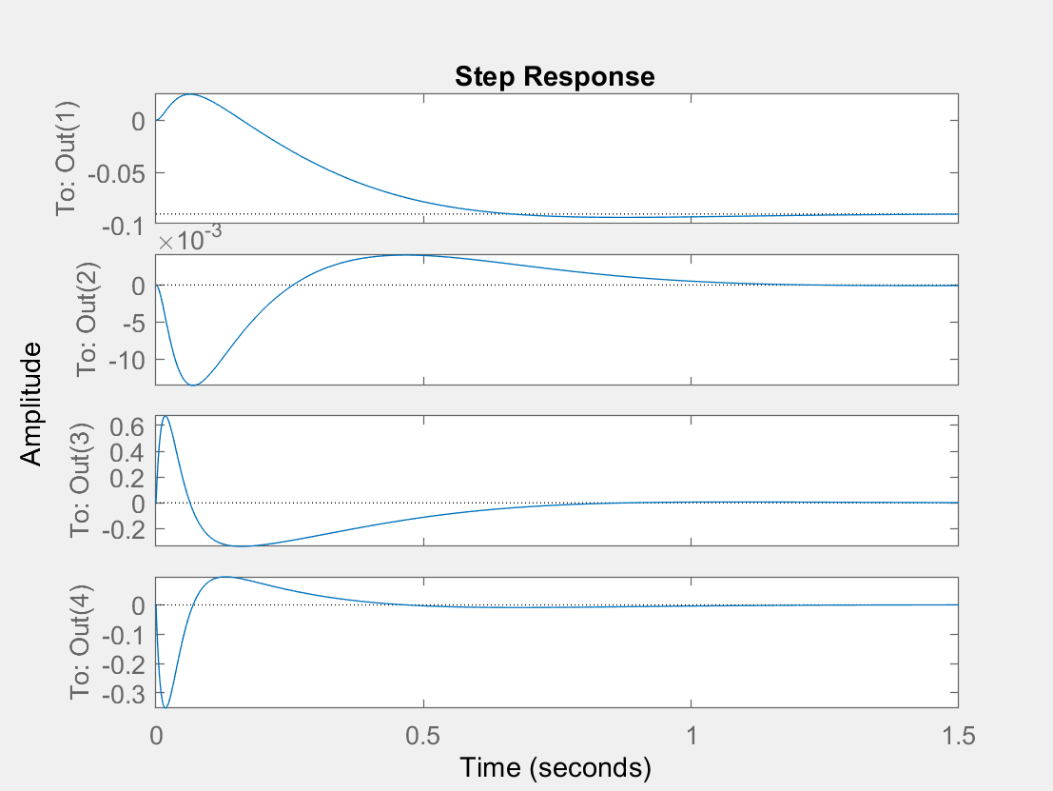
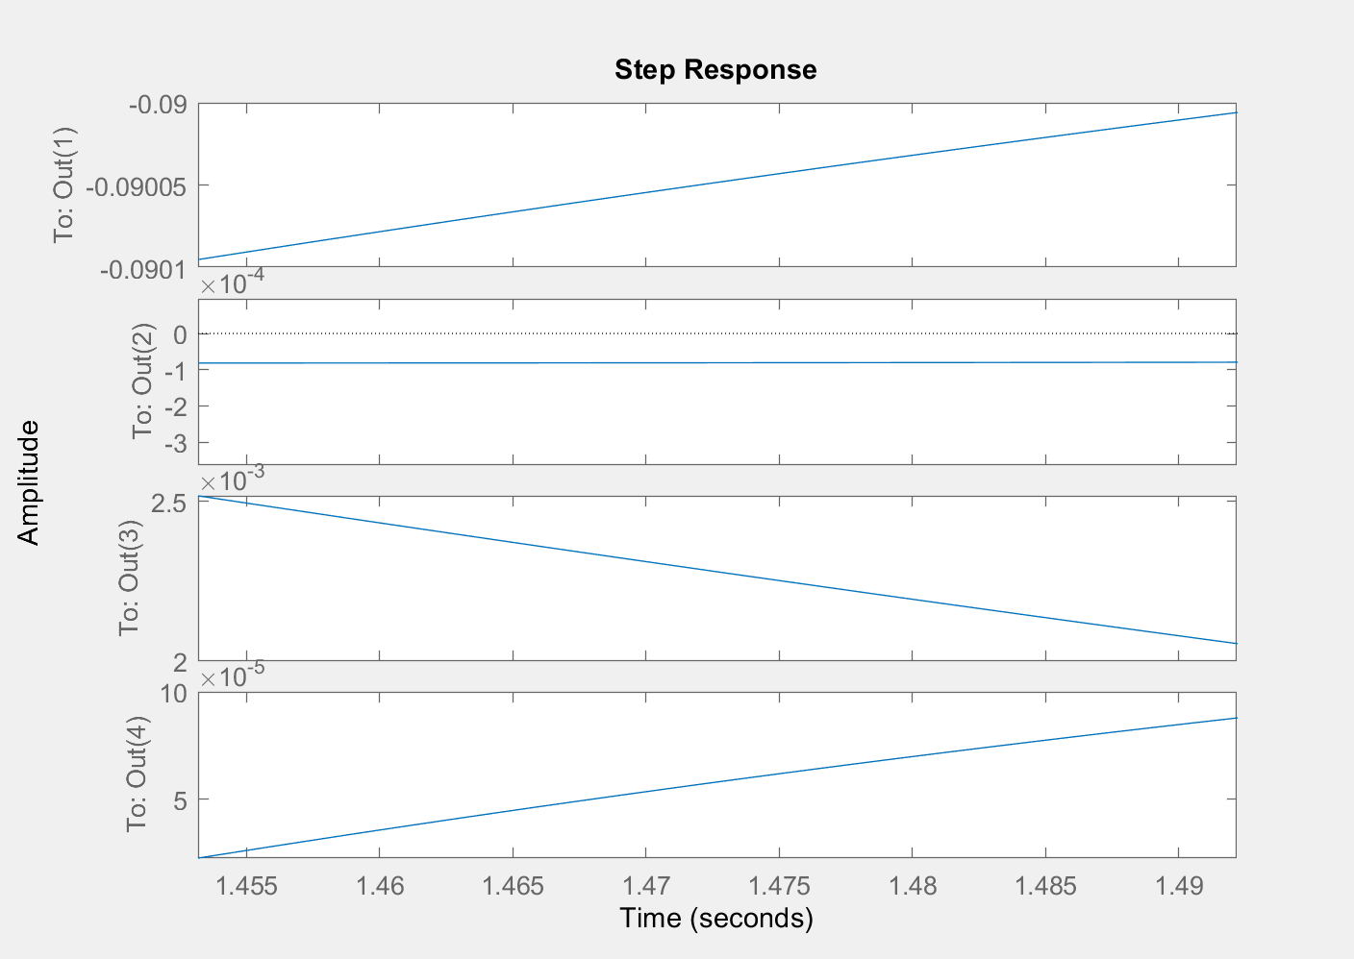
Design and Utilization of State Feedback Control (cont.)

Slide 11
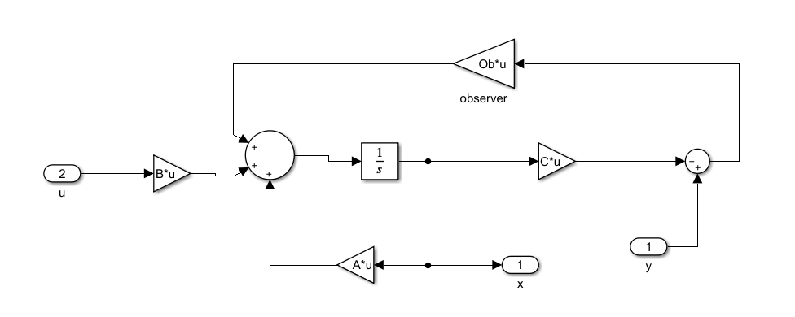
Design of State Observers
All State variables are observable.
It was found that (A',C') is controllable, and thus observable. We can choose any negative real eigenvalue.
E/V = [-40,-40,-40,-40]*10 , used MATLAB place function to determine L matrix (Ob)
Matrix Values

Slide 12
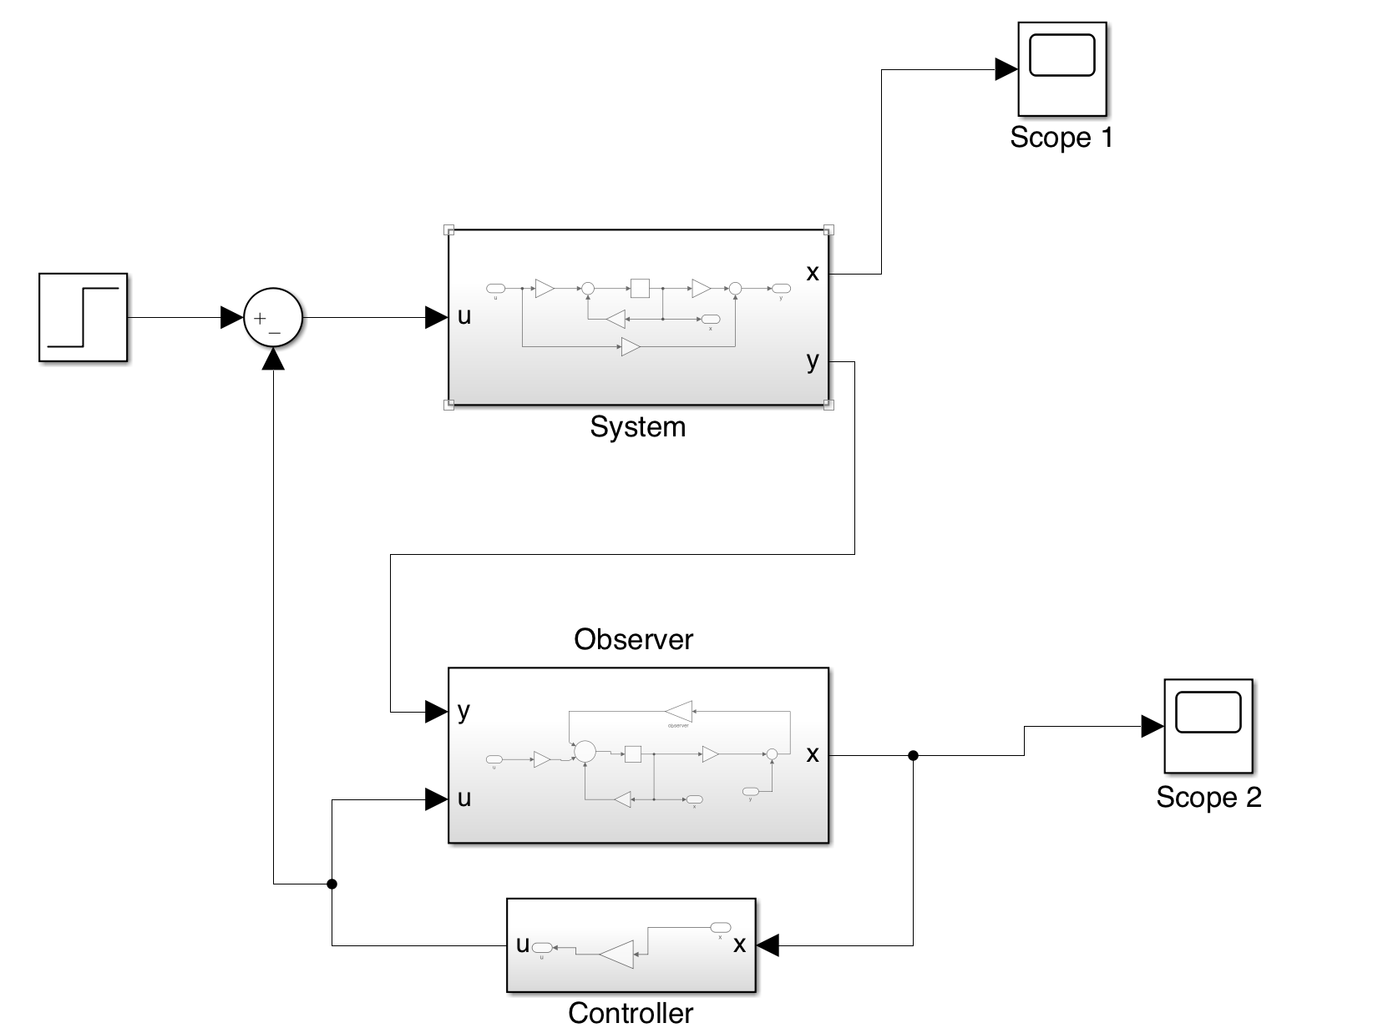
Utilization of State Feedback Control with the Designed Observers, and Comparison of Results
State Feedback Controller takes in X output from Observer and delivers u back to observer and to the system
Observer-Based Feedback Controller

Slide 13
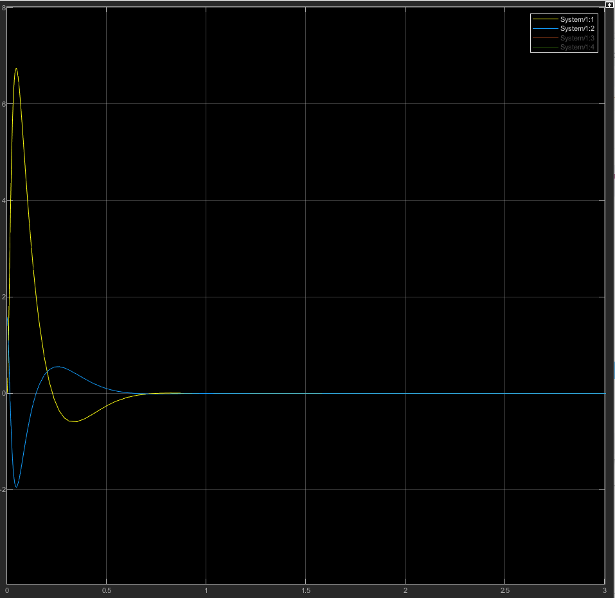
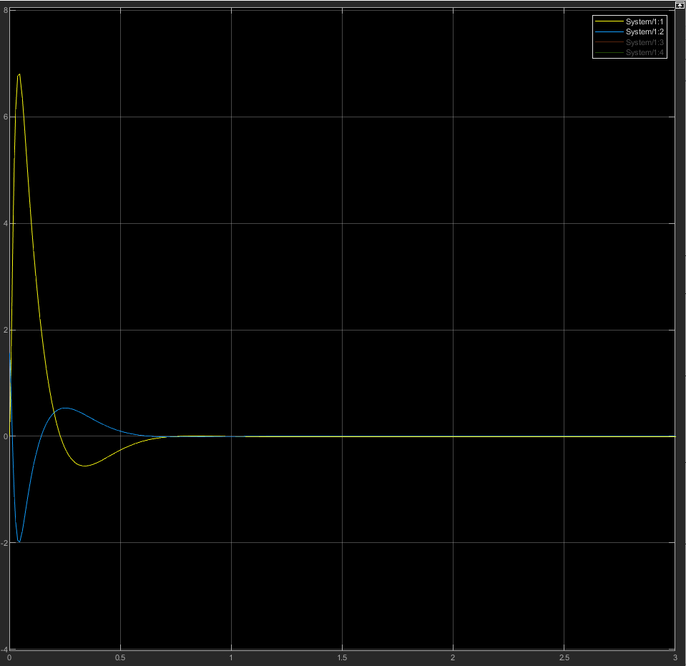
Utilization of State Feedback Control with the Designed Observers, and Comparison of Results
State Feedback Controller
(Theta , Psi)
Observer-based Controller
(Theta, Psi)

Slide 14
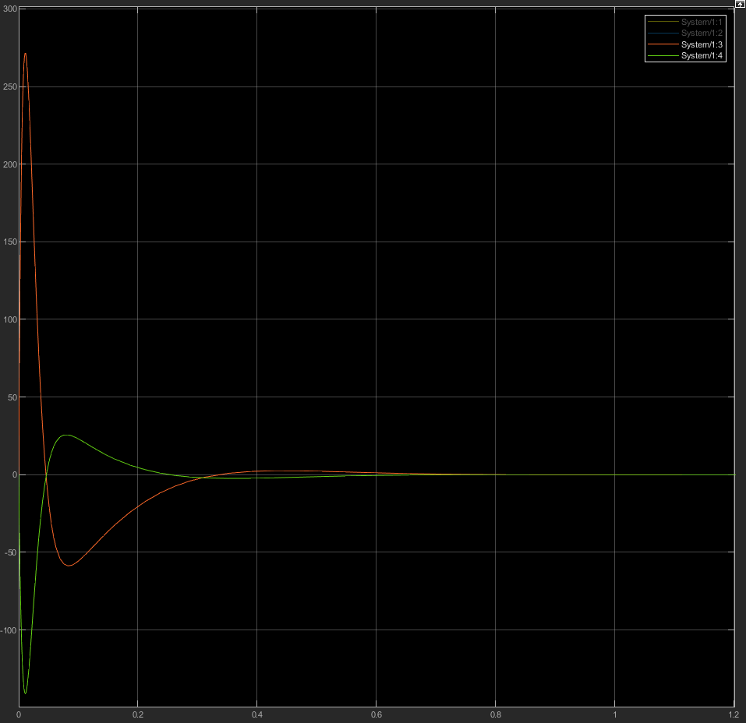
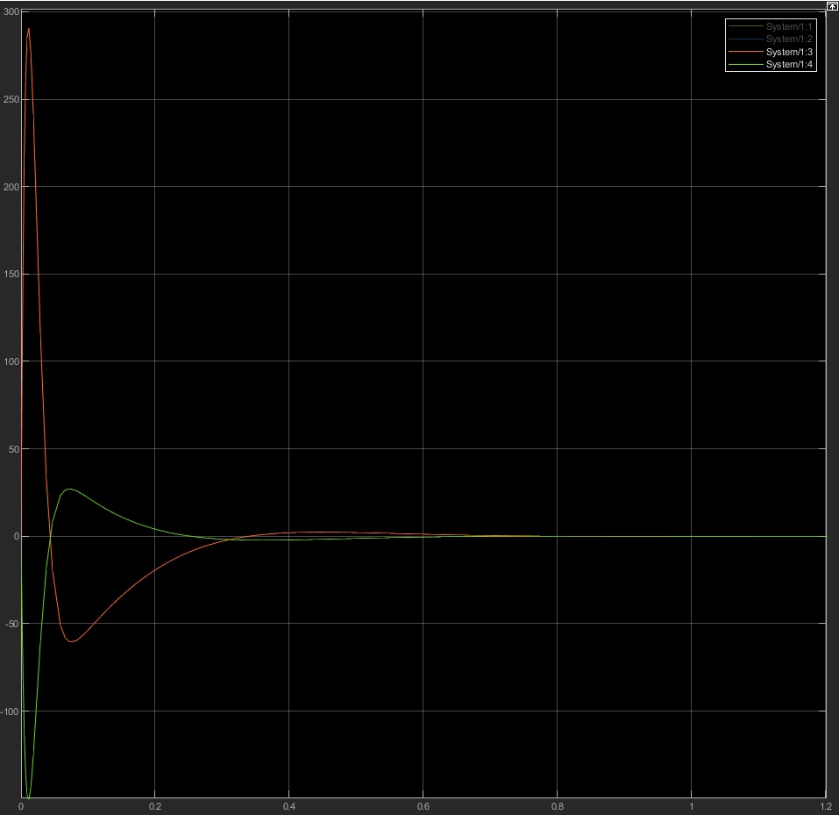
Utilization of State Feedback Control with the Designed Observers, and Comparison of Results
State Feedback Controller
(Theta_dot , Psi_dot)
Observer-based Controller
(Theta_dot , Psi_dot)
Notes:
Wheels are smaller ➔ faster rotational speed

