Slide 1

COMMUNICATION PROTOCOLS
BY: JUNAID JAWED KHAN

Slide 2
Definitions
Protocol
Set of rules & regulations
Communication
Exchange of information
Communication Protocol
Set of rules & regulations that ensure reliable exchange of information between two electronic systems.
Notes:
There are 1000s of communication protocols; Used everywhere in analog & digital communications; Without these protocols' computer networks cannot exist;
Classification of communication protocols:
Automation Protocols
Used for automation of processes e.g.
power-system automation
automatic meter reading
vehicular automation
CAN
VAN
Each example above has different types of protocols with different characteristics.
Bluetooth protocols
Developed for wireless data exchange
File transfer protocols
Designed for file transfer over a telecommunication network
Instant messaging protocols
Yahoo, Skype, Steam, Windows Live Messenger, Google Talk, SMS, MMS, Call
Web service protocols
HTTPS/HTTP in web addresses
Communication protocols cover: Authentication, error detection & correction, Signaling.

Slide 3
Types of Protocols
Inter System Protocol
Intra System Protocol
Notes:
Inter system protocol: Communication via internal system bus; Communication between systems on different circuit boards; Using wires two create a bridge to send information from one system to another;
E.g. UART, USB, UART
Intra System Protocol: Communication via intra system bus; The two communicating systems are on the same circuit board; E.g. The different peripherals on a micro-controller communicating with the processor on the board.
E.g. SPI, CAN & I2C
Advantages:
Inter-System protocols increase circuit complexity, power-consumption & cost, in comparison to the Intra system protocols.

Slide 4
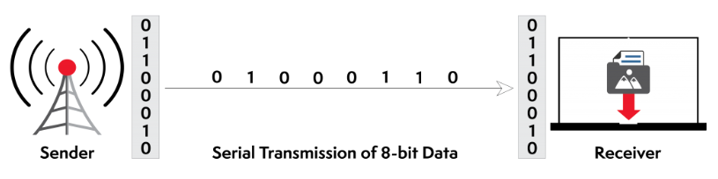
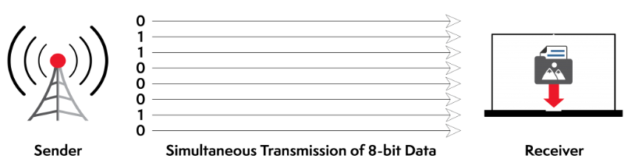
Data Transmission Types
Serial Transmission
Long-distance data transfer
Types
Asynchronous
No clock-source
E.g. UART
Synchronous
Transmission governed by a clock pulse
E.g. SPI
Parallel Transmission
Time-sensitive data transfer
Large amounts of data
E.g. Video streaming
Notes:
Serial Transmission: One bit at a time; Order of the bits matter; MSB first or LSB first, depends on the device;
Asynchronous: Data bit can be sent at anytime; Start and stop bits used between data bytes to synchronize the transmitter & the receiver. Timed gaps are used for transmission and receiving of data, i.e. the transmitter will send a few bits using a fixed transmission frame, then the receiver will transmit using the same transmission frame. Transmission frame = Startbit, followed by data bits(MSB/LSB bit – depends on the receiving device), followed by stop bit to signal it has transmitted its intended message. The receiver will respond in the same manner.
Advantage: No synchronization needed, cost-effective method as a bit transferred only if the previous bit is received;
Disadvantage: Slow data-transfer as compared to Synchronous, since the communicating devices are not in sync, there is room for timing errors which allows the transmitted data to be corrupted – there is a checking mechanism used to ensure the data transmitted is received.
Synchronous: Data bit transmission & receiving control by a clock pulse. One edge of the clock pulse used to transmit a bit, the other edge used to receive a data bit. No need for start & stop bits, and gaps, as the transmitter and receiver have a designated time to transmit and receive.
Advantages: Faster as compared to asynchronous;
Disadvantage: Implementation is expensive as compared to Asynchronous; Only useful for short distances as clock-pulse is needed to synchronize the communicating devices.
Parallel: Sending multiple bits simultaneously; Order of transmission is dependent on various conditions – proximity of data source, user location & bandwidth available; much faster than Serial transmission

Slide 5
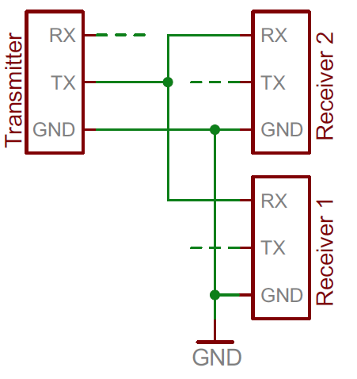
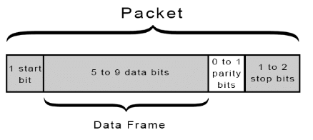
UART
Asynchronous Serial Communication
Universal Asynchronous Receiver Transmitter
Two-wired Protocol
Half-duplex
Data frame limited to 9-bits
Error Checking
E.g. Emails, SMS, Walkie-talkie, GPS
Notes:
Half-duplex: Both devices cannot communicate simultaneously. The communication is one-direction at a time; One party transmits and the receiver waits till transmitter stops, before replying.
Full-duplex: Both devices can communication simultaneously. The transmitter can send a bit and receive a bit at the same time. E.g. A Telephone, both callers can speak and listen at the same time.
Error-checking – Parity bits
In case of even parity − If number of 1s is even, parity bit value is 0. If number of 1s is odd, parity bit value is 1.
In case of odd parity − If number of 1s is odd, parity bit value is 0. If number of 1s is even, parity bit value is 1.

Slide 6
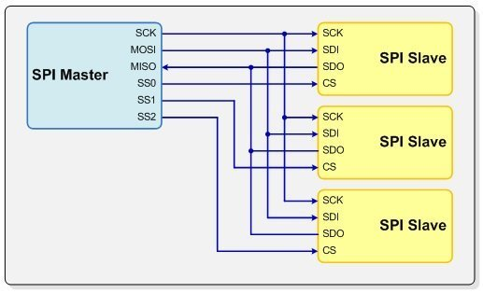
SPI
Synchronous serial communication
Synchronous Peripheral Interface
Four-wired Protocol
MOSI: Master-Out Slave-In
MISO: Master-In Slave-Out
SCLK: Clock
CS: Chip-select
Full-duplex
No limitation to data frame bits
No error checking mechanism

Slide 7
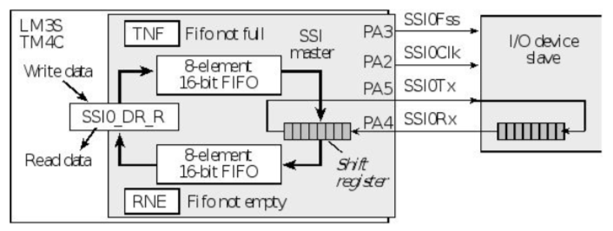
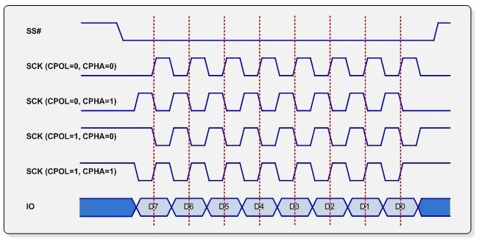
SPI Configuration & Example
Word size
Bit order
Clock Phase
Create delay
Clock Polarity
Select transmission edge
Bandwidth
Shortest clock pulse needed for data exchange
Notes:
Clock Phase and Polarity: For proper transmission between devices, one edge of the clock is used to change transmit output and the other edge of the clock is used to latch data in.
Clock Phase used for creating a delay in your transmission; CPH=0 Not delay; CPH = 1 Half cycle delay
Clock Polarity is used for when to transmit data? Rising edge or falling edge of clock; CPOL = 0; start transmission at rising edge of clock, CPOL=1; start transmission at falling edge of clock

Slide 8

THE END

