Slide 1
Bayesian Computational Statistics
Live Session Presentation

Slide 2
Live Session 3: Latent Dirichlet Allocation
Sara Jamshidi

Slide 3
Live Sessions
Live Session 1 – Bayesian models in plain sight
Live Session 2 – Naïve Bayes classifier example with Heart Disease
Live Session 3 – Bayesian networks

Slide 4
Objectives
Describe Bayesian networks.
Discuss Latent Dirichlet Allocation (LDA)

Slide 5
Bayesian Networks

Slide 6
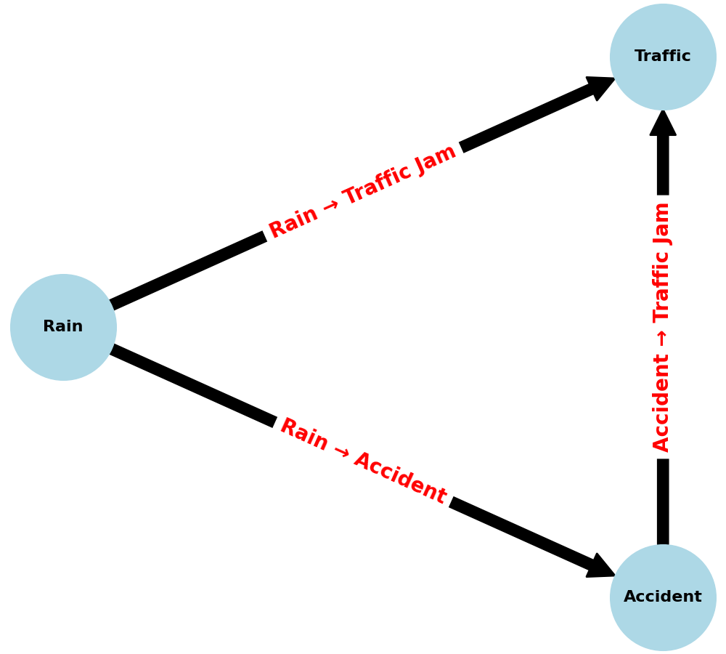
What are Bayesian Networks?
Bayesian networks are probabilistic network models.
Nodes represent variables.
Edges represent direct conditional dependencies.
Unconnected nodes are conditionally independent.
Traffic is influenced by accidents, which is influenced by rain.

Slide 7
Bayesian Network Example
Given that it isn’t raining, what is the probability of no traffic?
 | No Rain | Rain
No Accident | 0.9 | 0.4
Accident | 0.1 | 0.6
 | No Rain |  | Rain
 | No Accident | Accident | No Accident | Accident
No Traffic | 0.95 | 0.6 | 0.7 | 0.1
Traffic | 0.05 | 0.4 | 0.3 | 0.9

Slide 8

Bayesian Network Example
Using the chain rule and the graph, we compute:
$$P\left(T,A,R\right)=P\left(T | R, A\right)P\left(A | R\right)P(R)$$
Given that it isn’t raining, what is the probability of no traffic?
 | No Rain | Rain
No Accident | 0.9 | 0.4
Accident | 0.1 | 0.6
 | No Rain |  | Rain
 | No Accident | Accident | No Accident | Accident
No Traffic | 0.95 | 0.6 | 0.7 | 0.1
Traffic | 0.05 | 0.4 | 0.3 | 0.9

Slide 9
Bayesian Network Example
Given that it isn’t raining, what is the probability of no traffic?
 | No Rain | Rain
No Accident | 0.9 | 0.4
Accident | 0.1 | 0.6
 | No Rain |  | Rain
 | No Accident | Accident | No Accident | Accident
No Traffic | 0.95 | 0.6 | 0.7 | 0.1
Traffic | 0.05 | 0.4 | 0.3 | 0.9

Slide 10
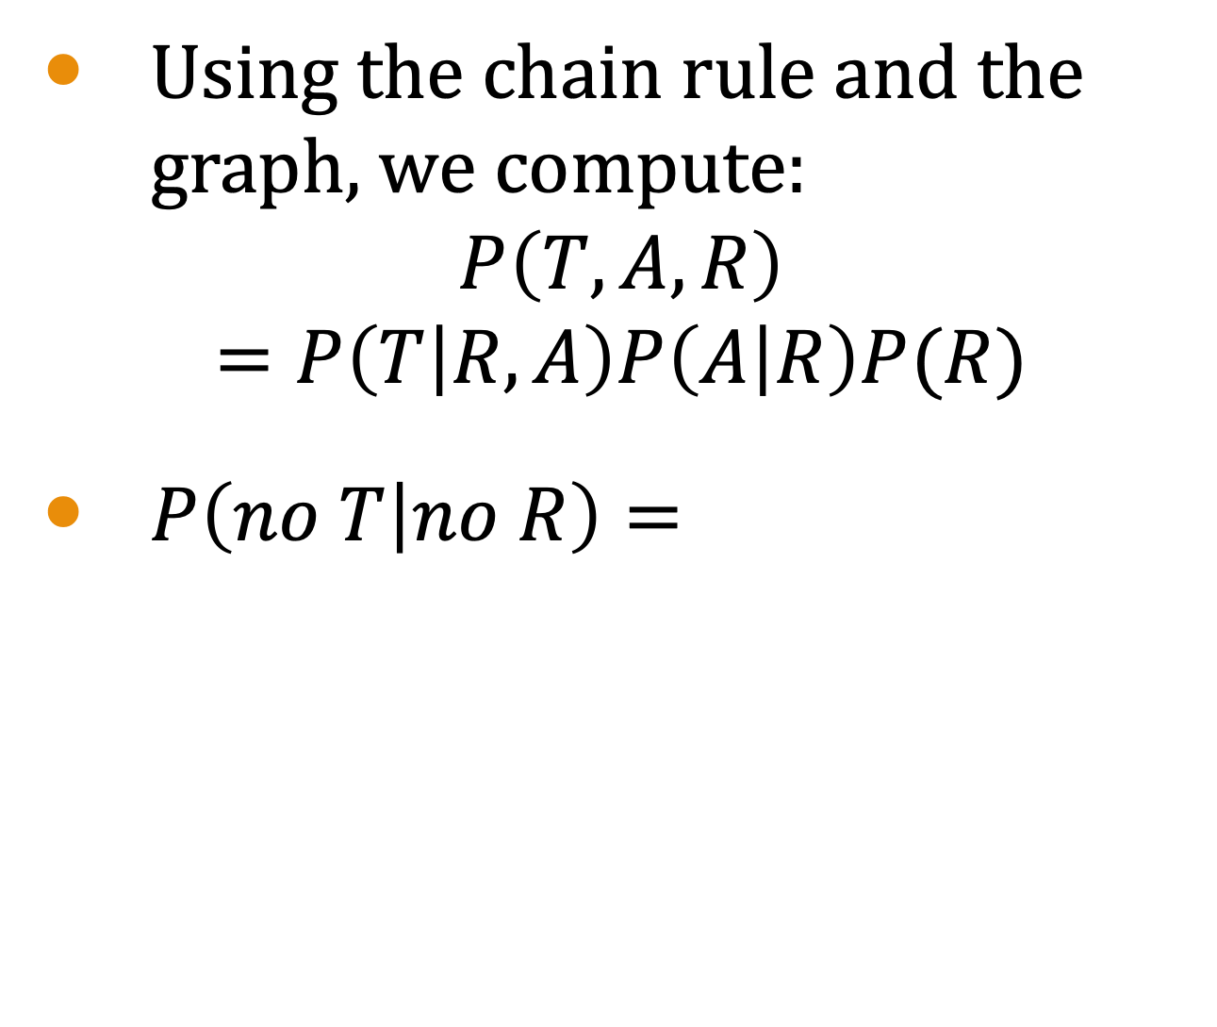
Bayesian Network Example
Using the chain rule and the graph, we compute:
$$P\left(T,A,R\right)=P\left(T | R, A\right)P\left(A | R\right)P(R)$$
$P\left(no T | no R\right)=$
Given that it isn’t raining, what is the probability of no traffic?
 | No Rain | Rain
No Accident | 0.9 | 0.4
Accident | 0.1 | 0.6
 | No Rain |  | Rain
 | No Accident | Accident | No Accident | Accident
No Traffic | 0.95 | 0.6 | 0.7 | 0.1
Traffic | 0.05 | 0.4 | 0.3 | 0.9

Slide 11
Bayesian Network Example
Using the chain rule and the graph, we compute:
$$P\left(T,A,R\right)=P\left(T | R, A\right)P\left(A | R\right)P(R)$$
$P\left(no T | no R\right)=$
Given that it isn’t raining, what is the probability of no traffic?
 | No Rain | Rain
No Accident | 0.9 | 0.4
Accident | 0.1 | 0.6
 | No Rain |  | Rain
 | No Accident | Accident | No Accident | Accident
No Traffic | 0.95 | 0.6 | 0.7 | 0.1
Traffic | 0.05 | 0.4 | 0.3 | 0.9

Slide 12
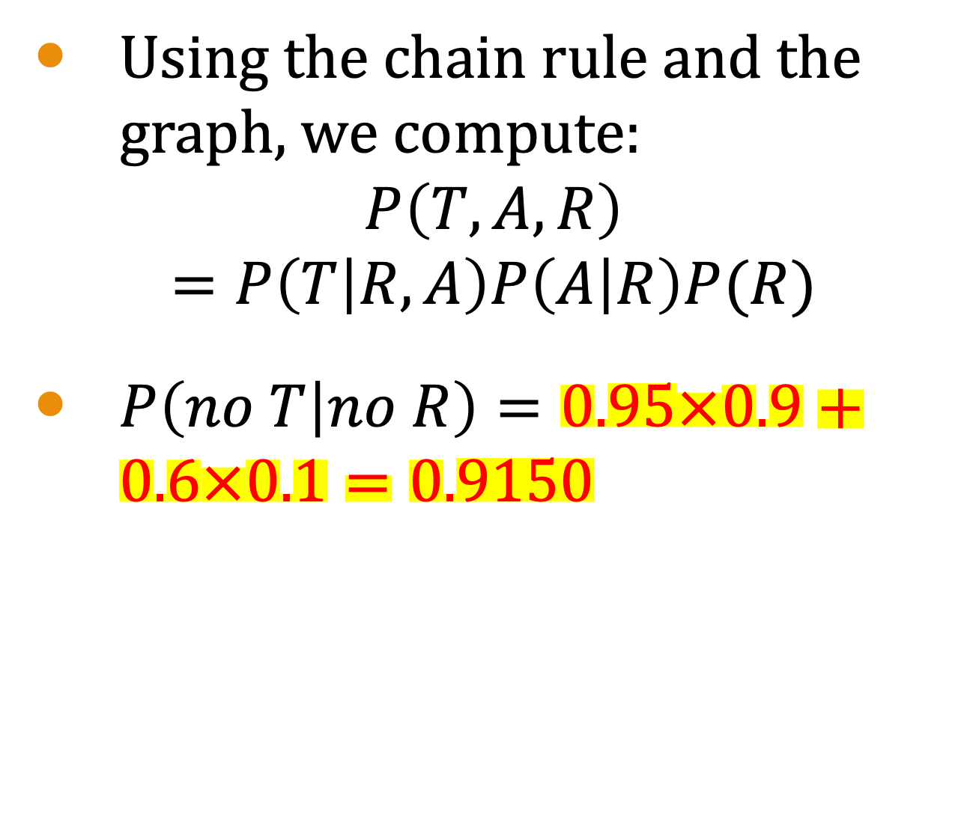
Bayesian Network Example
Using the chain rule and the graph, we compute:
$$P\left(T,A,R\right)=P\left(T | R, A\right)P\left(A | R\right)P(R)$$
$P\left(no T | no R\right)=0.95×0.9+0.6×0.1=0.9150$
Given that it isn’t raining, what is the probability of no traffic?
 | No Rain | Rain
No Accident | 0.9 | 0.4
Accident | 0.1 | 0.6
 | No Rain |  | Rain
 | No Accident | Accident | No Accident | Accident
No Traffic | 0.95 | 0.6 | 0.7 | 0.1
Traffic | 0.05 | 0.4 | 0.3 | 0.9

Slide 13
Bayes Networks
Full specification involves assigning a probability distribution to each node.
Bayes networks can get quite large and model complex behaviors.
They can answer probabilistic queries about variables using observed evidence.
One of the primary applications is text-based data.

Slide 14
Latent Dirichlet Allocation (LDA)

Slide 15
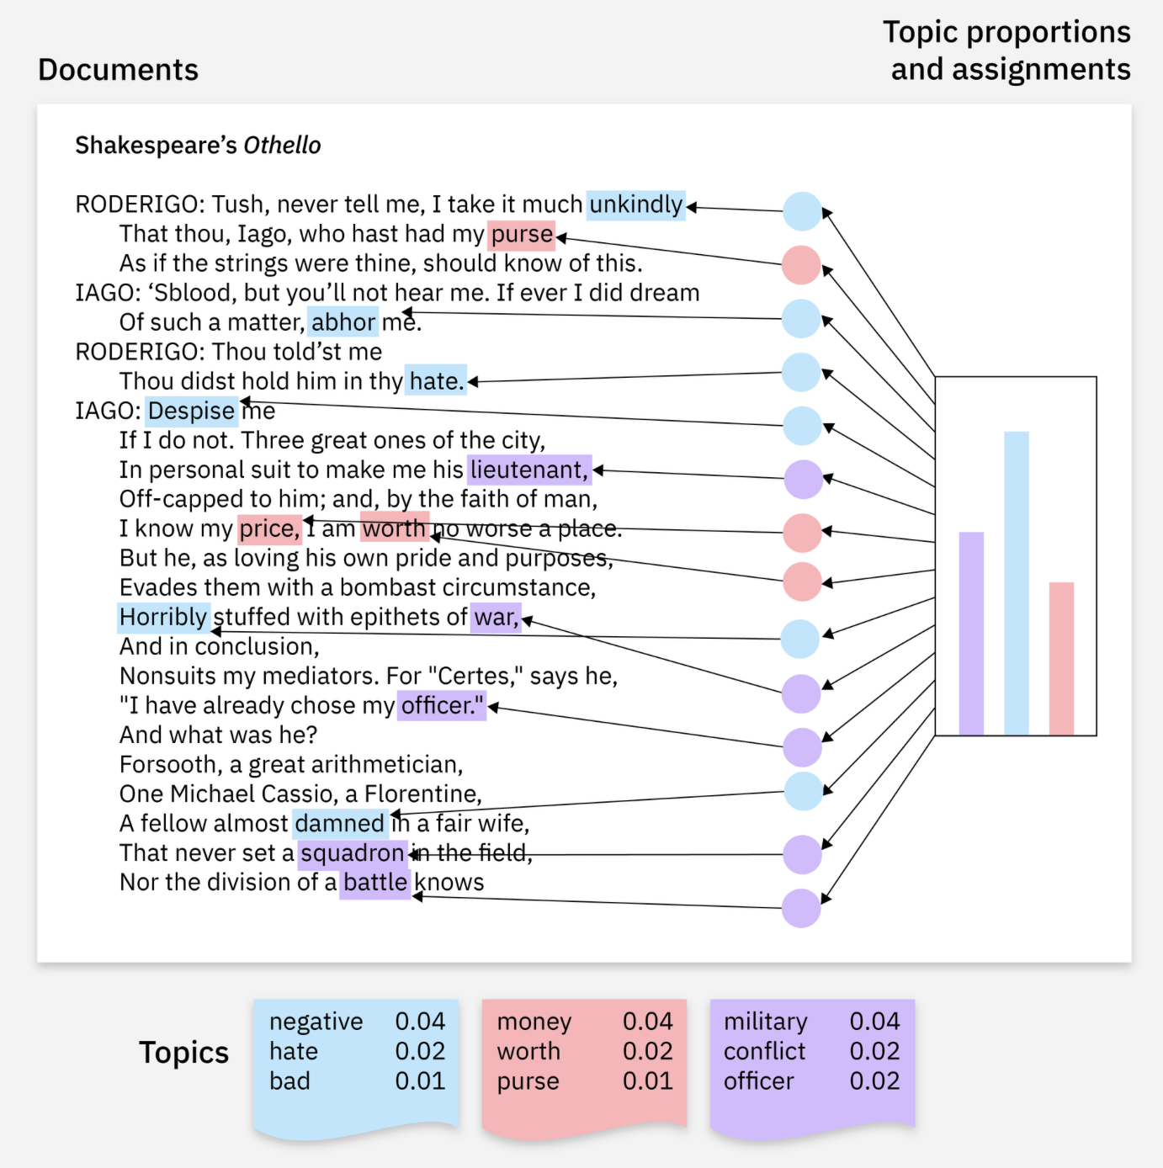
What is Latent Dirichlet Allocation (LDA)?
Latent Dirichlet Allocation (LDA) is a Bayesian network model.
It is used for topic modeling within text data.
It identifies topics within a set of documents by representing the relationships between documents, topics, and words probabilistically.
Taken from IBM

Slide 16

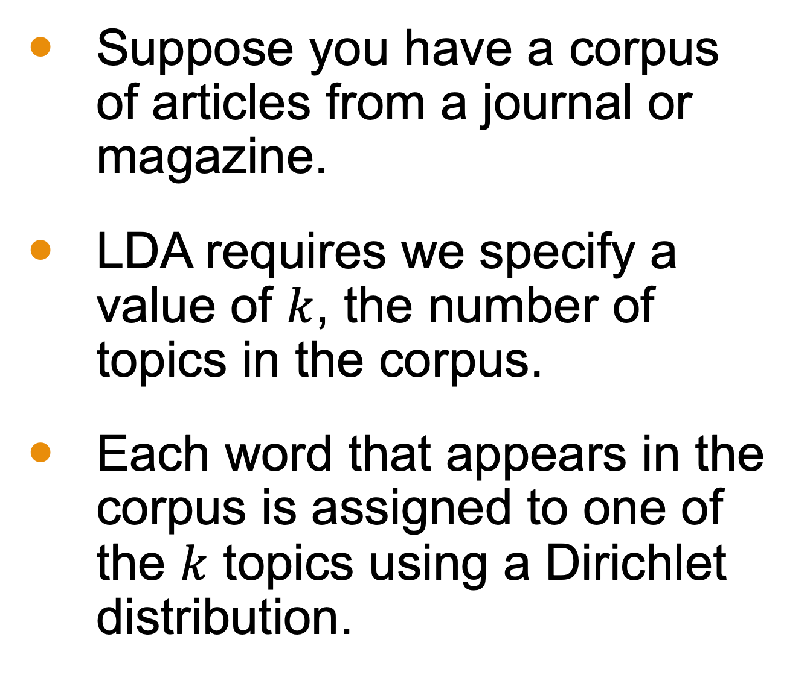
How LDA Works
Suppose you have a corpus of articles from a journal or magazine.
LDA requires we specify a value of $k$, the number of topics in the corpus.
Each word that appears in the corpus is assigned to one of the $k$ topics using a Dirichlet distribution.

Slide 17
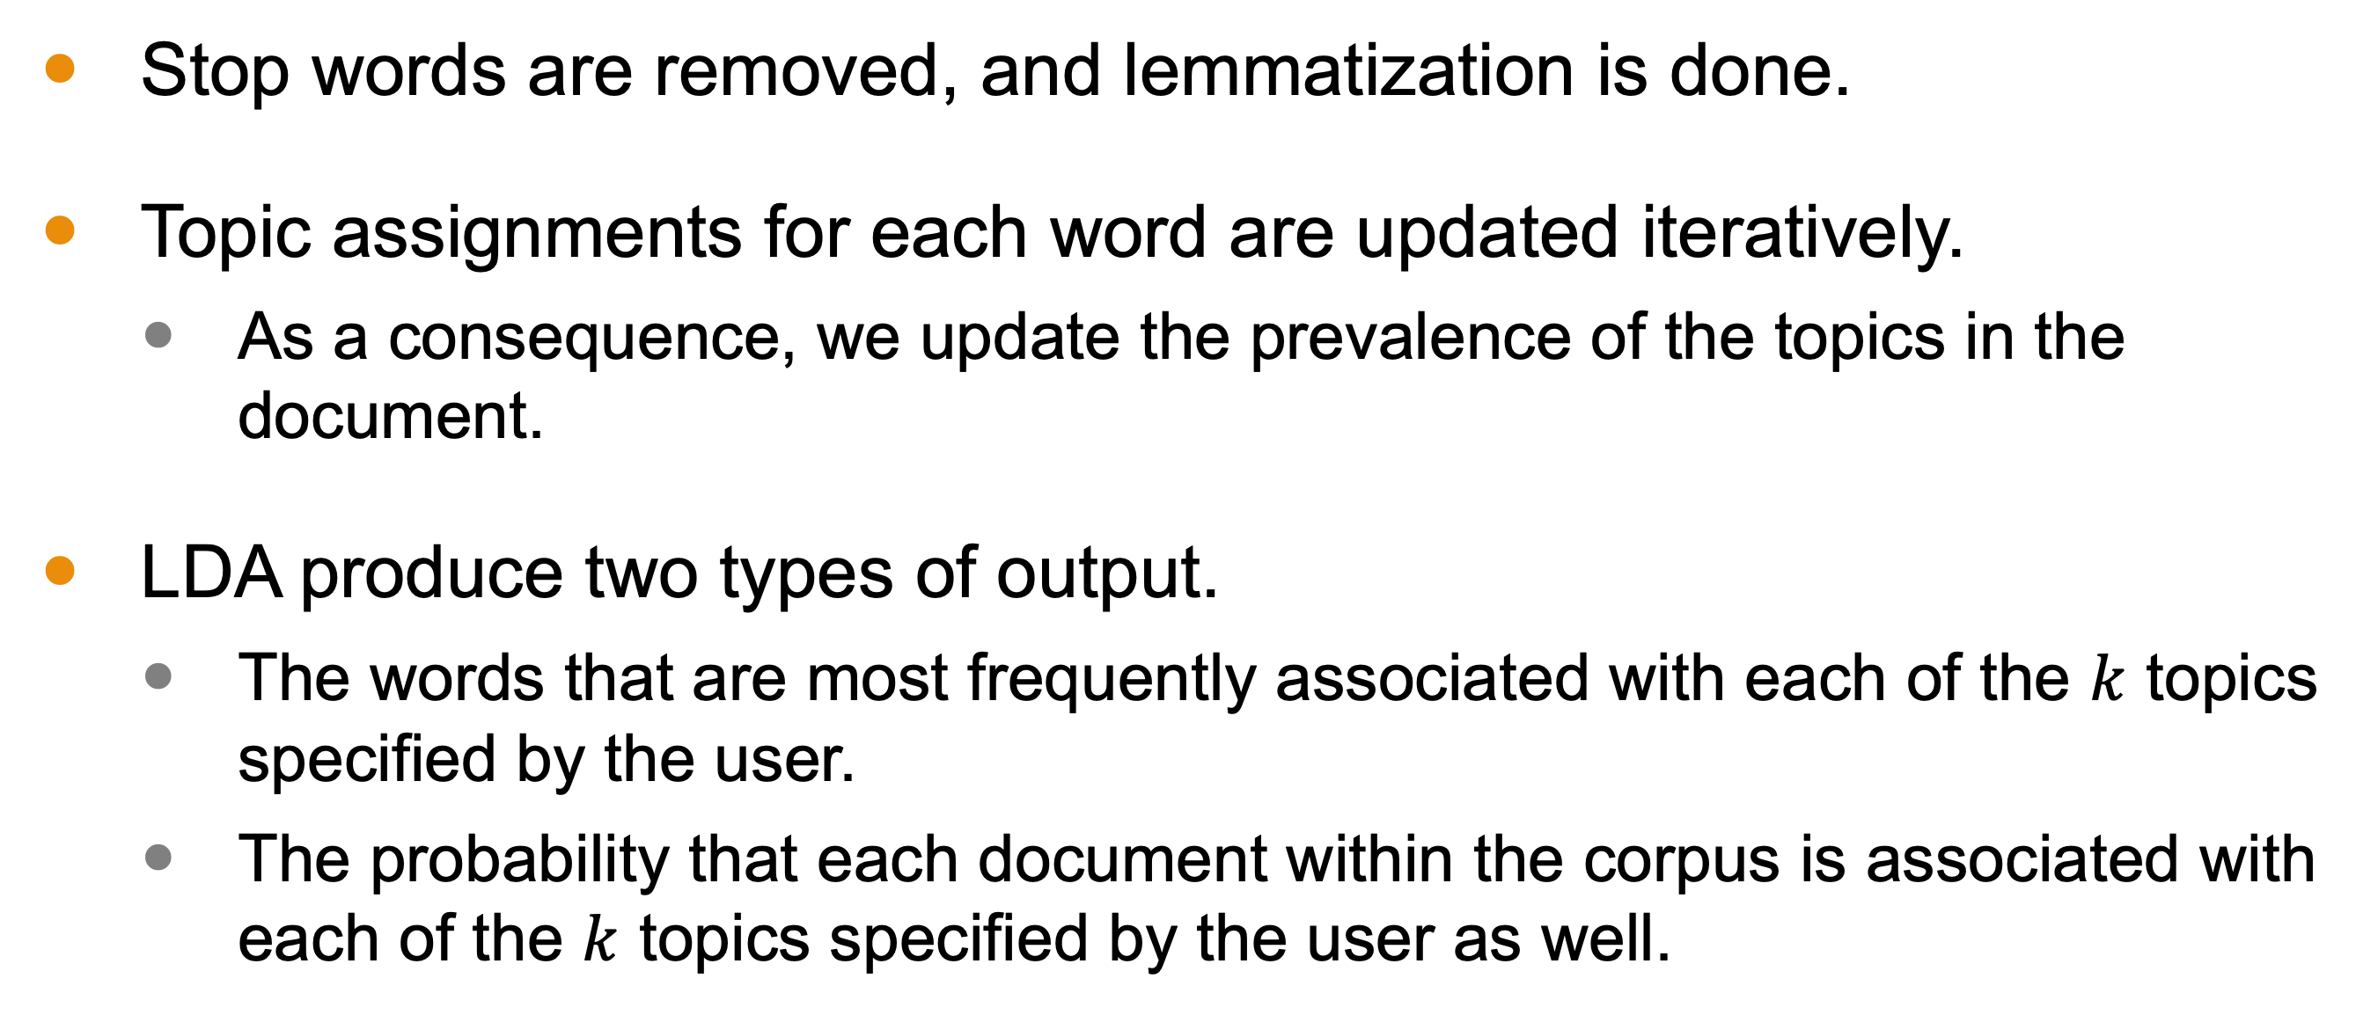
How LDA Works
Stop words are removed, and lemmatization is done.
Topic assignments for each word are updated iteratively.
As a consequence, we update the prevalence of the topics in the document.
LDA produce two types of output.
The words that are most frequently associated with each of the $k$ topics specified by the user.
The probability that each document within the corpus is associated with each of the $k$ topics specified by the user as well.

Slide 18
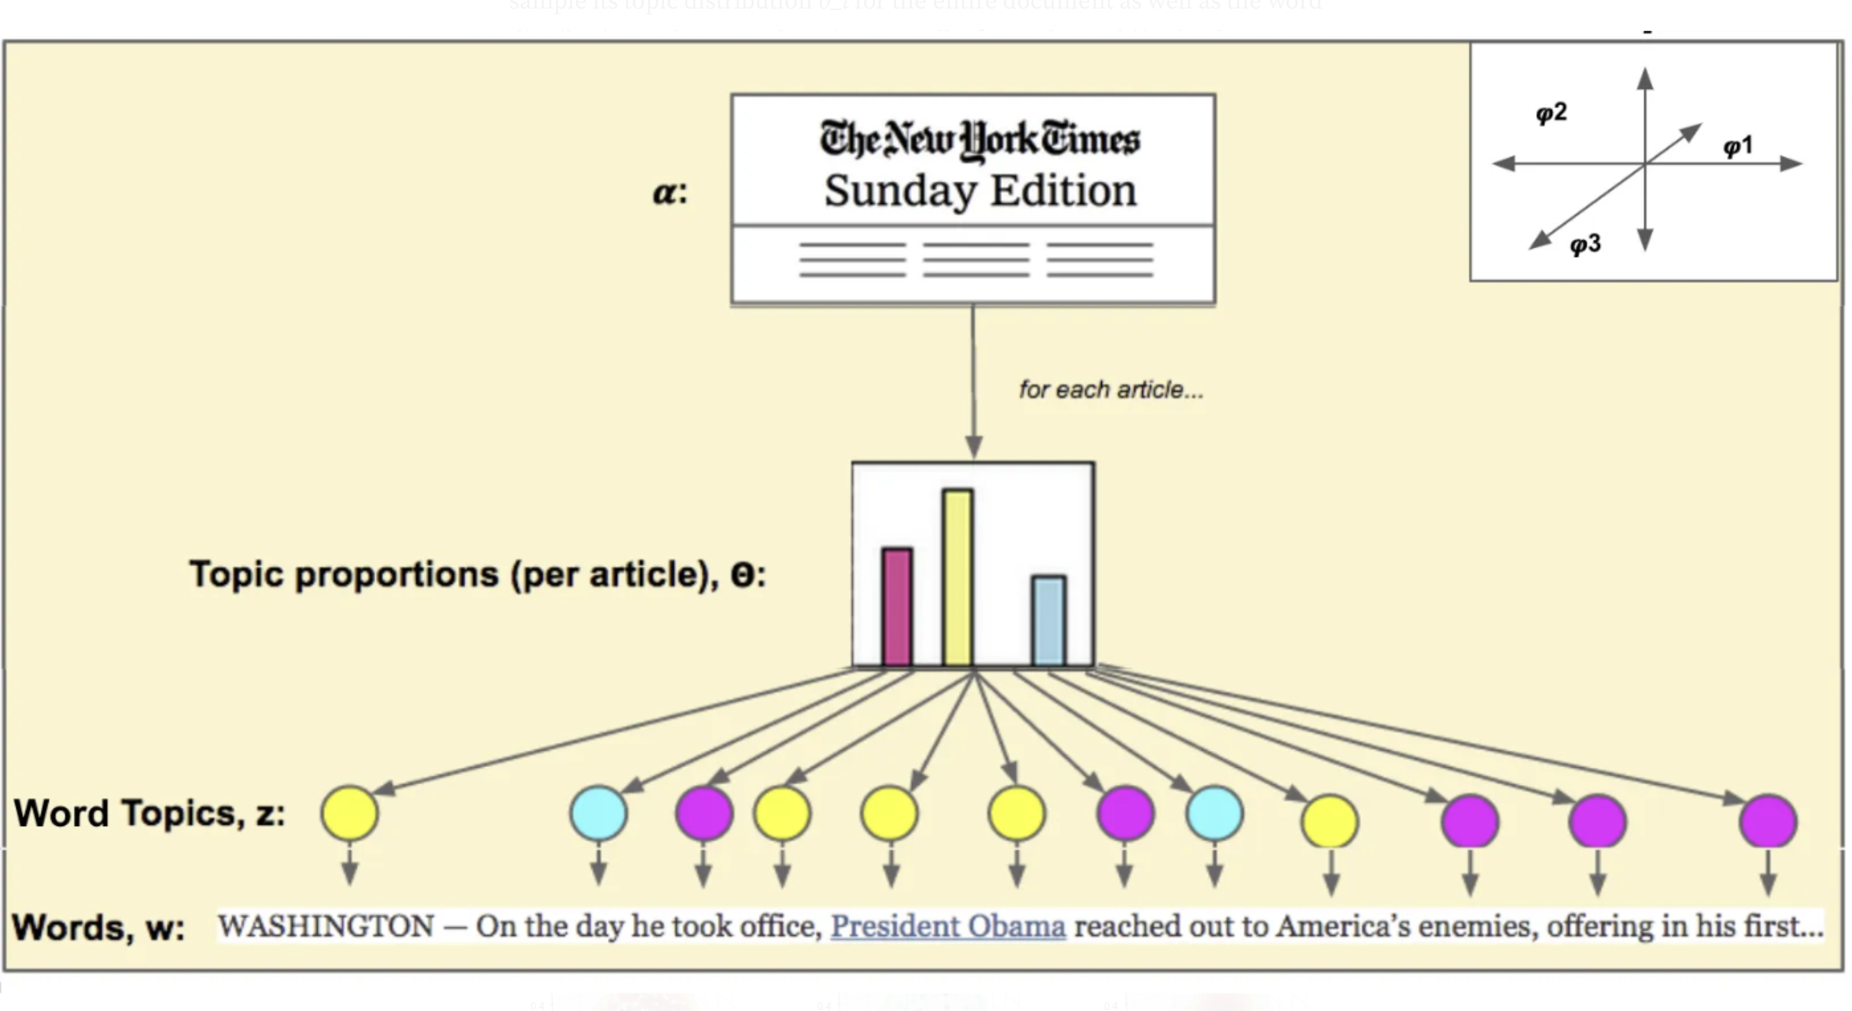
Results of LDA
Documents in the corpus are generally assigned the topic they have the strongest association.
LDA allows for a classification of text-based objects.
Sort books and articles by topics.
Sort movies by script.
Taken from Medium, Kung-Hsiang, Huang (Steeve)

Slide 19
Simple Example with Associated Press Dataset

Slide 20
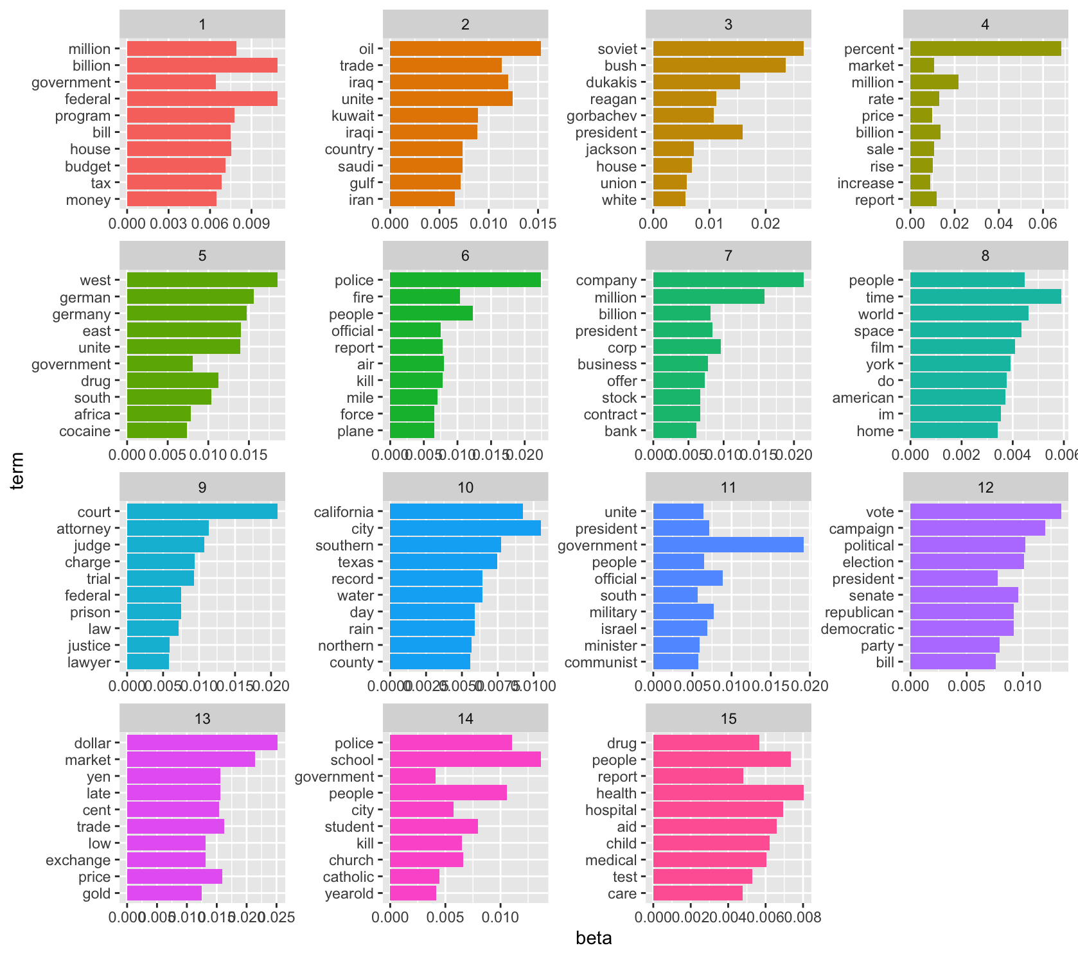
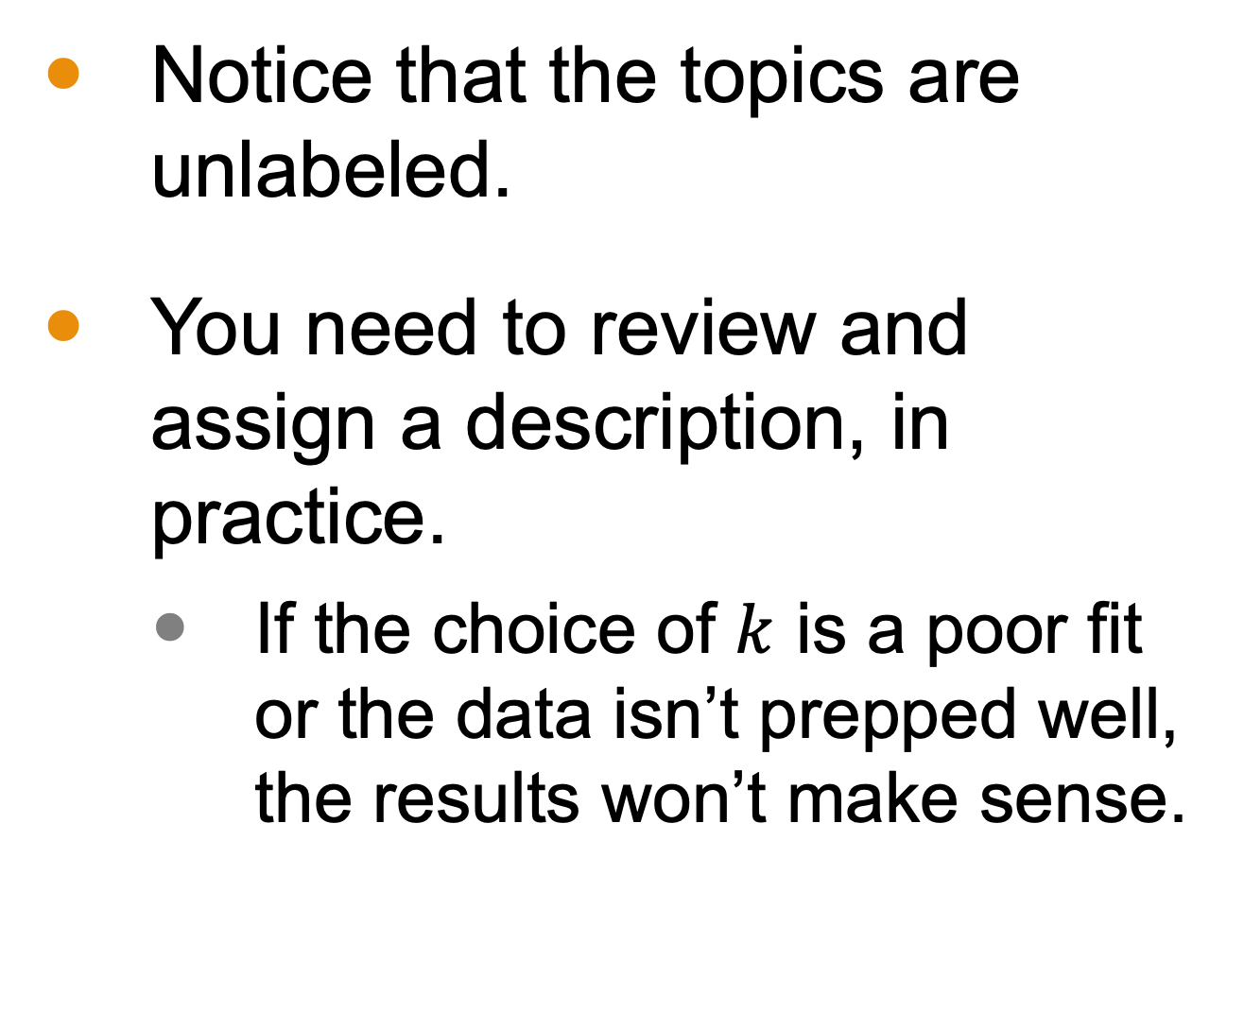
Results
Notice that the topics are unlabeled.
You need to review and assign a description, in practice.
If the choice of $k$ is a poor fit or the data isn’t prepped well, the results won’t make sense.

Slide 21
How is this a Bayesian Network?
This process builds tables, where words are columns and documents are rows.
Cells contain the frequency of the word within the document.
Words are iteratively assigned to a (nameless) topic using Gibbs sampling.
After convergence, conditional probabilities can be computed
We aim to compute the likelihood of a topic given the set of words present.

Slide 22
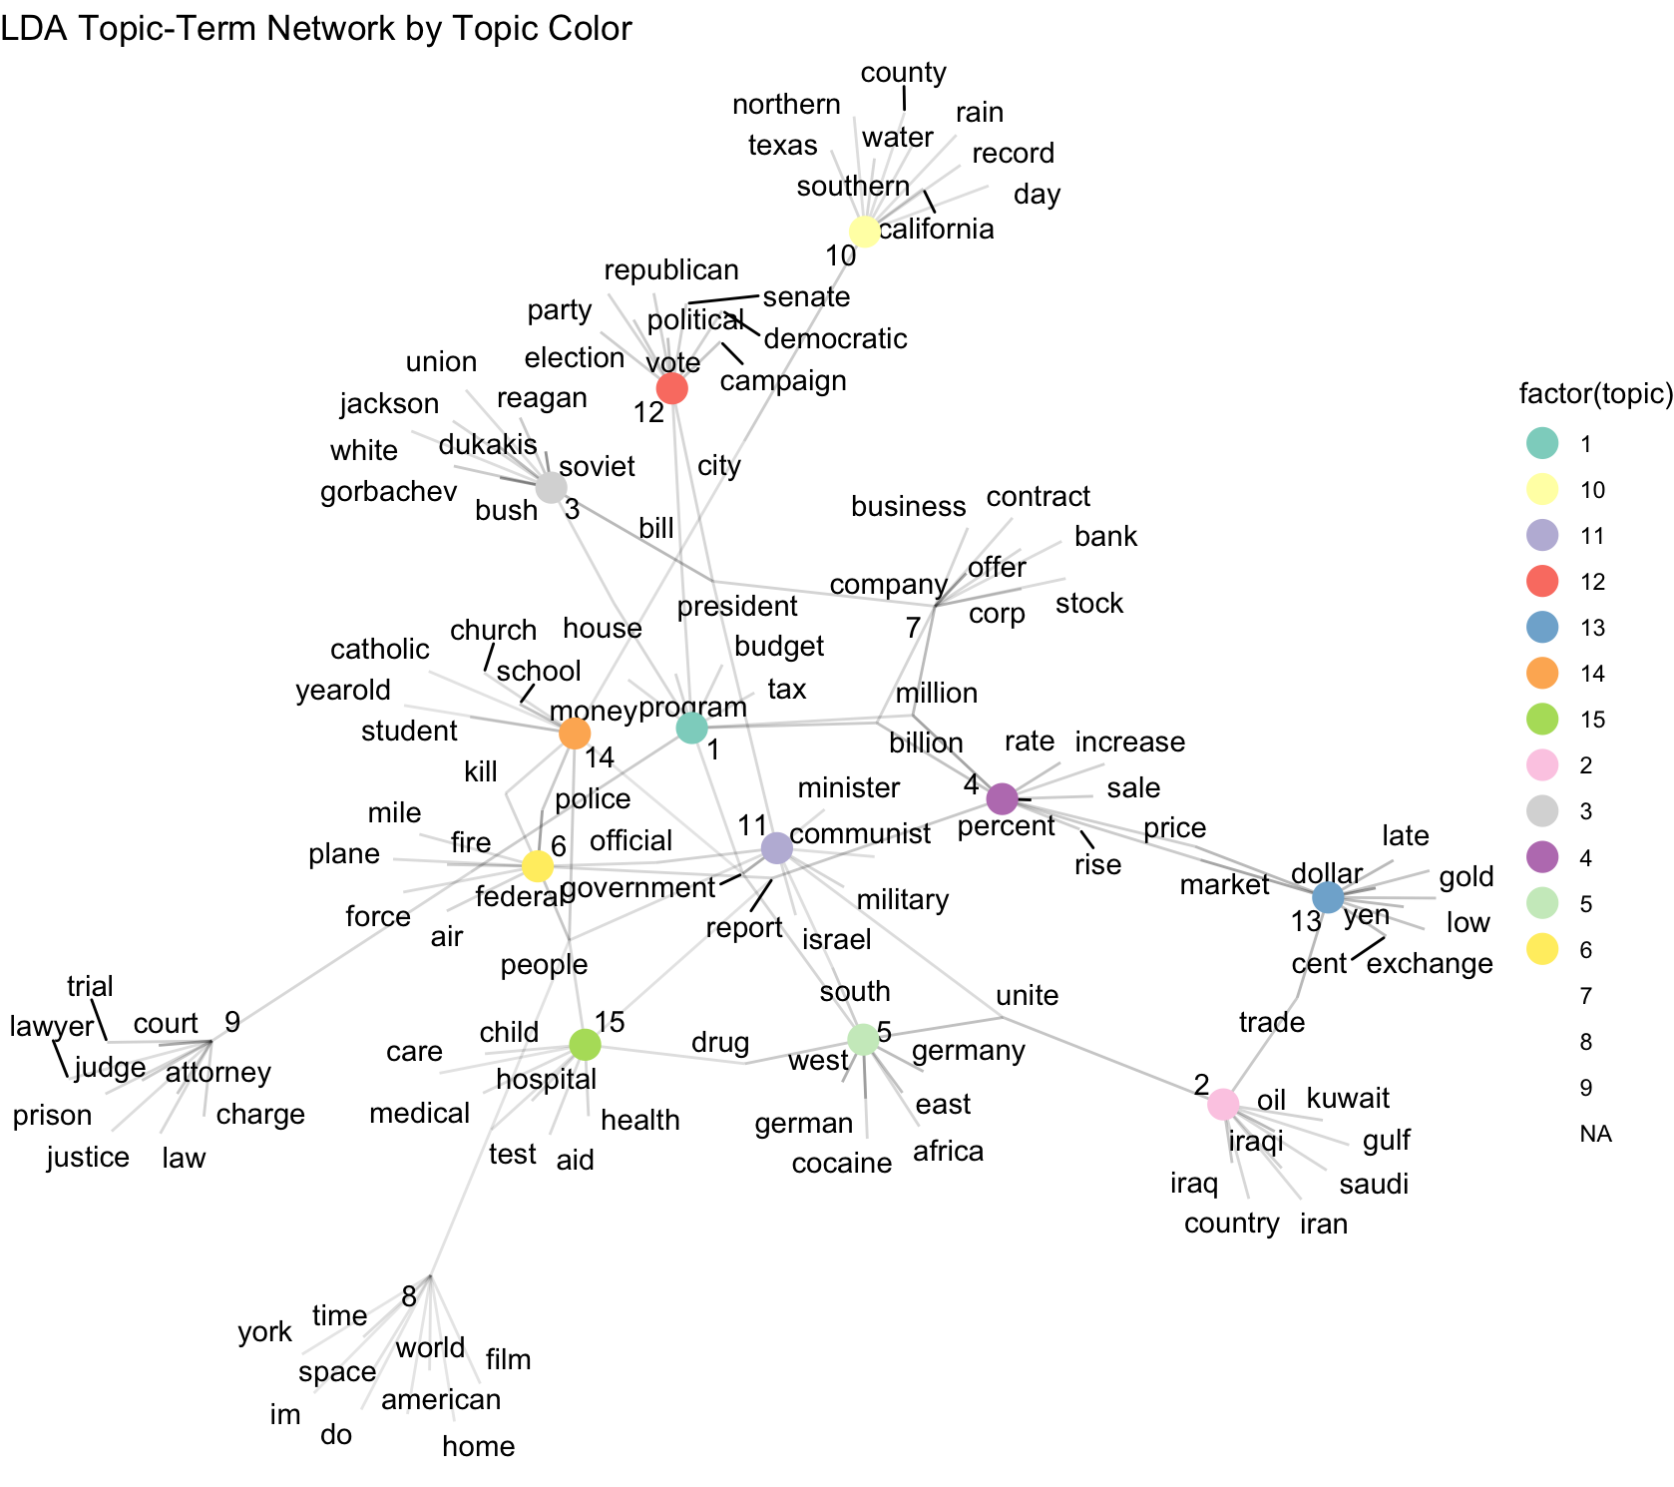
Network Graph
We can draw the underlying network defining the relationship between the words and the topics.
Documents are classified based on how strongly they associate with a topic.

Slide 23
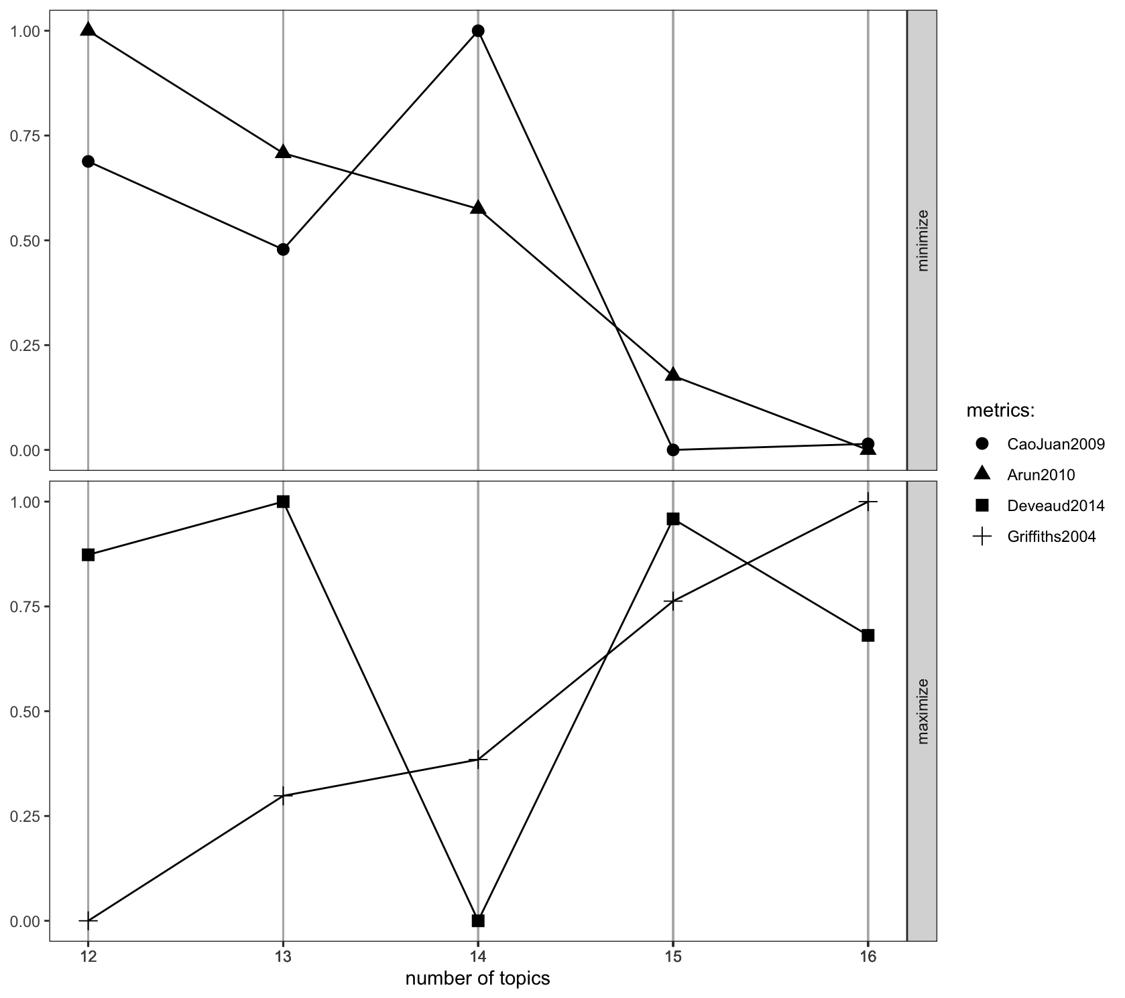
Computing k
These topics are nameless and inferred; picking the right number is crucial.
We look for k that
maximize likelihood (e.g. Griffiths2004)
minimize complexity (e.g., Arun2010, which minimizes KL-divergence).

Slide 24
Summary
Bayesian networks model data by tracking conditional dependencies.
One application is Latent Dirichlet Allocation, which determines the probability that a document in a corpus belongs to an unlabeled topic.
Intermediary nodes are the words within that document.

