Slide 1
Group 3 – Our event planning application
By: GURNECK JOHAL
Dennis Nguyen,
Devon Gillis,
Mikhail Starikov
Notes:
We are group 3 – we designed a group event planning application

Slide 2
Our project – initial development plans
The idea that we decided to focus on was making a calendar application which supports functions that alternative applications support but with more of a focus on group event planning.
Notes:
Before we fully focused in on a distinct event planning application, we were thinking of designing a calendar application with event planning functionality as that is the area we believed calendar applications could most improve on.

Slide 3
Our project – why?
We chose to focus on the event planning aspect of calendar applications because that is the area in which we feel that there is room for improvement.
Notes:
- Currently Calendars applications mostly seem to be used to organize personal stuff.
- We thought that they would be useful to plan group stuff too.

Slide 4
Our Project – Why?
Though some current calendar applications do offer the ability to share calendars for event planning, it is either not intuitive, or too inflexible.
Notes:
There is an ability to share calendars, but in its current state it does not allow for flexible social planning. You can only share the entire calendar, and it’s generally unintuitive.

Slide 5
Relevant Users/Stakeholders
We plan to design our application such that anybody could use it without any technical knowledge.
However, we understand that most people who use calendar applications are teenagers to older adults and as such we can make design decisions that complement their application usage habits
Notes:
We wanted to design our application in such a way that anybody could use it however we also recognized that the application would be used by people who are around teenaged to older adult ages. Given this age range we could design based on general trends of application usage.

Slide 6
Research - aim
To get an idea of what current calendar applications lack, and perhaps what we can improve on, we made a survey which asked about current calendar application usage and opinions on some ideas we had regarding changes we thought to make.
Notes:
To get an idea of what we should focus on designing, we decided to make a survey to get a better understanding of how calendar applications are currently used and to get opinions on the direction we wanted to take the design.

Slide 7
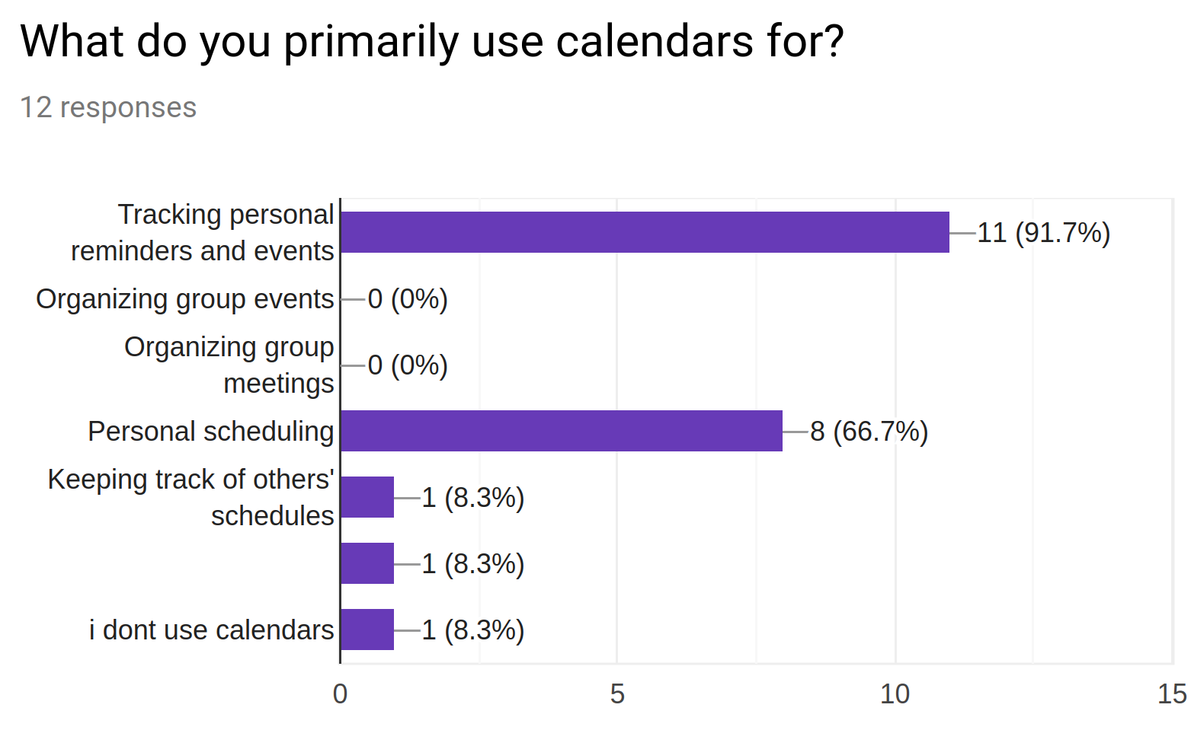
Research - Results
It seemed like people didn’t really use calendar applications for event planning

Slide 8
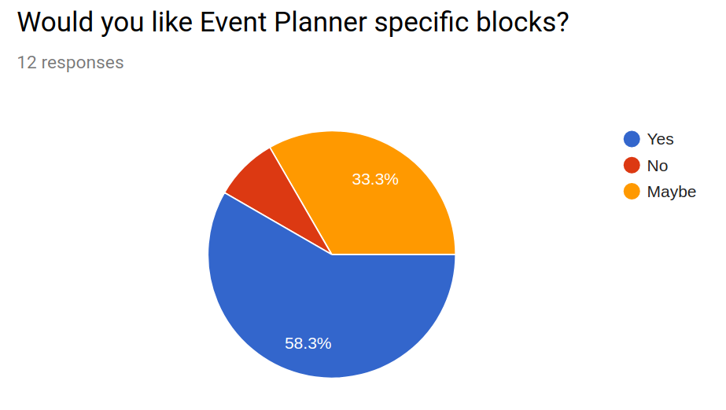
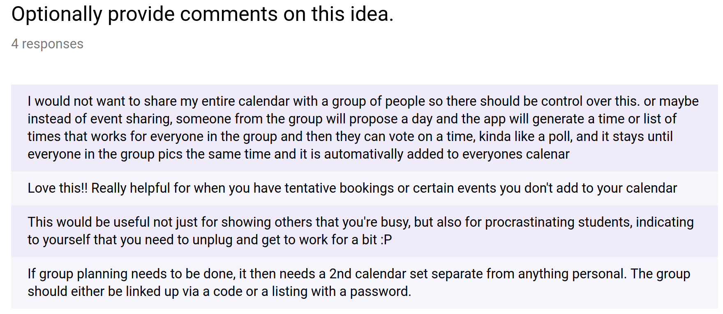
Research – Our conclusion
From our results, we can conclude that event planning functionality is currently in a state which is not conducive to widespread usage. Thus, our design must improve upon current event planning standards.
Notes:
The majority of people we surveyed indicated that they were interested in additional functionality in a Calendar for group planning.

Slide 9
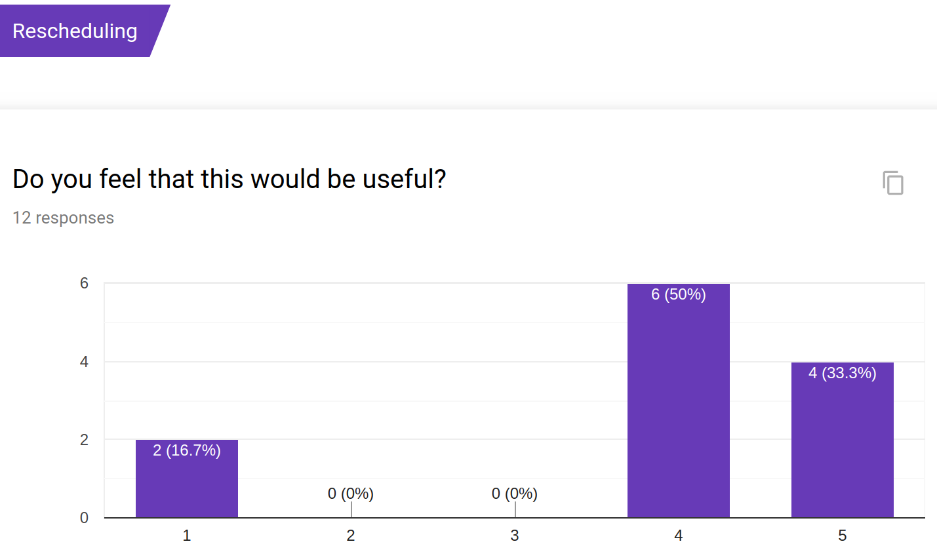
Research – Another conclusion
We can also conclude that event rescheduling functionality could be useful. However, based on the results of the survey it may not be used by everyone.

Slide 10
Our desired functionality
Maintain current calendar norms of having the ability to add, remove, edit, and view events on your own personal calendar.
Add event planning functionality, so users can create events for a group of people with greater ease.
Add event rescheduling functionality for users who might have scheduling issues.
Notes:
The scope of this ended being a bit too large.

Slide 11
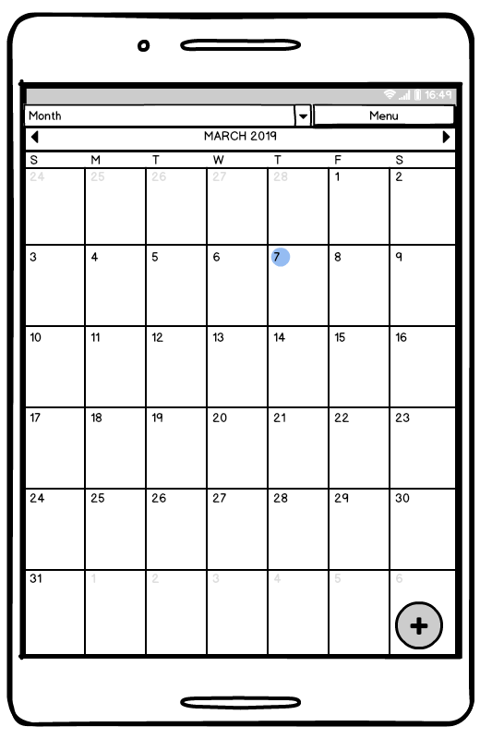
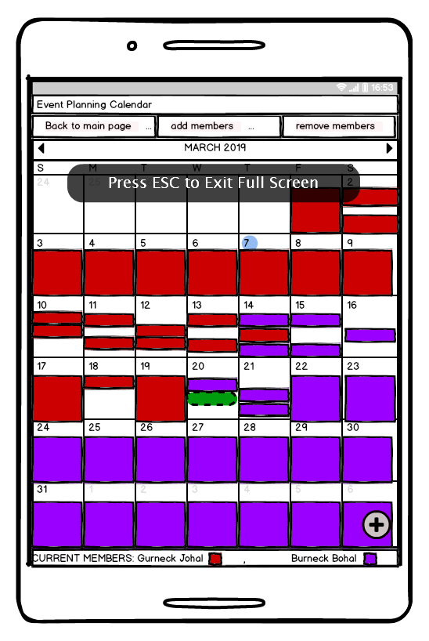
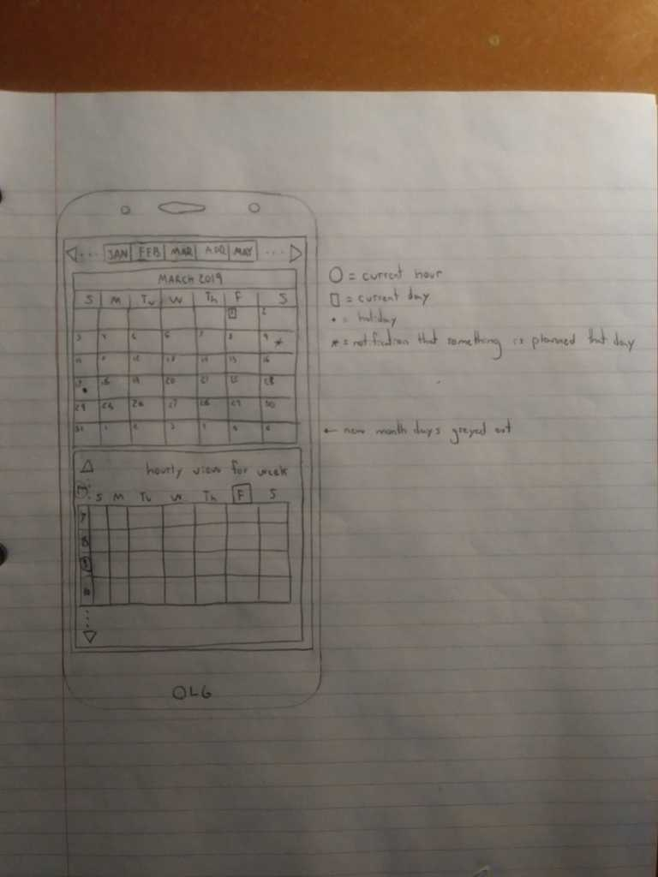
Brainstorming designs
Notes:
As you can see most of our ideas were centered around existing concepts of a Calendar application, but with a little extra stuff to facilitate group planning.

Slide 12
Changing our Focus
From the feedback that we received from the TA we realized that the calendar functionality was not an important part of our design so we decided to pivot and fully focus on the event planning aspect of our application.

Slide 13
A new direction
Given the fact that we changed our design focus, the design of our hi-fidelity prototype was drastically different from our low-fidelity prototype. Given these drastic differences, we inevitably faced some challenges with the design process.

Slide 14
Some new challenges
Since we now were fully focused on the event planning aspect of our design, we had to be more specific for our design intentions regarding that new idea.
A specific challenge was deciding how to go about presenting availability information without tunneling on the idea of a calendar alone.

Slide 15
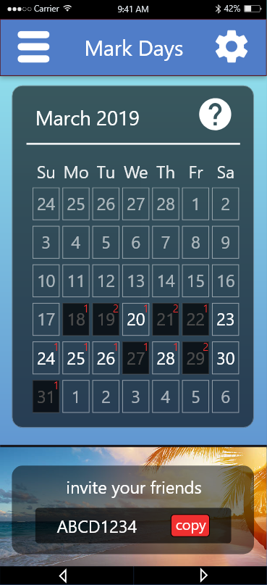
Our new solutions
We still offer a Calendar view to quickly allow users to mark off days.
Notes:
At this stage the point is just to narrow down potential dates that work for the most people.

Slide 16
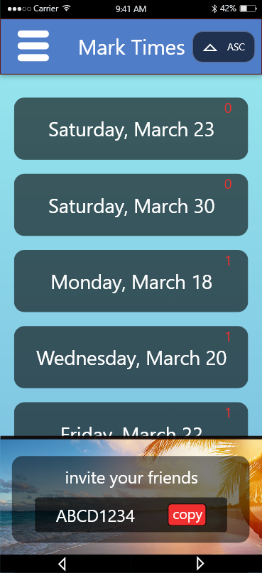
Our new solutions
The user can then move to a separate view that sorts possible dates based on how many people have that day marked.
Notes:
We allow people to enter times for dates where more people were marked busy as well, just in case there end up being big time conflicts.

Slide 17
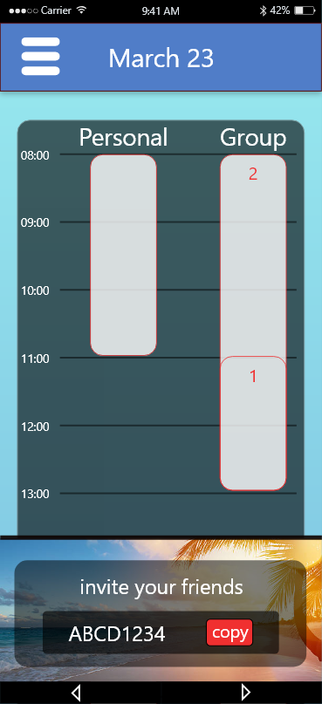
Our new solutions
Finally on days where most if not all people are available, the users will be able to indicate times.

Slide 18
Evaluation and Challenges
The evaluation revealed some key oversights for clarity of intent that we as designers did not notice
Ambiguity in whether marked dates and times are available or unavailable.
No clear ending to the process.
Notes:
On a phone interface where things were already looking rather small, trying to clarify these intentions was difficult. We decided to implement a simple help overlay.
Though this was not implemented for a prototype, for future direction, adding a setting that could allow a user to specify whether they're marking availability or unavailability and syncing that appropriately to the other participants views would be ideal. Different people will have different preferences for this.
For future direction, we would look to implement a feature where the event creator could decide on a date for the event. Once decided on, the event would effectively archive itself into an event history on the app in case it needed to be referred to and prompt to create an event for the user on their preferred Calendar service using the API. It would offer this prompt to other users part of the event as well the next time they opened the app.

Slide 19
Our final product
https://xd.adobe.com/view/474fe7e4-2568-4ff2-6df9-801926b1efbd-317e/

