Slide 1

Lecture 2: Introduction to Network Programming

Slide 2
Table of Contents
Recap lecture 1 (Slide 3)
Socket (Slide 9)
Winsock (Slide 12)
Encoding and Serialization (Slide 37)
Handling TCP stream (Slide 41)

Slide 3












Computer Network
Two or more computers connected for the purpose of sharing resources (send and receive data)
Network hosts (sender/receiver, client/server) equipped with Network Interface (Ethernet, WiFi, etc.)
Network elements (switch, router, access point, hub, etc.)
Communication Medium (cable, wireless)
Services/Protocols (rules governing the way that devices communicate with each other)
How the data is presented (appearance and format: image, video, audio, text, web, email, etc.). Encryption?
What type of communication is needed? Connection oriented? Guaranteed delivery (reliable) or unreliable?
What is the employed addressing scheme? What is the route that the data packets will take to reach the destination (routing)?
When and how will the devices access the medium? Next hop data delivery (switching)
TCP/IP suite
TCP/IP suite
Payload
Header
Electrical/optical signal
Header
Payload
110100110……0111111
110100110……0111111
Notes:
For the end communications points to communicate, there are services that must be carried out to setup, manage and control the connection and exchange of data.
The data flow from over computer networks is based on layered architecture where at each layer specific functionalities are provided.
The layered architecture enables the decomposition of network services into manageable components, and provides a modular design
OSI (7 layers) vs. TCP/IP (4 layers)
HTTP - 80
HyperText Transfer Protocol
HTTPS - 443
HyperText Transfer Protocol over SSL/TLS (HTTPS)
Telnet - 23
Telnet is an application protocol. It provides bidirectional interactive text orientated communication feature. Configuration elements of networking hardware can be achieved using telnet
FTP - 21
FTP stands for File Transfer Protocol. It is a application layer protocol that is used for transforming a file from one location to another
SNMP - 161
SNMP stands for Simple network management protocol which is used to collect and organize the data of managed devices on IP networks
SMTP - 25
SMTP stands for Simple mail transfer protocol is used to transfer the mails.
DNS - 53
DNS stands for Domain Name System is a decentralized naming system for the computers and other devices on the internet to translate the domain name of the devices connected on the internet or any other private network to the numerical IP addresses and vice versa.
DHCP - 67
DHCP stands for Dynamic Host Configuration Protocol. It is a network management protocol present in the application layer. With its help, an Internet Protocol IP address can be assigned to any device or node on a network dynamically so that they can communicate using this IP.

Slide 4
IP Address v4
32-bit (4 octets) identifier that identifies a host on a network.
Divided into network ID and host ID
Host ID bits can’t be 0s or 1s
IP classes: A, B, C, D, and E.
Reserved IP addresses: are reserved for loopback, LAN, multicast, and research & experiment
Loopback IP Addresses (127.0.0.1 – 127.255.255.255): managed entirely by and within the operating system. 127.0.0.1 is the host’s self address “Localhost”
Network
Host
0NNNNNNN.HHHHHHHH.HHHHHHHH.HHHHHHHH
Class A
Network
Host
10NNNNNN.NNNNNNNN.HHHHHHHH.HHHHHHHH
Class B
Network
Host
110NNNNN.NNNNNNNN.NNNNNNNN.HHHHHHHH
Class C
Network
Host
110NNNNN.NNNNNNNN.NNNNNNNN.NNHHHHHH
Classless
Notes:
10000000 → 128
11000000 → 192
11100000 → 224
11110000 → 240
11111000 → 248
11111100 → 252
11111110 → 254

Slide 5
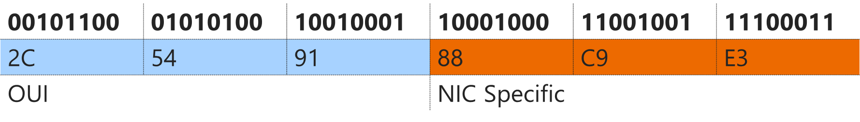
MAC Address
MAC Address
The address of the network card, also known as Physical Address
6-bytes (12 Hex character) identifier, divided into 3 bytes Vendor specific and 3 Bytes Network card specific
Physical Address
2C:54:91:88:C9:E3

Slide 6
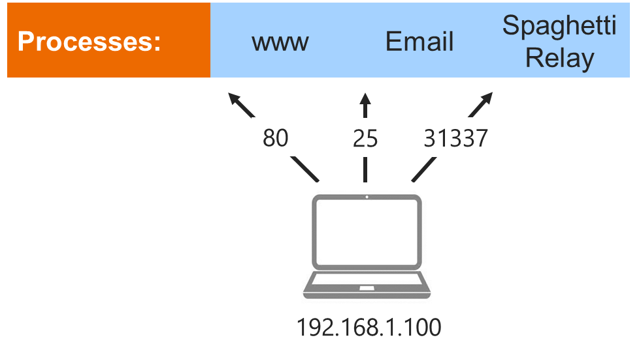
Port Number
Port
16-bits identifier that identify a process/application on a host machine
Can range from 0 to 65353
Ports 0 to 1023 are reserved ports for privileged services (http 80, ftp, 20, DNS 53, etc.)
Port Number for Process-to-Process communication

Slide 7
Byte Ordering
1011 0110 1111 0011
There are two number formats that processors use to store data in memory:
Big endian: the high-order bit to be in the lowest memory address, e.g., sun SPARC processors, IBM® mainframe processors
Little endian: the low-order bit to be in the lowest memory address, e.g., Intel x86 processors
Network byte order defines the bit-order of network addresses as they pass through the network
Network Byte Order is Big-Endian
Little-endian systems should apply the conversion to network byte order to work with TCP/IP
Big Endian
Lowest Memory Address
Little Endian
1011
0110
1111
0011
0011
1111
0110
1011
n
n
n+1
n+1
n+2
n+2
n+3
n+3
n+4
n+4
n+5
n+5
Highest Memory Address

Slide 8
Socket
Socket
App2
App1
Server
fstream
Client
#include<fstream>
main()
{
Cin;
Cout;
//read & write from cne.txt
Open file—>fstream
read();
write();
close()
}
HHD: cne.txt
Electrical/optical signal
#include<wincosk2.h>
OPEN SOCKET()
READ()
WRITE()
CLOSE()
TCP/IP suite
TCP/IP suite

Slide 9
Network Socket
What’s a socket?
A socket is an abstraction through which an application may send and receive data. In other words, it is a representation of a connection between two applications or program running on the same machine or on different machines on a network.
A Socket:
Represents a connection endpoint
Provides an interface to TCP/IP
Is a generic interface for many protocols
Why socket?
Program network application to send/receive data over a communication network
How to use a socket?
Setup the socket on the communicating points
Send/Receive data
Close the socket

Slide 10
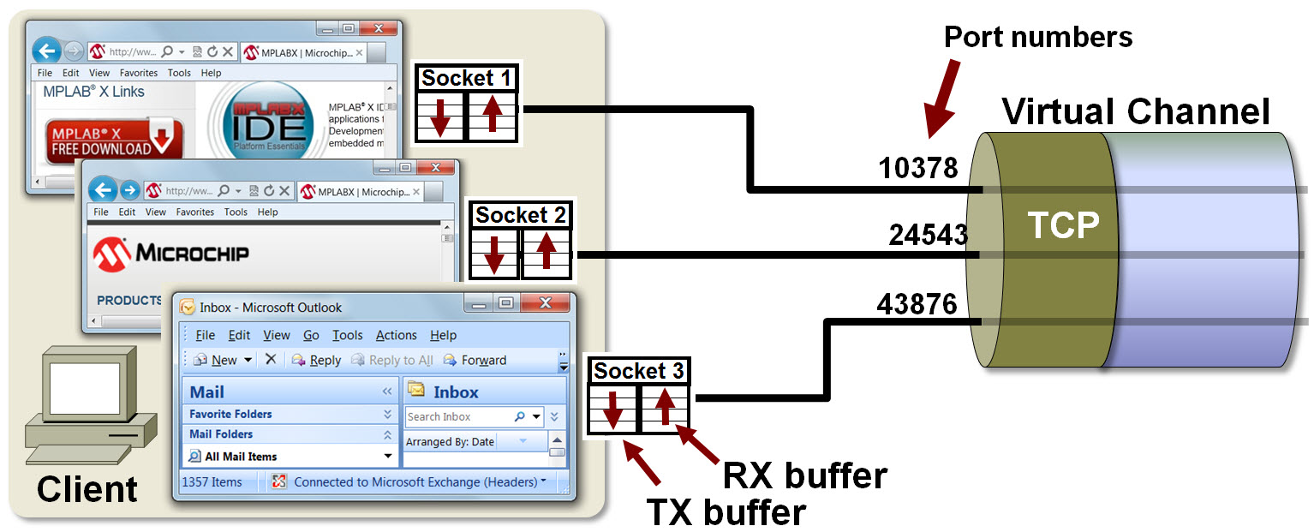
Socket
A software abstraction layer for communication between application layer and TCP/IP protocol family
Socket TX and RX buffers
Application TX: write to the send buffer
Application RX: read from the receive buffer
Source: https://microchipdeveloper.com/com4104:start

Slide 11


Network Socket
Logical connection between the applications
110100110……0111111
110100110……0111111
TCP/IP suite
TCP/IP suite

Slide 12
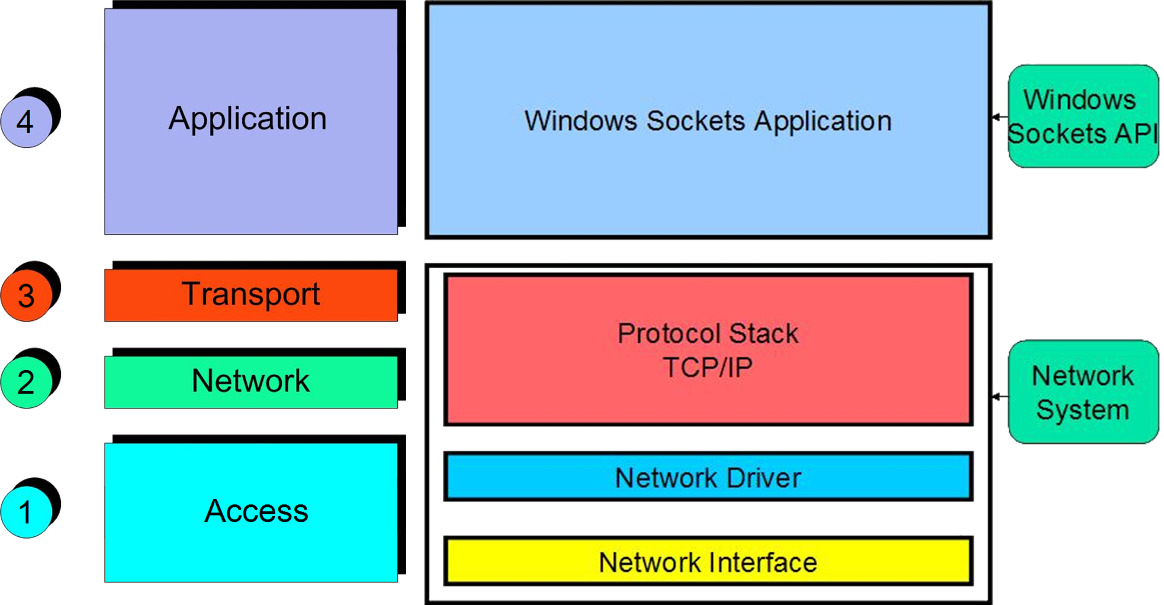
Networking in Windows “winsock
Access to networking capabilities in windows can be done through the Windows Sockets Application “Winsock”
Developers can access winsock data structures and functions to create network-capable applications
Winsock runs as a Windows dynamic link library (DLL), “WS2_32.dll”, file that other applications can call on to perform network related functions

Slide 13
Structures and Functions
Socket Structures
IP Address Structures
Byte Order Functions
Winsock Functions
Socket Functions

Slide 14
Network Socket
A socket using TCP/IP protocol family is uniquely identified by an IP address, a transport protocol (TCP/UDP), and a port number.
Socket reference
File (socket) descriptor in UNIX
Socket handle in WinSock
Protocol | Family | Type | Protocol
TCP | AF_INET | SOCK_STREAM | IPPROTO_TCP
UDP |  | SOCK_DGRAM | IPPROTO_UDP

Slide 15
Socket Calls
SOCKET: Obtains a socket to read from or write to.
BIND: Associates a socket with a port number.
LISTEN: Tells TCP/IP that this process is listening for connections on this socket.
SELECT: Waits for activity on a socket.
ACCEPT: Accepts a connection from a client.
SOCKET: Allocates a socket to read from or write to.
CONNECT: Allows a client to open a connection to a server’s port.
SEND, WRITE: Sends data to the process on the other host.
RECV, READ: Receives data from the other host.
CLOSE: Terminates a connection, deallocating the socket.
https://www.ibm.com/docs/en/zos

Slide 16
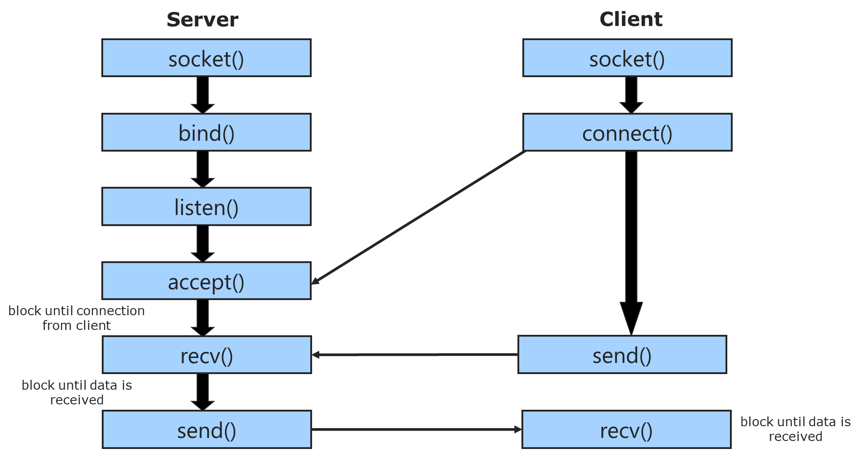
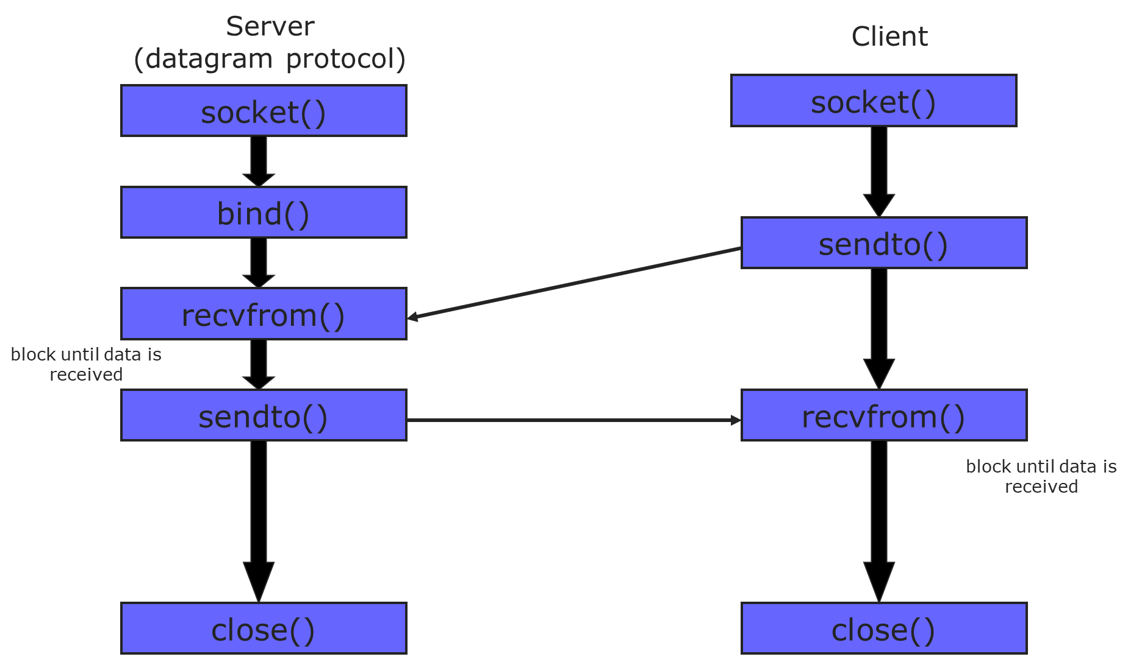
Data Flow
Connection Oriented
Connectionless

Slide 17

Socket Setup
Server
Create socket
1
Server
Socket
Bind socket
2
4
connect()
Listen
3
Create socket
accept()
TCP
1
S
5
Client
socket
4
Connect
6
send() / recv()
7
Server
Create socket
1
Bind socket
2
UDP
S
socket
1
Create socket
Client
3
sendto() /recvfrom()

Slide 18
Connection Set Up
Server Side Set Up
Client Side Set Up
Functions
Allocate Space
Create Endpoint | socket()
Bind Address | bind()
Specify Queue | listen()
Wait for Connections | accept()
Get new socket
Functions
Allocate Space
Create Endpoint | socket()
Bind Address (optional) | bind()
Connect to Server | Connect()

Slide 19
Address Structures
The sockaddr structure varies depending on the protocol selected
Generic
struct sockaddr
{
unsigned short sa_family; // Address family (AF_INET)
char sa_data[14]; // Protocol-specific information(in network byte // order)
};
IP Specific
struct sockaddr_in
{
unsigned short sin_family; // Internet protocol (AF_INET)
unsigned short sin_port; // Port (16-bit) (net order)
struct in_addr sin_addr; // Address (32-bit) (net order)
char sin_zero[8]; // Not used (padding)
};

Slide 20
IP Address Structures
The in_addr structure represents an IPv4 Internet address
struct in_addr {
union {
struct {
u_char s_b1; u_char s_b2;
u_char s_b3; u_char s_b4;
} S_un_b;
struct {
u_short s_w1; u_short s_w2;
} S_un_w;
u_long S_addr;
} S_un;
};
The in6_addr structure represents an IPv6 address
struct in6_addr {
union {
u_char Byte[16];
u_short Word[8];
} u;
} IN6_ADDR;
An IPv4 address formatted as four u_chars, two u_shorts or
a u_long
An IPv6 address formatted as
an array of sixteen u_chars, or
an array of eight u_shorts

Slide 21
Common IP Addresses – Constants
INADDR_ANY: denotes an arbitrary address. Applications commonly use this macro to initialize the sin_addr field in a sockaddr_in struct before calling bind().
INADDR_NONE: denotes an invalid IP address. Winsock returns this from the inet_addr() function to indicate failure.
INADDR_BROADCAST: denotes a 32-bit value for standard IP limited broadcast address “255.255.255.255”. (UDP ONLY)
INADDR_LOOPBACK: denotes the standard IP loopback address 127.0.0.1

Slide 22
Byte Order Functions
Host-To-Network
Network-to-Host
unsigned short
htons(unsigned short number);
Converts a 16-bit number from host order to network order.
unsigned int
htonl(unsigned int number);
Converts a 32-bit number from host order to network order.
unsigned short
ntohs(unsigned short number);
Converts a 16-bit number from network order to host order.
unsigned int
ntohl(unsigned int number);
Converts a 32-bit number from network order to host order.

Slide 23
Winsock Functions
#include <winsock2.h>
Must be included before <windows.h>
#pragma comment(lib, "Ws2_32.lib")
…
int WSAStartup(WORD wVersionRequested, LPWSADATA lpWSAData);
Initiates use of WS2_32.DLL by a process and must be called before any network functions!
…
int WSACleanup();
Terminates use of the WS2_32.DLL

Slide 24
Socket() Create a socket, giving access to the transport layer service
Socket protocol (IPPROTO_TCP, IPPROTO_UDP).
Specifying a protocol of 0 causes socket() to use an unspecified default protocol
Address family
e.g., AF_INET (IPv4 protocol), AF_INET6 (IPv6 protocol)
SOCKET sockfd = socket(int domain, int type, int protocol)
If no error occurs, socket returns a descriptor referencing the new socket. Otherwise, a value of INVALID_SOCKET is returned, and a specific error code can be retrieved by calling WSAGetLastError.
Int code = wsagetlasterror();
Type of socket SOCK_STREAM: TCP
SOCK_DGRAM: UDP
/*Example:*/
SOCKET sockfd = socket(AF_INET, SOCK_STREAM, IPPROTOTCP);
SOCKET sockfd = socket(AF_INET6, SOCK_DGRAM, 0);

Slide 25
Bind() Assign an address and a port number to the socket
Returns zero. Otherwise, a SOCKET_ERROR. Error code can be retrieved by calling WSAGetLastError()
A pointer to a structure containing the details of the address to bind to
int bind(SOCKET sockfd, const struct sockaddr *addr, socklen_t addrlen);
sockeaddr_in addr;
sin_port
sin_addr
Listening socket
Socket descriptor, (like a file-handle)
Size of the sockaddr_in
should be size of (*addr)

Slide 26
Listen() Change the socket state to begin listening for incoming requests
Socket
descriptor
int listen(SOCKET sockfd, int backlog);
max number of connections to queue. It is used to limit the number of outstanding connections in the socket's listen queue
Returns zero. Otherwise, a SOCKET_ERROR. Error code can be retrieved by calling WSAGetLastError()
/*Example:*/
listen(sockfd, 5)

Slide 27
Accept() Return a completed connection
Return a value of type SOCKET that is a descriptor for the new socket. Otherwise, a value of INVALID_SOCKET
length of the client address.
should be size of (*addr)
SOCKET accept(SOCKET sockfd, struct sockaddr *addr, socklen_t *addrlen);
Socket descriptor
IP address and port of the connecting client

Slide 28
Connect() Client requests a connection to a server
Returns zero. Otherwise, a SOCKET_ERROR. Error code can be retrieved by calling WSAGetLastError()
length of the server’s address, should be size of (*addr)
int connect(SOCKET sockfd, const struct sockaddr *addr, socklen_t addrlen);
Socket
descriptor
Server IP address and port.

Slide 29
Send()
NOTE: send() is called after a connection has been established.
int send(SOCKET sockfd, char* buffer, int length, int flags);
Send up to length bytes from array buffer to socket sockfd.
Return Value:
Returns the total number of bytes sent
Otherwise, a value of SOCKET_ERROR is returned, and a specific error code can be
retrieved by calling WSAGetLastError.
The successful completion of a send does not indicate that the data was successfully delivered. The return value of the send function indicates that the data was copied to the OS’ buffer.
If no buffer space is available within the transport system to hold the data to be transmitted, send will block unless the socket has been placed in nonblocking mode.
On blocking stream-oriented sockets, the number of bytes written can be between 1 and the requested length, depending on buffer availability on both client and server computers.
Notes:
Send information
Length bytes from the array buffer which is the application buffer to socket s
TCP buffer is not your application buffer and is managed by the kernel
Letter inside the mailbox outside your house (kernel buffer)
Graceful disconnect: the other side has sent a disconnect request
The default mode for the created socket is always blocking
The flags argument is the bitwise OR of zero or more of the following flags.

Slide 30
Receive()
The buffer that will be used to store the data that is received.
The length of the buffer in bytes
flags that can be used to control the behavior of the send() function
int recv(SOCKET sockfd, char* buffer, int length, int flags);
Return Value
Returns the number of bytes received and the buffer pointed to by the buffer parameter will contain this data received. If the connection has been gracefully closed, the return value is zero.
Otherwise, a value of SOCKET_ERROR is returned, and a specific error code can be retrieved by calling WSAGetLastError.
If no bytes are available in the buffer space within the transport system, recv will block unless the socket has been placed in nonblocking mode.
On blocking stream-oriented sockets, the number of bytes read can be between 1 and the requested length, depending on how many bytes are available.
Notes:
Block until the buffer has space

Slide 31
Sendto()
Points to a buffer containing the message to be sent.
Specifies the size of the message in bytes.
int sendto(int socket, const void *message, size_t length, int flags, const struct sockaddr *dest_addr,socklen_t dest_len);
Return Value
sendto() shall return the number of bytes sent, -1 otherwise.
flags that can be used to control the behavior of the send() function
Points to a sockaddr structure containing the destination address
Notes:
Block until the buffer has space

Slide 32
recvfrom()
Points to the buffer where the message should be stored.
Specifies the length in bytes of the buffer pointed to by the buffer argument.
int recvfrom(int socket, void *restrict buffer, size_t length, int flags, struct sockaddr *restrict address, socklen_t *restrict address_len);
Return Value
recvfrom() shall return the number of bytes received, 0 if the peer has performed an orderly shutdown, and -1 shall be returned otherwise.
flags that can be used to control the behavior of the recvfrom() function
A null pointer, or points to a sockaddr structure in which the sending address is to be stored
Notes:
Block until the buffer has space

Slide 33
Client and Server Operations
Send and Receive Data
Transfer Data (stream) | Unix Only read()/write()
 | Unix/Windows recv()/send()
Transfer Data (datagram) | recvfrom()
 | sendto()
Closing the Connections
Windows | shutdown(SD_Both)
Unix Windows | close()
 | closesocket()

Slide 34
IP / String Conversion
unsigned long inet_addr(const char *cp );
Convert a dots and number string IPv4 address to a struct in_addr.
Example: inet_addr("10.0.0.1”);
newer version: int inet_aton(const char *cp, struct in_addr *inp);
Example: inet_aton("10.0.0.1", &antelope.sin_addr);
char * inet_ntoa(struct in_addr in );
Convert a network address in a struct in_addr to a dots-and-numbers format string
Example: char* addr = inet_ntoa(in.sin_addr);

Slide 35
USE THE MSDN
SOCKET FUNCTION REFERENCE
LINK: http://msdn.microsoft.com/en-us/library/windows/desktop/ms741394(v=vs.85).aspx
Example Code:
https://docs.microsoft.com/en-us/windows/win32/api/winsock/nf-winsock-recv

Slide 36
Framing, Encoding and Serialization

Slide 37
Framing
TCP has no concept of message boundaries.
Framing enables the receiver to locate the beginning and end of a message.
Types of Framing:
Fixed length messages
Can be wasteful
Variable length messages
Delimiters: ‘\r\n’, etc. Should not occur within the message itself.
Explicit Length
Each message is preceded by a length field
Preferred method for most game applications

Slide 38
Framing
TCP Data Stream
Length
Type
Data
Length
Type
Data
…
16bit
8bit
(varies)
16bit
8bit
(varies)
UDP Messages
Other
Headers
Other
Headers
Type
Data
Type
Data
8bit
(varies)
(varies)
8bit
(varies)
(varies)

Slide 39
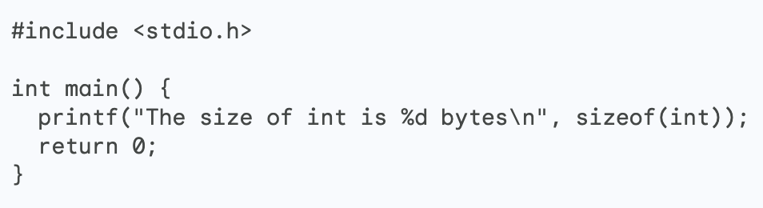


Encoding Objects
There is no C / C++ standard for the size of datatypes or how they are stored in memory, except:
a char is always one byte
The int type is always platform native. The size of an int variable is always the same as the size of a native integer on the platform that the code is running on. The compiler will automatically choose the largest size that is available on the platform. This is important because it ensures that code will work correctly on any platform that it is compiled for.
On a 32-bit platform
On a 64-bit platform
Notes:
"Encoding" is a very general term, referring to any format in which data can be represented, or the process of converting data into a particular representation.
What do we need to pay attention to is the size of data types
• C’s ‘int’, ‘long’, … not well defined • Use ‘standard’ int types instead: • #include • int32_t, int8_t, uint64_t, uint8_t, …
In C++, there are no standards for datatype sizes or how they’re stored in memory except chars are always one byte and it’s are always platform native
char and byte are pretty much the same
Encoding / decoding
Converting a message to/from an application data structure

Slide 40
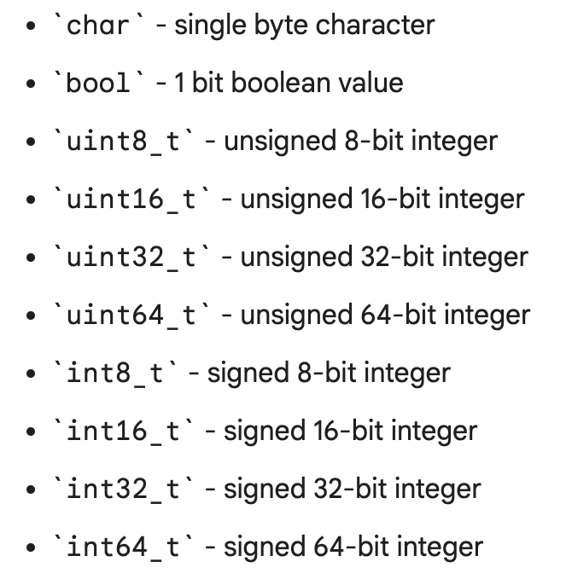
Serialization
Serialization allows code to take an instance of an object and convert it into a format (byte sequence) that is easily transmittable (and readable) over the network.
We must know the byte width of each type first. We can do this using network safe types.
We must also eliminate padding in the object.
Don’t forget byte order!
send(skSocket, (const char*)&(htonl(msgData.x)), sizeof(uint32_t)), 0);
send(skSocket, (const char*)&(htonl(msgData.y)), sizeof(uint32_t)), 0);
send(skSocket,(const char*)&(htons(msgData.ammo)),sizeof(uint16_t)), 0);

Slide 41
Lab 1. Handling Receives - Streams
Receive the packet header (we should know its size.)
Loop until we have received all of the bytes in the packet header.
Receive the message’s data element.
Loop to receive the remaining bytes in the message:
bytesRecvd = 0;
while (bytesRecvd < msgSize)
{
result = recv(s, buffer + bytesRecvd, msgSize – bytesRecvd, 0);
(does result yield an error? If so, deal with it.)
bytesRecvd += result;
}
At this point we have at least one complete message, so parse the message.

