Slide 1
Computer Networks
Cod372-l
Lecture 3: Network IO Models
Full Sail University

Slide 2
Table of Contents
I/O models overview
Blocking
Multiplexing
Non-blocking
Notes:
This lecture is about network input out IO models

Slide 3
I/O methods
Blocking
Non-blocking
Multiplexing
This list is a toolbox to choose from.
Can use a mixture of methods? Based on the application need

Slide 4
I/O methods
What happens when cin is executed?
The program waits for the User Input before the function returns.

Slide 5
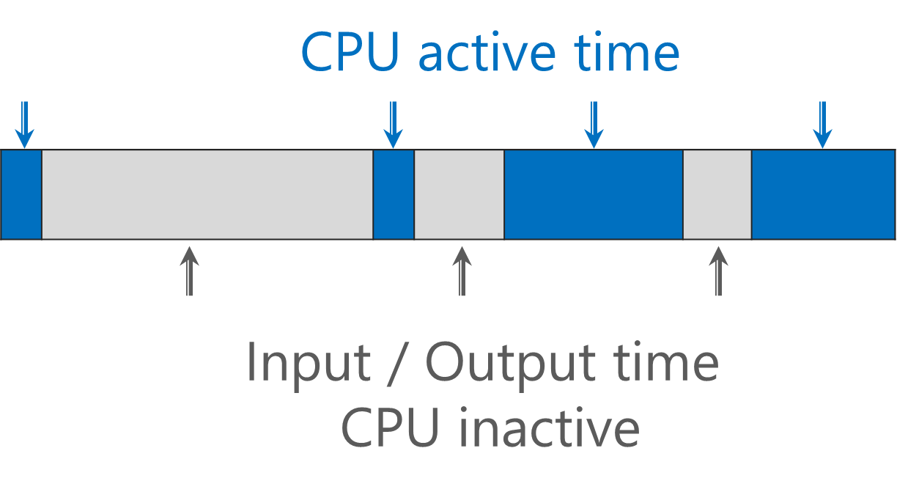
CPU and IO
The execution of programs and processes alternates between CPU execution state and IO waiting state
CPU operations: mathematical computation, 3D rendering, image and video processing, etc.
IO operations: reading from a file, database, or a network etc.
While the program is under IO operations, the CPU is in idle mode waiting for the IO operation to be complete
Program/Process
Starts with CPU execution
IO operations
CPU execution
.
.
.
.
IO operations
Terminates with CPU execution

Slide 6
Input Operation in General
The input operation in general has two distinct phases:
Waiting for the data to be ready
Copying the data from the kernel to the process
System call: switching from running in the application to running in the kernel, followed by some time later by a return to the application.
Output operation would be similar.
The input operation relating to networking
Waiting for data to arrive on the network
Copying data from the kernel buffer to the application buffer

Slide 7
Blocking Calls
Blocking functions wait until the requested operation completes or when an error occurs.
Blocking mode is the default; unless specified, sockets are blocking.
This can cause us problems when serving multiple clients.
Function Name | Blocks Until…
accept() | The application receives a connection request.
connect() | The connect completes (stream sockets).
recv() | The network system receives data for this socket.
send() | Buffers are available in the network system for outgoing data (stream sockets).

Slide 8
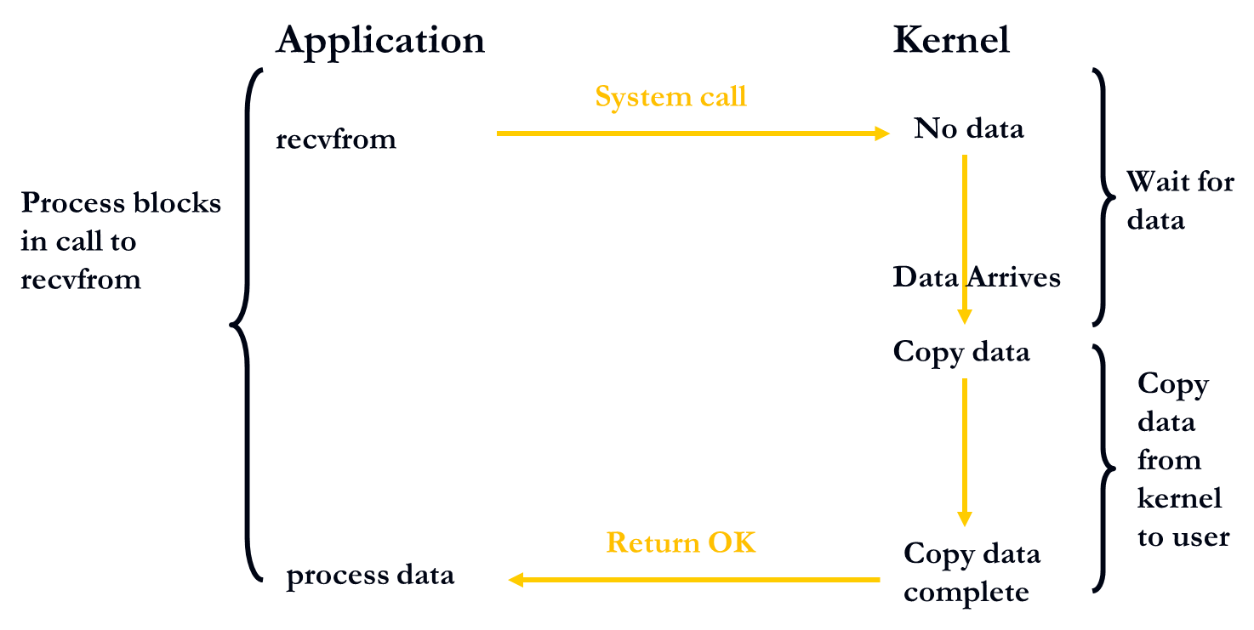
Blocking I/O Model
The process is blocked for the entire time from when recvfrom is called until it returns.

Slide 9
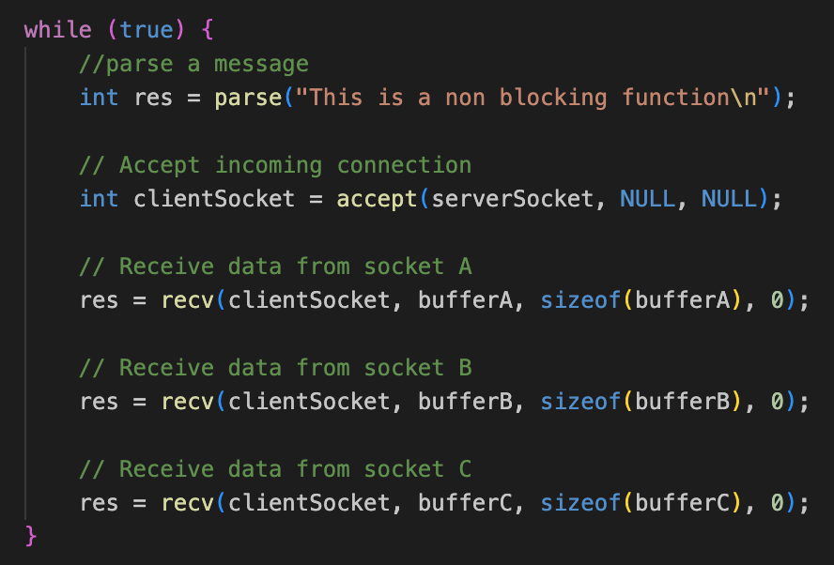
Blocking I/O Model
One listening socket
3 connected client sockets
Default socket mode “Blocking”
Parse
//—————-——Server stuck at ClientA, and ClientB and ClientC can’t be processed —————————//
Accept
Connected
connect()
accept()

Slide 10
Blocking I/O
Applications using blocking sockets are typically simpler to write.
Only handle one pending task.
Must wait for network operation to finish.
Function calls wait on results
Program can appear to ‘hang’ until timeout
What if the application needs to do other work and perform multiple tasks at a time?
Multithreading
Multiplexing (in-thread multiplexing)

Slide 11
Some Example Times to Use Multiplexing
When client is handling multiple descriptors (i.e. interactive input and network socket)
A TCP server handling listening socket and connected sockets.
A server handling TCP and UDP
A server handling multiple serves and multiple protocols

Slide 12
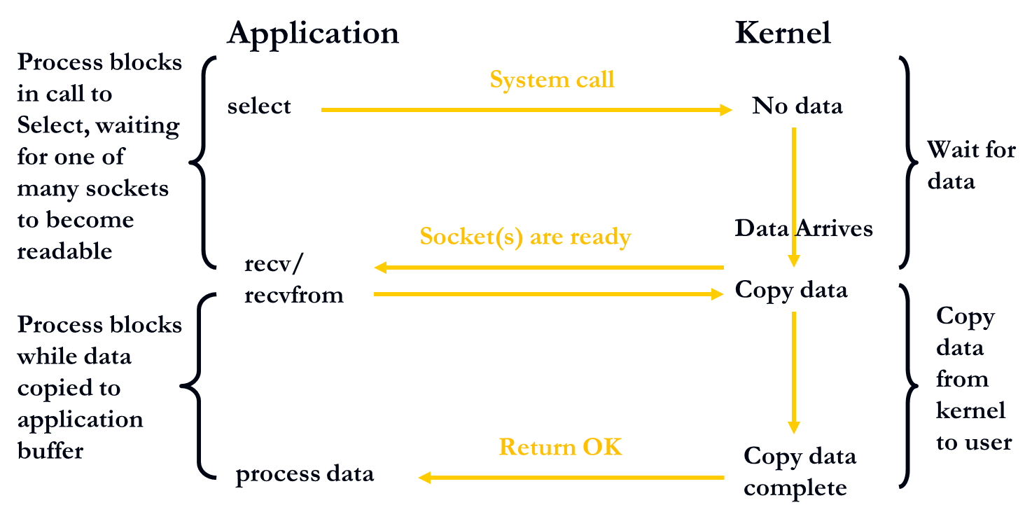
Multiplexing I/O Model
Application
Kernel
Instead of calling recvfrom directly, the application calls select, which is a system call directly to the kernel.
When the data arrives, select function returns and alerts the system that data ready
recvfrom copies the data from the kernel to the user application and returns successfully

Slide 13
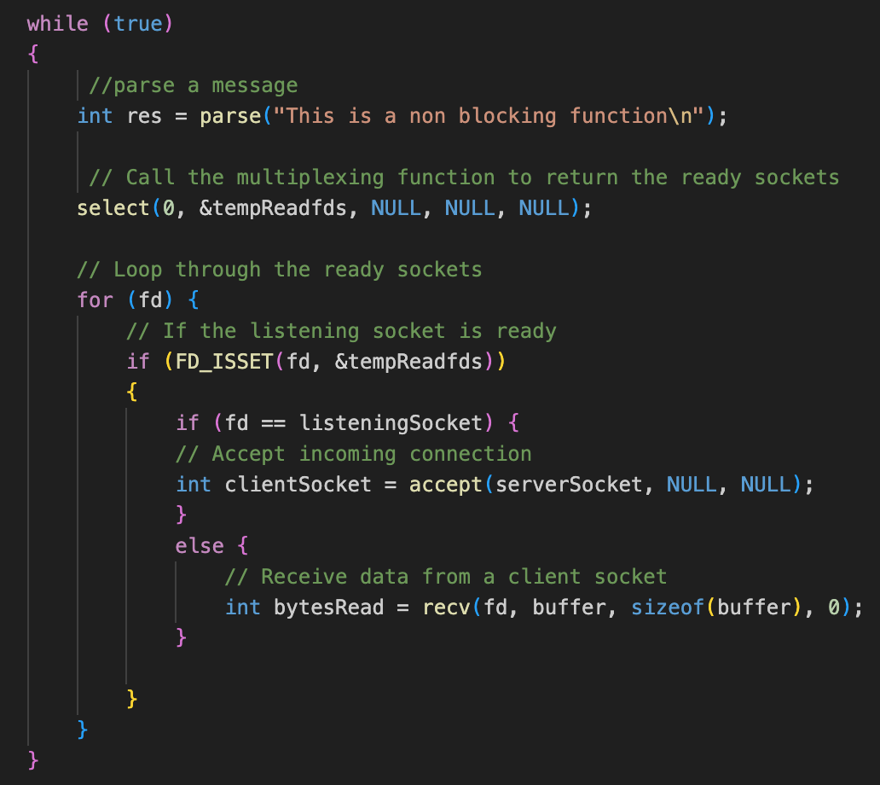
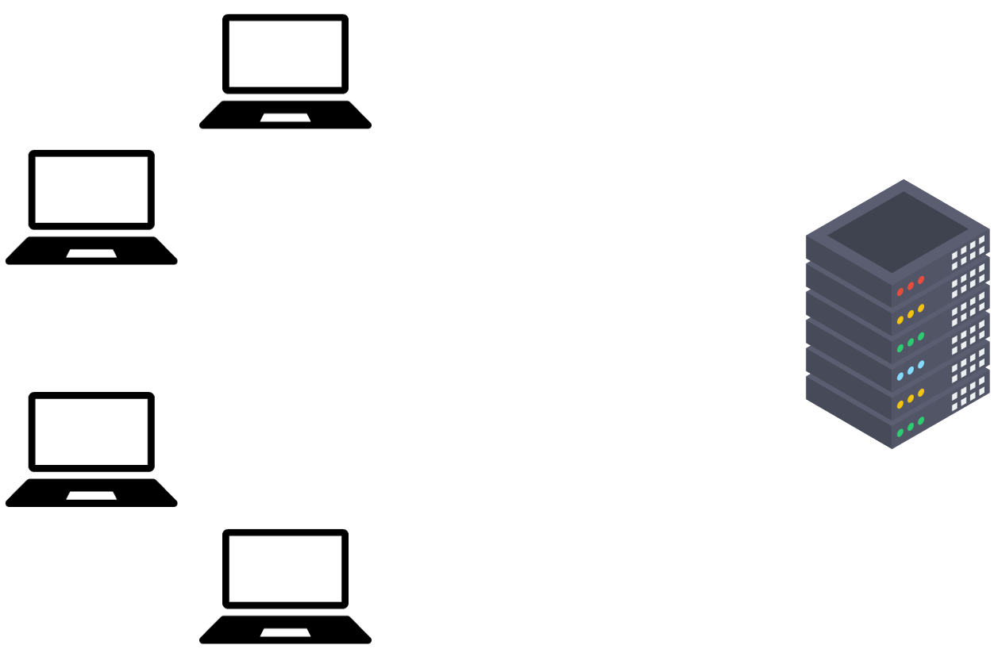

Blocking I/O Model
Parse
Socket C
Socket B
Select
Listening
Socket
connect()
Connected
accept()

Slide 14
Selectively Processing Sockets
Select function on a group of sockets
See which ones are “ready” and ignore the ones that are not.
The data type struct fd_set represents the set of file descriptors or sockets for the select function.
Loop and test whole set to see which ones are ready, and selectively process those ready sockets
Examples of conditions you can check readiness for:
Any of the descriptors in set are ready for reading
Any of the descriptors in set are ready for writing
Any of the descriptors in set have an exception condition
Timeout
A file descriptor or a socket is considered ready for reading if a read call will not block
typedef struct fd_set {
u_int fd_count;
SOCKET fd_array[FD_SETSIZE];
} fd_set;

Slide 15
Select Function
Max number of ready descriptor. In winsock, Ignored. The nfds parameter is included only for compatibility with Berkeley sockets.
Descriptor set that the kernel will test for exceptions conditions
Descriptor set that the kernel will test for reading
Descriptor set that the kernel will test for writing
int select(int nfds, fd_set* readfds, fd_set* writefds, fd_set* exceptfds, timeval* timeout);
How long to wait for select to return
Return value: The total number of ready descriptors, Zero if the timeout period expires, -1 If an error occurs
Macros:
FD_ZERO(*set) - Initializes set to the empty set. A set should always be cleared before using
FD_CLR(s, *set) - Removes socket s from set
FD_ISSET(s, *set) - Checks to see if s is a member of set and returns TRUE if so
FD_SET(s, *set) - Adds socket s to set
NOTE: select MODIFIES the sets that are passed in to reflect ready sockets, depending on the option(s) specified!

Slide 16
Timeval Structure
struct timeval
{
int tv_sec; // seconds
int tv_usec; // microseconds
};
Defines a specific length of time is seconds & microseconds; is used by select() to determine blocking time.
In select(), there are three interpretations of the timeout:
NULL – Wait / Block forever (or until a socket is ready)
Fixed Time – Wait / Block for a specified time (or until a socket is ready)
Zero (0sec) – Don’t wait / block; return immediately with the ready sockets.
NOTE: Regardless of the timeout value, select() will return as soon as any socket listed is ready!

Slide 17
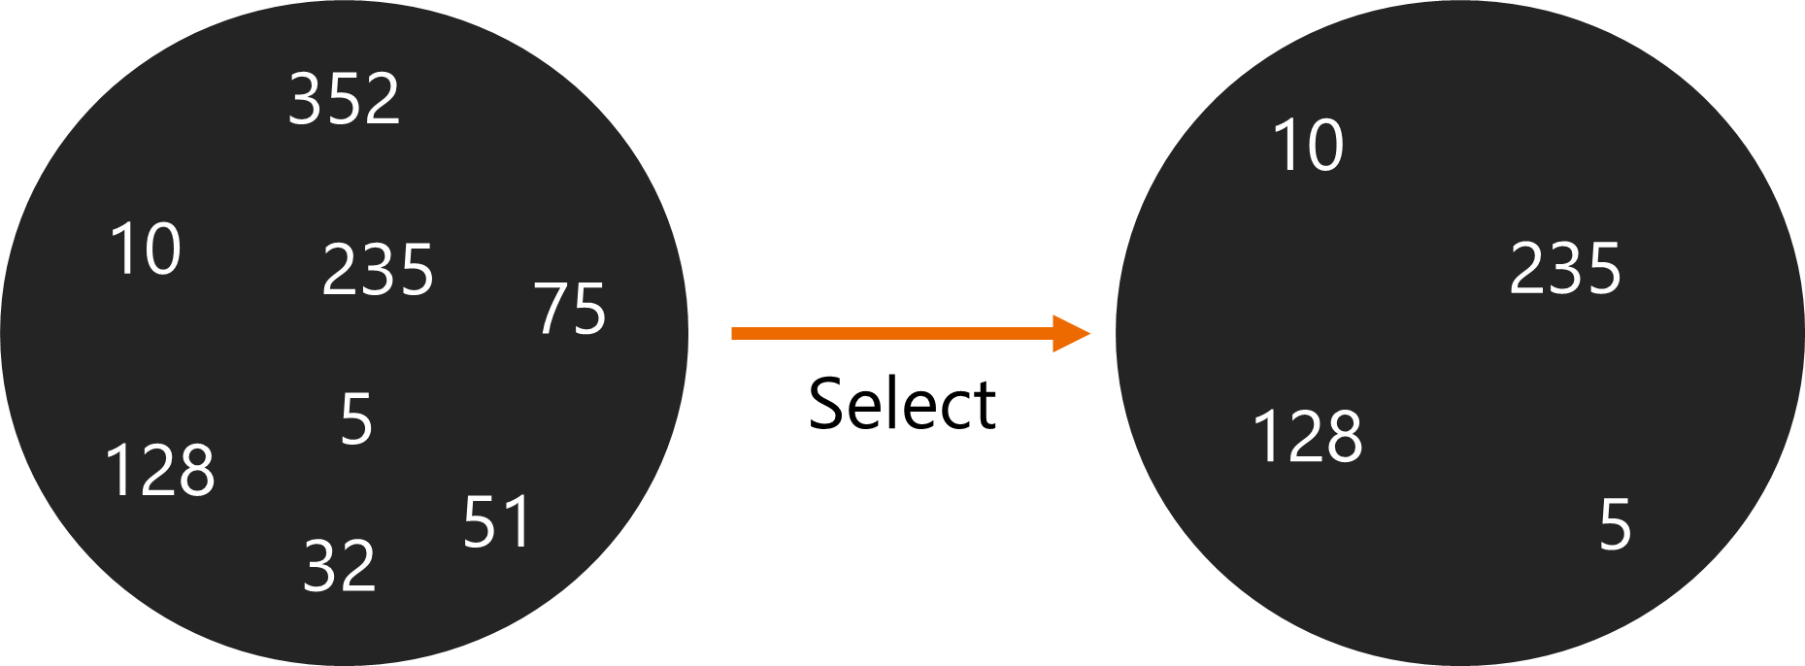
Select Function
Application
Kernel
A multiplexing function is employed; select()
select function returns and alerts the system that data ready
File Descriptors
Ready File Descriptors

Slide 18
Select - Readable Sockets
Readability means that queued data is available for reading such that a call to recv or accept is guaranteed not to block.
For connection-oriented sockets, readability can also indicate that a request to disconnect has been received from the peer.
If the connection was closed, then a socket is considered ready for both reading and writing (and should also appear in the exception socket list.)

Slide 19
Using Select ()
Server:
Create socket (TCP or UDP)
listenSocket = socket(AF_INET, SOCK_STREAM, 0);
Bind the socket to the server address
bind(listenSocket,,));
Listen on the socket for incoming connections
listen(listenSocket, 15);
Initialize a descriptor set fd_set
fd_set masterSet, readySet;
FD_ZERO(&masterSet);
FD_SET(listenSocket, &masterSet);
FD_ZERO(&readySet);
readySet = masterSet
Call select and get the ready descriptor
int readyFD = select(0, &readySet, NULL, NULL, NULL);
Handle new connection
if (FD_ISSET(listenSocket, &readySet))

Slide 20
Using Select ()
Client:
Create a socket.
Connect to a server (TCP) or send a message to the server (UDP)
If TCP, write a message to a server once the connection is accepted
Receive the response from the server
Close socket

Slide 22

Multiplexing Connection-Oriented Server
serverInit
{
initialize the server(create socket, bind socket, listen)
Create the fd_set masterSet, readySet;
Add listneSocket in masterSet;
}
serverRun
{
while (serverActive)
{
readySet = masterSet;
use select to find ready sockets;
…..
if listen socket is ready:
{
accept a new connection;
add new connection to masterSet;
}
for each ready client socket:
{
If socket is listening socket → continue;
read from client socket;
}
}
close the socket;
}
Multiplexing Server Algorithm

Slide 23
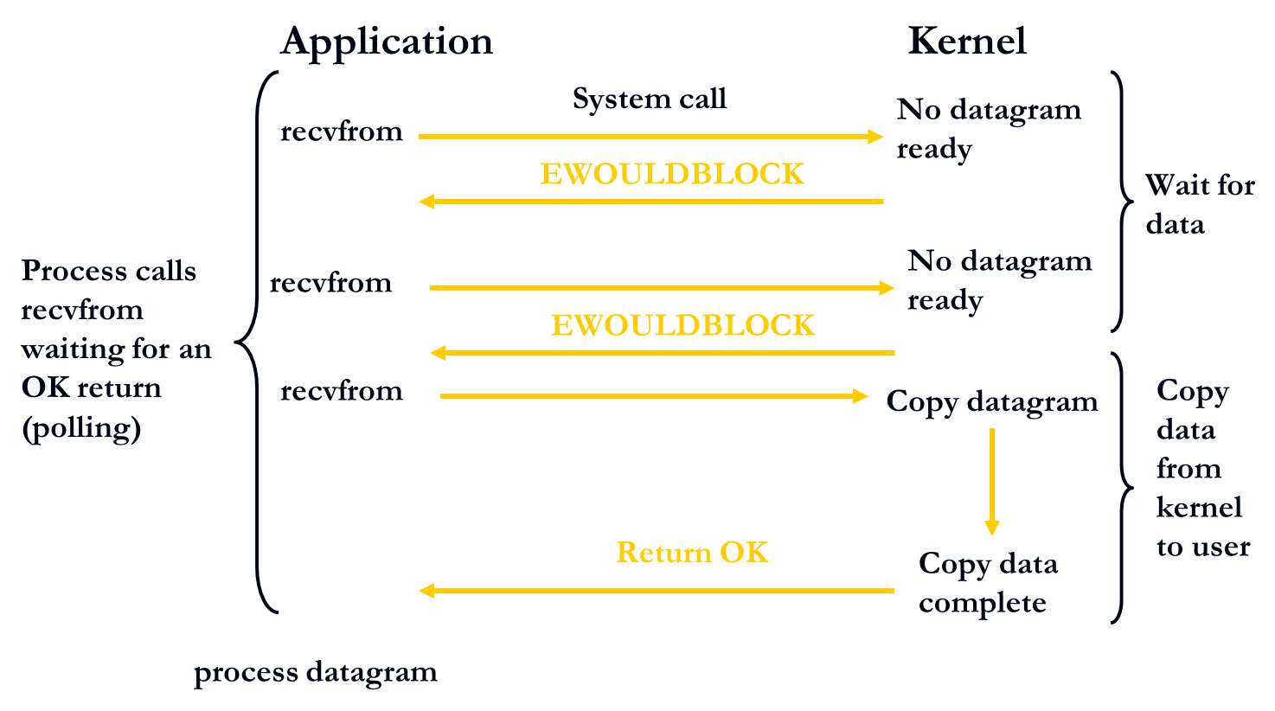
Non-blocking I/O
Notes:
The Application calls recvfrom and if the socket is non-blocking
If there is no data → it is not going to wait, it is gonna return immediately
Then the application calls recevfrom → again no date received → it is not going to wait, it is gonna return
the same behavior goes on until the data is ready, the kernel copies the date and return successfully
One thing to notice is that in the two time that the function returned with an error; this is not an error. It is an expected behavior of a non-blokcing socket.
We’ve talking about how blocking works, now we’re going to get into Non-Blocking
Non-blocking IO means an IO request is queued straight away and the function returns. The actual IO is then processed at some later point by the kernel.
For non-blocking IO you can send off multiple requests but you need to bear in mind that the data will not be available until some "later" point. This checking that the data has actually arrived is probably the most complicated part.
In 99% of applications you will not need to care that your IO blocks. Sometimes however you need the extra performance of allowing yourself to initiate an IO request and then do something else before coming back and, hopefully, finding that the IO request has completed.
https://stackoverflow.com/questions/1241429/blocking-io-vs-non-blocking-io-looking-for-good-articles
Same as before, one machine, application on the left, kernel on the right
On a non-blocking socket, if the application calls receivefrom and there is no data ready, it will not wait until there is data ready. The function would return an “error code” immediately. This error code is not actually an error, but is the result of expected behavior of a non-blocking socket.
On the third recvfrom call, there is data ready on the kernel, so it would copy the data and return successfully

Slide 24
Advantages
Can be very fast and light weight.
Function calls return immediately no matter what the conditions are!
If there is data to be read, or connections to be accepted, or room in send buffer to write, returns normal
If there is no data to be read, etc., returns error
Application is “notified” of I/O completion
Can avoid deadlocks that might be caused by network or connecting host
Disadvantages
Continuous polling can be wasteful.
Might miss time sensitive data during current round of polling, then have to wait for non network operation to finish before making request again.
Non-Blocking Socket I/O –

Slide 25
Socket Options
Function to set non-blocking
Ioctlsocket()
Functions to get and set socket options
getsocketopt(), setsocketopt()
Options affect different layers
Socket layer
Ability to send broadcast datagrams
IP layer
Specify next-hop address
Transport layer
Size of MSS for TCP

Slide 26
Set a Socket as Non-Blocking
int ioctlsocket(SOCKET s, long cmd, u_long* argp);
The ioctlsocket function sends commands to sockets
Arguments
s – SOCKET whose I/O mode is to be changed.
cmd – I/O mode to change. Non-blocking I/O is FIONBIO (see API for details.)
argp – A pointer to a long holding a value for the mode.
Set to zero (0) for OFF or nonzero for ON.
NOTE: This may be used with TCP or UDP.
Example – Turn on Non-Blocking Mode
{
…
unsigned long value = 1;
if (ioctlsocket (clSocket, FIONBIO, &value) == SOCKET_ERROR)
deal with the error;
…
}

Slide 27
Get or Set a Socket Options
int getsockopt(SOCKET s, int level, int optname, char* optval, int*optlen);
int setsockopt(SOCKET s, int level, int optname, char* optval, int*optlen);
Arguments
s – SOCKET whose options the function will get / set.
level – The layer in which the option resides* (uses OSI layering.)
optname – The name of the socket option to be changed / acquired.
optval – The new value of the option / the place to write the current value of the option.
optlen – The length of the optval parameter.
Types of options:
Boolean options that enable or disable a feature.
Options that get or set specific values.
NOTE: For flag options, the optlen should be zero if it is disabled or nonzero if enabled.
WARNING: NOT ALL OPTIONS ARE SUPPORTED IN WINDOWS!

Slide 28
Commonly Used Socket Options
level = SOL_SOCKET
Socket-Level Options
Level = SOL_SOCKET
Value | Type | Meaning
SO_BROADCAST | BOOL | Permits sending of broadcast messages, if this is supported by the protocol.
SO_LINGER | linger { } | Lingers on close if unsent data is present. (Stream sockets (TCP).
SO_REUSEADDR | BOOL | Specifies that the rules used in validating addresses supplied to bind() should allow reuse of local addresses, if this is supported by the protocol.
SO_MAX_MSG_SIZE | int | Maximum size of a message for message-oriented socket types (for example, SOCK_DGRAM). Has no meaning for stream-oriented sockets (TCP).
Notes:
SO_LINGER Sets or gets the SO_LINGER option. The argument is a linger structure. struct linger { int l_onoff; /* linger active */ int l_linger; /* how many seconds to linger for */ };

