Slide 1

Basic Details of the Team and Problem Statement
Ministry/Organization Name/Student Innovation:
Ministry of Law and Justice
PS Code: SIH1286 Problem Statement Title: Incentives based Design for onboarding Legal Service Providers such as Advocates, Arbitrators, Mediators, Notaries, Document Writers, etc. on eMarketPlace for extending Legal Services to Citizens in India Team Name: ENIGMA-X Team Leader Name: SEPHIN SEBASTIAN E Institute Code (AISHE): C-9462
Institute Name: School of Engineering, CUSAT
Theme Name: Miscellaneous

Slide 2
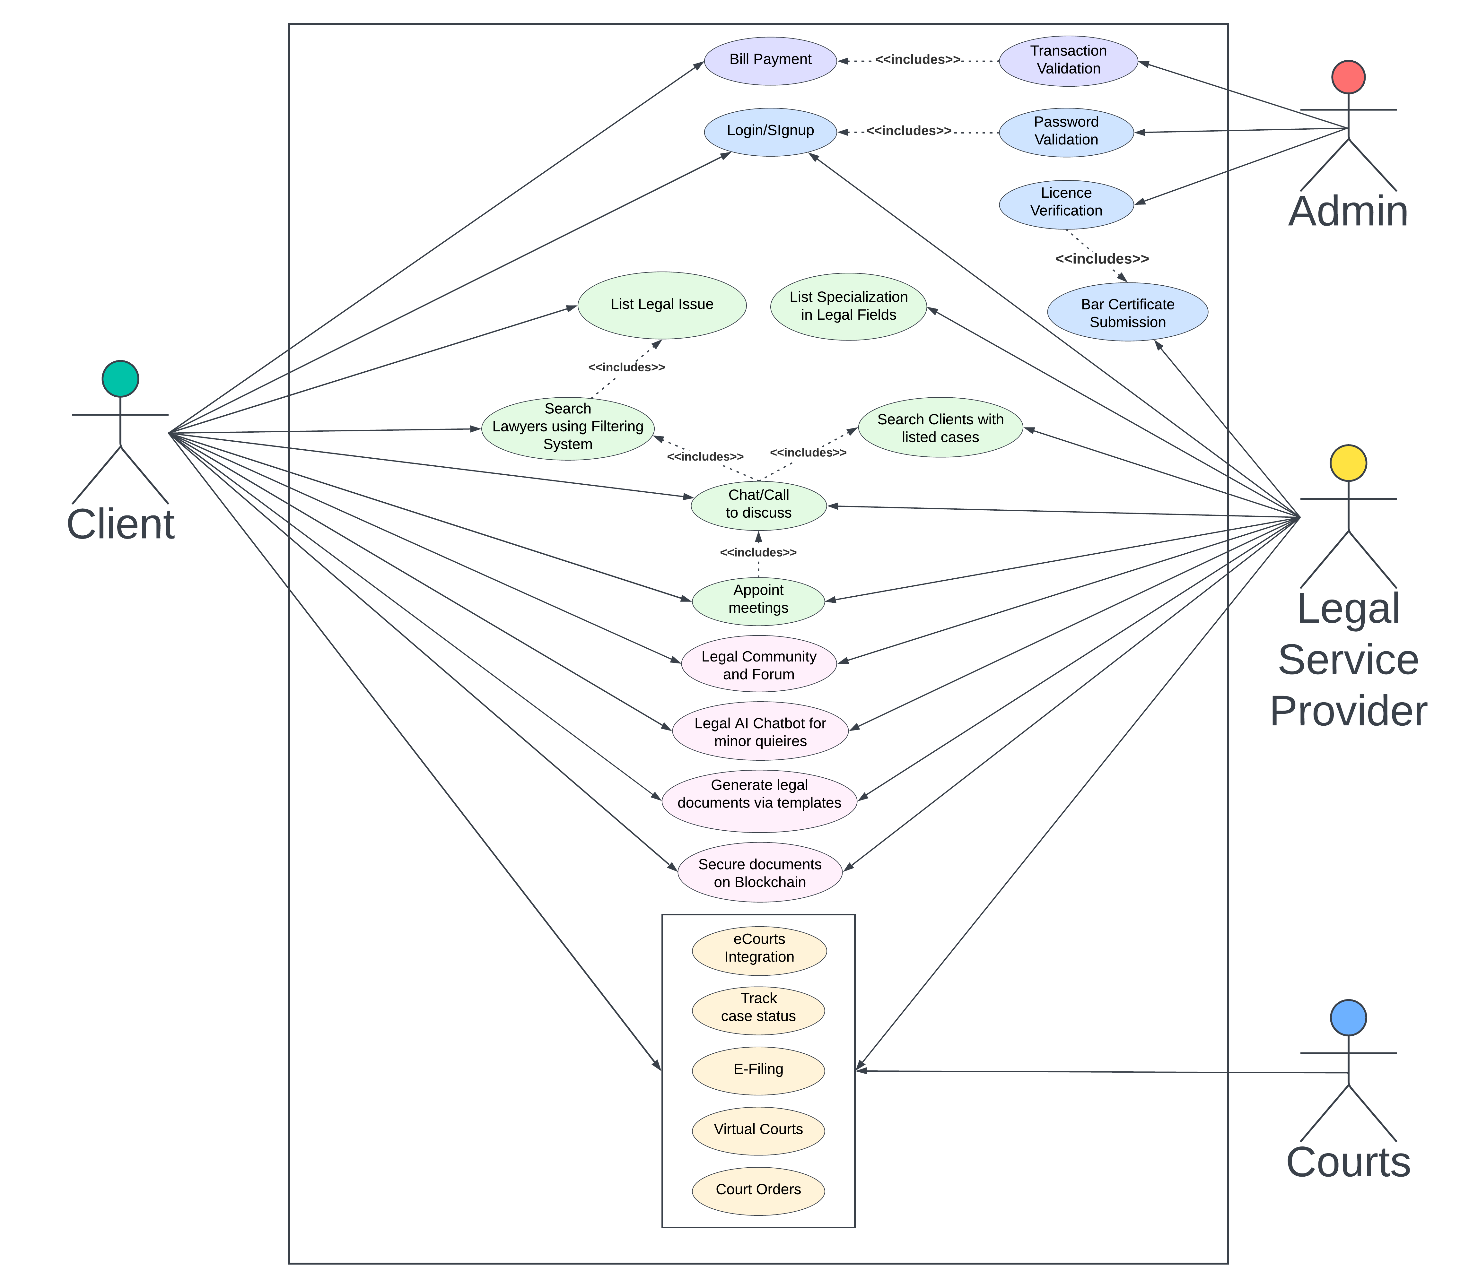

Idea/Approach Details
We are creating a solution by developing a cross-platform web-based application which acts as a multipurpose e-Marketplace for both the legal service providers and citizens of India. Our aim is to centralize the entire legal structure on a single platform, which helps people to find lawyers as per their needs, to acquire legal knowledge and to get the best legal representation. The prototype will function as follows:
Clients search for best legal options through efficient filtering system and legal professionals look for clients with cases who need representation
Clients can seek for any type of legal service providers — advocates, arbitrators, notaries, brokers, mediators, document writers etc.
24/7 accessible legal AI chatbot ready to be solving any type of queries and doubts
The application is made available in 32 different languages and it can also be deployed at Akshaya centres which makes the platform accessible to people from all socio-economic backgrounds
Proposed rating algorithm for legal professionals which takes into consideration performance, client feedbacks, experience, case history and specialization
Incentivization — Leaderboards are published each week that display the top lawyer performances, hence increasing ratings, competition and ultimately their quality of service. This in turn expands their reach and recognition
Blockchain technology is implemented in the application to secure sensitive legal documents on web3 network, raising security and transparency standards
Courts and Bar Councils are integrated in our system to cater for needs of a multipurpose platform and onboarding of whole legal system
Beneficial for both legal professionals and clients — advocates can expand their network and reach while clients can find best legal representation with lower costs
Clients can make use of legal information database to increase their knowledge in legal aspects and make informed decisions
Describe your Technology stack here:

Slide 3
Idea/Approach Details
Describe your Use Cases here
Describe your Dependencies /
Show stopper here
Clients register on the platform and list their legal issue. They search for advocates through a efficient filtering system based on legal issue listing, specialization, location, years of experience, and LawBridge lawyer ratings
Clients connect with advocates through chat/call and discuss the case. If both parties agree then they can appoint a meeting to further sign the power of attorney (vakalatnama/contract)
Advocates register themselves and look for clients with cases matching their specialization. This helps solo practitioners to increase their reach
Clients directly pay fees to advocates on the platform using payment gateway feature
Legal AI Chatbot helps both clients and lawyers with minor queries, users can also ask questions in FAQs section
Sensitive legal documents and information to be securely stored using blockchain technology, furthering transparency and security
Legal professionals make use of community forums to get insights and publish blogs/articles/posts
Courts integration helps with tracking case status, court orders, e-filing and virtual courts
Users can quickly generate legal documents using inbuilt document templates feature
Provider Participation: Incentives are proposed to onboard legal service providers on the platform
License Verification & Authentication: Participation of legal authorities is subject to certificate verification by Bar Council’s advocate registry
Legal Entity Integration: Courts and Bar Council is to be integrated to the application to provide seamless experience
Multilingual support: The applications provides support for 32 different languages of India, increasing accessibility
Blockchain: Securing documents on blockchain require Ethereum network as main net and Sepolia as test net and is subject to scalability concerns with large amount of data
Payment Gateway: Advocate fees payment by clients to be operated on external payment gateways
Chatbot: Chatbot API based on OpenAI model
Regulatory Compliance: Authorisation and involvement by legal bodies required for project to be implemented
Budget Allocation: Needed for keeping up gas prices on Ethereum/Blockchain network amongst other expenses

Slide 4
Team Member Details
Team Leader Name: SEPHIN SEBASTIAN E
Branch (Btech/Mtech/PhD etc): BTECH Stream (ECE, CSE etc): IT Year (I,II,III,IV): III
Team Member 1 Name: ADIL BIN SYED
Branch (Btech/Mtech/PhD etc): BTECH Stream (ECE, CSE etc): IT Year (I,II,III,IV): III
Team Member 2 Name: ANNASUSAN MANJALY B
Branch (Btech/Mtech/PhD etc): BTECH Stream (ECE, CSE etc): IT Year (I,II,III,IV): III
Team Member 3 Name: CHINMAY V
Branch (Btech/Mtech/PhD etc): BTECH Stream (ECE, CSE etc): IT Year (I,II,III,IV): III
Team Member 4 Name: L GOWRI VINOD
Branch (Btech/Mtech/PhD etc): BTECH Stream (ECE, CSE etc): IT Year (I,II,III,IV): III
Team Member 5 Name: SRAVAN V S
Branch (Btech/Mtech/PhD etc): BTECH Stream (ECE, CSE etc): IT Year (I,II,III,IV): III
Team Mentor 1 Name: Adv K Santhoshkumaran Thampi
Category: Legal Sector (High Court of Kerala) Expertise (AI/ML/Blockchain etc): LAW Domain Experience (in years): 20 years
Team Mentor 2 Name: Aman Zishan
Category: IT Sector Expertise (AI/ML/Blockchain etc): Blockchain Domain Experience (in years): 3 years

