Slide 1

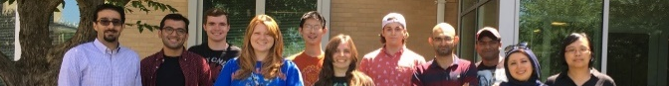

Supervised linear regression machine learning model to predict the primary dendritic arm spacing
Sepideh Kavousi Department of Mechanical Engineering & Materials Science Program
Colorado School of Mines
ZaeemLab.com

Slide 2
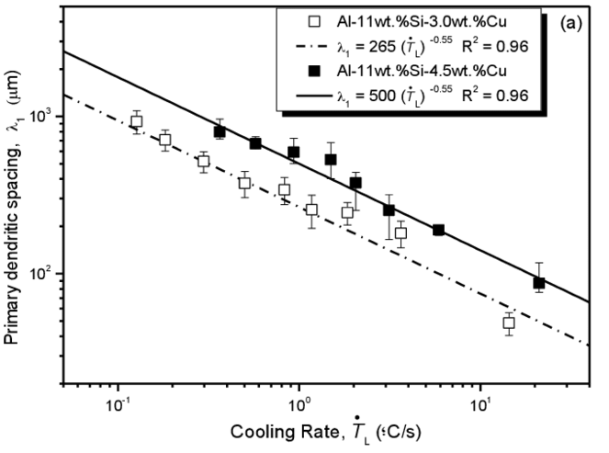


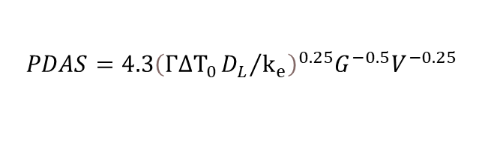
Problem Statement
Analytical Models predicting Primary Dendritic Arm Spacing (PDAS)
$$PDAS=2.83{\left(k_{e}ΓΔT_{0}D_{L}\right)}^{0.25}G^{−0.5}V^{−0.25}$$
Hunt-Burden (HB) model
$$PDAS=4.3{\left(ΓΔT_{0}{D_{L}}/{k_{e}}\right)}^{0.25}G^{−0.5}V^{−0.25}$$
Kurz-Fisher (KF) model
Analytical relations for PDAS have significant deviations from computational predications and experimental data
Computational PDAS versus analytical models for Si-9at.%As ¹
Experimental PDAS versus analytical models for Al-11Si ²
¹ https://doi.org/10.1016/j.actamat.2020.116562
² https://doi.org/10.3390/met8100784
2

Slide 3
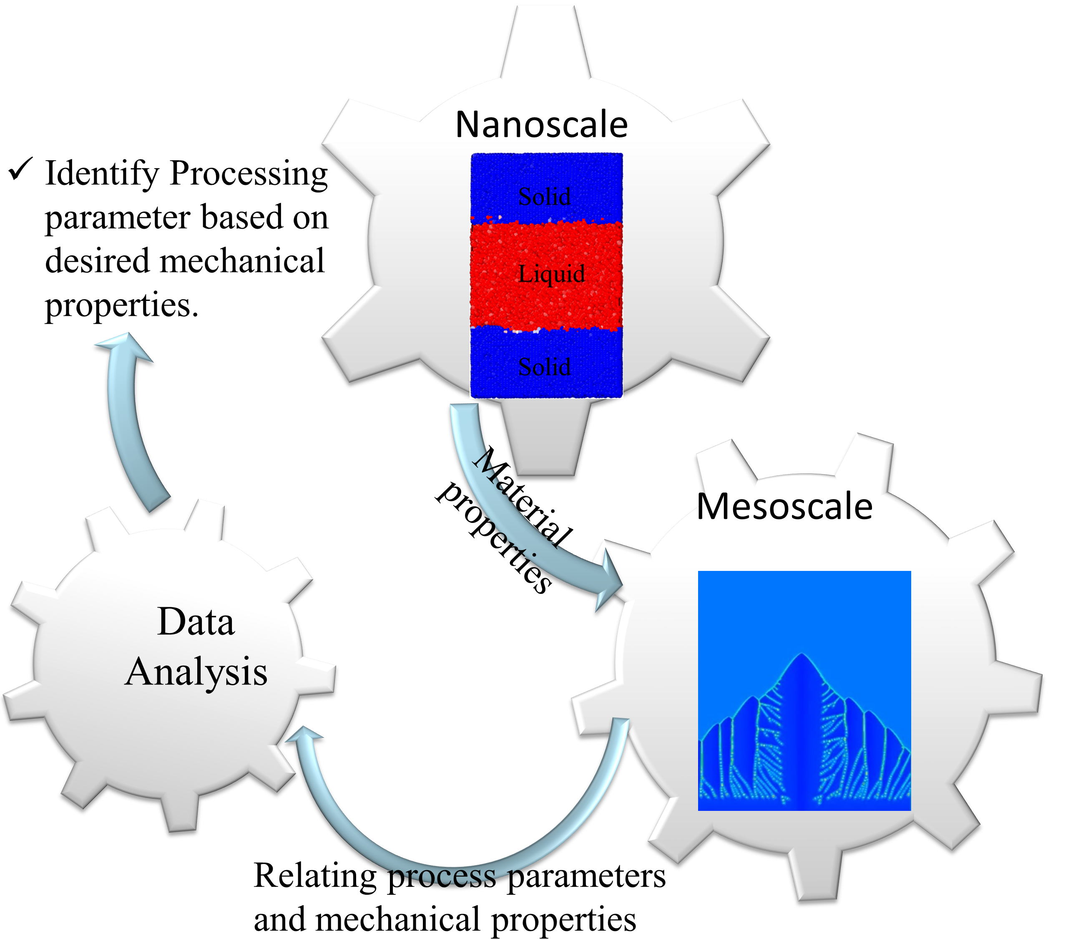
Workflow
FCC system: Ti-X at% Ni ( X=3.4, 7.1, 10.7)
HCP system: Mg-9 at%Al
BCC system: Al-X at%Cu (X=6,8,10)
3

Slide 4
The Computational Data
 | V (m/s) | G (K/m) | Number of data points from PF modeling
Ti-3.4 at% Ni | 0.01-0.09 | 10^{7,} 8×10^{6,} 7×10^{6,} 6×10^{6,} 5×10⁶ | 45
Ti-7.1 at% Ni | 0.01-0.09 | 10^{7,} 8×10^{6,} 7×10^{6,} 6×10^{6,} 5×10⁶ | 42
Ti-10.4 at% Ni | 0.0001-0.02 | 10^{7,} 5×10⁶ | 22
Mg-9 at% Al | 0.005-0.12 | 5×10^{6,} 3×10^{6,} 1×10⁶ | 21
Al-6 at% Cu | 0.001-0.06 | 10^{7,} 8×10^{6,} 7×10^{6,} 6×10^{6,} 5×10⁶ | 47
Al-8 at% Cu | 0.01-0.08 | 10^{7,} 8×10^{6,} 7×10^{6,} 6×10^{6,} 5×10⁶ | 43
Al-10 at% Cu | 0.008-0.005 | 10^{7,} 8×10^{6,} 7×10^{6,} 6×10⁶ | 30
4

Slide 5
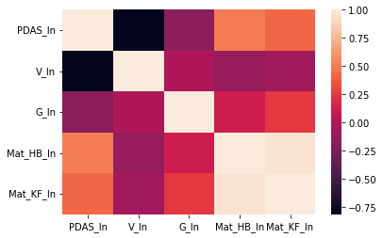
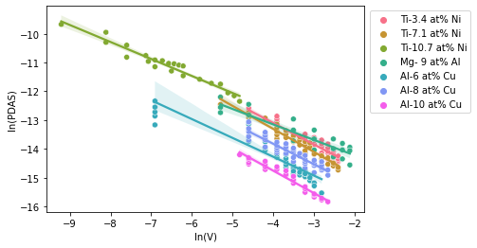


ML model
$$PDAS=A ×V^{α}{ G}^{β} {\left(mat_HB\right)}^{γ}$$
HB model
$$mat_{HB}=k_{e}ΓΔT_{0}D_{L}$$
KF model
$$mat_{KF}=ΓΔT_{0}{D_{L}}/{k_{e}}$$
$$PDAS=A ×V^{α}{ G}^{β} {\left(mat_KF\right)}^{γ}$$
$$\ln\left(PDAS\right)=\ln\left(A\right)+α×\ln\left(V\right)+β×\ln\left(G\right)+γ×\ln\left(mat_HB\right)$$
HB model
$$\ln\left(PDAS\right)=\ln\left(A\right)+α×\ln\left(V\right)+β×\ln\left(G\right)+γ×\ln\left(mat_KF\right)$$
KF model
5

Slide 6
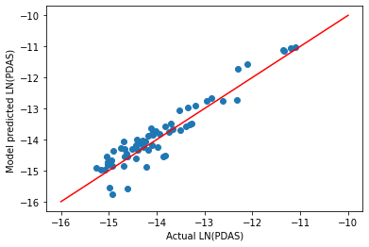



Supervised Machine Learning Linear Regression Model
HB model
$$PDAS=A ×V^{α}{ G}^{β} {\left(mat_HB\right)}^{γ}$$
$$α=−0.699±0.0063$$
$$β=−0.676±0.011$$
$$γ=0.459±0.004$$
6

Slide 7
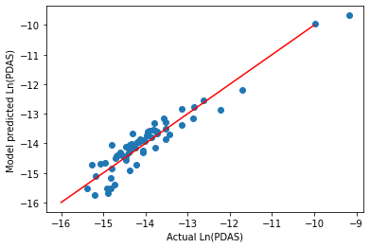



Supervised Machine Learning Linear Regression Model
KF model
$$PDAS=A ×V^{α}{ G}^{β} {\left(mat_KF\right)}^{γ}$$
$α=−0.719±0.00$7
$β=−0.836±0.01$2
$γ=0.654±0.00$7
7

Slide 8
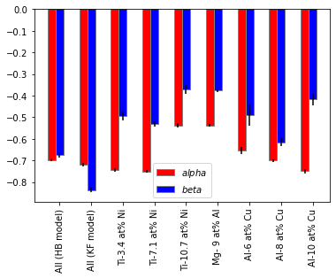
Supervised Machine Learning Linear Regression Model
$$PDAS ∝V^{α}{ G}^{β}$$
8

Slide 9
Conclusion
In this project we develop a supervised-regression machine learning model to obtain a correlation between the PDAS and velocity and temperature gradient
We obtain a very important conclusion that in contract to analytical models, where temperature gradient plays much important role in the PDAS estimations, the velocity and temperature play almost equal roles in PDAS correlation!
Fitting the data for the individual alloys were not helpful because we did not put any restriction on how the material properties equation looks like and therefore alpha and beta values seem all around the place
9

Slide 10
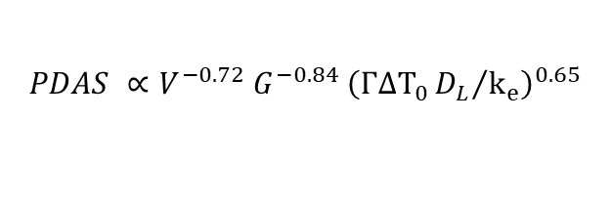

Recommendation
The material scientists are recommended to use the modified-HB and modified-KF models instead of the original analytical HB and KF models.
$$PDAS ∝V^{−0.25}{ G}^{−0.5} {\left(k_{e}ΓΔT_{0}D_{L}\right)}^{0.25}$$
HB model
$$PDAS ∝V^{−0.7}{ G}^{−0.68} {\left(k_{e}ΓΔT_{0}D_{L}\right)}^{0.46}$$
Modified HB model
$$PDAS ∝V^{0−0.25}{ G}^{−0.5} {\left(ΓΔT_{0}{D_{L}}/{k_{e}}\right)}^{0.25}$$
KF model
$$PDAS ∝V^{−0.72}{ G}^{−0.84} {\left(ΓΔT_{0}{D_{L}}/{k_{e}}\right)}^{0.65}$$
Modified KF model
10

