Slide 1

Theory of Errors
Part II
Department of Surveying and Geomatics Engineering
Mahdi Motagh

Slide 2
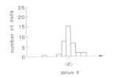

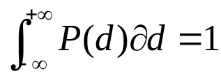
Noise and Random Variables
Measurements are known to contain noise. To characterize the data completely, we need information about the range and shape of the scattered data
Department of Surveying and Geomatics Engineering Mahdi Motagh

Slide 3
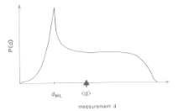
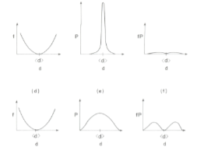
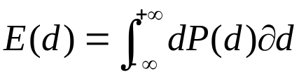
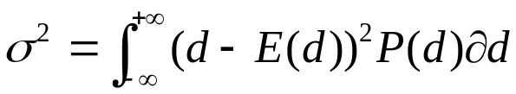
The most likely measurement is the one with the highest probability. If the distribution is skewed, the peak or maximum likelihood point, may not be a good indication of the typical measurements
Department of Surveying and Geomatics Engineering Mahdi Motagh

Slide 4

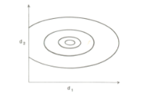
Correlated Data
Experiments usually involve the collection of more than one datum. We thus need to quantify the probability that
a set of random variables will take on a given value. This is done with the help of joint probability distributions
Department of Surveying and Geomatics Engineering Mahdi Motagh

Slide 5
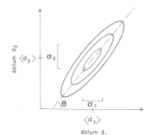
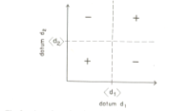
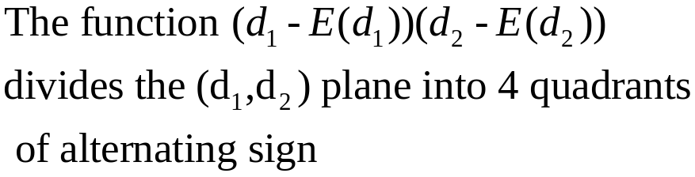
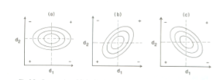
Correlated Data
Department of Surveying and Geomatics Engineering Mahdi Motagh

Slide 6
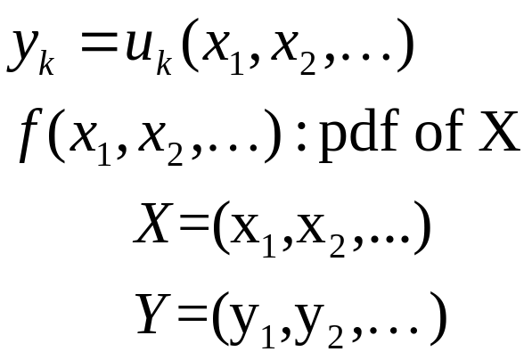
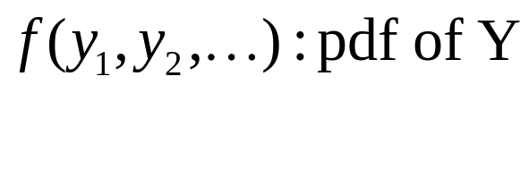
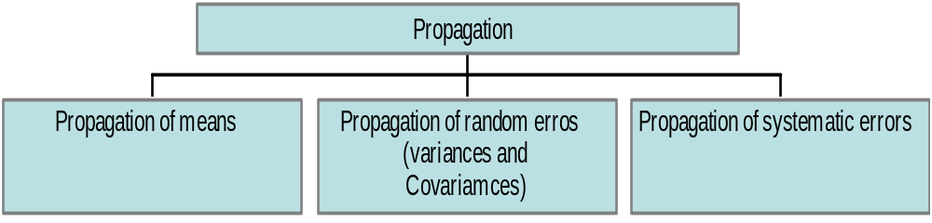
Techniques of Propagation
Propagation
Department of Surveying and Geomatics Engineering Mahdi Motagh

Slide 7
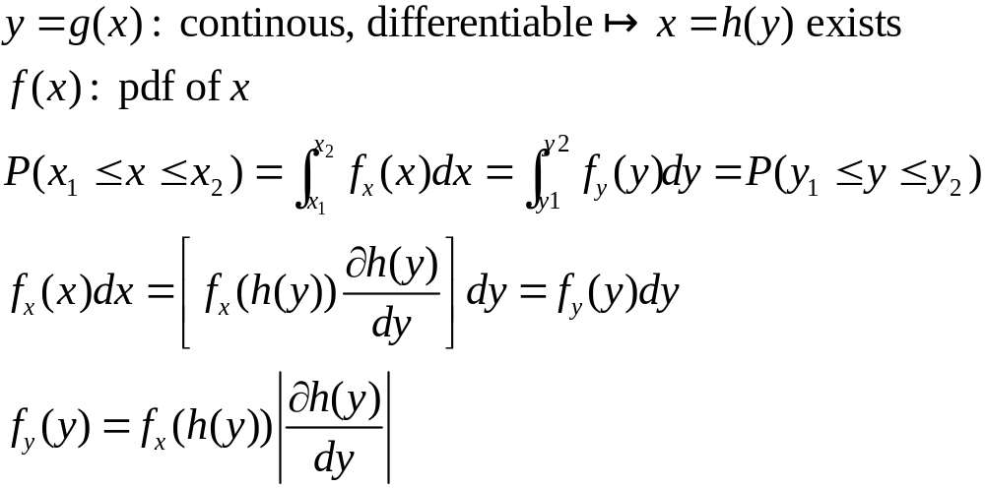
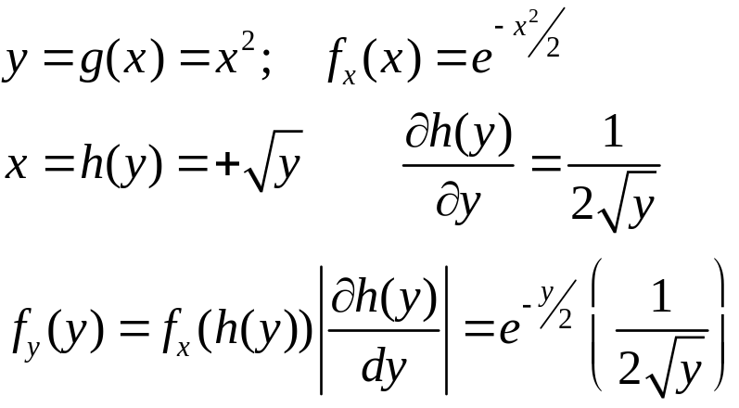
Propagation of distribution
Example:
Department of Surveying and Geomatics Engineering Mahdi Motagh

Slide 8
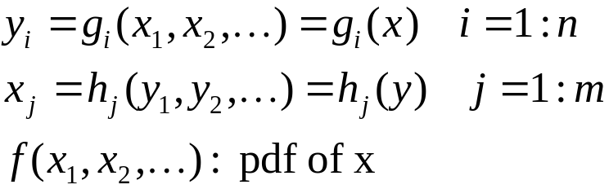
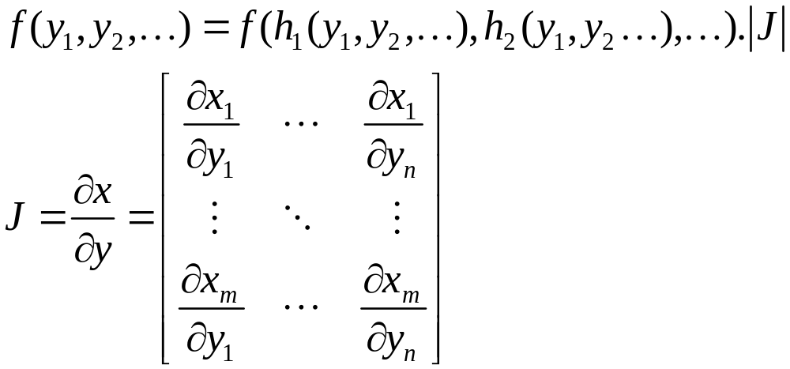
Multi-dimentional case
Department of Surveying and Geomatics Engineering Mahdi Motagh

Slide 9
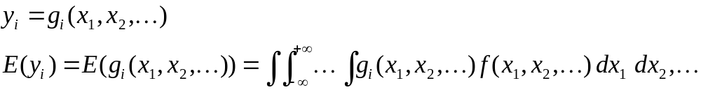
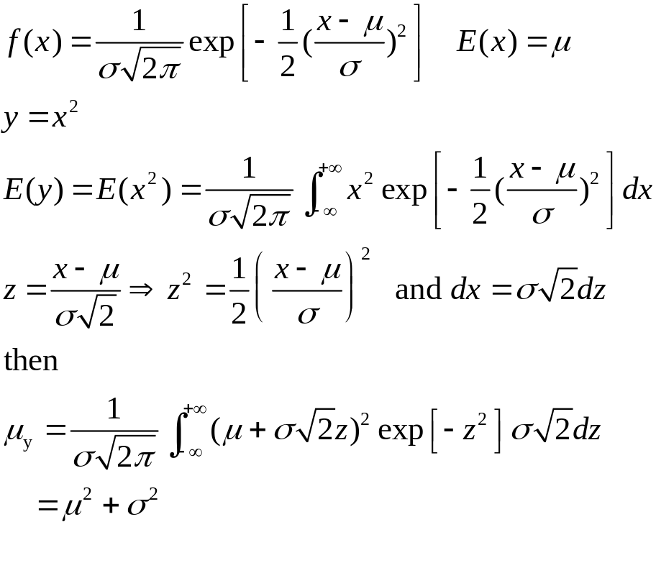
Propagation of means
Department of Surveying and Geomatics Engineering Mahdi Motagh

Slide 10
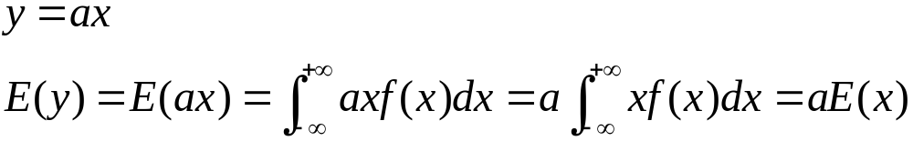
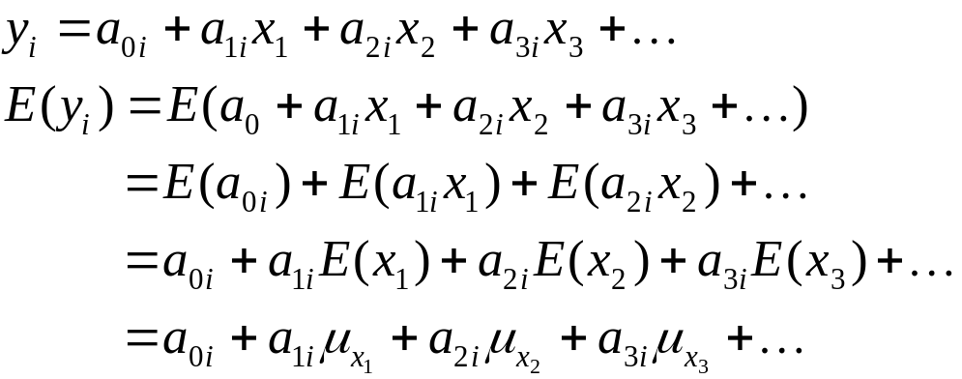
Propagation of Means for Linear Functions
Department of Surveying and Geomatics Engineering Mahdi Motagh

Slide 11
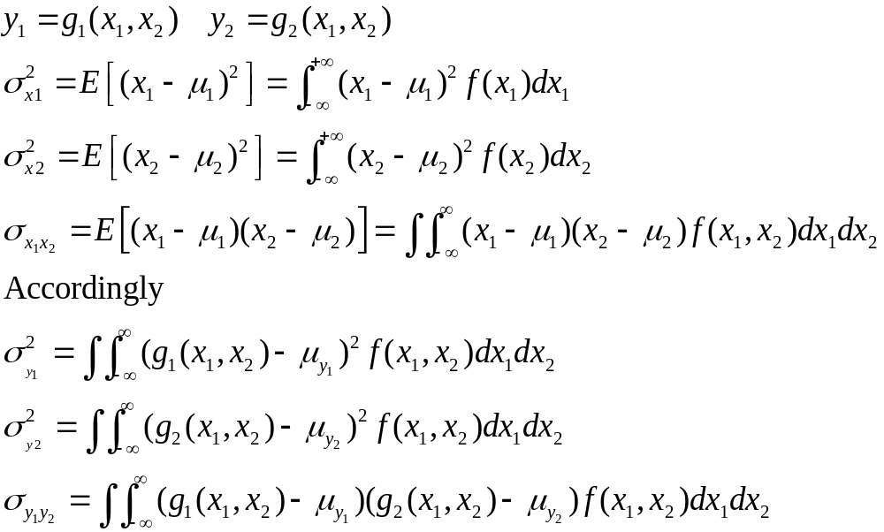
Propagation of Variances and Covariances
Department of Surveying and Geomatics Engineering Mahdi Motagh

Slide 12
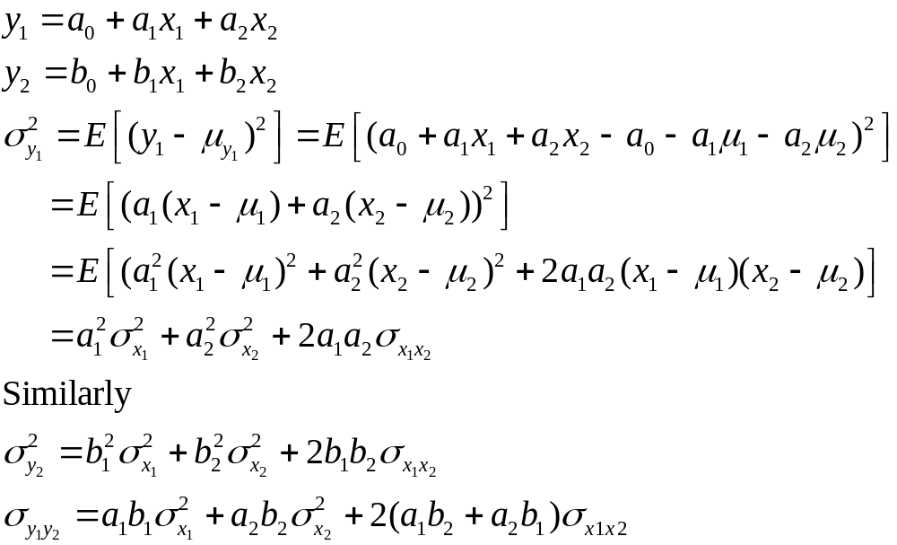
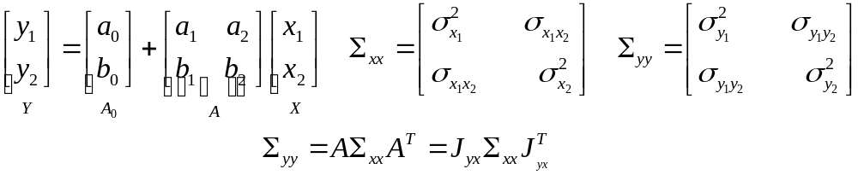
Propagation of Variances and Covariances for linear functions
Department of Surveying and Geomatics Engineering Mahdi Motagh

Slide 13
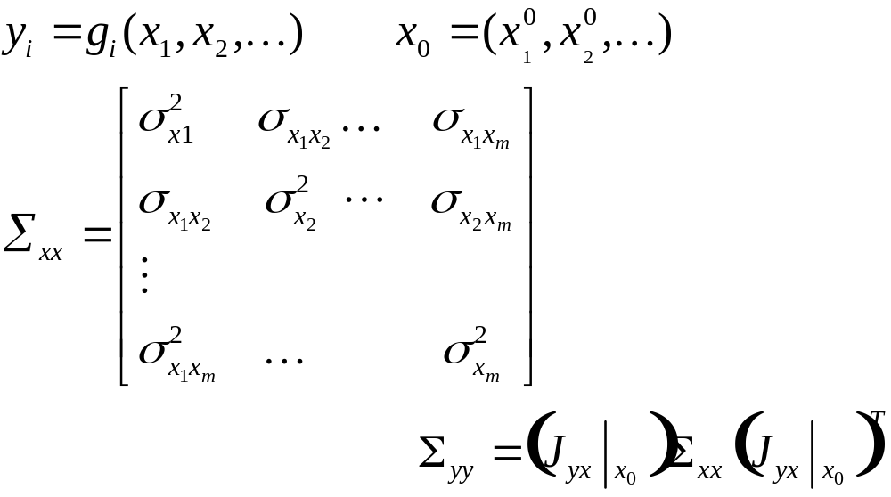
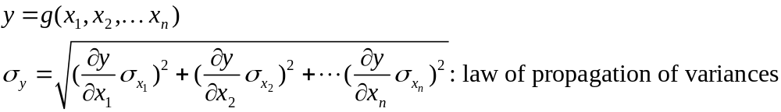
Propagation of Variances and Covariances for linear functions
Department of Surveying and Geomatics Engineering Mahdi Motagh

Slide 14
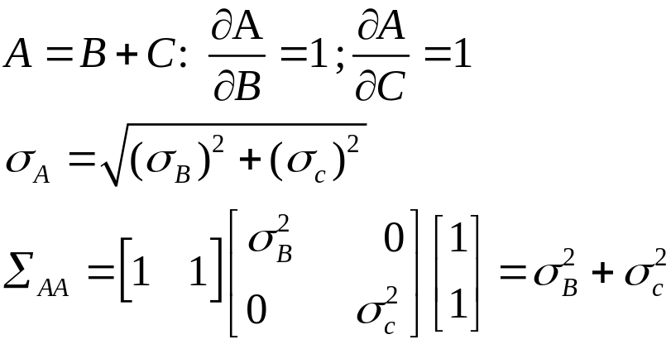
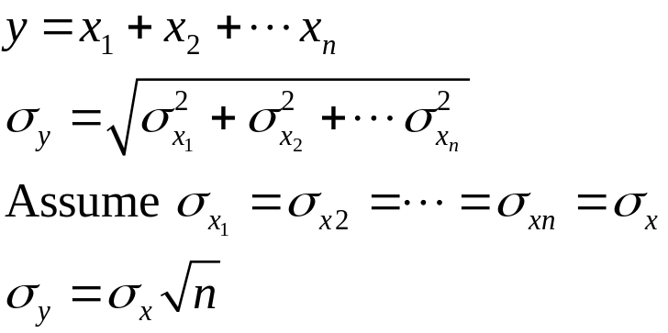
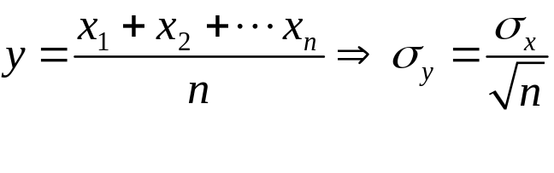
Propagation of Variances
Department of Surveying and Geomatics Engineering Mahdi Motagh

Slide 15
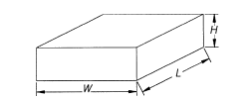


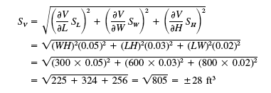
Example
Department of Surveying and Geomatics Engineering Mahdi Motagh

Slide 16
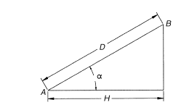
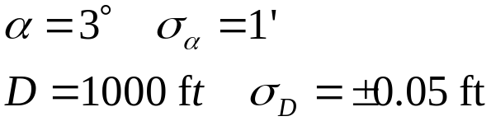


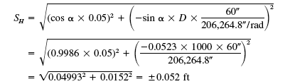
Example
Department of Surveying and Geomatics Engineering Mahdi Motagh

Slide 17
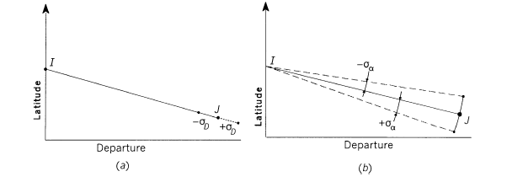


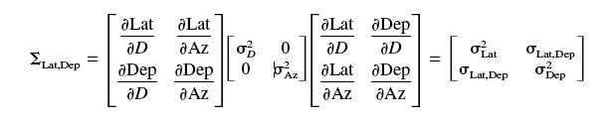
Example
Department of Surveying and Geomatics Engineering Mahdi Motagh

Slide 18
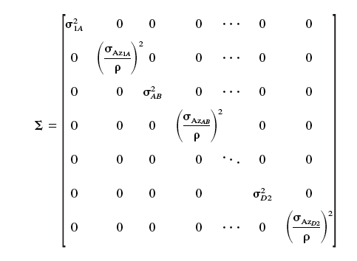
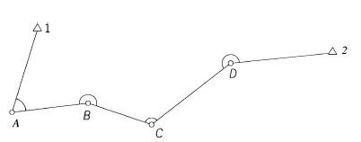
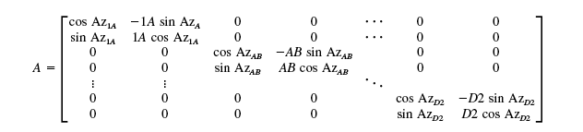
Example
Department of Surveying and Geomatics Engineering Mahdi Motagh
Notes:
Barname ash bayad neveshte shavad

Slide 19
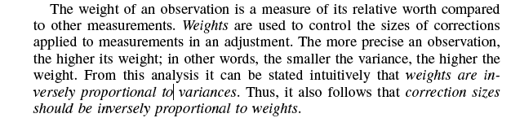
Weights of Observations
Surveying data (measurements) must usually conform to a given set of geometric condition. If they don’t, they should be adjusted to force that
Geometric conditions.
Department of Surveying and Geomatics Engineering Mahdi Motagh

Slide 20
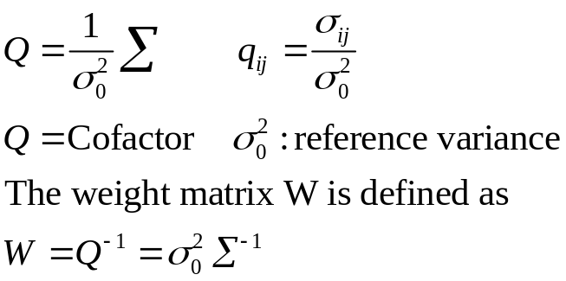
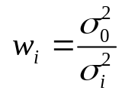

Weights of Observations
If the measurements are independent:
is often called the variance of an observation with unit weight or variance of unit weight or unit weight.
Department of Surveying and Geomatics Engineering Mahdi Motagh

Slide 21
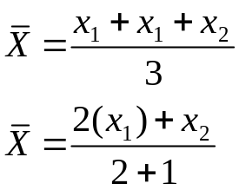
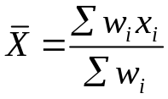
Weighted Mean
Assume we have two measurements of x₁ and x₂ and the first is twice as good as the second
The weighted mean for a group of uncorrelated observations:
Department of Surveying and Geomatics Engineering Mahdi Motagh

Slide 22
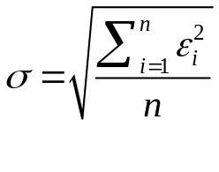



Statistics of weighted observations
For a group of observations with equal weight:
If weights are not equal:
Department of Surveying and Geomatics Engineering Mahdi Motagh

Slide 23
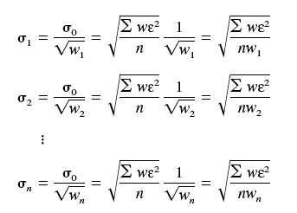


Standard Error of Weight W and Standard error of the Weighted Mean
Department of Surveying and Geomatics Engineering Mahdi Motagh

Slide 24

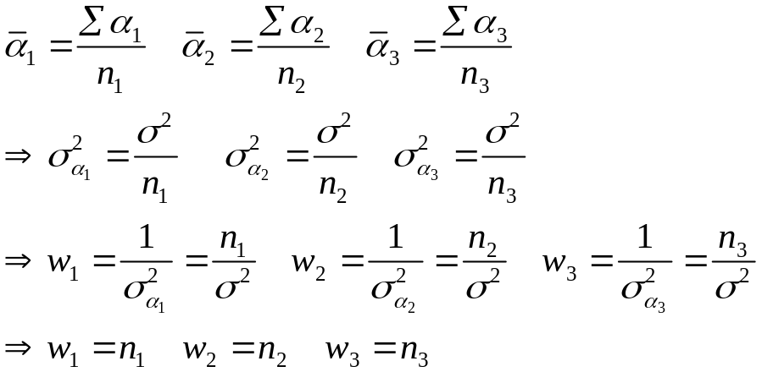

Weights in angle observations
is the standard deviation of a single measurement
Department of Surveying and Geomatics Engineering Mahdi Motagh

Slide 25
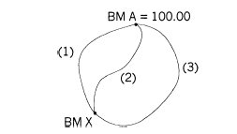

Weights in Leveling networks
L(1)=2 ; L(2)=3 ; L(3)=4 km
∆(h1)=21.20 m
∆(h2)=21.23 m
∆(h2)=21.29 m
The weight in leveling networks is expected to depend
on the lengths of leveling lines
W(1)=1/2; W(2)=1/3; W(3)=1/4
Since weights are relative, we can multiply them by an arbitrary number (e.g. 12)
Department of Surveying and Geomatics Engineering Mahdi Motagh

Slide 26
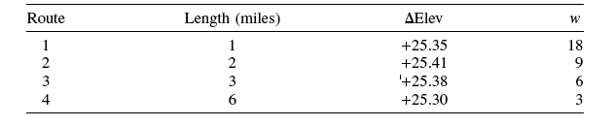





Example
A
3
4
1
2
B
Note that the weights were computed as 18/l for computational convenience only
Department of Surveying and Geomatics Engineering Mahdi Motagh

Slide 27


Example
A
B
C
Adjust the angles?
Solution:
Assume the angle with the highest precision (B) gets the of x; then the corection factor for A and C would be (8/4)x and (8/6)x
Department of Surveying and Geomatics Engineering Mahdi Motagh

Slide 28








More on error propagation
We have seen for
Now assume we have two sets of equations as follows:
Department of Surveying and Geomatics Engineering Mahdi Motagh

Slide 29


Example
Department of Surveying and Geomatics Engineering Mahdi Motagh

Slide 30


Example
Department of Surveying and Geomatics Engineering Mahdi Motagh

Slide 31
Example
Department of Surveying and Geomatics Engineering Mahdi Motagh

Slide 32


Example
Assume the two angles a and b and the side c are measured and known to be uncorrelated. What is the autocofactor of side a?
Department of Surveying and Geomatics Engineering Mahdi Motagh

Slide 33



Fundamental principles of Least Squares
Department of Surveying and Geomatics Engineering Mahdi Motagh

Slide 34






Fundamental principles of Least Squares
Department of Surveying and Geomatics Engineering Mahdi Motagh

Slide 35



Fundamental principles of Weighted Least Squares
Department of Surveying and Geomatics Engineering Mahdi Motagh

Slide 36

Least Squares Adjustment
Functional Model: an equation or a set of equations that defines an adjustment conditions
In a conditional adjustment, geometric conditions are enforced on the
observations and their residuals. Examples of conditional adjustment are:
the sum of the angles in a closed polygon is (n- 2)180°, where n is the
number of sides in the polygon; (2) the latitudes and departures
of a polygon traverse sum to zero; and (3) the sum of the angles in the horizon
equal 360°_x0004_
When performing a parametric adjustment, observations are expressed in
terms of unknown parameters that were never observed directly. For example,
the well-known coordinate equations are used to model the angles, directions,
and distances observed in a horizontal plane survey. The adjustment yields
the most probable values for the coordinates (parameters), which in turn provide
the most probable values for the adjusted observations
Department of Surveying and Geomatics Engineering Mahdi Motagh

Slide 37





Least Squares Adjustment - Parametric models
+
+
+
: Normal equations
L.S. solution
Department of Surveying and Geomatics Engineering Mahdi Motagh

Slide 38






Least Squares Adjustment
Department of Surveying and Geomatics Engineering Mahdi Motagh

Slide 39

Least Squares Adjustment
Normal equations
Department of Surveying and Geomatics Engineering Mahdi Motagh

Slide 40

Normal equations
Department of Surveying and Geomatics Engineering Mahdi Motagh

Slide 41





Least Squares Adjustment
Department of Surveying and Geomatics Engineering Mahdi Motagh

Slide 42




Example

Slide 43



Weighted Least Squares Adjustment

Slide 44



Nonlinear Adjustment
For weighted least-squares:
Steps to solve a nonlinear system:

Slide 45










Example
(1)
(2)
Apply the corrections to the initial approximations for the first iteration
(3)
Repeat step 1 to derive a new correction

Slide 46









Example

Slide 47



Example

Slide 48







Example

Slide 49



Example

Slide 50




Another Example

Slide 51









Trilateration

Slide 52







Trilateration
After least-squares Adjustment:

Slide 53



Exercise

Slide 54









Triangulation

Slide 55








Triangulation

Slide 56




Example
After least-squares Adjustment:

Slide 57


Exercise

Slide 58


Exercise

Slide 59



Exercise

Slide 60


Exercise

Slide 61



Precision estimation

Slide 62
Iteration Termination
Maximum iteration
Maximum correction: Monitoring the absolute size of corrections. The iteration process is stopped when all corrections become negligibly small.
Monitoring the adjustment’s Reference Variance:The iteration process is stopped if the reference variance increases.
An increasing reference variance suggests:
A large blunder in the data
The maximum correction size is less than the precision of observations.

Slide 63







2D coordinate transformation

Slide 64
2D coordinate transformation

Slide 65


Example

Slide 66



Other 2D Transformation
In matrix form:

Slide 67



Projective transformation

Slide 68




3D transformation

Slide 69
Appendix
Department of Surveying and Geomatics Engineering Mahdi Motagh

Slide 70




Linearization
Department of Surveying and Geomatics Engineering Mahdi Motagh

Slide 71




Linearization
Department of Surveying and Geomatics Engineering Mahdi Motagh

Slide 72




Linearization
Department of Surveying and Geomatics Engineering Mahdi Motagh

Slide 73

Linearization
Department of Surveying and Geomatics Engineering Mahdi Motagh

Slide 74

Matrix differentiation
Department of Surveying and Geomatics Engineering Mahdi Motagh

Slide 75


Matrix differentiation
Department of Surveying and Geomatics Engineering Mahdi Motagh

Slide 76


Matrix differentiation
Department of Surveying and Geomatics Engineering Mahdi Motagh

Slide 77



Matrix differentiation
Department of Surveying and Geomatics Engineering Mahdi Motagh

