Slide 1
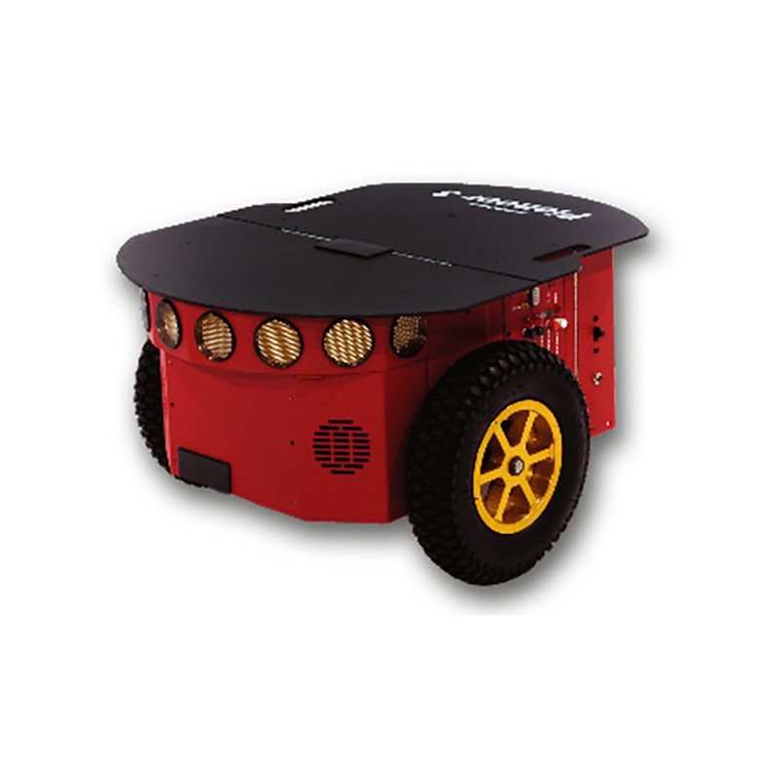
P-SLAM: simultaneous Localization and Mapping with environmental- structure Prediction
Content of the presentation:
Introduction
What is P-SLAM?
Problem formulation
prediction of an unexplored region with a built up map
Use of predicted Map
Environmental structure prediction
Search for reference region
Feature extraction
Homogenous transformation matrix
Similarity measurement
P-SLAM versus SLAM
Bayesian formulation of P-SLAM
P-SLAM with an RBPF
Experimental results
Computer simulation
Experiment on a pioneer 3-DX robot
conclusion
Sepideh Hadadi
Probabilistic Robotics
Master in computer vision (MSCV), semester 2, Centre universitaire Condorcet, Le Creusot
22-May 2017
Notes:
The aim of the presentation is to introduce P-SLAM and to explain to which way P-SLAM is different.
In this presentation, I will present following topics:
What is P-SLAM
What is the problem? And how does author formulate the problem?
Using image processing approach to resolve the problem
P-SLAM formulation using Bayesian predictor and particle filter
Finally experimental result will be presented and concluded

Slide 2
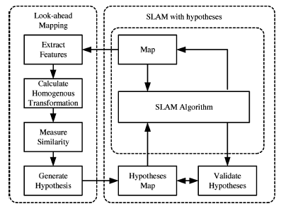
What is P-SLAM?
Introduction
SLAM
P-SLAM working structure
mapping
New step
(subject of the paper)
Localization
SLAM
Application: the entire region is explored
P-SLAM
mapping
Look-ahead
Mapping
New step
Localization
Application: the region is partially explored
Notes:
SLAM is recursive process of Mapping and localization using Kalman filter or extended Kalman filter
P-SLAM as seen has a new step : look-ahead mapping
P-SLAM algorithm can be summarized as shown in the right
As seen, SLAM is still the core of P-SLAM
P-SLAM is used in environment where is partially explored by a robot

Slide 3

Prediction of an unexplored region
Problem formulation
The the proposed P-SALM focuses on predicting a structure of an unexplored region.
To identify where the unexplored region is, P-SLAM adopts the occupancy-grid map.
In the occupancy- grid map the prediction can be divided into four major steps:
Locate a target frontier cell to predict
Collect structure information near the target region(feature)
Search for similar structures in the built map
Generate a hypothesis if a similarly match exist
The above four steps can be formulated as an optimization problem
All the parameters are known except f’
Problem: finding optimization solution is very time consuming and can not be done in real-time (3600s for instance)
Notes:
The paper is focus how to find new map in an unexplored region and attached this map to the existing map
P-SLAM adopts Occupancy-grid map which contains 4 steps:
Locate a target structure to predict
Collect information
Search for similar structure in the existing map
Generate a hypothesis
The problem can be seen as optimization problem given , Cf’, Sf, f and M and request to find best f’ on condition that f≠f’.
The problem is that, solving this problem is time consuming
For instance, it can take up to one hour

Slide 4
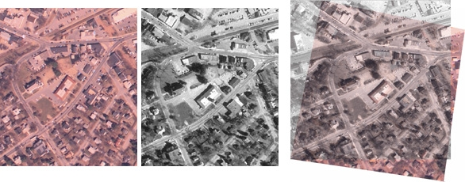
Alternative solution to the previous problem
Problem formulation
An alternative solution to overcome the above problem is to use image processing technique:
image registration algorithm
Image registration consist of following steps
Feature extraction
Feature matching
Calculation of transformation matrices
Notes:
Alternative solution is to use image processing algorithm of image registration
Image registration has three main steps:
Feature extraction
Feature matching
Calculation of transformation matrix
In fact, the idea is to analyze unexplored regions which has common feature with the reference region.

Slide 5
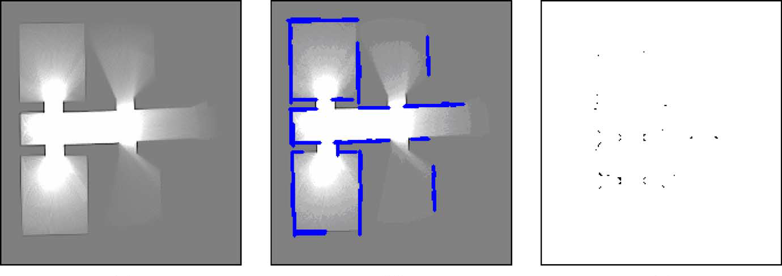
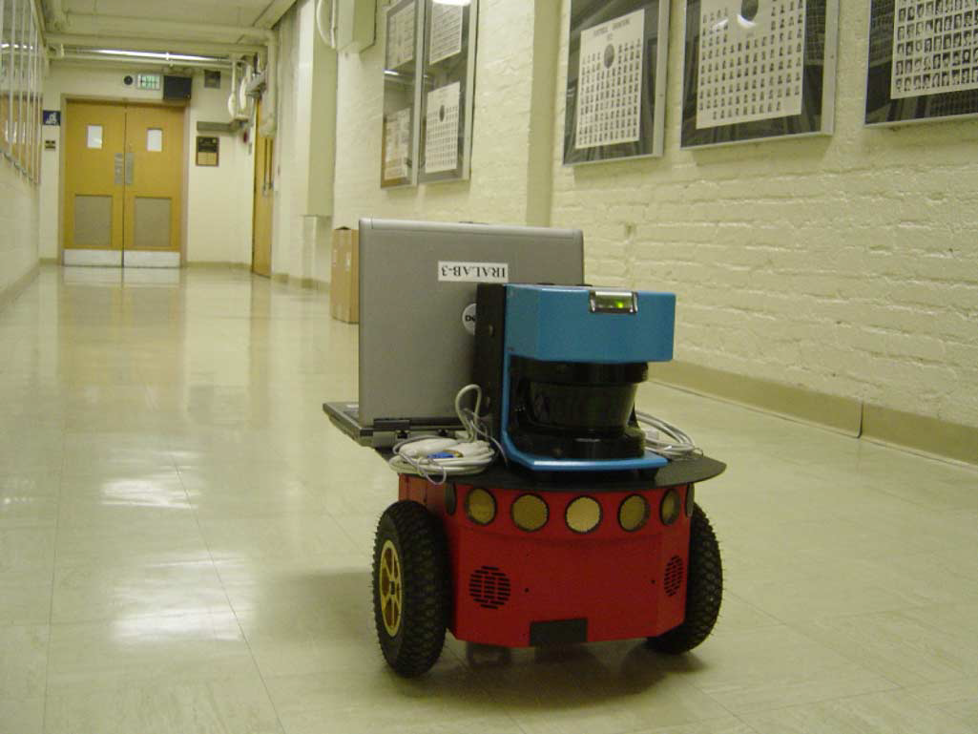
feature extraction
Environmental structure prediction
The entire paper is discussing about indoor move of robot
Lines and corners are selected as features because they are the elementary representation of walls, hallways or rooms
Extracted features
Part of target indoor path of robot
Notes:
This paper is only discussing indoor environment:
Edges and corners are used as feature
The environment, edge and corner are shown in the fig.

Slide 6
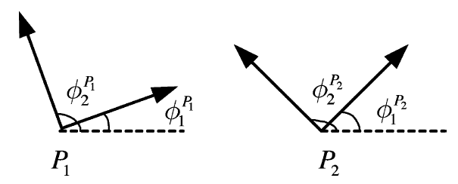
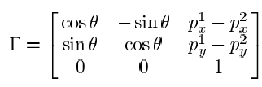
Homogenous transformation matrix
Environmental structure prediction
The angle θ is the difference between Φ₁^{P1}-Φ₁^{P2} and
P_{x}, P_{y} is the projection of each vector P on x and y axis
Notes:
P1 and P2 are two corner selected from reference region (explore) and new region (un-explored)
Each corner has two edges
We will find the a Homogenous transformation to between edges by selecting some control points
In fact a new map is made of these feature point

Slide 7
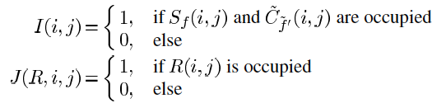
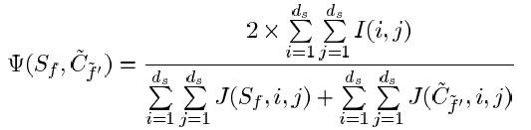
Similarity measurement
Environmental structure prediction
Similarity is measured based on following equations:
Hypothesis: If the similarity measurement of every possible reference region is below the threshold the prediction process is terminated until the next target is determined. The selected target regions will be part of the mapping
Notes:
We have two Mapping in this stage: Sf reference region, Cf’ new region
We can not use similarity measurement like Euclidian distance and other similarity measurement we know.
Because a lot of cells in the new Map will be empty
So the first equations shows that we consider only those cells are not empty.
If the new map is similar we keep in Hk and we use it in the P-SLAM later

Slide 8
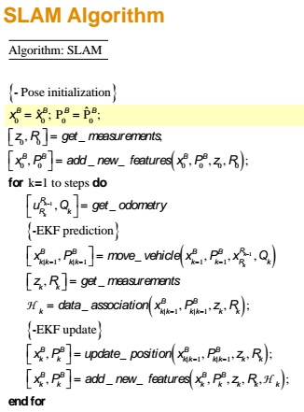

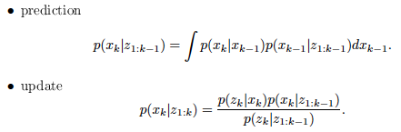
SLAM predictor
SLAM
State estimation
measurement
Depending on the process model, there is three possibility:
Here, last condition is met and SLAM use FP of Bayesian filter
h, f linear | w, v Gaussian | KF
h, f non-linear | w, v Gaussian | EFK
h, f non-linear | w, v non-Gaussian | PF, Bayesian | ✔
predictor
Notes:
At the right side you will see the standard SLAM algorithm
SLAM uses predictor such as Kalman filter(EKF) or Kalman filter(KF) so far.
However, in general predictor depends on f and h and noise distribution as shown in the table.
Here because the system is non-linear (Markov) and noise is non-Gaussian therefore particle filter or Bayesian filter is applied in the SLAM.

Slide 9
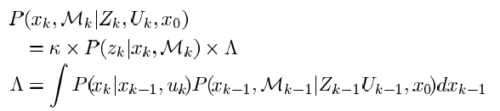
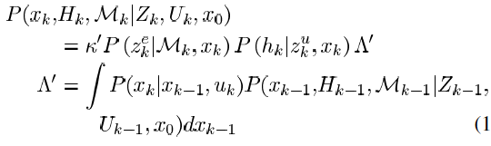
Bayesian P-SLAM
P-SLAM
Standard Bayesian SLAM has following recursive equations:
Above equation were updated by the author to construct
new set of equations for P-SLAM.
Bayesian P-SLAM will have following recursive equations:
Notes:
The recursive equation of the Bayesian SLAM is shown at the top.
Author included the Hypothesis Map and the measurement in unexplored region and recalculate recursive equation for P-SLAM
The highlighted coefficient and variable belongs to unexplored region.
The Bayesian P-SLAM is shown in the bottom

Slide 10
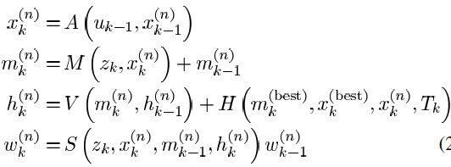
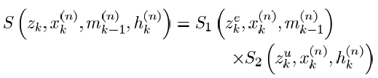

RBPF P-SLAM
P-SLAM
The recursive equation of RBPF SLAM is formulated in the following reference:
A. Doucet, J. de Freitas, K. Murphy, and S. Russel, “Rao-Blackwellized particle filtering for dynamic Bayesian networks,” in Proc. Conf. Uncertainty Artif. Intell., 2000, pp. 499–516.
The recursive equation of RBPF SLAM is updated for P-SLAM as follow:
Robot pose
Map explored
Sensor model for explored region
Map unexplored
Weight update eq.
Sensor model for unexplored region
Sensor model
Weighting update eq.
Notes:
Rao-Blackwellized Particle Filter = RBPF
The SLAM based on particle filter (RBPF) is already presented in this paper on 2000.
The author provide new formulation for the recursive operation of P-SLAM
However, the coefficient of weighting and S function is different than standard SLAM based on RBPF.
Besides, as seen the weighting formula and update equation has new terms as highlighted in red.

Slide 11
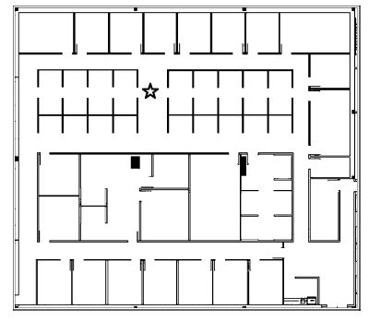
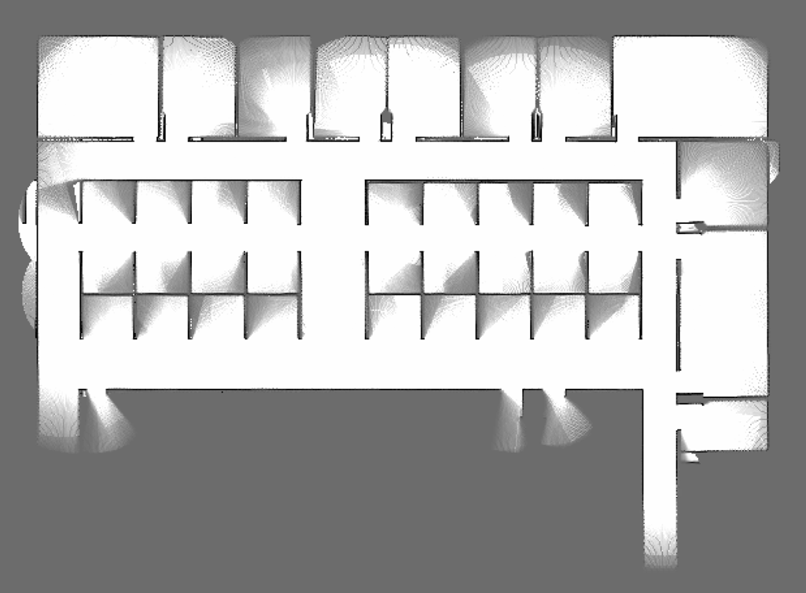
Simulation result
Experimental result
Office environment used in the computer simulation. The star indicates the initial location of the mobile robot.
Map generated by the proposed P-SLAM of the upper-office environment. The predictions in the unexplored regions were also added in this map, such as the leftmost part, which cannot be reached by the robot.
Notes:
The result achieved by computer simulation and without robot
The top view of the environment is shown at the top
The result of P-SLAM mapping is shown in the bottom image.

Slide 12
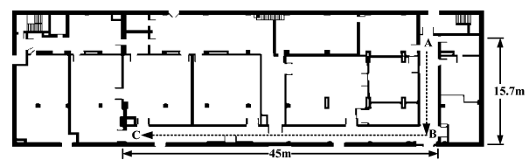
Real-time result using Pioneer 3-DX robot
Experimental result
experimental environment is shown above (tope view). The mobile robot explored the L-shaped corridor starting from location A and ending at location C.
Notes:
Robot successfully moved from location A to location C through an L shape path.
Part of the path is shown in the bottom figure.

Slide 13
improvement
conclusion
Experimental result is shown that the essential problem of time is been resolved
The proposed algorithm based on Bayesian filter and Rao-Blackwellized Particle Filter (RBPF) are very efficient in practice.
Using image processing algorithm(image registration) is an alternative solution for robotics mapping problem
The algorithm has been tested for indoor.
Notes:
The result shows that algorithm in real-time was successful.
The main problem of time-consuming process is resolved
Bayesian and particle filter are working well for non-linear process with non-Gaussian noise
The algorithm is tested for indoor

